Slide 1
ThreatIntel Correlator
AI-Powered Threat Intelligence Correlation & Alert Prioritisation
IBM BoB AI Innovation Hackathon 2026
The Team
What We Built
Name Yad nahi
A working prototype that ingests raw threat alerts, correlates related events into incidents, scores risk severity, detects false positives, maps to MITRE ATT&CK, and delivers analyst-ready BLUF summaries — all through a unified dashboard.
Arya Raval
Rudra Tanti
Arav Patel
Salman Meman

Slide 2

The Problem: Too Many Alerts, Too Little Context
Alert Overload
The Result: Alert fatigue, delayed incident response, and missed threats — the three most dangerous outcomes in any security operation.
Security teams receive hundreds of alerts daily from firewalls, EDR, SIEM, and threat feeds — far beyond what any analyst team can manually triage.
100s
False Positive Drain
Alerts Per Day
False positives consume analyst time and erode trust in alerting systems, causing teams to deprioritize even legitimate detections.
Typical SOC volume across multi-source feeds
~80%
Disconnected Events
Related alerts appear as isolated, disconnected events across different tools and consoles, making it nearly impossible to see the full scope of an attack.
False Positive Rate
Industry-reported noise in raw alert streams
Critical Threats Buried
High-severity incidents can be buried beneath lower-priority noise, causing delayed response at the most critical moments.
Lack of Rapid Context
Analysts need faster contextual intelligence to decide what requires immediate action versus what can wait — without manual cross-referencing.

Slide 3

From Alert Overload to Actionable Intelligence
ThreatIntel Correlator transforms raw threat data into prioritized, correlated incidents with actionable intelligence through an eight-stage pipeline.
Ingest
Normalize
Correlate
Prioritize
01 Ingest
02 Normalize
03 Correlate
04 Score
Feeds, CSV, JSON
Standardize fields
Group incidents
Risk prioritisation
05 Filter
06 Map
07 BLUF
08 Display
False positive detection
MITRE ATT&CK
Analyst summaries
Unified dashboard

Slide 4
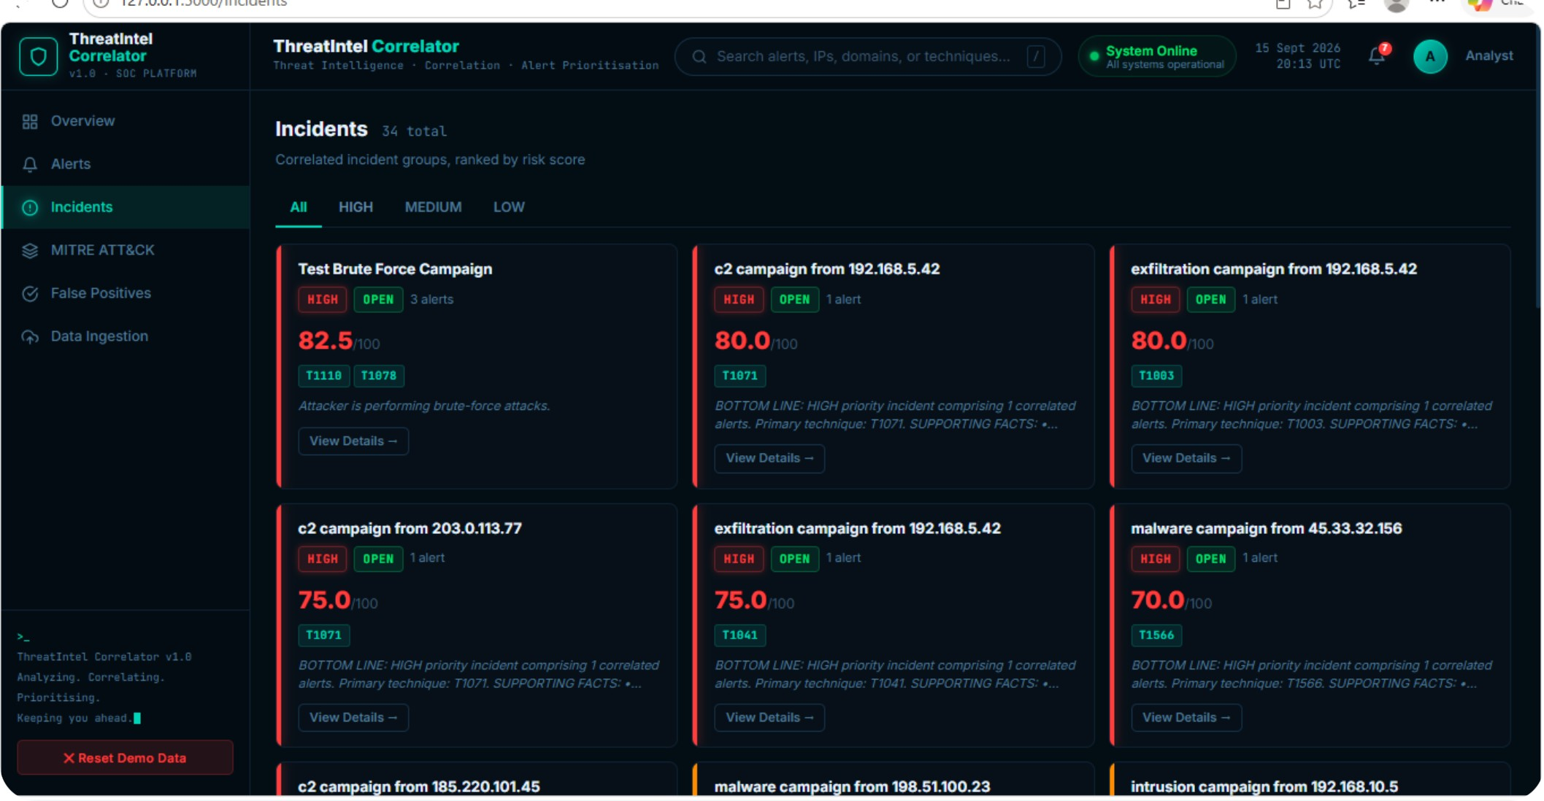
Turning Individual Alerts into Meaningful Incidents
Instead of treating every alert independently, ThreatIntel Correlator groups related alerts into correlated incidents — giving analysts the full picture rather than disconnected fragments.
Live Correlation View
Connect Related Activity
Alerts from the same source IP, target, or timeframe are automatically grouped into a single coherent incident.
Reduce Complexity
One consolidated incident replaces 5–10 disconnected alert notifications, dramatically cutting triage time.
Accelerate Investigation
Analysts understand the full scope and impact of an attack in seconds, not hours of manual correlation.

Slide 5
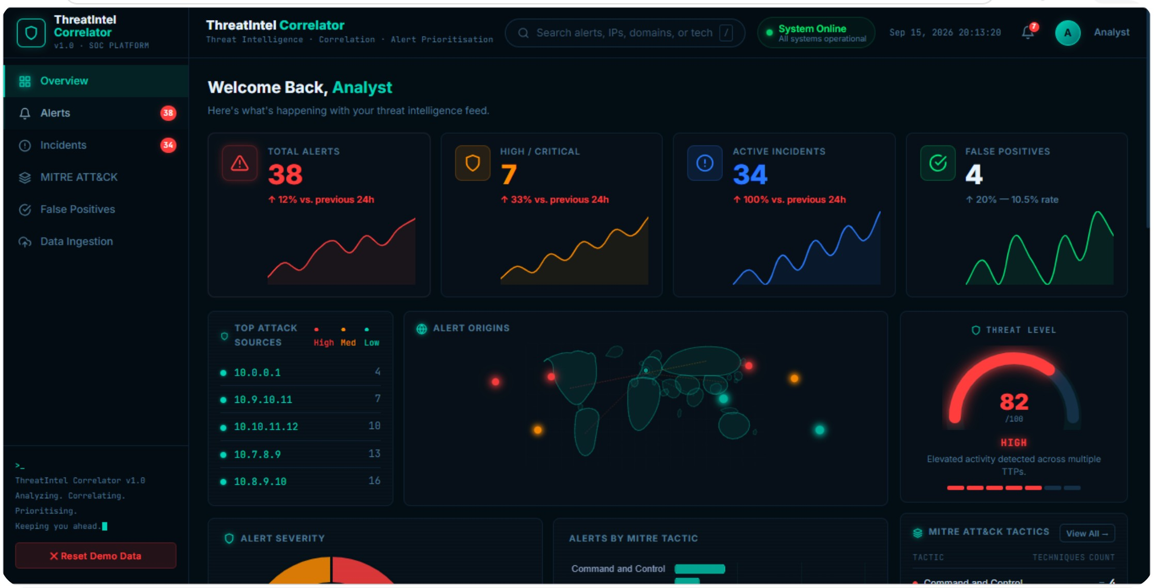

Which Threat Requires Attention First?
ThreatIntel Correlator assigns risk scores to every correlated incident, enabling analysts to immediately identify what demands urgent attention versus what can wait.
HIGH
MEDIUM
Immediate investigation required. Correlated indicators suggest active compromise or imminent threat.
Monitor and investigate within hours. Suspicious behavior warrants analyst attention but is not yet critical.
LOW
Background monitoring. Lower-priority signals logged for pattern analysis and future correlation.
Risk scores are calculated from threat characteristics, behavioral indicators, and contextual signals — enabling systematic prioritisation instead of guesswork.

Slide 6
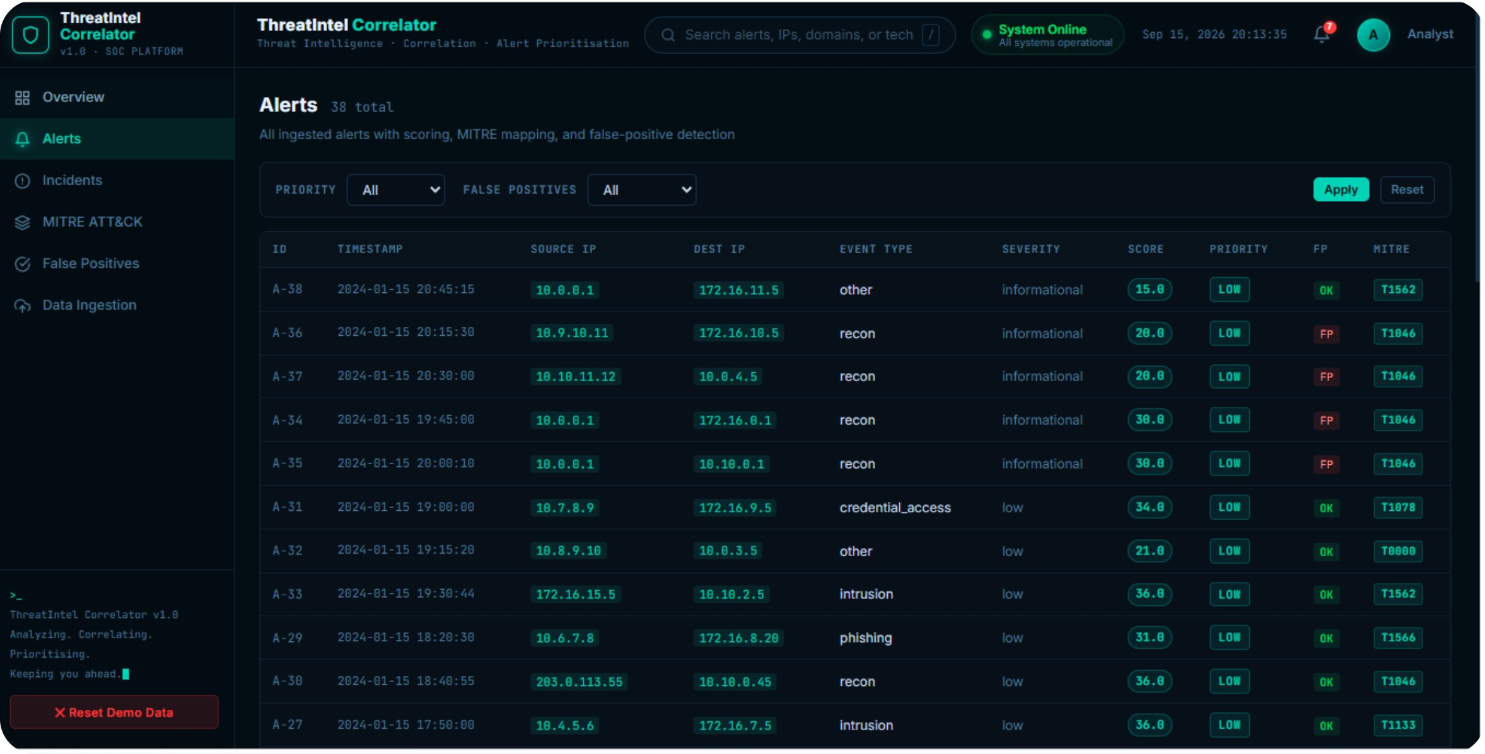
Reducing Alert Fatigue Through False Positive Detection
False positive detection filters out benign or low-confidence alerts, allowing analysts to focus exclusively on genuine threats that warrant investigation.
False Positive Analysis in Action
Identify Likely Benign Alerts
Alerts that match historical patterns of known-safe activity are flagged automatically, removing them from the active investigation queue.
Flag Low-Confidence Detections
Detections below the confidence threshold are marked as probable noise rather than silently dismissed, preserving analyst oversight.
Improve Signal-to-Noise Ratio
By systematically reducing non-actionable alerts, the dashboard surfaces only what genuinely requires analyst attention across the entire security operation.

Slide 7
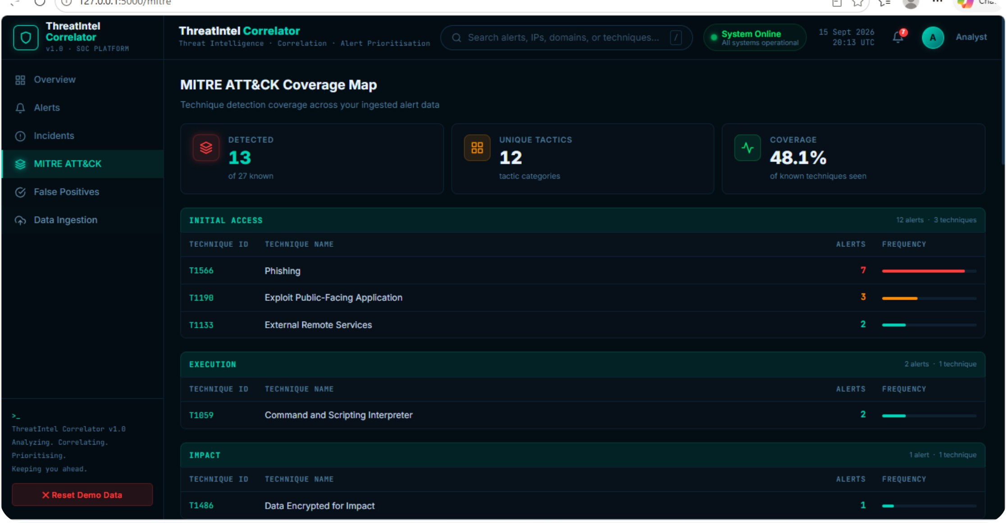
Connecting Alerts to Attacker Behaviour
MITRE ATT&CK Mapping
ThreatIntel Correlator maps observed alerts to MITRE ATT&CK techniques, giving analysts behavioral context rather than just raw indicators.
Behavioral Context
Tactic Classification
Understand what the attacker is trying to achieve — not just that an alert fired, but what tactic it represents.
Identify reconnaissance, lateral movement, persistence, privilege escalation, and exfiltration from alert patterns.
Threat Intelligence Context
Investigation Guidance
Know what to look for next — each mapped technique suggests the likely next steps an attacker might take.
Compare observed techniques against known attack patterns and threat campaigns documented in MITRE ATT&CK.

Slide 8

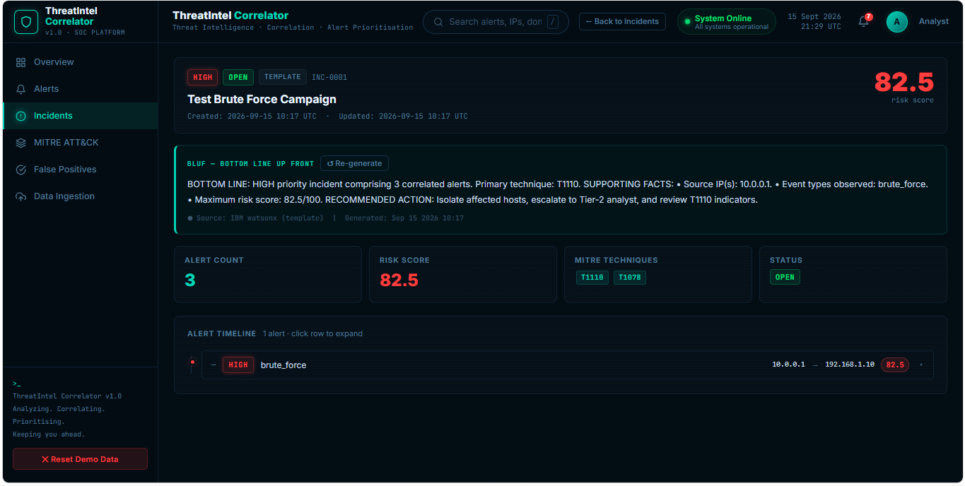

From Technical Alerts to Actionable Intelligence
BLUF: BOTTOM LINE UP FRONT
BLUF Output — Live Prototype
ThreatIntel Correlator generates concise BLUF summaries that distill correlated incident data into structured, analyst-ready intelligence — replacing raw alert dumps with clear, decision-ready context.
What Happened
Why It Matters
The observed activity and associated indicators of compromise, presented in plain language.
Threat context, potential impact, and business risk — connecting the technical signal to operational consequences.
How Serious
What's Next
Risk level and urgency classification drawn directly from the correlation engine's scoring output.
Recommended investigation steps based on the mapped MITRE ATT&CK technique and incident context.
BLUF summaries are generated through the system's analysis pipeline — providing structured intelligence from correlated incident data, not raw alert output.

Slide 9
Technology Behind the Solution
A pragmatic, production-ready stack designed for rapid development, scalability, and easy integration with existing security tooling.
Python
Flask
Core processing and analysis logic — orchestrates the full pipeline from ingestion through BLUF generation.
Web application framework powering the analyst dashboard interface and REST API endpoints.
SQLite
Pandas
Lightweight relational storage for alert data, incident records, correlation results, and historical patterns.
Data manipulation and correlation analysis — handles normalization, grouping, and behavioral pattern detection.
Chart.js
IBM BoB
Real-time visualization and metrics rendering within the dashboard for live incident monitoring.
Hackathon platform and infrastructure — providing the foundation and compute environment for this prototype.

Slide 10

ThreatIntel Correlator
A working prototype that transforms alert overload into analyst-ready intelligence.
What We Demonstrated
The Core Value: ThreatIntel Correlator doesn't just surface alerts — it delivers the context, correlation, and clarity analysts need to act with confidence and speed.
01
Alert Correlation
The Team
Related events grouped into coherent incidents, not disconnected noise.
02
Arya Raval
Rudra Tanti
Risk Prioritisation
HIGH / MEDIUM / LOW scoring that tells analysts exactly where to look first.
Arav Patel
Salman Meman
03
IBM BoB AI Innovation Hackathon 2026 — Name Yad nahi
False Positive Filtering
Systematic noise reduction to protect analyst focus and reduce fatigue.
04
MITRE ATT&CK Mapping
Behavioral context that connects raw alerts to attacker tactics and strategy.
05
BLUF Intelligence
Structured analyst summaries — what happened, why it matters, what's next.

