Slide 1

Softtek Knowledge Management System
Case study: Softtek · Lifecycle, ontology, automated classification and semantic search · Project progress, October 2026
Notes:
This presentation summarizes the progress of the knowledge management system project, applied as a case study to Softtek, a Mexican IT services company: the company, the knowledge lifecycle, the ontology, the classification prototype, the semantic search component and the practical exercises.

Slide 2





Softtek: Mexican IT services firm founded in 1982 in Monterrey
Type of organization
Private IT services and consulting company; ~15,000 employees, 30 offices; pioneer of the Nearshore model
Core activities
Agile development and application modernization
QA, DevOps and site reliability engineering
SAP and Salesforce services
Application, cloud and end-user support
Digital consulting and cognitive automation
KNOWLEDGE HANDLED: 5 DOCUMENT TYPES
Technical Documentation
API references, architecture, deployment guides
Policies & Procedures
Security, remote work, expenses, change control
Project Reports
Status reports, sprint reviews, lessons learned
Training Manuals
Onboarding guides, courses, tutorials
Incident Reports
Post-mortems, root-cause analyses
Source: Softtek Fast Facts 2024 and Wikipedia. Documents and results are illustrative.
Notes:
Company facts: Softtek Fast Facts 2024 and Wikipedia. The sample documents, ontology and results are illustrative, not Softtek internal data. Its five document types are also the five categories predicted by the classifier. Besides explicit documents, the firm has tacit knowledge in consultants' heads that the lifecycle aims to capture.

Slide 3
Knowledge moves through a closed six-stage cycle
1
Create and acquire
2
Store and document
3
Organize and classify
Projects, incidents, courses; tacit know-how captured in templates
Central KMS repository with owner, date, version metadata
TF-IDF classifier assigns the type; ontology links concepts
new cycle
Automated by the Python prototype
indexed documents
6
Update and improve
5
Apply
4
Share
Lessons learned update docs; feedback retrains the classifier
Reuse designs, resolve incidents with runbooks, follow policies
Semantic search with ontology synonyms; onboarding paths
Notes:
Example walk-through: the Payments API outage is created as knowledge (1), written as post-mortem IR01 (2), classified as an Incident Report and linked to the Payments API (3), found by searching 'payment system went down' (4), used by the on-call engineer next time (5), and its lesson updates the monitoring guide TD07 (6).

Slide 4
The ontology anchors each document type to a domain concept
Document superclass; its 5 subclasses are the classifier's categories
Technical Documentation
Policies & Procedures
Project Reports
Training Manuals
Incident Reports
describes
governs
reportsOn
teaches
documents
updates
System
Process
Project
Skill
Incident
usesTechnology
ownsProcess
worksOn
hasSkill
resultsIn
Technology
Department
Employee
Lesson learned
memberOf
OWL/SKOS file ontology/softtek_ontology.ttl · 13 domain classes, 5 document classes, 22 relationships, 372 triples
Notes:
Shaded boxes are document classes, outlined boxes are domain concepts, arrows are ontology properties. The incident loop is visible: an Incident Report documents an Incident, which results in a Lesson learned that updates other documents. Other properties in the model: authoredBy, ownedBy, references, about, affects, hasRisk, deliveredFor.

Slide 5

Typed relationships make the knowledge graph queryable
Property | From → To | Example
describes | Technical Doc → System | TD01 → Payments API
governs | Policy → Process | PP07 → Change management
reportsOn | Project Report → Project | PR10 → Mobile banking
teaches | Training Manual → Skill | TM03 → Kubernetes operation
documents | Incident Report → Incident | IR01 → Payments outage
references | Document → Document | IR01 → TD01
updates | Lesson learned → Document | Add perf. test → TD04, PP07
Competency question
Which documents must be updated after incidents?
Payments outage
→ Logging and Monitoring Setup
Inventory DB degradation
→ Database Schema (TD04)
→ Change Management (PP07)
Answered by exercises/ex6_ontology_queries.py
Notes:
These document-concept relationships turn the repository into a graph. SPARQL queries answer competency questions such as which documents relate to the Payments API, or what a new SRE should read to operate Kubernetes.

Slide 6




The classifier turns raw text into a document type in four steps
1. Load
2. Preprocess
3. TF-IDF
4. Train and classify
60 labelled sample documents, 12 per category (documents.csv)
Lowercase, remove stop words, Porter stemming
Unigrams + bigrams, sublinear tf: ~2,180 weighted terms
Naive Bayes vs Logistic Regression; category + confidence
TF-IDF weight: tfidf(t, d) = (1 + ln tf_{t,d}) × (ln((1 + N) / (1 + df_{t})) + 1), then each vector is L2-normalized
Run: python src/classifier.py | python src/classifier.py --text "..."
Notes:
Title and body are joined into one text field. The vectorizer and the model are a single scikit-learn pipeline. The final model is retrained on all 60 documents and saved to outputs/classifier.joblib.

Slide 7
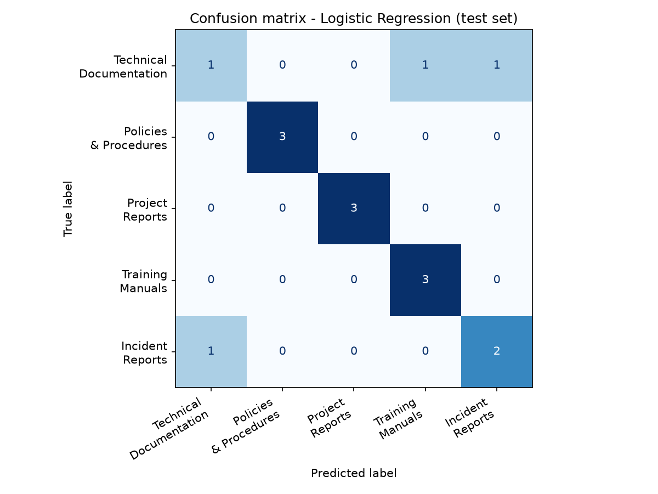
Logistic Regression classifies document types at 0.90 accuracy
Errors only between Technical Documentation and Incident Reports, which share words like API, service, deploy.
Hold-out has 3 docs per class: one error moves accuracy by 0.07. Cross-validation is the reliable figure.
Notes:
Policies, Project Reports and Training Manuals are perfect on the test set. Most discriminative stems: incident/cause/outage for Incident Reports, policy/approve/procedure for Policies, project/client/budget for Project Reports, api/version/schema for Technical Documentation, course/train/practice for Training Manuals.

Slide 8

Five of six unseen documents were classified correctly
Id | Text (start) | Predicted | Conf. | OK
N01 | The checkout service was down for 25 minutes after a certificate expired… | Incident Reports | 0.61 | Yes
N02 | Employees must lock their screen when leaving the desk… | Policies & Procedures | 0.32 | Yes
N03 | The search service exposes a GET /v1/search endpoint… | Technical Documentation | 0.49 | Yes
N04 | Module 3 of the course teaches how to write SQL queries… | Training Manuals | 0.69 | Yes
N05 | The project is two weeks behind schedule; budget spent is 70%… | Project Reports | 0.76 | Yes
N06 | New team members should complete the onboarding lessons on Docker… | Project Reports | 0.34 | No
N06 should be a Training Manual: "team" and "client project" are strong Project Report terms. Predictions below 0.40 confidence could go to a human reviewer.
Notes:
These six documents are not part of the training data (data/new_documents.csv). Confidence is the highest class probability of the Logistic Regression model.

Slide 9
Search ranks documents by cosine similarity to the query
1
2
3
4
5
Natural-language query
Ontology expansion
TF-IDF vector
Cosine similarity
Top-k results
"what happened when the payment system went down"
SKOS altLabel "went down" adds "outage incident"
Same fitted vectorizer as the documents
Score against all 60 document vectors
IR01 Payments API Outage ranked first (0.197)
cos(q, d) = (q · d) / (‖q‖ ‖d‖)
1 = same term distribution, 0 = no shared terms. Run: python src/semantic_search.py --demo
Notes:
Step 2 is the link between the ontology and the search engine: the code reads skos:altLabel from the Turtle file and appends the concept's preferred label and its broader concept. The --baseline flag turns off stemming and expansion for comparison.

Slide 10
Stemming and ontology synonyms put the right document first
Query: "what happened when the payment system went down"
Plain TF-IDF (baseline)
1. IR10 Cache Stampede post-mortem (0.103)
2. PR01 Retail Platform status report (0.098)
IR01 not found: it says "Payments" and "Outage"
Stemming + ontology expansion
1. IR01 Post-mortem: Payments API Outage (0.197)
2. IR11 Email Service Outage (0.195)
3. IR04 Data Center Network Failure (0.168)
MRR 1.00: a relevant document is ranked first for every test query.
Notes:
P@3 is the share of relevant documents in the top 3; MRR is the mean of 1/rank of the first relevant document. Limitation: TF-IDF is lexical, so only synonyms listed in the ontology are covered; embeddings are the next step.

Slide 11



Six exercises from Topics 1–6 built the prototype's pieces
1. Text preprocessing
2. TF-IDF by hand
3. Cosine similarity
Vocabulary 986 words → 704 stems (29% smaller)
Manual values equal scikit-learn exactly
Same-type docs 2–5× more similar than other types
4. Classification tests
5. Retrieval evaluation
6. Ontology queries
4 representations × 3 models; best 0.90 CV accuracy
8 judged queries: MRR 0.79 → 1.00
5 SPARQL competency questions on 372 triples
Notes:
Each exercise is a standalone script in exercises/ and its output is saved in outputs/. Exercise 3 also explains the classifier's confusions: the most similar pairs cross document types around the same system, for example the caching strategy guide and the cache stampede post-mortem.

Slide 12
Basic techniques already cover the KMS core
Next steps
Grow the collection beyond 60 documents
Send low-confidence predictions to human review
Add sentence embeddings for meaning-based search
Link new documents to the ontology automatically
TF-IDF + Logistic Regression classifies at 0.90; ontology-expanded search ranks a relevant document first for every test query
Notes:
Thank you. The code, data, ontology and exercises are in the project folder; the README explains how to run each part.

