Slide 1
Simple Physics & Vectors
Speed, acceleration, and collision
Intro to PVector
Notes:
Basic physics principles can improve your work.

Slide 2
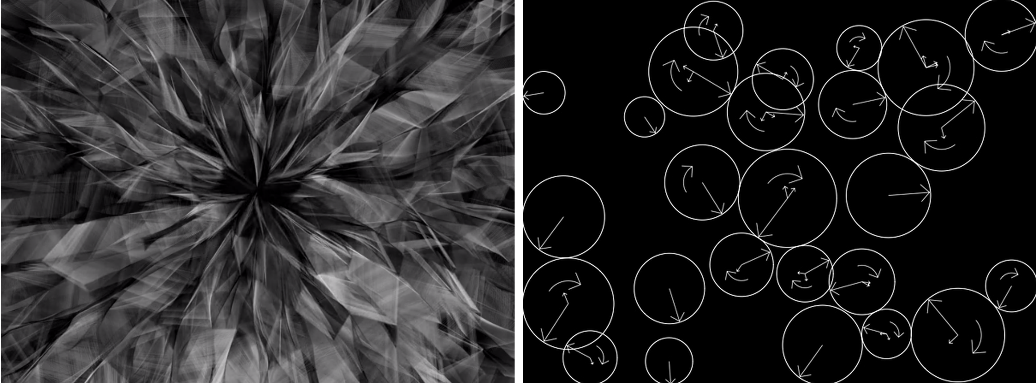
Casey Reas, Process Compendium
Notes:
You can find examples of code that uses simple physics in simulations...
Link to video:
https://vimeo.com/22955812

Slide 3
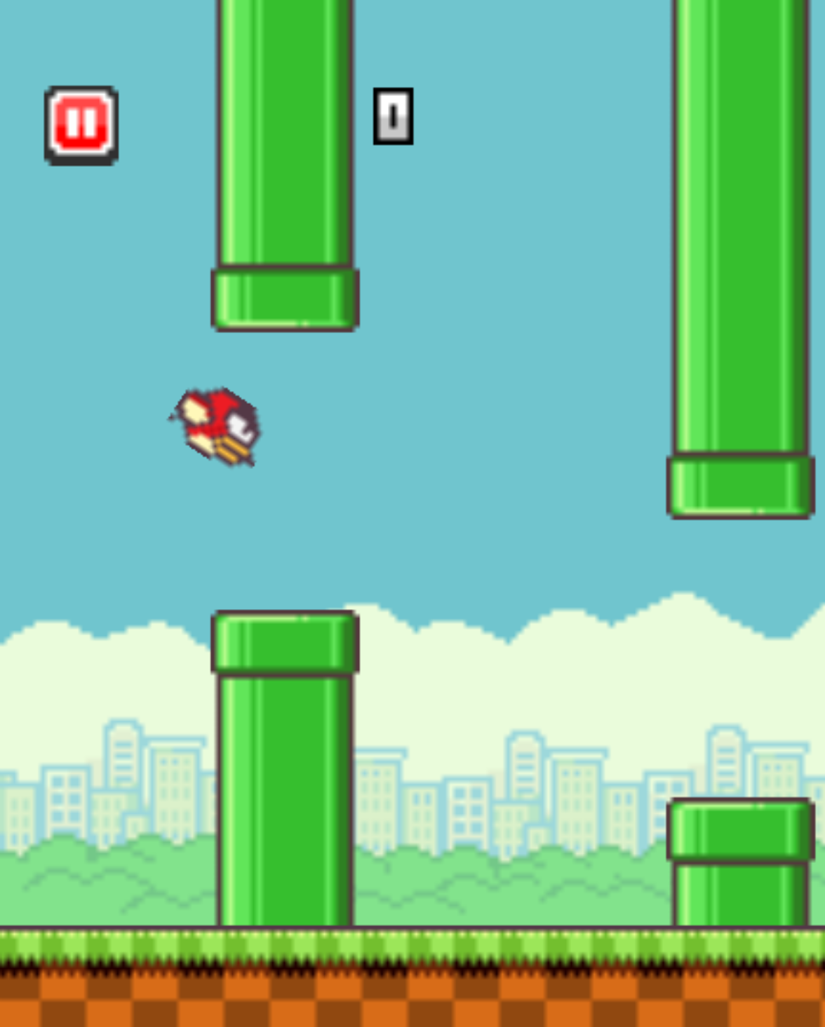
Flappy Bird
Notes:
...games...

Slide 4
Distance
Notes:
Going back to day_08_08_collision, there's a basic behaviour going on here. The letters 'repel' each other. To do so, they need to know how far they are from each other.

Slide 5
Distance
dist(x1, y1, x2, y2);
// How far is this point from the mouse?
dist(x, y, mouseX, mouseY);
Notes:
Processing has a built-in function to calculate the distance between 2 points. Let's use that to create add a simple rollover behaviour to our letter. If the mouse is hovering over it, its color will change to a lighter one.
day_08_02_distance

Slide 6
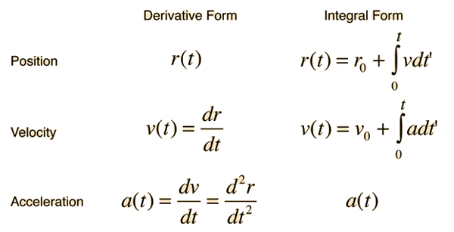
Calculus
Notes:
Now for the physics part. These are equations to describe what we're going after.

Slide 7
Calculus
(Don't worry, you don't need to know this)
Notes:
But we don't really need to use any of this. We're gonna do very simple physics.

Slide 8

Speed: a change in the position of an object over time
http://gifselections.tumblr.com/post/91157492343/foxadhd-big-soda-ban-struck-down-forever-after
— this object is moving at the same speed, that is, in a constant velocity

Slide 9
POSITION = POSITION + SPEED
This is how "objects" on our screen "move."

Slide 10
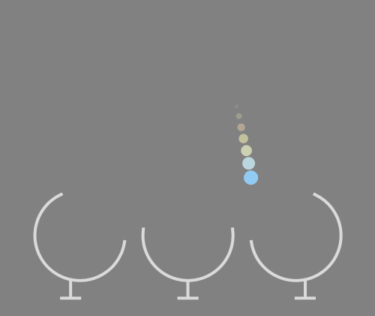
Acceleration: a change in the speed of an object over time
http://gifselections.tumblr.com/post/87798725173
— gravity is the most common example of that

Slide 11
position = position + speed speed = speed + gravity
Notes:
Let's try it now! day_08_03_gravity
// Should start by just adding regular speed. Than adding gravity (acceleration)
// From that on, keep adding functions to the letters:
// Respond to mouse direction: day_08_04_direction
// Bounce: day_08_05_bouncing
//Then create the "particle system" (with arrays): day_08_06_array
// Add the collision with boundaries day_08_07_boundaries
Now to the next slide!

Slide 12
Collisions Circles
x2, y2
r
r
r
r
x1, y1
Two circles collide when the distance between their centers is less than the combined radii
Notes:
To detect the collision between the letters, we'll use the same function we had to detect mouse collision. Attention to the radii detail, though!

Slide 13
Collisions Circles
dist() calculates the distance between two points
float distance = dist(x1, y1, x2, y2);
if (distance < 2 * r) {
// we have a collision!
}
r
r
Notes:
//collision with each other: day_08_08_collision

Slide 14
Vectors
Notes:
Basic physics principles can improve your work.

Slide 15
Vectors
This is an arrow
Magnitude
Direction
Notes:
Going back to day_08_08_collision, there's a basic behaviour going on here. The letters 'repel' each other. To do so, they need to know how far they are from each other.

Slide 16
Vectors
length
Y
θ
X
Notice that there is an
X component and a Y component
of this arrow’s direction
Magnitude
Direction
Notes:
Going back to day_08_08_collision, there's a basic behaviour going on here. The letters 'repel' each other. To do so, they need to know how far they are from each other.

Slide 17
PVECTOR
Y = 50
X = 100
float x;
float y;
Pvector location;
location = new Pvector(100, 50);
Notes:
Going back to day_08_08_collision, there's a basic behaviour going on here. The letters 'repel' each other. To do so, they need to know how far they are from each other.

Slide 18
Objects & Classes
Object Oriented Programming

Slide 19
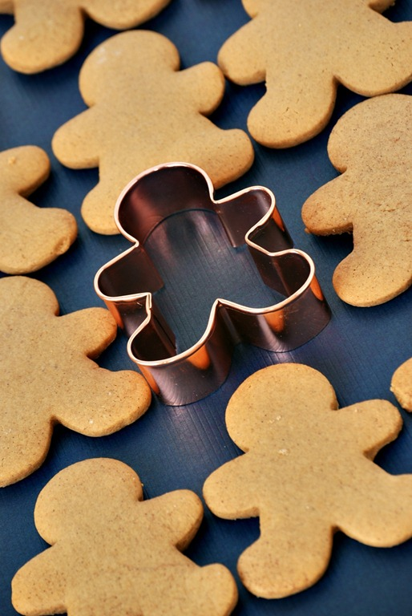
Class
Object

Slide 20
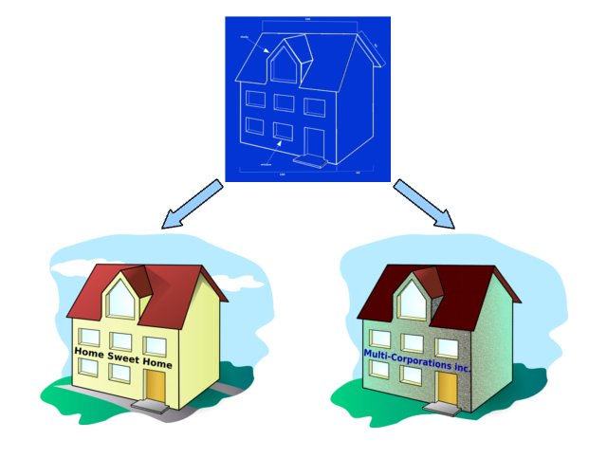
Class
Object

Slide 21
Some classes we’ve been using already:
PImage
PFont
PShape

Slide 22
Why use objects?
Management
Modularity
Abstraction
Structure
Inheritance
Hierarchy

Slide 23
The Class:
name Any name you choose
data Collection of variables fields
constructor Default setup
methods Functions of a class

Slide 24
Class Structure
class Name { //class name
float posX; //declare variables
float posY;
Name() { //build constructor
posX = 50;
posY = 60;
}
void move() { //add movement method
posX += 5;
}
void display() { //add display method
ellipse(posX, posY, 5, 5);
} }

Slide 25
Create Object from the Class
Alpha a, b, c, d; //declare object from class Alpha
void setup() { //initialize objects… pass argumt.
a = new Alpha (200, 20, 400, 200, (char) 65, .5, .1, false, .02);
b = new Alpha (200,400, 30, 7, (char) 66, .5, .1, false, .02);
c = new Alpha (90, 77, 90, 67, (char) 67, .5, .1, false, .02);
d = new Alpha (88,56, 300, 150, (char) 68, .5, .1, false, .02);
void draw() { //call methods on your object
a.move();
a.collide();
a.display();
}

Slide 26
Homework
Write your own Class.
Think about different examples of physics (speed and acceleration) in nature. Wind? Springs? Friction? Can you simulate any of them?
Notes:
See work of Casey Reas.
(Note: point is to create a complex pattern computationally).
Introduce save function, too. See here: http://processing.org/reference/save_.html
http://mike-tucker.com/13/
http://gamemechanicexplorer.com/

