Slide 1

Key to Happiness
Team ANACONDA

Slide 2

Team Members
Bismaad Minhas Caitilin Beatty Regine Strey Sara Patel Letha Varughese

Slide 3
Objective
Our goal is to understand, on a data-driven level, the factors contributing to and correlated with happiness. We are motivated to know what makes for a happy country. We have examined the relationships between several metrics of individual countries or regions and their happiness scores or ranks to determine their influences and effects.

Slide 4
Hypothesis
Our hypothesis is the following factors increase levels of happiness:
Low unemployment rates
Higher Government Spend on Healthcare
Increased social support
Democratic government type
Further insight:
If we want to move to a ‘happy county’- what weather should we expect?

Slide 5
Scope
2020+
Years 2014-2019
State-level data
Country- level Data
countries in World Happiness Report
countries not in World Happiness Report
Out of scope
In scope

Slide 6
Data Sources
World Happiness Report
https://www.kaggle.com/unsdsn/world-happiness
World Health Organization Global Expenditure Database https://apps.who.int/nha/database/Select/Indicators/en
International Monetary Fund
https://www.imf.org/en/Publications/SPROLLS/world-economic-outlook-databases#sort=%40imfdate%20descending
World Bank Data Catalogue
https://documents.worldbank.org/
Weather API
https://openweathermap.org/api

Slide 7
Data exploration and clean –up process
World Happiness Report (WHR) was base of the project
Obtained additional external datasets to see what other factors would influence happiness
Based on question to answer, merged appropriate dataset with WHR on ‘country name’ (left join)
Clean Up
Remove NaN’s from datasets
Rename duplicate column names for clarity
Identify top (and bottom) countries based on happiness

Slide 8
Analysis Process
Calculating numerical correlations Scatter plots and linear regression
Understanding categorical correlations Bar charts
Calculating relationship with more than 2 variables Scatter plots with color label

Slide 9
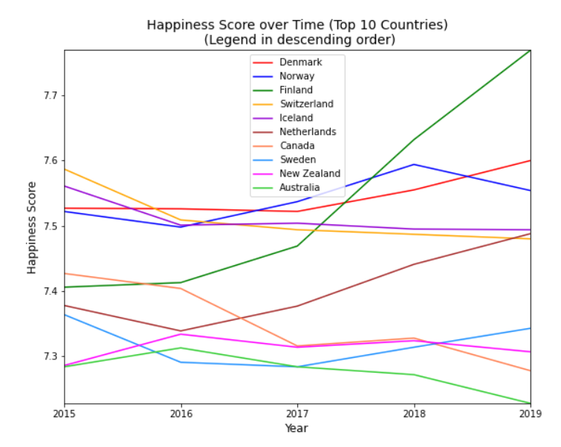
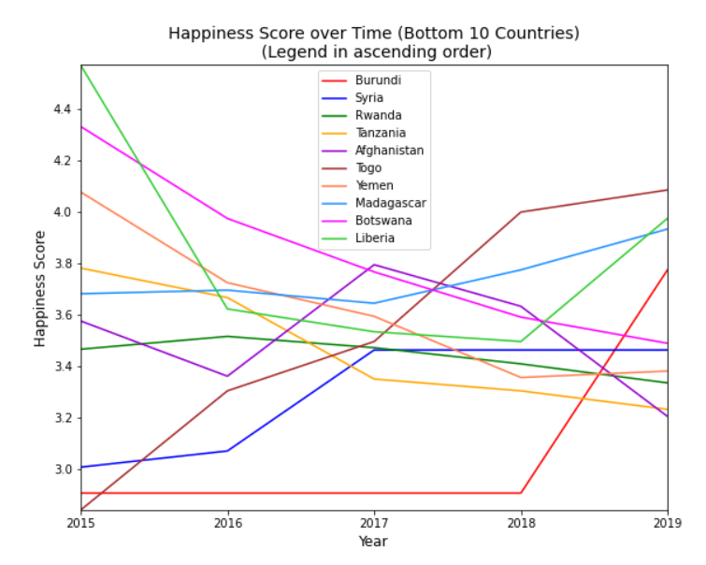
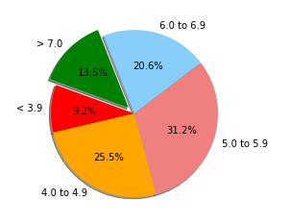
Happiness
Happiness score comes from Gallop World Poll responses regarding six factors – economic production, social support, life expectancy, freedom, absence of corruption, and generosity.
Happiness breakdown per score

Slide 10
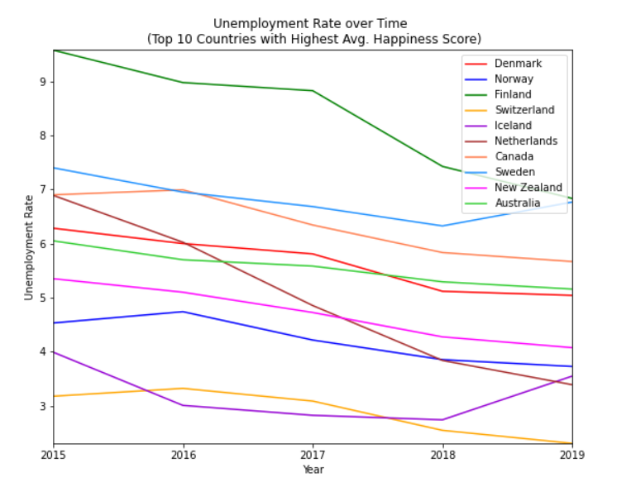
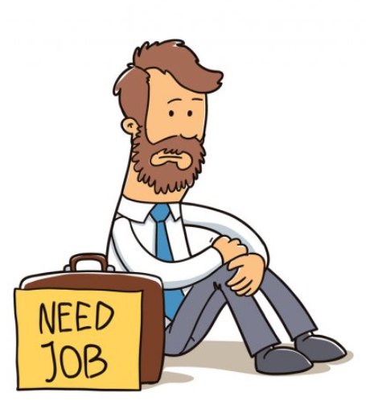
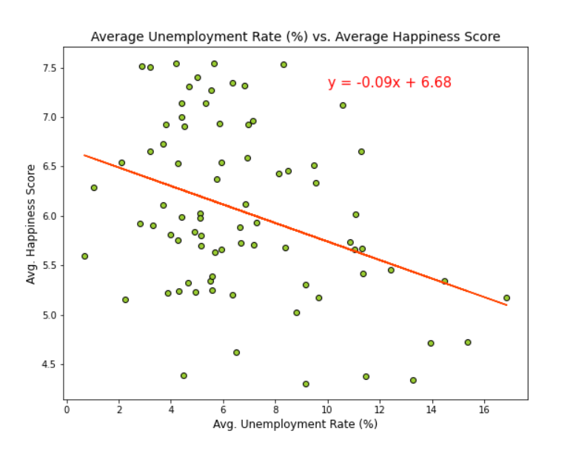
Unemployment/Happiness Correlation
Strong correlation between low unemployment and happiness
Finland 2017,
sharp unemployment drop, inverse spike in happiness!

Slide 11

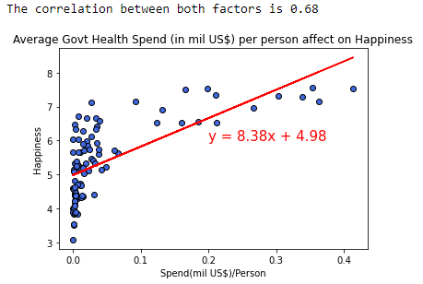
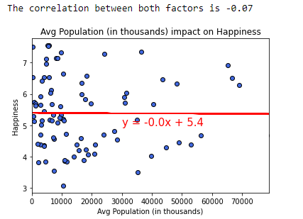
Healthcare/Happiness Correlation
Capital health spend include health infrastructure (buildings, machinery, IT) and stocks of vaccines for emergency or outbreaks
The more govt spend on health infrastructure, the more likely for happier country
No correlation between population and happiness
Notes:
https://apps.who.int/nha/database/Select/Indicators/en

Slide 12

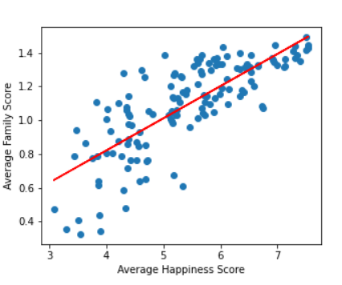
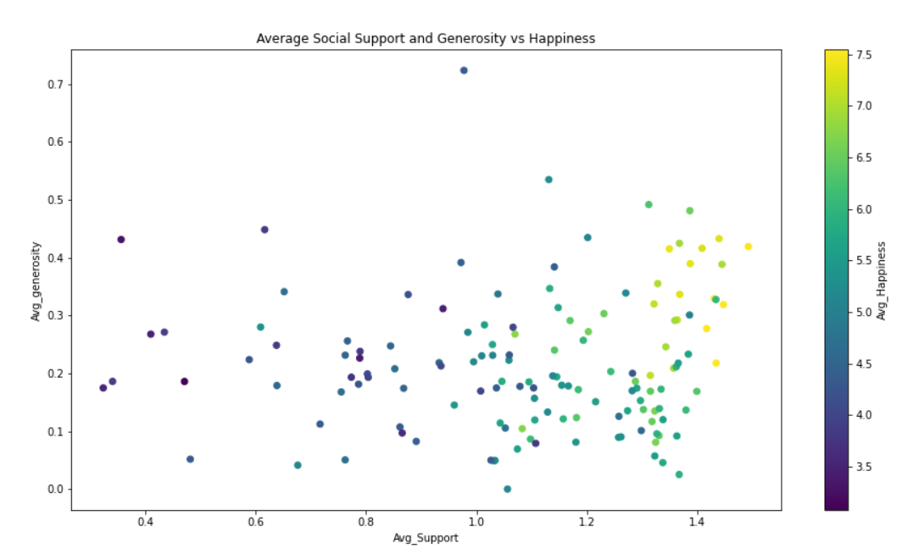
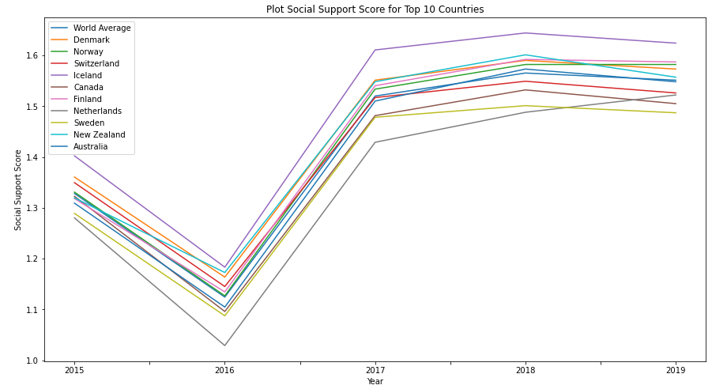
Social Support/Happiness Correlation
“if you were in trouble, do you have someone to count on”
“have you donated to a charity in the past month?”
Strong correlation between amount of social support and happiness!
Generous counties, were not automatically happy until social support was added in too! We like to think this says people, in general are good, and want to make others happy, even if they aren’t happy themselves.

Slide 13

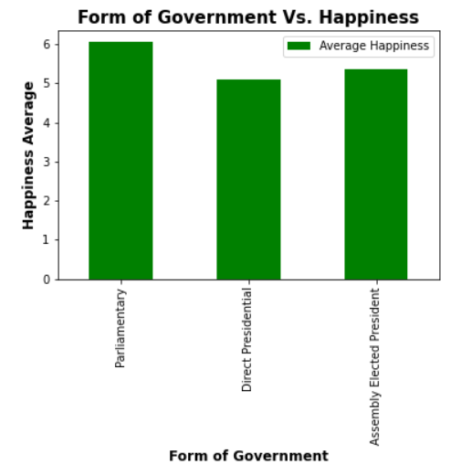
Government Types/Happiness
Parliamentary- Countries in which the legislature elects the chief executive. In this system, the executive and legislative branches of government are combined and the political head of state is chosen from within the legislature
Direct Presidential - chief executive is chosen by the people to serve a limited term in office with a distinct separation of powers (the executive branch) as well as specific limitations on exactly what he/she can do while in office. Systems with presidents who are elected directly or by an electoral college #(whose only function is to elect the president) and in cases where there is no prime minister
Assembly-elected President - any means of executive selection not involving A Direct Or Indirect mandate from An electorate when that assembly or group cannot easily recall them.

Slide 14

Pick a perfect spot based on weather preference

Slide 15
Implications
To be happy….
Access to employment
Access to best medicine/technology
Surround yourself with a strong social support
Government that aligns with commitment to happiness

Slide 16

Questions?

