Slide 1

Key to Happiness
Team ANACONDA
Notes:
Regine

Slide 2

Team Members
Bismaad Minhas Caitilin Beatty Regine Strey Sara Patel Letha Varughese
Notes:
Regine

Slide 3
Objective
Our goal is to understand, on a data-driven level, the factors contributing to and correlated with happiness. We are motivated to know what makes for a happy country. We have examined the relationships between several metrics of individual countries or regions and their happiness scores or ranks to determine their influences and effects.
Notes:
Regine

Slide 4
World Happiness Report
World Happiness Report, first published in 2012, invites countries to measure the happiness of their people and use this information when making policy decisions
Happiness Score is based on the Gallup World Poll , specifically the Cantril ladder question about life satisfaction – participants evaluate their current life on a 0 to 10 scale
Six Factors:
GDP per capita
Life expectancy,
Social support (as measured by having someone to count on in times of trouble)
Trust (as measured by a perceived absence of corruption in government and business)
Perceived freedom to make life decisions, and generosity (as measured by recent donations adjusted for differences in income)
Notes:
Bismaad

Slide 5
Hypothesis
Our hypothesis is the following factors increase levels of happiness:
Low unemployment rates
Higher Government Spend on Healthcare
Increased social support
Democratic government type
Further insight:
If we want to move to a ‘happy county’, what weather should we expect?
Notes:
Bismaad

Slide 6
Scope
2020+
Years 2014-2019
State-level data
Country- level Data
countries in World Happiness Report
countries not in World Happiness Report
Out of scope
In scope
Notes:
Caitilin

Slide 7
Data Sources
World Happiness Report (base for happiness)
https://www.kaggle.com/unsdsn/world-happiness
World Health Organization Global Expenditure Database (for health care spend comparisons) https://apps.who.int/nha/database/Select/Indicators/en
International Monetary Fund (for unemployment data)
https://www.imf.org/en/Publications/SPROLLS/world-economic-outlook-databases#sort=%40imfdate%20descending
World Bank Data Catalogue (government types)
https://documents.worldbank.org/
Weather API (current weather)
https://openweathermap.org/api
Notes:
Sara

Slide 8
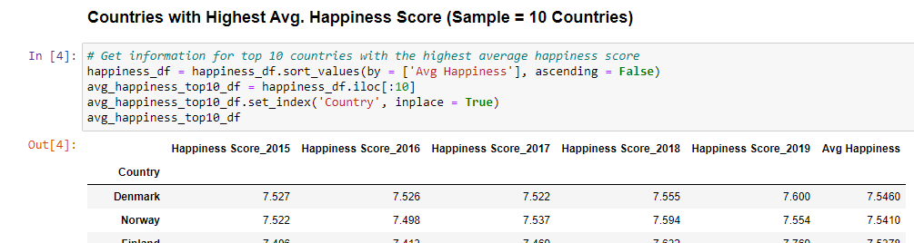
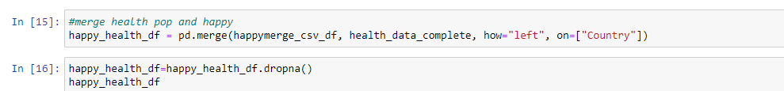
Data exploration and clean –up process
World Happiness Report (WHR) was base of the project
Obtained additional external datasets to see what other factors would influence happiness
Identify top (and bottom) counties based on happiness
Each exploration has a file with required applicable csv’s, merged appropriate dataset with WHR on ‘Country’
Clean Up
Remove NaN’s from datasets
Rename duplicate column names for clarity
Notes:
Caitilin – screenshot of cleanup

Slide 9
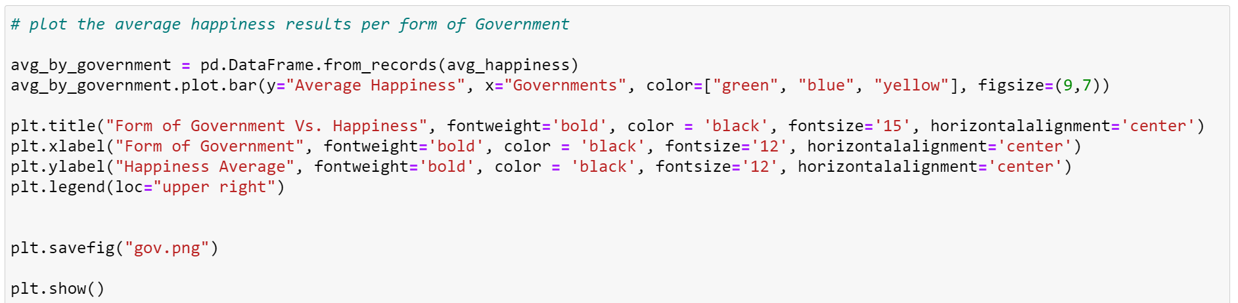
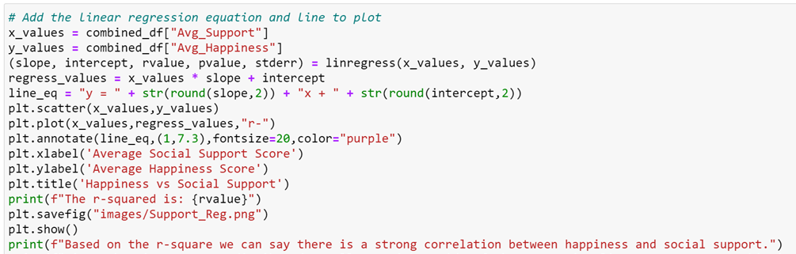
Analysis Process
Calculating numerical correlations Scatter plots and linear regression
Understanding categorical correlations Bar charts
Calculating relationship with more than 2 variables Scatter plots with color label
Notes:
Bismaad to present and enter screenshots

Slide 10
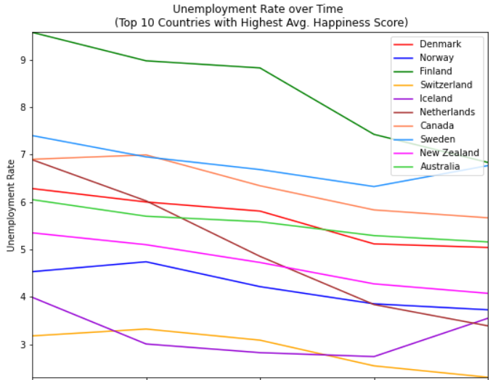
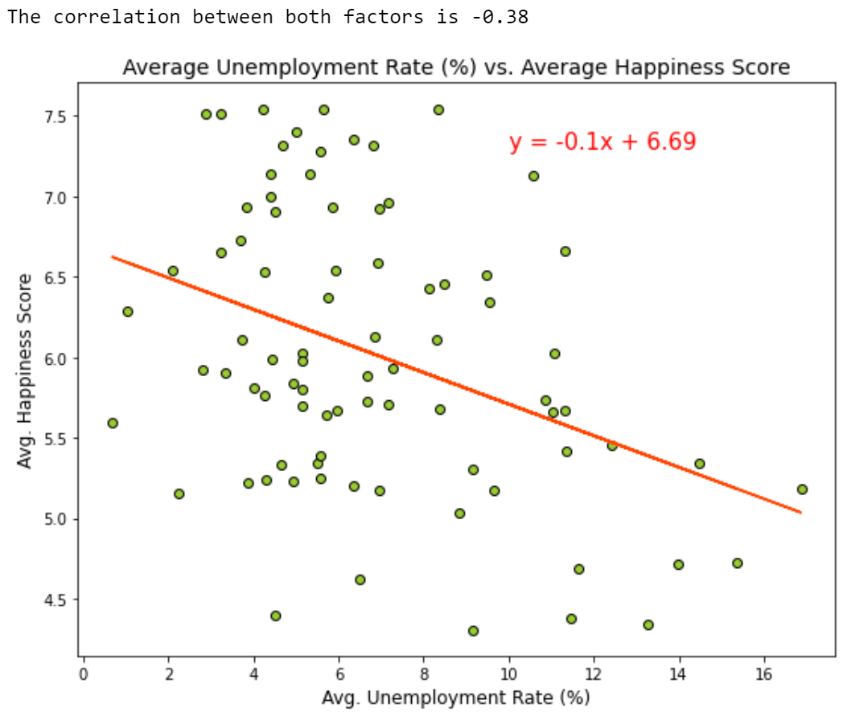
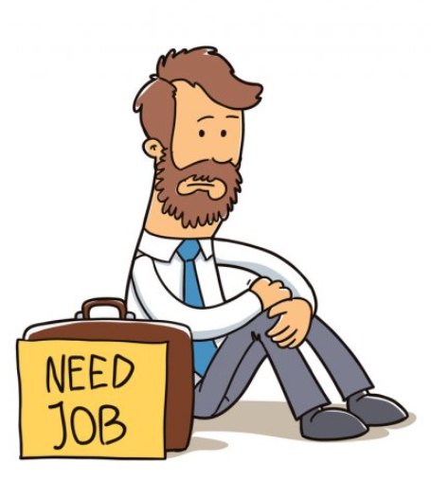
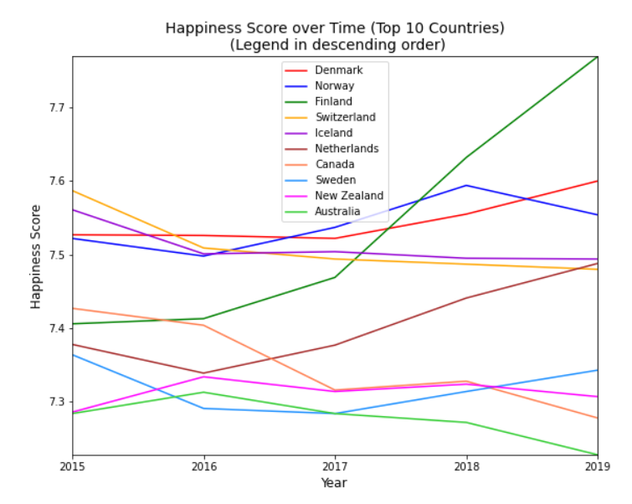
Unemployment/Happiness Correlation
Finland 2017,
sharp unemployment drop, inverse spike in happiness!
Moderate correlation between low unemployment and happiness
Notes:
Bismaad

Slide 11

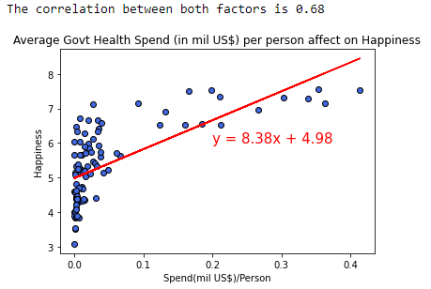
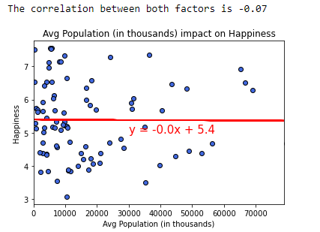
Healthcare/Happiness Correlation
Capital health spend include health infrastructure (buildings, machinery, IT) and stocks of vaccines for emergency or outbreaks
The more govt spend on health infrastructure, the more likely for happier country
No correlation between population and happiness
Notes:
Caitilin

Slide 12

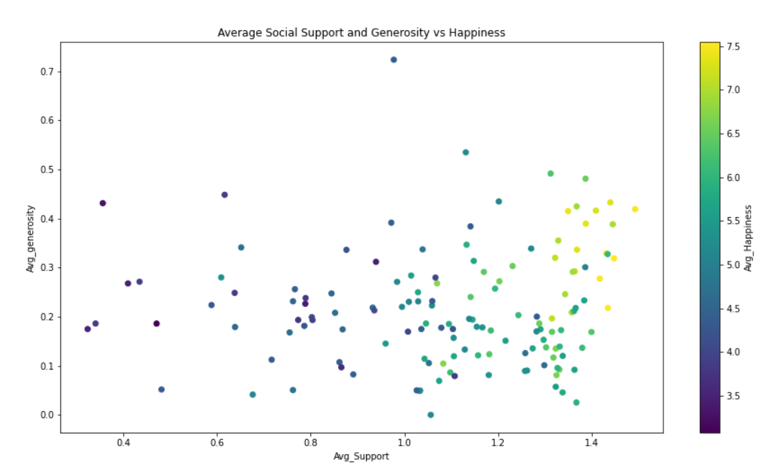
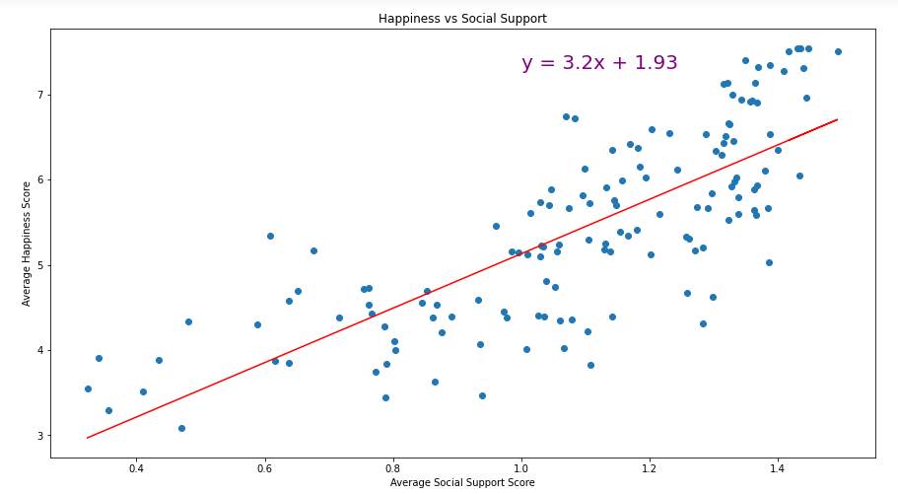
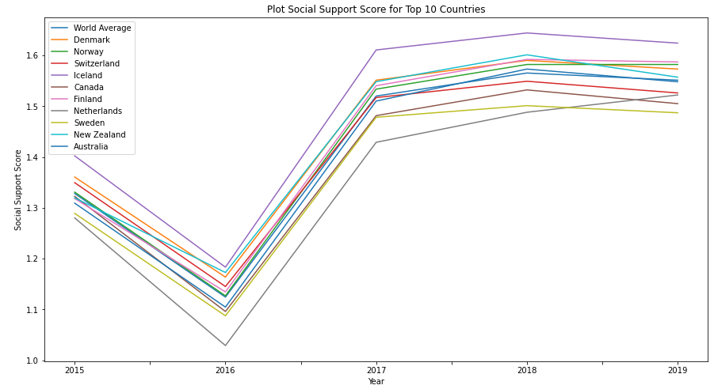
Social Support/Happiness Correlation
“if you were in trouble, do you have someone to count on”
“have you donated to a charity in the past month?”
Strong correlation (.78) between amount of social support and happiness!
Myanmar
Togo
Generous counties, were not automatically happy until social support was added in too! We like to think this says people, in general are good, and want to make others happy, even if they aren’t happy themselves.
Notes:
Letha Change graph label to avg social support and move happiness to Y axis

Slide 13

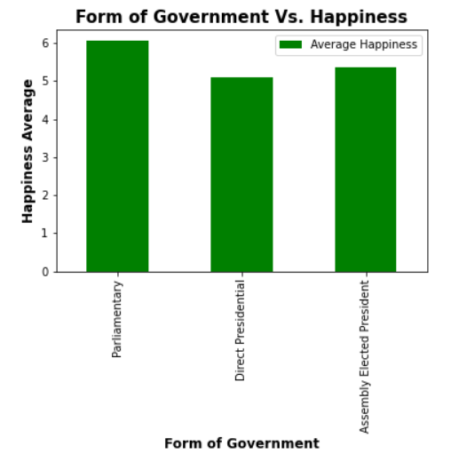
Government Types/Happiness
Why we chose to look government type– we noticed bottom countries on happiness score were going through political turmoil in the last few years.
Direct Presidential – Countries in which people vote for the executive leader directly. (ex: USA, MX, Peru)
Assembly-elected President – executive leader is selected by an assembly and not by the people. (ex: Vietnam, Cuba, Pakistan)
Parliamentary- Countries in which people vote for a party and the party selects leader. (ex: Britain, Denmark, Norway)
Notes:
Sara – update assembly elected pres info

Slide 14

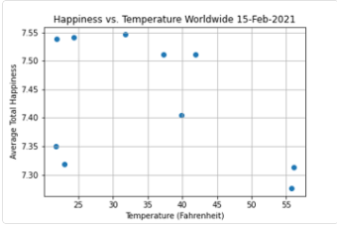
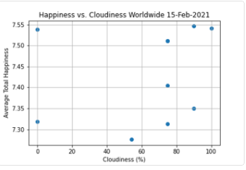
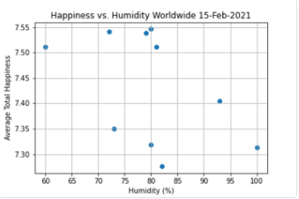
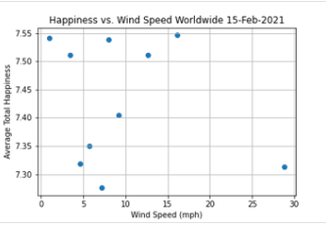
What’s the weather today for our happy countries?
Notes:
Regine -Add labels for scatter plot or pick a country and show the weather – add in happiness level by region (top 5)

Slide 15
Implications
To be happy….
Surround yourself with a strong social support
Access to best medicine/technology
Access to employment generally helps
Government that aligns with commitment to happiness
Notes:
Caitilin

Slide 16

Questions?
Notes:
Caitilin

Slide 17
Backup
Notes:
Caitilin

Slide 18
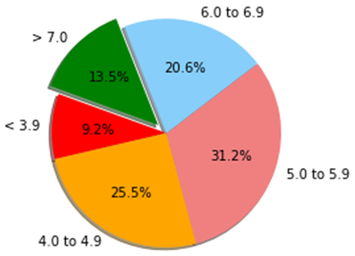
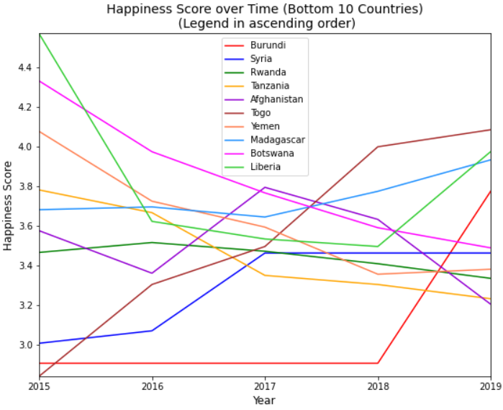
Happiness Score
Breakdown of Happiness Score
Notes:
Bismaad:
A majority of the countries in the dataset have scores between 5.0 and 5.9
The graphs in the right show the changes in Happiness Scores for the 10 countries with the highest average happiness score and 10 countries with the lowest average happiness score

Slide 19
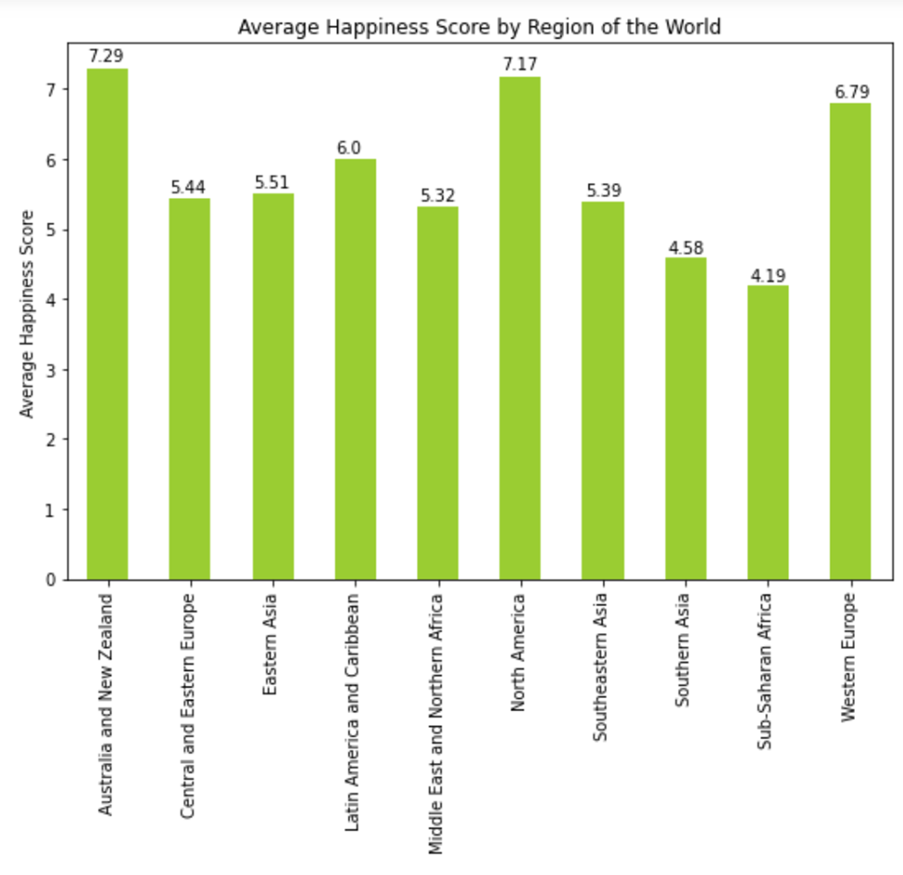
Region Analysis
Notes:
Substantial differences across regions
Highest scores are 7.29 (Australia and New Zealand) and 7.17 (North America)
Lowest scores are 4.19 (Sub-Saharan Africa) and 4.58 (Southern Asia)
Differences between regions of the world that are next to each other:
Western Europe = 6.79
Central and Eastern Europe = 5.44
That is an increase of 24.8%

