Slide 1

Key to Happiness
Team ANACONDA

Slide 2

Team Members
Bismaad Minhas Caitilin Beatty Regine Strey Sara Patel Letha Varughese

Slide 3
Objective
Our goal is to understand, on a data-driven level, the factors contributing to and
correlating with World Happiness. We have examined the relationships between
several metrics of individual countries or regions and their happiness scores or
ranks to determine their influences and effects.

Slide 4
Hypothesis
Our hypothesis is the following factors increase levels of happiness:
Low unemployment rates
Government Spend on Healthcare
Increased social support
(insert) government type
Further insight:
If we want to move to a ‘happy county’- what weather should we expect?

Slide 5
Scope
2020+
Years 2014-2019
State data
Country Data
Countries listed in World Happiness Report
Countries not in World Happiness Report
Out of scope
In scope

Slide 6
Data Sources
World Happiness Report
https://www.kaggle.com/unsdsn/world-happiness
World Health Organization Global Expenditure Database https://apps.who.int/nha/database/Select/Indicators/en

Slide 7
Data exploration and clean –up process
World Happiness Report (WHR) was base of the project
Added additional external datasets to see what other factors would influence happiness
Based on question to answer, merged appropriate dataset with WHR on ‘country name’ (left join)
Clean Up
Remove NaN’s from datasets
Rename duplicate column names for clarity

Slide 8
Analysis Process
Calculating numerical correlations Scatter plots and linear regression
Understanding categorical correlations Bar charts

Slide 9

Unemployment/Happiness Correlation

Slide 10

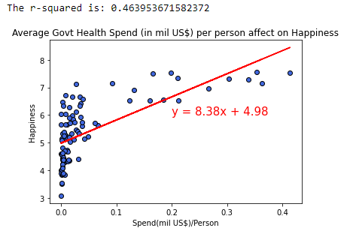
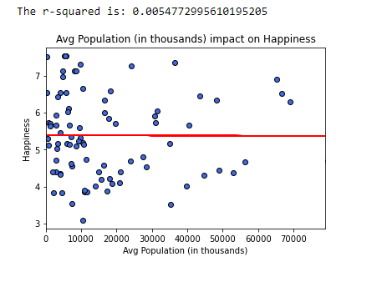
Healthcare/Happiness Correlation
Capital health spend include health infrastructure (buildings, machinery, IT) and stocks of vaccines for emergency or outbreaks
The more govt spend on health infrastructure, the more likely for happier country
No correlation between population and happiness
Notes:
https://apps.who.int/nha/database/Select/Indicators/en

Slide 11

Social Support/Happiness Correlation

Slide 12

Government Types

Slide 13

Weather/Happiness Correlation

Slide 14
Implications
To be happy….
Access to employment
Access to best medicine/technology

Slide 15

Questions?

