Slide 1
VBA-Challenge
Submission Screenshots, Sources and References
Regine Strey 1/9/2021

Slide 2
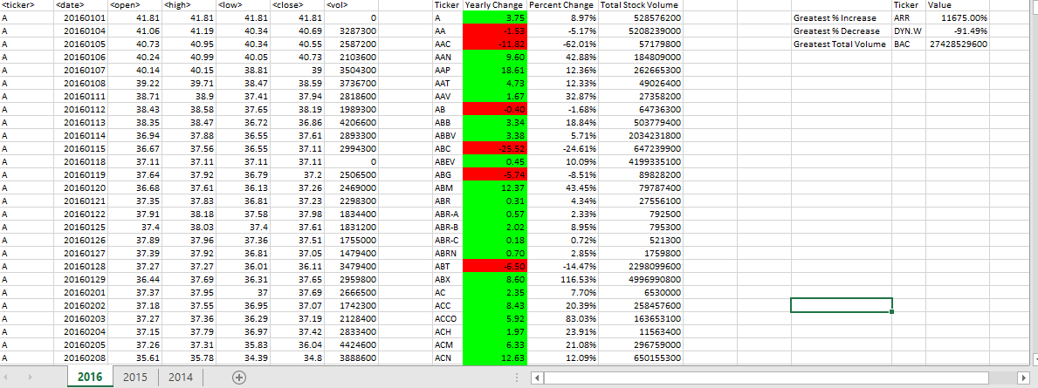
Screenshot of year 2016 worksheet result

Slide 3
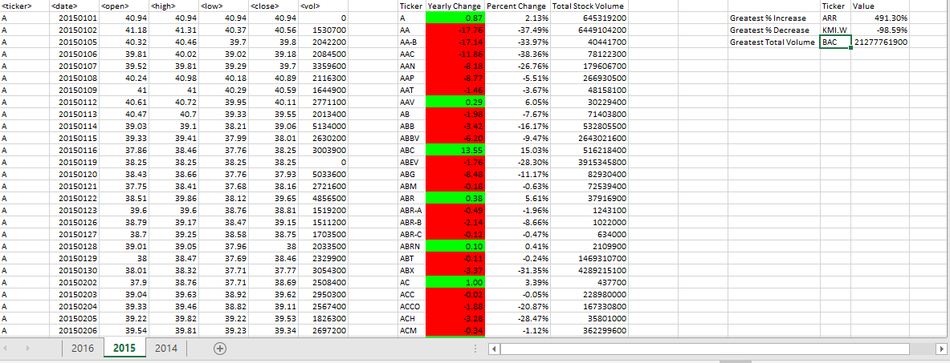
Screenshot of year 2015 worksheet result

Slide 4
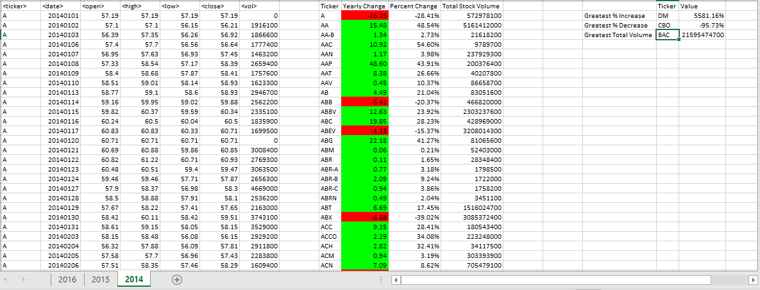
Screenshot of year 2014 worksheet result

Slide 5
Sources:
https://www.educba.com/vba-last-row/ *
https://stackoverflow.com/questions/42633273/finding-max-of-a-column-in-vba/42633375 *
https://stackoverflow.com/questions/43490299/excel-vba-using-find-how-to-select-the-cell-where-the-item-is-found *
http://www.java2s.com/Code/VBA-Excel-Access-Word/Excel/MovetheactivecellbyusingActiveCellOffset.htm *
* Source used directly in submitted code

Slide 6
References:
https://youtu.be/xkRl14pHLBU
https://www.youtube.com/watch?v=MeKL_n6SiYY&list=RDCMUCqyBfm_H9ugGirk1ufYA2YA&index=2

