Slide 1

Side meeting AI-Agent Network Requirements and Protocols
November 2025

Slide 2
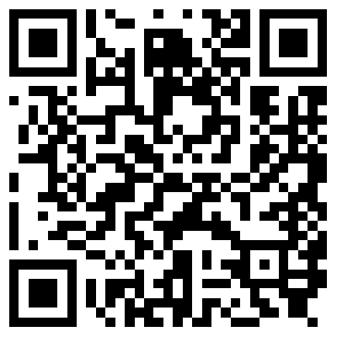
Note Well
By participating in the IETF you agree to follow IETF processes and policies. This Note Well is a reminder of some of those policies. For a linked version of this text, please visit www.ietf.org/note-well or use the QR code below.
IETF participants are expected to behave in a professional manner and extend respect and courtesy to their colleagues at all times (see RFC 7154: IETF Guidelines for Conduct and IETF Anti-Harassment Policy). If you have any concerns about behavior, please contact the Ombudsteam who have a duty of confidentiality and extensive powers to act, as set out in RFC 7776: IETF Anti-Harassment Procedures.
If you are aware that any IETF contribution (as defined in RFC 5378: Rights Contributors Provide to the IETF Trust) is covered by patents or patent applications that are owned or controlled by you, your employer or your sponsor, you must disclose that fact, or not participate in the discussion (see RFC 8179: Intellectual Property Rights in IETF Technology).
For detailed process information consult RFC 2026: Internet Standards Process and RFC 2418: IETF Working Group Guidelines and Procedures and updates to those.
The IETF routinely makes public written, audio, video, and photographic records of IETF activities, including your personal information as set out in the IETF Privacy Statement.
For advice, please talk to Working Group chairs or Area Directors.
Notes:
The IETF Note Well should be shown at the start of every IETF working session. The guidance below is adapted from IETF legal counsel presentation during IETF 120
DO
Do make sure people have enough time to read through the slide before you move on,
Do give a high-level summary of what’s covered in the Note Well: “IETF policies on conduct, privacy and IPR.”,
Do encourage people to read through all the linked policies & documents in detail before participating or contributing,
Do explain where people can direct questions or concerns (IETF Executive Director or Ombudsteam).
DON'T
Don’t dismiss the importance or relevance of any of the information on the Note Well.
Don’t interpret the meaning or get into the substance of any of the topics or content of the policies.
Don’t communicate that the Note Well conveys all the information participants need to know.
Don’t address questions or concerns in the meeting itself.

Slide 3
Agenda
10min: Agenda and Introduction (Lionel)
60min: Presentations
15mn: AI Agents Communication Use Cases and Requirements (China Telecom)
10mn: Telecom AI Agent Use cases and Requirements (China Mobile)
10mn: Multi-Access Collaboration Requirements for AI Agent Protocol (China Unicom)
25mn: AI agent networks framework (ANP)
40min: Additional items for the proposed charter?
10min: Conclusions and Next Steps

Slide 4
Output of AI Protocols side meeting (Tuesday, Nov 4)
Discussion on the Strawman charter:
https://github.com/jdrosen/aiproto-wg/blob/3f1cb59b980f31326a1c3965c2c40ad4badeffd1/charter.txt
Current charter items
(1) A standards track AI Agent session protocol for creation and maintenance of long-lived sessions between AI agents, or between AI agents and tools that have long-lived operation.
(2) An Agent-to-Agent protocol that allows one AI Agent to invoke the services of another AI Agent.
(3) A protocol for enabling human users to confirm operations invoked by AI agents acting on their behalf.
(4) A protocol that allows an AI Agent to obtain and exchange OAuth tokens with extremely limited scopes, bound to the specific operations that the AI Agent is permitted to perform on behalf of the user.

Slide 5
Objectives of this side meeting
Present some specific telco use cases and requirements
Identify additional aspect(s) not addressed in the current proposed charter
Potential proposal for charter update.

Slide 6
3GPP 6G workplan
2024
2025
2026
2027
2028
2029
*
Feasibility Study Phase (Rel-20)
Normative Phase (Rel-21)
Service requirements
Service requirements
Architecture
Architecture
Security
Security
Media
Media
O&M
O&M
Application Enablers
Application Enablers
Protocols
Protocols
*Exact timeline for Rel-21 TBD

Slide 7
Status
Ongoing study demonstrates the potential of AI agent communication in the scope of 6G.
Study on architecture, functional and protocol related aspects will be studied in the upcoming months
If a multi-AI agent-based system is formally adopted by 3GPP in the scope of 6G, standard solutions will be required to support secure and reliable communication between agents and between agents and external tools.
Standard solutions for intra-network but also for inter-network and interaction with 3rd-party platforms.
Close coordination between IETF and 3GPP is expected

Slide 8
Agenda
10min: Agenda and Introduction (Lionel)
60min: Presentations
15mn: AI Agents Communication Use Cases and Requirements (China Telecom)
10mn: Telecom AI Agent Use cases and Requirements (China Mobile)
10mn: Multi-Access Collaboration Requirements for AI Agent Protocol (China Unicom)
25mn: AI agent networks framework (ANP)
40min: Additional items for the proposed charter?
10min: Conclusions and Next Steps

Slide 9
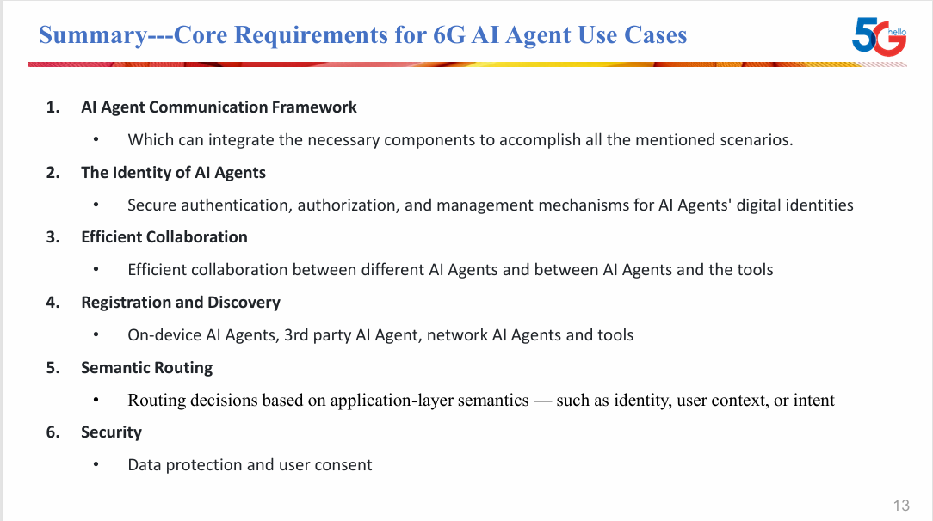
AI Agents Communication Use Cases and Requirements

Slide 10
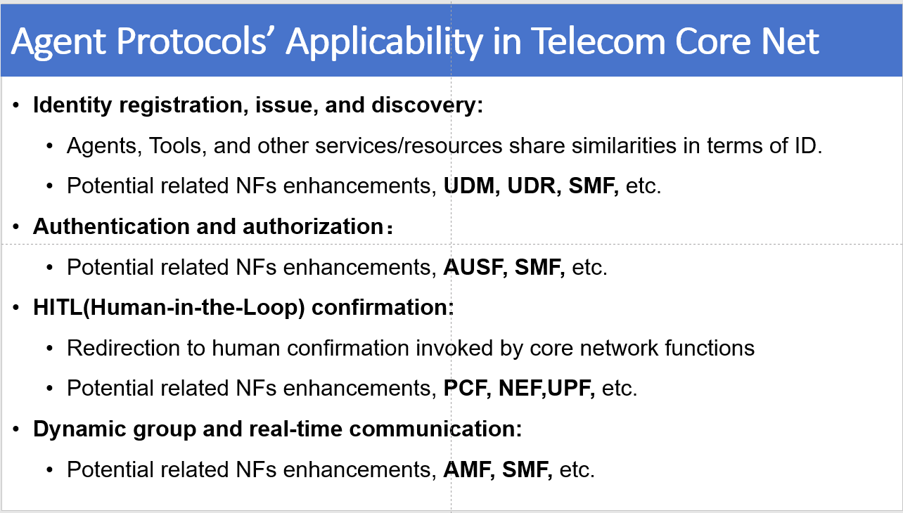
Telecom AI Agent Use cases and Requirements

Slide 11
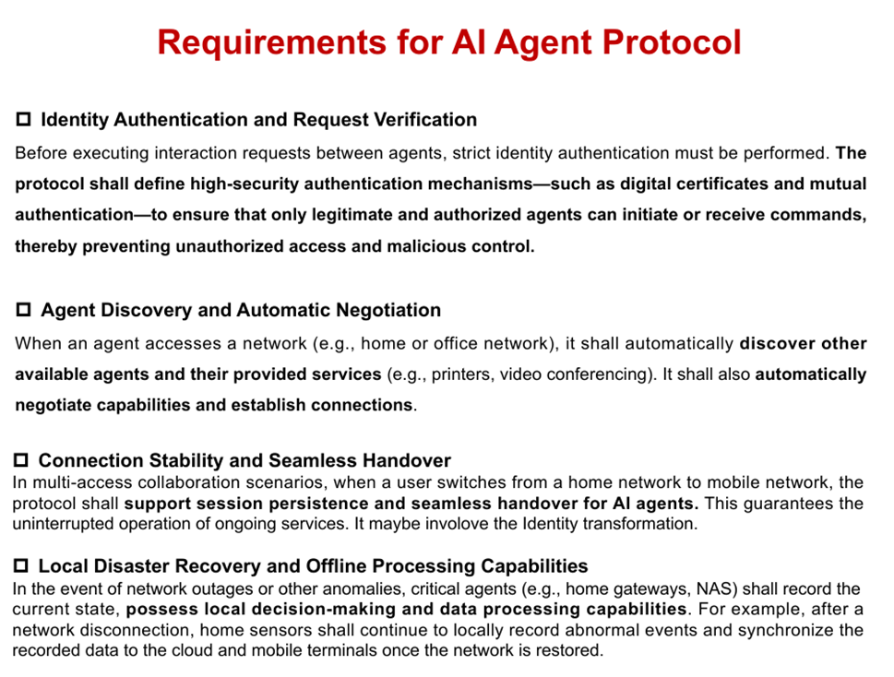
Multi-Access Collaboration

Slide 12
Agenda
10min: Agenda and Introduction (Lionel)
60min: Presentations
25mn: AI agent networks framework (ANP)
10mn: Multi-Access Collaboration Requirements for AI Agent Protocol (China Unicom)
15mn: AI Agents Communication Use Cases and Requirements (China Telecom)
10mn: Telecom AI Agent Use cases and Requirements (China Mobile)
40min: Additional items for the proposed charter?
10min: Conclusions and Next Steps

Slide 13
Current items identified in the proposed charter 1/2
(1) A standards track AI Agent session protocol for creation and maintenance of long-lived sessions between AI agents, or between AI agents and tools that have long-lived operation. These sessions allow for the bidirectional exchange of data, incuding model context, tool call results, and chat messages. The protocol will facilitate highly scalable and reliable session management, able to survive network and server failures while gracefully recovering. It is capable of exchanging real-time data (such as voice), semi-real-time data like chat, and non-real-time data like tool call inputs and outputs, all concurrently during the session.
This protocol is a foundational layer on top of which additional protocols can be built. It is anticipated that the AI Agent session protocol will make use of modern IETF application transfer protocols, such as webtransport or MOQ, based on the anticipated use cases. The protocol must also be usable by non-IETF protocols, like the Model Context Protocol (MCP) or Agent-to-Agent (A2A) protocol, with the appropriate layering enabling its usage by any application

Slide 14
Current items identified in the proposed charter 2/2
(2) An Agent-to-Agent protocol that allows one AI Agent to invoke the services of another AI Agent. This protocol will allow for the exchange of user messages from the end user, including voice, video, images and chat. It will provide basic lifecycle management, enabling the establishment, update, and termination of the services of the downstream agent. This A2A protocol will make use of the AI Agent session protocol, and be the first application specified on top of it. It is anticipated that this protocol would be a next-gen version of the A2A protocol currently under the auspices of the Linux Foundation, building upon that foundation.

Slide 15
Agenda
10min: Agenda and Introduction (Lionel)
60min: Presentations
25mn: AI agent networks framework (ANP)
10mn: Multi-Access Collaboration Requirements for AI Agent Protocol (China Unicom)
15mn: AI Agents Communication Use Cases and Requirements (China Telecom)
10mn: Telecom AI Agent Use cases and Requirements (China Mobile)
40min: Additional items for the proposed charter?
10min: Conclusions and Next Steps

