Slide 1
Telecom AI Agent Use cases and Requirements
Kehan Yao, China Mobile
IETF 124

Slide 2



Holistic AI agent communication scenarios
Agent
OTT X
Agent
Tool y_1
Tool a_1
OTT Y
Tool a_2
Tool y_2
Operator A
Application
Tools Service
Network
Tools Service
Operator B
Agent
Agent
User
Agent
AI agent types:
Agent in Apps. Provider: OTT, operator, third party, etc.
Agent in UEs. Provider: phone vendor, robot vendor, etc.
Agent in network. Provider: operator, OTT.
Tools types:
Application tools.
Network tools.

Slide 3
Terminology
Ownership and Roles of AI agents:
OBO(On-behalf-of) User: the agent may require the authorization from user(s) to implement jobs for user(s).
OBO Agent Itself: the agent itself has indentity and implements jobs and represents itself.
OBO Other Agent(s): the agent may represent other agents to implement some jobs, given that other agents may not have the capabilities to implement the jobs.
Domain:
Task-wise Domain: a temporary domain that is created to target on a specific job, when the job is finished, the domain is destroyed. A typical example is a domain that is created by 6G systems.
Application Domain: a durable domain that is created by a specific application, e.g., a web or mobile application offerred by cloud service providers.

Slide 4
Use cases: Trip Planning (Agent OBO User)
AI agent delegates its user to plan trip services.
AI agent can do payment execution for booking.
ticket booking service
Application 1
User
AI Agent
Trip Planning Agent
(UE native/App native)
map service
Application 2
Requirements:
MUST support HITL(human-in-the-loop) to avoid wrong execution.
MUST define risk levels, what level MUST require HITL, what level is in “whitelist”, and what level requires user confirmation but can then put into “whitelist”.

Slide 5
Use cases: Health Care (Agent OBO other agent)
For children, specific elder people (e.g., Alzheimer's patients), and people with disabilities who require guardians
Their agents (e.g., smart watches) collect biosensing data and transmit it to the guardians' agents which make decisions on whether sending requests to external institutions such as hospitals on behalf of the wards' agents
Ward
Guardian
Hospital, etc.
User
User
External
resources/API
AI Agent
AI Agent
Smart Watch
Phone
Requirements:
MUST define clear scope or boundaries for resource access and decision making under delegated authorization.

Slide 6

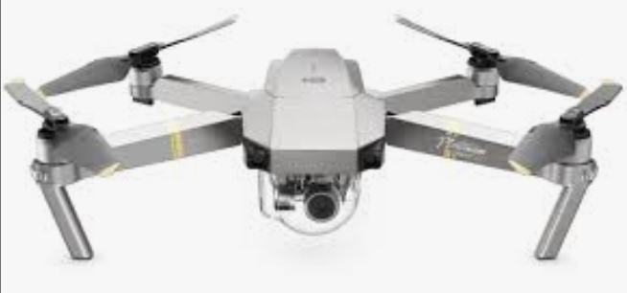
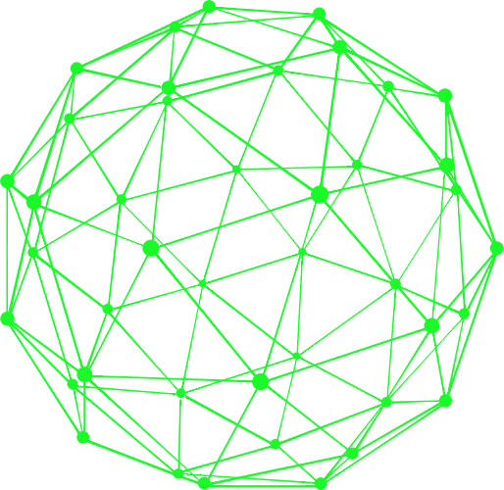
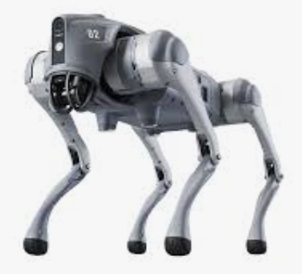
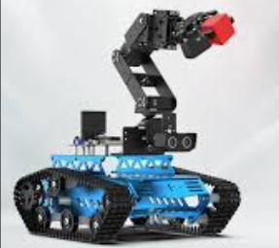
Use cases: Remote Rescue (Agent OBO itself)
Multiple AI agents collaborate to finish remote rescue tasks.
UAV
Mobile Core Network
External Agent
Robot Dog
Robot Arm
ACN
Subnet
task-wise domain
Requirements:
MUST support real-time communication between agents, as well as reliablity.
MUST support dynamic groups of agent communication for temporary tasks.
MUST support life-cycle management of groups, including construction and destroy.

Slide 7
Agent Protocols’ Applicability in Telecom Core Net
Identity registration, issue, and discovery:
Agents, Tools, and other services/resources share similarities in terms of ID.
Potential related NFs enhancements, UDM, UDR, SMF, etc.
Authentication and authorization：
Potential related NFs enhancements, AUSF, SMF, etc.
HITL(Human-in-the-Loop) confirmation:
Redirection to human confirmation invoked by core network functions
Potential related NFs enhancements, PCF, NEF,UPF, etc.
Dynamic group and real-time communication:
Potential related NFs enhancements, AMF, SMF, etc.

Slide 8
Summary
There are some important use cases in telecom network, beyond enterprise networks and the Internet. They are not limited to use just A2A, but also open to MCP, ANP, etc.
Fine-grained requirements and new requirements are proposed for protocol design, beyond the 4 main work item listed in AIproto strawman charter.
Do you agree with these use cases and requirements?
Any interests to join?

Slide 9
THANKS!
IETF 124

