Slide 1
Distributed Split-Path Routing Strategy for Multi-hop Mesh Networks
Paulo Alexandre Regis, Shamik Sengupta

Slide 2
Outline
Introduction
System model
Metric model
Results
Conclusion and future work

Slide 3
Outline
Introduction
System model
Metric model
Results
Conclusion and future work

Slide 4
Mission-centric network
Varied range of applications (smart-city, traffic monitoring, first responders)
Various challenging components to manage (power constraint, mobility, resource allocation, time scheduling)

Slide 5
Outline
Introduction
System model
Metric model
Results
Conclusion and future work

Slide 6
System model
Cross-layer information is available to enable metric calculation
Network layer aware of radio characteristics
Nodes can act as relays, source, or both
All network traffic has the same destination, i.e. headquarters, mission controller

Slide 7
Outline
Introduction
System model
Metric model
Results
Conclusion and future work

Slide 8
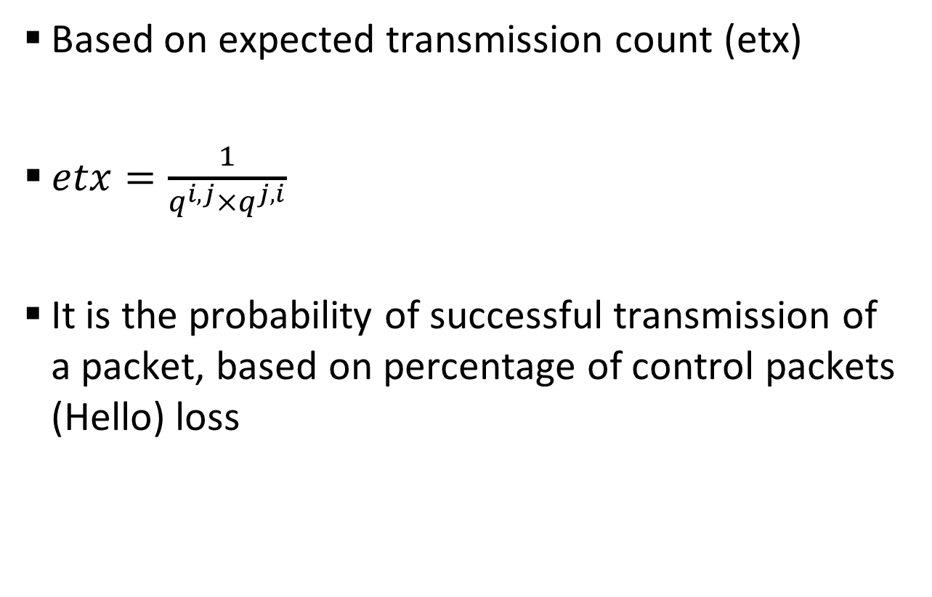
Relative link quality: q^{i,j}
Based on expected transmission count (etx)
$etx=\frac{1}{q^{i,j}×q^{j,i}}$
It is the probability of successful transmission of a packet, based on percentage of control packets (Hello) loss

Slide 9

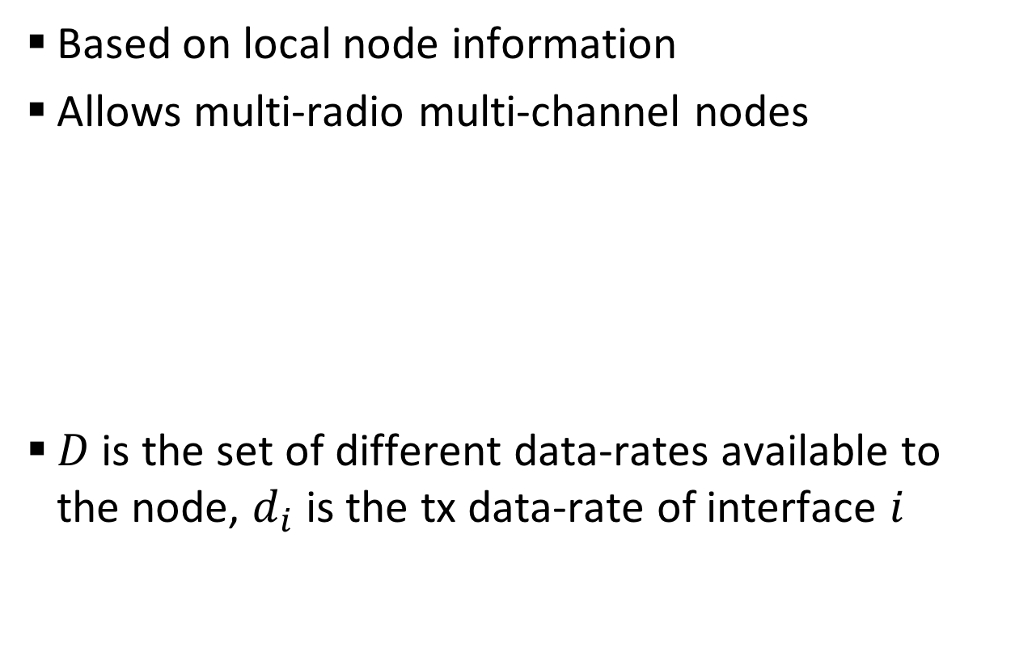

Normalized data-rate: $δ_{i}$
Based on local node information
Allows multi-radio multi-channel nodes
$D$ is the set of different data-rates available to the node, $d_{i}$ is the tx data-rate of interface $i$

Slide 10



Remaining energy: $e$
Simply the current percentage of remaining energy of the power supply
If a node has no battery (i.e. powered by infrastructure), then $e=1$

Slide 11
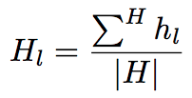

History stack percentage: $H_{l}$
Tries to capture the link utilization based on recent routing activity

Slide 12
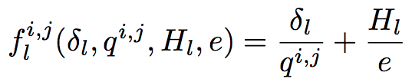

Combined metric: $f_{l}^{i,j}$
Since all parameters are normalized we can combine them together
Tries to:
utilize low data-rate links first (save energy)
transmit to less jammed links (avoid bottleneck by dividing the flow into multiple paths)

Slide 13
Outline
Introduction
System model
Metric model
Results
Conclusion and future work

Slide 14
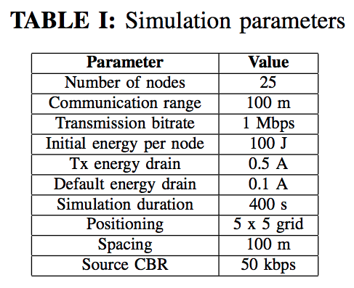
Simulation setup

Slide 15
Performance metric
Common networking metrics: throughput, delay, hop count
Network lifetime, based on energy models present in ns3. Average time a node still has energy

Slide 16
Results

Slide 17

Trade-off indicator
To help design the network, helping decide the mechanism to be used
Weighted aggregation of throughput and lifetime
$t=w_{1}\left|tp\right|+w_{2}\left|lt\right|$, where $w_{1}+w_{2}=1$ and both throughput ($tp$) and lifetime ($lt$) are normalized

Slide 18
Results

Slide 19
Outline
Introduction
System model
Metric model
Results
Conclusion and future work

Slide 20
Conclusion and Future Work
New link metric incorporating multiple parameters: energy, history stack, relative link quality
No absolute ”winner”:
Each method works better in different situations, depends on the objective
Future work:
Variable history size
Multi-radio multi-channel HetNets
Mobile networks

Slide 21
Acknowledgement
This research was partially supported by the NSF Career Award No. 1346600, NSF Partnership for Innovation Award No. 1430328, and CAPES Brazil 13184-13-0.

Slide 22
Thank You!

