Slide 1
Unmanned Aerial Vehicles Positioning Scheme for First-responders in a Dynamic Area of Interest
Paulo Alexandre Regis, Amar Nath Patra, Shamik Sengupta

Slide 2
Outline
Introduction
System model
Positioning mechanism
Simulation and results
Conclusion and future work

Slide 3
Outline
Introduction
System model
Positioning mechanism
Simulation and results
Conclusion and future work

Slide 4
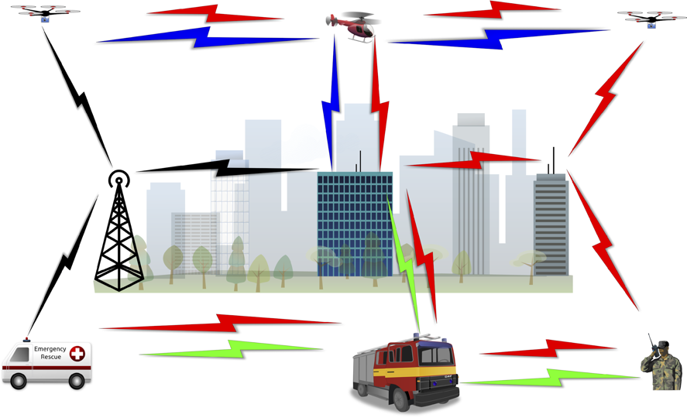
UAV Networks
Varied range of applications (smart-city, traffic monitoring, first responders aid)
Various challenging components to manage (power constraint, mobility, resource allocation, time scheduling).

Slide 5
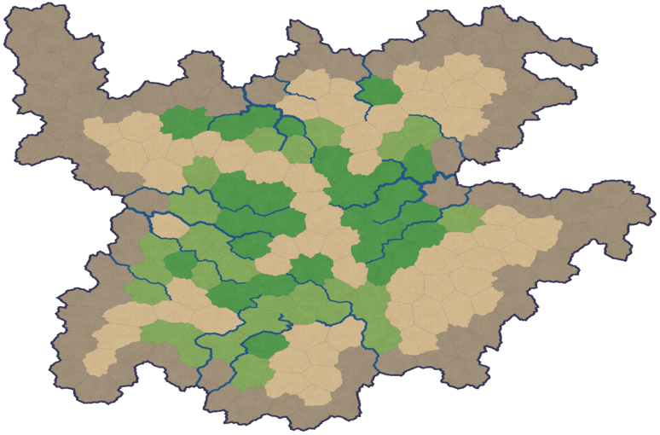
Map coverage
Map can be of an infinite number of shapes and forms.
Hard to find the perfect positioning for any generic map in a small amount of time.
Contained in the map there might be areas that do not need coverage.

Slide 6
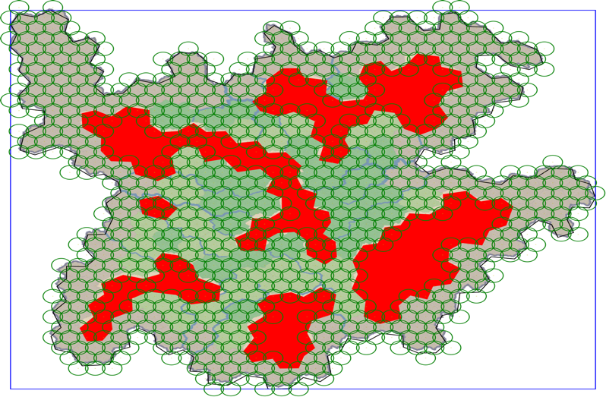
What we did
We find a feasible UAV positioning solution, for any given map, in a short(ish) amount of time.
Complexity is mandated by the administrator.

Slide 7
Outline
Introduction
System model
Positioning mechanism
Simulation and results
Conclusion and future work

Slide 8
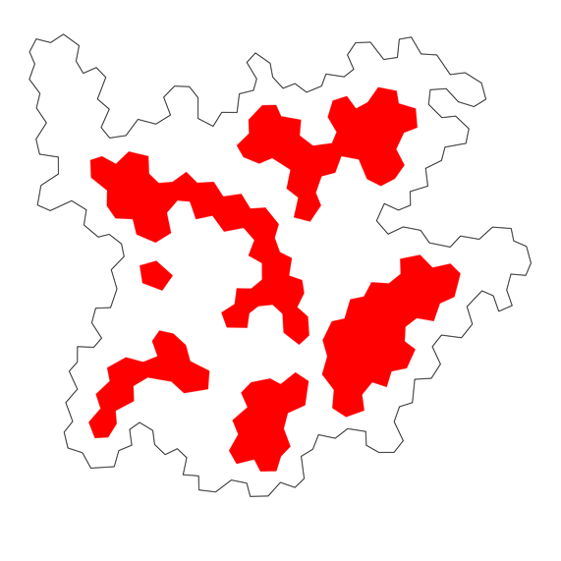

System model and assumptions
Area of interest: polygon that represents the outer limits of the map
Excluding zone(s): one or more areas, contained inside the AoI, that do not need coverage

Slide 9
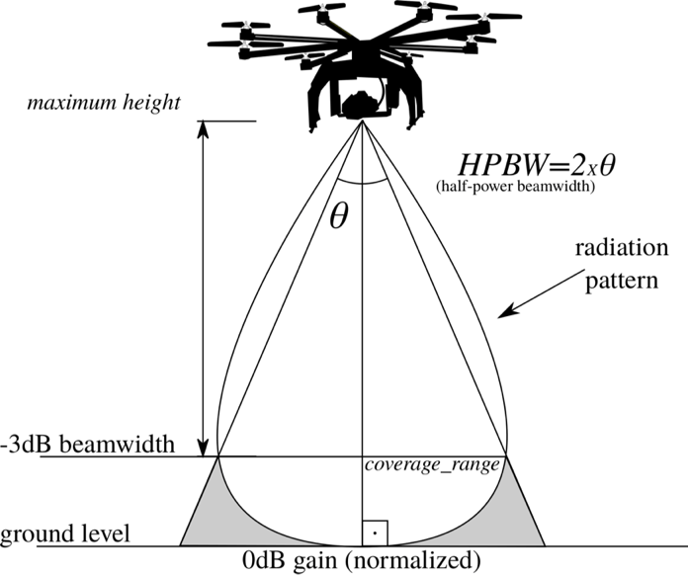
System model and assumptions
Coverage range: radius that a UAV can cover on the map
Communication range: distance between two nodes at which they can still communicate
How to maximize the coverage with the least number of UAVs as possible?

Slide 10
Outline
Introduction
System model
Positioning mechanism
Simulation and results
Conclusion and future work

Slide 11
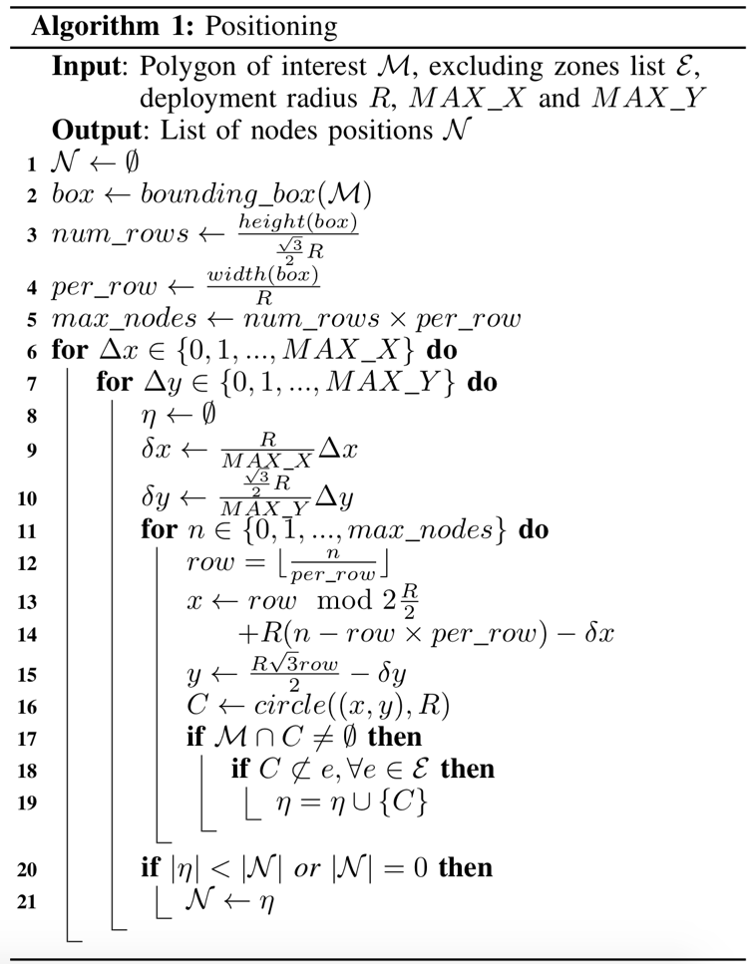
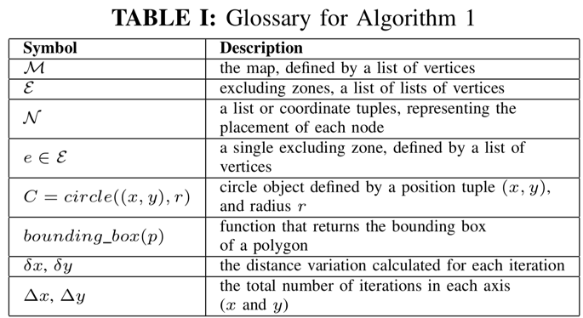

Algorithm
Complexity is linear:

Slide 12
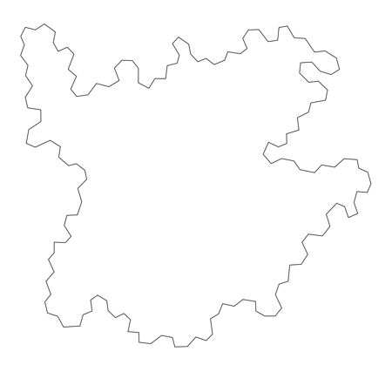



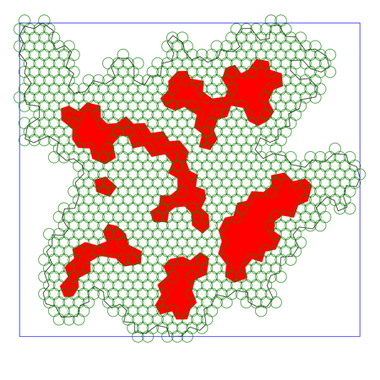
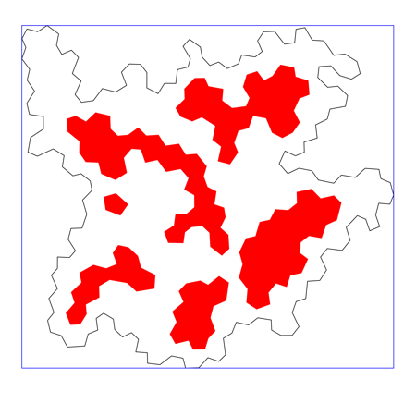
Behind the scenes

Slide 13
Outline
Introduction
System model
Positioning mechanism
Simulation and results
Conclusion and future work

Slide 14
Performance indicators
Benchmark: hexagonal tiling circle packing algorithm (highest density with no overlapping)
Number of nodes: size of the solution yielded by the algorithms
Uncovered area: areas in the AoI that are uncovered by the solution. The benchmark allows gaps between nodes, while our method guarantees this to be zero
Wasted coverage: the total area covered by the solution and not contained in the AoI
Time to compute: time taken to compute the solution

Slide 15
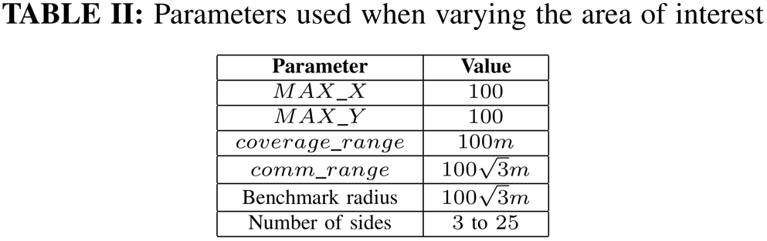
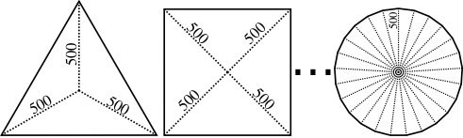
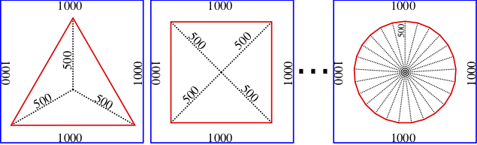
Parameters
Varying the AoI Varying the EXC

Slide 16
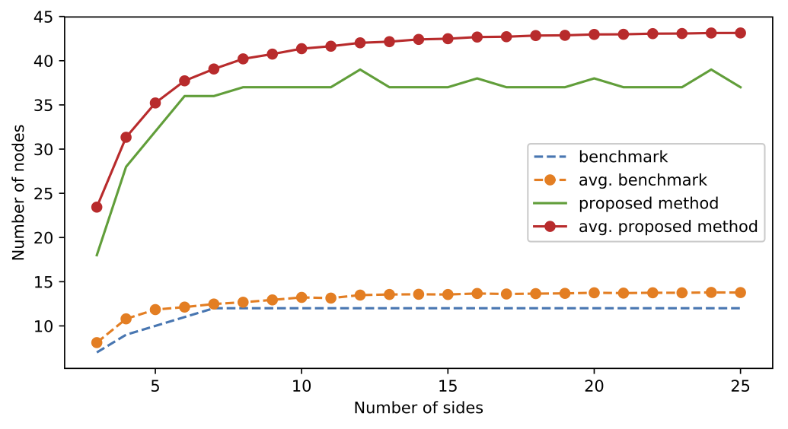
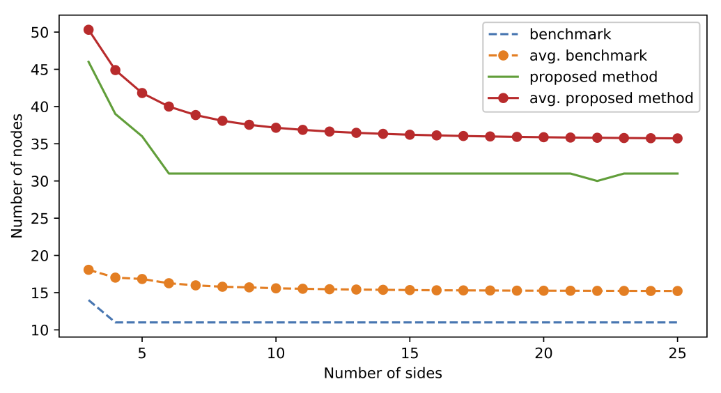
AoI
Exc

Slide 17
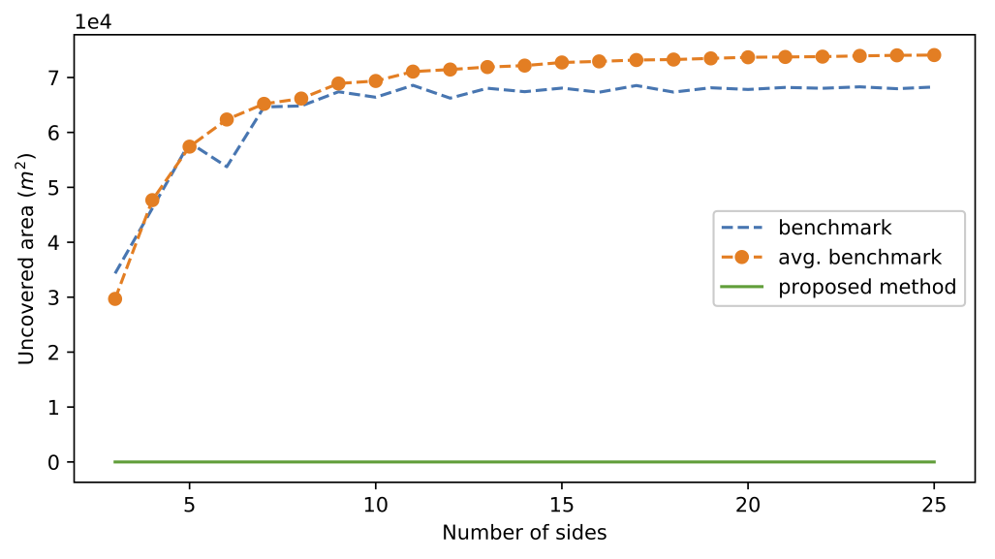
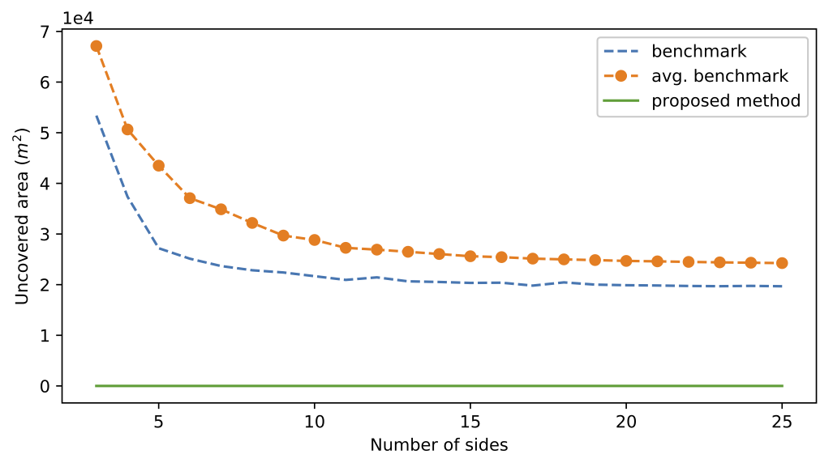
AoI
Exc

Slide 18
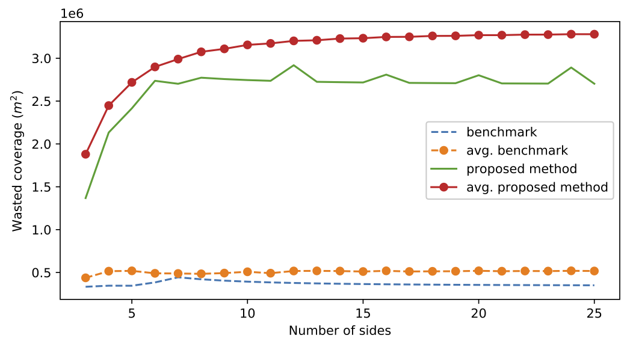
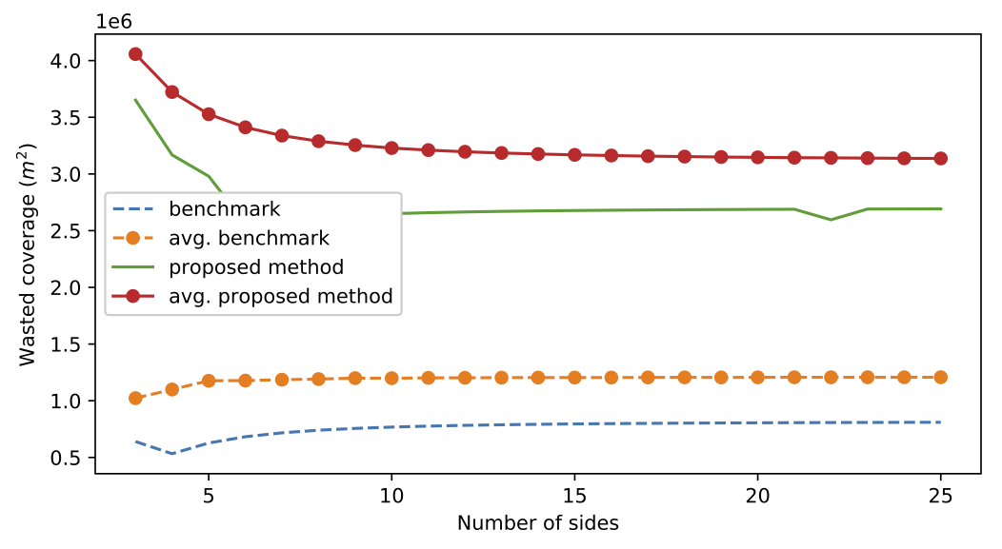
AoI
Exc

Slide 19
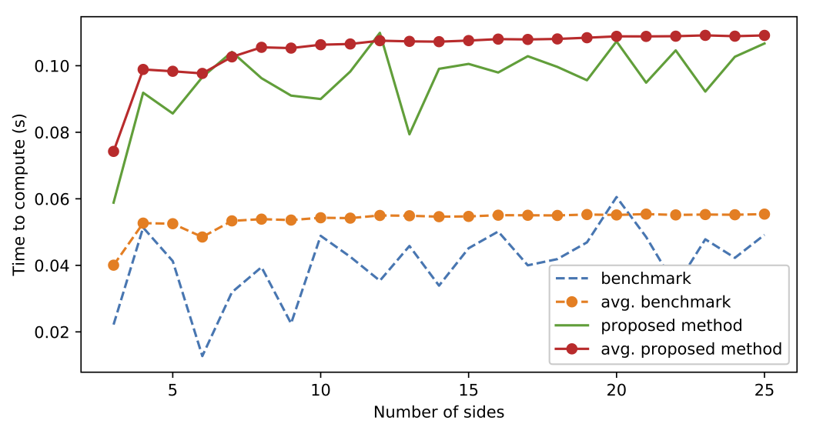
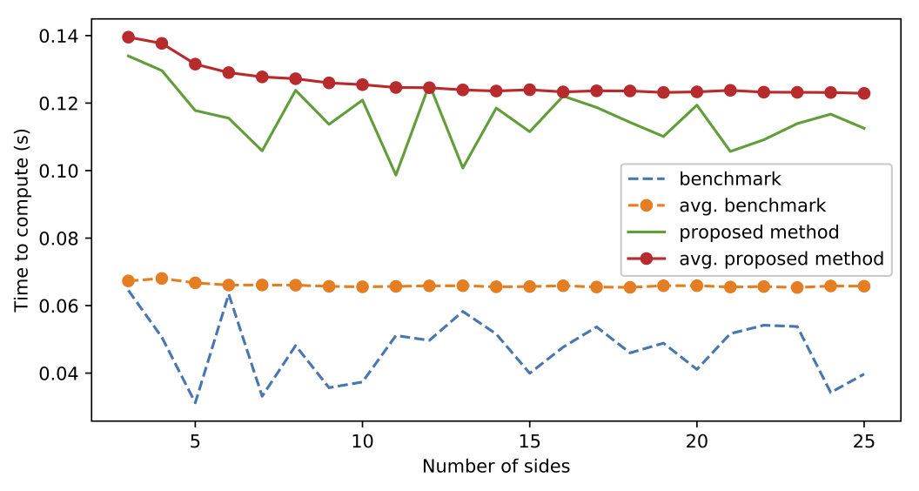
AoI
Exc

Slide 20
Outline
Introduction
System model
Positioning mechanism
Simulation and results
Conclusion and future work

Slide 21
Conclusion and future remarks
Algorithm finds a feasible solution in a linear amount of time.
Avoids non-interesting areas, reduces number of UAVs needed.
Future work:
3D: introduces an extra layer to the complexity
Adaptive map: change positioning as the map changes (wildfires, floods, etc.) without recalculating the entire solution again.

Slide 22
Thank you!

