Slide 1
Enhancing Performance and Longevity of Multi-radio Multi-channel HetNets through Dynamic Path-assignment
Paulo Alexandre Regis, Suman Bhunia, Shamik Sengupta

Slide 2
Outline
Introduction
System model
Utility model
Flow assignment
Results
Conclusion and future work

Slide 3
Outline
Introduction
System model
Utility model
Flow assignment
Results
Conclusion and future work

Slide 4
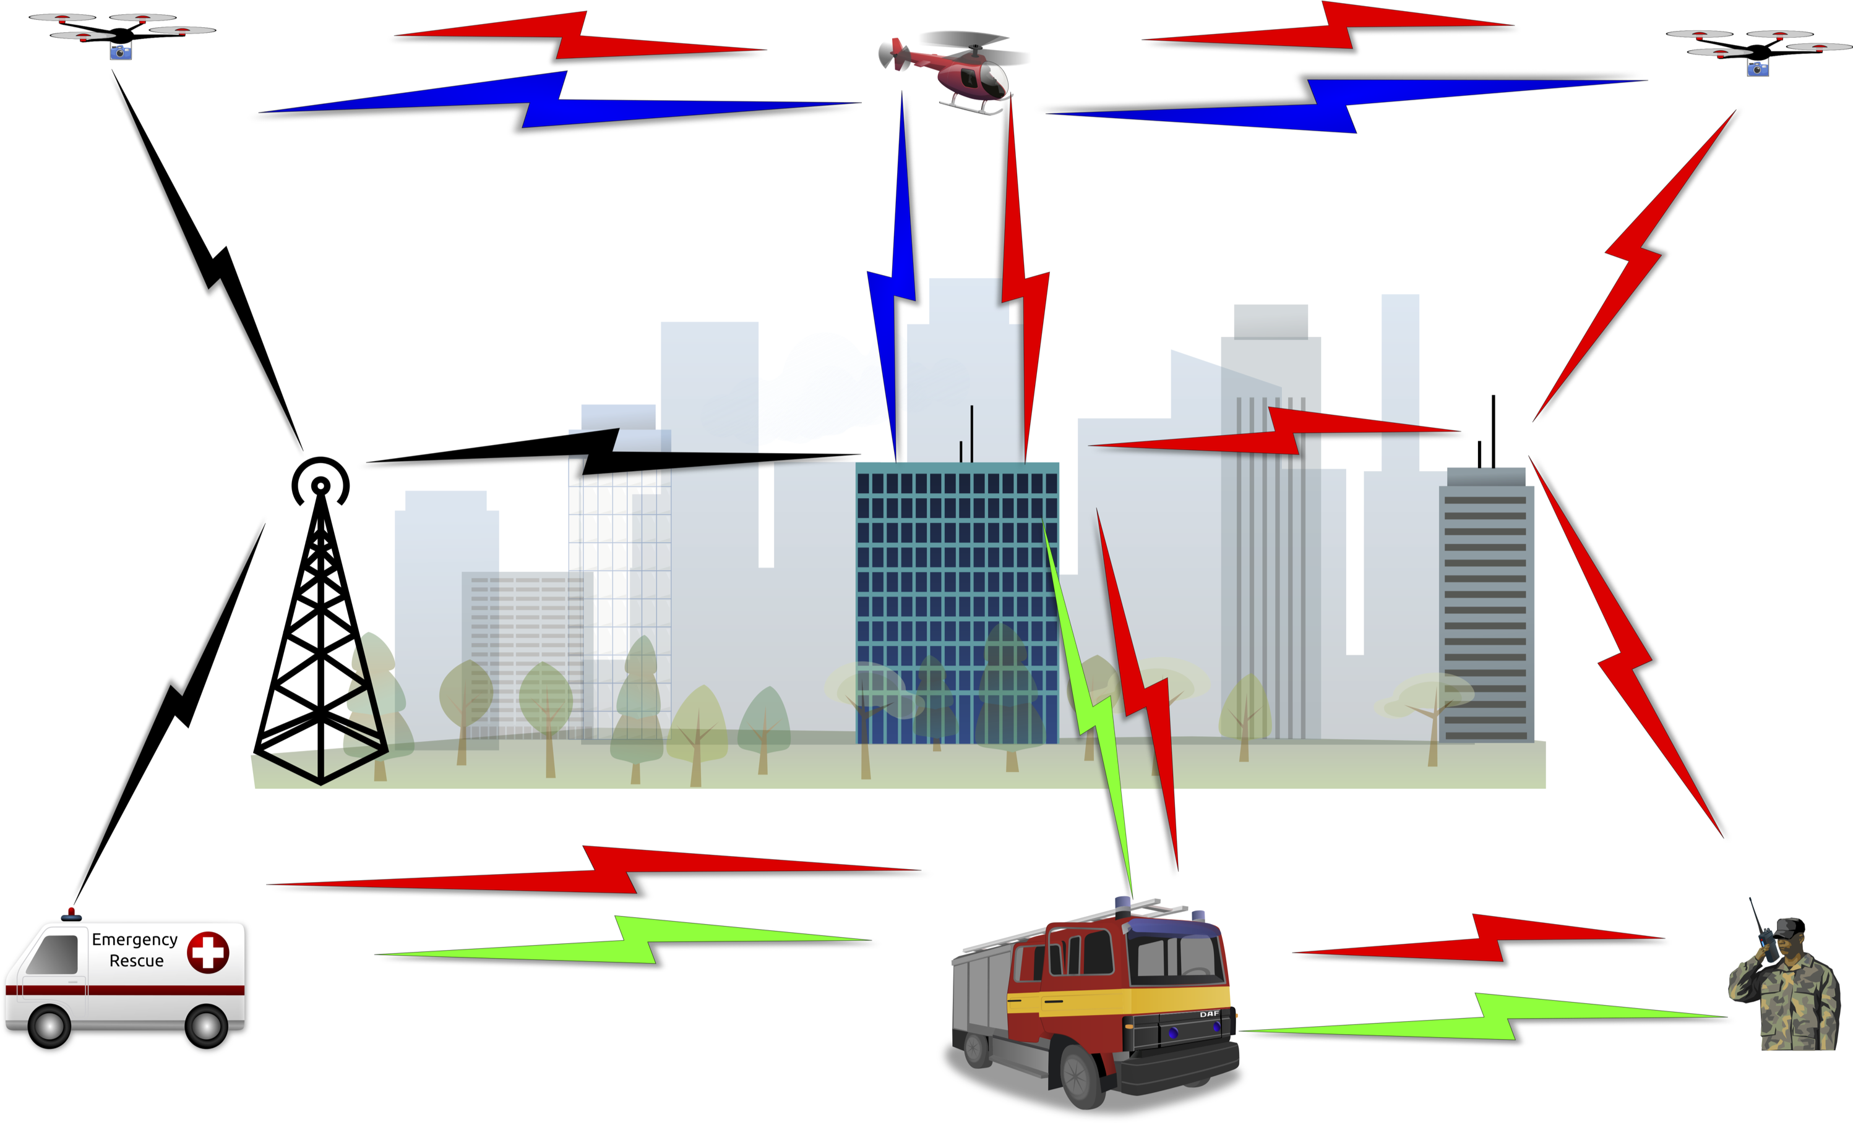
Multi-radio Multi-channel HetNets
Varied range of applications (smart-city, traffic monitoring, first responders)
Various challenging components to manage (power constraint, mobility, resource allocation, time scheduling).

Slide 5
Outline
Introduction
System model
Utility model
Flow assignment
Results
Conclusion and future work

Slide 6
System model and assumptions
Command and Control (CC): a centralized agent that computes the assignments.
Arbitrary number of sinks (sink != CC): they consume the traffic generated.
Sinks may generate traffic; consumed elsewhere.
All nodes can act as relays.
Nodes have arbitrary number of radio interfaces.
An interface enables access to a frequency channel.
Different interfaces can Tx/Rx at the same time.
Nodes are stationary

Slide 7
Flow model
Each flow has a source, destination (sink), and a requirement (data-rate).
Flow types:
Streaming: video and/or voice streaming, highest data-rate requirement
Imagery: image file transfers, data-rate requirement only lower than Streaming
Sensor: small data collected from sensors, lowest traffic data-rate requirement

Slide 8
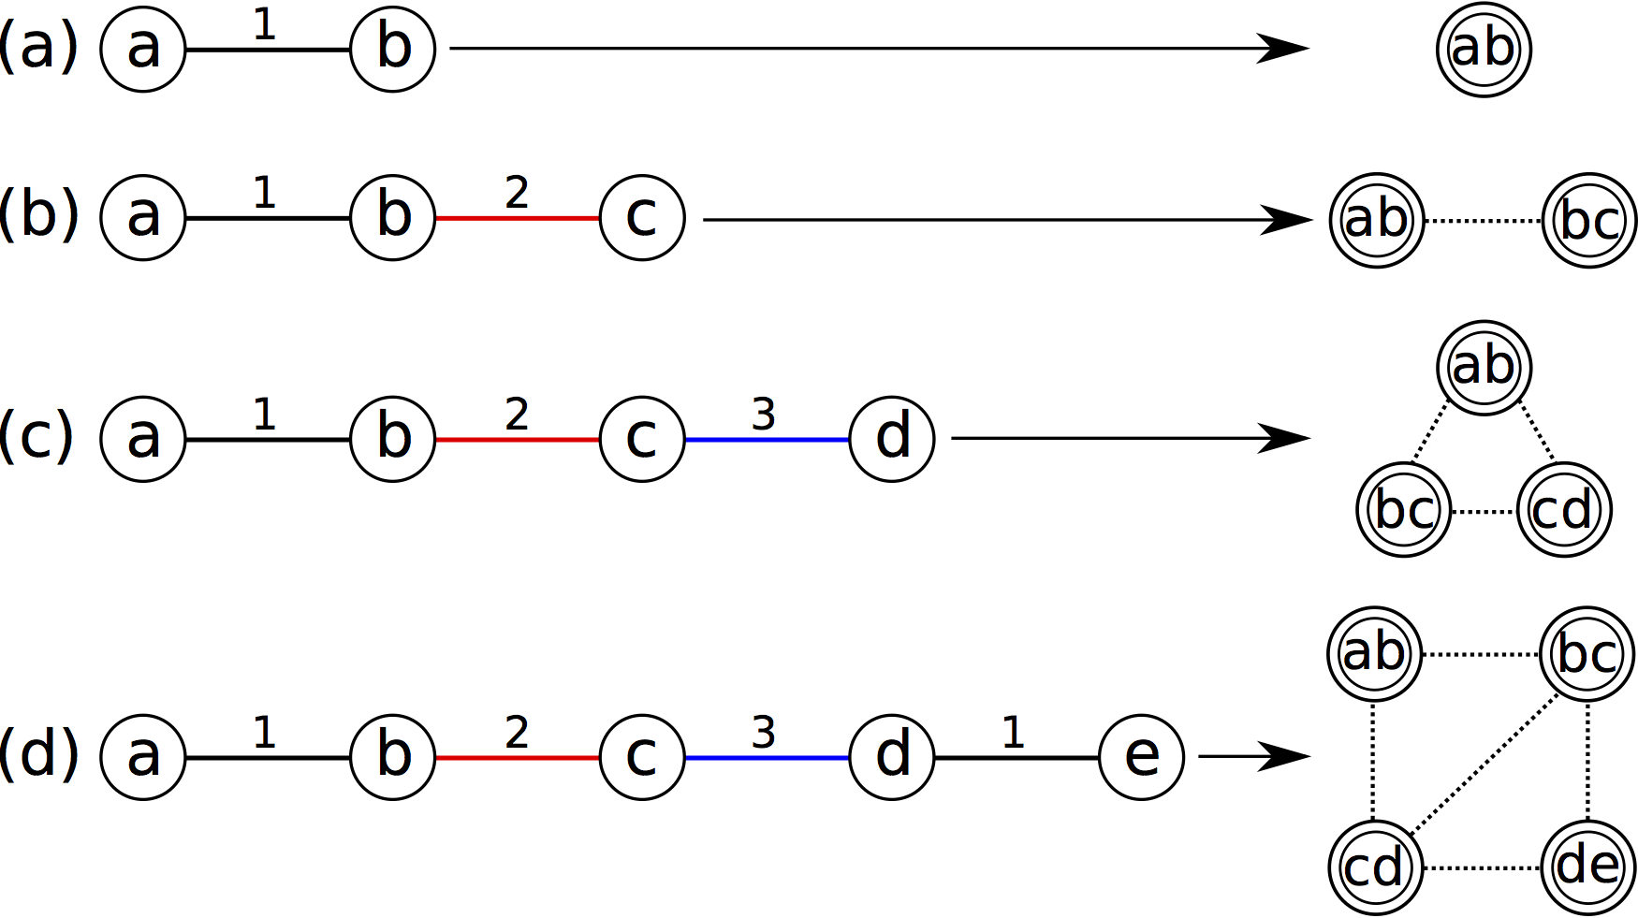
Interference model

Slide 9
Outline
Introduction
System model
Utility model
Flow assignment
Results
Conclusion and future work

Slide 10
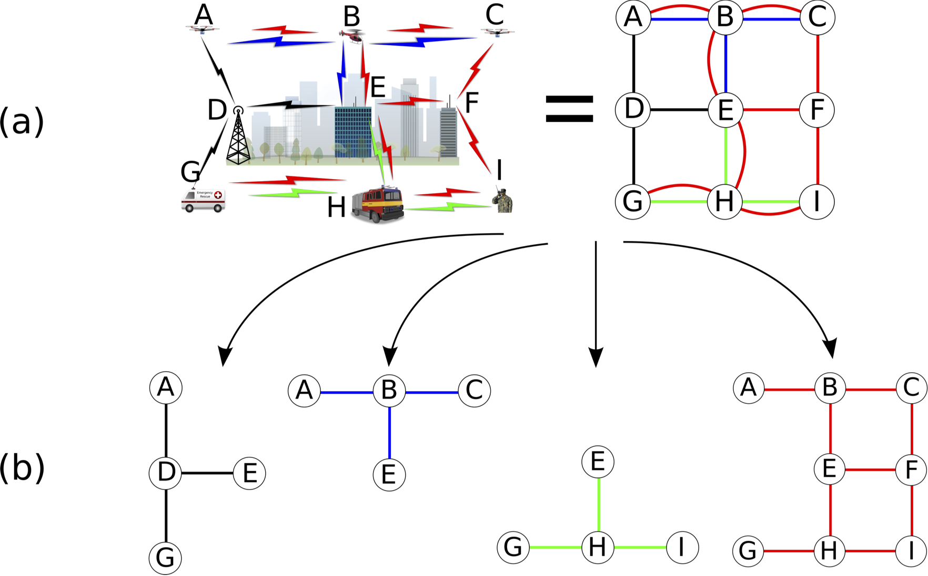
Utility model

Slide 11
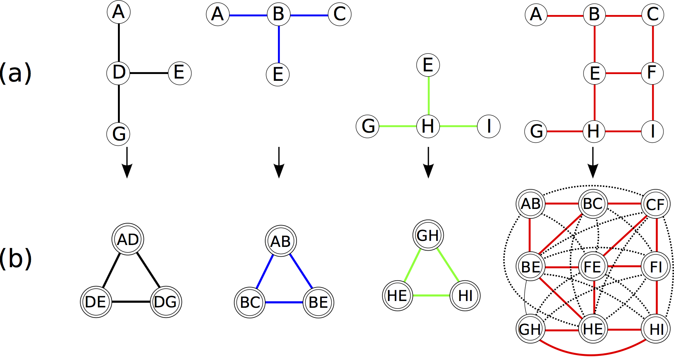
Utility model

Slide 12
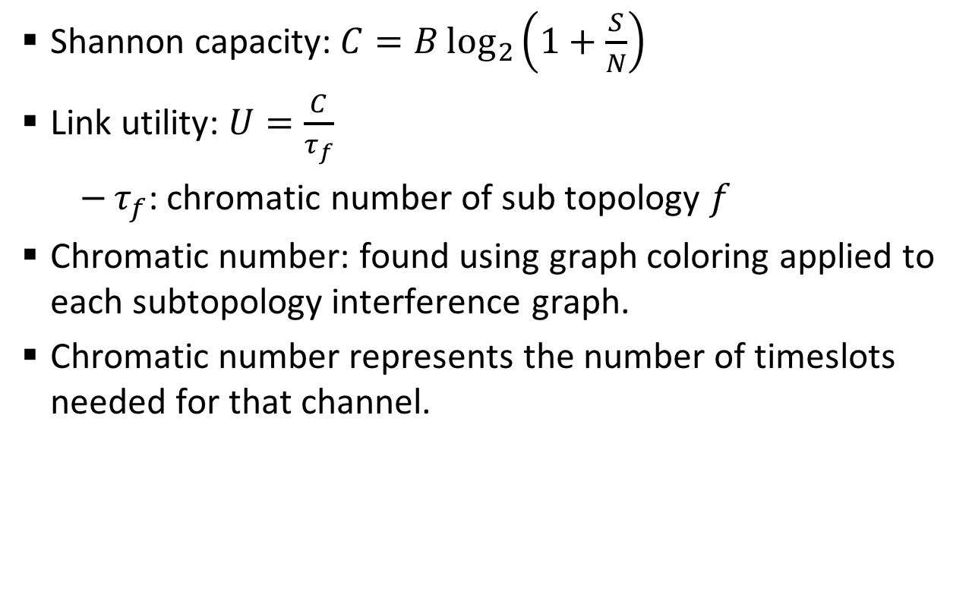
Utility model
Shannon capacity: $C=B\log_{2}\left(1+\frac{S}{N}\right)$
Link utility: $U=\frac{C}{τ_{f}}$
$τ_{f}$: chromatic number of sub topology $f$
Chromatic number: found using graph coloring applied to each subtopology interference graph.
Chromatic number represents the number of timeslots needed for that channel.

Slide 13
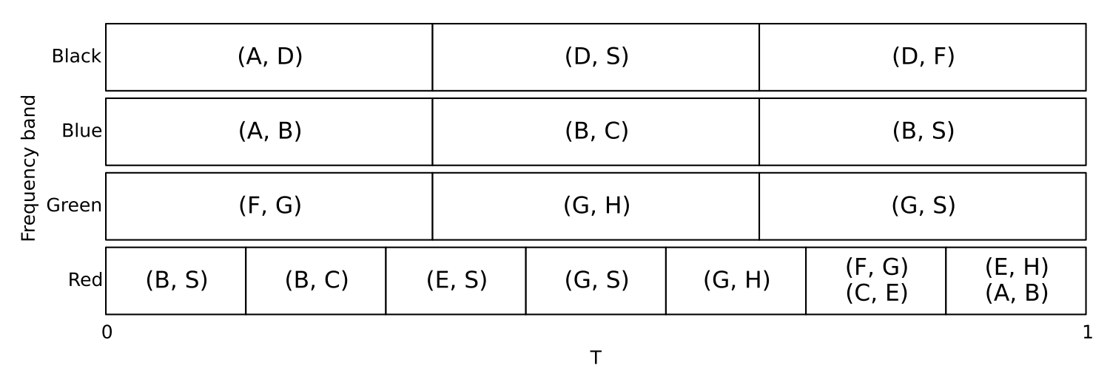
Utility model

Slide 14
Outline
Introduction
System model
Utility model
Flow assignment
Results
Conclusion and future work

Slide 15
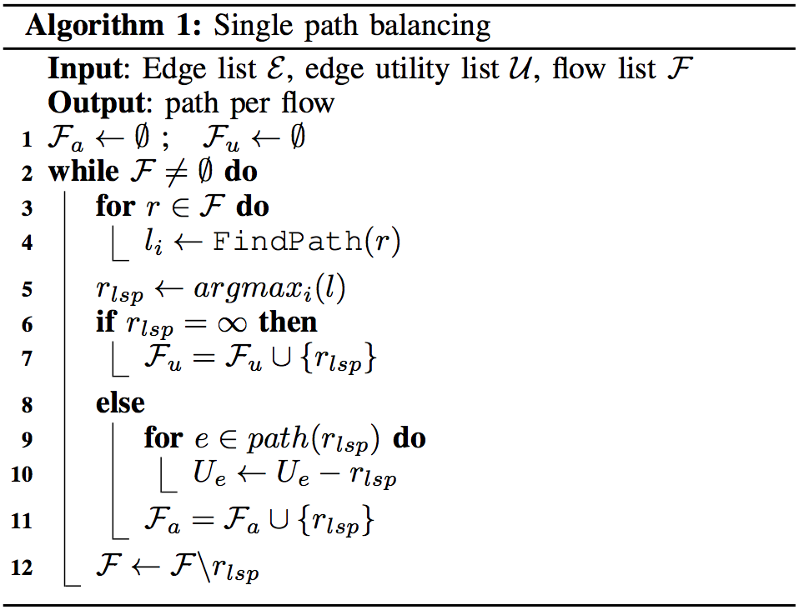
Single path

Slide 16
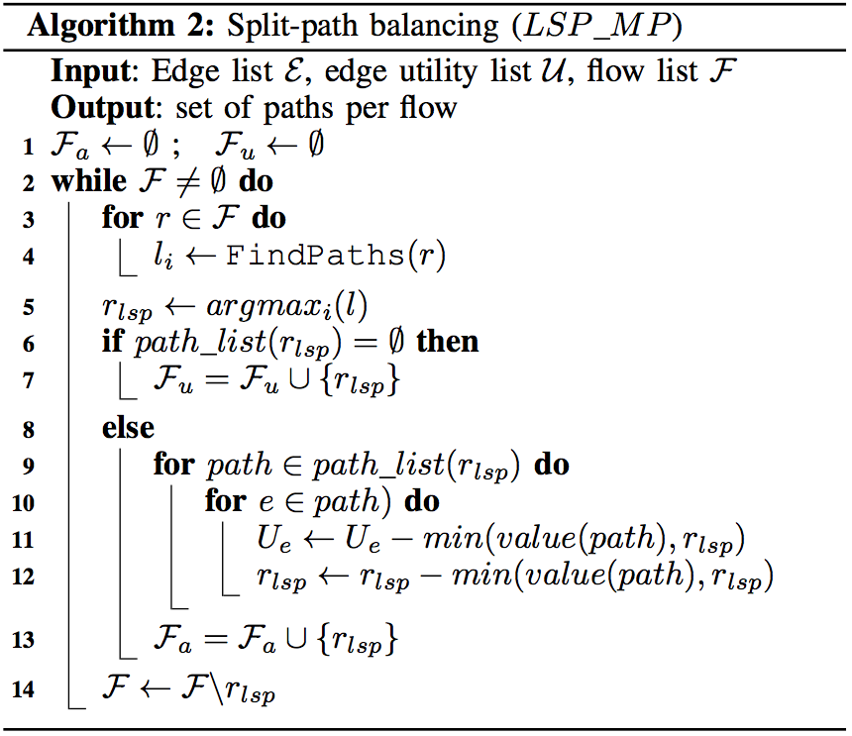
Split path

Slide 17
Algorithm variations
Longest shortest path, lower data rate link first (LSP LF): uses Algorithm 1.
Shorter shortest path, higher data rate link first (SSP HF): based on Algorithm 1. Selects the flow with shorter shortest path first, based on the data-rate path.
Longest shortest path, higher data rate link first (LSP HF): finds the fastest path possible for the longest shortest path. Based on Algorithm 1.
Longest shortest path, multi-path flow (LSP MP): the original Algorithm 2.
Longest shortest path, hop count as weight (LSP HC): uses Algorithm 1. Assumes uniform weight for links (hop count). Used as benchmark.

Slide 18
Outline
Introduction
Motivation
Related Work
System Model
Flow assignment
Results
Conclusion and Future Work

Slide 19
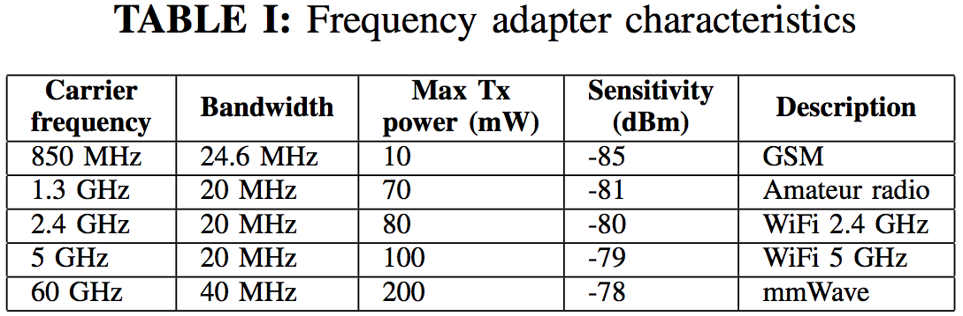
Simulation Parameters
Types of flow probability:
• Streaming: 1%, 1Mbps
• Imagery: 10%, 100Kbps
• Sensor: 60%, 1Kbps • No traffic: 29%, 0bps

Slide 20
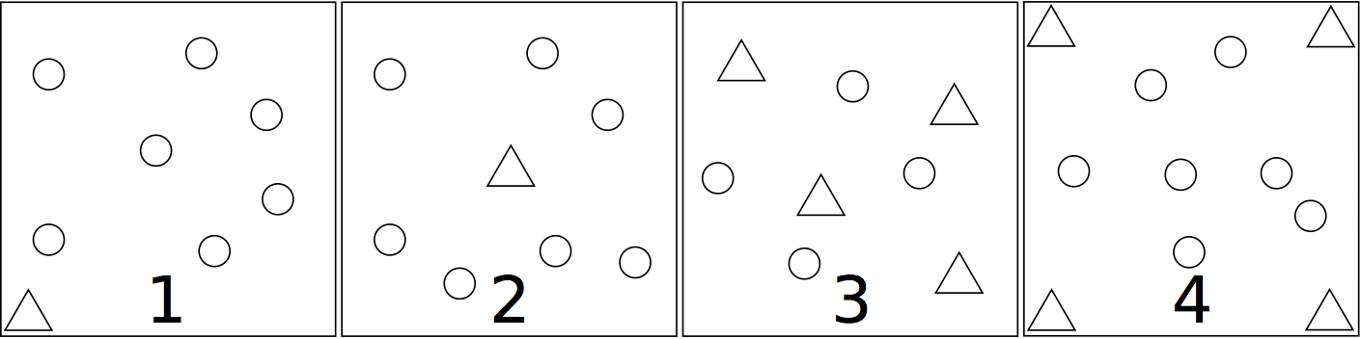
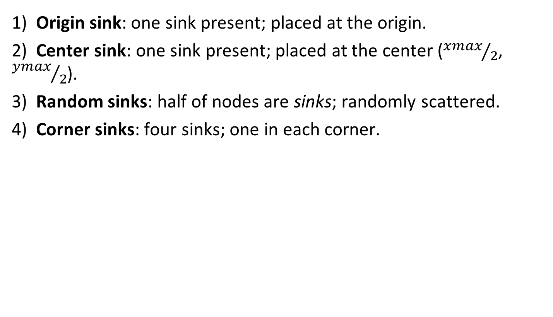
Sink positioning cases
1) Origin sink: one sink present; placed at the origin.
2) Center sink: one sink present; placed at the center (${xmax}/2$, ${ymax}/2$).
3) Random sinks: half of nodes are sinks; randomly scattered.
4) Corner sinks: four sinks; one in each corner.

Slide 21
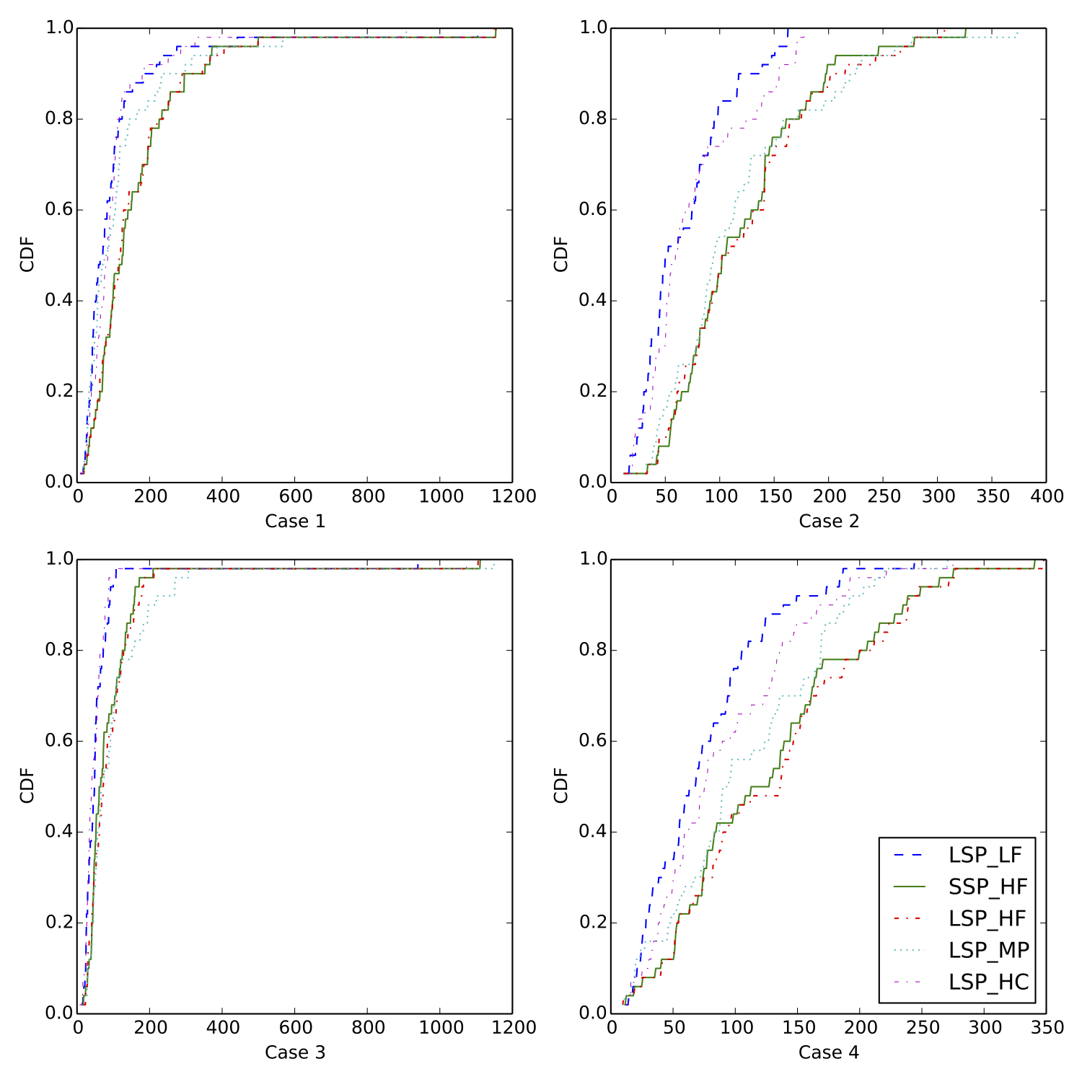
Power distribution

Slide 22
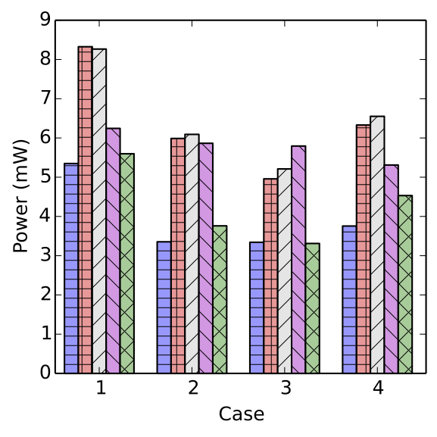
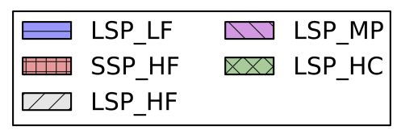
Power consumption

Slide 23
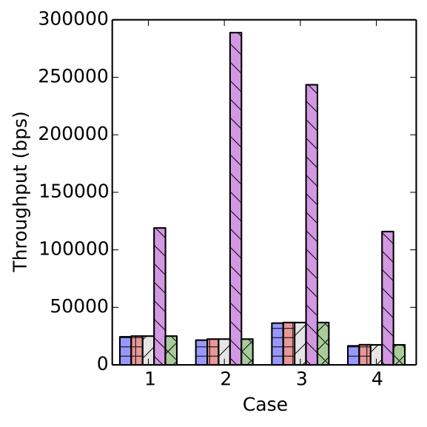
Overall throughput

Slide 24
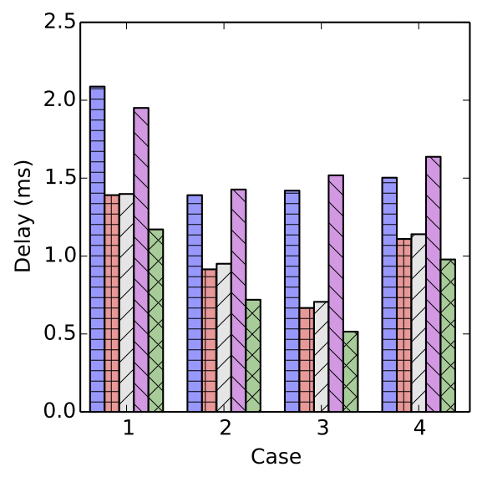
Average delay per flow

Slide 25
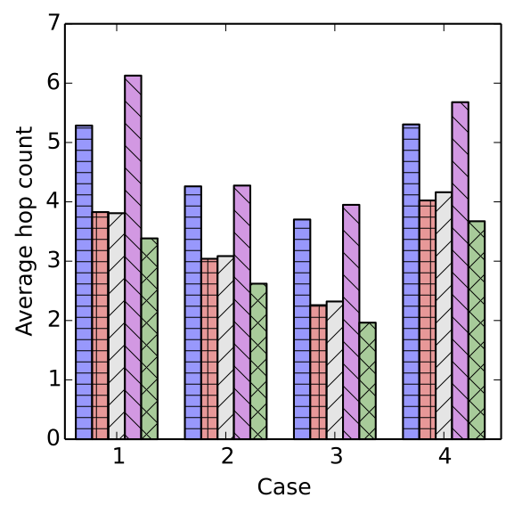
Hop count per flow

Slide 26
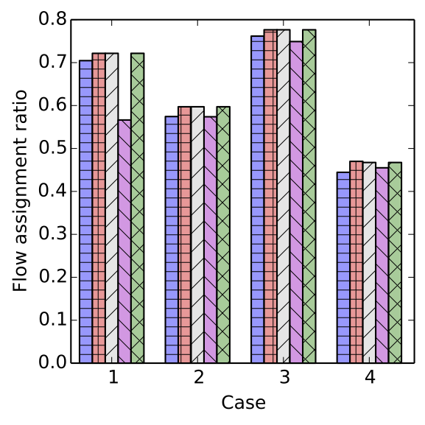
Flow assignment ratio

Slide 27
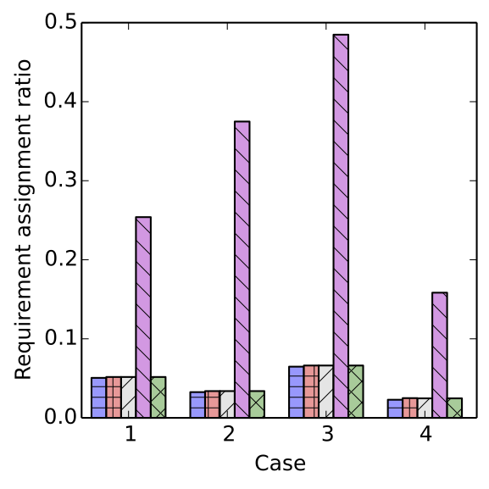
Requirement assignment ratio

Slide 28
Outline
Introduction
System model
Utility model
Flow assignment
Results
Conclusion and future work

Slide 29
Conclusion and Future Work
New centralized methods to couple path(s) and flow(s) using greedy strategies
No absolute ”winner”:
Each method works better in different situations, depends on the objective
Future work:
Ad-hoc Networks: decentralization
Mobility factor

Slide 30
Acknowledgement
This research was partially supported by the NSF Career Award No. 1346600, NSF Partnership for Innovation Award No. 1430328, and CAPES Brazil 13184-13-0.

Slide 31
Thank You!

