Slide 1
Smart-Cities Enabled by Multi-radio Multi-channel Heterogeneous Networks
Paulo Alexandre Regis

Slide 2
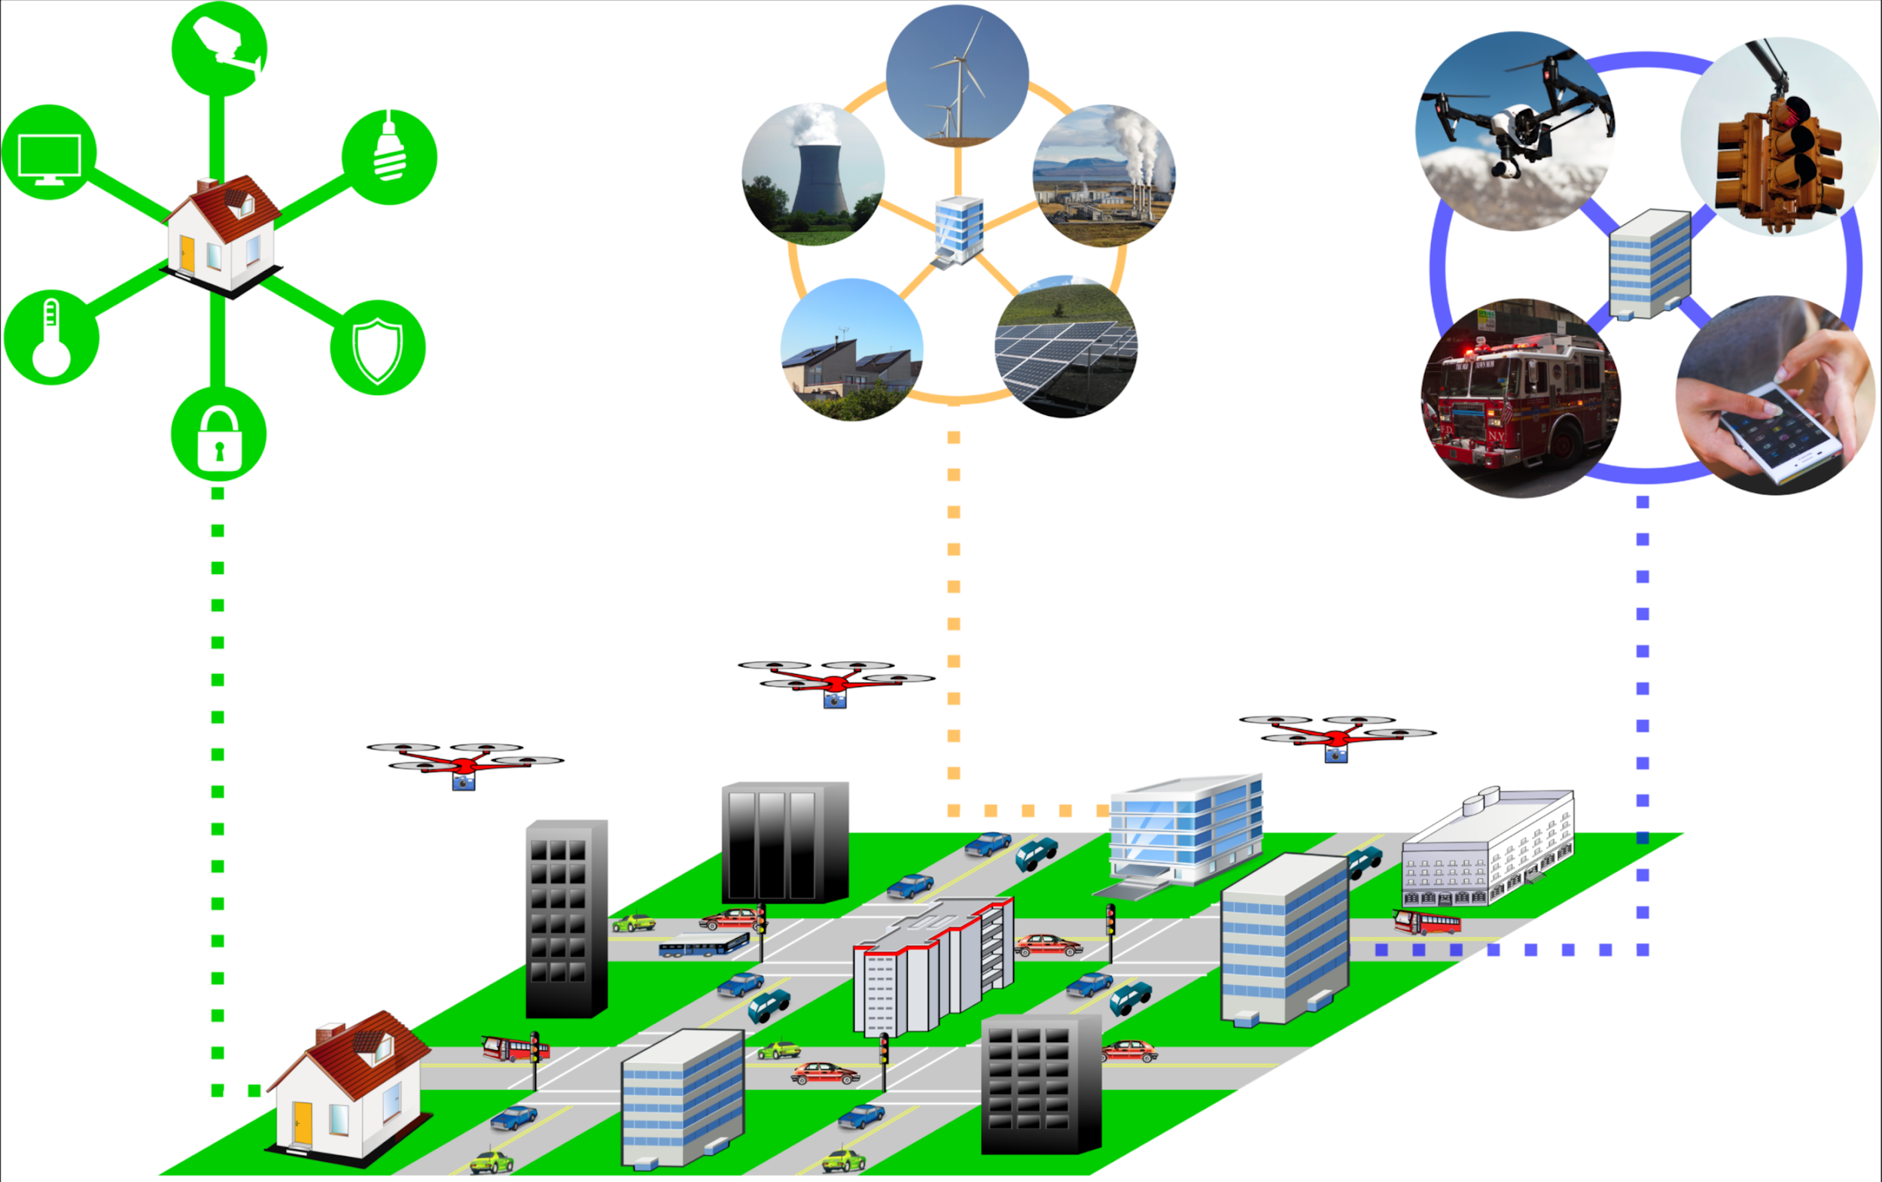
What is a Smart-City?

Slide 3
What is a Smart-City? Why should we care?
Using data analysis to make better/automated decisions
Multiple (different) hardware and software technologies to solve each small piece of the puzzle
Examples:
Smart-house and smart-grid
Traffic management
Temporary service provision

Slide 4
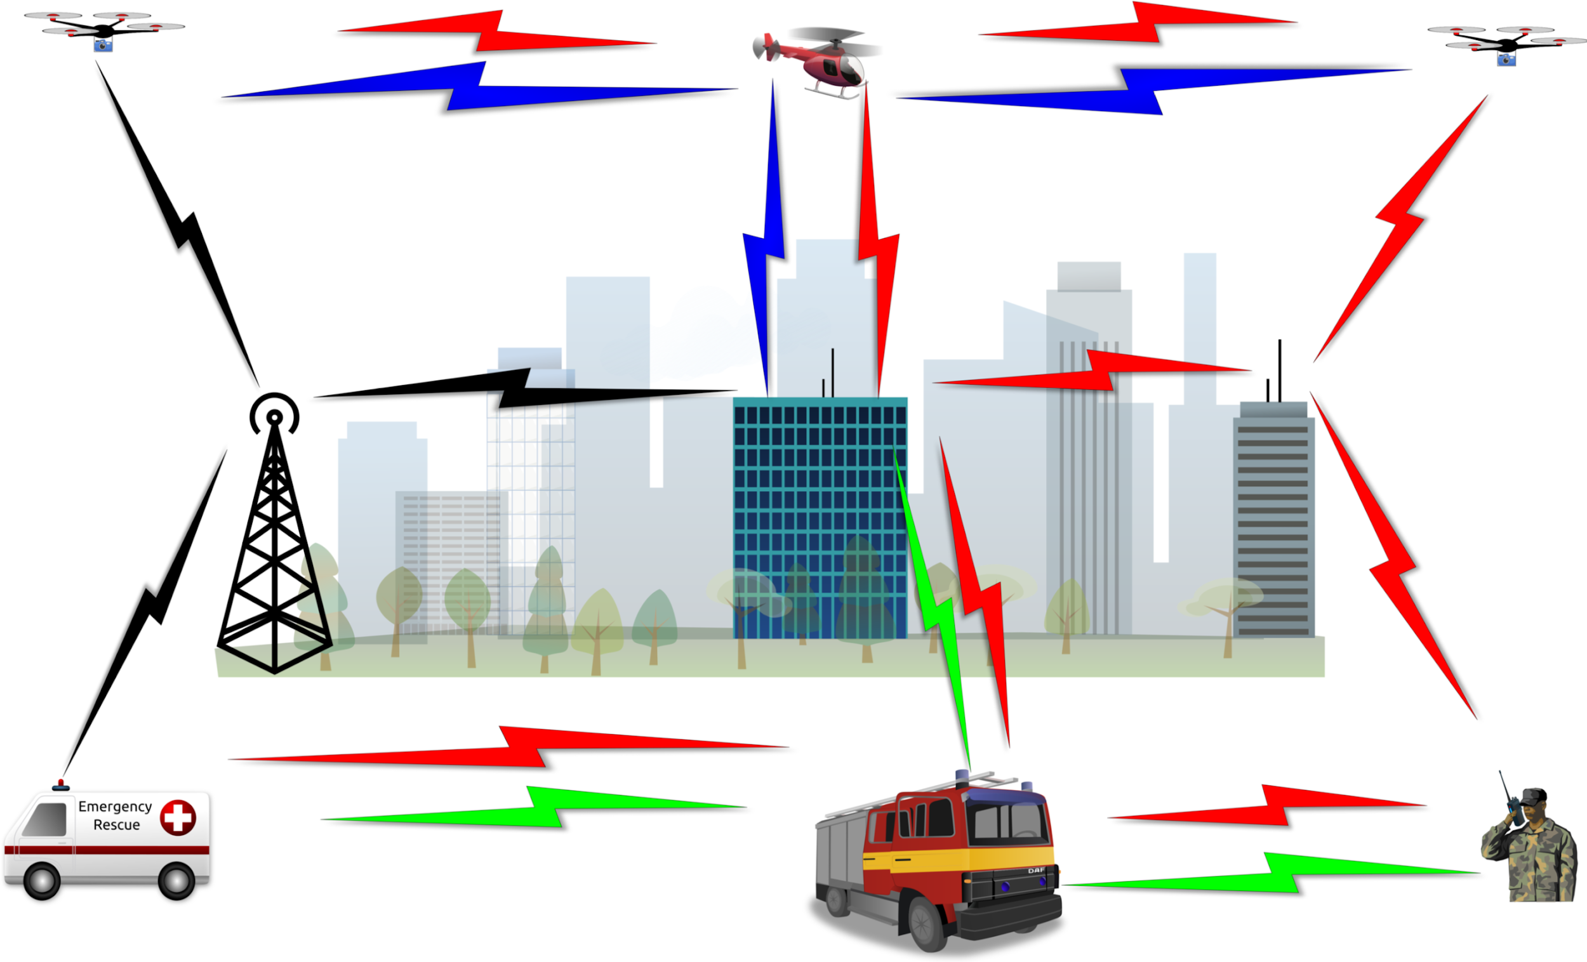
Multi-radio multi-channel HetNets

Slide 5
Multi-radio multi-channel HetNets
Multi-radio: more than one transceiver, each capable to transmit in a specific channel
Multi-channel: ability to transmit in more than a single frequency
Heterogeneous:
Nodes might have different radios available
Nodes may move differently
Nodes can have different energy source (UAV/cars/base stations)

Slide 6
NSF:S&CC initiative
NSF: Smart & Connected Communities
Funding opportunities
Interdisciplinary efforts
Broad foreseen impact: agriculture, infrastructure, emergency management, smart electric power grid, health, public safety, rural and urban planning, transportation, water management, etc.

Slide 7
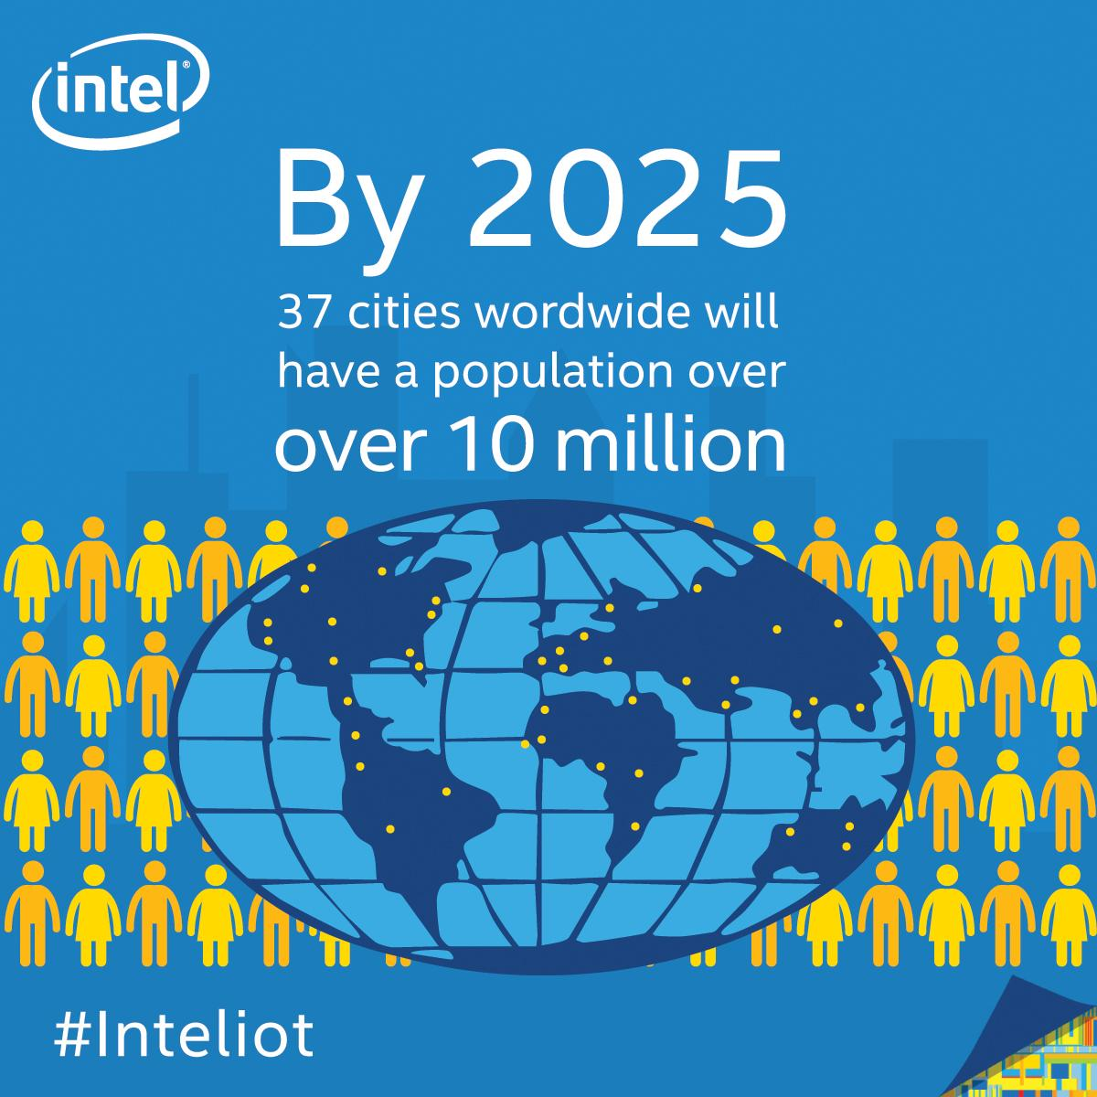
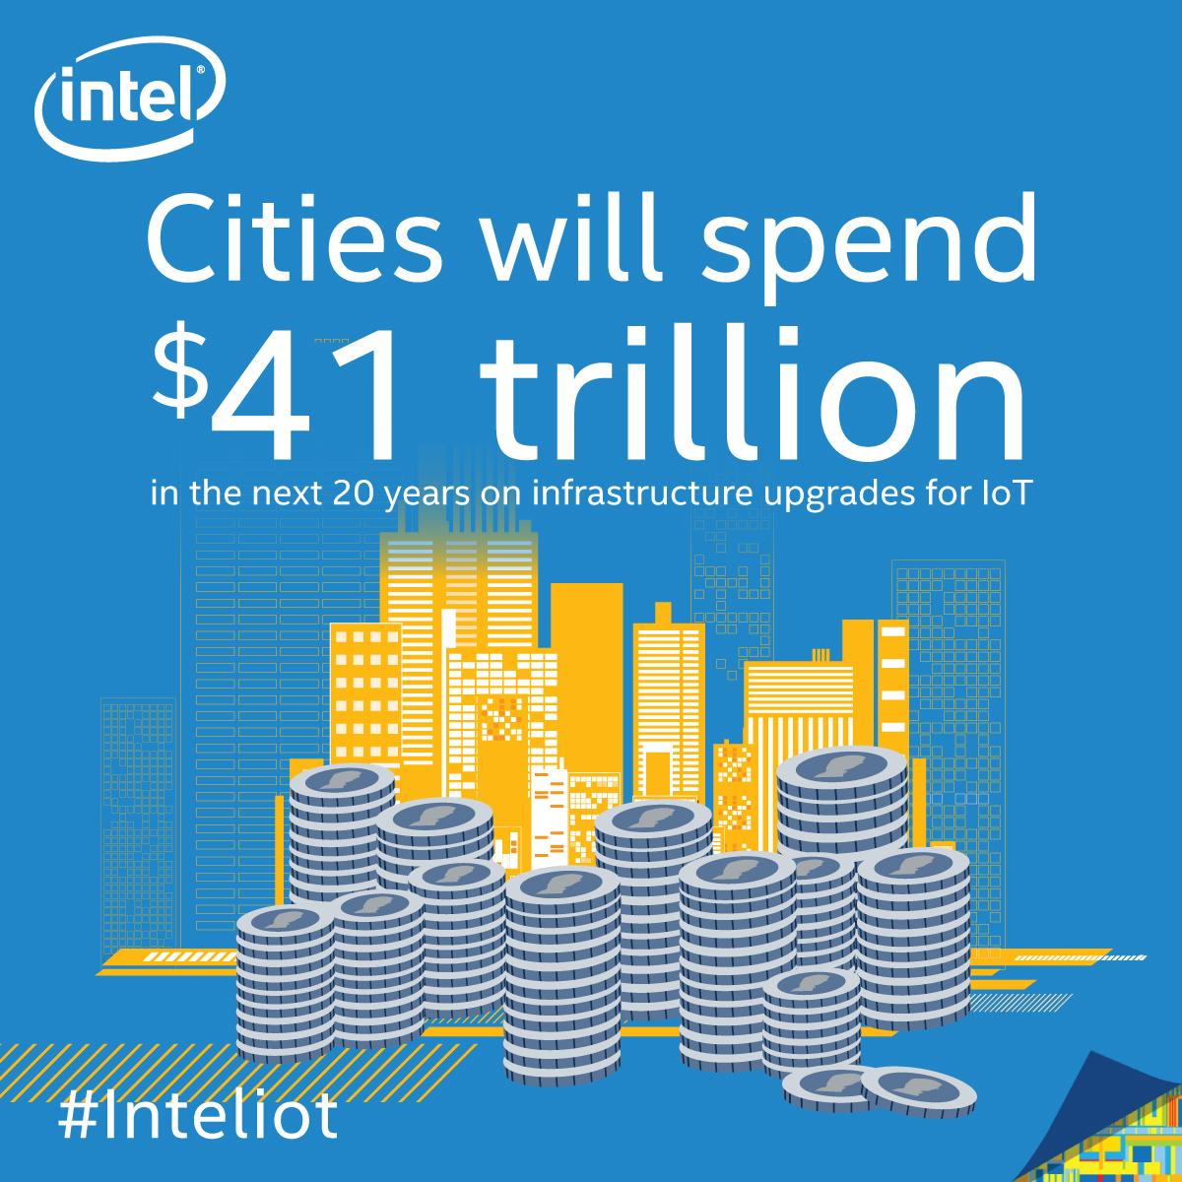
Commercial potential
Private sector is already deploying solutions¹
Improve quality of life generates revenue
Efficient resource management: smart-grid, water distribution
Decision/policy making: data gathered and analyzed help legislators
1 - https://newsroom.intel.com/news-releases/san-jose-implements-intel-technology-for-a-smarter-city/

Slide 8

3D obstacle compliant mobility model
Network simulator (ns-3) provide vast amount of libraries to allow simulations of different communications scenarios and technologies.
Mobile Ad Hoc Networks is a possible scenario to simulate.
Mobility models dictate how nodes move around.
Physical objects (i.e. buildings) are accounted from a communications perspective but not from a mobility model point-of-view.

Slide 9
Existing Models
Random Walk (2D):
Move in a straight line for a determined amount of time.
Randomly choose new parameters.
Random Direction (2D):
A node moves in straight line until it reaches the boundary.
Randomly chooses new parameters.
Gauss-Markov (3D):
Moves for a certain time before changing parameters.
Parameters can be constrained by random distributed variables.

Slide 10
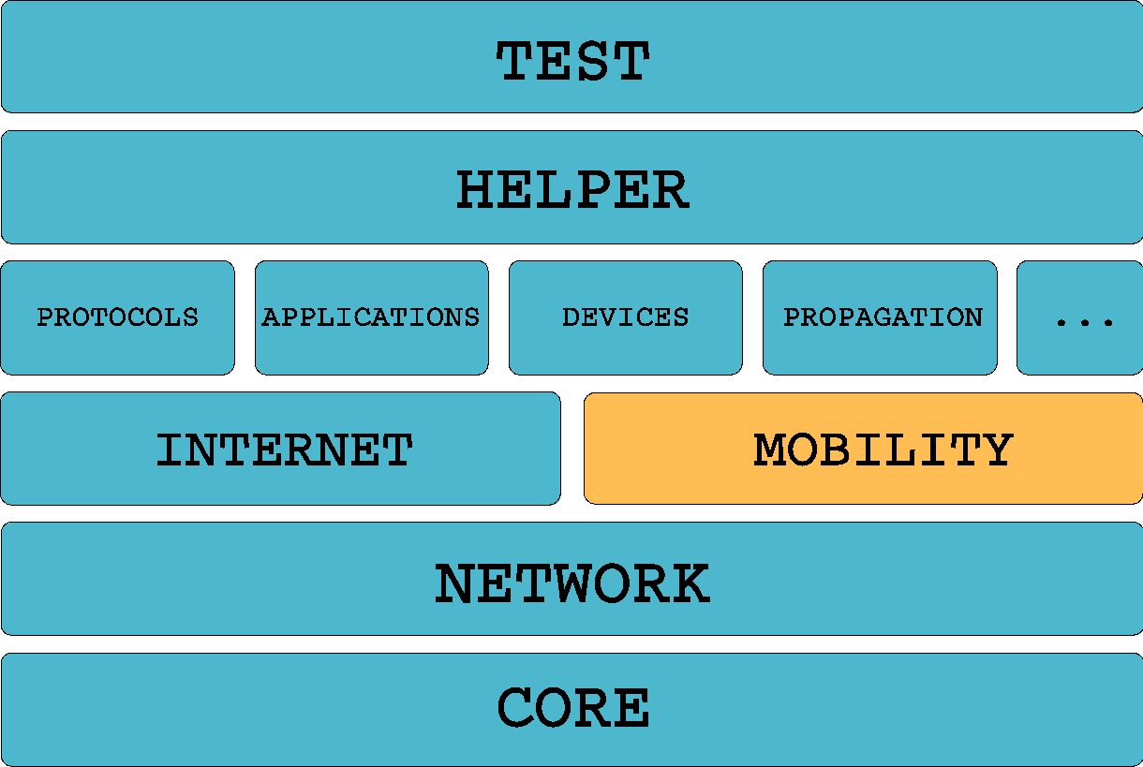
Scope of work
New classes added to the mobility module
Modification of existing auxiliary classes
No functions were removed/modified
Only new methods added to account for 3D geometry

Slide 11
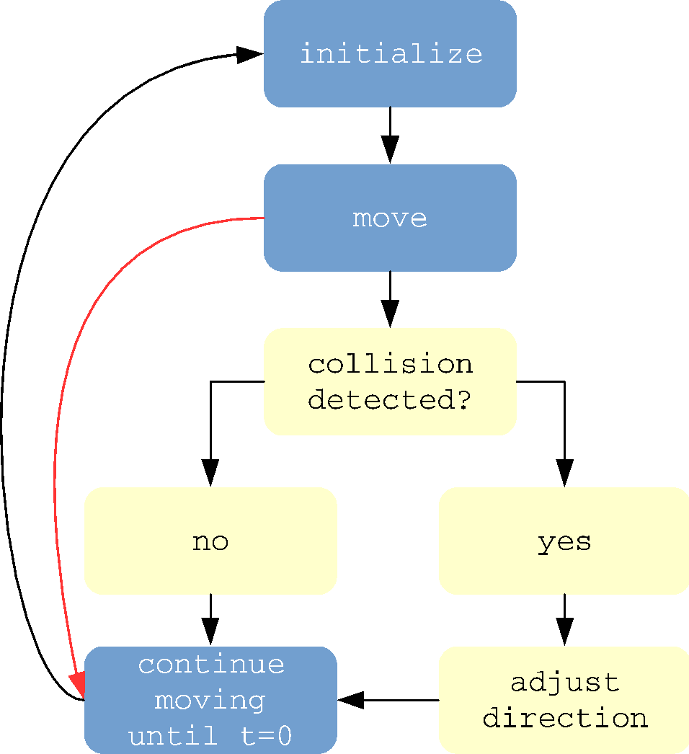
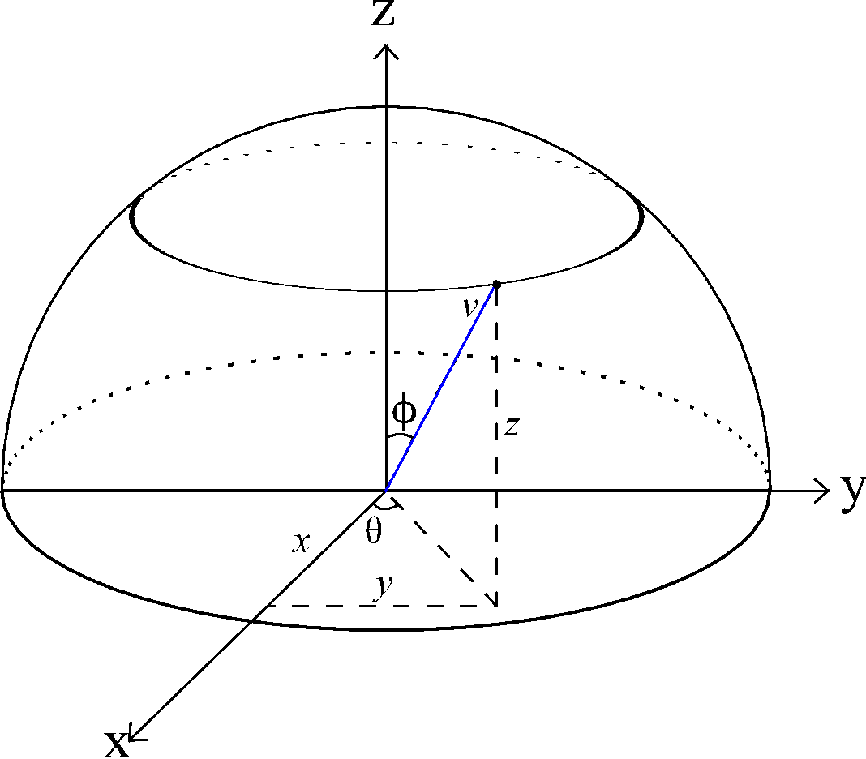
General block diagram
All models follow similar flow
Intermediate yellow blocks represent the new features
Coordinate system used in ns-3

Slide 12
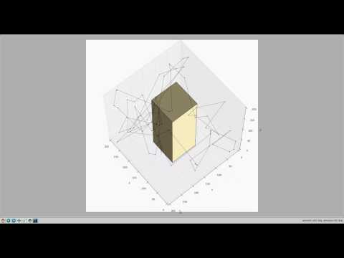
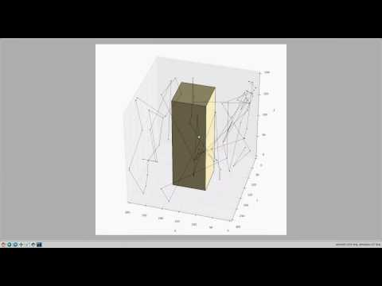
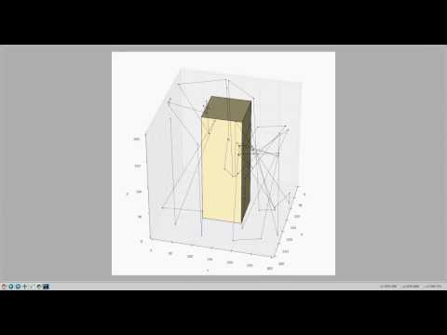
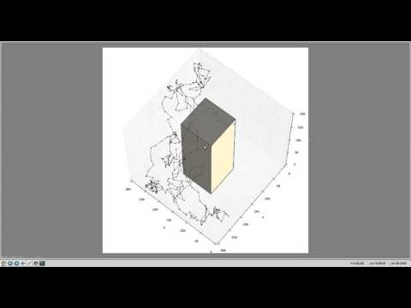
Random Walk (time mode)
Random Walk (distance mode)
Gauss-Markov
Random Direction

Slide 13
External links
Project website:
http://www.cse.unr.edu/~regis/ns-3/
Source-code on GitHub:
https://github.com/regisin/ns-3-obstacles

Slide 14
Future work
Network-aware application and application-aware network:
Application will adapt depending on current network conditions (generate data in a different if network is lossy)
Network will create redundant packets and send them through different paths to reduce risk of loss

Slide 15
Future work
Network-constrained node deployment/placement:
Find the best positions to deploy a UAV network without compromising connectivity and increasing coverage
Minimize the number of aircrafts needed, saving resources and potential for interference

Slide 16
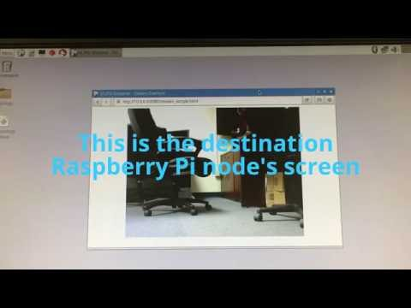
Future work
Testbed development (in parallel):
Build a proof-of-concept testbed where the proposed/future mechanisms can be validated
Have modularity in mind to be able to update the hardware as new technologies become available

Slide 17
Thank You!

