Slide 1
Introduction to Recursion

Slide 2
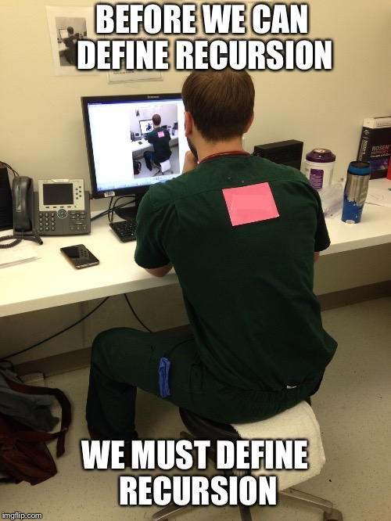

Slide 3
What is recursion?
A recursive function is a function that calls itself directly or indirectly.
Direct recursion: when the function calls itself in the same function.
Indirect recursion: when there is a chain of two or more function calls in which the original function is called again.

Slide 4
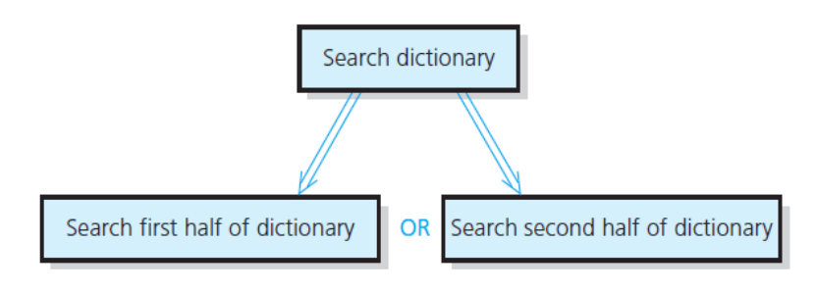
Why and when use recursion?
Recursion breaks the original problem into smaller, identical sub-problems
Divide and conquer approach.
Recursive solutions tend to be inefficient, impractical. Typically, the iterative solution for the same problem is more efficient. Rule of thumb: avoid them!
Can have infinite sequence of function calls (infinite recursion), similar to infinite loop, NOT GOOD.
Many complex problems can lead to simple, elegant recursive solutions. Ex.:

Slide 5
Recursive solutions
A recursive solution calls itself to solve a smaller sized problem than the original one.
Must have at least one base case, which will avoid infinite recursive calls.
The general case is the part of the solution that will call itself.
Eventually the problem will be so small that it will be considered the base case, which in turn will return a concrete result.

Slide 6
Recursive solutions
Questions that help when constructing a recursion solution:
Can the problem be solved by dividing it into smaller problems of the same type?
How would each recursive call reduce the size of the problem?
What is the smallest possible size of this problem? aka the base case.
As the problem size diminishes, will it eventually reach the base case?

Slide 7
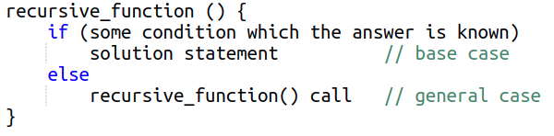
Recursive solutions: general format
Each successive recursive call should bring you closer to a situation in which the answer is known.
Each recursive algorithm must have at least one base case (stopping criteria) and one general (recursive) case.
Pseudo-code:

Slide 8
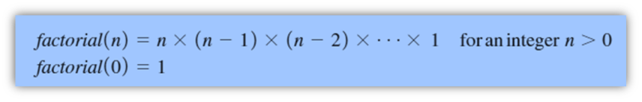
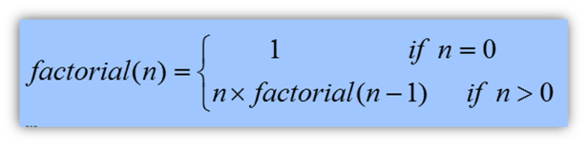
The Factorial of n
An iterative solution
A recursive solution
Note: avoid using a recursion if there is a simple efficient iterative solution.

Slide 9
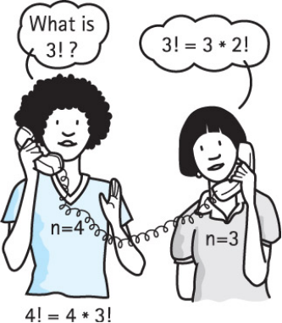
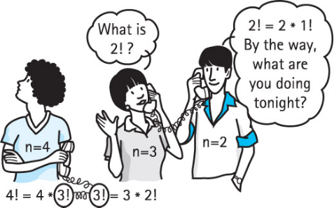
Recursive query

Slide 10
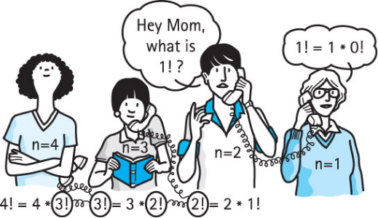
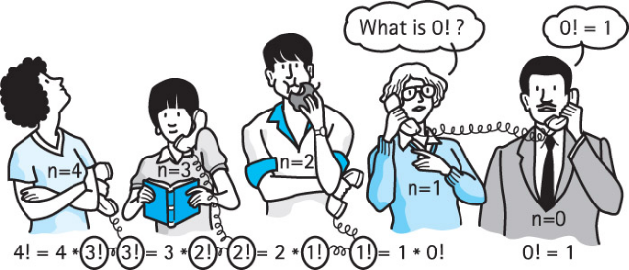
Recursive query

Slide 11
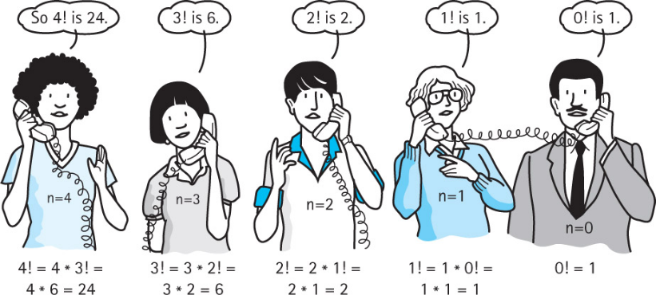
Recursive solution

Slide 12
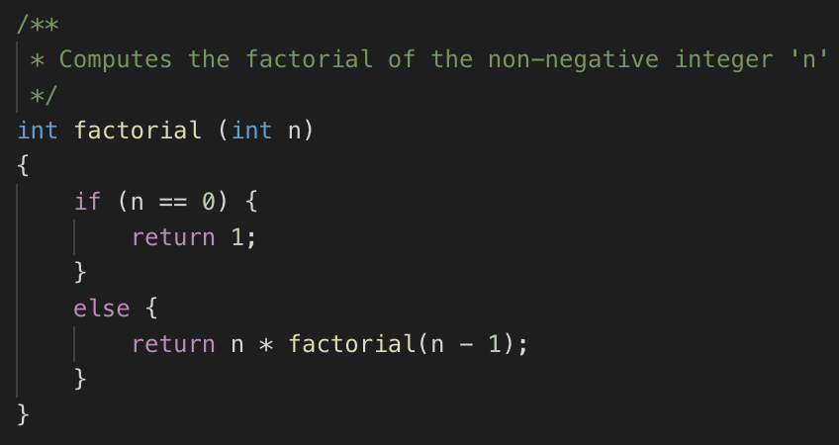
Recursive valued function: factorial

Slide 13
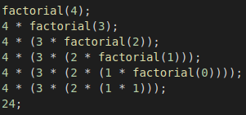
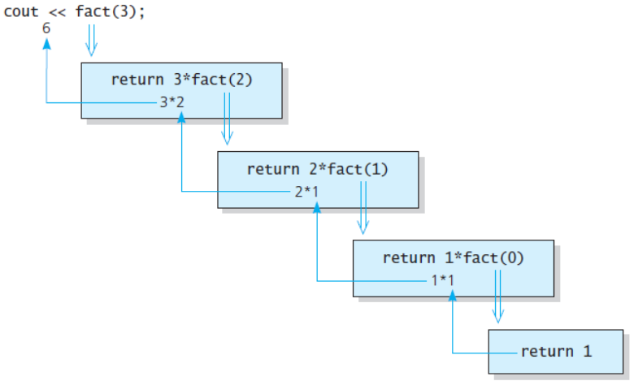
Recursive call chain
Note: all the unsolved calls will remain in memory until the base case is reached!

Slide 14
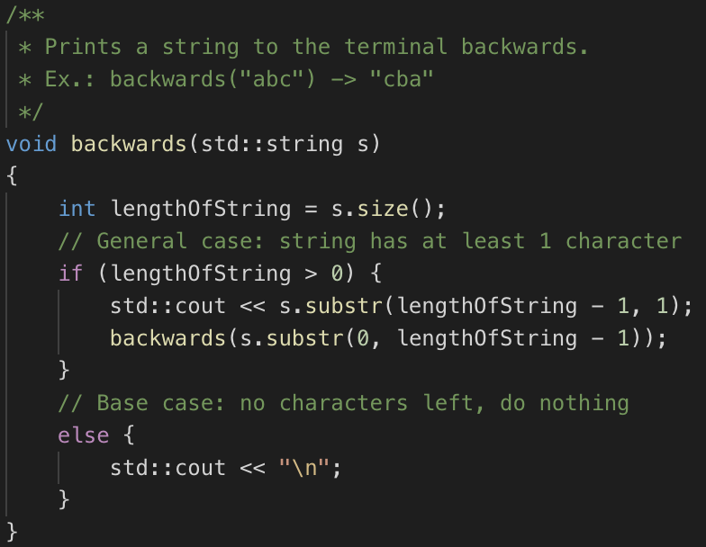
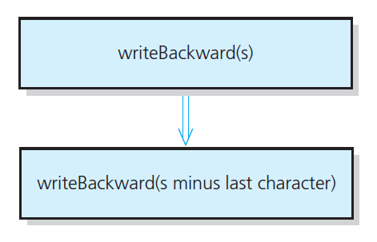
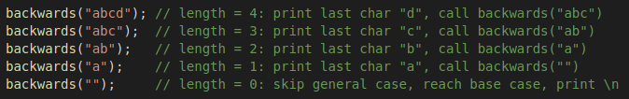
Recursive void function: write a string backwards
Note: Even though there is no return statement, all calls will remain in memory until base case is reached.

Slide 15
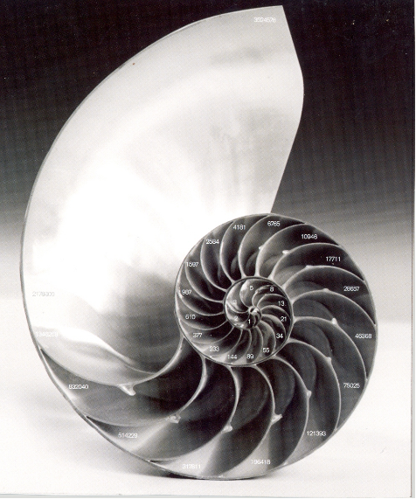
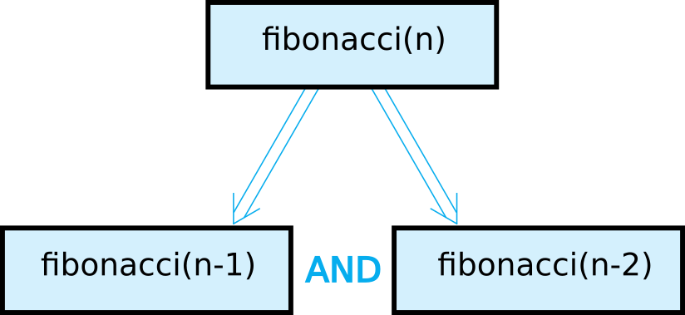
The Fibonacci Sequence

Slide 16
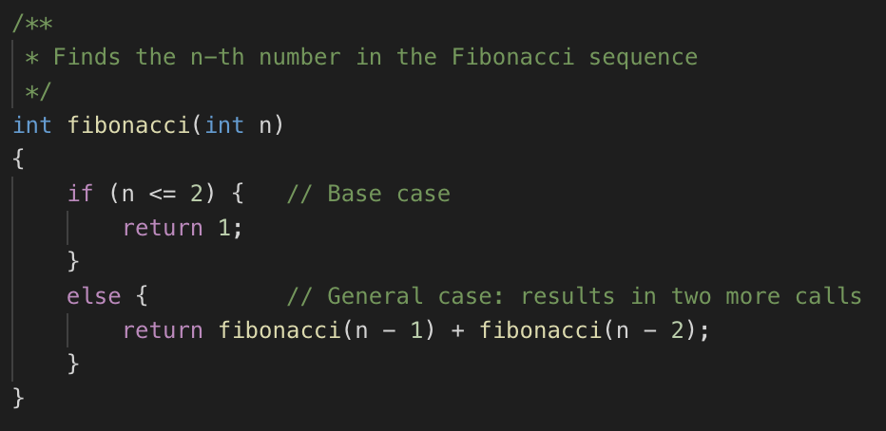
The Fibonacci Sequence

Slide 17
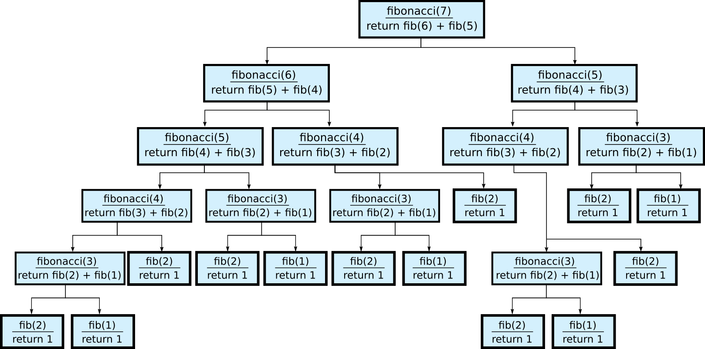
The Fibonacci Sequence: generated recursive calls

Slide 18



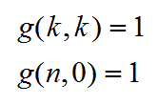
The n-choose-k problem
Given a set of n things, how many ways can you choose k of them, given that n >= k?
"A band wants to tour k out of n cities."
The order is not an issue
Let g(n, k) be the number of groups of k cities chosen from n, then:
Base cases:

Slide 19
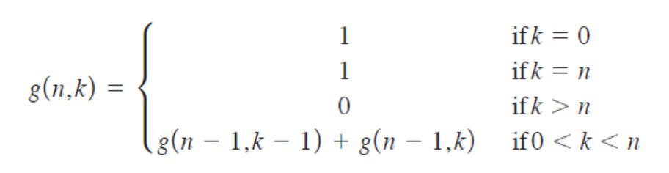
Combinations
How many combinations of a certain size can be made out of a total group of elements?

Slide 20
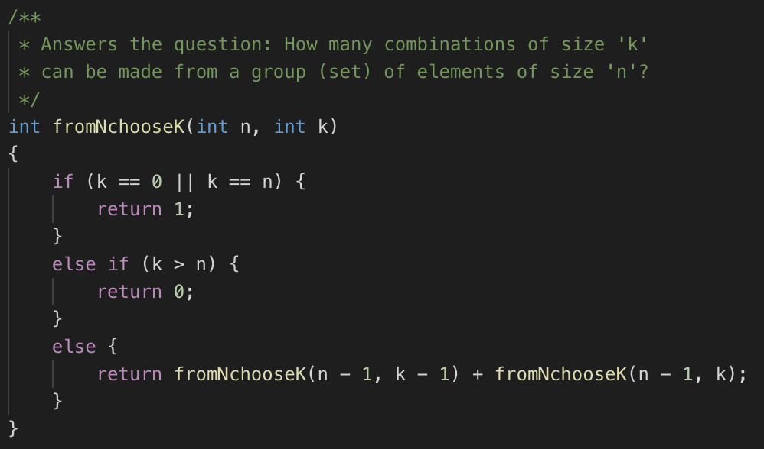
n-choose-k solution

Slide 21
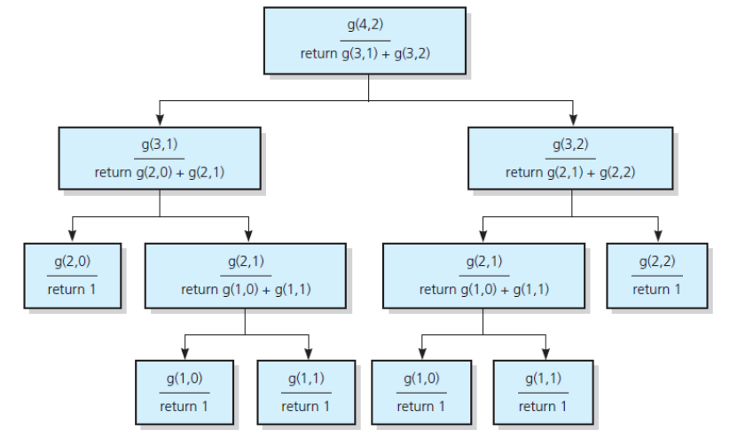
Calls generated (n=4, k=2)

Slide 22
Tail Recursion
When a function can pre-compute the result and pass it along to the subsequent recursive calls. The next recursive call simply updates the pre-computed value.
Tail recursive solutions may need less memory, depending on the cimpiler.
Tail recursion can be replaced by iteration, effectivelly removing recursion from the solution.

Slide 23
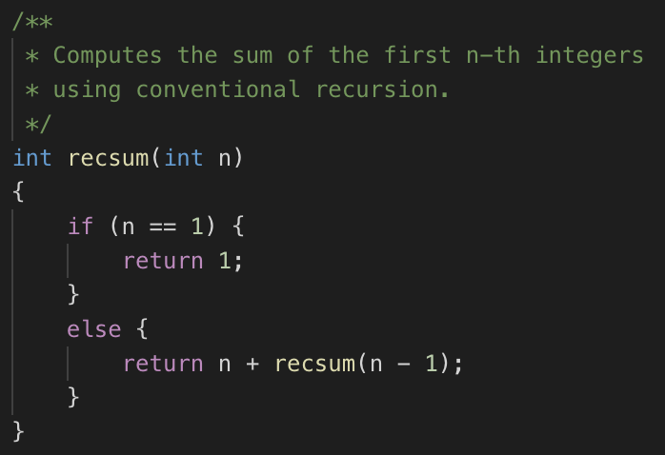
Cumulative sum
The sum of the first N integers: f(n) = n + (n-1) + (n-2) + ... + 1, n >=1
Typical recursive solution:

Slide 24
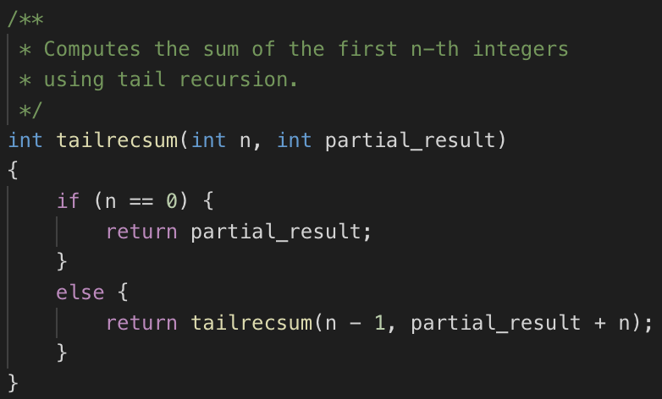
Cumulative sum: tail-recursive solution

Slide 25
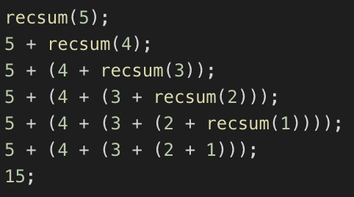
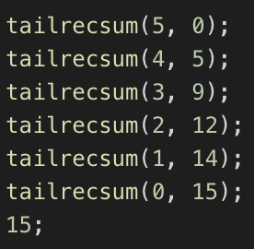
Call comparison
In the conventional way, the program has to wait for all the recursive calls to finish and then actually executing the sum. The tail-recursive updates the result at each recursive call.

Slide 26
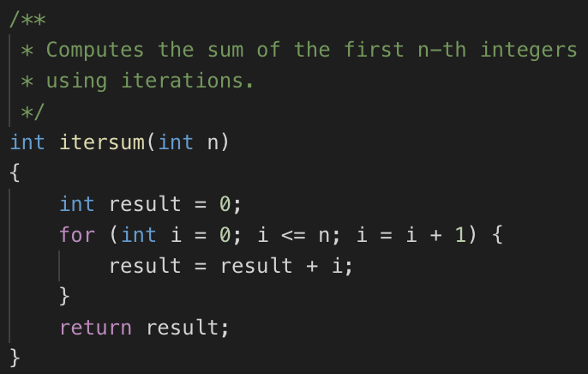
Iterative solution

Slide 27
Recursion and Efficiency
Factors that contribute to inefficiency:
Overhead associated with function calls.
Repeated recursive calls: some algorithms execute the same task multiple times
e.g. the Fibonacci sequence
Keep in mind:
Recursion can clarify complex solutions. However ...
Clear, efficient, iterative solutions are better.
Why do we need to know recursion at all?
Interviews
Sometimes quicker to find a first solution

Slide 28
When to use recursive solution
When the depth of the recursive calls is relatively "shallow" compared to the size of the problem.
When the recursive solution does less work than its iterative counterpart.
When the recursive version is much shorter and simpler than the non-recursive solution.
SHALLOW DEPTH
EFFICIENCY
CLARITY

Slide 29
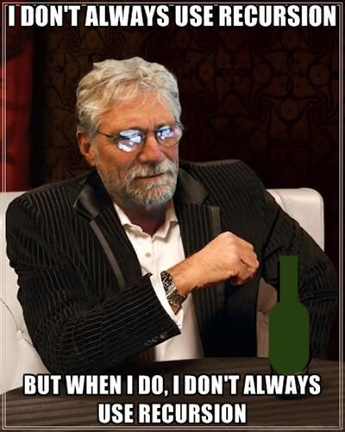

Slide 30
Recursion is not difficult, needs practice!
Some more examples:
Tower of Hanoi
Binary Search

Slide 31
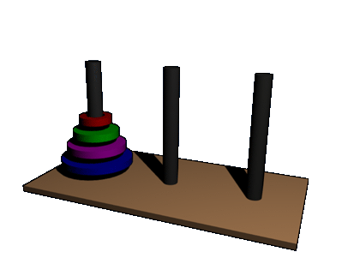
Towers of Hanoi

Slide 32
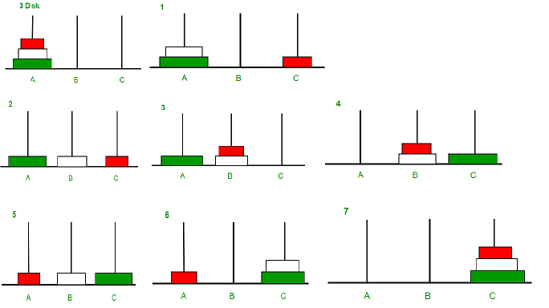

Slide 33
Towers of Hanoi
Problem: starting with n disks on pole A and zero on poles B and C. Move all disks to pole C without having a larger disk resting on top of a smaller disk. Solve function solveTowers(n, A, B, C).
Solution:
With all disks on A, solve solveTowers(n-1, A, C, B).
With largest disk on A, and all others on C, solveTowers(n-1, A, B, C).
With largest disk on B, and all others on C, solveTowers(n-1, C, B, A).

Slide 34
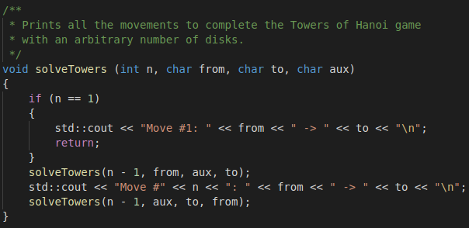
Towers of Hanoi: solution

Slide 35
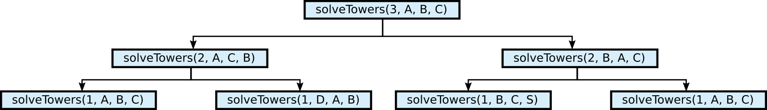
Towers of Hanoi: recursive calls
Minimal number of moves: 2^{n} - 1
Example iterative solution: https://www.geeksforgeeks.org/iterative-tower-of-hanoi/

Slide 36
Binary Search
Given a sorted array, find the position of a given target value.
Example array: ascending prime numbers
Solution:
Find the middle point
If middle point is target value, return
If middle point is greater than target, repeat procedure with left half of list
If middle point is lower than target, repeat procedure with right half of list
Return -1 if target not found
Index | 0 | 1 | 2 | 3 | 4 | 5 | 6 | 7
Value | 2 | 3 | 5 | 7 | 11 | 13 | 17 | 23

Slide 37
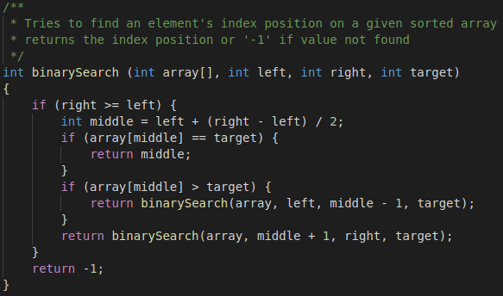
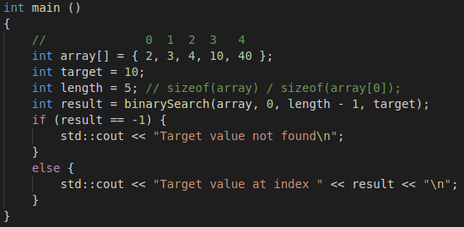
Binary Search

Slide 38
Summarizing
The challenge in using recursion to solve a problem relies on identifying that a problem CAN be solved by recursion.
Determining the base case and make sure it will eventually be triggered, otherwise you'll end up with an infinite recursion call.
Important concept to understand, even if you don't use it in your future job.
Don't neglect recursion, sometimes an interview question can be solved by using it (and with fewer lines of code).

Slide 39
Questions?

