Slide 1
Eye and AI
Recent researches with a focus on Dry Eye

Slide 2
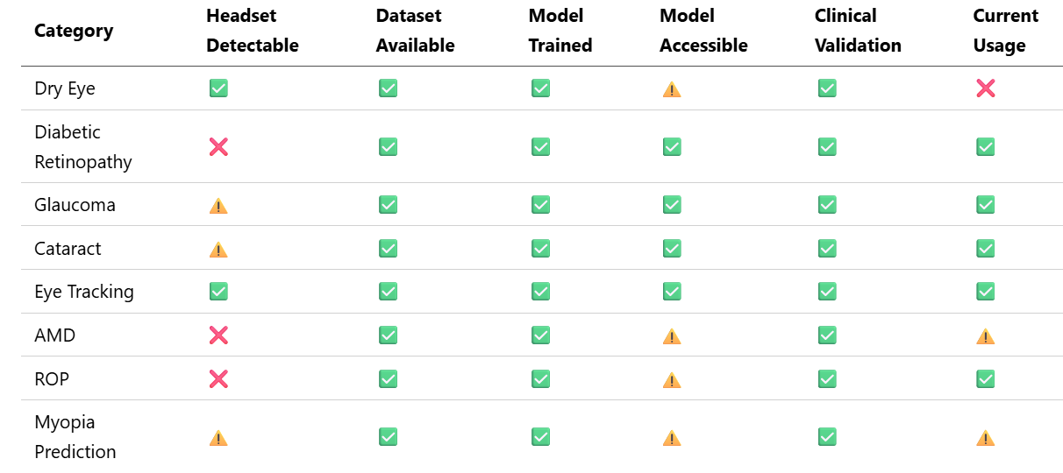
Last time recap

Slide 3
Last time recap

Slide 4
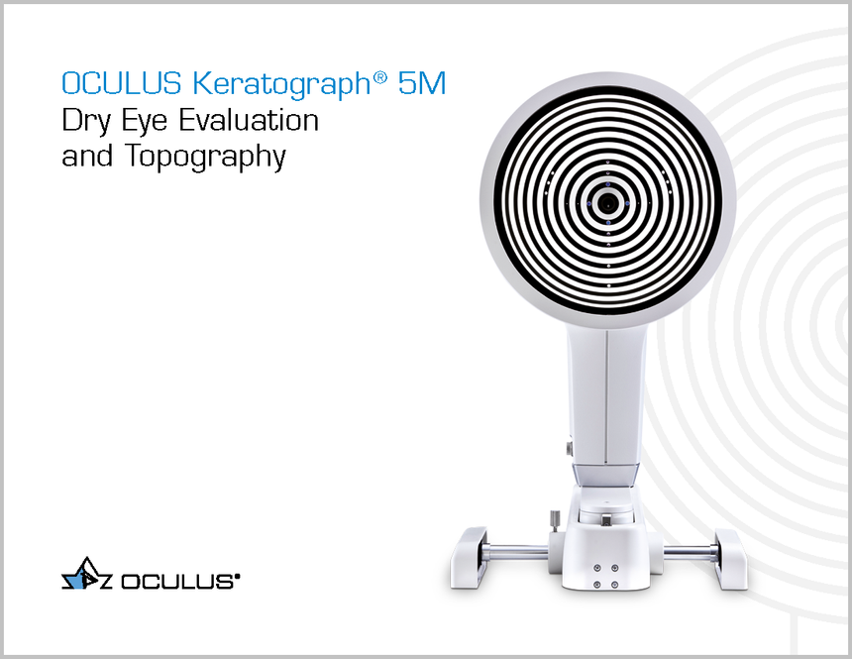
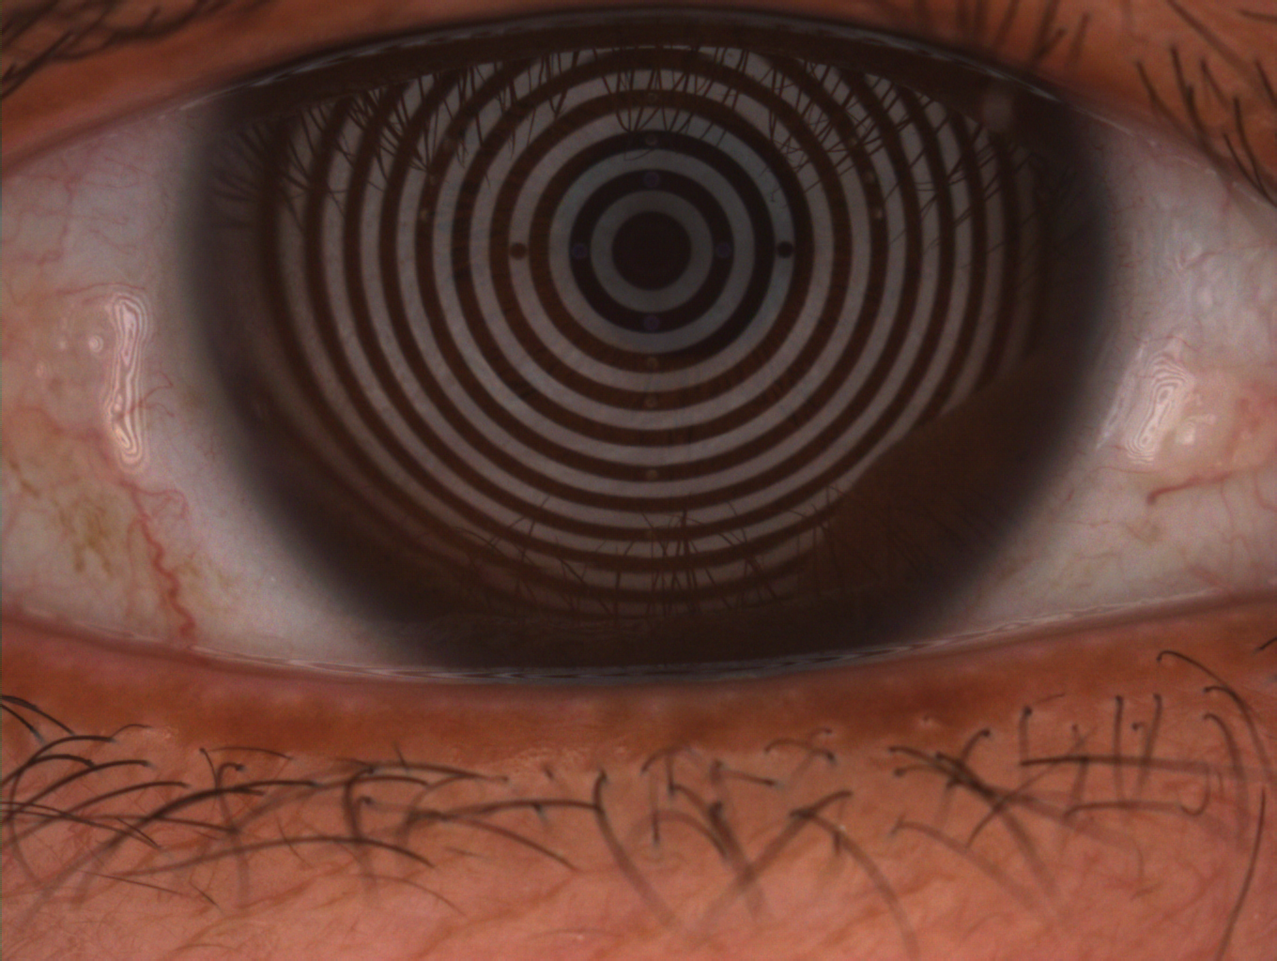

Tear meniscus dataset

Slide 5
Tests and Results
Height measurement
Diagnosis
U-Net : Semantic segmentation
F1-score = 0.9220
MIoU = 0.9279
Resolution : 1024x1360
Near-eye/anterior- eye camera images

Slide 6
Issues
Placido ring reflections
Only Brown eyes

Slide 7
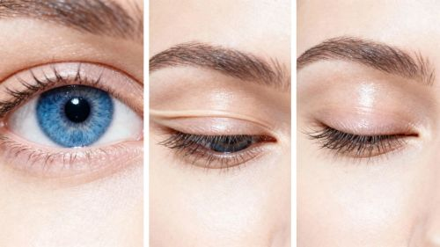
Add blinking as a second dry eye signal
Blink frequency
Blink duration
Partial blinks
No laballed dataset available

Slide 8
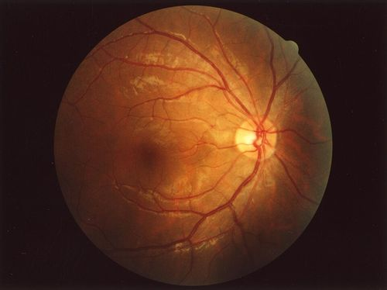
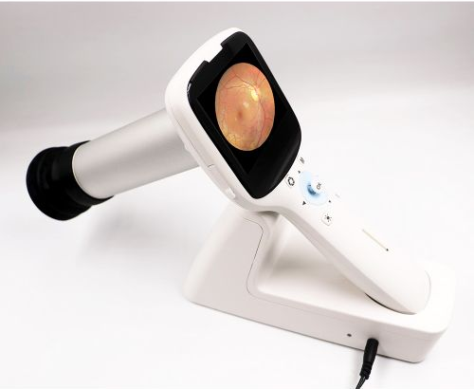
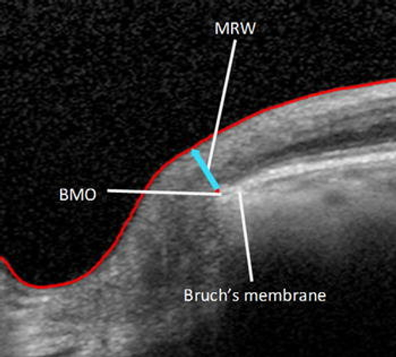
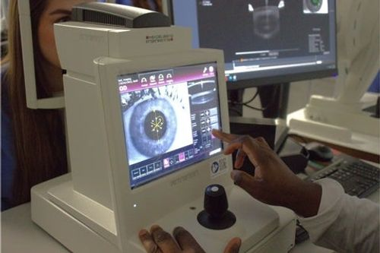
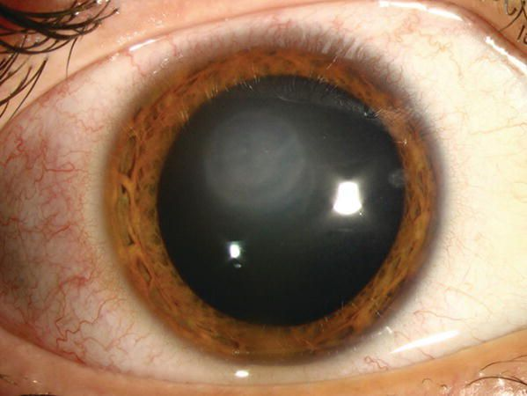
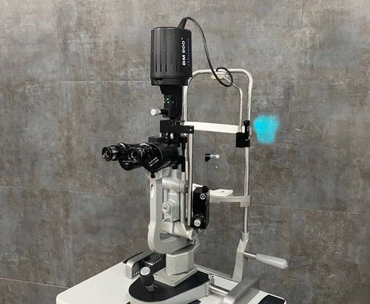
Image aquisition types and portability issues
Fundus Image
OCT like optic nerve image
Eye slit lamp

Slide 9
Cataract signs, datasets, results and headset issues
Fundus images with cataract label:
Result : ODIR-5K 97.27%
Fundus
Nuclear opacity
Result : AUC 0.9567
Slit lamp
Nuclear Color
Result : AUC 0.9650
Slit lamp

