Slide 1

Patient mit sozialer Angststörung
Gruppe Rot: T. Wacker, A. Khalife, S. Neuenschwander, P. Romao, S. Regli, F. Gashi
BTX8081 Software Engineering and Design

Slide 2
Inhalt
UML Component Diagram
UML Deployment Diagram
Product Backlog
UML Class Diagram
Sprint Backlog
Notes:
Begrüssung: Stefanie
Component, Deployment: Selina
Class: Stefanie
Product Backlog: Stefanie
Sprint Backlog: Selina

Slide 3
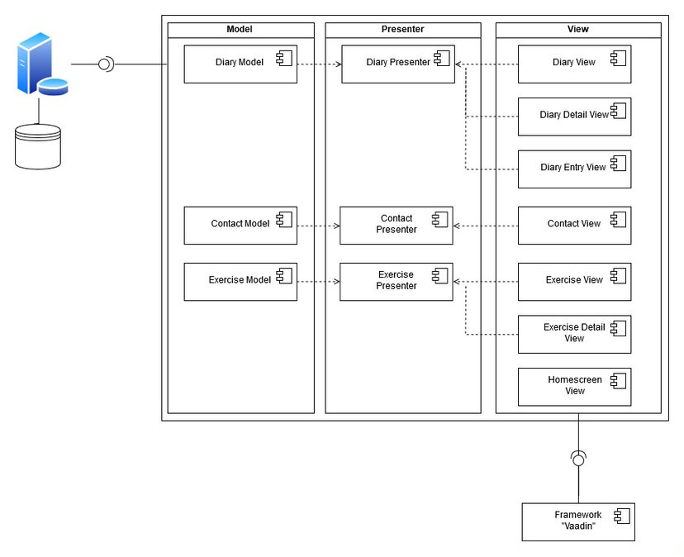
UML Component Diagram

Slide 4
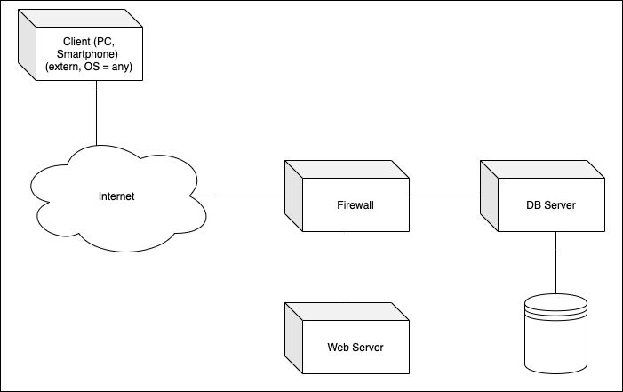
UML Deployment Diagram

Slide 5
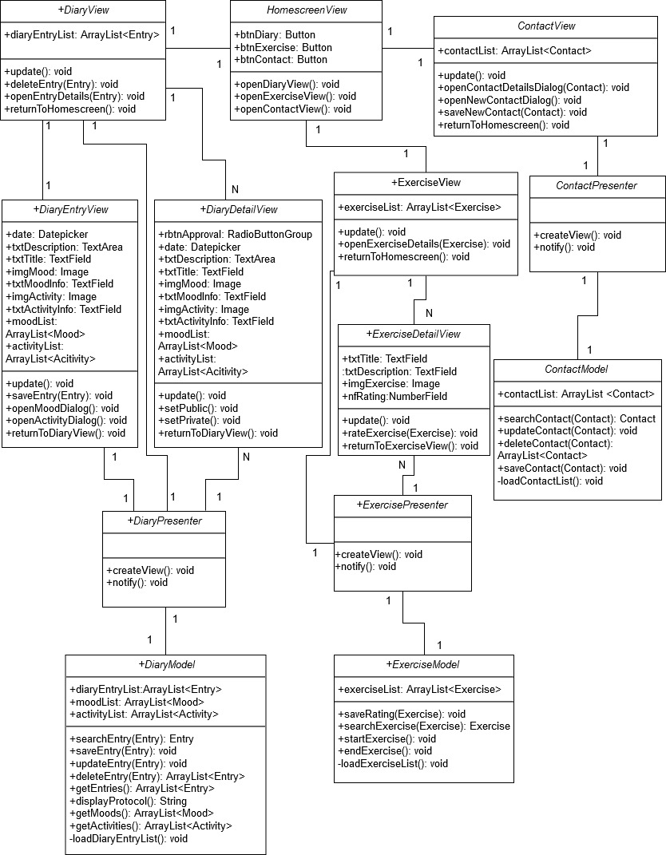
UML Class Diagram

Slide 6
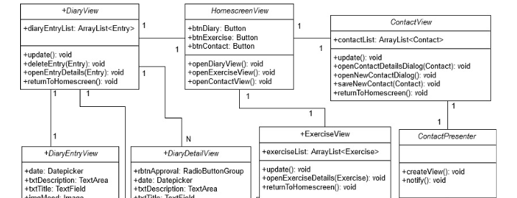
UML Class Diagram

Slide 7
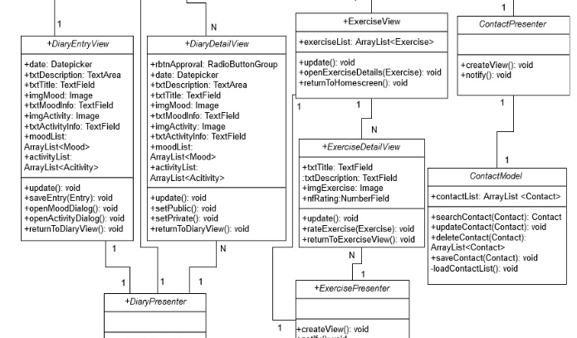
UML Class Diagram

Slide 8
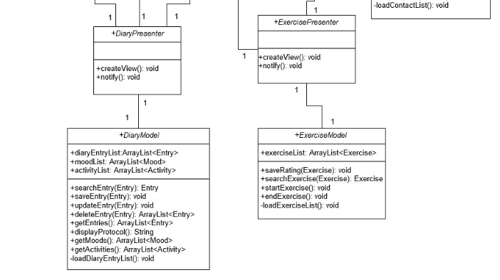
UML Class Diagram

Slide 9
Product Backlog

Slide 10
Product Backlog

Slide 11
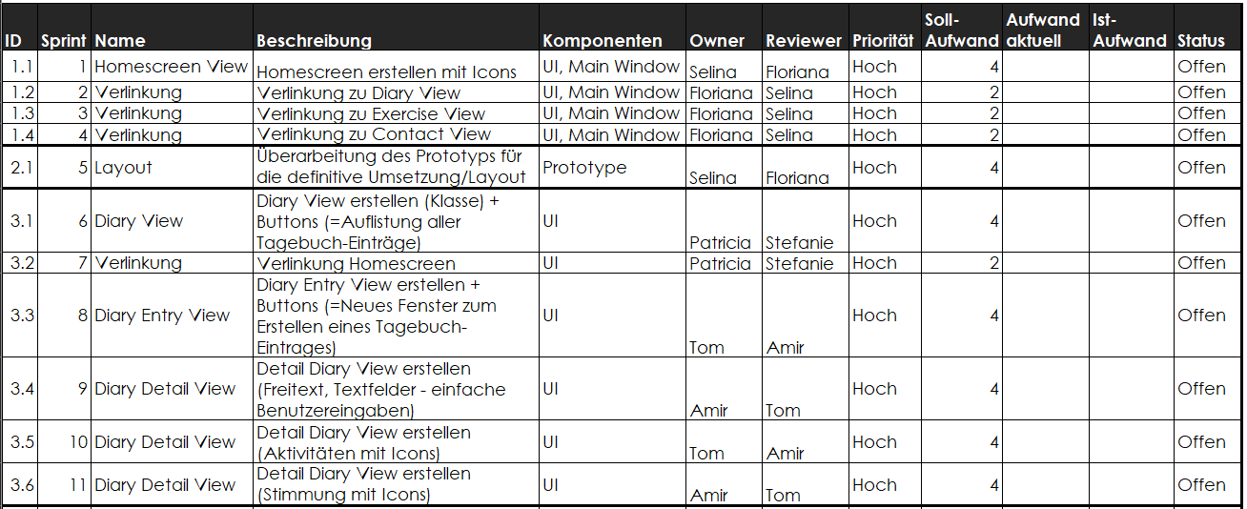
Sprint Backlog
Notes:
17 Sprints (à maximal 4 Stunden)
Unterteilung in 6 «Themen»
Unit Tests inbegriffen

Slide 12
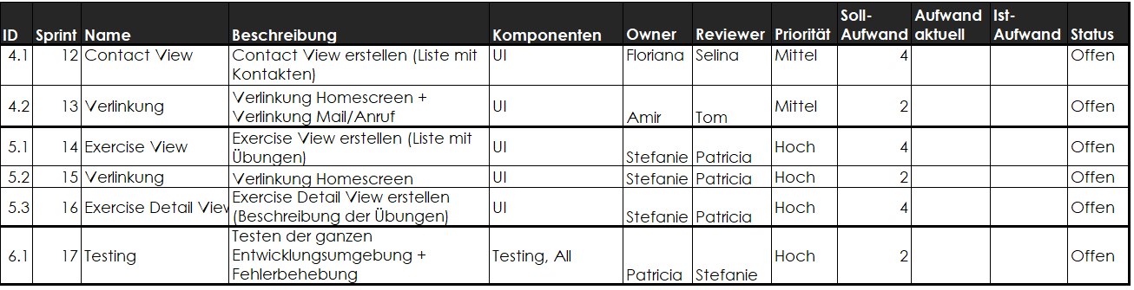
Sprint Backlog
Notes:
17 Sprints (à maximal 4 Stunden)
Unterteilung in 6 «Themen»

Slide 13

Fragen?

Slide 14
Vielen Dank für Ihre Aufmerksamkeit!
BTX8081 Software Engineering and Design

Slide 15
Quellen
http://seniorcarepsychological.com/social-anxiety-disorder-social-phobia-symptoms-diagnosis-and-treatment/ (Folie 1, 30.10.2019)​
https://www.simpleconsign.com/blog/buying-software/ (Folie 12, 30.10.2019)

