Slide 2
Monthly kW, kWh Comparison & Load Factor​
supply_period | Total Hours | Consumption(kWh) | Demand(kW) | Load Factor
30/09/2023 0:00 | 744.00 | 348,110.04 | 629.85 | 74.29%
31/10/2023 0:00 | 720.00 | 354,161.26 | 630.88 | 77.97%
30/11/2023 0:00 | 744.00 | 366,267.71 | 639.44 | 76.99%
31/12/2023 0:00 | 720.00 | 356,928.48 | 653.81 | 75.82%
31/01/2024 0:00 | 744.00 | 327,379.59 | 642.90 | 68.44%
29/02/2024 0:00 | 744.00 | 305,358.59 | 618.89 | 66.32%
31/03/2024 0:00 | 696.00 | 308,597.28 | 617.79 | 71.77%
30/04/2024 0:00 | 744.00 | 362,519.50 | 631.87 | 77.11%
31/05/2024 0:00 | 720.00 | 387,648.97 | 655.35 | 82.15%
30/06/2024 0:00 | 744.00 | 340,091.73 | 586.11 | 77.99%
31/07/2024 0:00 | 720.00 | 324,546.31 | 599.88 | 75.14%
31/08/2024 0:00 | 744.00 | 324,362.94 | 642.68 | 67.84%
30/09/2024 0:00 | 744.00 | 351,124.56 | 654.84 | 72.07%
Total | 9,528.00 | 4,457,096.96 | 655.35 | 71.38%
Average | 732.92 | 342,853.61 | 631.10 | 74.15%
Max | 744.00 | 387,648.97 | 655.35 | 82.15%
Min | 696.00 | 305,358.59 | 586.11 | 66.32%

Slide 3
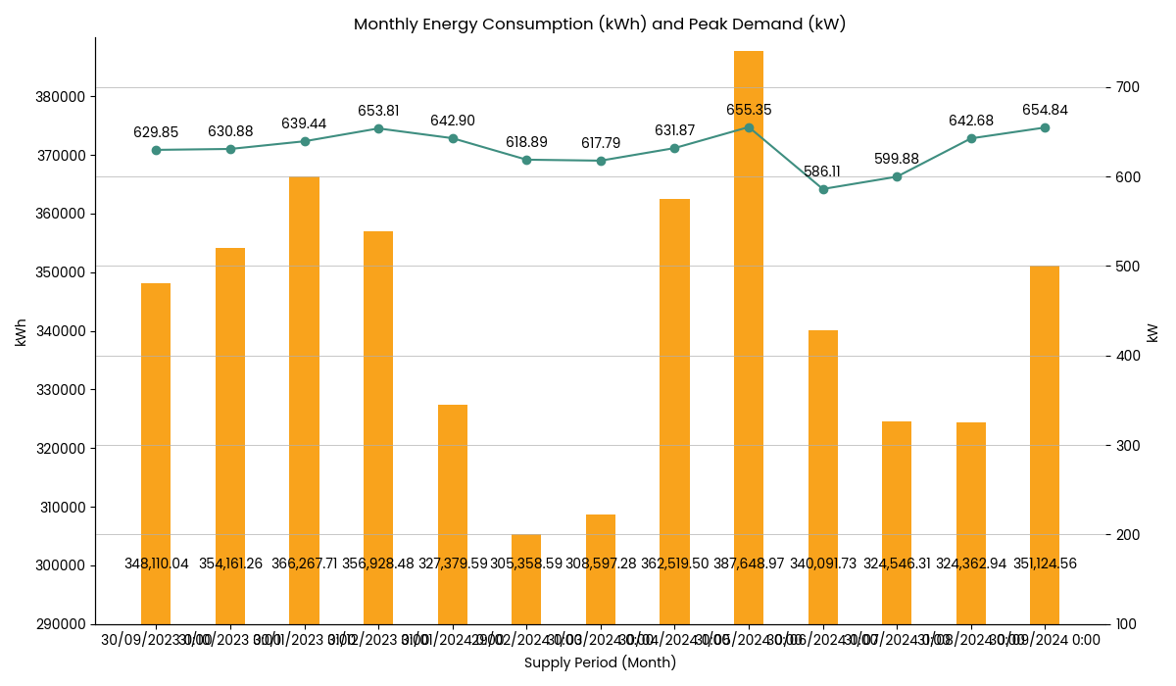
Monthly Energy Consumption (kWh) and Peak Demand (kW)

Slide 4
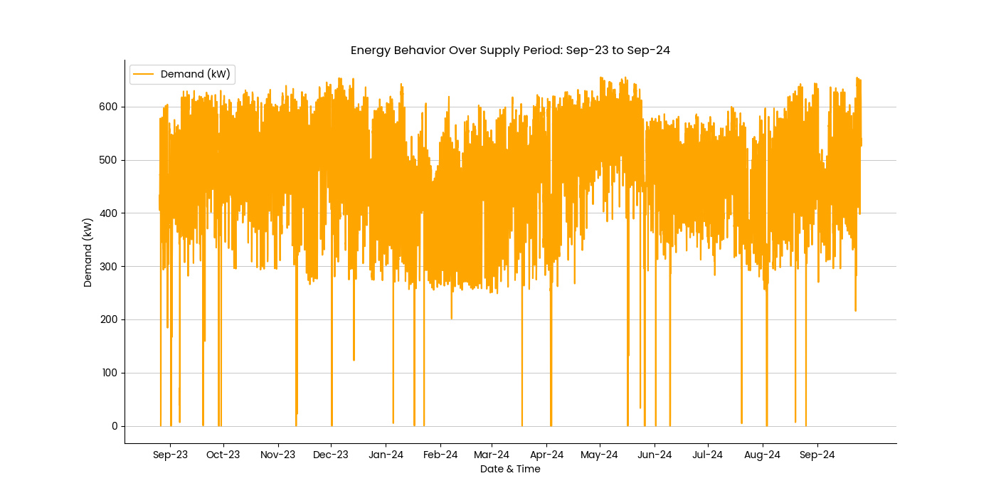
Load Graph

Slide 5
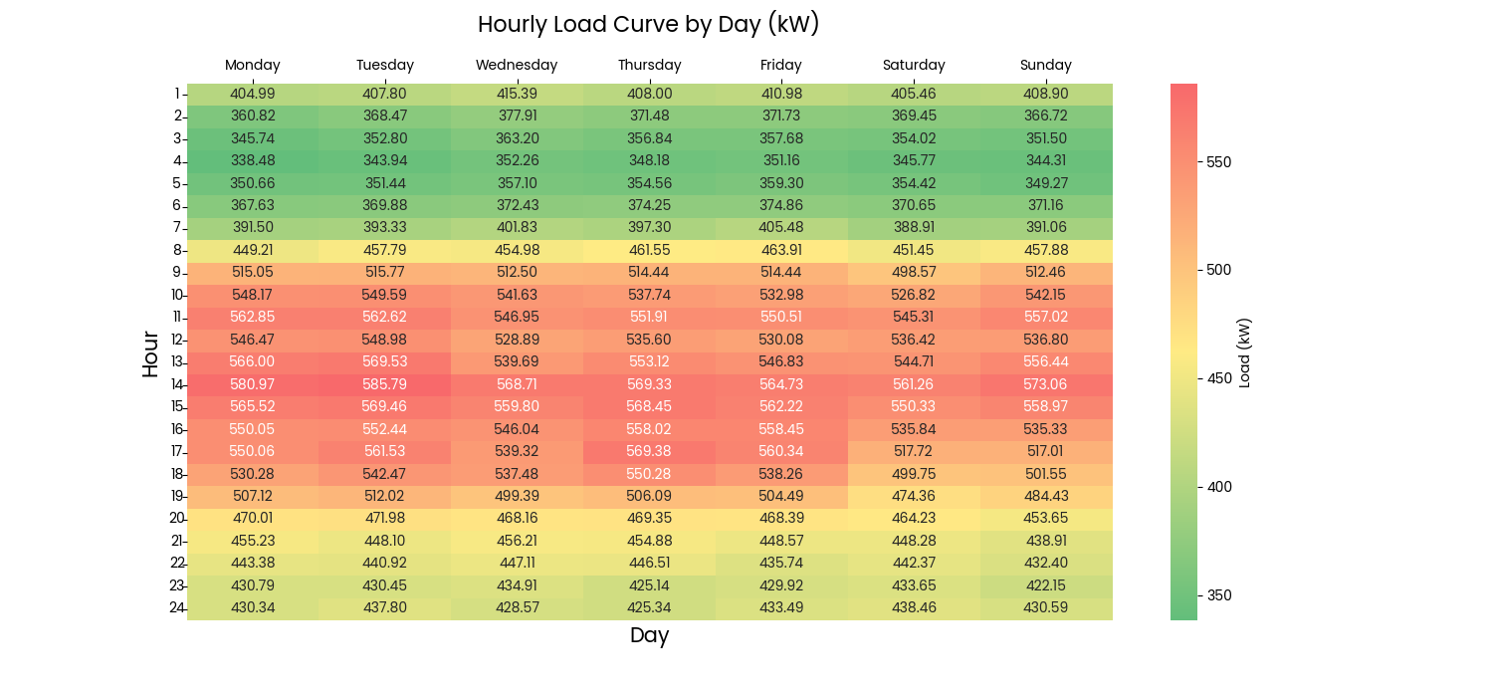
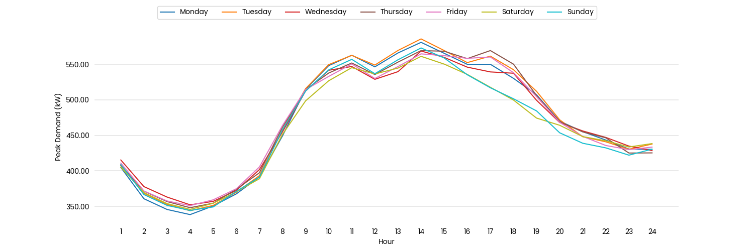
Daily Average Demand

Slide 6
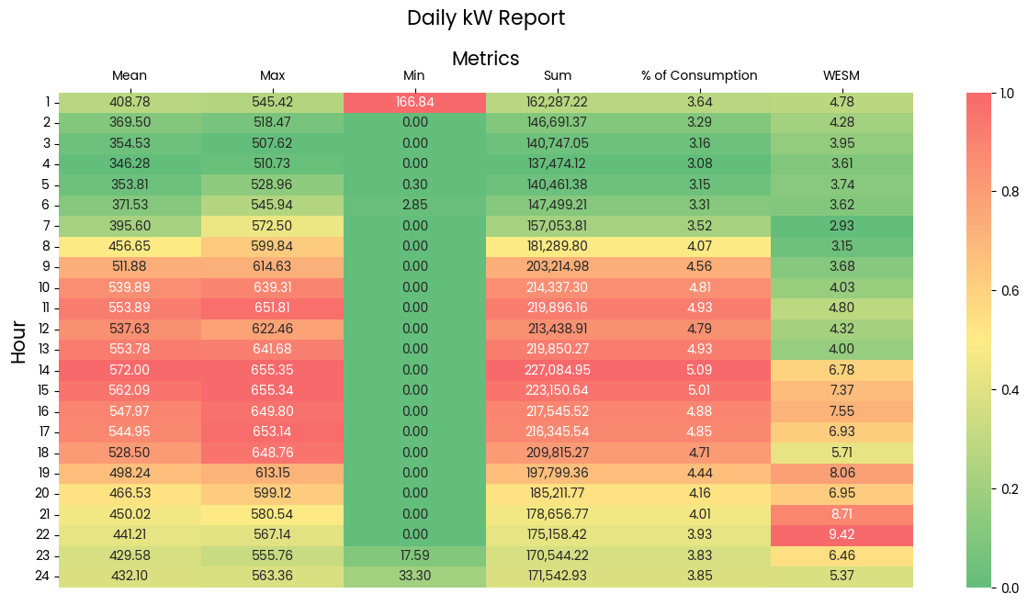
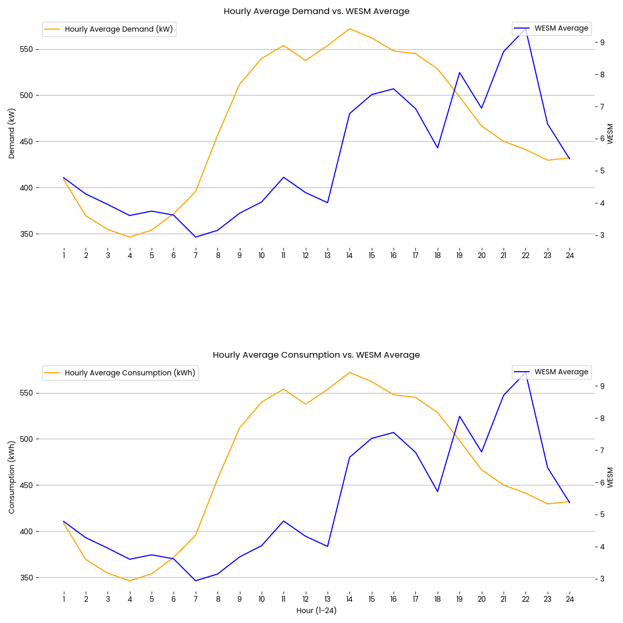
Hourly Averages Demand​

