Slide 1
A PCA-based feature extraction method for face recognition
— Adaptively weighted sub-pattern PCA
(Aw-SpPCA)
Group members: Keren Tan
Weiming Chen
Rong Yang

Slide 2
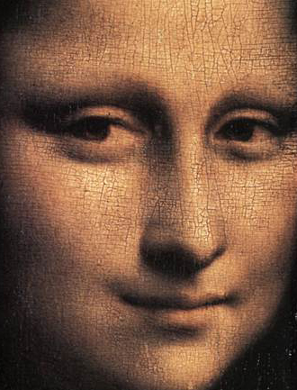
Face recognition introduction
Given an image or a sequence of images of a scene, identify or authenticate one or more people in the scene
It sounds simple
But it turns out being a rather challenging task:
automatically locate the face
recognize the face from a general view point under different illumination conditions, facial expressions, facial accessories, aging effects, etc.

Slide 3
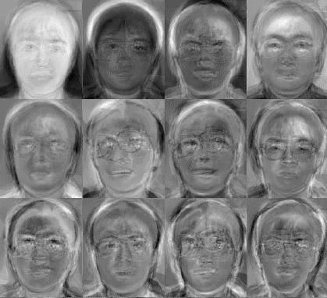
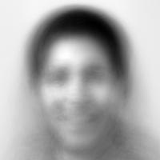
Identification vs. Verification
Identification (1:N)
Database
Biometric
reader
Biometric
Matcher
This person is
Emily
I am Emily
Verification (1:1)
Database
ID
Biometric
reader
Biometric
Matcher
Match

Slide 4
Difficulties with conventional PCA
Global projection suppresses local information, and it is not resilient to face illumination condition and facial expression variations
It does not take discriminative task into account
  ideally, we wish to compute features that allow good discrimination
  not the same as largest variance

Slide 5
Idea of Aw-SpPCA
To confine illumination conditions, facial expressions variations to local areas
  Divide a face image into several sub-images, and carry out PCA computation on each local area independently
To emphasize different parts of human face have different discrimination capabilities
  Adaptively compute the contribution factor of each local area, and incorporate contribution factor into final classification decision

Slide 6
Example: contribution factor?
Observation: “Eyes are the window of the soul.” Some parts of human face are more important than other parts to successful face recognition. Contribution factor wants to give the value of this kind of “importance”
* The size of blue mask is the same in all 3 images

Slide 7
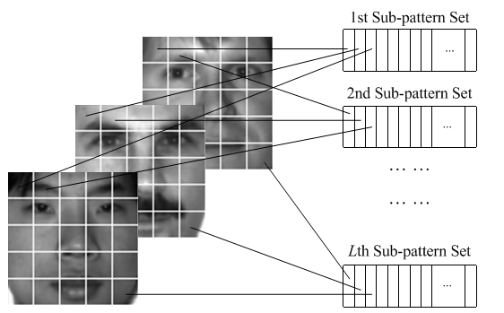
Aw-SpPCA Algorithm
Step 1: Partition face images into sub-patterns
* Face images are from Yale face database

Slide 8
Aw-SpPCA Algorithm
Step 2: Compute the expected contribution of each sub-pattern
  Generate the Mean and Median faces for each person, and use these “virtual faces” as the probe set in training
  Use the raw face-image sub-patterns as the gallery set in for training, and compute the PCA’s projection matrix on these gallery set
  For each sample in the probe set, compute its similarity to the samples in corresponding gallery set

Slide 9
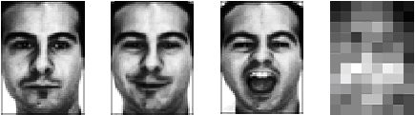
Aw-SpPCA Algorithm
  If a sample from a sub-pattern’s probe set is correctly classified, the contribution of this sub-pattern is added by 1
Face images from AR face database, and the computed contribution matrix

Slide 10
Aw-SpPCA Algorithm
Step 3: Classification
When an unknown face image comes in
  partition it into sub-patterns
  classify the unknown sample’s identity in each sub-pattern
  Incorporate the expected contribution and the classification result of all sub-patterns to generate the final classification result
3 Alice | 7 Bob
8 Bob | 6 Alice
Alice : 3+6 = 9
Bob : 7+8 = 15
It’s Bob

Slide 11
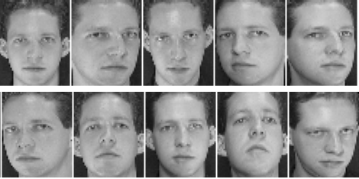
Experiment results
Dataset
  AR face database: 1400 images of 50 males and 50 females, each person has 14 images
  Yale face database: 165 images of 15 adults, 10 images per person
  ORL face database: 400 images of 40 adults, 10 images per person
* Face images from ORL face database

Slide 12
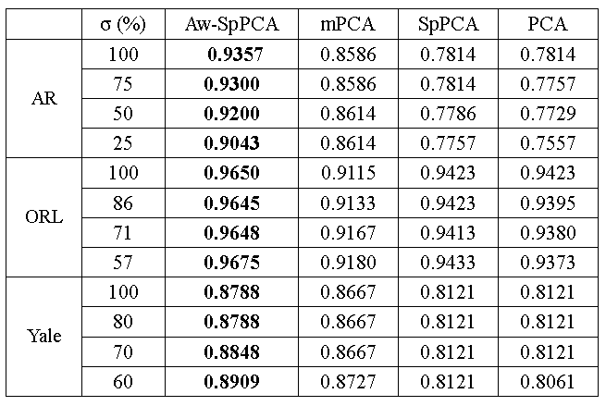
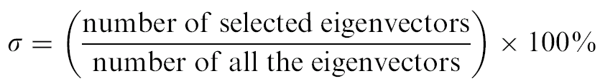
Comparison of classification accuracy
*

Slide 13
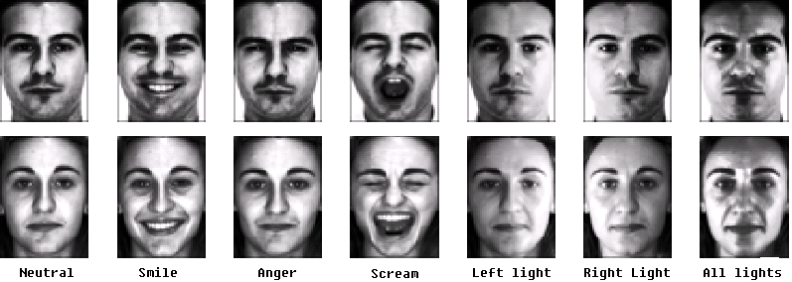
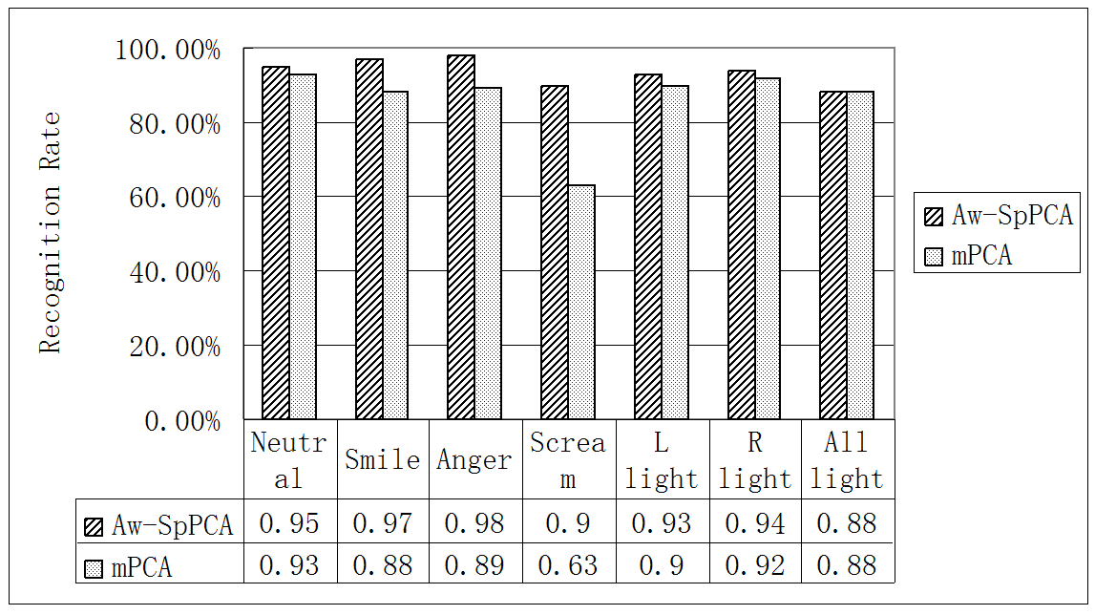

Slide 14
References
M. Turk and A. Pentland, Eigenfaces for recognition, J. Cognitive Neurosci. 3 (1991) (1), pp. 71–86
M. Kirby and L. Sirovich, Application of the KL procedure for the characterization of human faces, IEEE Trans. Pattern Anal. Machine Intell. 12 (1990) (1), pp. 103–108
K. Tan and S. Chen, Adaptively weighted sub-pattern PCA for face recognition, Neurocomputing 64 (2005), pp. 505–511
E. Demidenko, Mixed Models: Theory and Applications, Wiley-Interscience, Aug 2004
S. Chen and Y. Zhu, Subpattern-based principle component analysis, Pattern Recogn. 37 (2004) (1), pp. 1081–1083
R. Gottumukkal and V.K. Asari, An improved face recognition technique based on modular PCA approach, Pattern Recogn. Lett. 25 (2004) (4), pp. 429–436
A.M. Martinez, R. Benavente, The AR face database, CVC Technical Report #24, June 1998
P.N. Belhumeur, J.P. Hespanha and D.J. Kriegman, Eigenfaces vs. fisherfaces recognition using class specific linear projection, IEEE Trans. Pattern Anal. Machine Intell. 19 (1997) (7), pp. 711–720
The ORL Face Database, http://www.uk.research.att.com/facedatabase.html

Slide 15

Thanks a lot!
Any question?

