Slide 1
Customer Churn Analysis
Predicting Telecommunications Customer Churn With Machine Learning

Slide 2
Contents
Problem Overview
General Methods
Churn Analysis
Inferential Statistics
Model Evaluation
Conclusion

Slide 3
Problem Overview
Churn Rate: The average rate at which customers discontinue subscription/service
Volatility of income
Customer satisfaction
Why do customers churn
Which customers are more likely to churn
Where to market to find customers that stick around

Slide 4
General Methods
Sales focus
Contract length
Customer service quality
Offer unique customer benefits
Customer surveys
Price

Slide 5
Churn Analysis
Demographics and features of current customers
Demographics of potential customers
Identify individuals likely to churn
Understand features that most influence churn

Slide 6
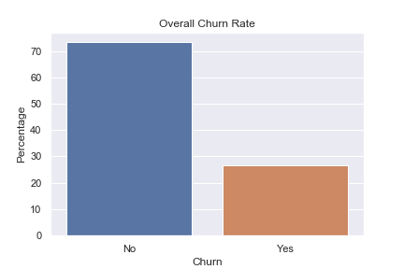
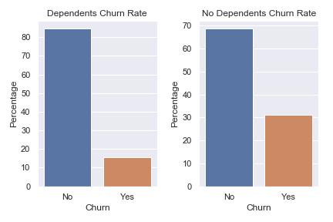
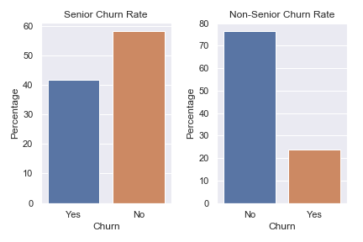
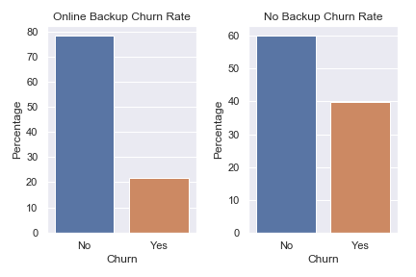
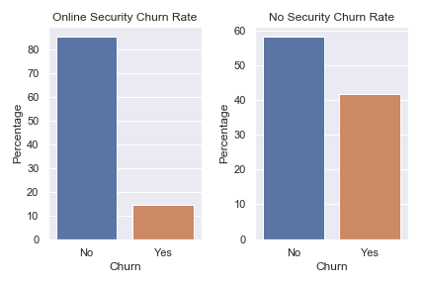
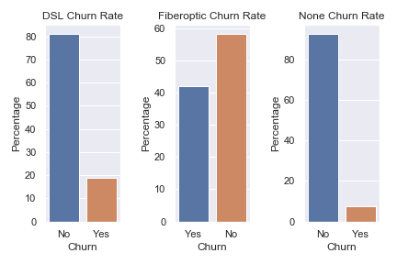
Churn Analysis

Slide 7
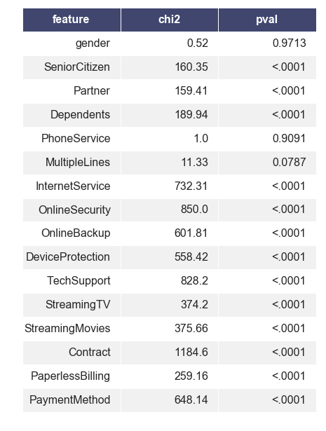
Churn Analysis
The Chi-square test can show categorical features that have a statistically significant relationship with Churn.

Slide 8
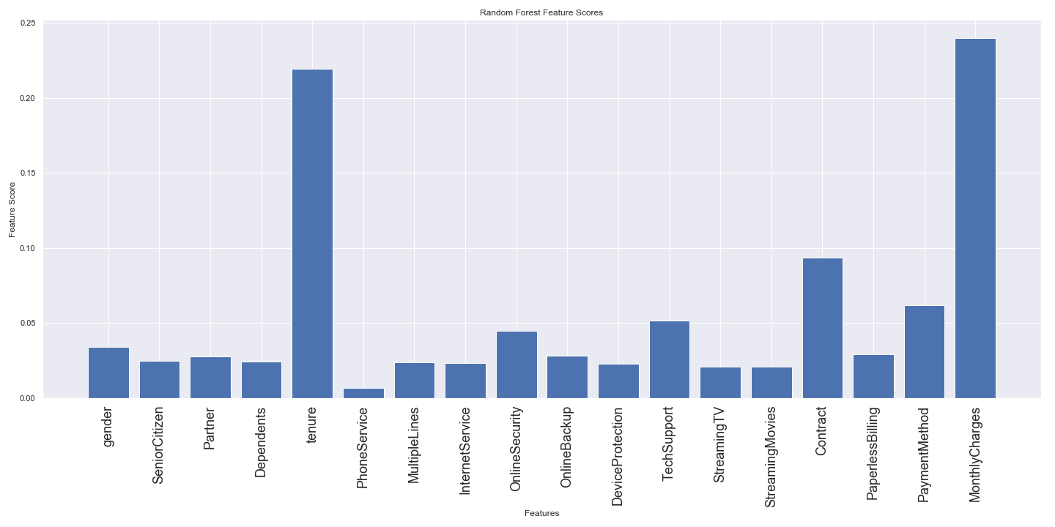
Churn Analysis

Slide 9
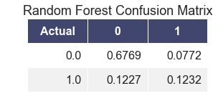
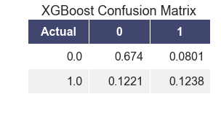
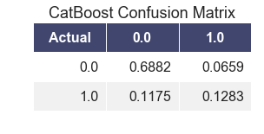

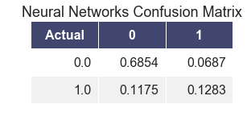

Model Evaluation
The Confusion Matrix shows the rate of true positive, true negative, false positive and false negative model predictions

Slide 10
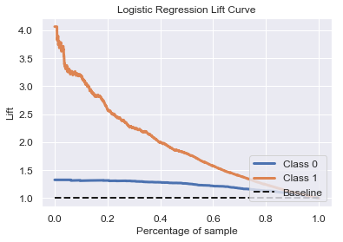
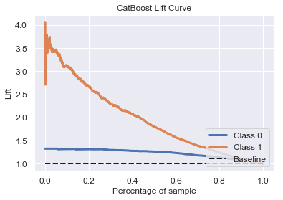
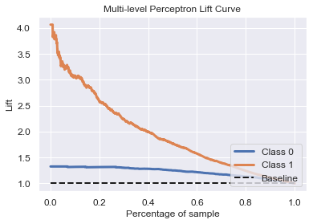
Model Evaluation
The lift curve orders the predicted probability of default and provides a lift score at each percentile of the ordered probabilities.
Ex: A lift score of 2 at the 20th percentile means that you would get 2 times the performance, over randomly guessing, by using the top 20% highest probabilities

Slide 11
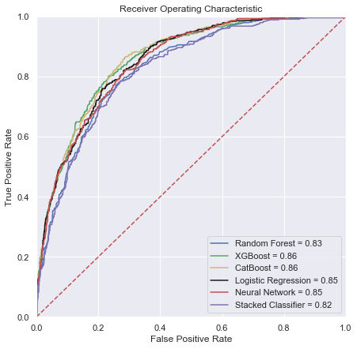
Model Evaluation
The ROC curve contains true positive rate on the Y axis, and false positive rate on the X axis. A curve with a larger area below (AUC) is better.

Slide 12
Conclusion
When predicting if a customer will churn the most important features are: Monthly Charges, Tenure, Senior Citizen, Partner, Dependents, Internet Service, Online Security, Online Backup, Device Protection, Tech Support, Streaming TV, Streaming Movies, Contract, Paperless Billing, and Payment Method. The data shows there are significant differences in churn rate within these categories. Using a CatBoost model we are able to achieve 82% prediction accuracy on individual churn.
To achieve the most efficient marketing and retention the data suggests to market to younger families, i.e. people with partners and dependents who aren’t considered senior citizens, and people who are less tech savvy, i.e. need tech support, online backup, and device protection.

