Slide 1
Predicting Loan Default
Using Personal Loan Data From Lending Club
Regan Russell

Slide 2
Contents
Problem
Lending Strategies
Solutions
Model Evaluation Metrics
Conclusion

Slide 3
Problem
Banks hold money and pay out interest on money held
Return on capital is often found in the form of personal loans
Goal is straightforward, get higher return from interest received from borrowers over interest paid to money held at bank
Personal loans are risky
Personal loans are not backed by collateral
Personal info required for underwriting can be costly to gather
Banks and credit card companies constantly face the problem of who to lend money too

Slide 4
Lending Strategies
Gather personal information of borrowers (e.g. credit score, income, etc)
Assign Underwriter’s to review each applicants information
Assign borrowers a grade based on risk
Spread risk by lending small amounts to many borrowers

Slide 5
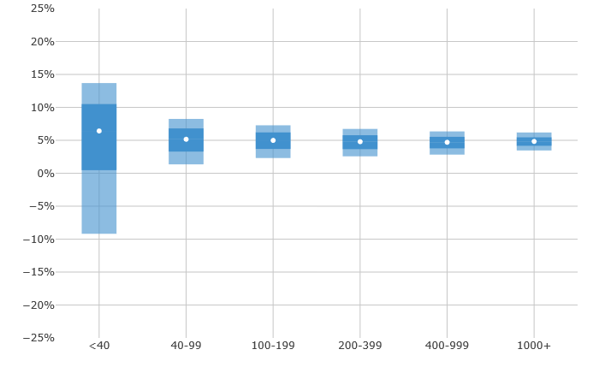
Lending Strategies
25%
20%
15%
10%
5%
0%
-5%
-10%
-15%
-20%
-25%
Adjusted Net Annualized Return
<40 40-99 100-199 200-399 400-999 1000+
Number of Notes Purchased

Slide 6
Lending Strategies
Problems:
Requires large amounts of capital to spread risk
Risk is not very well quantified (grade: A,B,C,etc)
Short term income streams can be unpredictable
Data retrieval is costly and time consuming

Slide 7
Solutions
Predictive Model Using Machine Learning
Predictive model requires less variables for accurate prediction
Risk is better quantified by using probabilities
Model predicts default on an individual basis
Fully Underwriting each case not required

Slide 8
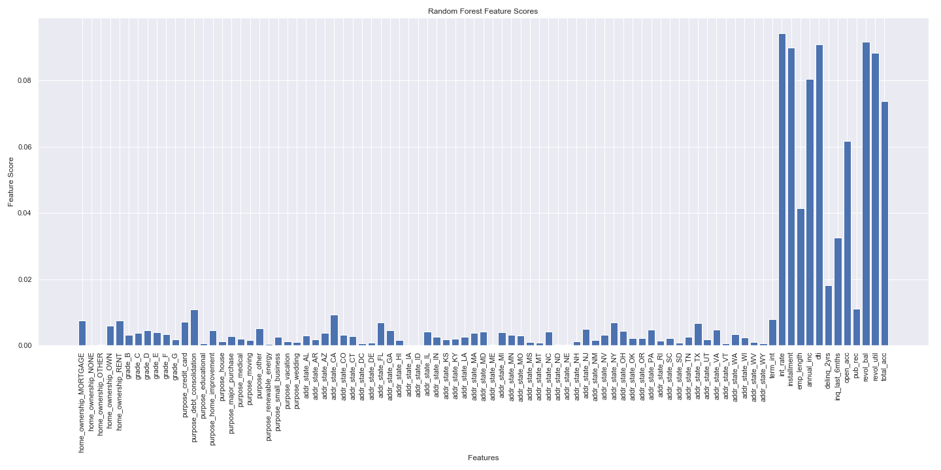
Solutions
Lending Club gathers well over 70 different variables for each individual borrower
Random Forest Classifier Identifies 9 variables that are most predictive of default

Slide 9
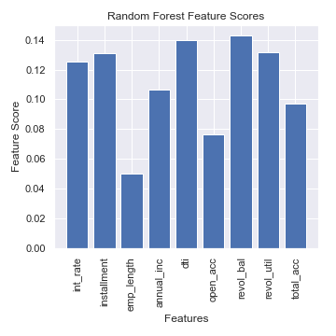
Solutions

Slide 10
Model Evaluation Metrics
The Confusion Matrix shows the rate of true positive, true negative, false positive, and false negative model predictions
Predicted
 | Random Forest |  | XGBoost |  | CatBoost |  | Logistic Reg
Actual | 0 | 1 | 0 | 1 | 0 | 1 | 0 | 1
0 | 0.000699 | 0.087119 | 0.000059 | 0.087759 | 0.001947 | 0.085871 | 0.000009 | 0.087809
1 | 0.000212 | 0.911970 | 0.000009 | 0.912173 | 0.000960 | 0.911222 | 0.000036 | 0.912146

Slide 11
Model Evaluation Metrics
ROC stands for Receiver Operating Characteristic and AUC stands for Area Under the Curve
AUC of 0.5 would be consistent with random guessing
 | Classifier
ROC AUC | Random Forest | XGBoost | CatBoost | Log Regression
Mean | 0.6981 | 0.7046 | 0.7285 | 0.5209
Std. Deviation | 0.8355 | 0.8394 | 0.8535 | 0.7217

Slide 12
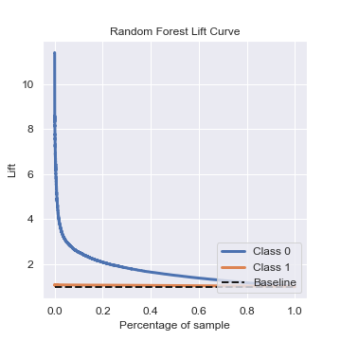
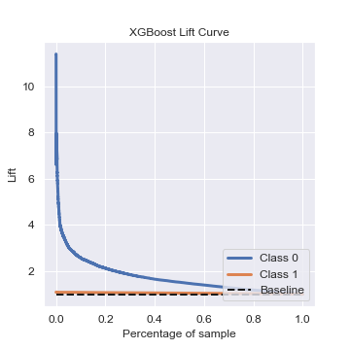
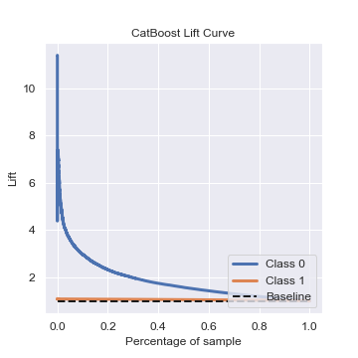
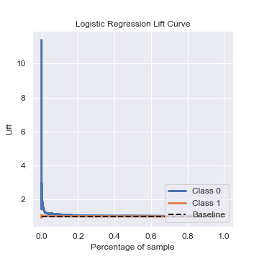
Model Evaluation Metrics
The lift curve orders the predicted probability of default and provides a lift score at each percentile of the ordered probabilities.
Ex: A lift score of 2 at the 20th percentile means that you would get 2 times the performance, over randomly guessing, by using the top 20% highest probabilities

Slide 13
Conclusion
Predictive Model Using Machine Learning
91% prediction accuracy
9 variables needed for model
Interest rate, installment amount, employment length, annual income, debt to income ratio, number of open credit accounts, revolving balance, revolving utility, and total credit accounts
FICO score not needed

