Slide 1
Predictive Model for Document Categorization

Slide 2
Introduction
Objective: Develop an Accurate Multi-Label Machine Learning Model
Dataset Overview: Collection of 10K+ News Articles
Training: 7769 and Testing: 3019 with labels.
Task: Predict Relevant Categories for Each Document
There are 90 different categories
Dataset Partitioned into Training and Test Sets
90 Categories Available for Classification
Approach: Data Exploration, Model Development, Evaluation

Slide 3
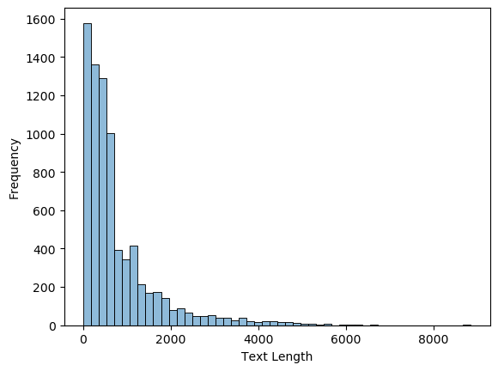
Data Preprocessing & Exploration
Preprocessing:
Generate tokens using NLTK’s word_tokenize .
Used NLTK’s WordNetLemmatizer to for Lemmantization.
TFIDFVectorizer to create word vectors and to remove the stopwords using the provided list.
Exploratory Data Analysis (EDA):
Check for missing values: No missing values found.
Check for text length across training data
Fig-1

Slide 4
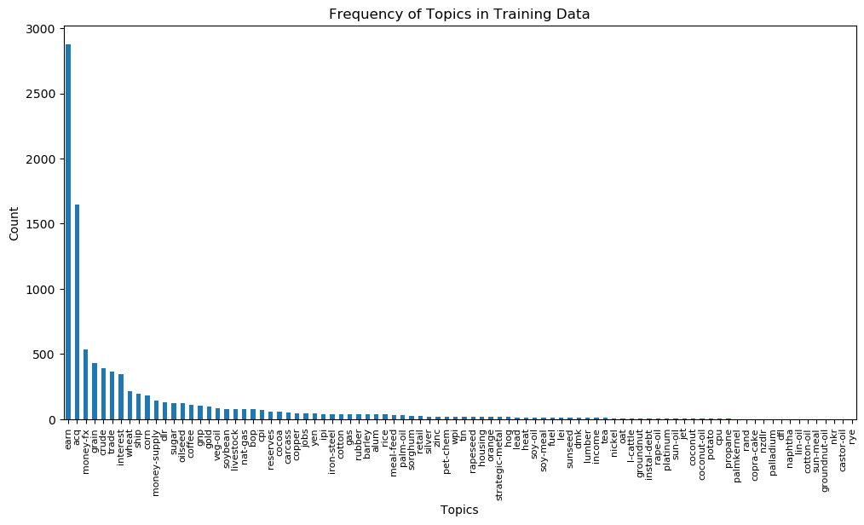
Data Preprocessing & Exploration (Contd.)
Topic frequency distribution in training data.
Fig-2

Slide 5
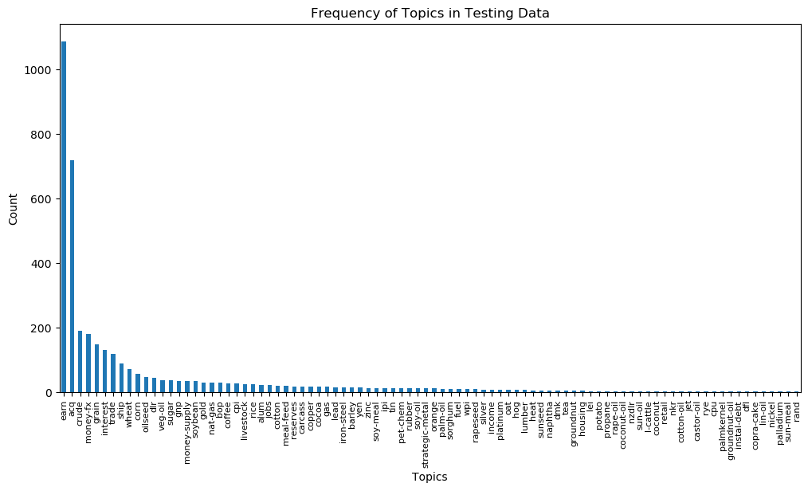
Data Preprocessing & Exploration (Contd.)
Topic frequency distribution in test data.
Fig-3

Slide 6
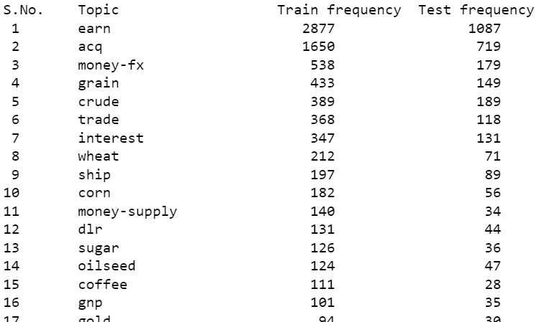
Data Preprocessing & Exploration
Frequency of different topics across training and test data
The analysis shows that dataset is unbalanced.
Some topics are way more popular than others.
Some docs are very short containing only one line, while some are very large.
Half of the labels in the dataset, occur in less than 5% of the training data.

Slide 7
Model Selection
Ensemble methods generally produces good results in multi-label classification. Hence Random Forest Classifier is selected.
To select the parameter n_estimators, which is the number of trees in Random Forest classifier, Grid search over [100, 200, 300, 400, 500] value is performed for 5 fold cross validation.
As a result, best performance comes out to be when the value is 400.
Random Forest | Precision | Recall | F1-score
Micro Avg | 0.97 | 0.60 | 0.74
Macro Avg | 0.37 | 0.11 | 0.15
Weighted Avg | 0.85 | 0.60 | 0.66

Slide 8
Model Selection
Considered another approach: KNN classifier.
To select the parameter n_neighbors, representing number of neighbors to consider, Grid search over [2,5,7,10,15] value is performed for 5 fold cross validation.
Best performance comes out to be when the value is 2.
Random Forest | Precision | Recall | F1-score
Micro Avg | 0.96 | 0.36 | 0.53
Macro Avg | 0.50 | 0.14 | 0.20
Weighted Avg | 0.89 | 0.36 | 0.46

Slide 9
Analysis
KNN is faster compared to Random forest.
Results show that the recall of KNN is in general lower compared to random forest in terms of micro averaged precision and recall, but not the other way around.
This means that Random forest classifier performs better in predicting the majority classes or in capturing overall true positives and minimizing false positives and false negatives for the entire dataset.
Whereas KNN performs better in some classes to boost the overall macro precision and recall.

Slide 10
Thank you

