Slide 1

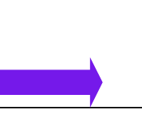


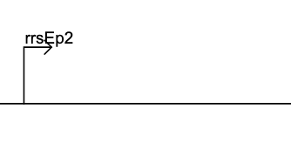

Transcription Factors
deoC
RNAP-centered regulatory proteins
Regulatory RNA: small RNA

