Slide 1
— DATA ANALYSIS PROJECT
Supply Chain
Data Analytics
Turning supply chain data into insights that improve efficiency, cut costs, and support better decisions.
● Digital Egypt Pioneers Initiative – DEPI
Instructor: Eman Ghanem · Under supervision of Dr. Mahmoud Raslan
Group code: ITC_ONL5_DAT3_G3
◆ Sara Elsayed Shoaib
◆ Eman Negem
◆ Ahmed Hosniy
◆ Rehab Khaled
◆ Hoda Negm
◆ Ahmed Sabih

Slide 2
SECTION 01 · THE DATA
About the Dataset
WHAT IS IT ABOUT?
PROBLEMS WE FOUND
DataCo Supply Chain: one row for every order item sold by a global company, covering orders from 2015 to early 2018.
1
Missing values
Order Zipcode 86% empty, Product Description 100% empty, a few blanks in customer name and zipcode.
2
Unneeded columns
180,519
53
4
Passwords, emails, street, image and duplicate columns add noise.
ROWS
COLUMNS
YEARS
3
Broken text
Special characters showed as "MÃ©xico" and country names like "EE. UU." did not match the map.
Each row describes
4
Mixed types
Customer & segment
Product & category
Order date & status
Prices, ids and date-time values were stored inconsistently.
Shipping mode & days
Sales, discount, profit
5
Outliers
Late delivery risk
Market & region
Profit, discount, price and sales have extreme values to check.
Solving these problems in Python and SQL gives a clean, trustworthy base for the Power BI dashboards.

Slide 3
SECTION 01 · PYTHON
Loading the Data
notebook.ipynb
1
read_csv()
1 df = pd.read_csv('/content/CoSupply_Chain_Dataset.csv',
2 encoding='latin1')
3
4 df.head()
Loads the supply chain file into a DataFrame called df.
2
encoding='latin1'
Reads special characters without errors.
3
head()
Shows the first 5 rows to preview the data.
OUTPUT
5 rows × 53 columns
 | Type | Days for shipping (real) | Days for shipment (scheduled) | Benefit per order | Delivery Status | Late_delivery_risk | Category Name | Shipping Mode
0 | DEBIT | 3 | 4 | 91.25 | Advance shipping | 0 | Sporting Goods | Standard Class
1 | TRANSFER | 5 | 4 | -249.09 | Late delivery | 1 | Sporting Goods | Standard Class
2 | CASH | 4 | 4 | -247.78 | Shipping on time | 0 | Sporting Goods | Standard Class
3 | DEBIT | 3 | 4 | 22.86 | Advance shipping | 0 | Sporting Goods | Standard Class
4 | PAYMENT | 2 | 4 | 134.21 | Advance shipping | 0 | Sporting Goods | Standard Class
Showing 8 of 53 columns

Slide 4
SECTION 01 · PYTHON
Understanding the Data
notebook.ipynb
180,519
53
73+ MB
4
1 df.info()
ROWS
COLUMNS
MEMORY
COLS WITH NULLS
DATA TYPES
53 columns
COLUMNS WITH MISSING VALUES
out of 180,519 rows
object
24
COLUMN
NON-NULL
MISSING
SHARE MISSING
Text
Order Zipcode
24,840
155,679
86.2%
float64
15
Product Description
0
180,519
100%
Decimal numbers
Customer Lname
180,511
8
< 0.01%
int64
14
Whole numbers
Customer Zipcode
180,516
3
< 0.01%
Only 4 of 53 columns have missing values: two are almost empty, and two are nearly complete.

Slide 5
SECTION 01 · PYTHON
Dropping Unneeded Columns
notebook.ipynb
● Personal & sensitive
3
1 df.drop(columns=[
2 'Customer Email', 'Customer Password',
3 'Customer Street', 'Latitude',
4 'Longitude', 'Order Zipcode',
5 'Order Customer Id', 'Benefit per order',
6 'Sales per customer',
7 'Order Item Product Price',
8 'Order Item Cardprod Id',
9 'Product Description', 'Product Image',
10 'Product Status', 'Product Category Id'
11 ], inplace=True, errors='ignore')
Customer Email
Customer Password
Customer Street
● Duplicate or overlapping
6
Order Customer Id
Order Item Cardprod Id
Product Category Id
Order Item Product Price
Benefit per order
Sales per customer
● Empty or not needed
6
inplace=True changes df directly
errors='ignore' no error if a column is missing
Product Description
Product Image
Product Status
Order Zipcode
Latitude
Longitude
53 COLUMNS BEFORE ➜ −15 COLUMNS REMOVED ➜ 38 COLUMNS KEPT

Slide 6
SECTION 01 · PYTHON
Handling Missing Values
notebook.ipynb
Customer Lname
Customer Zipcode
text
number
1 df['Customer Lname'] = df['Customer Lname'].fillna('Uk')
2 df['Customer Zipcode'] = df['Customer Zipcode'].fillna(0)
3
4 df.isnull().sum()
8 → 0
3 → 0
MISSING VALUES
MISSING VALUES
fillna('Uk')
fillna(0)
Uk = Unknown
0 = placeholder
OUTPUT · DF.ISNULL().SUM()
one square = one column
0
0
0
0
0
0
0
0
0
0
0
0
0
0
0
0
0
0
0
0
0
0
0
0
0
0
0
MISSING VALUES
0
0
0
0
0
0
0
0
0
0
0
0
in all 38 columns
The dataset is now complete and clean, so it is ready for analysis and visualization.

Slide 7
SECTION 02 · PYTHON
Outlier Detection: Setup
notebook.ipynb
1
describe()
1 df.describe()
2 columns = ["Sales", "Order Item Discount",
3 "Order Profit Per Order",
4 "Order Item Total", 'Product Price']
5
6 for col in columns:
7 if col in df.columns:
8 plt.figure(figsize=(8, 3))
9 sns.boxplot(x=df[col])
10 plt.title(f"Boxplot of {col}")
11 plt.show()
Summary statistics: count, mean, std, min, quartiles and max.
2
columns = [...]
The five numerical columns selected for the outlier check.
3
sns.boxplot()
Box = Q1 to Q3, whiskers = normal range, dots = potential outliers.
COLUMNS
Sales
Order Item Discount
Order Profit Per Order
Order Item Total
Product Price
Descriptive statistics and boxplots give a first visual look at extreme values in each column.

Slide 8
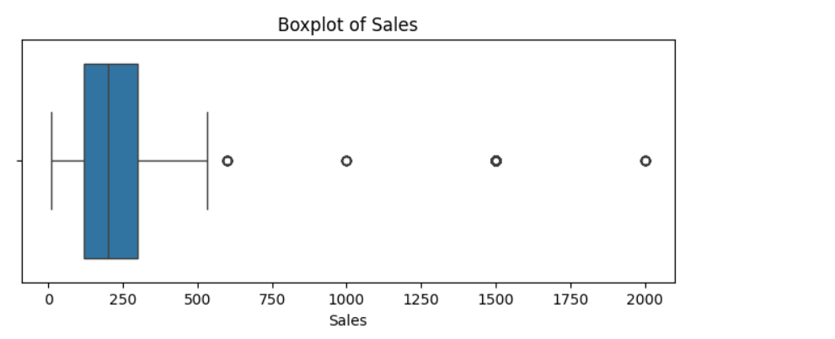
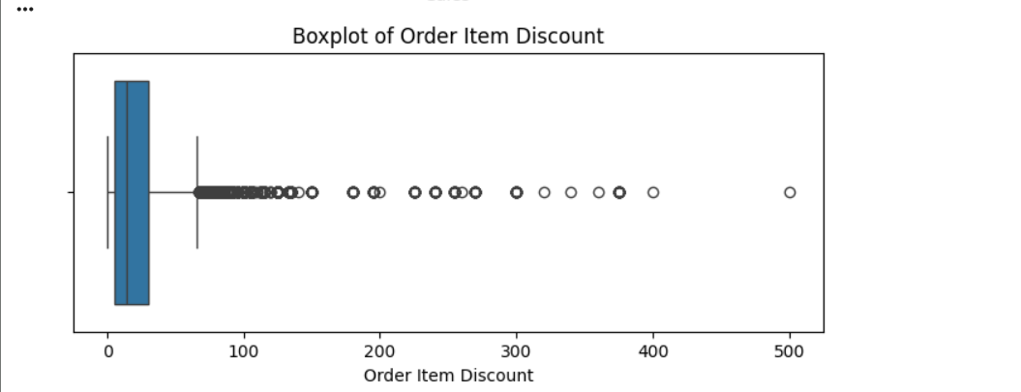
SECTION 02 · PYTHON
Boxplots: Sales & Discount
Sales
Most values sit below about 300. A handful of isolated dots appear far to the right, around 600, 1,000, 1,500 and 2,000.
Order Item Discount
Box is narrow (roughly 5 to 30). A dense line of dots starts just past the whisker and stretches out to about 500.
Each dot beyond the whisker is a potential outlier flagged by the IQR rule.

Slide 9
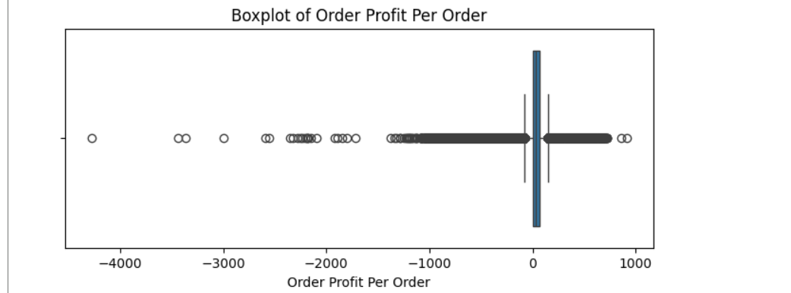
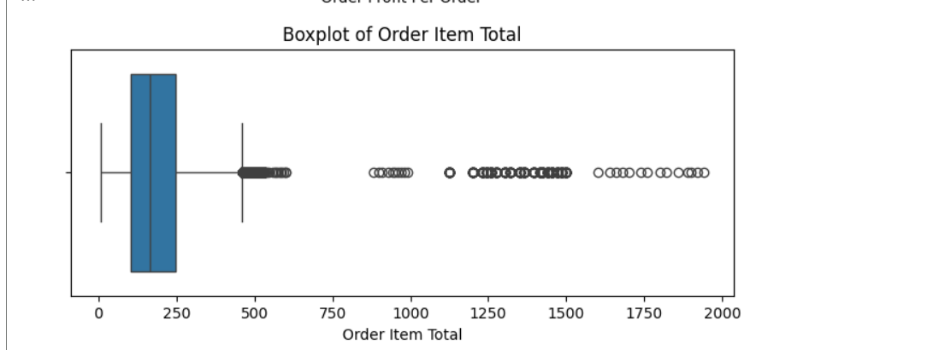
SECTION 02 · PYTHON
Boxplots: Profit & Item Total
Order Profit Per Order
The box is squeezed near zero, with dense dots on both sides. Extreme negative values reach about −4,300; positives reach about 900.
Order Item Total
Box roughly 100 to 250. Dots begin around 460 and spread out to nearly 2,000, with several gaps between clusters.
Profit shows the heaviest tails, especially on the negative side (losses).

Slide 10
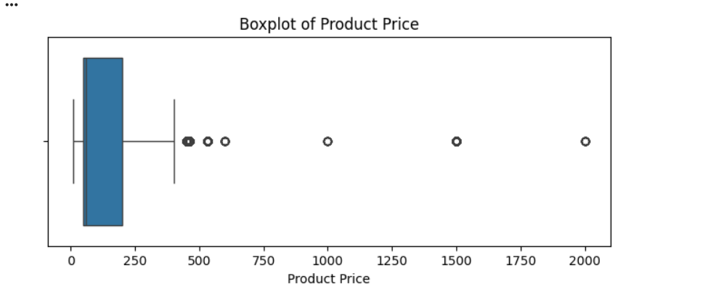
SECTION 02 · PYTHON
Boxplot: Product Price
Product Price
Box roughly 50 to 200, whisker ends near 400. Only a few separate dots appear, around 450, 530, 600, 1,000, 1,500 and 2,000.
HOW TO READ A BOXPLOT
Box = Q1 to Q3 (middle 50%)
Line inside = median
Whiskers = normal range
Dots = potential outliers
Boxplots show where the outliers are; the IQR calculation that follows measures exactly how many.

Slide 11
SECTION 02 · PYTHON
The IQR Method
notebook.ipynb
IQR
Q3 − Q1
1 for col in columns:
2 Q1 = df[col].quantile(0.25)
3 Q3 = df[col].quantile(0.75)
4 IQR = Q3 - Q1
5 lower = Q1 - 1.5 * IQR
6 upper = Q3 + 1.5 * IQR
7 count = ((df[col] < lower) | (df[col] > upper)).sum()
8 print(f"{col}: {count} outliers")
Lower Bound
Q1 − 1.5 × IQR
Upper Bound
Q3 + 1.5 × IQR
Any value outside these bounds is counted as a potential outlier.
Q1, Q3, IQR, bounds
Min / Max
sort_values().head(5)
Printed for every column to review the calculated limits.
Compared against the bounds to see how far values extend.
Shows the 5 lowest and 5 highest outlier values per column.
The IQR method is robust because it relies on quartiles, not on the mean.

Slide 12
SECTION 02 · PYTHON
Key Findings
Order Profit Per Order
18,942
1
Profit: highest
Unusually high positive values and extreme negative values.
Order Item Discount
7,537
2
Discount: considerable
Product Price
2,048
A large number of potential outliers worth investigating.
Order Item Total
1,943
3
Others: limited
Sales
488
Sales, Item Total and Price show far fewer extreme values.

Slide 13
SECTION 02 · PYTHON
Inspecting the Extremes
notebook.ipynb
1
Q1, Q3, IQR
1 for col in columns:
2 Q1 = df[col].quantile(0.25)
3 Q3 = df[col].quantile(0.75)
4 IQR = Q3 - Q1
5 lower = Q1 - 1.5 * IQR
6 upper = Q3 + 1.5 * IQR
7
8 print(f"\nColumn: {col}")
9 print("Q1:", Q1)
10 print("Q3:", Q3)
11 print("IQR:", IQR)
12
13 print("Min:", df[col].min())
14 print("Max:", df[col].max())
15 print("Lower Bound:", lower)
16 print("Upper Bound:", upper)
17
18 print("Lowest values:")
19 print(df.loc[df[col] < lower, col].sort_values().head(5).tolist())
20 print("Highest values:")
21 print(df.loc[df[col] > upper, col].sort_values(ascending=False).head(5).tolist())
Lines 2-4: the spread of the middle 50% of the data, printed per column.
2
Lower / Upper Bound
Lines 5-6: Q1 − 1.5×IQR and Q3 + 1.5×IQR set the normal range.
3
Min / Max
Lines 13-14: if Min is below the lower bound or Max is above the upper bound, outliers exist on that side.
4
df.loc[ ... ]
Lines 19, 21: filters only the rows outside the bounds.
5
sort_values().head(5)
Shows the 5 lowest and 5 highest outliers, so you see how extreme they really are.
Looking at the actual extreme values helps decide if they are errors or valid business cases.

Slide 14
SECTION 03 · SQL SERVER
Fixing Data Types & Dates
DataCoSupplyChain.sql
1
Prices → DECIMAL(18,1)
1 USE DataCoSupplyChain
2 EXEC sp_help 'dbo.DataCoSupplyChain' -- check column types
3
4 -- Money columns: one decimal place
5 ALTER TABLE dbo.DataCoSupplyChain
6 ALTER COLUMN [Sales] DECIMAL(18,1)
7 -- same for Order_Item_Discount, Order_Item_Total,
8 -- Order_Profit_Per_Order, Product_Price ...
9
10 -- All ids become INT
11 ALTER TABLE dbo.DataCoSupplyChain
12 ALTER COLUMN [Customer_Id] INT
13 -- same for Order_Id, Order_Item_Id, Product_Card_Id ...
14
15 -- Split date and time into separate columns
16 ALTER TABLE dbo.DataCoSupplyChain ADD [Date_Orders] DATE
17 ALTER TABLE dbo.DataCoSupplyChain ADD [Time_Orders] TIME
18 UPDATE dbo.DataCoSupplyChain
19 SET [Date_Orders] = CAST([order_date_DateOrders] AS DATE),
20 [Time_Orders] = CAST([order_date_DateOrders] AS TIME)
Consistent precision for every money column.
2
Ids → INT
One type for all keys, ready for relationships.
3
Date / Time split
Order and shipping timestamps become Date and Time columns; the originals are dropped.
Clean types make the model faster and the DAX measures safer.

Slide 15
SECTION 03 · SQL SERVER
Cleaning Text & Encoding
DataCoSupplyChain.sql
Why?
1 -- Repair broken characters in country names
2 UPDATE dbo.DataCoSupplyChain
3 SET [Order_Country] =
4 CASE
5 WHEN [Order_Country] LIKE '%MÃ©xico%' THEN 'Mexico'
6 WHEN [Order_Country] LIKE '%PerÃº%' THEN 'Peru'
7 WHEN [Order_Country] LIKE '%JapÃ³n%' THEN 'Japon'
8 WHEN [Order_Country] LIKE '%PanamÃ¡%' THEN 'Panama'
9 ELSE [Order_Country]
10 END
11 WHERE [Order_Country] LIKE '%Ã%'
12 -- same pattern for Order_State and Order_City
13
14 -- Make the country name work on the map
15 UPDATE dbo.DataCoSupplyChain
16 SET [Customer_Country] = 'United States'
17 WHERE [Customer_Country] = 'EE. UU.'
18
19 UPDATE dbo.DataCoSupplyChain
20 SET [Customer_State] = 'CA'
21 WHERE [Customer_State] LIKE '%[0-9]%'
The CSV was read with the wrong encoding, so names like México showed as MÃ©xico. A CASE expression maps each one to its clean name.
Map-ready values
"EE. UU." became United States, and zipcodes found in the state column were replaced with CA.
Correct city, state and country names are required for the map visuals in Power BI.

Slide 16
SECTION 03 · SQL SERVER
Building the Star Schema
DataCoSupplyChain.sql
Dim_Customers
1 SELECT [Customer_Id],
2 MAX([Customer_Name]) AS Customer_Name,
3 MAX([Customer_Segment]) AS Customer_Segment,
4 MAX([Customer_City]) AS Customer_City
5 INTO dbo.Dim_Customers
6 FROM dbo.DataCoSupplyChain
7 GROUP BY [Customer_Id]
8
9 ALTER TABLE dbo.Dim_Customers
10 ADD CONSTRAINT PK_Dim_Customers PRIMARY KEY ([Customer_Id])
11 -- Dim_Products built the same way on [Product_Card_Id]
12
13 ALTER TABLE dbo.DataCoSupplyChain
14 ADD CONSTRAINT FK_Order_Customer
15 FOREIGN KEY ([Customer_Id]) REFERENCES dbo.Dim_Customers([Customer_Id])
16 ALTER TABLE dbo.DataCoSupplyChain
17 ADD CONSTRAINT FK_Order_Product
18 FOREIGN KEY ([Product_Card_Id]) REFERENCES dbo.Dim_Products([Product_Card_Id])
19
20 -- Remove columns now stored in the dimensions
21 ALTER TABLE dbo.DataCoSupplyChain DROP COLUMN [customer_state]
22 ALTER TABLE dbo.DataCoSupplyChain DROP COLUMN [product_name]
PK Customer_Id
▼ FK
DataCoSupplyChain
Fact table
▲ FK
Dim_Products
PK Product_Card_Id
One fact table and two dimensions with primary and foreign keys, so every attribute is stored once.

Slide 17
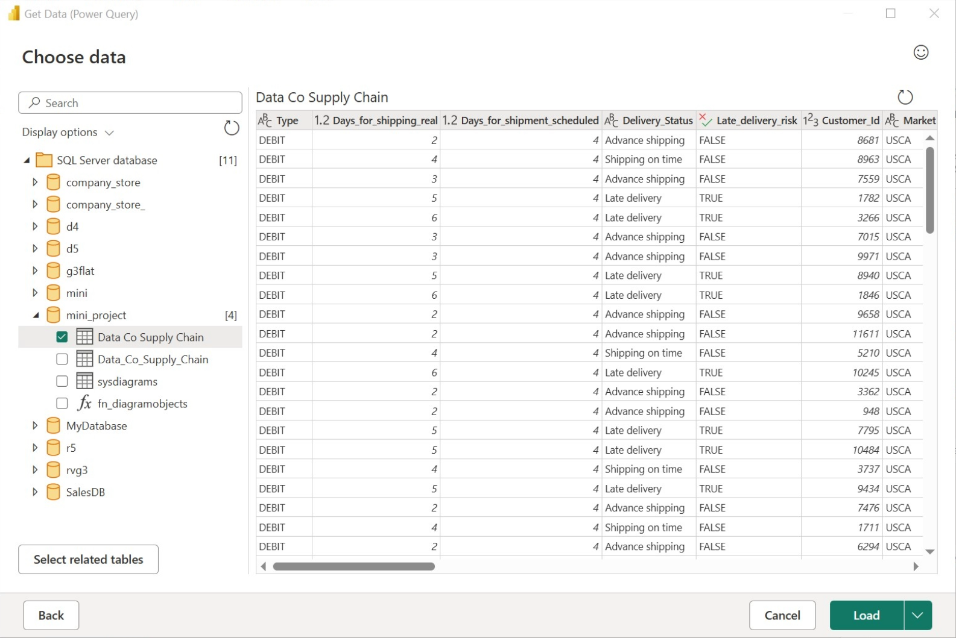
SECTION 04 · POWER BI
Connecting Power BI to SQL Server
1
SQL Server database
Connect to the server and open the mini_project database.
2
Get Data → SQL Server
Home → Get data → SQL Server, then enter server and database.
3
Choose data
Tick Data Co Supply Chain (the main fact table); the Dim Customers and Dim Products tables are loaded the same way.
4
Power Query
Order City / Country / Region by Reference + Remove Duplicates; Date_Orders split into Day, Month, Year.
5
Load & model
Load, then relate Customer_Id and Product_Card_Id to the dimensions.
Every dashboard in this report is driven by the SQL data model, not by the raw CSV.

Slide 18
SECTION 05 · POWER BI REPORT
Key DAX Measures
DAX measures
1
Sales & profit
1 Total Sales = SUM('Data Co Supply Chain'[Sales])
2 Total Orders = DISTINCTCOUNT('Data Co Supply Chain'[Order_Id])
3 Total Profit = SUMX('Data Co Supply Chain',
4 [Sales] * [Order_Item_Profit_Ratio])
5 Profit Margin % = DIVIDE([Total Profit], [Total Sales], 0)
6 Late Orders % = DIVIDE(
7 CALCULATE([Total Orders],
8 'Data Co Supply Chain'[Late_delivery_risk] = TRUE()),
9 [Total Orders], 0)
10 Shipping Delay Days =
11 [Avg Actual Shipping Days] - [Avg Scheduled Shipping Days]
12 Sales MoM Growth % = DIVIDE(
13 [Total Sales] - [Sales Previous Month],
14 [Sales Previous Month], 0)
Total Sales, Total Profit, Profit Margin %
2
Orders & customers
Total Orders, Customers, Sales per Order
3
Delivery
Late Orders %, Shipping Delay Days
4
Time
Sales Previous Month, MoM Growth %
Measures: sales, orders, customers, profit, discount, late orders, shipping days, margin and month-over-month growth.

Slide 19
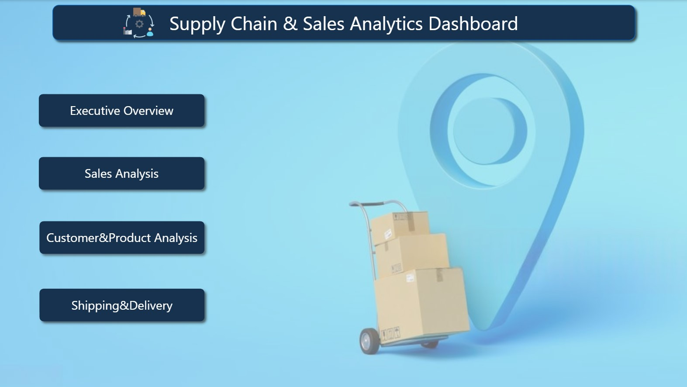
SECTION 05 · POWER BI REPORT
Intro Page
Navigation hub
The landing page of the Supply Chain & Sales Analytics Dashboard.
Executive Overview
Sales Analysis
Customer & Product
Shipping & Delivery

Slide 20
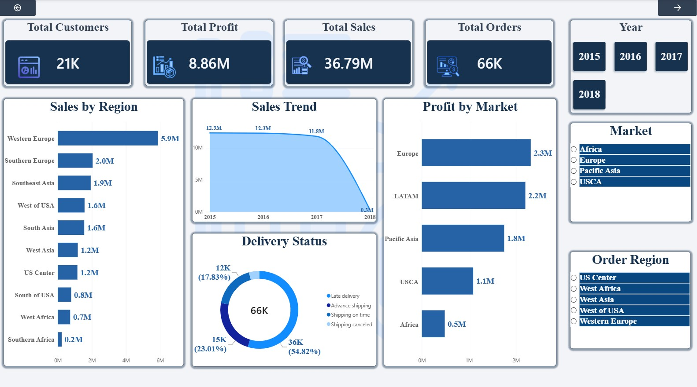
SECTION 06 · DASHBOARDS
Executive Overview
36.79M
8.86M
TOTAL SALES
TOTAL PROFIT
66K
21K
ORDERS
CUSTOMERS
What it shows
Sales by region
Sales trend over the years
Profit by market
Delivery status split
Year, region and market slicers

Slide 21
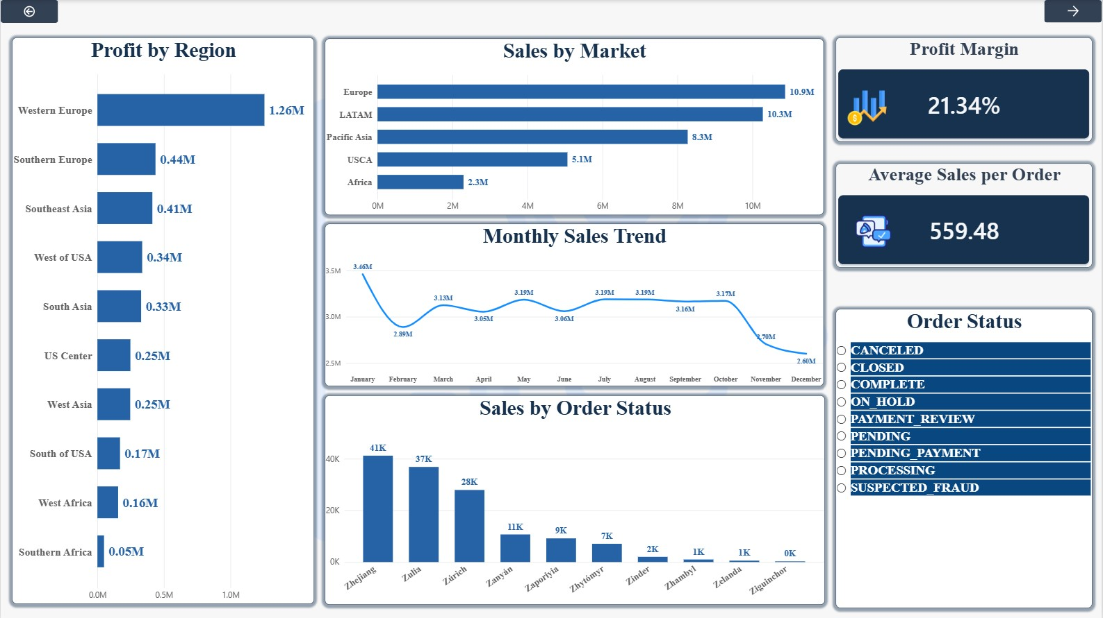
SECTION 06 · DASHBOARDS
Sales Analysis
21.34%
559.48
PROFIT MARGIN
AVG SALES / ORDER
What it shows
Profit by region
Sales by market
Monthly sales trend
Sales by order status
Order status slicer

Slide 22
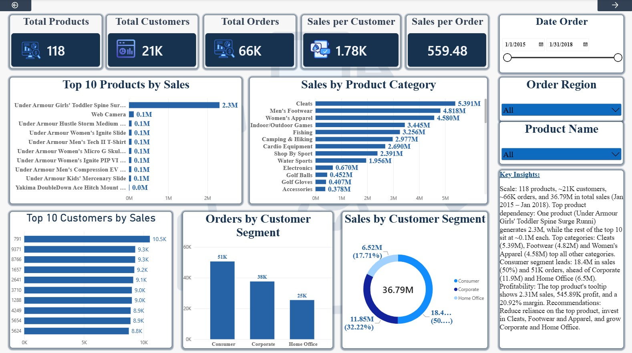
SECTION 06 · DASHBOARDS
Customer & Product
118
21K
PRODUCTS
CUSTOMERS
66K
1.78K
ORDERS
SALES / CUSTOMER
What it shows
Top 10 products by sales
Sales by product category
Top 10 customers by sales
Orders and sales by segment
Key insights text box

Slide 23
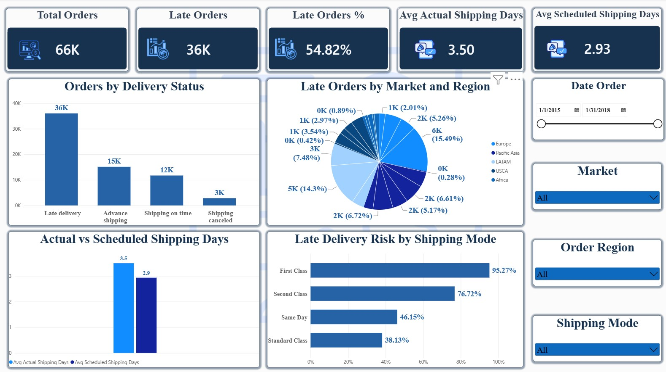
SECTION 06 · DASHBOARDS
Shipping & Delivery
36K
54.82%
LATE ORDERS
LATE ORDERS %
3.50
2.93
ACTUAL DAYS
SCHEDULED DAYS
What it shows
Orders by delivery status
Late orders by market
Actual vs scheduled days
Late risk by shipping mode

Slide 24
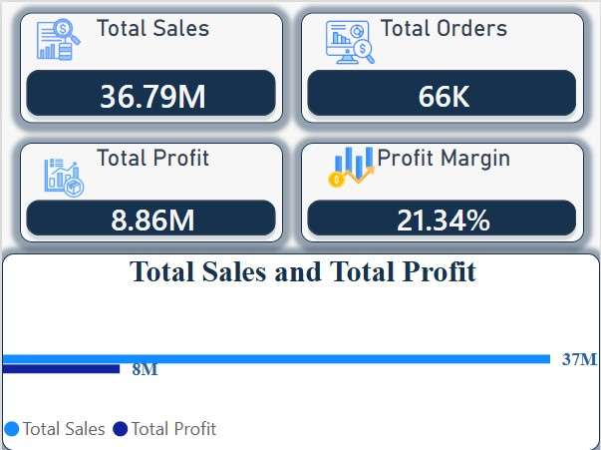
SECTION 06 · DASHBOARDS
Tooltip Page
1
Hover details
Appears when the user hovers over a visual in the report.
2
Four KPI cards
Total Sales 36.79M, Total Orders 66K, Total Profit 8.86M and Profit Margin 21.34%.
3
Bar chart
Compares Total Sales with Total Profit.
The Tooltip page gives a quick sales and profit summary without leaving the dashboard.

Slide 25
SECTION 07 · SUMMARY
Key Takeaways
36.79M
8.86M
21.34%
54.82%
SALES
PROFIT
PROFIT MARGIN
LATE ORDERS
1
Clean, reliable data
2
Strong model
53 → 38 columns, zero nulls, fixed types, text and dates.
SQL star schema feeding Power BI with reusable DAX measures.
3
Profitable sales
4
Delivery is the weak spot
About 21% margin across 66K orders and 21K customers.
Actual shipping takes 3.50 days against 2.93 scheduled, and more than half of orders are late.
Priority: improve delivery performance to protect customer satisfaction and profit.

Slide 26
Thank You
Questions?
Group ITC_ONL5_DAT3_G3 · Digital Egypt Pioneers Initiative

