Slide 1

ICET-PT20 : HUMAN POSE ESTIMATION FOR HYPOTHYROIDISM USING DEEP LEARNING TECHNIQUES
INT 200 Internship
First Review
Team Members
1. Rehalya shree.S (e0221022)
2. Sreevijnya.M (e0221040)
Project Guide
Prof.B.Nirmala

Slide 2
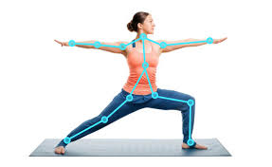
Introduction
Pose estimation is a computer vision task that infers the pose of a person or object in an image or video.
This is typically done by identifying, locating, and tracking a number of key points on a given object or person, for humans, these key points represent major joints like an elbow or knee.
The goal of our machine learning model is to track these key points in images and videos.

Slide 3
Problem statement [1/2]
Hypothyroidism's deficiency of thyroid.
Yoga is one the effective method to reverse hypothyroidism, but incorrect posture during yoga session can be unproductive.
This leads to the necessity of having an instructor to supervise the session but again the problem arises since not all of us have access to an instructor.
So, here our main objective is to solve the above problem by constructing a machine learning model to estimate the yoga poses to reverse hypothyroidism

Slide 4
Problem Statement [2/2]
Yoga poses to reverse hypothyroidism
SARVANGASANA
HALASANA
MATSYASANA
USTRASANA
BHUJANGASANA

Slide 5
Research
S.NO | TITLE | AUTHOR | YEAR | OVERVIEW
1 | Yog.ai: Deep Learning For yoga | Annai Lai, Bhargav Reddy, Bruis Van Vijmen | 2019 | Model : CNN + Open pose Accuracy : 73%
2 | Yoga Pose Detection and Classification Using Deep Learning | Anurag Sinha | 2020 | Model : CNN + Open pose Accuracy : 99.38%
3 | Yoga Pose Classification Using Deep Learning | Shruti Kothari | 2020 | Model : CNN + Open pose Accuracy : 99%

Slide 6
Work Flow
DATA COLLECTION
What data exists?
DATA PREPARATION
Exploratory data analysis(EDA)
TRAIN A MODEL
Choose an algorithm
Where can you get it?
Is it structured?
Data preprocessing
Data splitting
Over fit and regularize
Tune hyper parameters
Continuous process
Collect more
data
ANALYSIS
Evaluation matrix
SERVE MODEL
Put your model in production
RETRAIN MODEL
Are old productions still valid?
Feature importance and Training cost
Revaluate
Worst examples

Slide 7
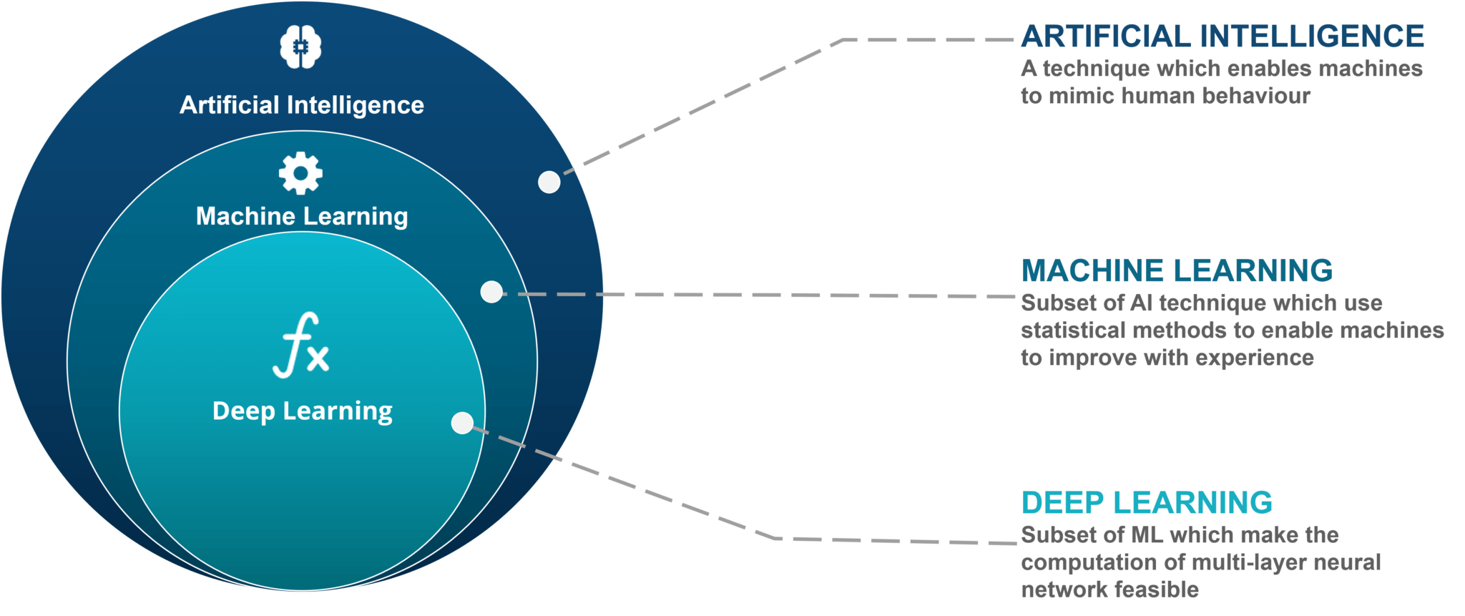
Work done [1/4]
Overview of Artificial Intelligence, Machine learning and deep learning
OpenCV - It is a library of programming functions mainly aimed at real-time computer vision.

Slide 8
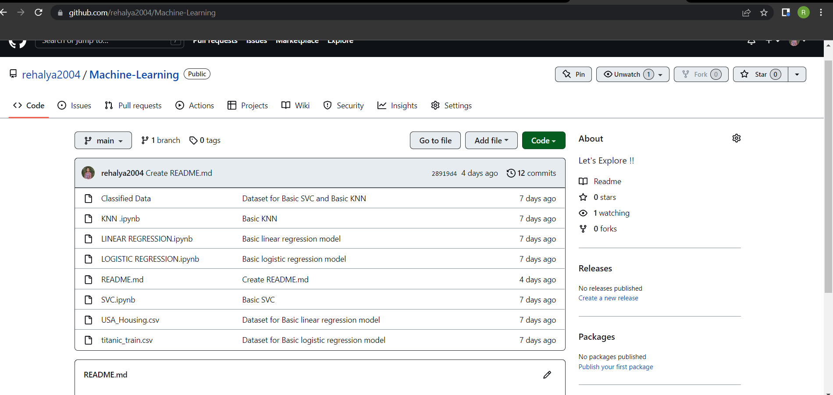
Work done [2/4]
MACHINE LEARNING MODELS
GITHUB LINK - https://github.com/rehalya2004/Machine-Learning

Slide 9
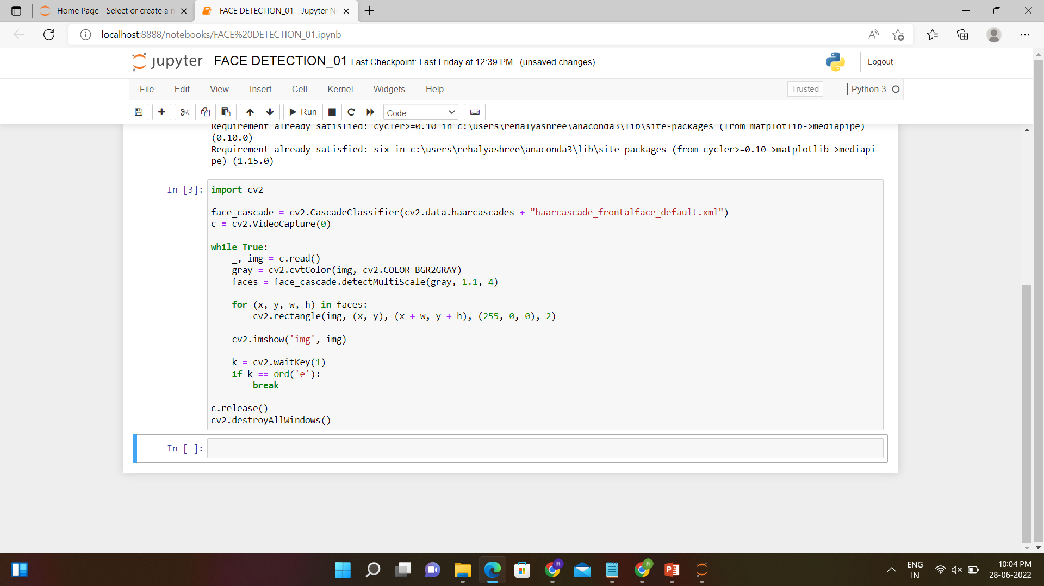
Work done [3/4]
OPENCV - Code on real-time face deduction using webcams
GITHUB LINK - https://github.com/rehalya2004/OpenCV
Code

Slide 10
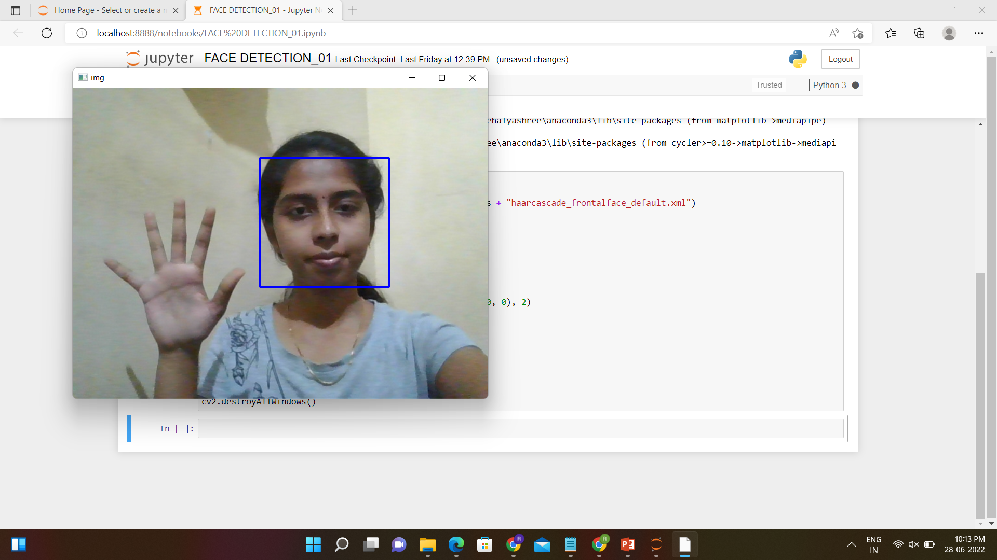
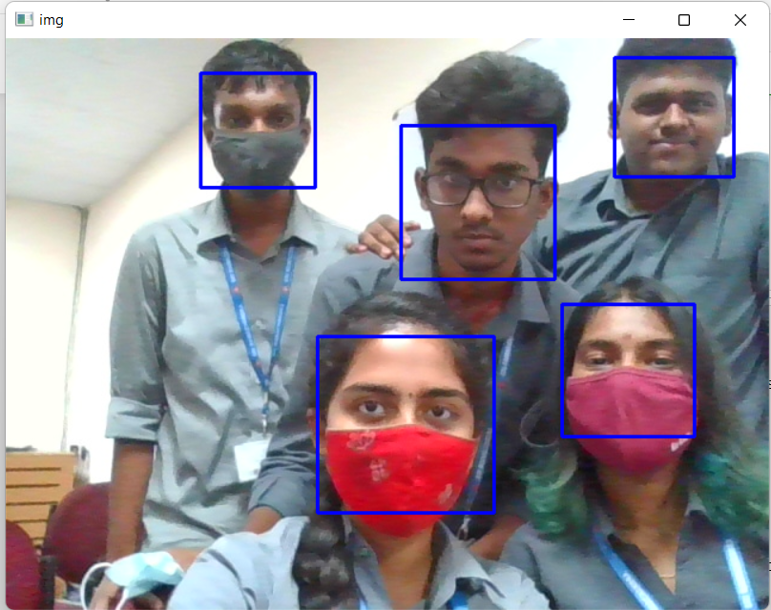
Work done [4/4]
OPENCV - Code on real-time face deduction using webcams
Output

Slide 11
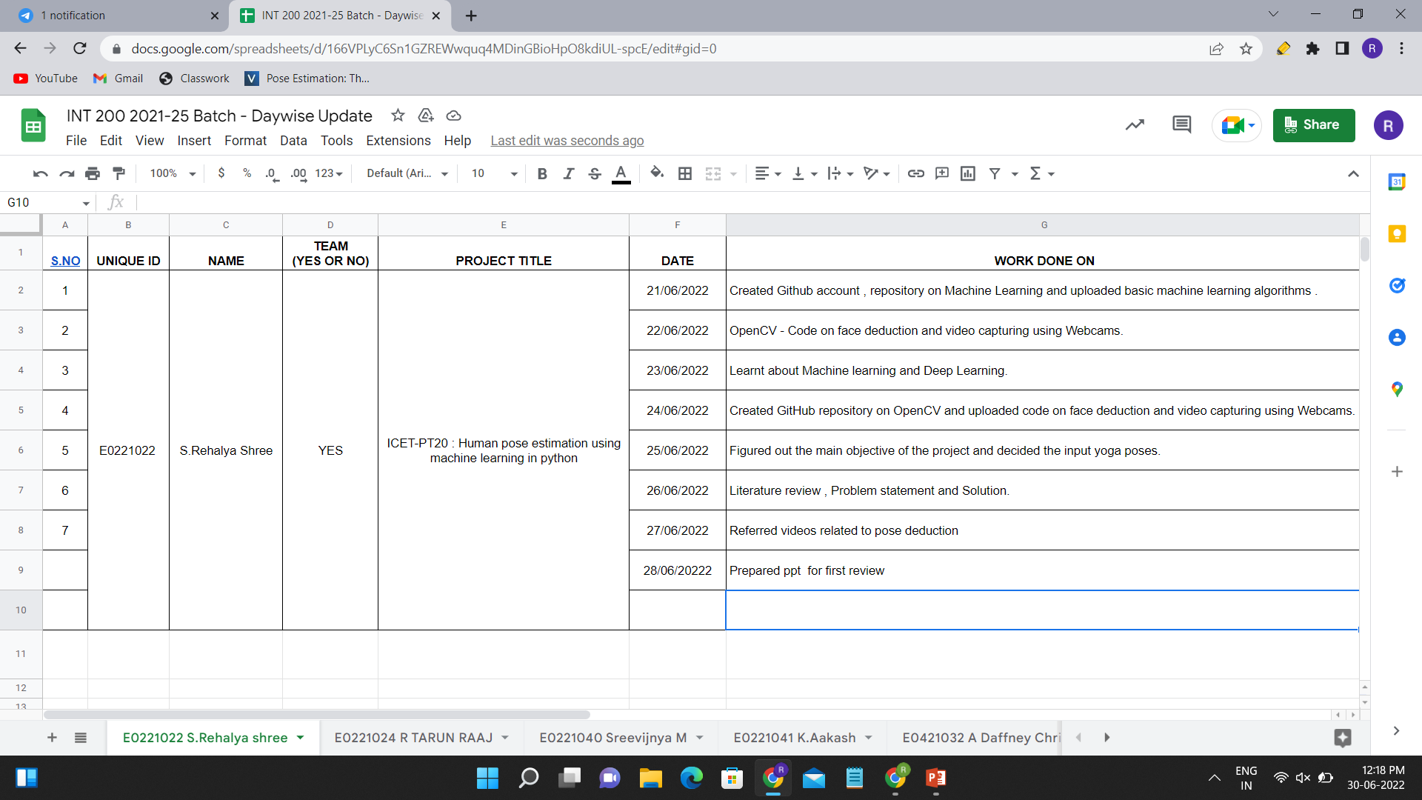
Timeline of the work

Slide 12
References
Papers
http://cs230.stanford.edu/projects_winter_2019/reports/15813480.pdf
https://www.researchgate.net/publication/346397541_YOGA_POSE_DETECTION_AND_CLASSIFICATION_USING_DEEP_LEARNING
https://scholarworks.sjsu.edu/cgi/viewcontent.cgi?article=1932&context=etd_projects
Videos referred
https://youtu.be/-ZrDjwXZGxI
https://youtu.be/7IFhsbfby9s
https://www.youtube.com/watch?v=pG4sUNDOZFg

Slide 13
Thank you

