Slide 1
Sprint 4
Team 8
Team Members: Ivan Magtangob, Harikrishan Singh, Nour Tayem, Harir Al-Rubaye, Ivan Magtangob
Team Lead: Thulasi Jothiravi

Slide 2
Summary of accomplishments
For sprint 4:
Refactoring sprint 3 codebase
Selected new game for implementation → Hangman CS Edition!
With 3 different levels of difficulty!
Implemented frontend, backend and unit testing for Hangman game
Adding and displaying new assets
Designed and conducted user test script
Fixing PHP/CSS Linting issues
Documentation (Game description/instructions, README, Project Wiki)
Notes:
30 to 60 seconds

Slide 3
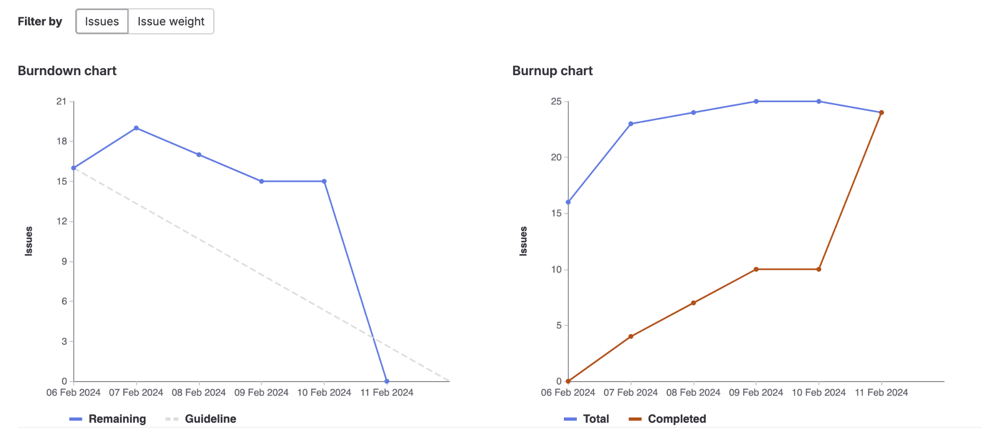
Sprint 4 burndown chart

Slide 4
Thulasi - Weights Completed: 16
Sprint Planning
Support with frontend (UI) + backend (Game Logic) for new Hangman game
Front end unit testing + User testing

Slide 5
Harir - Weights Completed: 15
Worked on fixing bugs and updating UI/Frontend for I - Spot
Created the game page for hangman
Generated pool of CS-related words and/or phrases and stored in a json file.
User Testing and Feedback

Slide 6
Ivan - Weights Completed: 12
Worked on hangman backend with Rehan
Added hangman game navigation
Fixed screen resolution bugs with Rehan

Slide 7
Rehan - Weights Completed: 12
🪢Worked on hangman backend + appropriate UI/Navigation with Ivan
📝User Testing
☁️Added linting to Docker
👾Fixing screen resolution bugs

Slide 8
Nour - Weights Completed: 14
Worked on the frontend on making the game page with Harir
Conducted User Testing and Gathered Feedback
Helped with the branch clean up

Slide 9
Harikrishan - Weights Completed: 16
Hangman - Displaying assets on screen and positioning them.
Update Game documentation (Rules + Description).
Waldo game fixes - score becomes negative webpage resolution compatibility.

Slide 10
Reflection – what didn’t go well
Resolving lingering bugs earlier in the sprint cycle
Dependent tasks delayed us a lot
ex: Backend work depended on rough Frontend to be completed sooner

Slide 11
Reflection – what did go well
Asking for help, support from each other
Pair programming when necessary
We added a complete Hangman game with 3 levels
Breaking down the task into tickets
Smoother branch merging throughout the week
Less merge conflicts

Slide 12
Reflection – changes for next sprint?
Regular check-ins
Setting internal deadlines, placing priority over dependent tasks
Hint button for the games
Possibly a new game??
For future sprints → Polishing the overall layout
Further enhancements based on User Testing Results
Integrating SQL

Slide 13
Demo Time!
Notes:
We should be about 5 minutes into the meeting at this point.
Team lead ends presentation, changes to presenting the demo.
Demo working new features, UI, gitlab documentation, working scripts, running tests, etc.
In the browser, gitlab.socs.uoguelph.ca, etc. With user stories for features and UI. Try to be familiar with developer tools in your chosen browser, especially in later sprints.
After demo we can start looking at code, designs, etc. Everyone should be prepared to screen share and discuss their work. We won’t have time to discuss everyone’s work in depth each week.

