Slide 1
Sprint 1
Team 8
Team Members: Ivan Magtangob, Harikrishan Singh, Harir Al-Rubaye, Nour Tayem, Thulasi Jothiravi
Team Lead: Rehan Nagoor Mohideen

Slide 2
Summary of accomplishments
For sprint 1:
Local dev was setup using Docker (currently only php and nginx)
Website’s home and about us pages are completed, linked and on the VM
All the member completed their about me sections and included it to the about us page
CI/CD is setup
Notes:
30 to 60 seconds

Slide 3
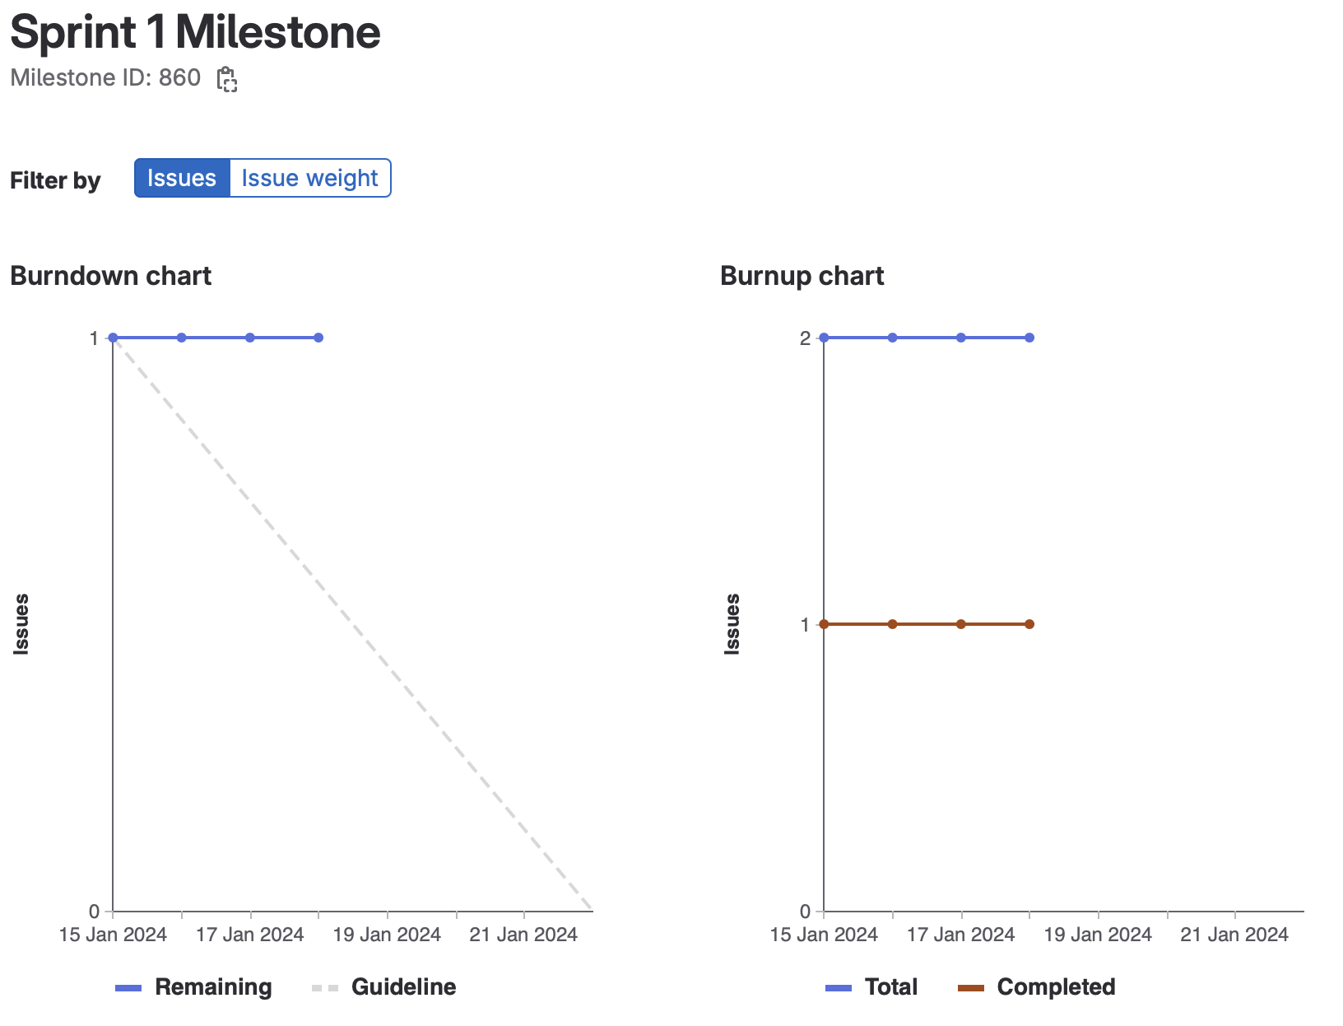
Sprint 1 burndown chart

Slide 4
Nour- Weights Completed: 12
Completed About Me Section
Did a research for CI/CD
Setting up the CI/CD Pipeline

Slide 5
Rehan - Weights Completed: 16?
Research + setting up local development using Docker with Ivan
Merged/consolidated code regarding the About Us page with Ivan
Created folder structure, linked and cleaned up pages
Completed About Me snippet
Managed tickets and tasks

Slide 6
Harikrishan - Weights Completed: 14
Created About Us page for our project.
Updated styling for the profile cards and incorporated social media links.
Completed About Me snippet.
Contributed to group meetings and standups.

Slide 7
Ivan - Weights Completed: 16
Research + setting up local development using Docker with Rehan
Assisting rest of the team with Docker setup
Merged/consolidated code regarding the About Us page with Rehan
Created folder structure, linked and cleaned up pages
Completed About Me snippet

Slide 8
Harir- Weights Completed: 14
Developed and design the landing page
Adding the navigation bar/linking the pages
Worked on writing the read me
About me snippet
Worked on cleaning the about us page

Slide 9
Thulasi- Weights Completed: 13
Research on CI/CD pipeline setup and usage in GitLab
Setting up the CI/CD Pipeline for our project (Build, Test, Deploy)
CI/CD: Automating HTML File Transfer to Production Server
Creating and updating to the Project Wiki
About me section

Slide 10
Reflection – what didn’t go well
Getting started was a bit slow and to understand how to get going.
Weight allocation could be done better
Docker

Slide 11
Reflection – what did go well
Once we got moving, everything came into place
People collaborating and helping each other
It was generally made clear what everyone’s responsibilities were
Enthusiasm to do more

Slide 12
Reflection – changes for next sprint?
More Meetings to help organize and plan
Try to get the important tasks or the a highly dependant task started and finished earlier

Slide 13
Demo Time!
Notes:
We should be about 5 minutes into the meeting at this point.
Team lead ends presentation, changes to presenting the demo.
Demo working new features, UI, gitlab documentation, working scripts, running tests, etc.
In the browser, gitlab.socs.uoguelph.ca, etc. With user stories for features and UI. Try to be familiar with developer tools in your chosen browser, especially in later sprints.
After demo we can start looking at code, designs, etc. Everyone should be prepared to screen share and discuss their work. We won’t have time to discuss everyone’s work in depth each week.

