Slide 1
Sprint 6
Team 8
Team Members: Ivan Magtangob, Harikrishan Singh, Nour Tayem, Harir Al-Rubaye, Ivan Magtangob
Team Lead: Nour Tayem

Slide 2
Summary of accomplishments
For sprint 6:
○ Added 3 hidden word puzzles/clues + word submission
"Invisible Ink" word puzzle
Binary puzzle
ASCII puzzle
○ Added a Secret Page
○ Created a Hint Button for Hangman and I-Spot games
○ Made changes based on Sprint 4 User Testing
Made Webpage Logo Clickable → Redirect to Home Page
○ Documentation (README, Project Wiki, Home Page, Instruction Page )

Slide 3
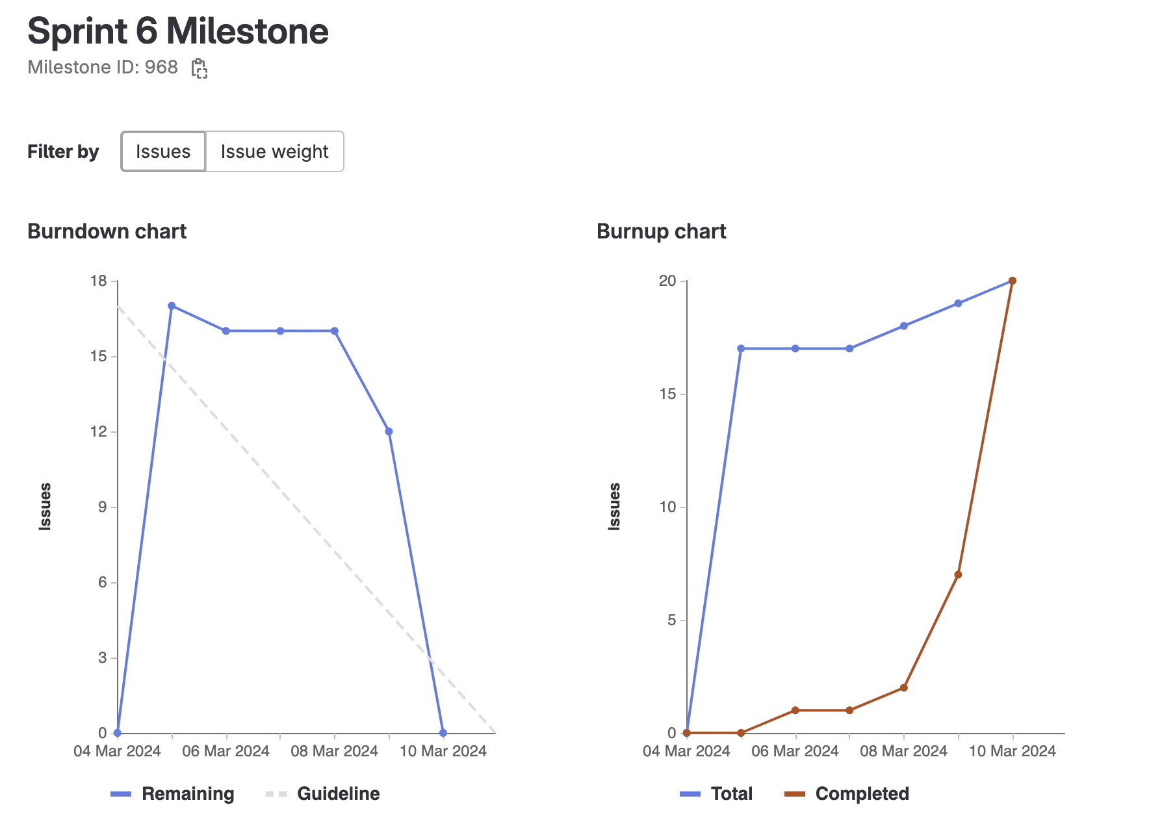
Sprint 6 burndown chart

Slide 4
Thulasi - Weights Completed: 14
Main contributions:
Cryptogram Puzzle Development
Implemented Backend logic using JavaScript
Updated Frontend styling with CSS
Integrated mystery into Cryptogram
Documentation
Wrote a simple and clear JavaScript Linting Guide (View Project Wiki)

Slide 5
Harir - Weights Completed: 12
Created the following:
Cryptogram game frontend
The cryptogram completion Page (with nour)
Authentication Page (with ivan)

Slide 6
Ivan - Weights Completed: 12
Created authentication page with Harir
Added hidden word hints with Rehan
Hidden word script + folder consolidation/restructuring

Slide 7
Rehan - Weights Completed: 16
Created Stories and updated them on the website with Harikrishan
Created authentication cookies and enabled new website functionailty
Added hidden word hints with Ivan

Slide 8
Nour - Weights Completed: 12
Worked on the cryptogram backend implementation with Thulasi
Worked on the implementation of the game completion UI with Harir
Updated the README & Wiki

Slide 9
Harikrishan - Weights Completed: 16
Main contributions:
Sprint planning.
Collaborated with Rehaan on Story generation with team 7 and 9.
Updated the hidden puzzle to have the sprint6 story tied together.
Added changes to website to provide clues to find the hidden words.

Slide 10
Reflection – what didn’t go well
Started a bit late working on the tasks
Lack of clarity of the sprint (needed more clarification on certain ideas)

Slide 11
Reflection – what did go well
● Asking for help, support from each other
○ Pair programming when necessary
● Breaking down the task into tickets
● Smoother branch merging throughout the week

Slide 12

Demo Time!

