Slide 1
Sprint 2
Team 8
Team Members: Ivan Magtangob, Harikrishan Singh, Harir Al-Rubaye, Nour Tayem, Thulasi Jothiravi
Team Lead: Ivan Magtangob

Slide 2
Summary of accomplishments
For sprint 2:
First level of Where’s Waldo game functioning
CI/CD deployment, linting, and tests set up
Notes:
30 to 60 seconds

Slide 3
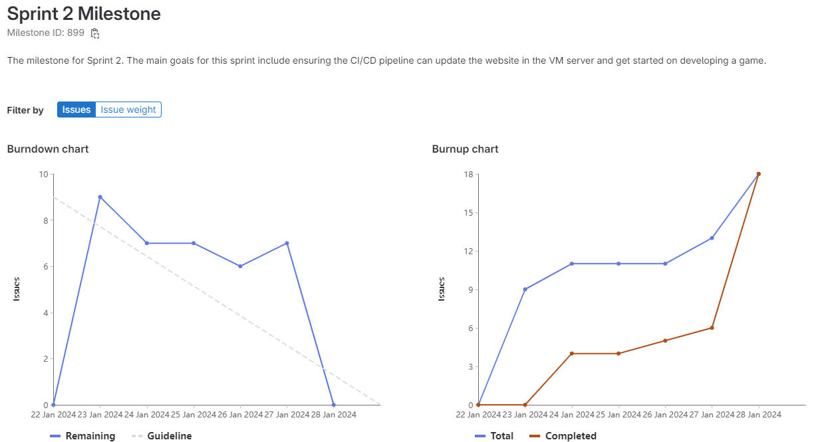
Sprint 2 burndown chart

Slide 4
Ivan - Weights Completed: 22
Completed CI/CD PHP linting
Setup CI/CD deployment with Rehan & Thulasi
Merge, fix, and polish code with Rehan

Slide 5
Rehan - Weights Completed: 21
Setup CI/CD deployment with Thulasi & Ivan
Created functionality for game logic (finding Waldo) with Thulasi & Nour
Merge, fix, and polish code with Ivan

Slide 6
Nour - Weights Completed: 14
Refactored code base for nav bar and styling
Updated the nav bar & linked website pages
Improved the UI/design of the nav bar
Helped with the branch clean up

Slide 7
Harikrishan - Weights Completed: 12
Created and update the game page.
Created instruction page and linked pages together.
Worked on the read me.

Slide 8
Harir - Weights Completed: 14
Worked on the frontend/UI of the Website.
Created the game Page
Updated Landing page with game card.

Slide 9
Thulasi - Weights Completed: 14
Game logic 1: Setting up clickable Waldo asset
Game logic 2: Setting up scorekeeping capabilities
Frontend/UI: Formatting the asset and scoreboard using CSS

Slide 10
Reflection – what didn’t go well
General consistency with everyone's design
Code clean up and polish

Slide 11
Reflection – what did go well
We completed a game
Pipeline deploys fully automatically once merged to main

Slide 12
Reflection – changes for next sprint?
Better ticket planning + assignment
Better communication
Review merge requests earlier

Slide 13
Demo Time!
Notes:
We should be about 5 minutes into the meeting at this point.
Team lead ends presentation, changes to presenting the demo.
Demo working new features, UI, gitlab documentation, working scripts, running tests, etc.
In the browser, gitlab.socs.uoguelph.ca, etc. With user stories for features and UI. Try to be familiar with developer tools in your chosen browser, especially in later sprints.
After demo we can start looking at code, designs, etc. Everyone should be prepared to screen share and discuss their work. We won’t have time to discuss everyone’s work in depth each week.

