Slide 1
Sprint 3
Team 8
Team Members: Ivan Magtangob, Harikrishan Singh, Nour Tayem, Thulasi Jothiravi, Ivan Magtangob
Team Lead: Harir Al-Rubaye

Slide 2
Summary of accomplishments
For sprint 3:
Added custom visuals to avoid copyright issues
Expanded game features with new levels
Improved code quality through unit tests and linting fixes
Prioritized user experience with UI updates and fullscreen option
Notes:
30 to 60 seconds

Slide 3
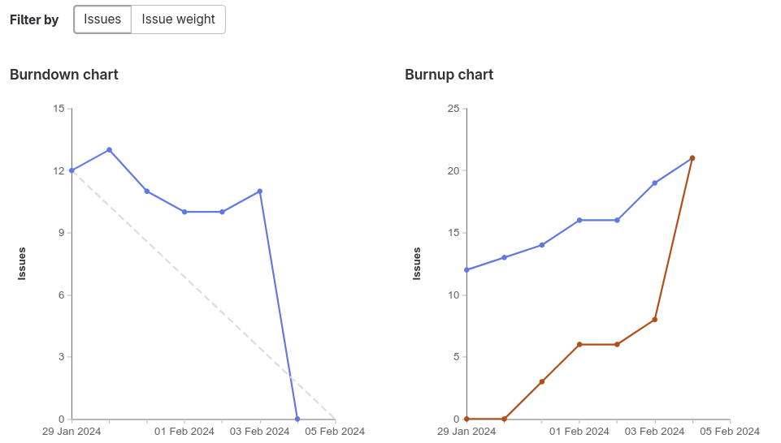
Sprint 3 burndown chart

Slide 4
Harir - Weights Completed: 13
Added new levels to the game with Rehan
Optimized the about us game
Updated the website documentation

Slide 5
Ivan - Weights Completed: 17
Configured + fixed PHP linting
Fixed inconsistent CSS with Rehan
Added navigation to other I-Spot levels

Slide 6
Rehan - Weights Completed: 16
Add new I-Spy levels with Harir
added stage navigation and made navbar consistent with Ivan
cleaned css files and final day linting

Slide 7
Nour - Weights Completed: 13
Added Waldo Fullscreen Option on our Website
Changed Waldo Images for our Website
Helped with the branch clean up

Slide 8
Harikrishan - Weights Completed: 15
Worked on setting up unit test using jest.
Updated the game over screen and updated the css .
Parallel programming with nour for full screen option.

Slide 9
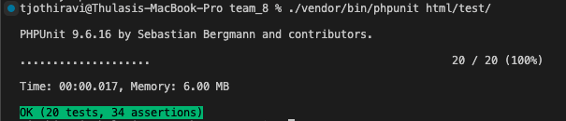
Thulasi - Weights Completed: 15
Frontend Unit Testing Research (Frameworks? Types of testing?)
Created 20 frontend unit tests (PHPUnit) + 34 unique assertions.
Integration Testing – Are the PHP scripts correctly integrated with external resources (ex: CSS files, components and snippets for each team member)?
Functional Testing – to verify that all components render as expected.
Updated CI/CD Pipeline to run front end tests

Slide 10
Reflection – what didn’t go well
Dependent tasks delays
Copyright :(

Slide 11
Reflection – what did go well
Early merge requests reviews
Effective ticket planning and assignments
Improved communication

Slide 12
Reflection – changes for next sprint?
Regular check-ins
Setting internal deadlines

Slide 13
Demo Time!
Notes:
We should be about 5 minutes into the meeting at this point.
Team lead ends presentation, changes to presenting the demo.
Demo working new features, UI, gitlab documentation, working scripts, running tests, etc.
In the browser, gitlab.socs.uoguelph.ca, etc. With user stories for features and UI. Try to be familiar with developer tools in your chosen browser, especially in later sprints.
After demo we can start looking at code, designs, etc. Everyone should be prepared to screen share and discuss their work. We won’t have time to discuss everyone’s work in depth each week.

