Slide 1
IBM University Engagement Project Submission
“Exploring the Power of Agentic AI with IBM Granite and IBM Bob”

Slide 2

Project Tile – AI Agent for Electricity Bill Fraud Detection
Domain of Project – Artificial Intelligence (AI)
Student Name | Recent Passport Photo | Email ID | Mobile number [WhatsApp]
K REHAN MAQSOOD |  | rehan8maqsood@gmail.com | 7736526371

Slide 3
Problem Statement -
Problem Statement - AI Agent for Electricity Bill Fraud Detection
The Challenge
Electricity fraud and billing anomalies lead to major financial losses for power distribution
companies. With thousands of consumers and massive billing data, detecting suspicious
consumption patterns manually is extremely difficult. Utilities need an intelligent AI system
that can automatically analyze electricity usage data and identify potential fraud cases.
The Objective
Build an AI Agent for Electricity Bill Fraud Detection that analyzes electricity
consumption and billing records to detect abnormal patterns and flag potential fraud cases.
The solution should:
1. Electricity Consumption Analysis – Analyze consumer electricity usage data to
understand normal consumption behavior and trends.
2. Fraud Pattern Identification – Detect suspicious activities such as sudden drops in
usage, unusual spikes, or inconsistencies between meter readings and billed units.
3. AI-Based Anomaly Detection – Automatically identify consumers whose usage patterns
significantly deviate from normal historical behavior.
4. Explainable AI Insights – Provide clear explanations for why a particular consumer or
electricity bill is flagged as suspicious.

Slide 4
Proposed Solution -
Proposed Solution
We propose to develop an AI-powered Electricity Bill Fraud Detection Agent that automatically analyzes consumer electricity consumption and billing data to identify abnormal and potentially fraudulent patterns.
The system will combine data analysis, anomaly detection, and AI-generated explanations to help electricity providers identify suspicious bills and consumers.
Proposed Solution Components
Consumer Data Collection
  Collect consumer ID, meter readings, previous consumption, current consumption, billing units, bill amount, and billing dates.
  Store historical records for comparison.
Electricity Consumption Analysis
  Analyze each consumer's historical electricity usage.
  Calculate normal/average consumption patterns.
  Compare current consumption with previous billing periods.
AI-Based Anomaly Detection
  Detect unusual changes such as:
    Sudden drop in electricity consumption
    Unusual increase in consumption
    Repeated abnormal readings
    Zero/very-low consumption despite previous high usage
    Large differences between meter readings and billed units
Fraud Risk Scoring
  Assign a risk score to each consumer based on detected anomalies.
  Categorize cases as:
    Normal
    Suspicious
    High Risk
Explainable AI
  Instead of simply saying “Fraud detected,” the system explains why the bill was flagged.
  Example:
  “Consumer C102 is flagged as suspicious because electricity consumption decreased by 72% compared with the previous 6-month average.”
AI Agent
  The AI agent reviews the detected anomalies and generates a human-readable investigation summary.
  It can answer questions such as:
    “Why was this consumer flagged?”
    “What changed in their consumption?”
    “Which bills require investigation?”
    “How many suspicious cases were detected?”
Interactive Dashboard
  Display:
    Total consumers analyzed
    Normal bills
    Suspicious cases
    High-risk cases
    Consumption trends
    Fraud/anomaly alerts
    Consumer-level investigation details

Slide 5
Technology Used
IBM Bob Platform – For designing and orchestrating the AI Agent workflow, including electricity consumption analysis, anomaly identification, and generation of fraud-detection insights.
React.js – For developing the interactive frontend dashboard to display electricity consumption data, suspicious cases, risk information, alerts, and AI-generated explanations.
Groq API – Used to connect the application with an AI/LLM model for analyzing detected anomalies and generating natural-language explanations and insights.
Node.js – Used as the backend runtime environment for handling server-side operations and connecting the frontend with the AI services.
Express.js – Used to build the backend REST APIs for receiving electricity billing data, processing requests, communicating with the AI service, and sending results back to the React frontend.

Slide 6
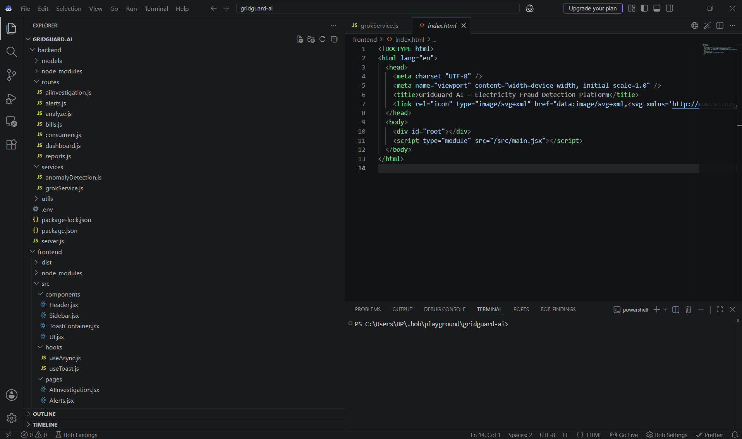
Required Files created using IBM bob -
1.Backend
server.js – Main backend server
.env – Stores API/environment configuration
package.json – Backend dependencies and scripts
routes/
  aiInvestigation.js
  alerts.js
  analyze.js
  bills.js
  consumers.js
  dashboard.js
  reports.js
services/
  anomalyDetection.js – Detects abnormal electricity consumption patterns
  grokService.js – Connects with Groq AI for AI-based analysis
models/ – Database/data models
utils/ – Utility/helper functions
2. Frontend
index.html – Main HTML entry point
src/main.jsx – React application entry point
src/components/
  Header.jsx
  Sidebar.jsx
  ToastContainer.jsx
  UI.jsx
src/hooks/
  useAsync.js
  useToast.js
src/pages/
  AIInvestigation.jsx
  Alerts.jsx
  Additional dashboard, billing, consumer and report pages

Slide 7
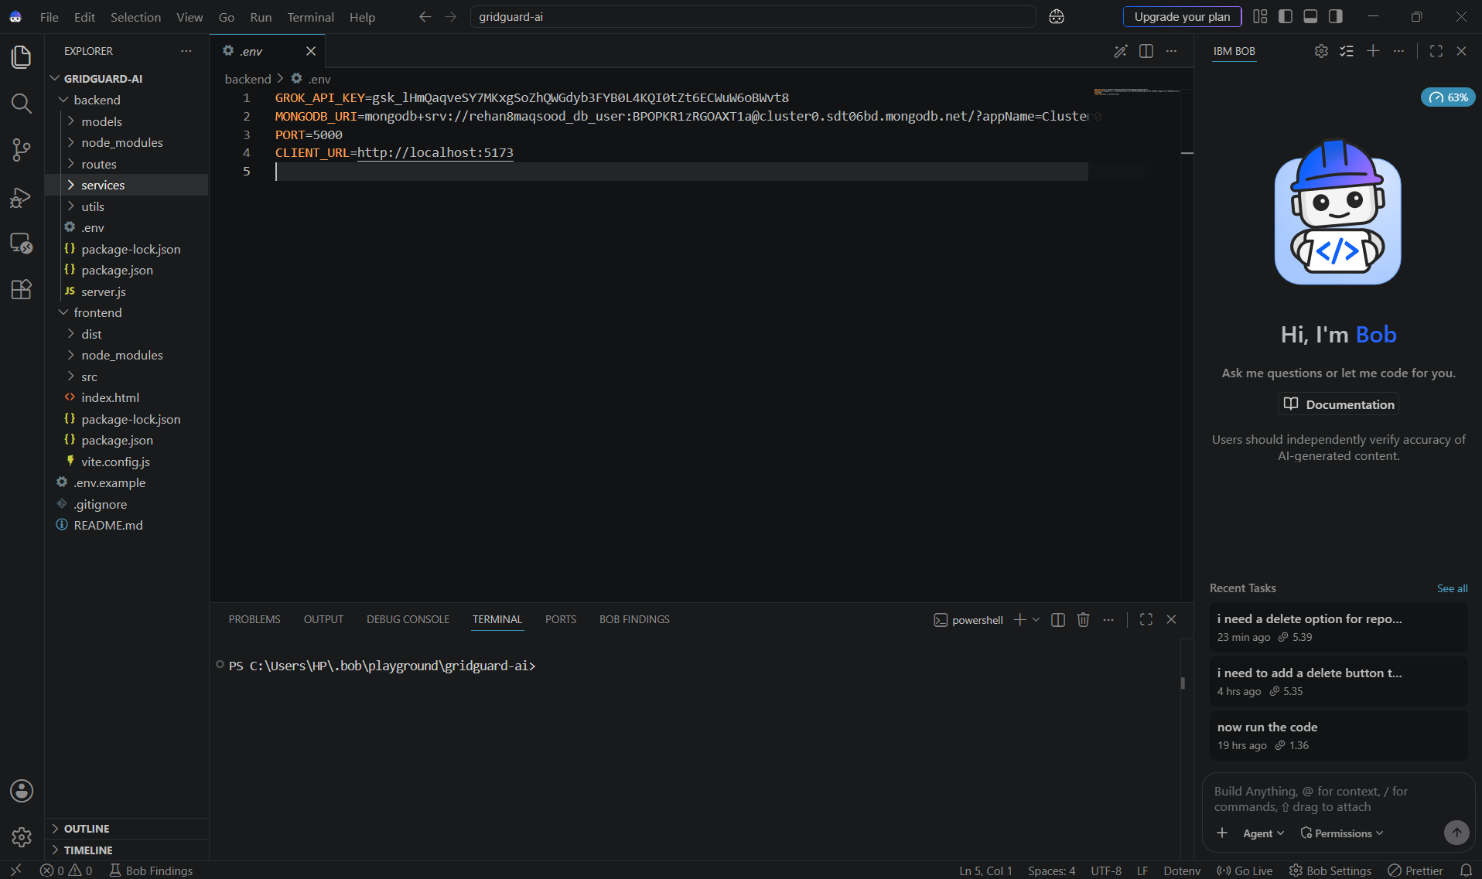
IBM Bob Screenshots:

Slide 8
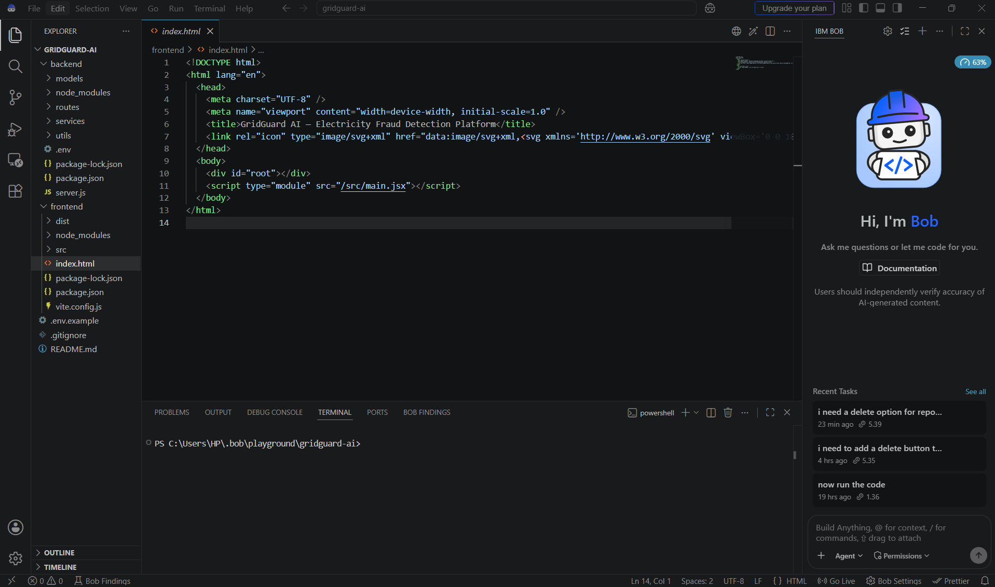

Slide 9

Role of Agentic AI in the solution
Role of Agentic AI in the Solution – Electricity Bill Fraud Detection Agent
Agentic AI enables the Electricity Bill Fraud Detection system to function as an intelligent, goal-driven system rather than a simple data-analysis application. Using IBM Bob to design and orchestrate the agent workflow and the Groq API for AI-powered reasoning, the system can analyze electricity billing information and generate meaningful fraud-detection insights.
The AI agent performs different tasks such as analyzing electricity consumption, identifying abnormal patterns, evaluating suspicious bills, generating risk assessments, and explaining why a particular case was flagged. These tasks work together to provide a complete investigation workflow.
Agentic AI provides context awareness by considering a consumer's historical electricity usage, previous bills, meter readings, and current consumption when analyzing a case. This allows the system to identify significant deviations rather than relying only on a single bill.
It also supports dynamic decision-making by analyzing detected anomalies and generating appropriate explanations. For example, when a consumer's consumption suddenly decreases significantly compared with their historical pattern, the agent can flag the case and explain the reason for the alert.
The agent can also coordinate different backend functions, such as anomaly detection, bill analysis, alert generation, and AI investigation, through the Node.js and Express.js backend.
Overall, Agentic AI makes the system proactive, context-aware, and investigation-oriented, helping electricity providers identify potential billing fraud and understand the reasons behind suspicious cases more efficiently.

Slide 10
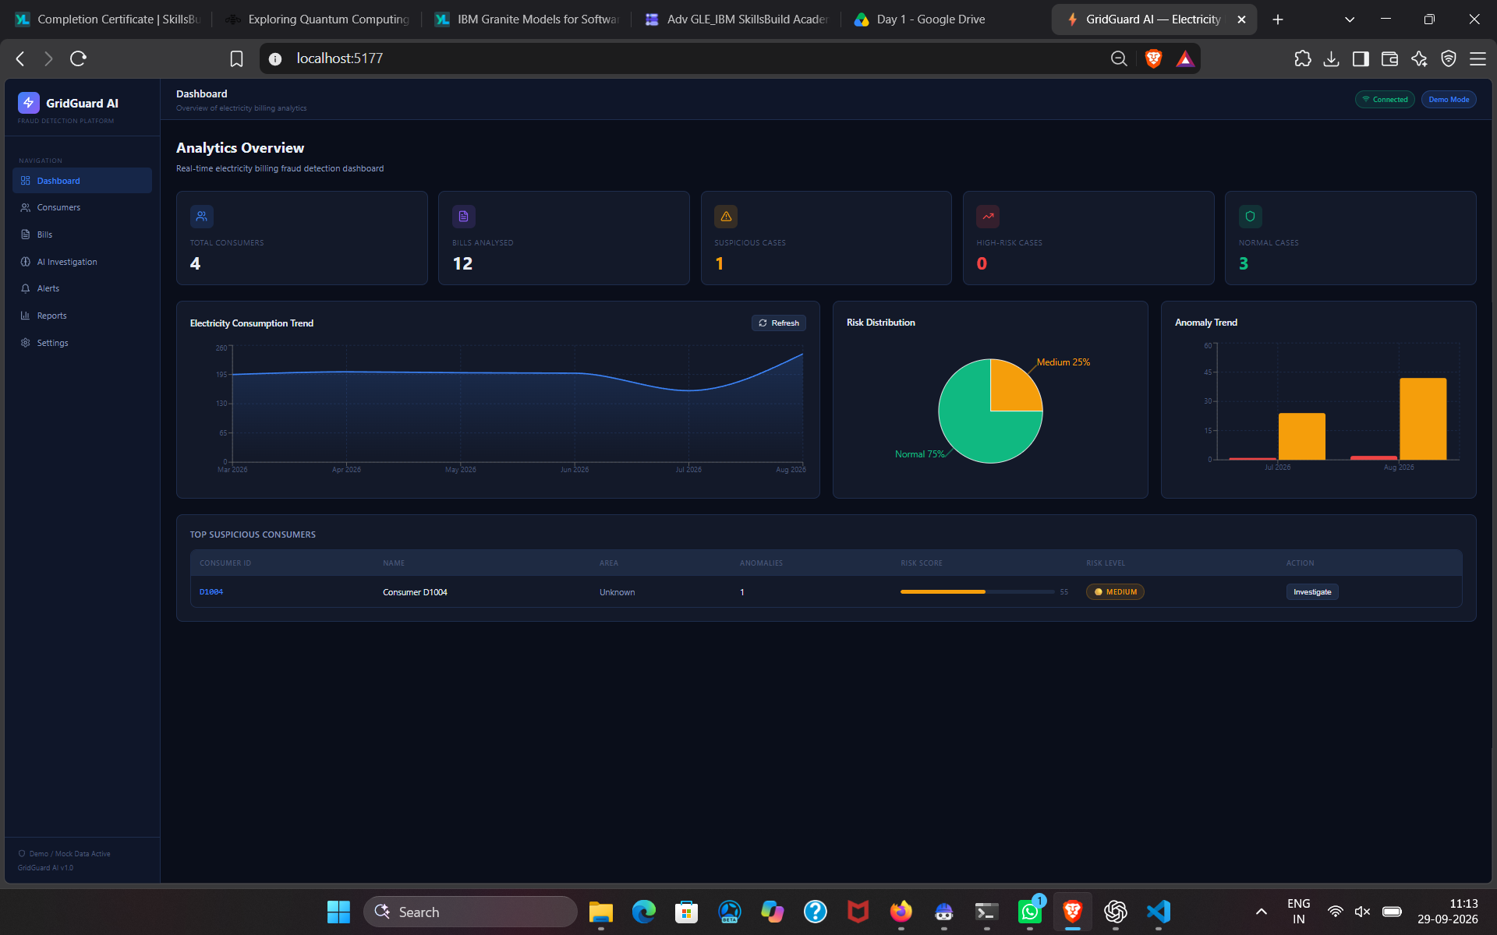
Project Output Screenshot
·
·
·

Slide 11
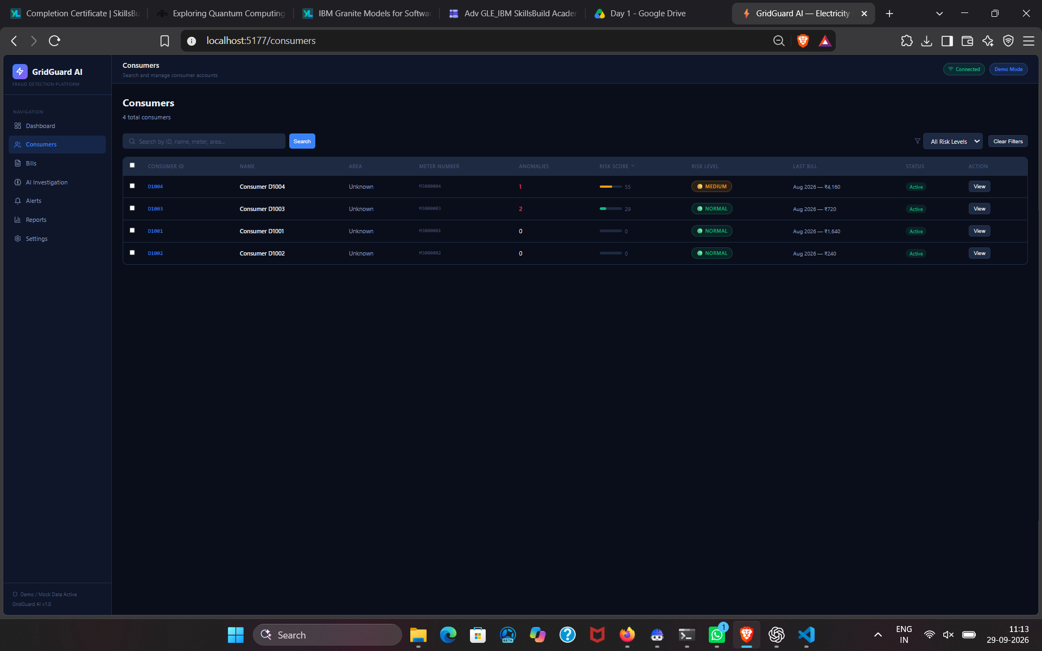
Project Output Screenshot
·
·
·

Slide 12
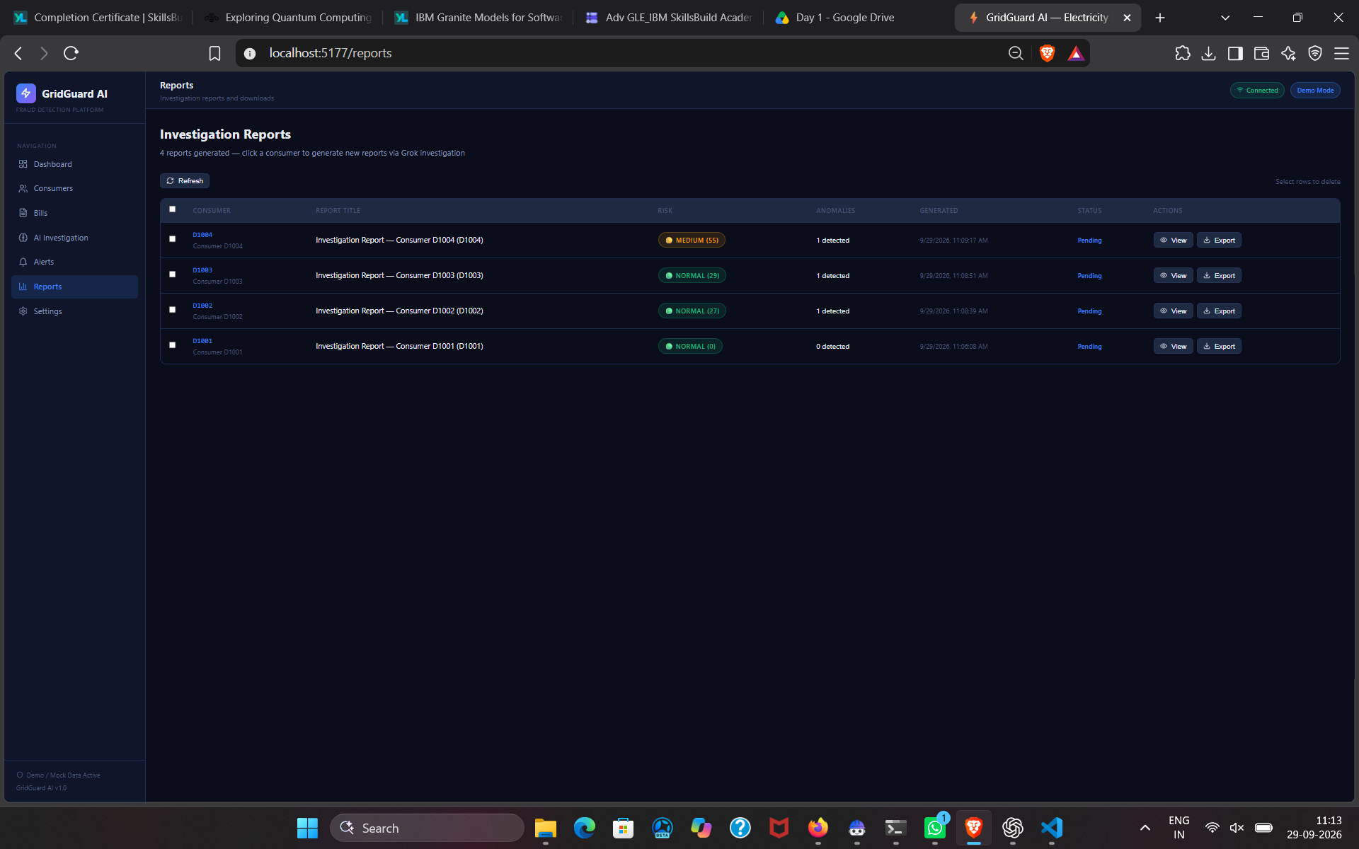
Project Output Screenshot
·
·
·

Slide 13
Novelty and Uniqueness
The proposed AI Agent for Electricity Bill Fraud Detection stands out by combining Agentic AI, anomaly detection, AI-powered investigation, and explainable insights into a single intelligent system.
Agentic AI-Based Fraud Investigation – Instead of simply displaying abnormal bills, the AI agent can coordinate different tasks such as consumption analysis, anomaly detection, bill verification, and investigation insights.
Consumption Pattern Analysis – The system analyzes a consumer's historical electricity usage to identify unusual changes, including sudden drops, unexpected spikes, and abnormal consumption trends.
AI-Based Anomaly Detection – Automatically identifies electricity bills or consumers whose consumption significantly deviates from their historical patterns.
Explainable Fraud Insights – Rather than simply marking a bill as “suspicious,” the system explains why it was flagged, making the results easier for electricity officials to understand and investigate.
AI-Powered Investigation – The Groq API can be used to analyze detected anomalies and generate a natural-language investigation summary for each suspicious case.
Interactive Fraud Detection Dashboard – The React.js interface provides a centralized view of consumers, bills, alerts, anomalies, and investigation results.
Automated Alert Generation – Suspicious cases can be automatically identified and presented as alerts, allowing investigators to focus on cases requiring further attention.
Human-in-the-Loop Investigation – The system supports human investigators by providing evidence and explanations rather than automatically declaring a consumer guilty of fraud.
Scalable Backend Architecture – Node.js and Express.js provide REST APIs that connect the React frontend, fraud-detection logic, and AI services.

Slide 14
Git Hub Link
Please test and Paste the working Github URL –
rehan8maqsood-wq/IBM
·
·
·

Slide 15
Future Scope
The AI Agent for Electricity Bill Fraud Detection can be further enhanced to provide more advanced, automated, and reliable fraud-detection capabilities.
1. Real-Time Smart Meter Integration – Connect the system with smart meters to continuously receive electricity consumption data and detect suspicious patterns in real time.
2. Advanced Machine Learning Models – Implement models such as Random Forest, Isolation Forest, XGBoost, or deep-learning techniques to improve anomaly detection using larger historical datasets.
3. Predictive Fraud Detection – Move beyond detecting existing anomalies and predict consumers who may develop suspicious consumption patterns in the future.
4. Multi-Agent Investigation System – Introduce specialized AI agents for consumption analysis, billing verification, meter analysis, fraud investigation, and report generation, allowing them to collaborate on complex cases.
5. Automated Investigation Reports – Generate detailed reports containing the consumer's consumption history, detected anomalies, risk indicators, and AI-generated explanations.
6. Real-Time Alerts and Notifications – Send alerts to authorized electricity officials through email, SMS, or a mobile application when high-risk anomalies are detected.
7. Geographical Fraud Analysis – Add location-based analysis to identify geographical areas with unusually high concentrations of suspicious cases.
8. Meter Tampering Detection – Integrate smart-meter and IoT sensor data to identify possible physical meter tampering or unauthorized connections.
9. Continuous Learning – Allow the system to learn from investigator feedback, such as whether a flagged case was confirmed as fraud or determined to be a legitimate anomaly.
10. Improved Explainable AI – Provide more detailed explanations and visual evidence showing exactly how the system reached an anomaly or risk assessment.
·
·
·

Slide 16
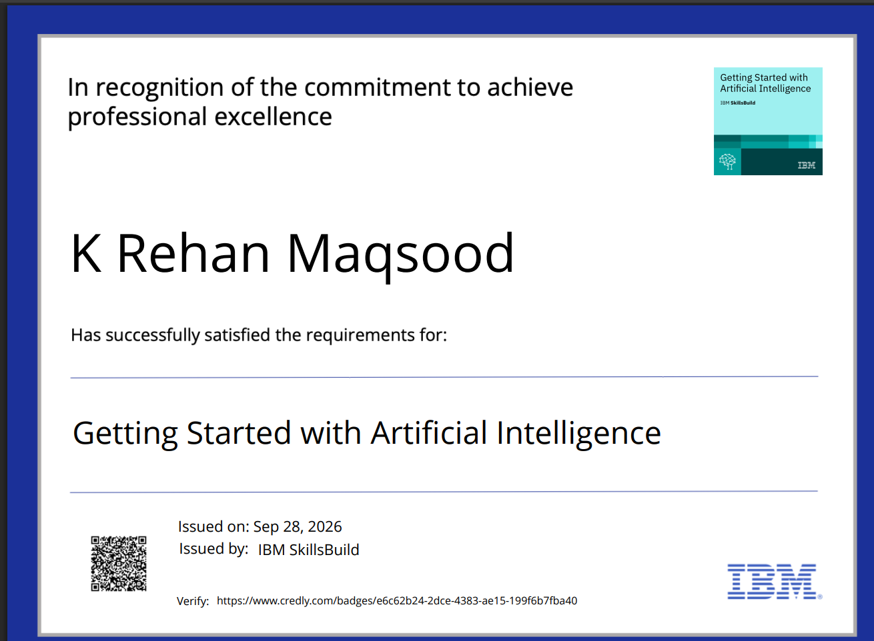
Certificates Earned:

Slide 17

Certificates Earned:​

Slide 18


