Slide 1

Node
Rehana

Slide 2
Agenda
Introduction
Setup
Modules
Builtin: HTTP Module
Own Modules
File System
URL Module
Events
Architecture
Global Objects
Demo Project

Slide 3
Introduction
Node.js is an open-source server environment.
Allows running JavaScript on the server.
Runs on various platforms (Windows, Linux, Unix, Mac OS X, etc.)
Node.js eliminates the waiting, and simply continues with the next request.

Slide 4
What does Node.js do?
Node.js can generate dynamic page content
Node.js can create, open, read, write, delete, and close files on the server
Node.js can collect form data
Node.js can add, delete, modify data in your database

Slide 5
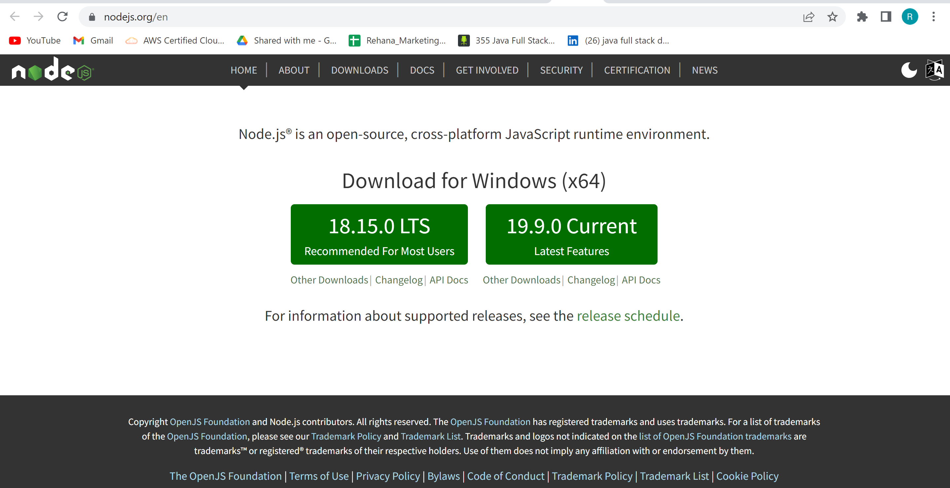
Setup
Download
https://nodejs.org

Slide 6
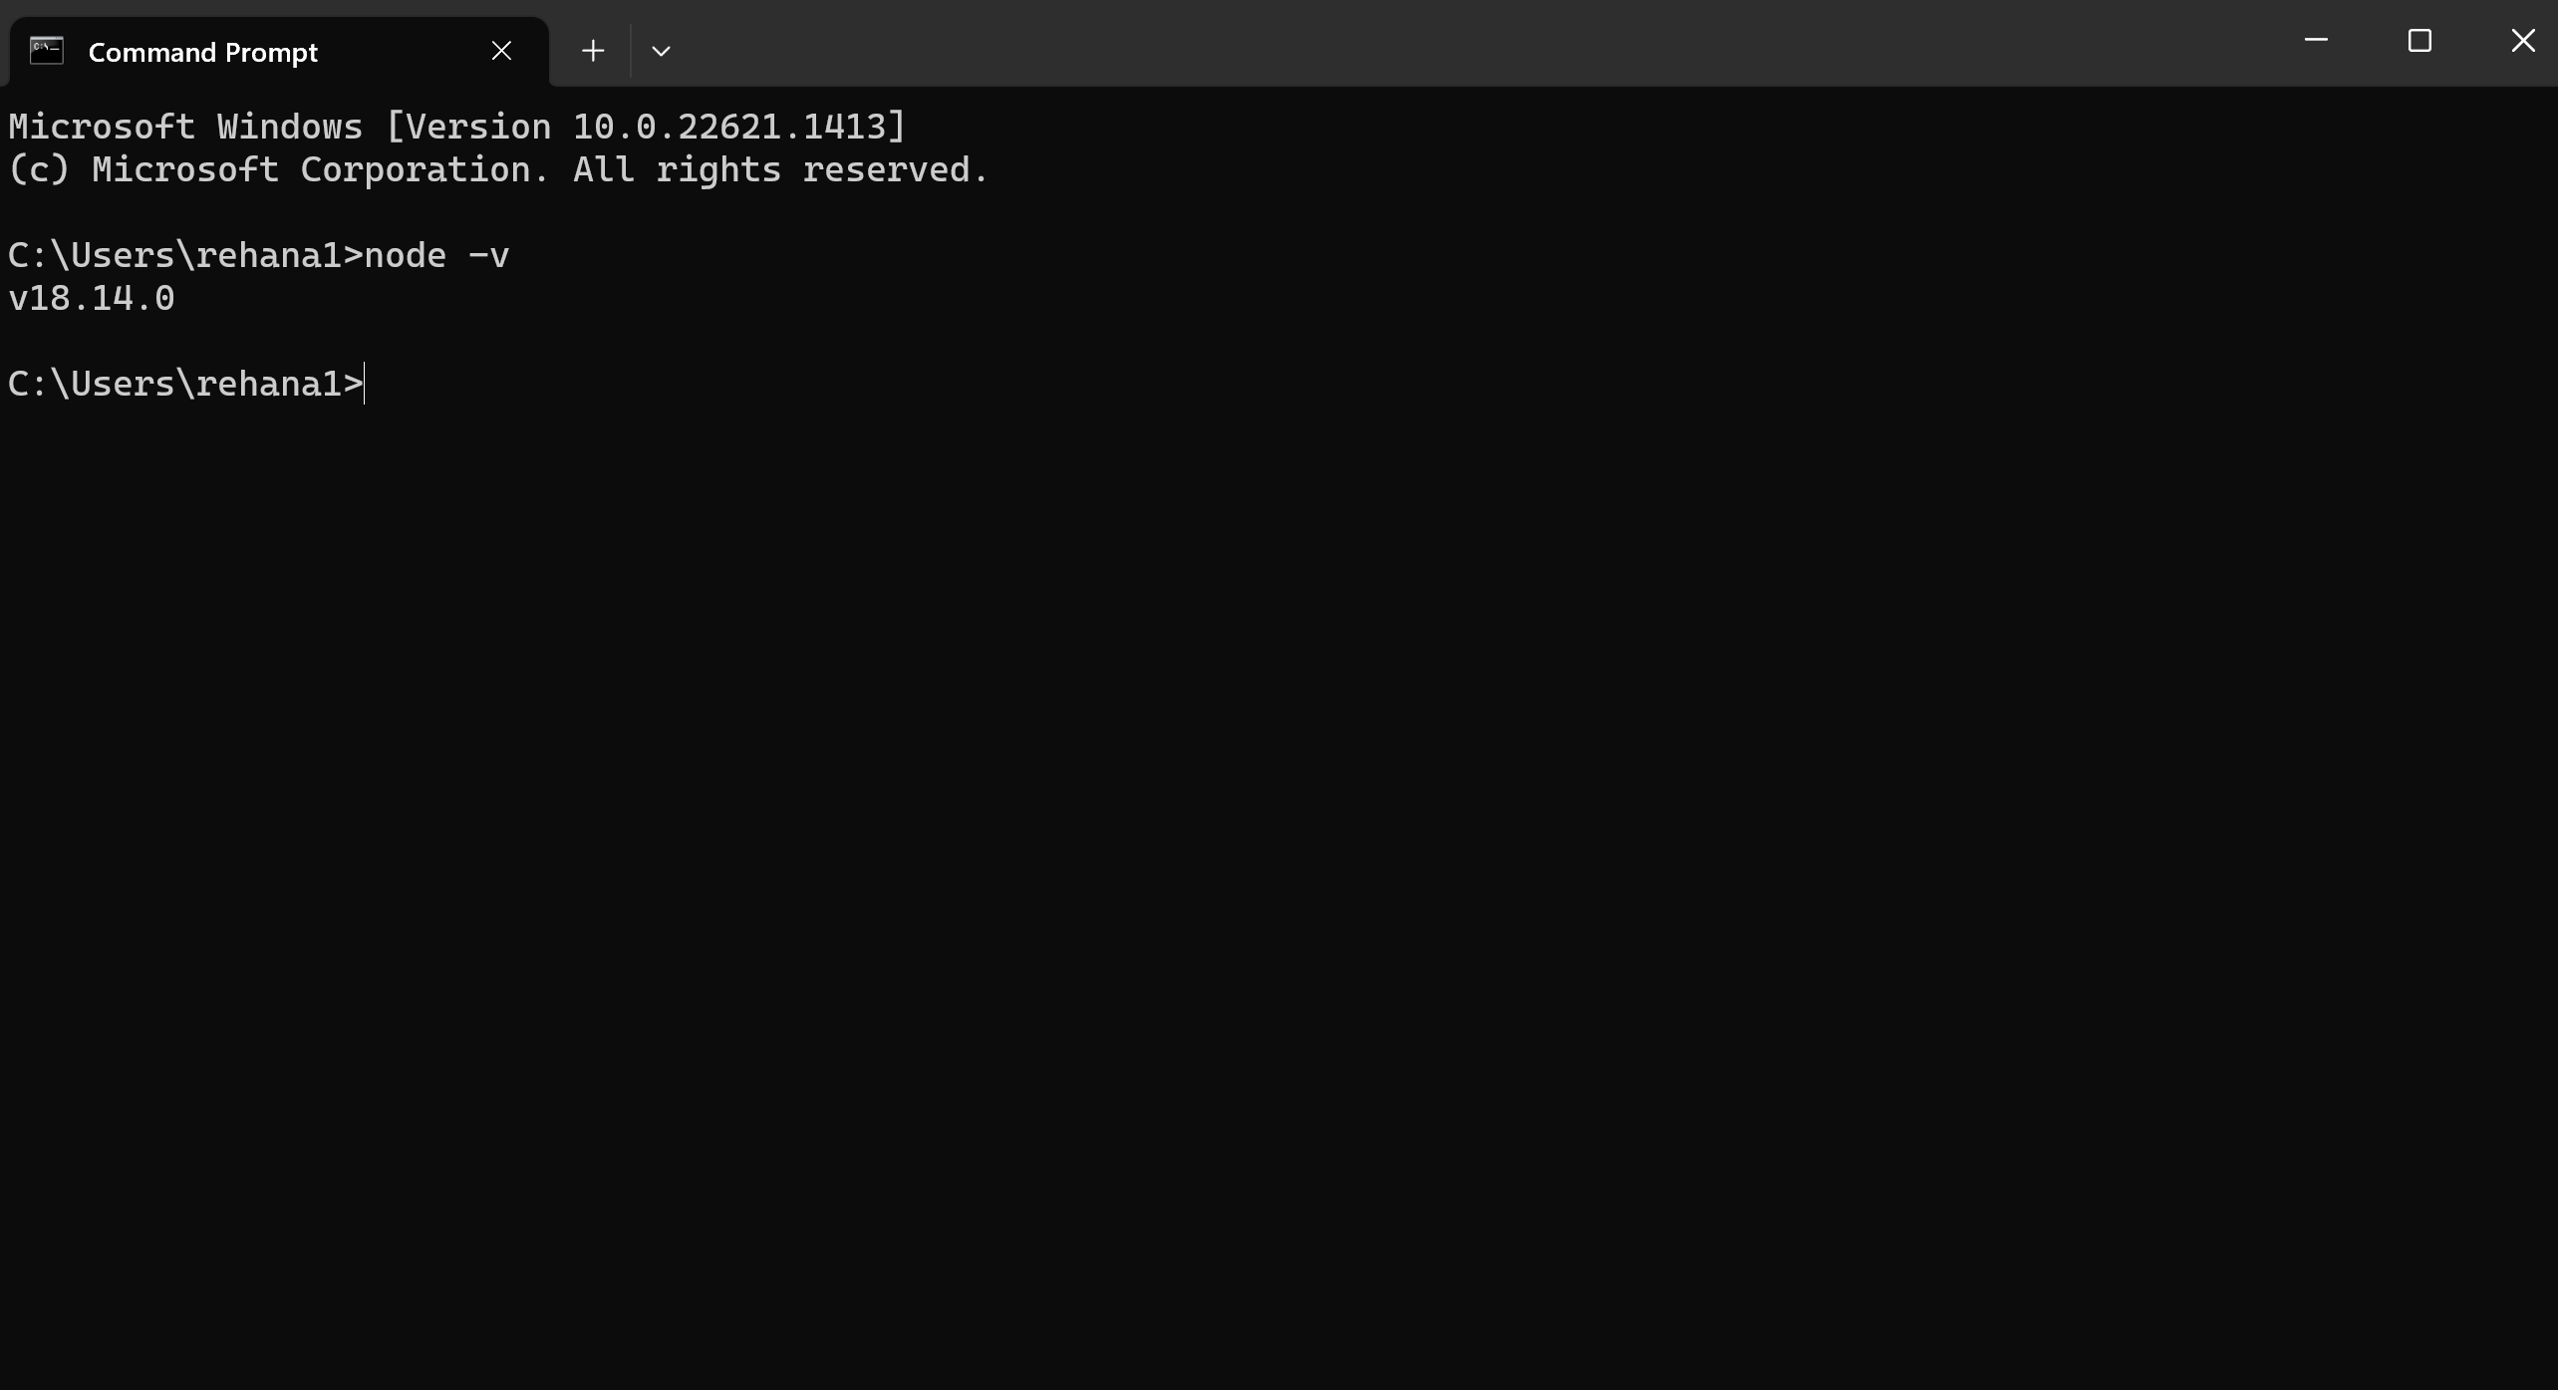

Slide 7

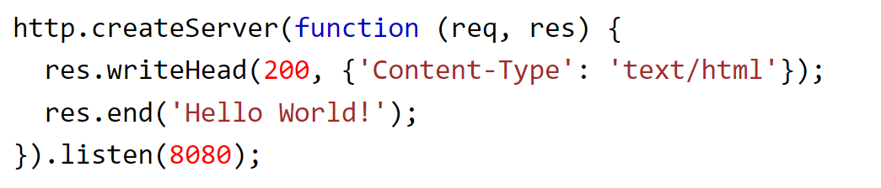
Modules
A set of functions you want to include in your application
Node.js has a set of built-in modules which we can use without any further installation.
To include modules: use require() function with the name of module.

Slide 8
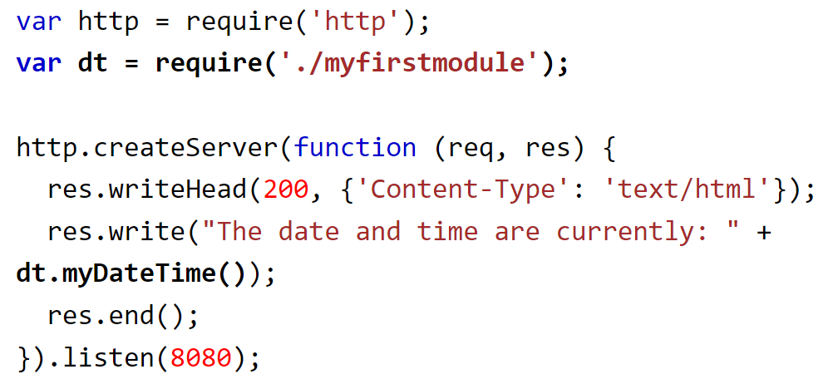
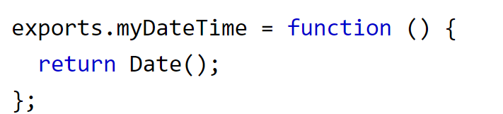
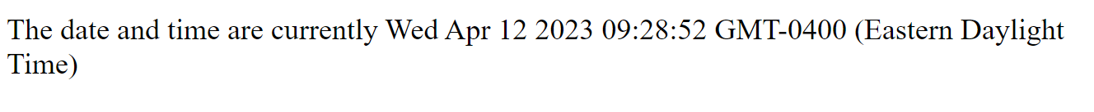
Modules (Cont...)
We can create our own modules, and easily include in our application.
Create a module that returns data and time.
Code is saved in a file called "myfirstmodule.js"
Include our own module in any of node.js files.

Slide 9
Node.js file system
Common use for the File System module:
Read files
fs.readFile()
Create files
fs.appendFile()
fs.open()
Fs.writeFile()
Update files
fs.appendFile()
fs.writeFile()
Delete files
Fs.unlink()
Rename files
Fs.rename()

Slide 10

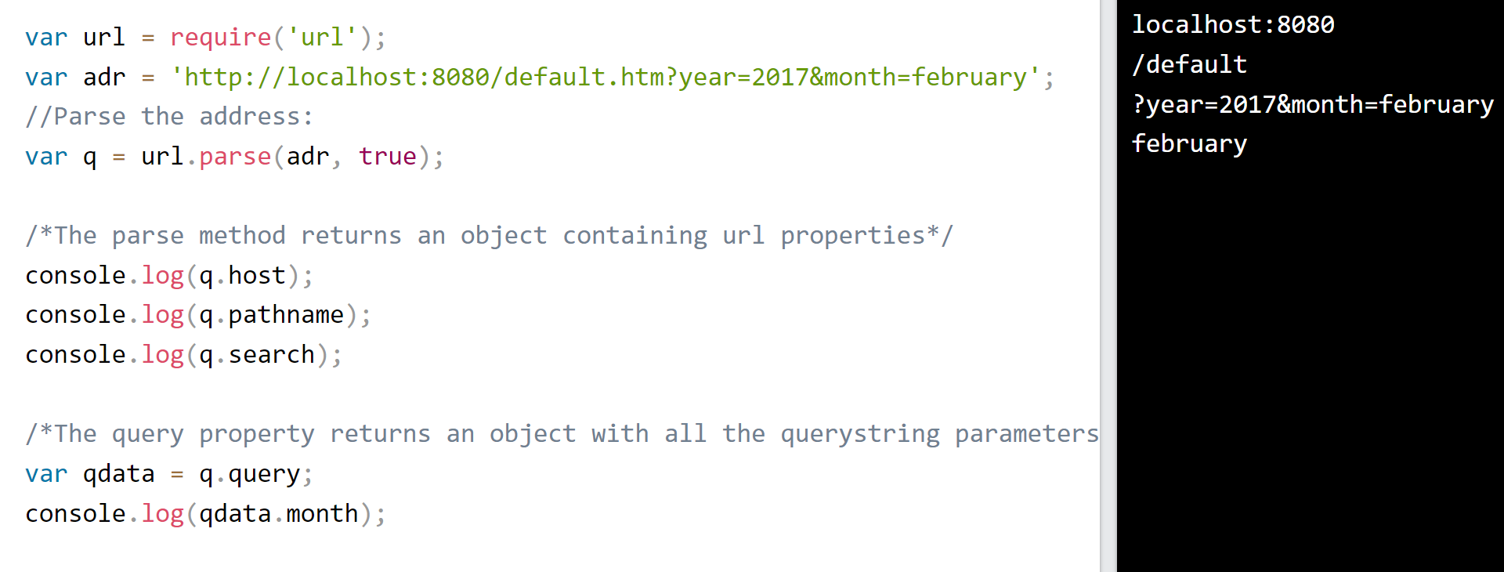
URL Module
URL module splits up a web address into readable parts.

Slide 11
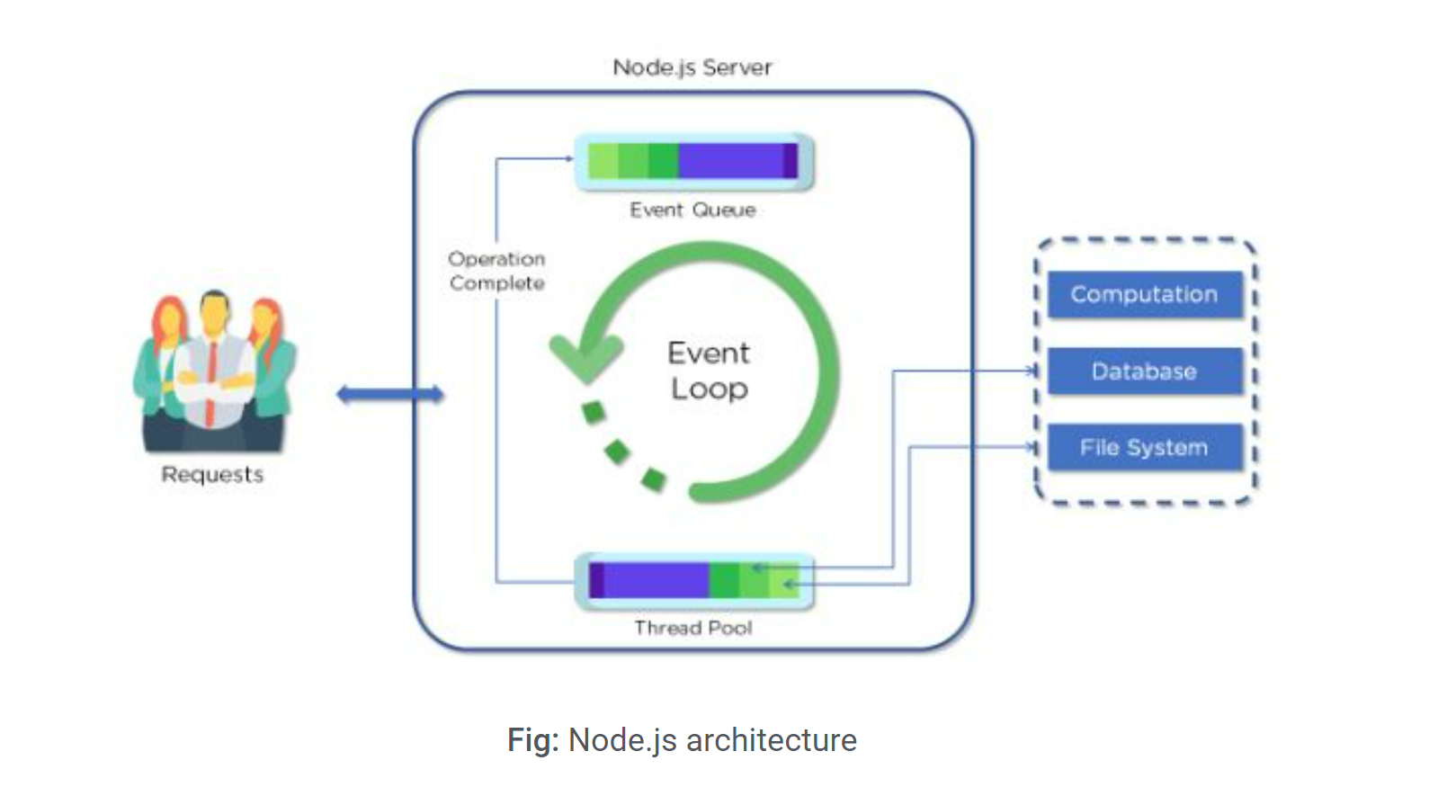
Node js Server Architecture
Node.js uses the “Single Threaded Event Loop” architecture to handle multiple concurrent clients.

Slide 12

Global Objects
These objects are available in all modules.
No need to include these objects in our application, rather we can use them directly.
These objects are modules, functions, strings, and the object itself.
__filename, __dirname etc..,

Slide 13
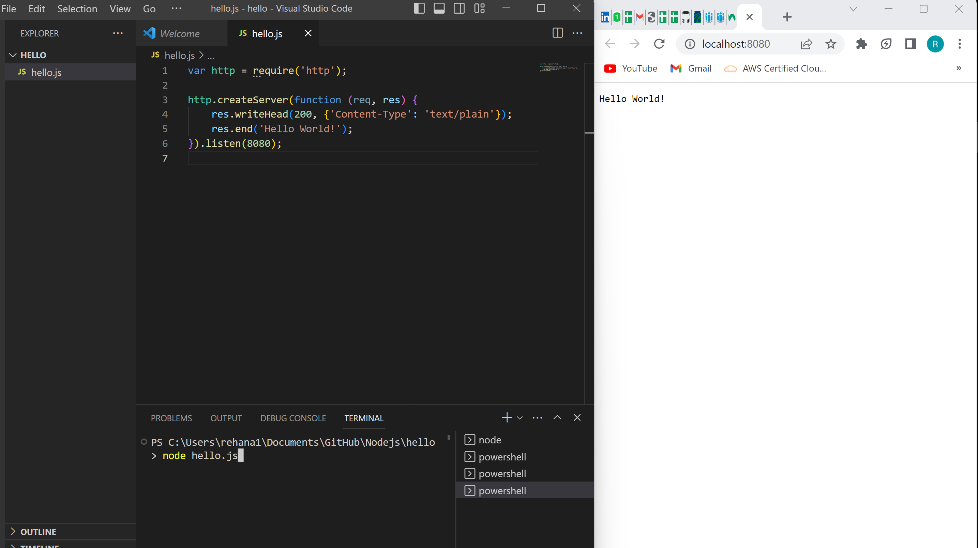

Slide 14
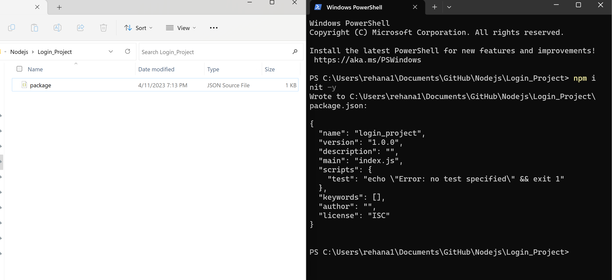
Demo Project

Slide 15
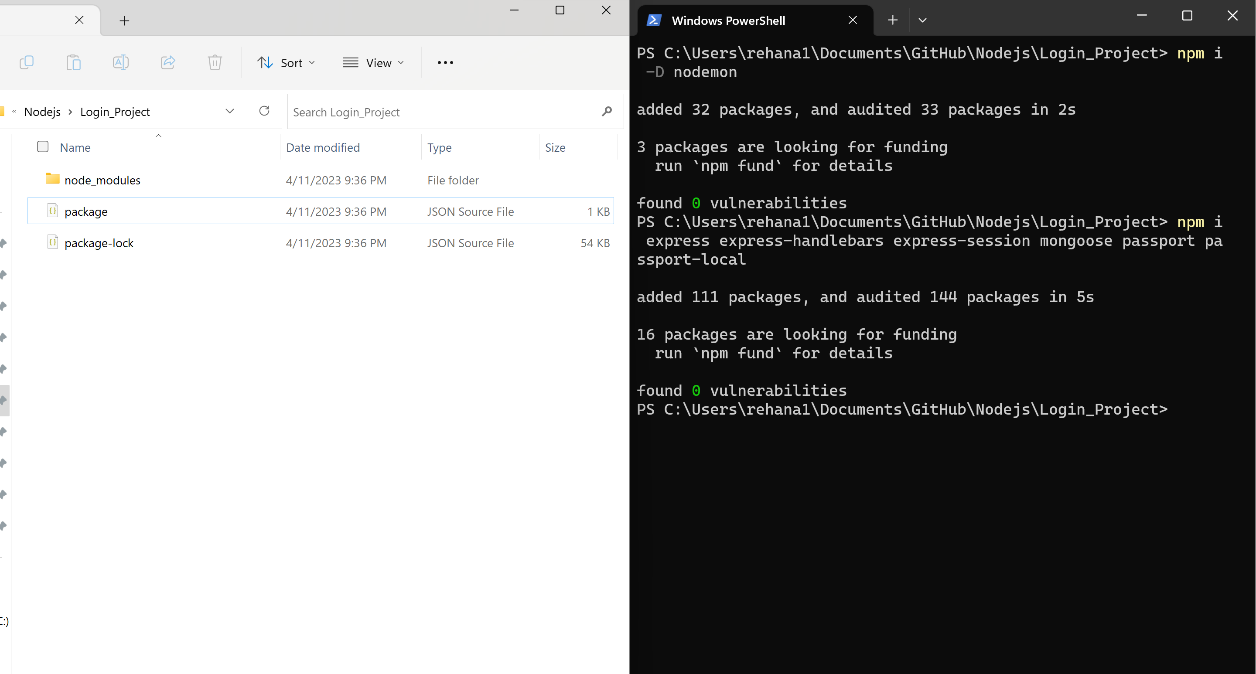

Slide 16
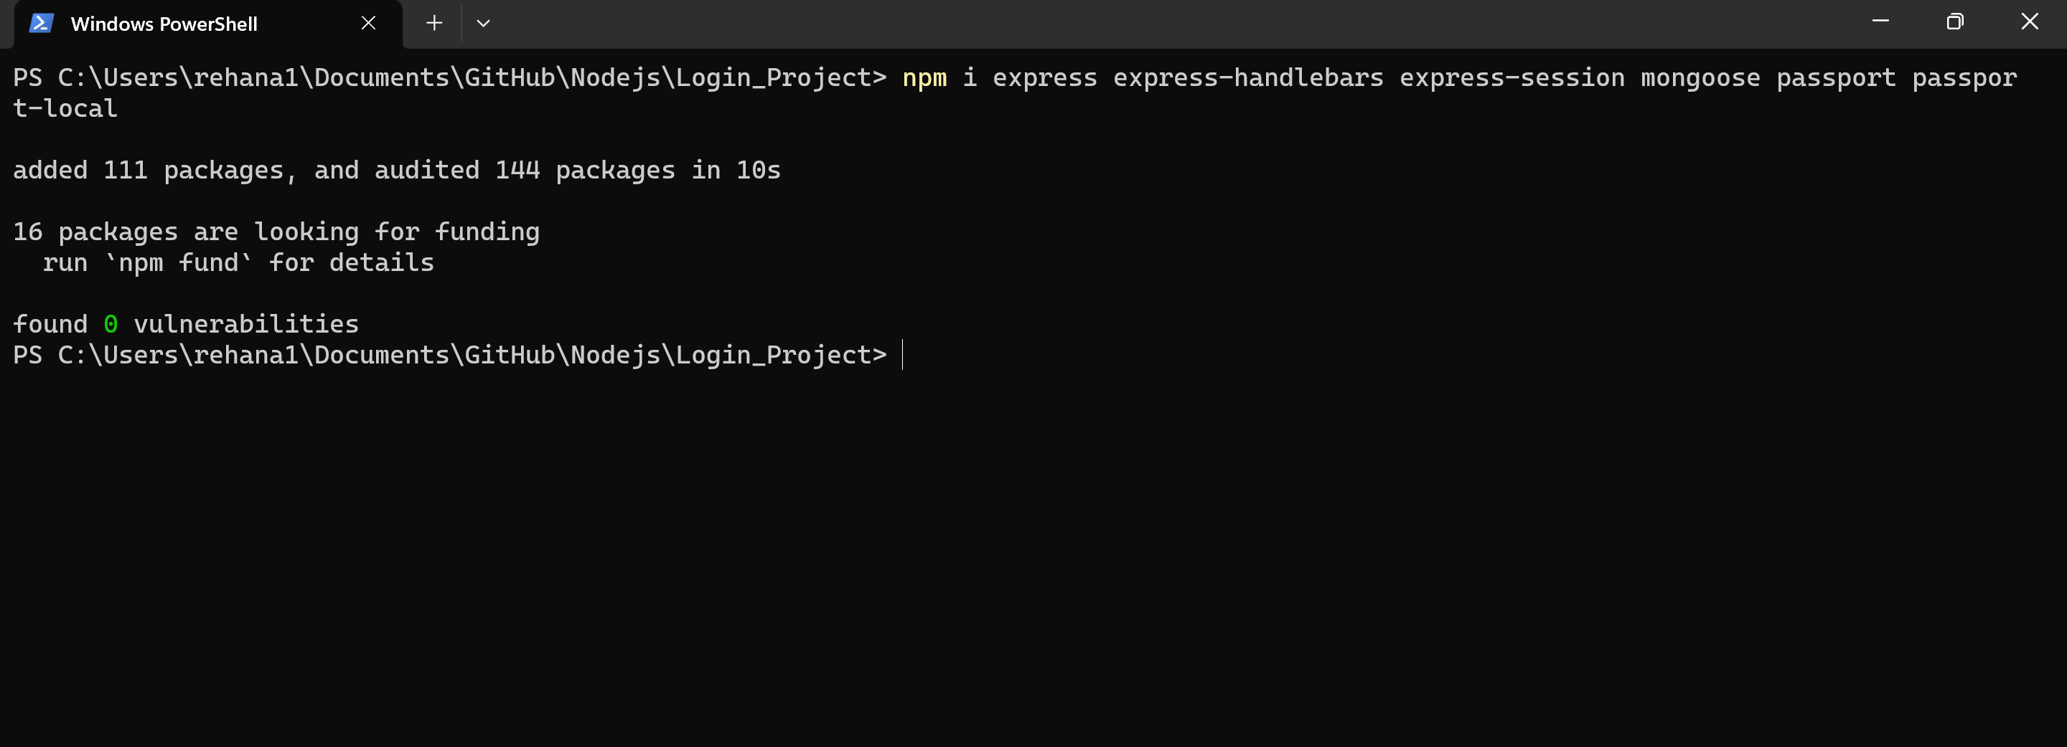

Slide 17
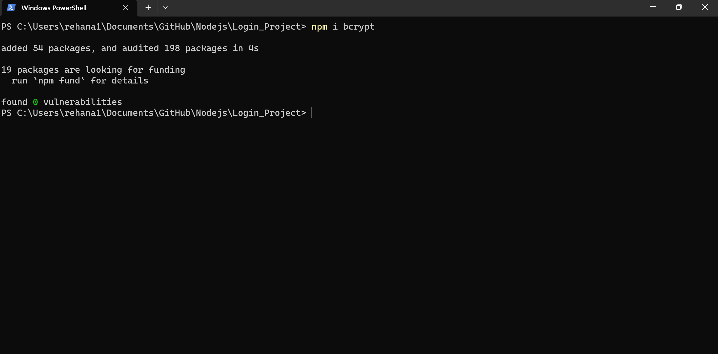

Slide 18
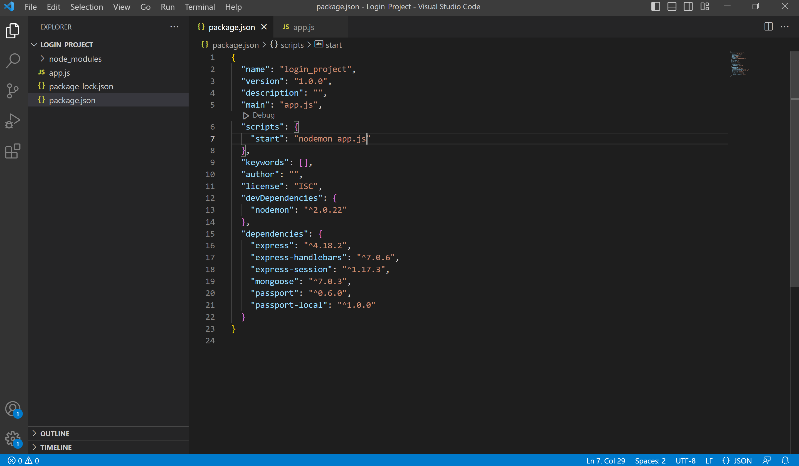

Slide 19
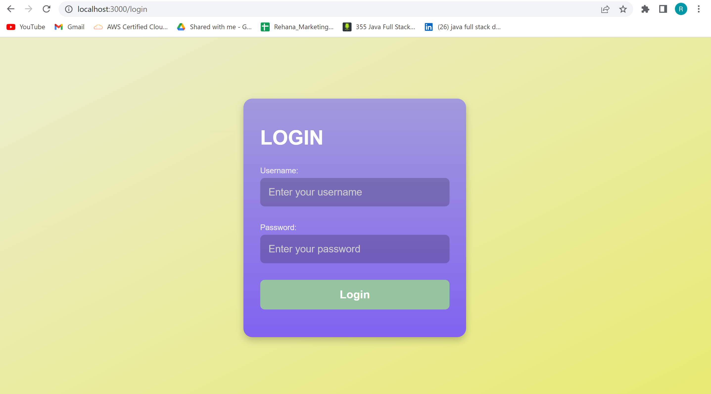

Slide 20
Thank you

