Slide 1

Angular

Slide 2
Agenda
Introduction
Features
Environment setup
Creating Sample Application
Files and Folders in Project
Run Project
Conclusion

Slide 3
Introduction
A Framework for building client applications in HTML, CSS, and JAVA Script /Type Script.
Used to develop a dynamic single-page web application.
Developed in 2009.

Slide 4
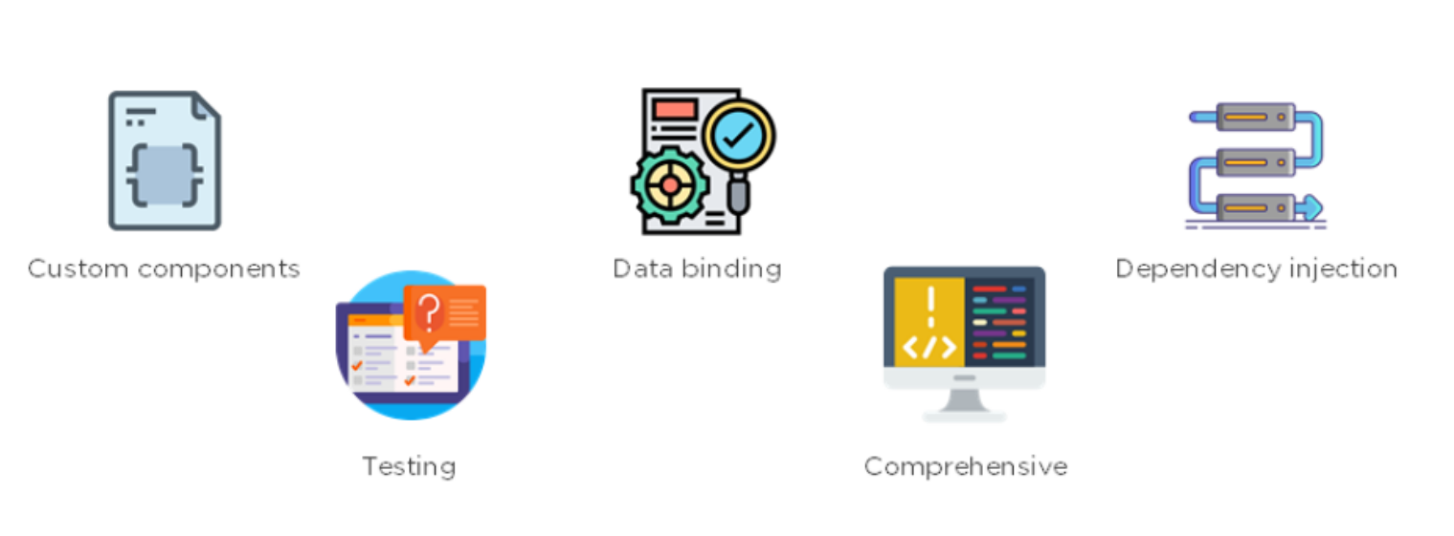
Features:

Slide 5
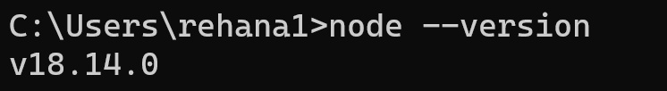

Environment Setup
Need to install the latest version of nodejs
We can use Node Package Manager (NPM) to install third-party libraries. Check npm is installed or not
Installing Angular CLI
To ensure installation is successful

Slide 6
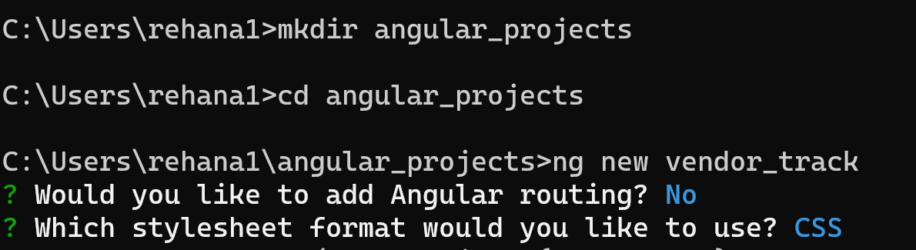
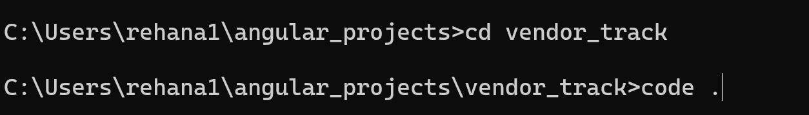
Sample Application
Creating a new project
Open with code

Slide 7
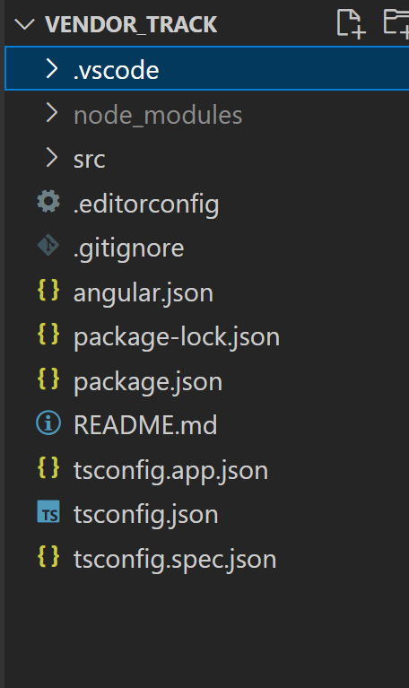
Files and Folders in Sample Application

Slide 8
Components
# component.component.css: Storing and styling selectors.
< > component.component.html : It is the main design page, Same has appeared in UI. Storing the tags.
TS component.component.specs.ts : It is for unit testing.
TS component.component.ts : It is all about the core logic handler.

Slide 9
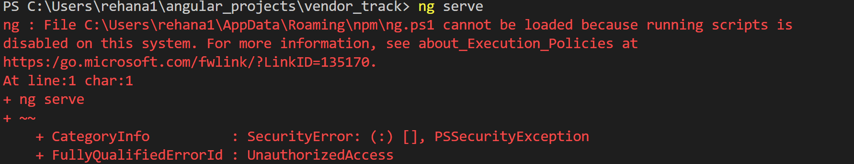
Run Application
Windows by default blocks running unsigned powershell scripts because of security concerns.
Set-ExecutionPolicy -ExecutionPolicy RemoteSigned -Scope CurrentUser

Slide 10
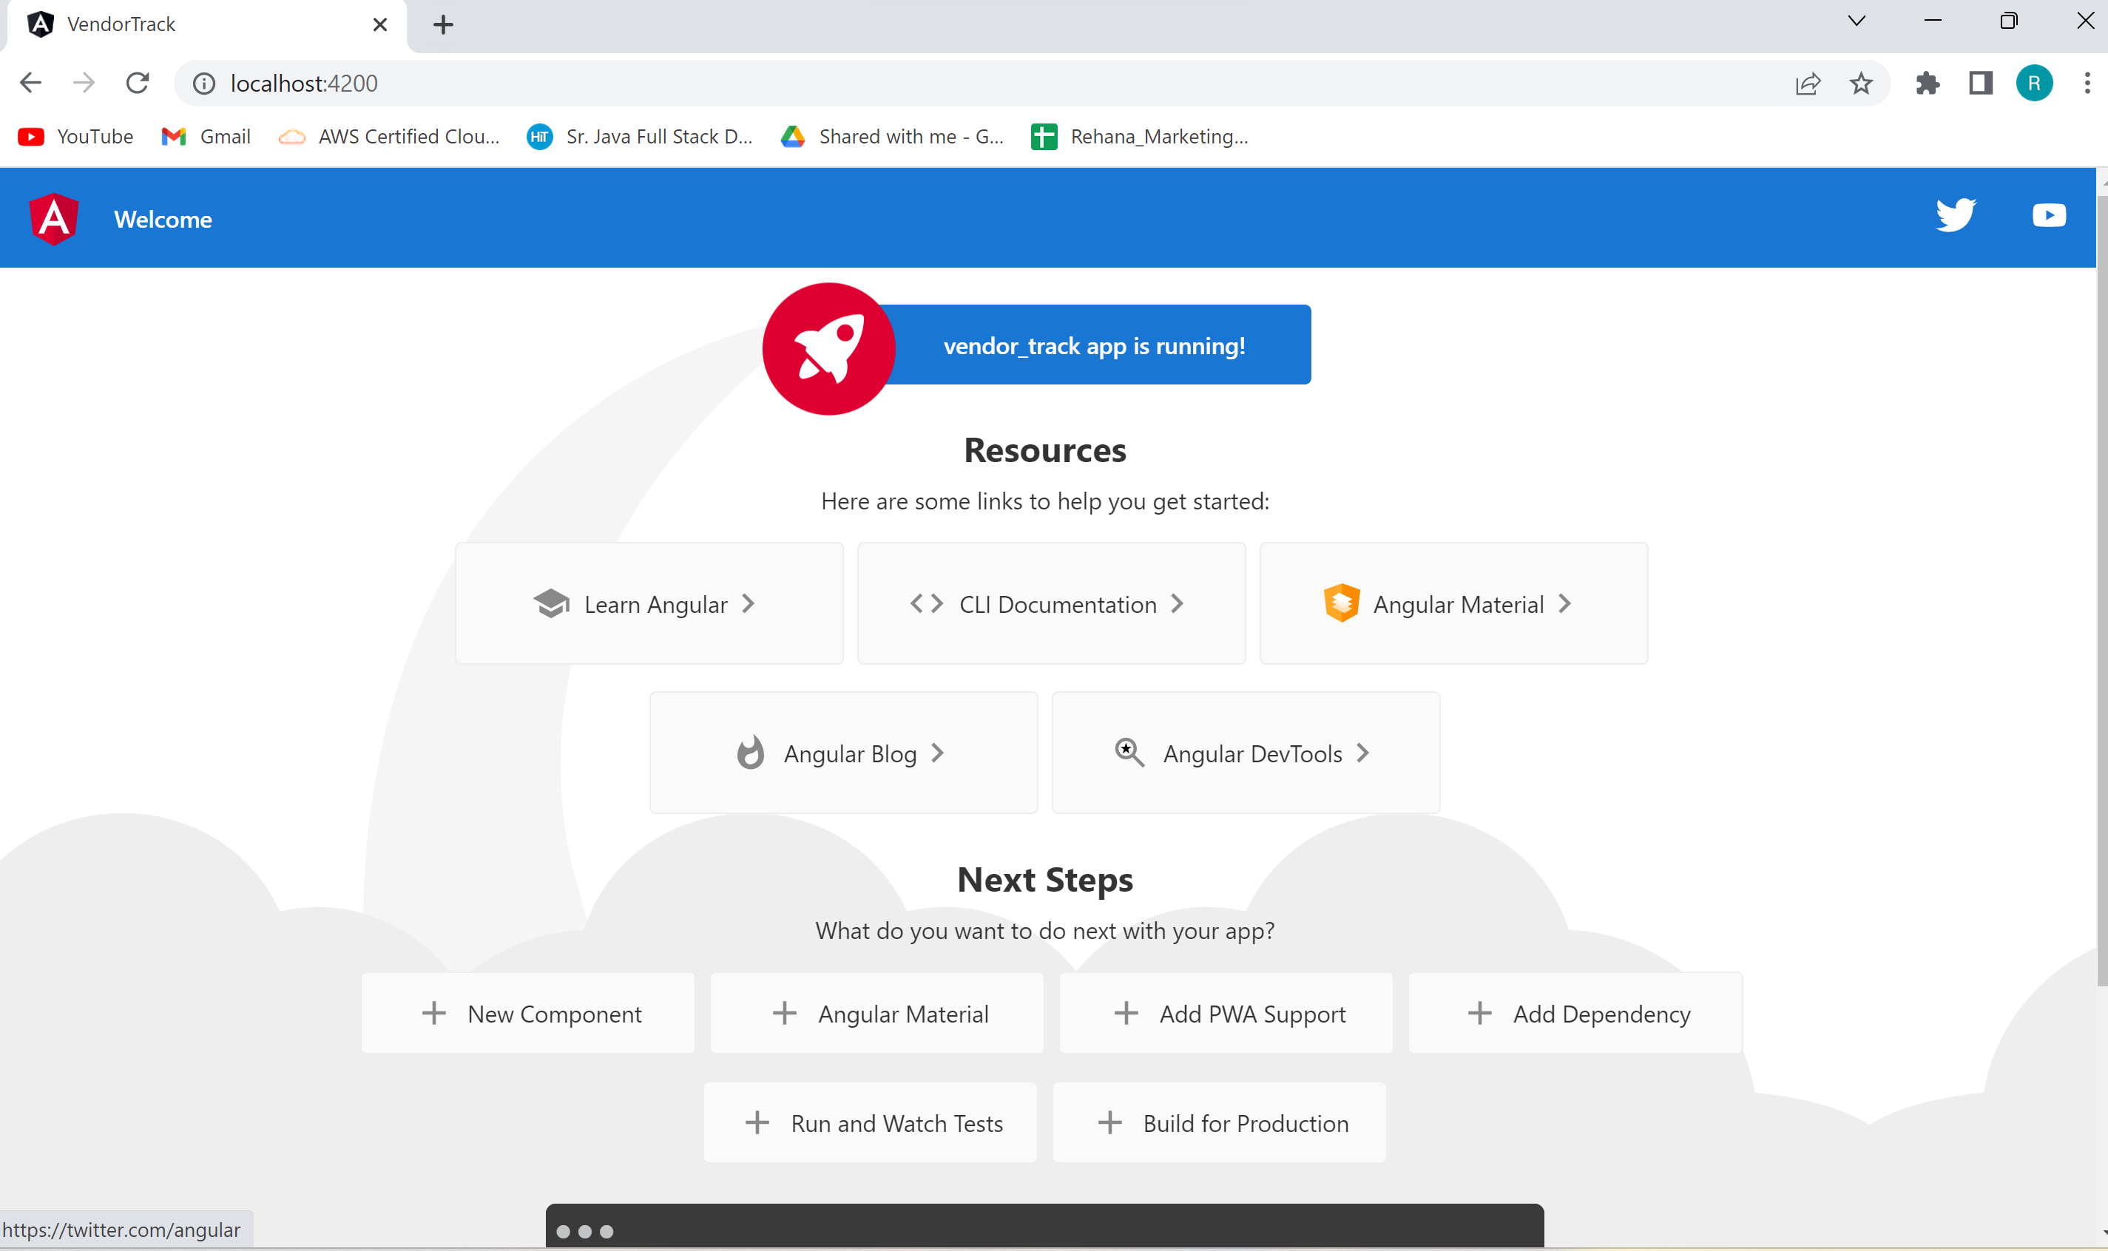

Slide 11
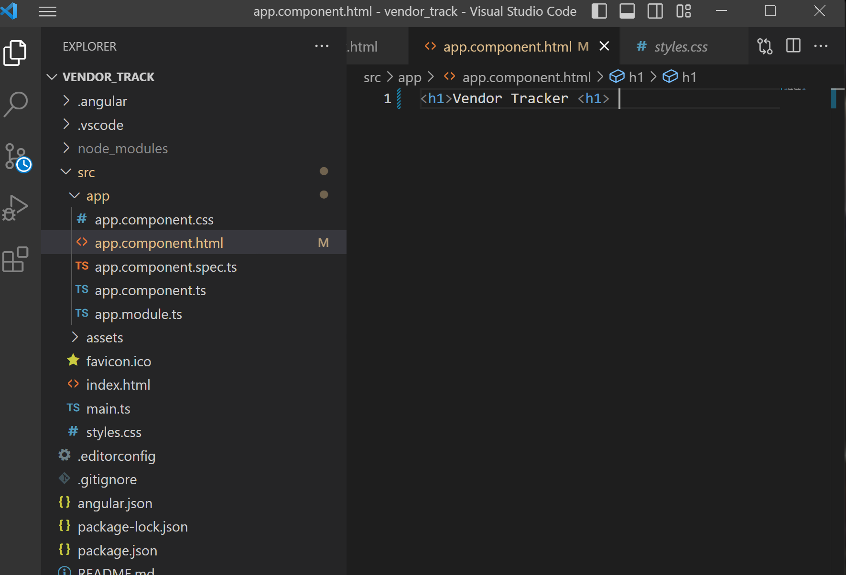
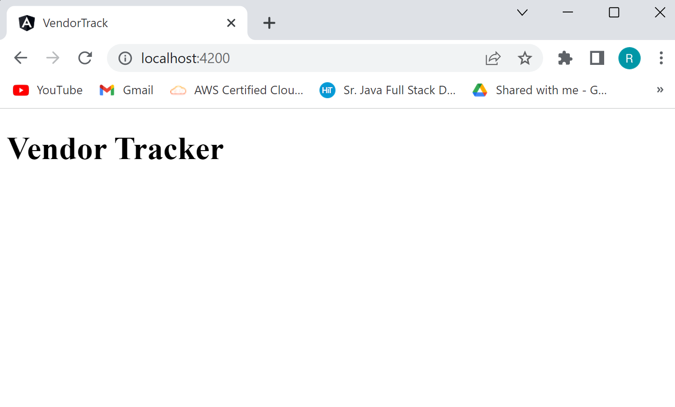
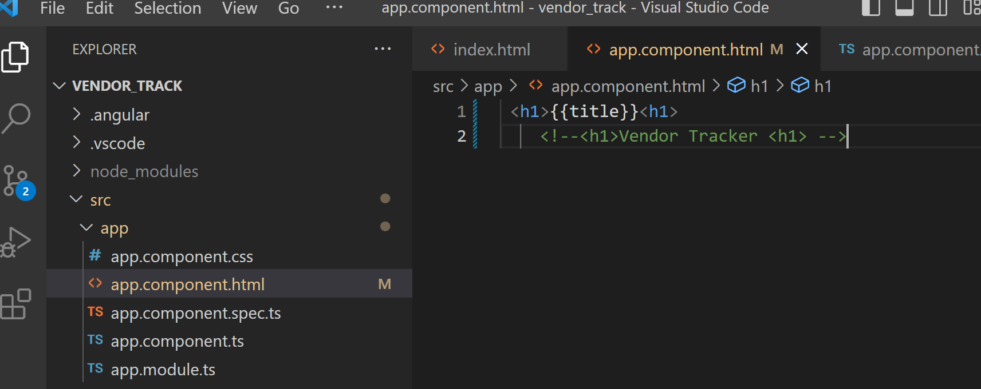

Slide 12
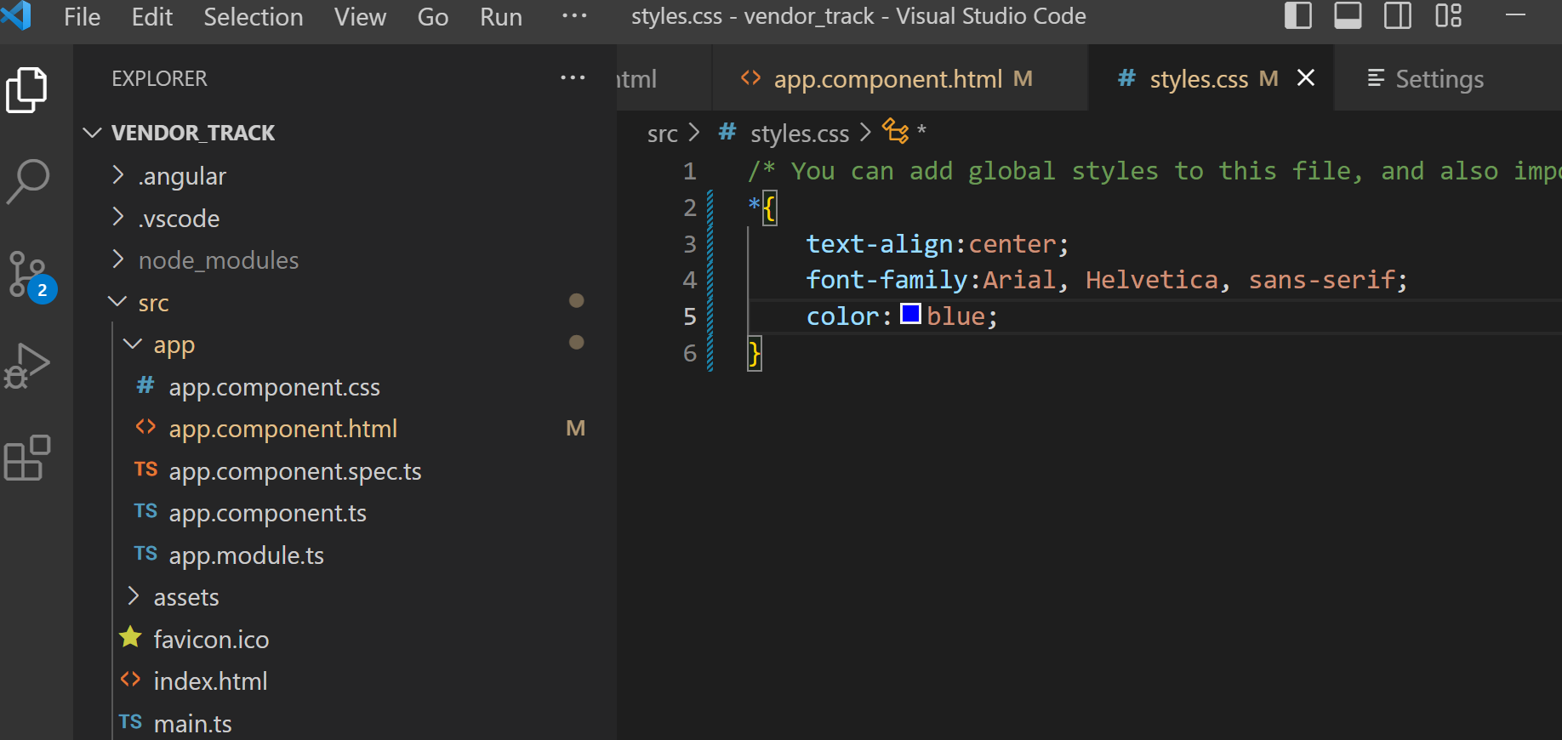
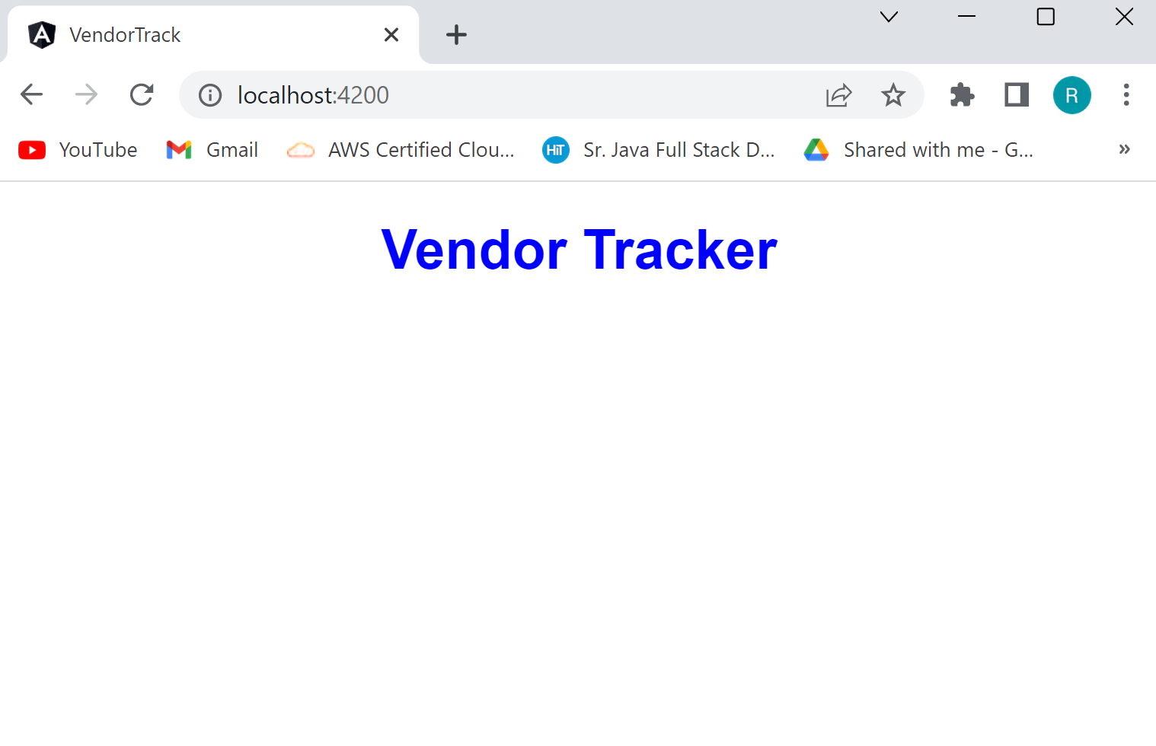
Styling
We do styling in “app.component.css”
Global-level styling is done in “styles.css”

Slide 13
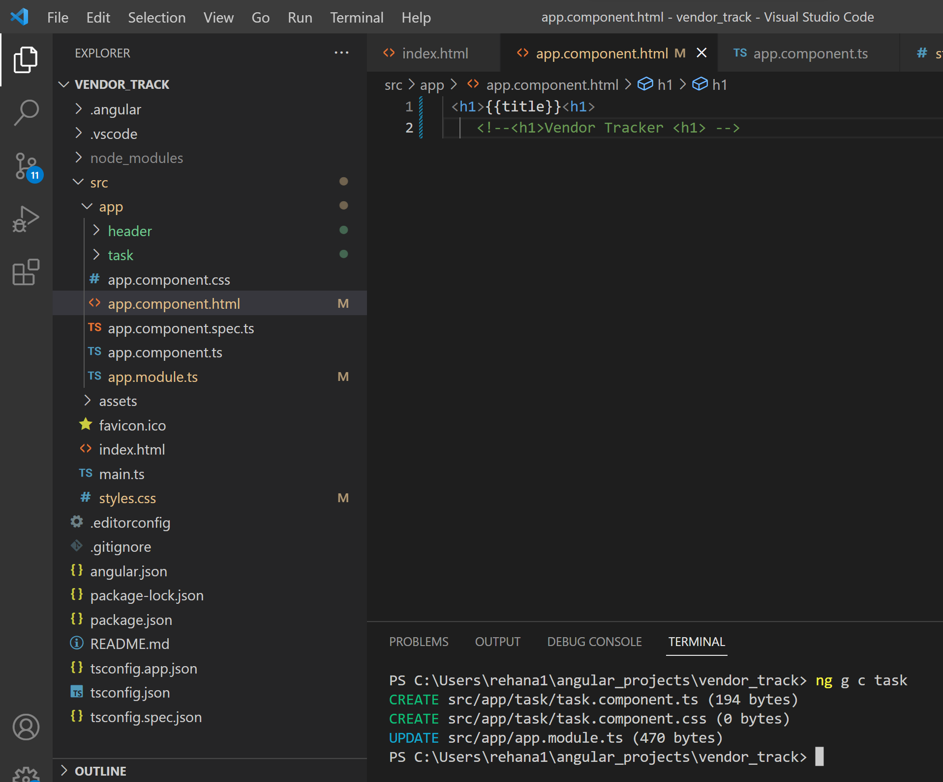
Creating Components:

Slide 14
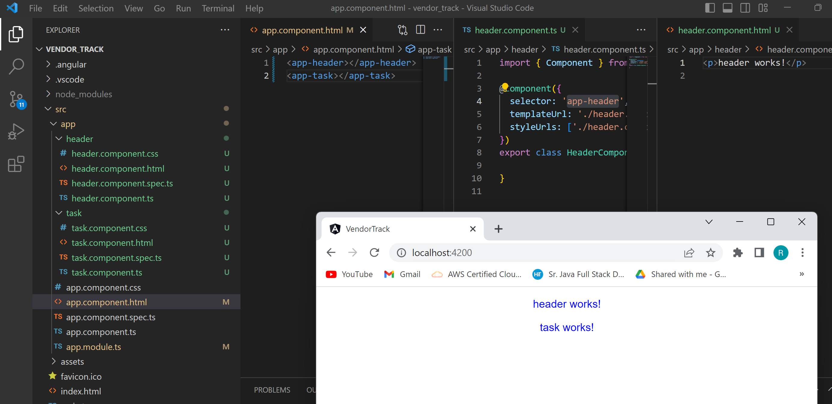

Slide 15
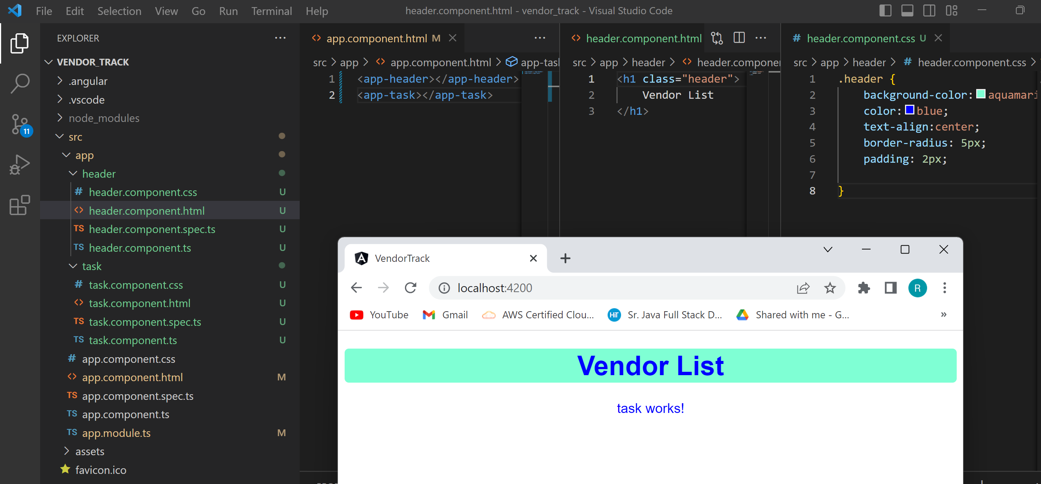

Slide 16
Thank you

