Slide 1
Strategy Pattern
Melvin Yu

Slide 2
Strategy
a class behavior or its algorithm can be changed at run time. This type of design pattern comes under behavior pattern.
we create objects which represent various strategies and a context object whose behavior varies as per its strategy object. The strategy object changes the executing algorithm of the context object.

Slide 3
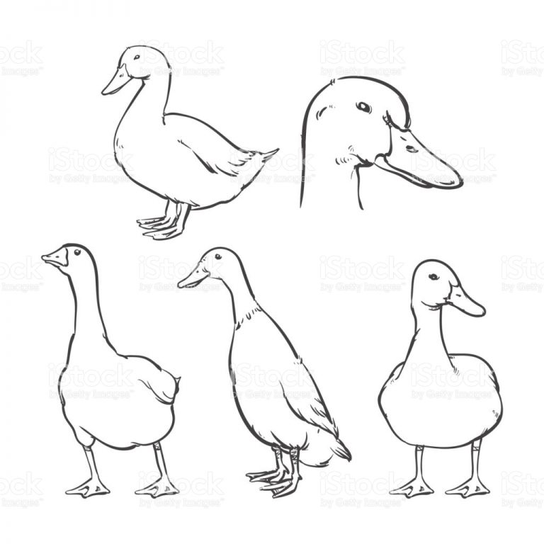


Base Class Duck
-quack
-swim
-display

