Slide 1
A diverse range of factors affect the nature of neural representations underlying short-term memory
A. Emin Orhan and Wei Ji Ma
Published: February 2019
Rehan Chinoy
31 July 2020

Slide 2
Research Goal and Experimental Setup

Slide 3
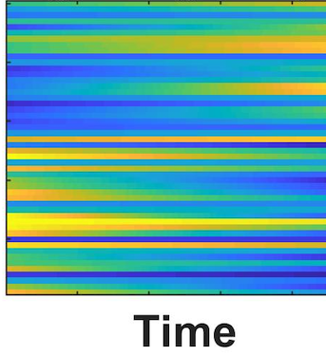
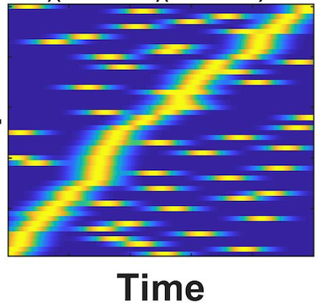
Research Goal
Persistent and sequential activity models are two prominent models of short-term memory in neural circuits.
Persistent
Sequential
Neurons
Notes:
In persistent activity models, memories are represented in (nearly) persistent activity patterns across a population of neurons, whereas in sequential models, memories are represented dynamically by a sequential activity pattern across the population.
the authors show that both sequential and nearly persistent solutions are part of a spectrum that emerges naturally in trained networks under different conditions.

Slide 4
Research Goal
Persistent and sequential activity models are two prominent models of short-term memory in neural circuits.
What is the underlying circuit mechanism that determines whether a persistent or sequential solution will emerge in the network?
Persistent
Sequential
Neurons
Notes:
In persistent activity models, memories are represented in (nearly) persistent activity patterns across a population of neurons, whereas in sequential models, memories are represented dynamically by a sequential activity pattern across the population.
the authors show that both sequential and nearly persistent solutions are part of a spectrum that emerges naturally in trained networks under different conditions.

Slide 5
Research Goal
Persistent and sequential activity models are two prominent models of short-term memory in neural circuits.
What is the underlying circuit mechanism that determines whether a persistent or sequential solution will emerge in the network?
Authors address this question by training RNNs on several short-term memory tasks under a wide range of circuit and task manipulations.
Persistent
Sequential
Neurons
Notes:
In persistent activity models, memories are represented in (nearly) persistent activity patterns across a population of neurons, whereas in sequential models, memories are represented dynamically by a sequential activity pattern across the population.
the authors show that both sequential and nearly persistent solutions are part of a spectrum that emerges naturally in trained networks under different conditions.

Slide 6
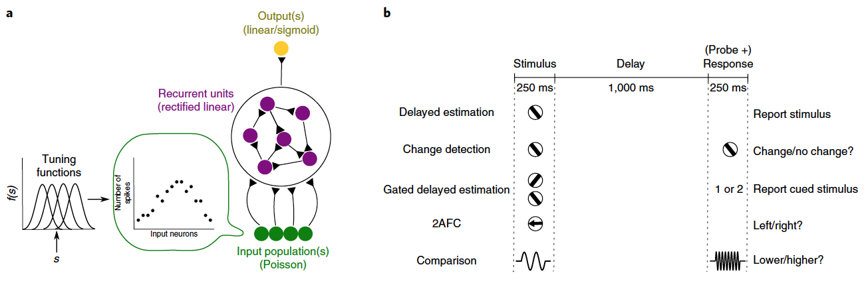
Networks
Each network is trained to learn a short-term memory task
Tuning functions map a stimulus to the firing rate of input neurons
Poisson input neurons fire independently at each time step of the task
ReLU units clip activity such that the lower bound is zero
Notes:
Adopted a discrete-time formulation instead of starting with a continuous dynamical system and discretizing
In a continuous system, alpha = deltaT/tau, which describes the time step of the simulation in units of the intrinsic time scale of individual units. Typically alpha is small, which corresponds to a long time constant
Here instead of messing with alpha, authors initialized the weight matrix such that the hyperparameter lambda naught controls the initial effective time constant
All networks had 50 Poisson input neurons in each input population and 500 recurrent neurons with ReLU activation
Gamma controls the strength of the Hebbian plasticity

Slide 7
Tasks
Notes:
Tasks:
(1) delayed estimation with one (DE-1)
or two stimuli (DE-2), where the task was to report the stimulus or stimuli presented at the beginning of the trial;
(2) change detection,
where the task was to report whether the stimulus presented before the delay was the same as the stimulus presented after the delay
(3) gated delayed estimation (GDE),
where two stimuli were presented simultaneously at the beginning of the trial and the task was to report the cued one after the delay
(4) two-alternative forced choice (2AFC),
where one of two possible stimuli (for example, left versus right moving dots) was presented at the beginning of the trial
and the task was to report which one was presented
(5) comparison (COMP),
where the task was to report whether the stimulus presented before the delay was smaller or larger than the one presented after the delay
Categorical tasks (COMP, CD, 2AFC)
Continuous output tasks (GDE, DE-1, DE-2)
Circular stimulus spaces (orientation) for first three tasks
Von Mises tuning functions
Linear stimulus spaces for last two
Gaussian tuning functions
In all tasks, each trial took 1500 ms in all: 250 ms for the stimulus period, 1000 ms for the delay period; and 250 ms for the response period
Training
Adam stochastic gradient descent
Learning rate of 0.0005
Cost function: mean squared error for continuous output tasks, mean cross-entropy for categorical tasks
For all tasks, an additional L2 regularizer with coefficient 0.0001 on the mean activity of all recurrent units in the last 50 ms of each trial
Batch size was 50 trials
Networks were trained for 25,000 iterations and tested on 300 new trials

Slide 8
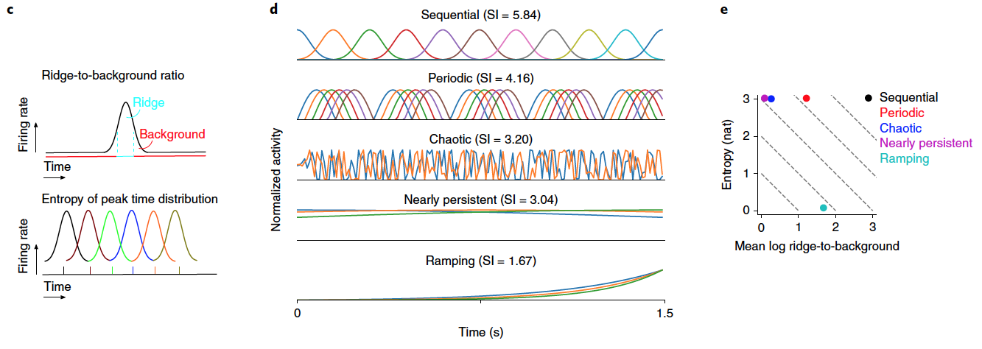
Sequentiality Index
SI = (entropy of peak response time distribution of the recurrent neurons) + (mean log ridge-to-background ratio of the neurons)
Notes:
The authors defined SI by starting from two qualitative assumptions: for a high sequentiality, each neuron should be active only during a short interval compared with the duration of the trial, and (2) the active periods of the neurons should tile the entire duration of the trial approximately uniformly.
These two assumptions translate to two quantities that can be summed together to form the SI.
SI = (entropy of the peak response time distribution of the recurrent neurons) + (mean log ridge-to-background ratio of the neurons)
The ridge-to-background ratio for a given neuron is defined as the mean activity of the neuron inside a small window around its peak response time divided by its mean activity outside this window.
The SI for a given experimental condition is then determined by averaging over the SIs of all trials belonging to that condition.
Entropy of peak time distribution is calculated by dividing the total trial duration into 20 bins and calculating the Shannon entropy of the resulting count distribution. A pseudocount of 0.1 was added to each bin before calculating entropy.

Slide 9
Factors Affecting SI of Network Solutions
Intrinsic circuit properties
Temporal complexity of tasks
Hebbian STSP
Delay duration variability

Slide 10
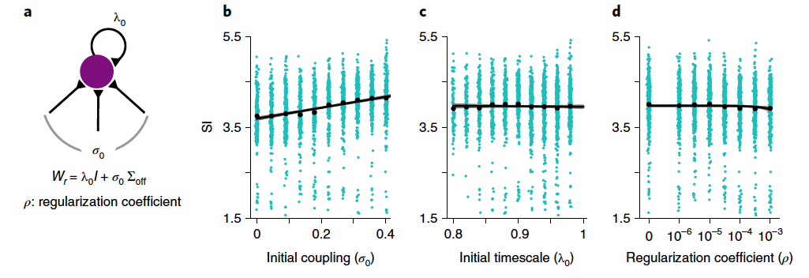
Intrinsic circuit properties
Notes:
Basic experiments were repeated with 800 different λ0, σ0, and ρ values on a 10x10x8 grid over the three-dimensional hyperparameter space (λ0, σ0, ρ)
Each cyan dot in b–d corresponds to the mean SI for a particular hyperparameter setting and a particular task. Black dots represent the means. Solid black lines are the linear fits.
In successfully trained networks, the sequentiality of the recurrent activity increased with σ (Fig. 2b); it did not change significantly with λ0 (Fig. 2c) and itslightly but significantly decreased with ρ (Fig. 2d). Larger σ0 values
introduce higher-frequency oscillatory dynamics in the initial network, which promotes the emergence of a high-frequency sequential structure in the trained networks. Larger ρ values, on the other
hand, have the opposite effect.
Initialized the recurrent connectivity matrix as λ0I + σ0Σ off, where λ0 and σ0 are
hyperparameters controlling the amount of initial self-recurrence
and networking coupling, respectively
Qualitatively, increasing
λ0 has the effect of increasing the intrinsic time constant of the individual
neurons, making their activity more persistent in response to
an input pulse.
On the other hand, increasing σ0 introduces oscillatory
components to the network response.

Slide 11
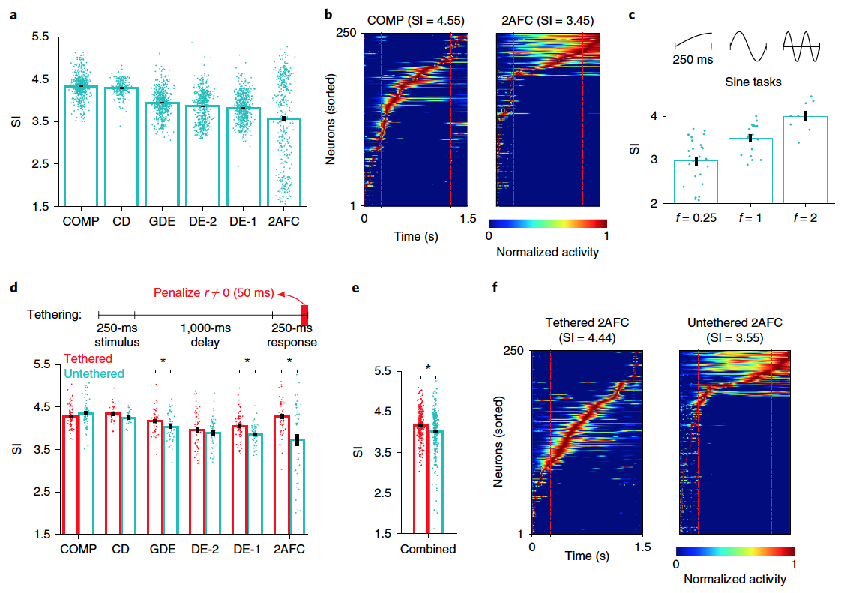
Temporal complexity of tasks increases SI
Hypothesis: increasing target function complexity (i.e. frequency) increases sequentiality of the network solution
Notes:
Significant variability in SI among different tasks
Task was most predictive variable in linear regression of SI
In change detection, gated delayed estimation, and comparison tasks, the target function depends on stimulus presented after the delay period. Thus, these tasks have higher temporal complexity.
Target function complexity can be formalized as the mean temporal frequency of the target function. Hypothesis is that increasing the target function complexity (ie frequency) would produce a more sequential solution from the network.
In practice, tethering is increasing the regularization coefficient from 0.0001 to 0.1. (Why doesn’t this decrease sequentiality, because when rho is increased in slide 10 it leads to a decreased SI)
Tethering increases the temporal complexity of the task because it forces the network’s output to sharply change from the roughly constant value it takes before the onset of tethering. Thus, we expected this manipulation to increase the sequentiality of the responses in successfully trained networks. Tethering indeed led to an overall increase in the sequentiality of the responses (Fig. 3d,e). Notably, in many cases, tethering changed the dynamics throughout the entire trial duration and not just toward the end of the trial (for example, see the representative pair of trials in Fig. 3f).

Slide 12

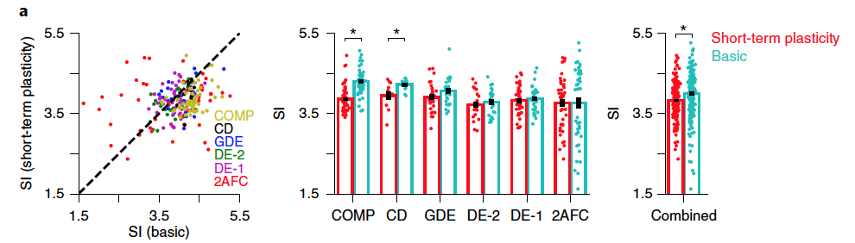
Symmetric Hebbian STSP decreases SI
Basic discrete-time formulation:
* Where f is ReLU, 𝛾=0.0007 is Hebbian contribution, and 𝜅 () is a clipping function for stability
With Hebbian STSP,
T>1 is unstable, so set T=1:
Notes:
Symmetric Hebbian short-term synaptic plasticity decreased the sequentiality of the recurrent activity in trained networks
A symmetric contribution to the recurrent connectivity matrix reduces the high-frequency oscillatory dynamics in the network, which in turn reduces the sequentiality of the recurrent activity. We emphasize again the symmetry of the short-term synaptic plasticity rule considered in this study, as asymmetric associative rules (for example, spike-timing-dependent plasticity) can often have opposite effects, as demonstrated in earlier studies

Slide 13
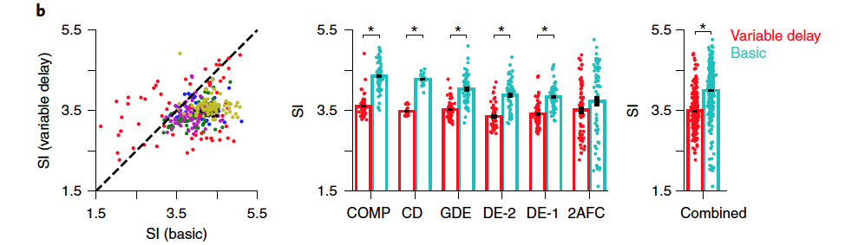

Delay duration variability decreases SI
Notes:
To test the effect of delay duration variability, authors designed versions of each of our tasks with delay duration variability.
In these versions, delay duration was one of 100, 400, 700, and 1,000 ms, chosen randomly on each trial. Variability in delay duration significantly decreased the sequentiality of the recurrent activity in successfully trained networks
In sequential solutions, the representations of task-relevant variables change over time. Thus, these representations cannot be decoded with a fixed decoder across time. However, the delay duration variability experiments demand that the learned representations be decodable with a fixed decoder at different delay durations, thereby forcing the network to learn more stable representations across time.

Slide 14
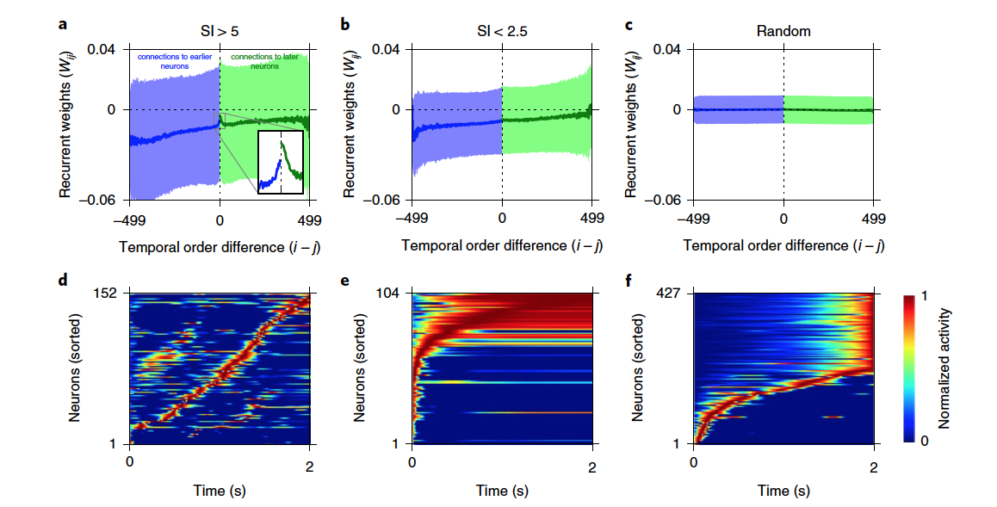
Circuit mechanism that generates sequential versus persistent activity
Notes:
First ordered the recurrent neurons in the network by their time of peak activity
In trained networks, connections from earlier to later peaking neurons had, on average, larger weights than connections from later to earlier peaking neurons.
The mean connection weight was an approximately monotonically increasing function of i − j This particular asymmetric structure was absent in untrained random networks (Fig. 6c); and it generated sequential activity in trained networks with increasingly prolonged responses in later peaking neurons in the sequence (Fig. 6e).
However, in trained networks with a high SI (SI > 5), a prominent asymmetric peak appeared in the connection weight profile (inset in Fig. 6a). This asymmetric peak corresponds to strengthened connections between temporally close neurons in the sequence at the expense of weakened connections between temporally distant neurons, with connections in the ‘forward’ direction being strengthened more than those in the opposite direction.
Conclusion: Notably, the preceding analysis suggests that both sequential and
persistent activity patterns underlying short-term memory under
different conditions emerge as two ends of a spectrum in trained
networks, rather than being categorically different solutions.
Qualitatively same results with a double-clipped ReLU activation function (can’t exceed 100) as well as greater and lower input noise

Slide 15
Concluding Remarks
This paper establishes a mechanism for the maintenance of STM and shows that persistent and sequential solutions are ends of a spectrum that emerges from training
Why does the network’s mechanism for maintaining short-term memory rely on non-normal dynamics?
Is the model biologically realistic?

Slide 17
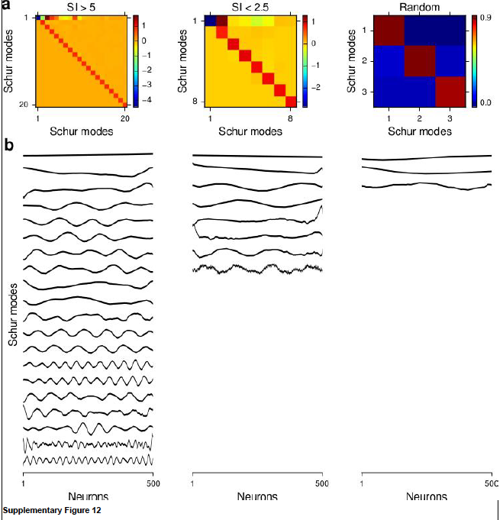
Non-normality of recurrent weight matrix demonstrated by Schur decomposition
Notes:
The sequential recurrent activity that we saw in the last slide is represented by a non-normal recurrent weight matrix
In this figure we are given three distinct trials: high SI, low SI, and random
The non-normality of each corresponding weight matrix roughly increases as SI increases
Schur mode interaction matrices for the mean recurrent connectivity patterns shown in Figure 6a-c. Only significant Schur modes with
at least one interaction of magnitude greater than 0.04 with another Schur mode are shown here. b The corresponding significant Schur
modes.
Networks with more sequential activity (SI>5) have more high-frequency Schur modes than networks with less sequential
activity (SI<2.5).
Schur decompositions for a normal matrix would create only one normal mode, so the number of Schur modes is a way to roughly quantify how non-normal a system is

