Slide 1
Task representations in neural networks trained to perform many cognitive tasks
Guangyu Robert Yang, Madhura R. Joglekar, H. Francis Song, William T. Newsome, and Xiao-Jing Wang
Published: 14 January 2019
Rehan Chinoy
14 February 2020

Slide 2
Table of Contents
Research Goals 3
Network architecture and DNMS Task 4-6
FTV as a measure of task selectivity between a pair of tasks 7
Functional clusters encode subsets of tasks 8
The emergence of compositionality in network model 9-10
Continual Learning Technique 11
Summary of Results 12

Slide 3
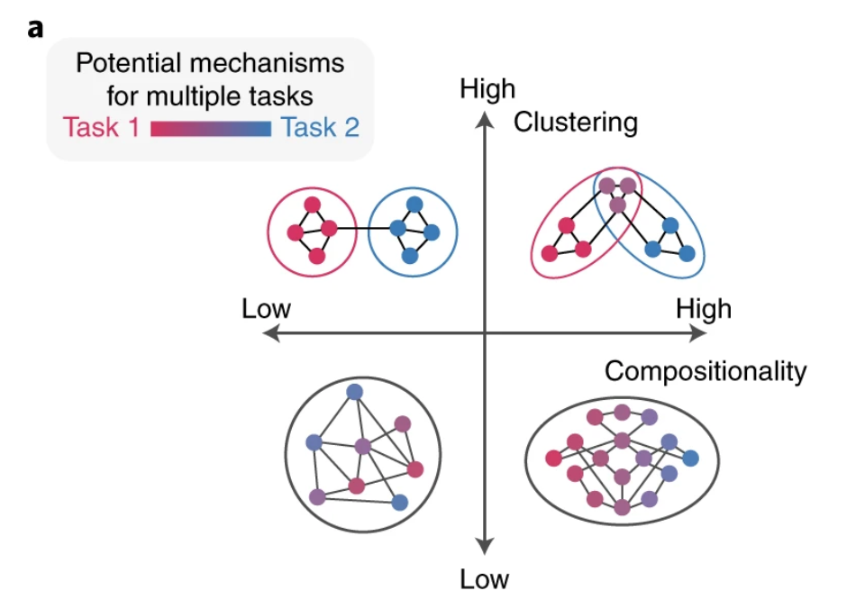
Research Goals
Do two related tasks use a shared cluster of neurons?
Can compositional task structures emerge in simple neural networks?
Notes:
OVERARCHING question: we want to know the mechanism of flexibly performing multiple cognitive tasks
To do this, the authors trained a single RNN to perform 20 cognitive tasks that require different computations (working memory, decision-making, etc)
After training, do units develop into clusters specialized for different cognitive functions?
If a network exhibits compositionality, it means it can recombine instructions from other tasks to perform a different task
Human studies based on verbal tasks have suggested that the representation of complex cognitive tasks in the lateral prefrontal cortex could be compositional. However, no conclusive studies have been performed for non-verbal tasks in animal models.
So, the authors wanted to see if, after training, compositional task structures emerged from the network.
To reiterate: goal is to elucidate neural mechanisms for flexibly performing multiple cognitive tasks, and we have a few potential models of what kind of structure can emerge after training the network

Slide 4
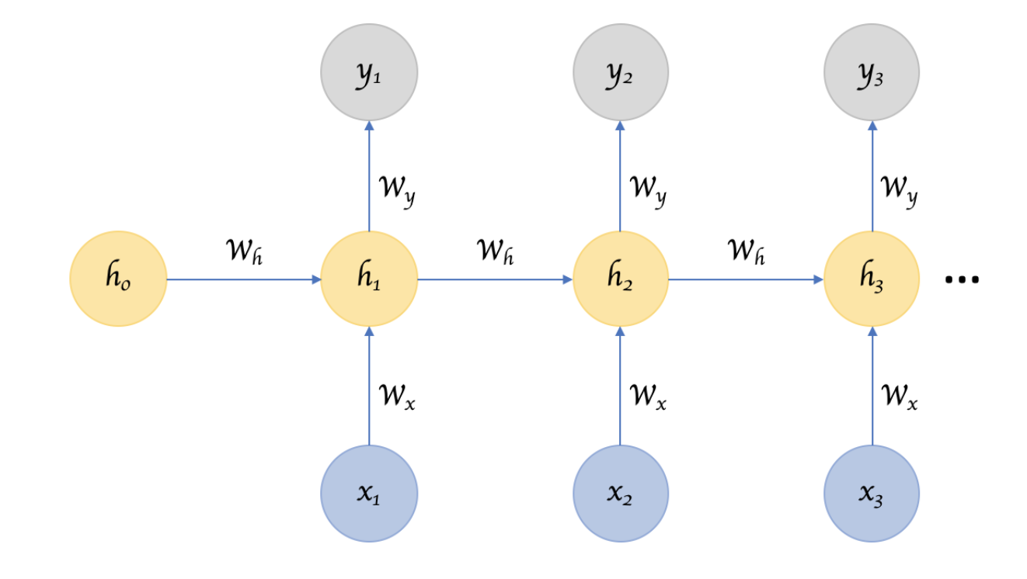
RNN architecture
Gao, Miao & Shi, Guoyou & Li, Shuang. (2018). Online Prediction of Ship Behavior with Automatic Identification System Sensor Data Using Bidirectional Long Short-Term Memory Recurrent Neural Network. Sensors.
Notes:
ARCHITECTURE
Recurrent neural networks, also known as RNNs, are a class of neural networks that accept an input vector x and give you an output vector y. However, this output vector’s contents are influenced not only by the input you just fed in, but also on the entire history of inputs you’ve fed in in the past.
The network has an internal state or hidden state (h) that it gets to update at every time step. The hidden state at time t is influenced by the input vector at time t as well as the hidden state of time t -1.
Because the network is now factoring in information from previous time steps, RNNs exhibit temporal dynamics, and are good for temporal processing.

Slide 5
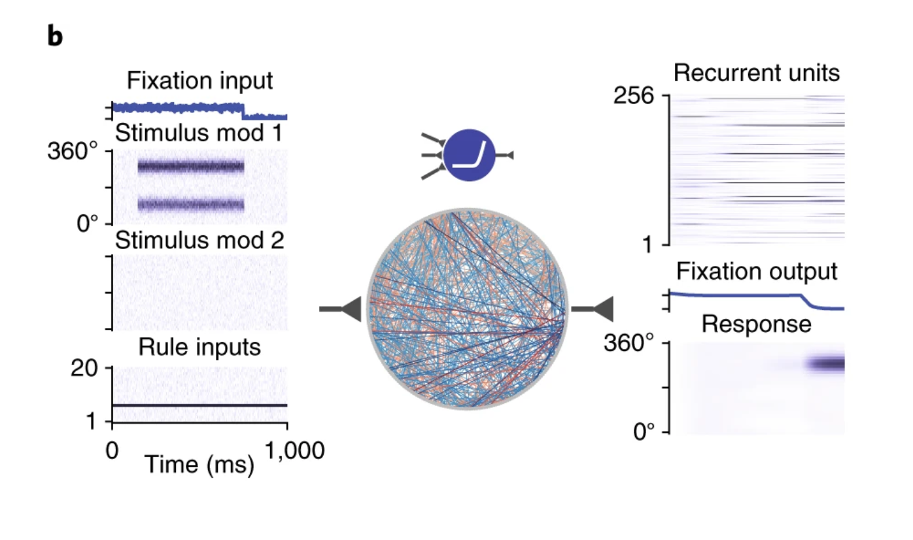
RNN architecture
Gao, Miao & Shi, Guoyou & Li, Shuang. (2018). Online Prediction of Ship Behavior with Automatic Identification System Sensor Data Using Bidirectional Long Short-Term Memory Recurrent Neural Network. Sensors.
Notes:
RNN USED IN THE PAPER
For every task, the network receives noisy inputs of three types: fixation, stimulus, and rule.
The fixation input indicates whether the network should ‘fixate’ or respond (for example, ‘saccade’). Thus, the decrease in the fixation input provides a ‘go signal’ to the network.
The stimulus inputs consist of two modalities, each represented by a ring of input units that encodes a one-dimensional circular variable such as motion direction or color on a color wheel.
A single rule input unit is activated in each trial, instructing the network on which task it is currently supposed to perform.
The network projects to a fixation output unit and a group of motor units encoding the response direction as a one-dimensional variable on a ring of outputs (for example, saccade direction, reach direction).
All network units receive private noise.

Slide 6
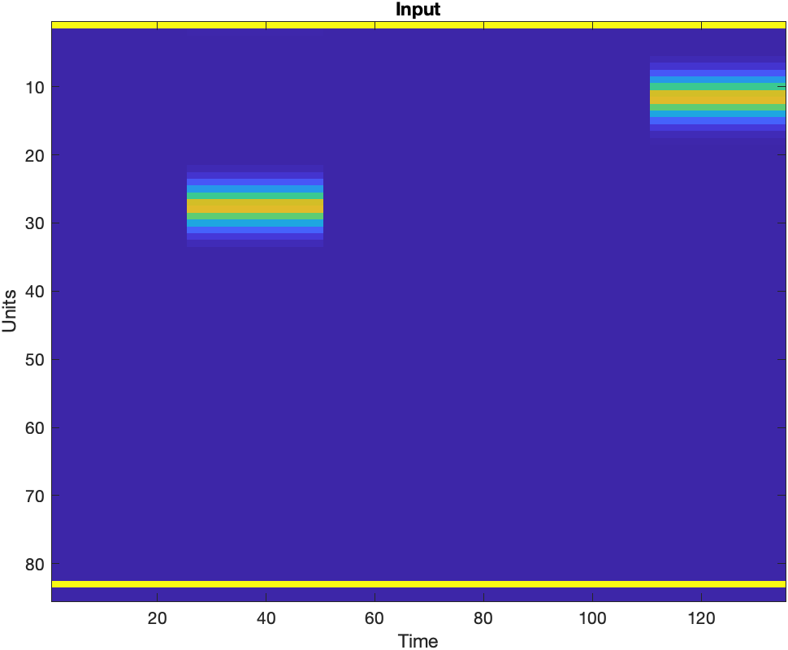
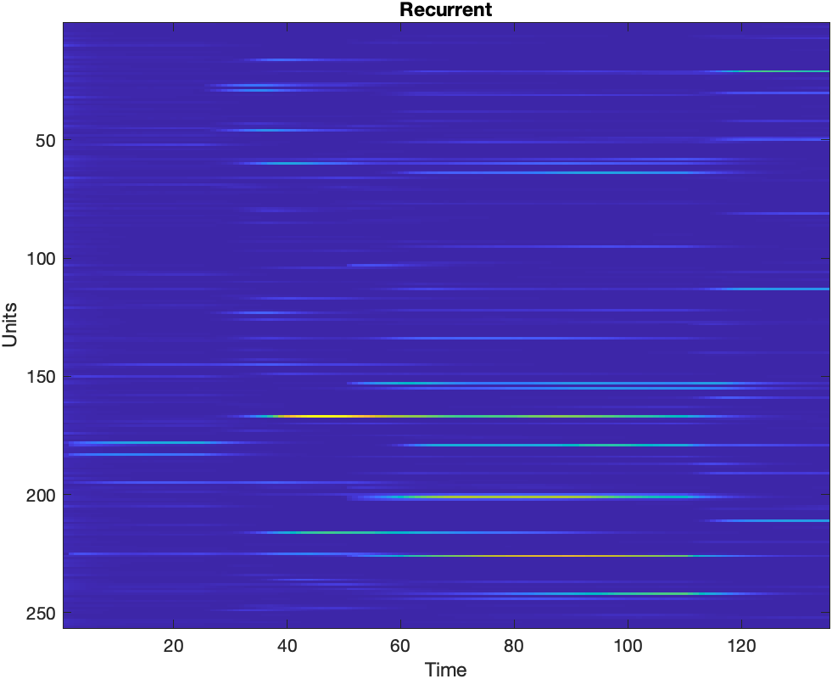
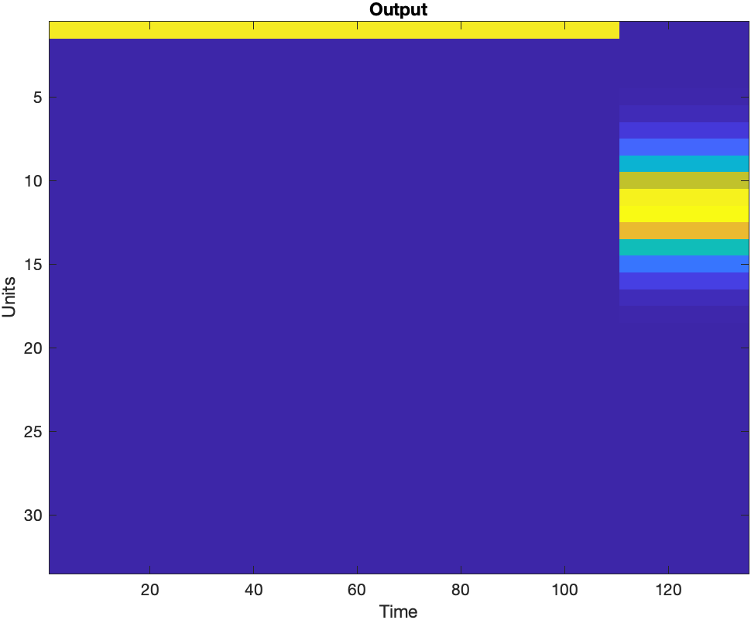
Delay Non-Match Sample (DNMS) Task
Notes:
Two modalities (retinas) and within each modality there is a circular ring (0 to 360 degrees) that the stimulus can take
Talk about dimensions (each tensor is 3 dimensional)
fixation input at the top
rule input at the bottom
private noise to each recurrent unit
A trial is considered correct if and only if the network correctly maintained a fixation and responded to the correct direction.
The response direction is considered correct if it is within 36° of the target direction. If the activity of the fixation output falls below 0.5, the network is considered to have broken fixation.

Slide 7
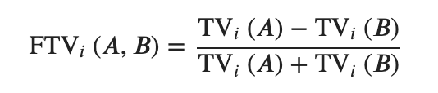
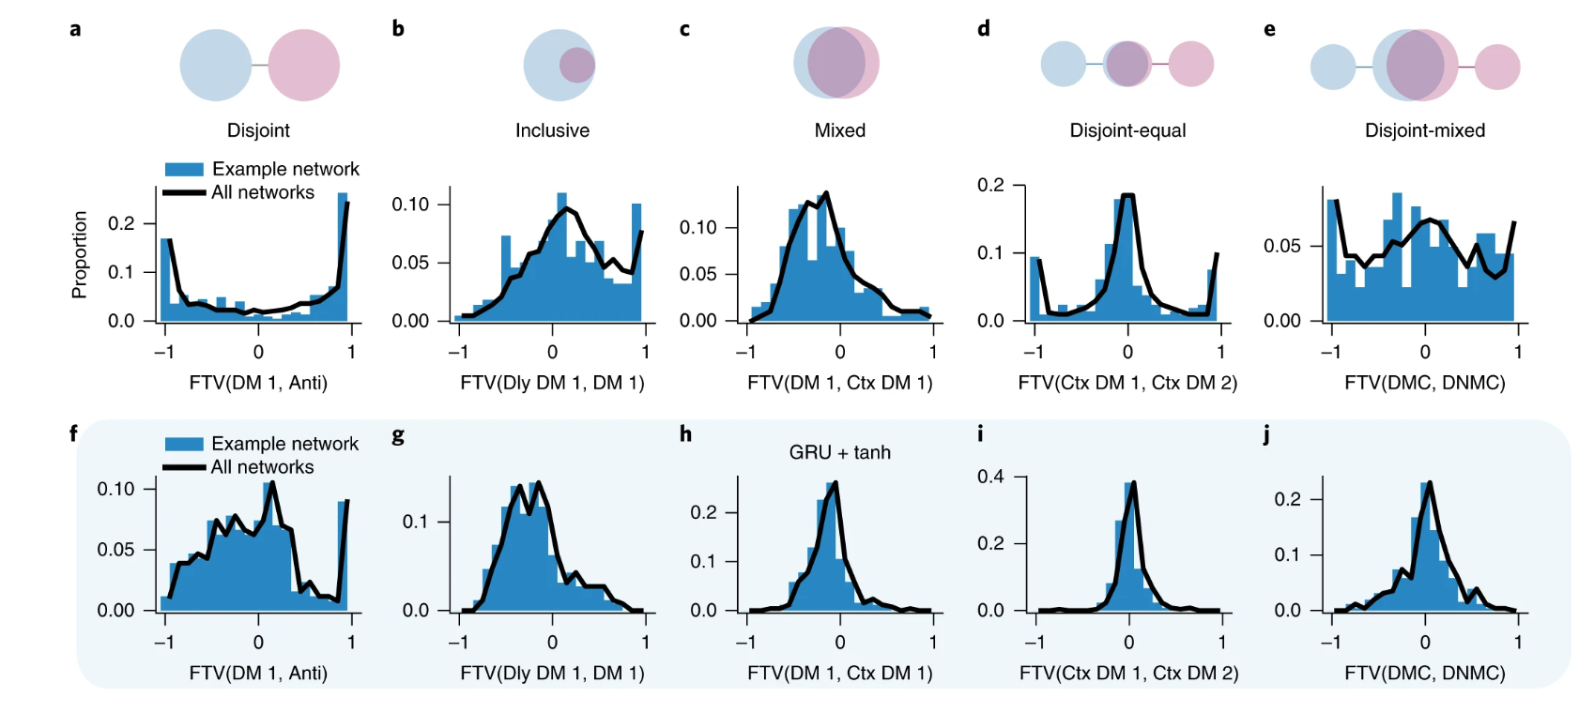
Relationships between neural representations of pairs of tasks
Notes:
GOAL: determine whether individual units in the network are selective to different tasks, or whether units tended to be similarly selective to all tasks.
Before we get into how selective individual units are to a pair of tasks, we need to define a metric that tells us the degree to which a unit is selective to a particular task.
To do this, the scientists defined a task variance metric. To compute the task variance TVi(A) for task A and unit i, they ran the network for many stimulus conditions that span the space of possible stimuli.
For example, in the DM family tasks, they ran the network for stimuli with directions ranging from 0 to 360° and with coherences ranging from almost 0 to 0.2.
After running the network for many stimulus conditions, they computed the variance across stimulus conditions (trials) at each time point for a specific unit then averaged the variance across all time points to get the final task variance for this unit.
The fixation epoch and private noise to the recurrent units is excluded from this analysis.
This process was repeated for each unit in the network.
Fractional Task Variance (FTV) is a measure based on task variance that quantifies how each unit is selective in one task in comparison to another task
FTV ranges between −1 and +1. Having a FTVi(A,B) close to +1 (or −1) means that unit i is primarily selective in task A (or B).

Slide 8
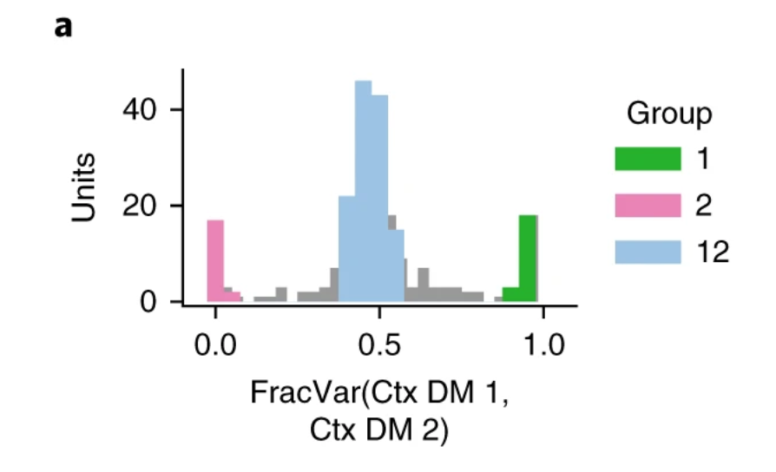
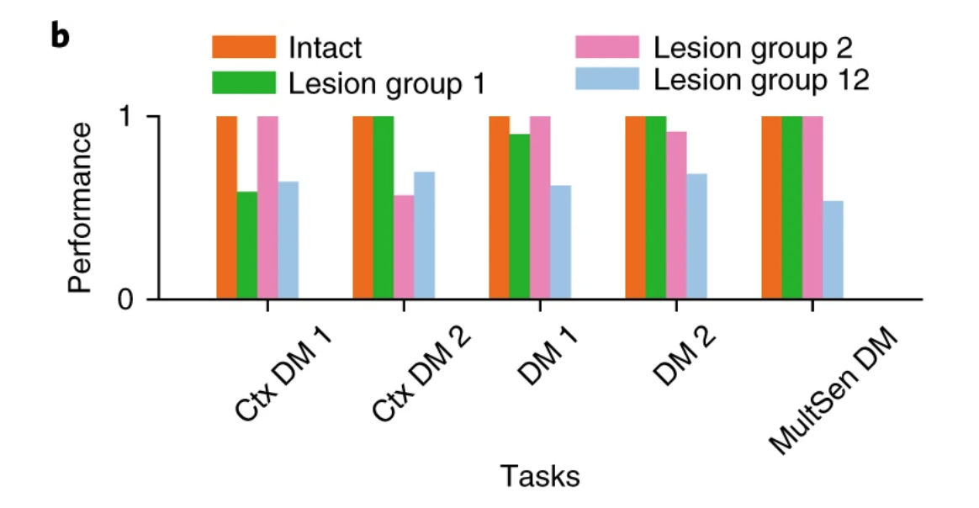
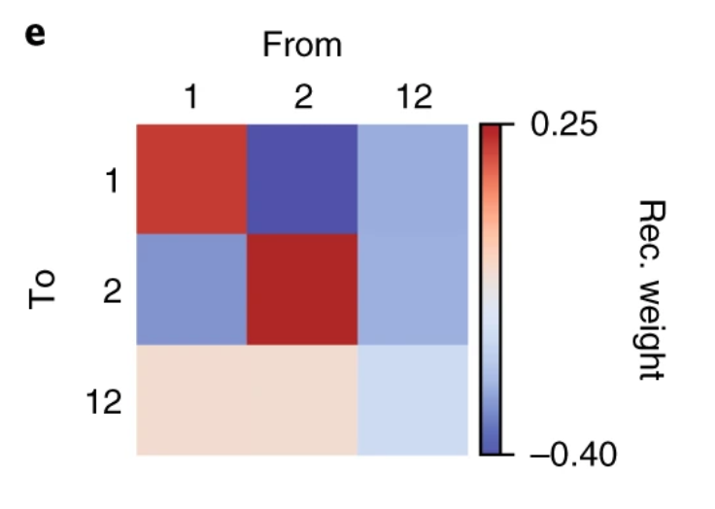
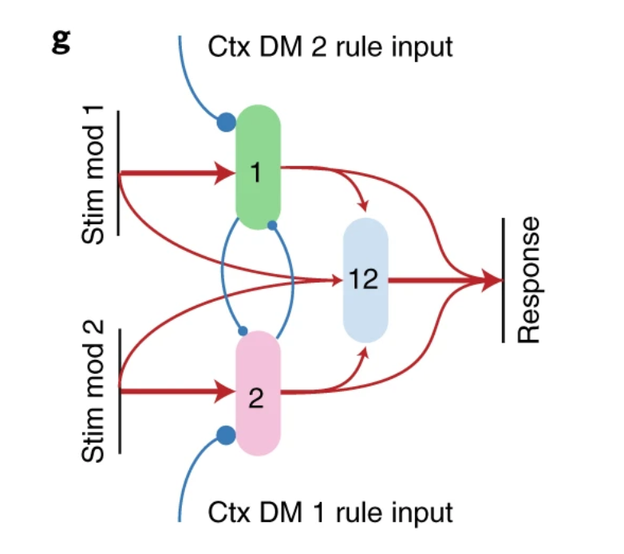
Functional clusters encode subsets of tasks
Notes:
Here the authors looked at two decision making tasks, Context Dependent Decision Making 1 and Ctx DM 2.
a. The FTV distribution for the Ctx DM 1 and 2 tasks in an example network. Most units are segregated into three groups on the basis of their FTV values. Group 1 (2) units were primarily engaged in context 1 (2), whereas group 12 (one-two) units were engaged equally in both contexts.
b. Inactivating or ‘lesioning’ all group 1 (2) units at once resulted in a failure in performing the Ctx DM 1 (2) tasks, respectively. But lesioning group 12 units impaired performance across all DM tasks. These results suggest that, in this network, groups 1 and 2 are responsible for selective processing of sensory inputs, whereas group 12 is critical for DM.
c. Average connections from modality 1 input units to recurrent units (c) and from recurrent units to output units (d). Modality 1 input units made strongly tuned projections to group 1 units. Input and output connections are sorted by each unit’s preferred input and output direction, respectively, defined as the direction represented by the strongest weight.
Summary: Group 1 and group 2 units excited themselves while inhibiting each other. Both projected to group 12 units (Fig. 5e). Group 1 units received negative connection weights from the rule input units representing the Ctx DM 2 task, which explained why group 1 units are silent during context 2. In summary, from training emerged two groups of units that were specialized for selective input processing. Along with the sensory inputs from both modalities, both groups fed into the third group that was specialized for DM.
NOTE:
We lesion a network unit by setting to 0 its projection weights to all recurrent and output units.

Slide 9
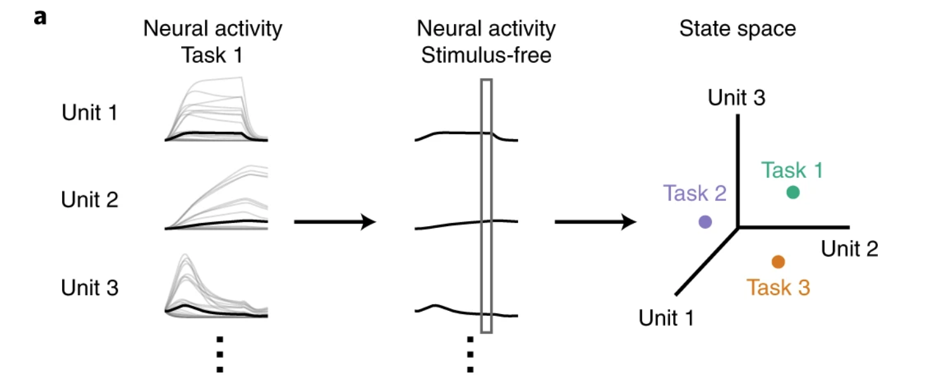
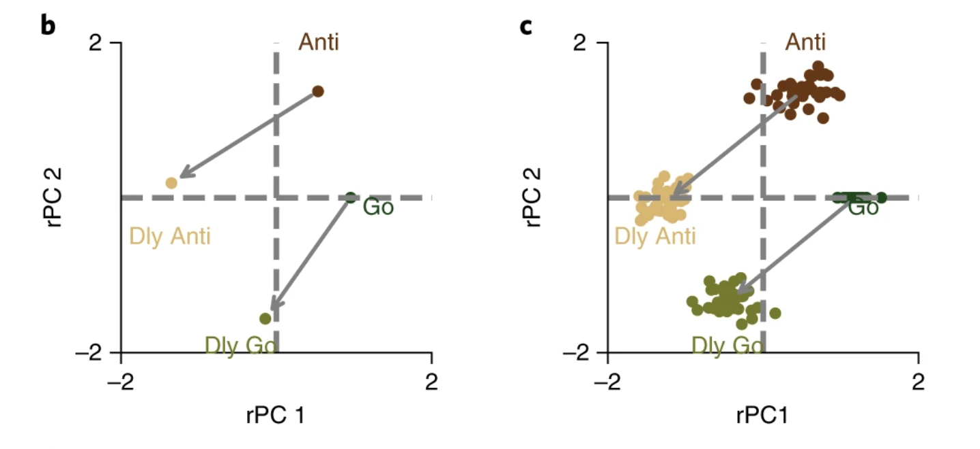
Compositional representation of tasks in state-space
Notes:
a. The representation of each task is the population activity of the recurrent network at the end of the stimulus presentation, averaged across different stimulus conditions (black). Gray curves indicate the neural activities in individual task conditions.
b, Representations of the Go, Dly Go, Anti, and Dly Anti tasks in the space spanned by the top two principal components (PCs) for a sample network. For better comparison across networks, the top two PCs are rotated and reflected (rPCs) to form the two axes.
c. The analysis described in b was performed for 20 networks, and the results are overlaid.

Slide 10
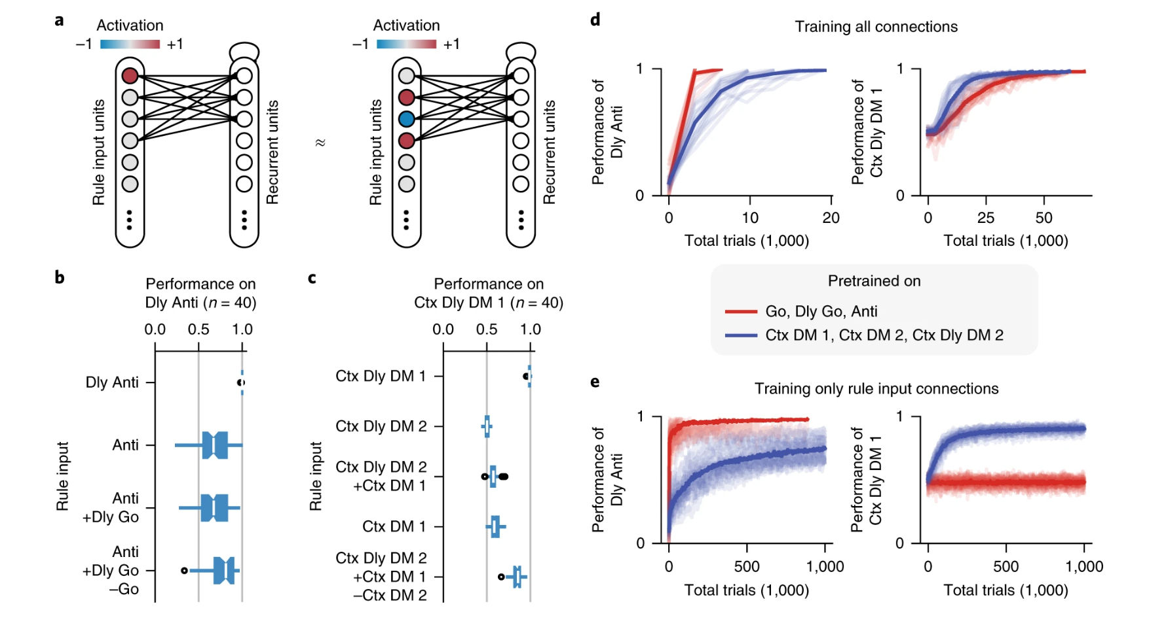
Performing tasks with algebraically composite rule inputs
Notes:
Returning to the idea of compositionality, or recombining rules from different tasks to generate a different task rule
In a neuronal circuit equipped with a compositional code, a new task might be represented as the algebraic sum of representations of the underlying elementary processes.
During training, a task is always instructed by activation of the corresponding rule input unit (left). After training, the network can potentially perform a task by activation or deactivation of a set of rule input units meant for other tasks (right).
The network can perform the Dly Anti task well if given the Dly Anti rule input or the Anti + (Dly Go − Go) rule input. The network fails to perform the Dly Anti task when provided other combinations of rule inputs.
Same for the Context Dependent Delay DM 1 task. When provided with the Ctx Dly DM 2 + (Ctx DM 1 − Ctx DM 2) rule input, network can perform the CTX Dly DM 1 task well. Circles represent the results of individual networks and bars represent median performances of 40 networks.
Left, network performance during training of the Dly Anti task when the network is pre-trained on Go, Dly Go, and Anti tasks (red), or the Ctx DM 1, Ctx DM 2, and Ctx Dly DM 2 tasks (blue). Right, network performance during training of the Ctx Dly DM 1 task under the same pre-training conditions. Individual networks (light); mean across 40 networks (bold). All connections are adjusted during training.
Similar to d, but only training the rule input connections in the second training phase.

Slide 11
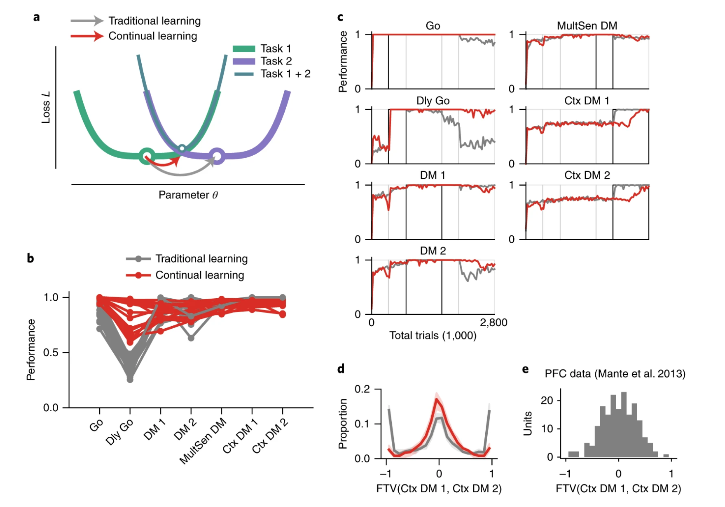
Continual learning versus traditional learning
Notes:
In most of the networks presented so far, all tasks were randomly interleaved during training, and the networks adjusted all of the connection weights to perform the 20 tasks optimally. However, adult animals typically learn tasks sequentially. When an adult animal is learning some new tasks, its brain needs to implicitly balance the need of learning with the need of retaining past memories. Sequential learning is a big problem for deep learning models.
Catastrophic forgetting: learning new tasks will happen at the expense of forgetting previous memories. The network learns to perform a task by modifying parameters to minimize the loss function for this task. During sequential training of two tasks, if the network uses traditional learning techniques, training for the second task can easily result in the failure of performing the first task, as the minima of the loss functions of tasks 1 and 2 are far apart.
a. Schematics of continual learning compared with traditional learning. Network parameters (such as connection weights) optimal for a new task can be destructive for old tasks. Arrows show changes of an example parameter θ when task 2 is trained after task 1 is already learned.
b. Final performance across all trained tasks with traditional (gray) or continual (red) learning techniques. Lines represent the results of individual networks. Only networks that achieved more than 80% accuracy on Ctx DM 1 and 2 are shown.
c. Performance of all tasks during sequential training. Example networks used traditional (gray) or continual (red) learning techniques, respectively. For each task, the black box indicates the period in which this task was trained. DM 1 and 2 tasks were trained in the same block to prevent bias, as were Ctx DM 1 and 2 tasks.
d. FTV distribution for CTX DM 1 and 2 for networks with traditional (gray) or continual (red) learning techniques. Solid lines are median over 20 networks. Shaded areas indicate the 95% confidence interval of the median estimated from bootstrapping.
e. The FTV distribution computed used single-unit data from the PFC of a monkey.

Slide 12
Summary of the Results
Each cluster is specialized for a subset of tasks
Network showed a form of compositionality, but it could not perform all tasks with algebraically composite rule inputs
Network successfully learned many tasks sequentially using a continual learning technique
Notes:
3. The FTV distribution derived from experimental data mainly consists of a broad, unimodal distribution, consistent with networks sequentially trained using a continual-learning technique. These findings suggest that adult brains do not necessarily develop the ‘optimal’ circuit-level solution for newly learned tasks, even if they have been trained for months on the same tasks. Instead, the brain may balance the need between performing the tasks at hand and retaining past memories.

