Slide 1
Presentation templates
Directorate 7 – Strategy and Communication
Corporate Design
in TU Dresden Corporate Design // as of May 2022
Corporate design rules - Guidelines for using the template and ensuring accessibility

Slide 2
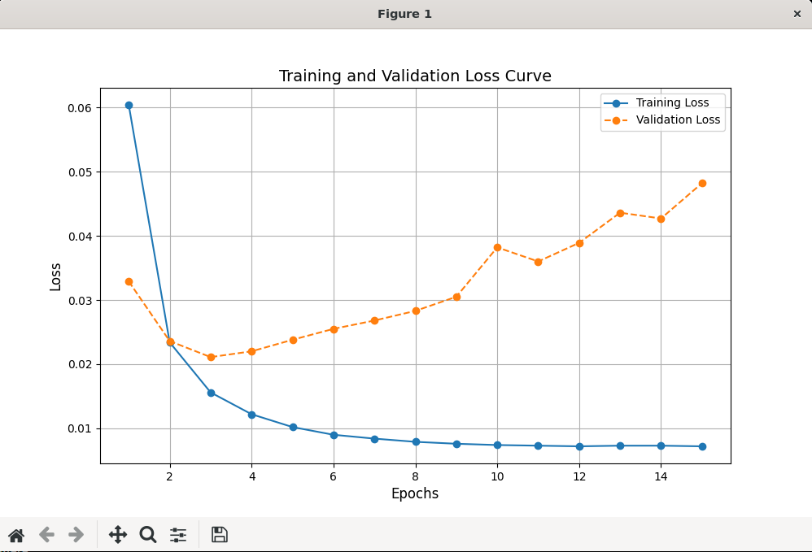
CNN Model Results
Architecture
Three convolutional layers (16, 32, 64 filters), each followed by 2x2 max-pooling with a fully connected layer for 80 output labels with sigmoid activation.
Training Results
Training loss decreases steadily, saturating at 8 epochs
Validation loss rises after epoch 3, indicating overfitting
Key Takeaways
Accuracy: 0.7396
Precision: 0.8781
Recall: 0.9881
F1 Score: 0.8830

