Slide 1

SMART INDIA HACKATHON 2026
TITLE PAGE
Problem Statement ID – 26102
Problem Statement Title- Development of an AI-powered system to detect anomalies, fraud, and inefficiencies in MPLAD Scheme implementation regd.
Theme- Smart Automation
PS Category- Software
Team ID-
Team Name - sns

Slide 2
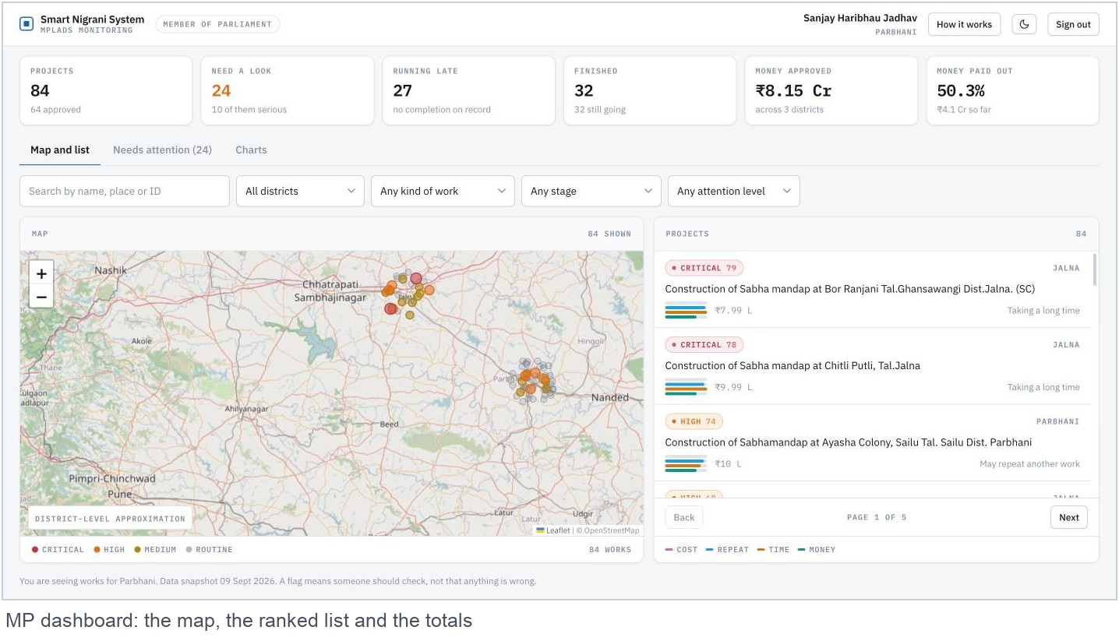
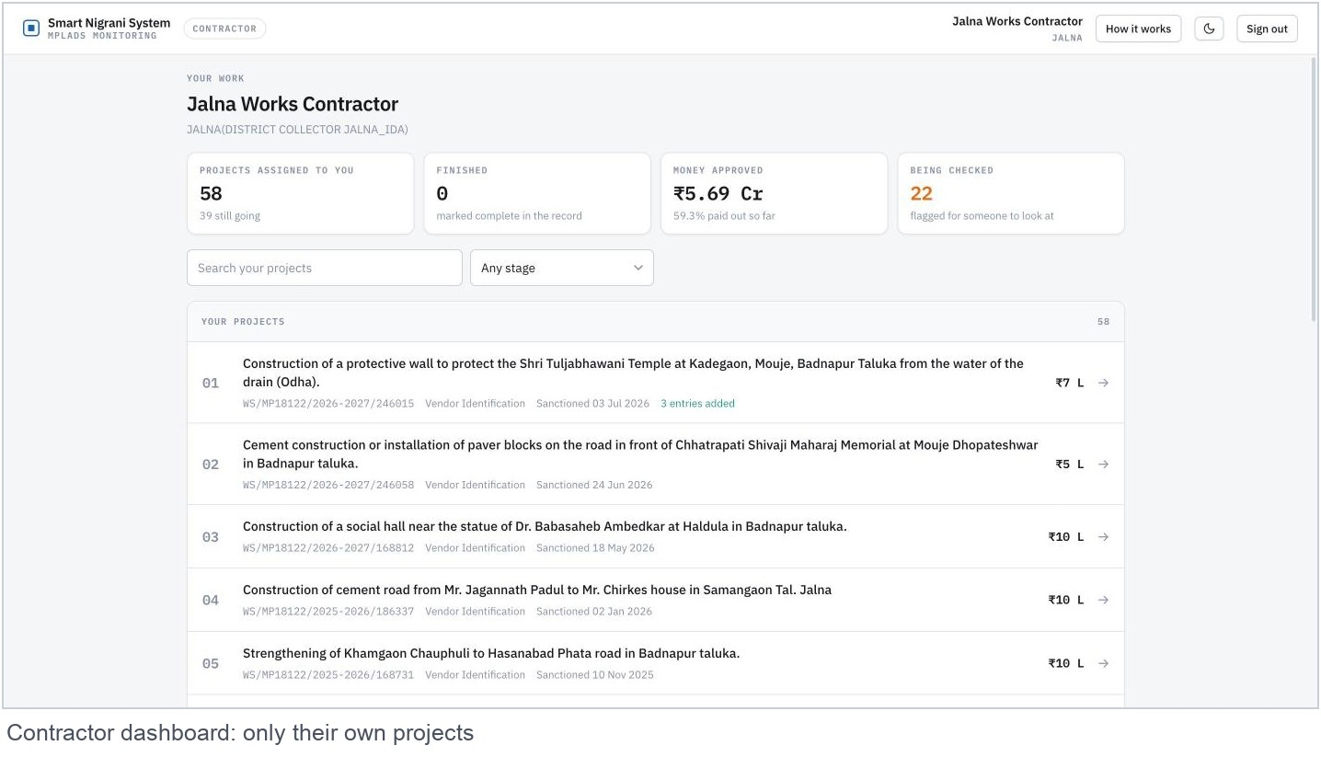
Smart Nigrani System
sns
Proposed Solution: Smart Nigrani System, one screen that shows which public works need checking
What it does
Reads the records: It takes the MPLADS files the government already publishes and puts them all in one place.
Runs four checks: Is the cost normal, has the same work been entered twice, is it taking too long, has the money moved ahead of the work.
Ranks the list: Every work gets a number out of 100, and the ones that need a look sit at the top.
Says why: Each flag comes with a plain sentence. Nothing is hidden inside a black box.
Who uses it
Member of Parliament: sees every work in their constituency, on a map and in a ranked list.
Contractor: sees only their own projects and adds each piece of work with its cost and date.
Running on real data today
4,807 works, 47 constituencies, 39 districts and Rs. 463 crore of approved money. Nothing on the screen is invented.
264 works are flagged: 4 Critical, 74 High and 186 Medium.
What makes it different
It never claims fraud. It ranks records for a person to check, and it shows its working every single time.
@SIH Idea submission- Template

Slide 3
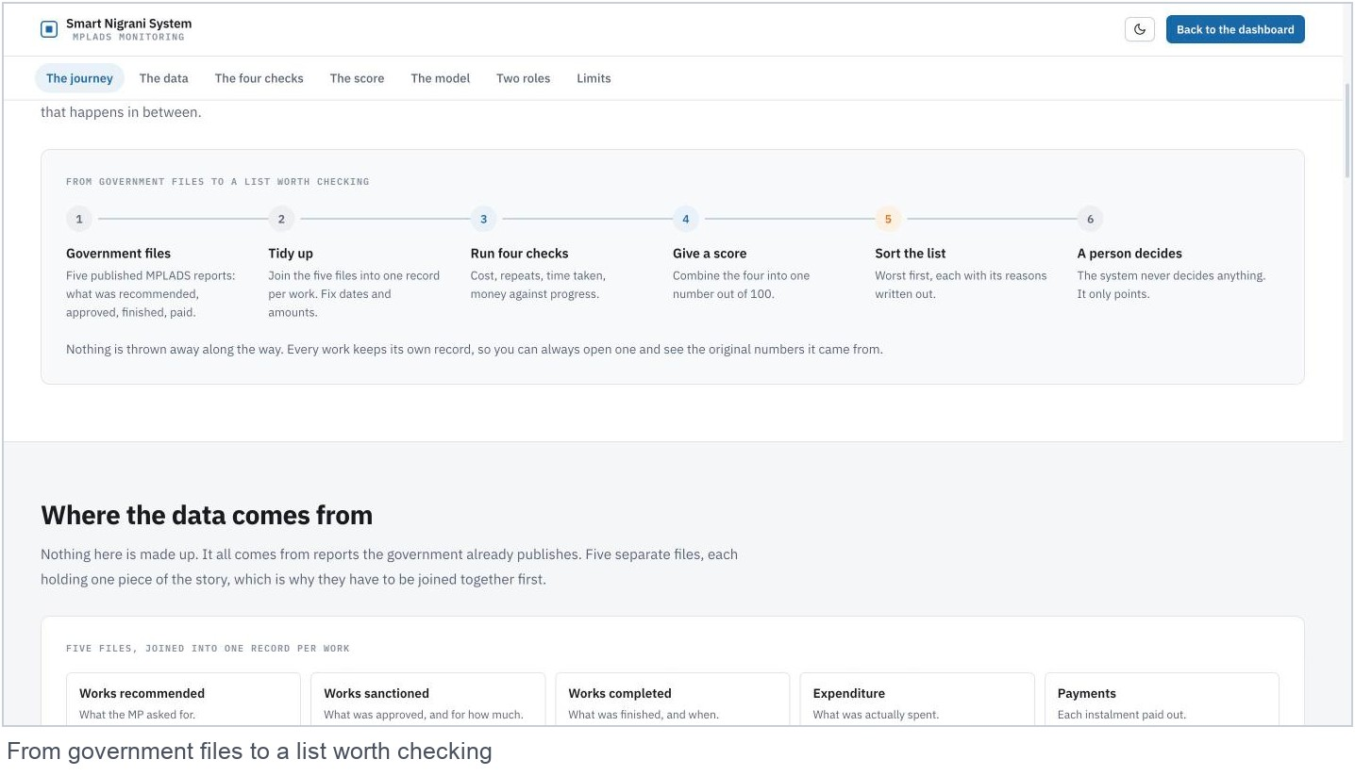
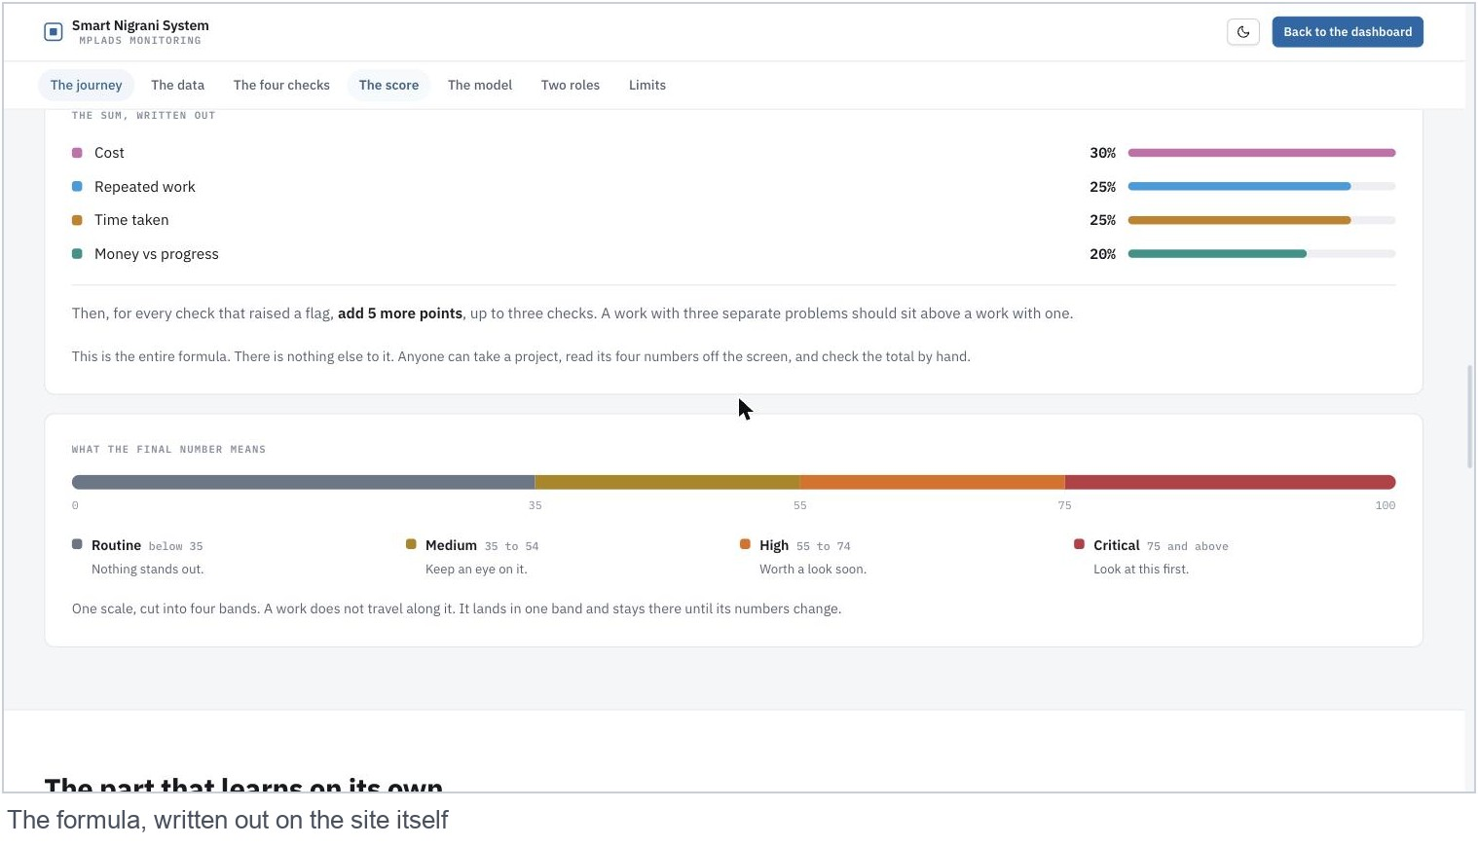
TECHNICAL APPROACH
sns
What we built it with
Website: React 19 with TypeScript, built using Vite. Plain CSS, no UI kit.
Map: Leaflet with free OpenStreetMap tiles.
Server: Python with FastAPI. Five packages listed, and not one of them is a machine learning library.
Data: All 4,807 works load from one JSON file. Logins and contractor entries live in SQLite. Supabase holds an exported copy.
Learning part: Isolation Forest. Trained once offline with scikit-learn, saved as JSON, then scored inside the server using plain Python.
Sign in: Passwords are hashed with PBKDF2 and tokens are signed. Both come from the Python standard library.
How it works, step by step
1. Five government CSV files go in.
2. A script cleans them, joins them on the work ID and writes one JSON file.
3. The four checks score every work out of 100.
4. The four scores are added with weights: cost 30, repeated work 25, time taken 25, money against progress 20. Each check that fires adds 5 more, up to three checks.
5. 75 and above is Critical, 55 to 74 is High, 35 to 54 is Medium, below 35 is Routine.
6. The Isolation Forest gives a separate second opinion. It sits next to the score and is never mixed into it.
@SIH Idea submission- Template

Slide 4
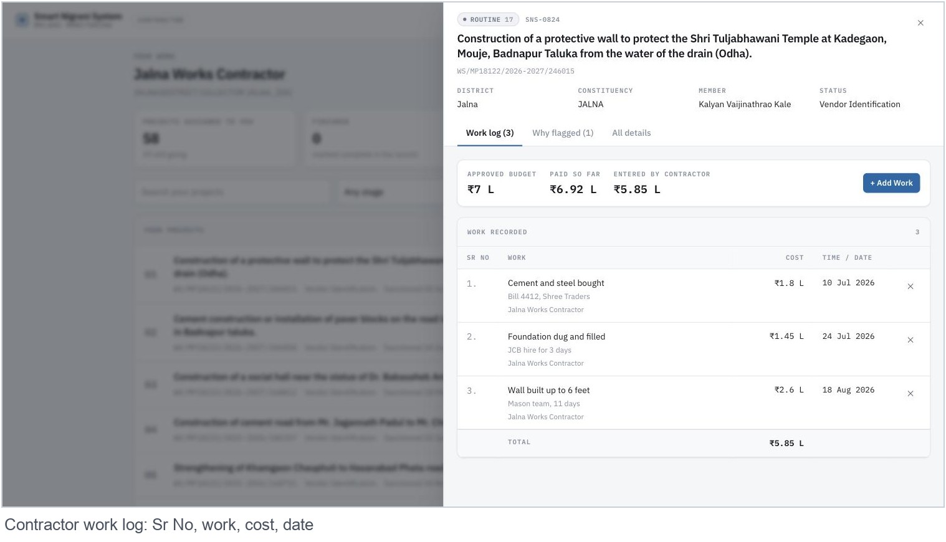
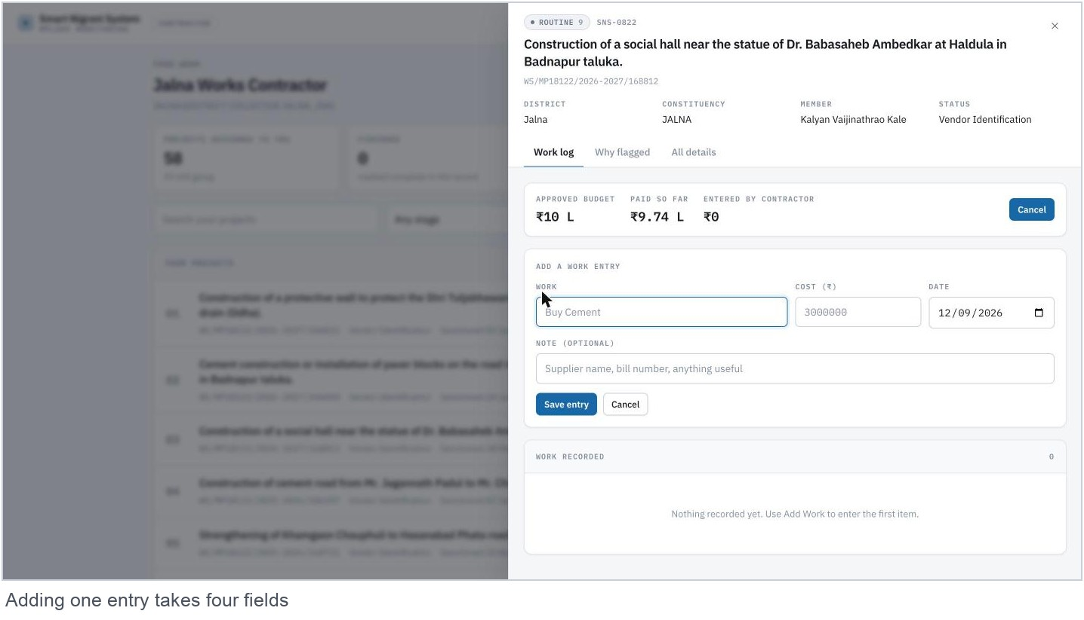
FEASIBILITY AND VIABILITY
sns
Feasibility
It runs today on a normal laptop. The server installs in about twenty seconds.
Nothing paid is needed. The data is public and the map tiles are free.
The whole website is about 150 KB of code over the network, so it opens fast on a weak connection.
Covering another state means running the same script on that state’s files.
Challenges
The source files are messy. Joining them the simple way gave 468,322 rows instead of 4,807, because blank work IDs matched each other.
The files carry no site coordinates and no progress percentage.
Nobody has a labelled list of fraud cases, so an ordinary trained model is not possible.
This snapshot covers Maharashtra only.
How we handled them
The data script skips blank IDs before joining. The result is exactly 4,807 works, and a test checks that number on every run.
Map pins are placed at district level, and the screen says so in plain words.
The contractor work log fills the missing progress, entered by the person doing the work.
The model needs no labelled cases, and it is kept out of the score people act on.
@SIH Idea submission- Template

Slide 5
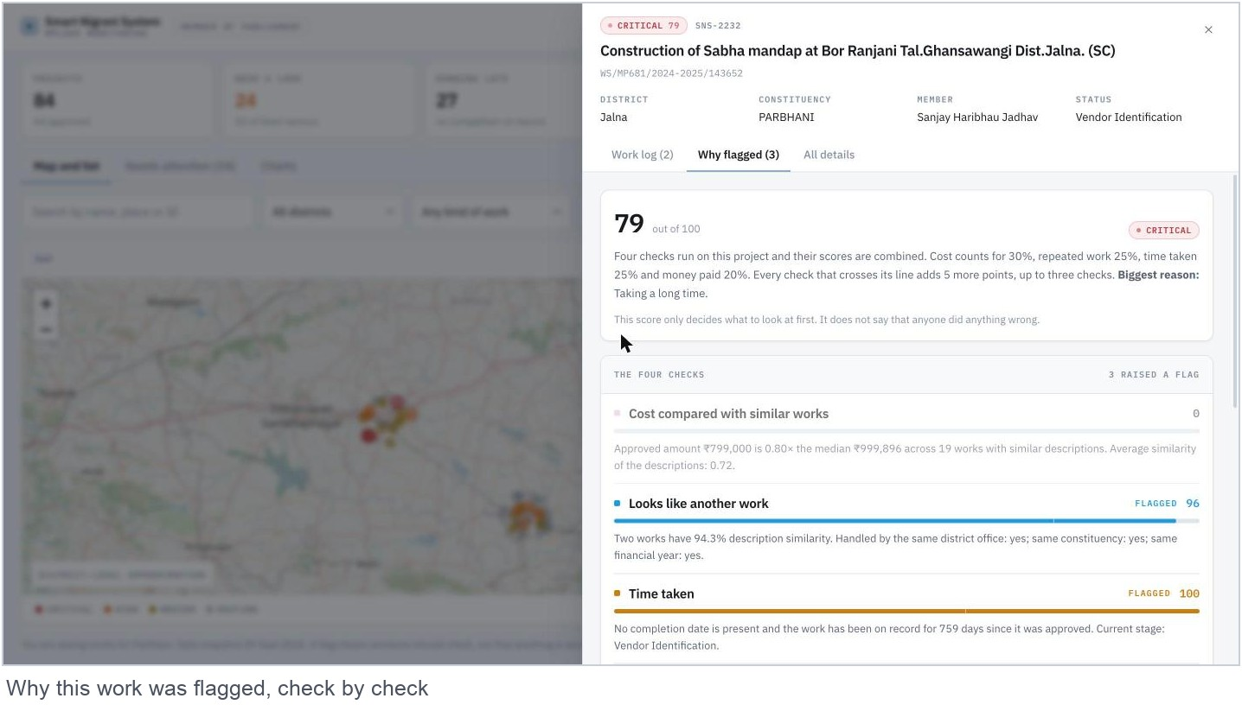
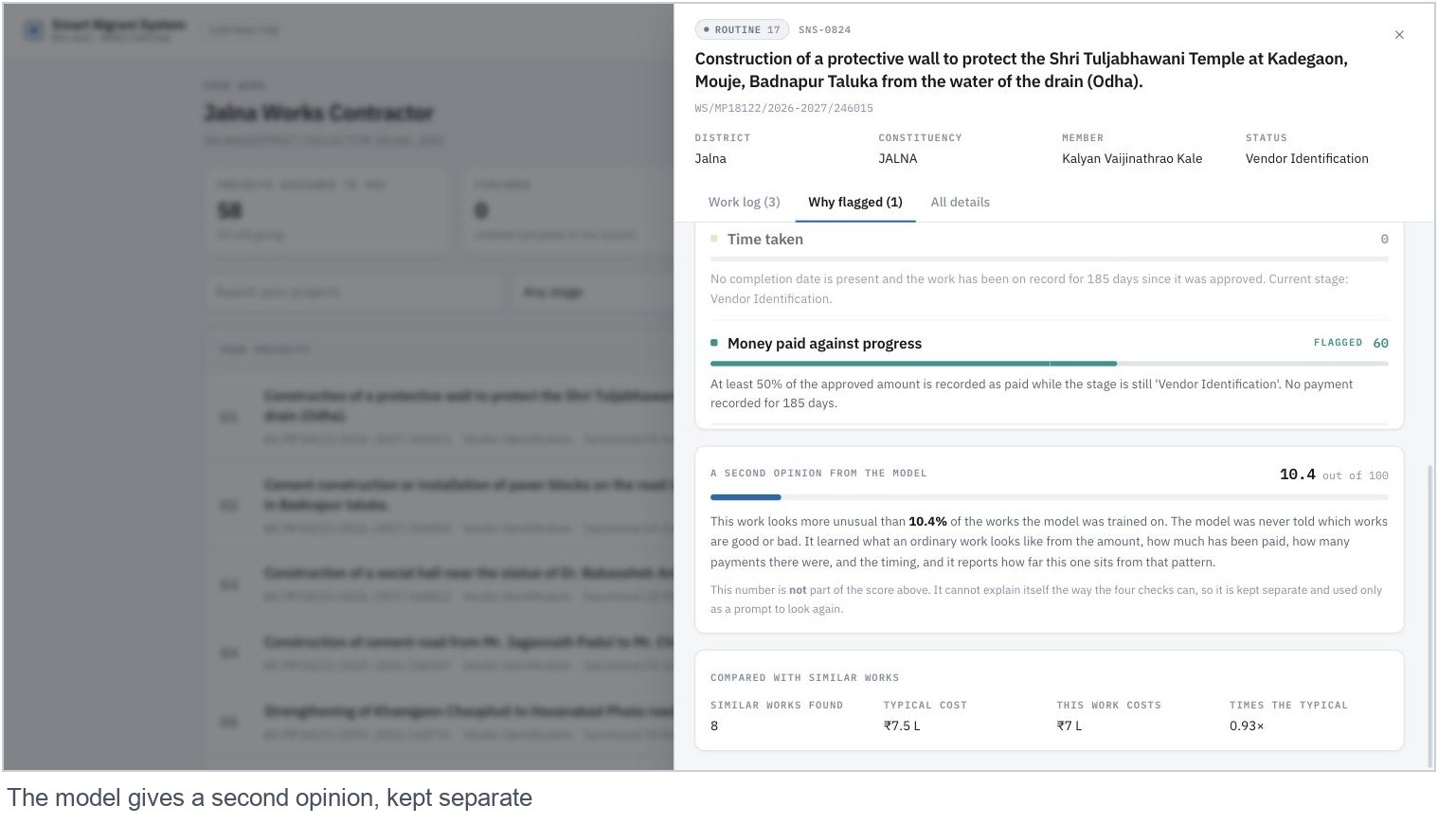
IMPACT AND BENEFITS
sns
Impact
An MP opens one screen and sees 84 works and the 24 that need a look, in a few seconds.
Every flag carries a sentence, so an officer can agree or disagree without asking how the number was made.
Money paid ahead of the work shows up now, instead of in an audit a year later.
Contractors record work as it happens, so progress stops being a phone call.
Benefits, measured on this snapshot
4,807 works checked. 264 flagged: 4 Critical, 74 High and 186 Medium.
The model picked its 24 most unusual works. 18 of them had been marked Routine by the four checks, so that is 18 extra works worth a second look.
Rs. 463 crore of approved money brought into one view, with Rs. 147 crore recorded as paid.
Screening goes from reading 4,807 rows to reading a short ranked list.
@SIH Idea submission- Template

Slide 6
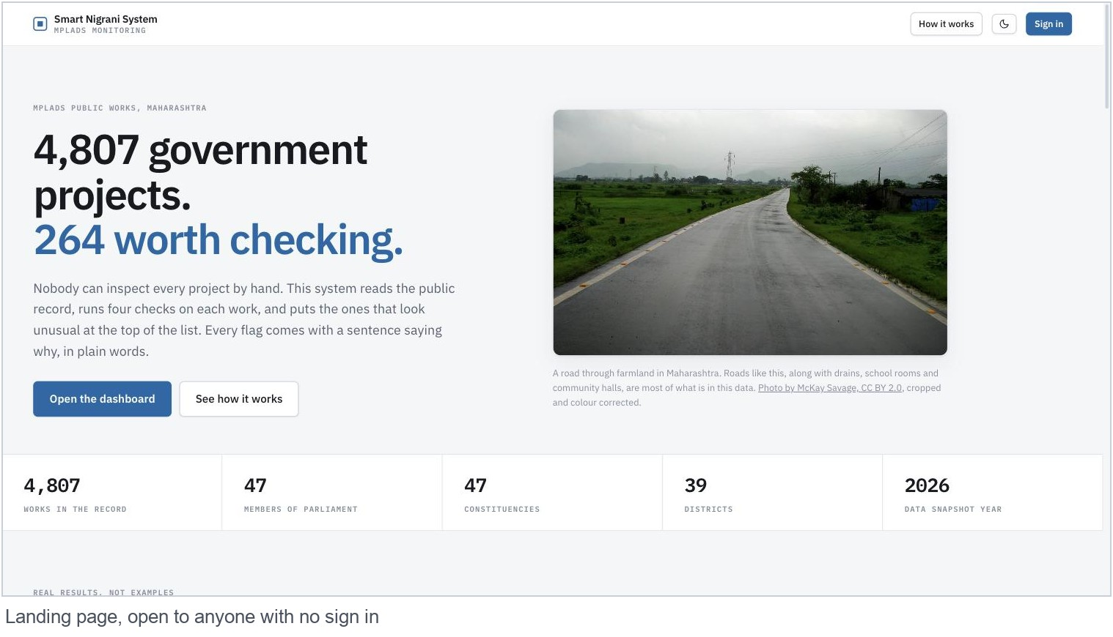
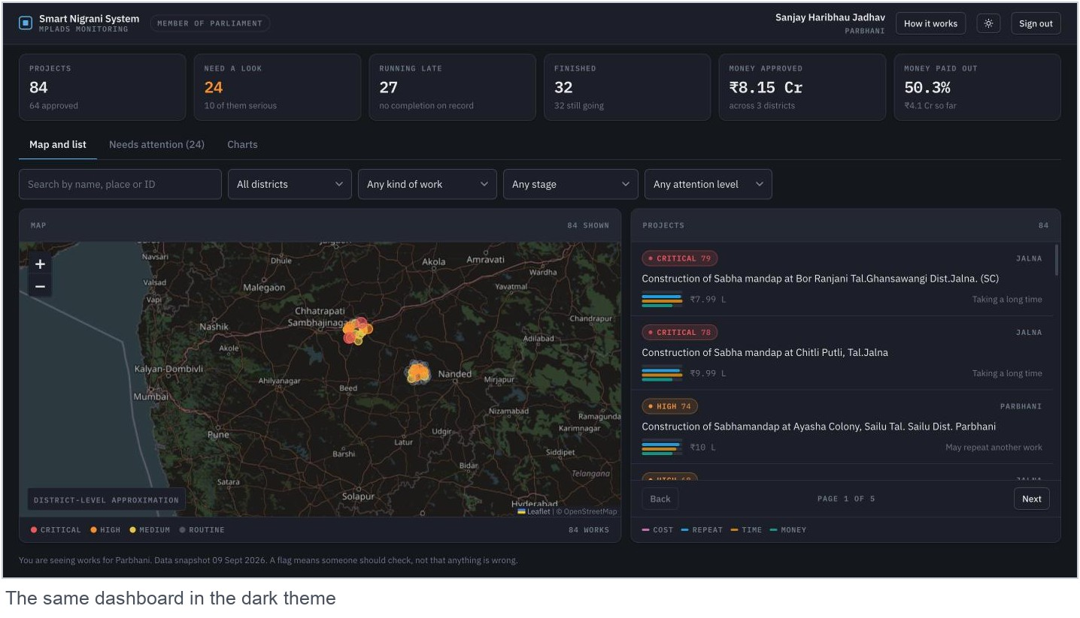
RESEARCH AND REFERENCES
sns
Where the data comes from
MPLADS eSAKSHI portal: works recommended, works sanctioned, works completed, expenditure, and the allocated limit for each MP. Maharashtra, snapshot dated 09 September 2026.
The five files are read exactly as they are. Nothing is edited by hand.
Tools used
FastAPI: the server and the API
scikit-learn and numpy: training the Isolation Forest, offline only
React, Vite and TypeScript: the website
Leaflet and OpenStreetMap: the map
SQLite: logins and contractor work entries
What we read up on
Isolation Forest. Liu, Ting and Zhou, 2008. Finding unusual records when nobody has labelled them.
Near duplicate text matching, for spotting the same work written twice.
Rule based scoring with published weights, so anyone can check a score by hand.
One honest note: the score ranks records for a person to check. It is not a claim that anyone did anything wrong.
@SIH Idea submission- Template

