Slide 1
Battle for Toronto Neighbourhood
Rehan Chaudhry

Slide 2
Background
Toronto is a vibrant multicultural city. Finding a right neighbourhood is not easy. A young family with children have to decide which neighbourhood to live in. So, there are certain criteria for the family to choose what is important for them in the neighbourhood. They are:
Grocery Stores - Since most families eat at home, they have to be closed to at least one grocery store.
Shopping Mall - For a busy family a shopping mall would be an ideal place to shop in one area and also for entertainment.
Parks - For a family to enjoy the outdoors and get exercise.
Movie Theatres - This is for family entertainment.
Gym - The family also have to have access to a gym for exercise.
Pharmacy - Family do get sick (especially children) and they would require access to medicines from the pharmacy.
Metro Station – To use for commute to work.
There could be other criteria for family to consider in a neighbourhood but for this analysis, the above criteria are selected.

Slide 3
Data
For the analysis, the following are the data sources are used:
Toronto Geospatial data - This is required for mapping out neighbourhoods and also for visualization for different neighbourhood clusters. http://cocl.us/Geospatial_data
Postal code data - This will be necessary to identify neighbourhoods that needed to be studied as well as being linked with geospatial data. List of postal codes of Canada: M
Foursquare data for Toronto - This is necessary for selecting venues such as grocery stores, shopping mall and so on for cluster analysis.

Slide 4
Data cleansing
Since there are three datasets that are going to be combined together, there is bound to be some dataset with null value. Throughout the analysis any null value will be removed from the dataset for the purpose of this analysis. No other data cleaning is required for this data analysis.

Slide 5
Feature selected
Geographical Information:
Postal Code
Borough
Neighbourhood
Longitude and Latitude
Venue Selection:
Playground
Supermarket
Metro Station
Gym, Park
Shopping Mall
Grocery Store
Organic Grocery
Salon / Barbershop

Slide 6
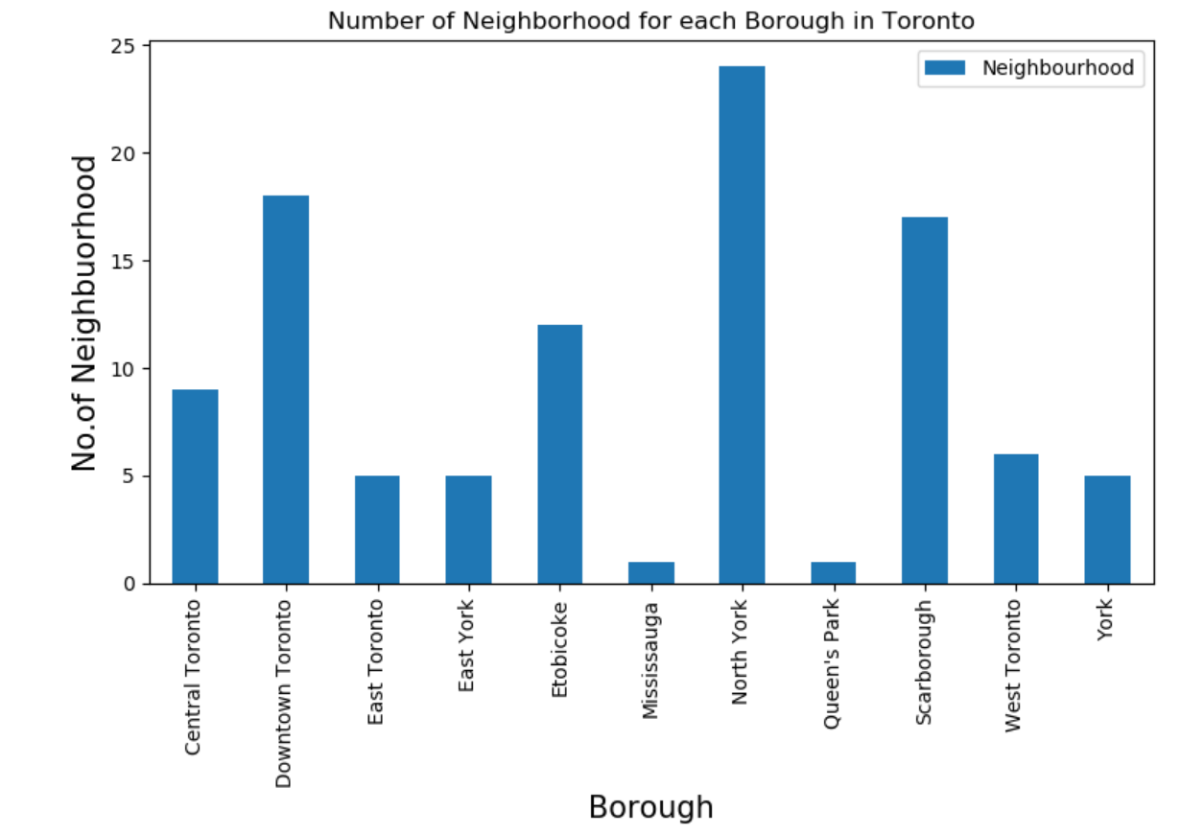
Analysis
The first step is to determine which neighbourhood to choose for analysis. For this analysis, three largest neighbourhoods are select to provide choice for a family. Based on Geographical information, the following bar chart is generated to determine the size of the neighbourhood.
Based on the above bar chart, the top 3 neighbourhood are:
1) North York
2) Scarborough
3) Downtown Toronto

Slide 7
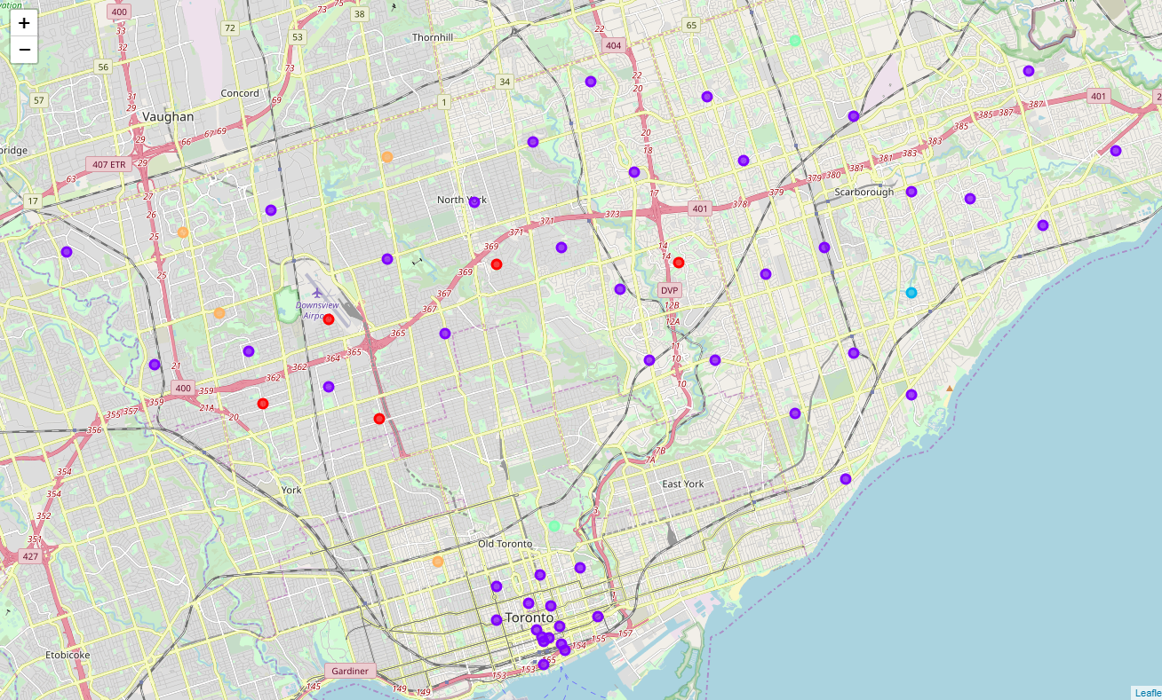
Analysis - Continued
For the cluster analysis, K=5 was selected. Also, the top 10 most common venue analysis was done as part of the cluster analysis. The following is the distribution of cluster among the top 3 neighbourhood.

Slide 8
Analysis Continue
k-cluster analysis
Cluster 1 is in the North York neighbourhood. The most common venues (1-10) are the same for this cluster.
Cluster 2 has the largest number of neighbourhoods. They are spread out in the three boroughs. There is no commonality in the venues (1-10). As it was in Cluster 1
Cluster 3 has only one neighbourhood and it is in Scarborough.
Cluster 4 has two neighbourhood (one downtown Toronto and one Scarborough). The most common venues (1-10) are the same for this cluster.
Cluster 5 has 4 neighbourhoods. There are some similarities in venues. Also, the neighbourhood is the downtown Toronto and North York.

Slide 9
Further consideration
This analysis was done based on Four Square data. However, other consideration for families to decide which neighbourhood to choose are as follows:
School and their ranking in the city
Price of houses
The ethnic makeup of the neighbourhoods.

