Slide 1

Cardiovascular Diseases Prevention
November 2023
Rehahn Qureshi

Slide 2
Plan

Slide 3
Objective
Cardiovascular diseases (CVDs including strokes) are the leading cause of death globally, taking an estimated 19 millions lives in 2021 (32% of all deaths, whereas it was 27% in 1990).
This study aims to better understand the causes of CVD for a better prevention and longer life.

Slide 4
II. Data Sources
- Flat File download from https://www.cdc.gov/brfss/annual_data/annual_2021.html (CDC)
The 2021 annual telephone survey organized by the BRFSS (Behavioral Risk Factor Surveillance System, part of the U.S. Department of Health)
- Web scraping
- https://www.cdc.gov/brfss/annual_data/2021/llcp_varlayout_21_onecolumn.html oo
- https://en.wikipedia.org/wiki/Federal_Information_Processing_Standard_state_code
- API
- https://datausa.io/api/data?drilldowns=State&measures=Air%20Pollution&year=2021
- https://datausa.io/api/data?drilldowns=State&measures=Population&Year=2021
- Big Data (BigQuery on Google Cloud)
- dataset from the America’s Health Rankings

Slide 5
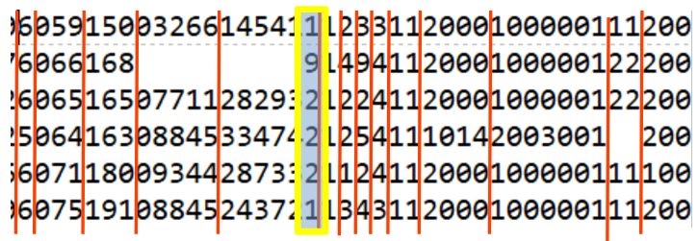
II. Data Sources - CDC - Data extraction from the ASCII file
A HUGE serie of digits: 438,000 rows of 2072 characters (303 features)
Example: the BMI feature with the codes
1 = underweight / 2 = normal weight / 3 = overweight / 4 = obese
7 = don’t know / 9 = refuse to answer / <blank> = not asked or missing

Slide 6
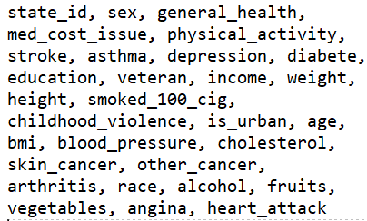
II. Data Sources - CDC
Selected 30 features →
heart attack “+” angina = CDC
Anonymized data → free of GDPR considerations

Slide 7
III. Data Cleaning - CDC table mostly
- Numerical codes replaced by meaningful names
- Correct the data types
- Correct the units (imperial/metric for height & weight, daily/weekly, …)
- No duplicates

Slide 8
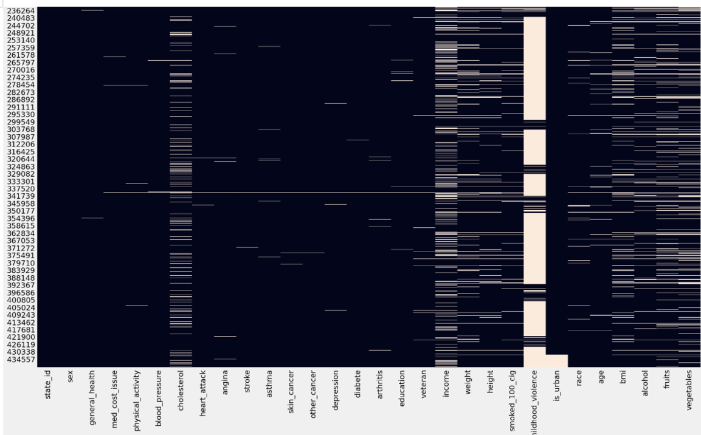
III. Data Cleaning - CDC mostly
- Missing values
- income : 33% missing → group by age & education → most frequent
- is_urban : ‘white block’ → google search for Puerto Rico/Guam/Virgin
- childhood_violence : 85% missing → removed
- other persons with missing values → removed

Slide 9
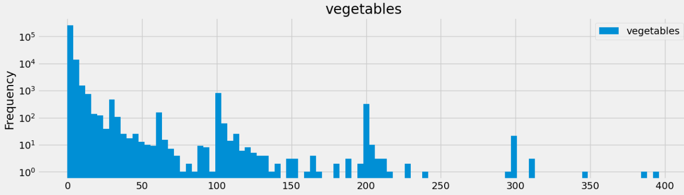
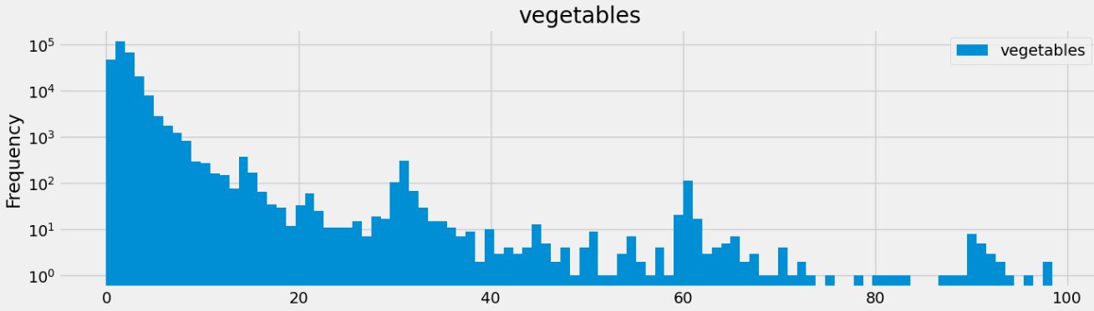
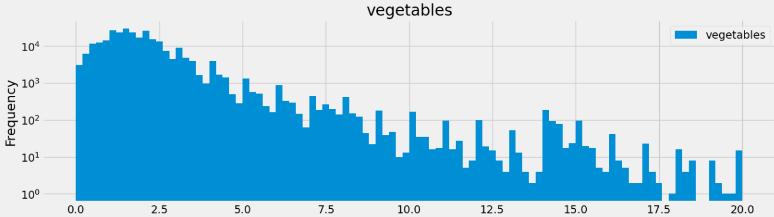
II. Data Cleaning - CDC mostly
- Outliers

Slide 10
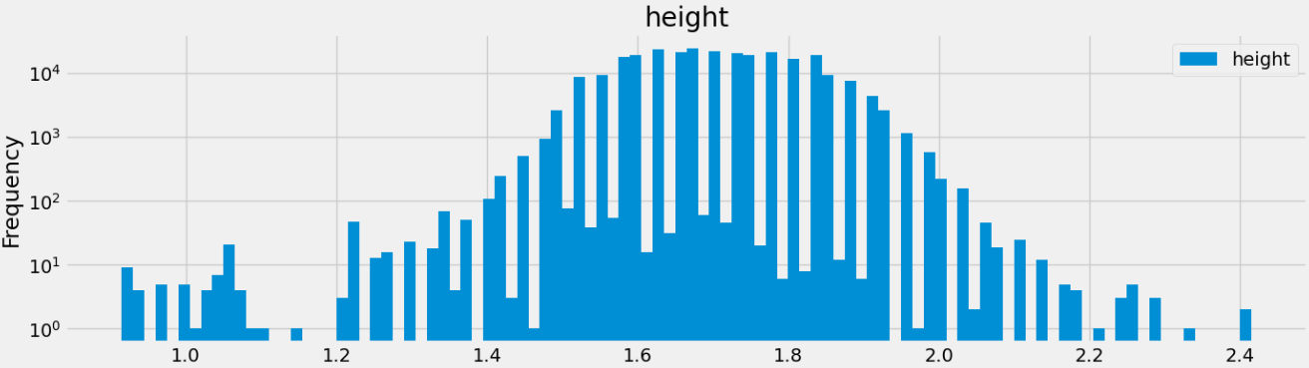
II. Data Cleaning - CDC mostly
- Outliers - example 2
Fat tails = jokers ?
Many small heights = kids over 18 ?!
36 persones are > 7 feet (2.13m) out of 275,000 ie 1 / 8,000
<> Google → 1 /900,000 adults!
Remove all persons outside [1.30m, 2.10m]

Slide 11
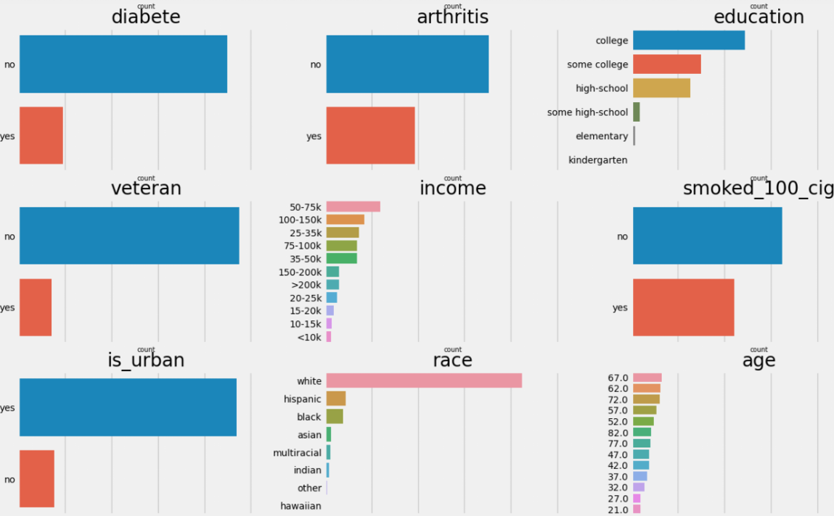
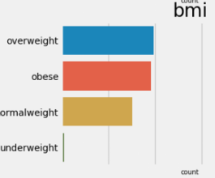
III. Visualizations - Data distribution
- Data not exactly in line
with the U.S. population:
- age 65+ (38%<>18%)
- race (85%<>60%)
- bmi(?) (70% = 70%)

Slide 12
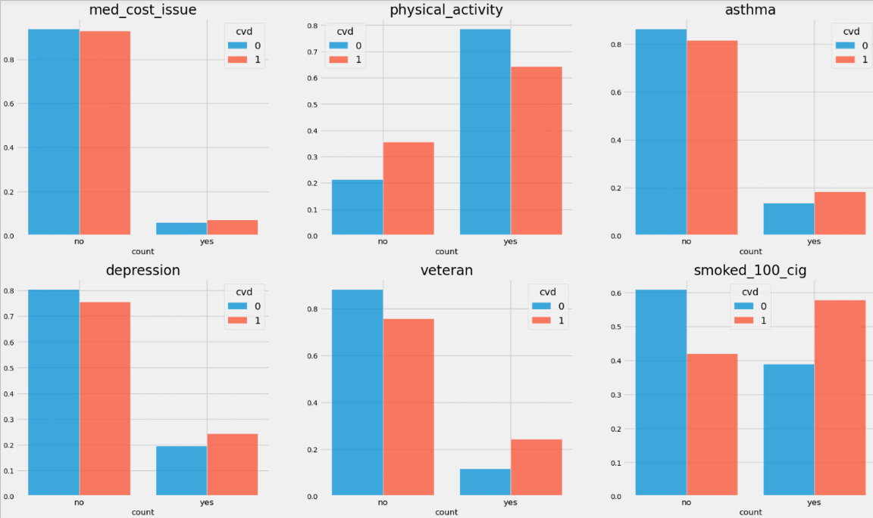
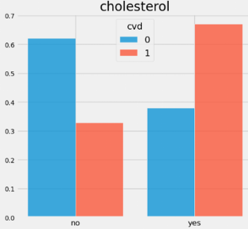
III. Visualizations - Relationships between CVD and the features
Many factors seem to be linked to CVD …

Slide 13
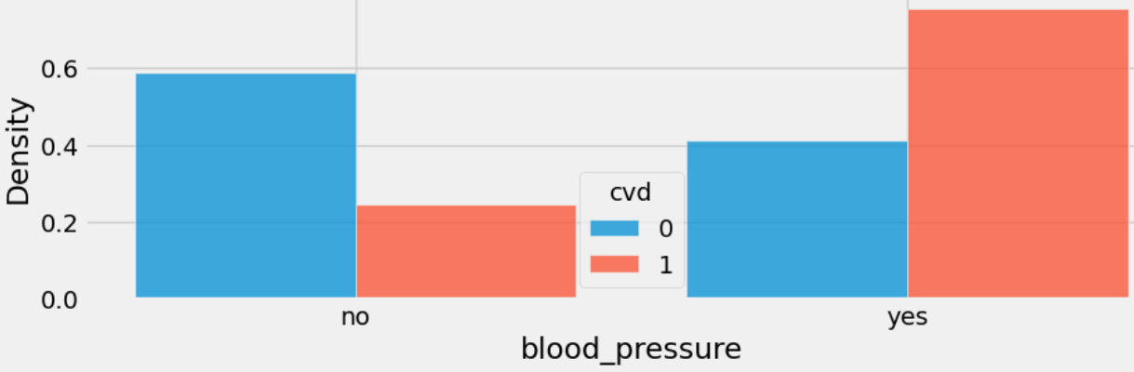
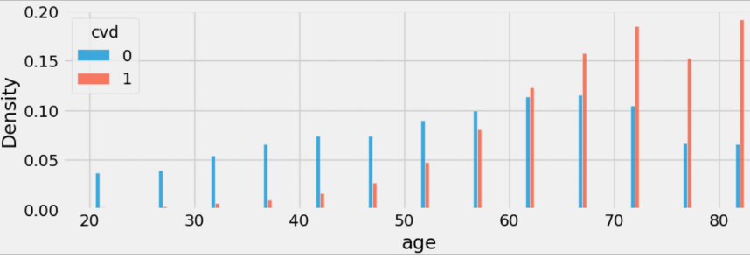
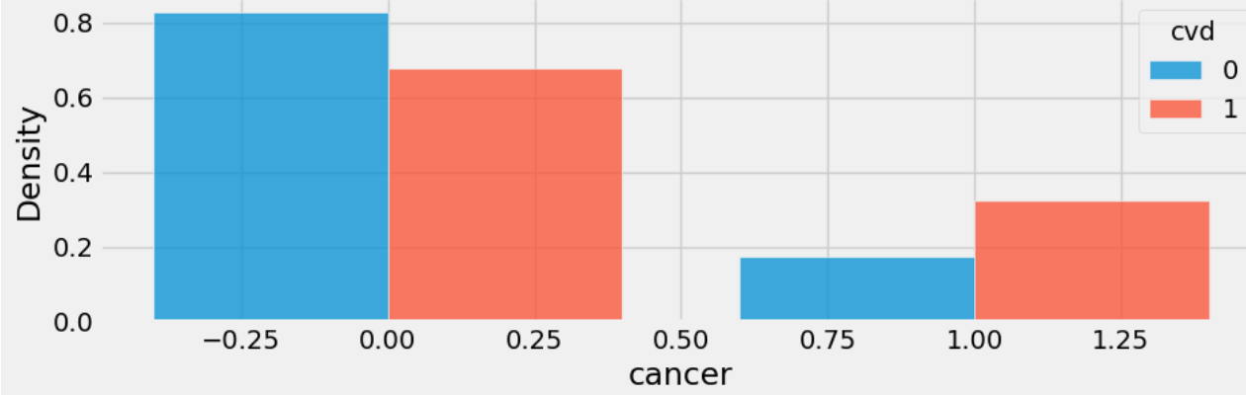
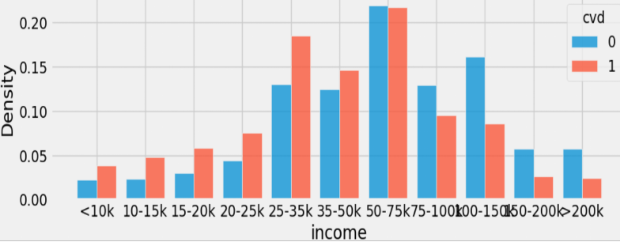
III. Visualizations - Relationships between CVD and the features

Slide 14
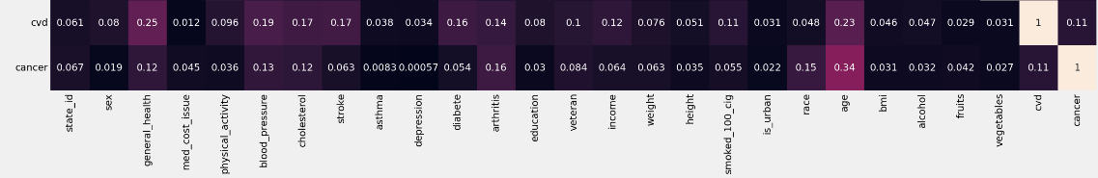
III. Visualizations - Correlation (Cramer-V) with CVD
- Confirms most of the links seen in the visualizations BUT the level of “correlation” is not so high maybe because of the limitations seen in dataset.
- Surprisingly vegetables & fruits & alcohol have very small correlation with CVD, why? → french fries! & past 30 days

Slide 15
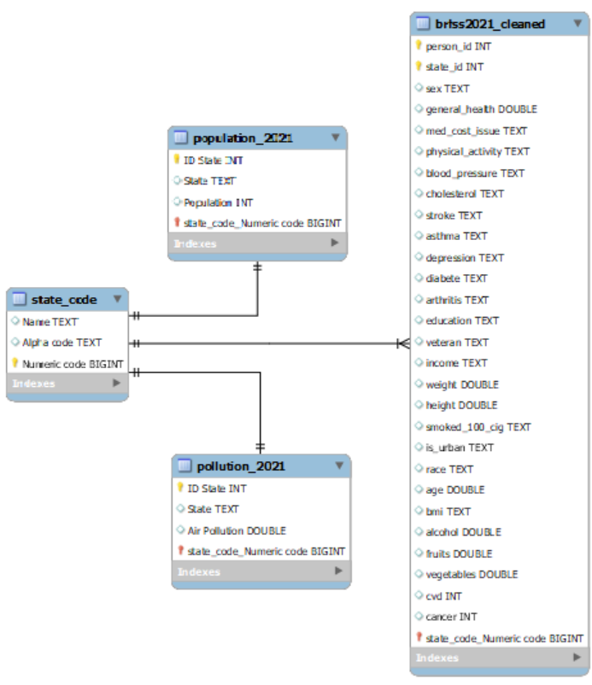
IV. Database - ERD
A relational database (MySQL)
was used to merge the 4 tables

Slide 16
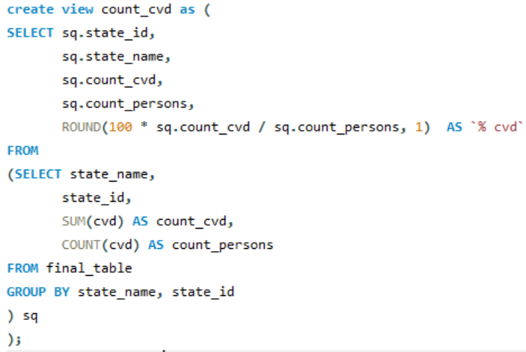
IV. Database - Queries
SQL query to find the Top 5
and Bottom 5 states based on % CVD

Slide 17
