Slide 1
Disaster Tweets
Classification
Building the Best Classifier for Emergency Tweet Detection
Reha
Masterschool — Data Science & Machine Learning

Slide 2
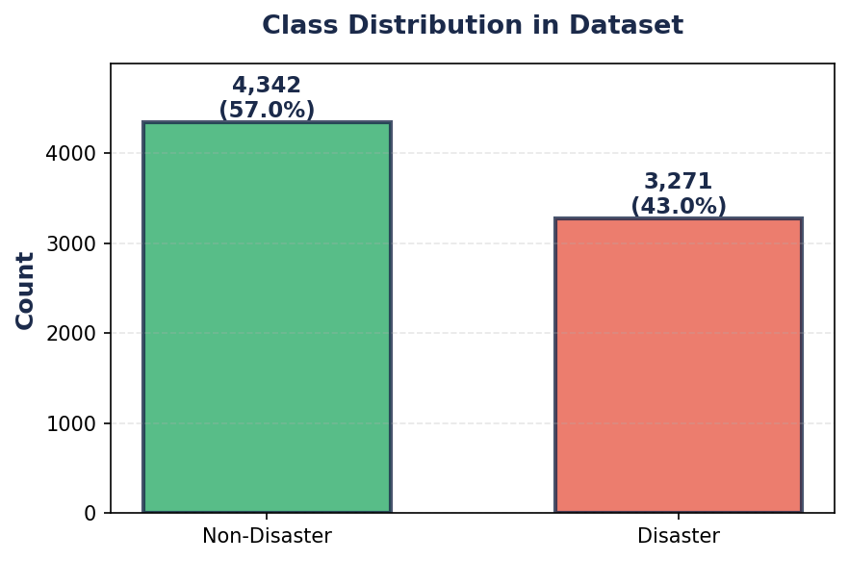
The Problem & Dataset
Kaggle — "Natural Language Processing with Disaster Tweets" competition dataset.
The Problem
People use Twitter to report real emergencies — earthquakes, wildfires, floods. But not every tweet mentioning "fire" or "crash" is about a real disaster.
The challenge: distinguish real disaster reports from everyday language that uses disaster words metaphorically.
The goal: build the most reliable classifier so it can be deployed in real emergency response systems.
The Dataset
7,613
2
80/20
6,090
1,523
0
Tweets
Columns
Split
Train
Test
Missing
human-labeled
text + target
stratified
tweets
tweets
values

Slide 3
Text Preprocessing
1. Cleaning
Output After Preprocessing
Removed URLs, @mentions, hashtags, special chars, numbers. Kept hashtag text (#earthquake → earthquake).
Clean: our deeds are the reason of this earthquake may allah forgive us all
Tokens: ['deed', 'reason', 'earthquake', 'may', 'allah', 'forgive']
2. Tokenize, Remove Stop Words & Lemmatize
Tokenize: Split tweets into individual words so we can process each one.
Stop words: Remove "the", "is", "and" — no meaning for classification.
POS-aware lemmatization: POS = Part of Speech. Tag each word (noun, verb, etc.) first, then reduce to base form. "running" as verb → "run", as noun stays "running". Without POS tags, the lemmatizer guesses wrong.
Clean: forest fire near la ronge sask canada
Tokens: ['forest', 'fire', 'near', 'la', 'ronge', 'sask', 'canada']
Clean: all residents asked to shelter in place are being notified by officers no other evacuation or shelter in place orders are expected
Tokens: ['resident', 'ask', 'shelter', 'place', 'notify', 'officer', 'evacuation', 'shelter', 'place', 'order', 'expect']
3. Custom Stop Words
Found "amp" and "get" in top 15 of BOTH classes. Removed — no distinguishing signal.
22 words → 11 tokens — noise cut in half, meaningful words kept.

Slide 4
Our Pipeline & Model Selection
Small dataset (7,600 tweets) — we chose fast, proven methods to save time and cost.
TF-IDF Pipeline
Why These Three Models?
What is TF-IDF?
Converts each tweet into a vector of 5,000 numbers. Words frequent in one tweet but rare overall score high — distinctive words stand out.
Why TF-IDF for this project:
With only 7,600 tweets, we need a lightweight method. TF-IDF is fast, needs no GPU, and costs nothing to run — no point using heavy approaches like BERT on a small dataset.
The sklearn Pipeline:
Wraps TF-IDF + model into one step. No data leakage, easy to deploy.
All three are fast to train on small datasets — no GPU, no cloud costs.
Logistic Regression
Standard baseline for text. Fast, interpretable, handles sparse TF-IDF data well.
SVM (LinearSVC)
Finds optimal decision boundary in high dimensions. Often best on TF-IDF features.
Random Forest
Captures non-linear patterns. Included to test if the data needs non-linear approaches.
Pipeline parameters: max_features=5000 | ngram_range=(1,2) | Unigrams + bigrams capture both "earthquake" and "forest fire"
Why not BERT/Neural Networks? 110M parameters on 7,600 tweets = overfitting risk, GPU cost, and longer training — not worth it for this dataset size.

Slide 5
Finding the Best Model
We used 5-fold cross-validation instead of a separate validation set — with only 6,090 training samples, CV uses all the data and gives a more reliable estimate.
Model | Train F1 | Test F1 | Gap | CV F1
SVM Tuned (C=0.1) | 0.83 | 0.77 | 0.06 | 0.74
Logistic Regression | 0.83 | 0.77 | 0.06 | 0.74
SVM (default) | 0.90 | 0.76 | 0.14 | 0.73
Random Forest | 0.98 | 0.76 | 0.22 | 0.71
RF Tuned (depth=30) | 0.76 | 0.70 | 0.06 | 0.63
The winner: SVM Tuned (C=0.1) — Test F1: 0.7728, nearly tied with LR (0.7718). We tuned SVM and RF because their default versions showed overfitting (red Gap values). RF's 0.98 Train F1 looks impressive but is misleading — it memorized training data. We needed to prove our best model works on data it has never seen.

Slide 6
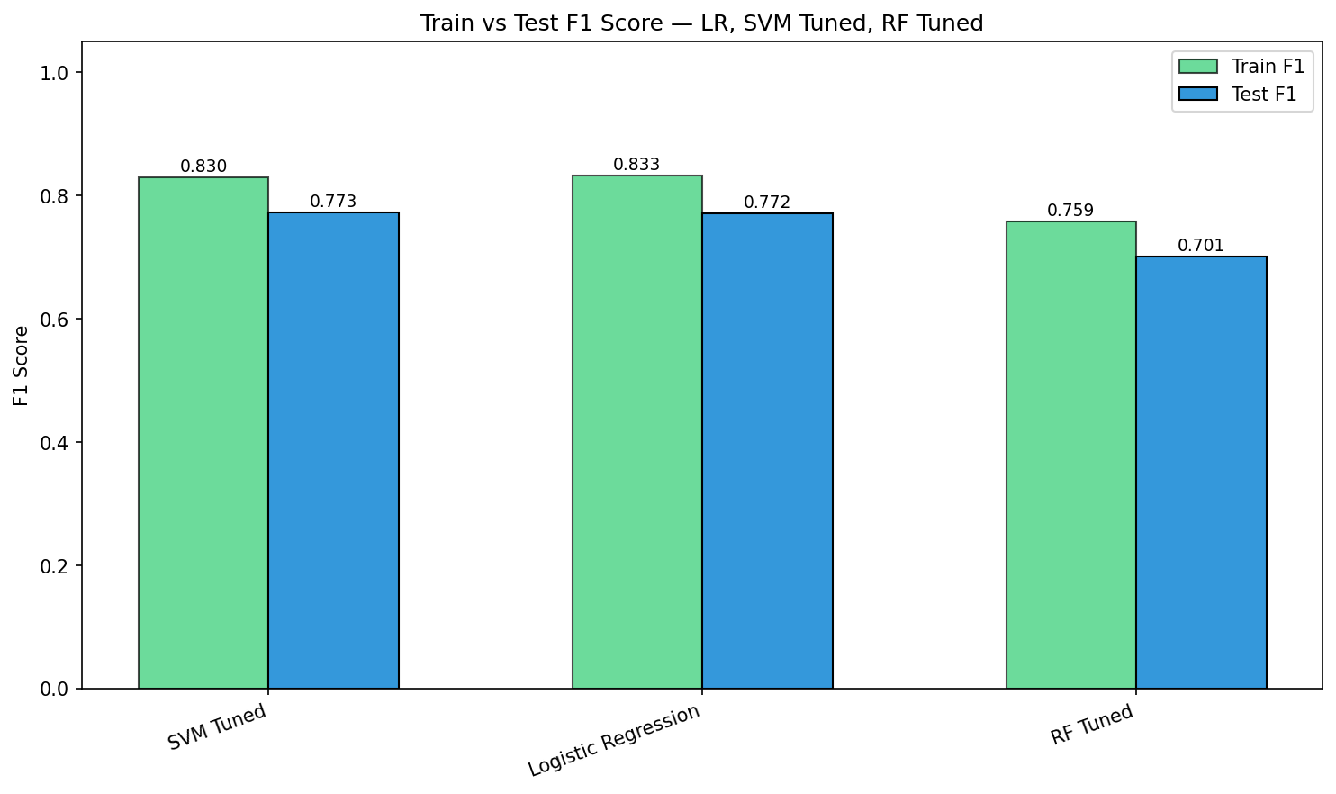
Default Model Results
Before any tuning — how did the three default models perform?
Logistic Regression
SVM (LinearSVC)
Random Forest
Train F1: 0.83
Test F1: 0.77
Gap: 0.06
Strong out of the box. Small gap means it generalizes well. No tuning needed.
Train F1: 0.90
Test F1: 0.76
Gap: 0.14
Good test score but the 0.14 gap signals overfitting. The C parameter is too aggressive — needs tuning.
Train F1: 0.98
Test F1: 0.76
Gap: 0.22
0.98 looks impressive but is misleading — the model memorized the data. Huge 0.22 gap. Needs tuning.

Slide 7
Tuned Model Results
After tuning SVM and RF — comparing to their default versions.
SVM Tuned (C=0.1)
RF Tuned (depth=30)
Train F1: 0.83
Test F1: 0.77
Gap: 0.06
vs Default SVM: Train 0.90, Test 0.76, Gap 0.14
What changed: Lowered C from 1.0 to 0.1 — widens the decision margin.
Result: Gap dropped 0.14 → 0.06, Test F1 improved 0.76 → 0.77. Less overfitting AND better performance.
Train F1: 0.76
Test F1: 0.70
Gap: 0.06
vs Default RF: Train 0.98, Test 0.76, Gap 0.22
What changed: 1,000 trees, max_depth=30, min_samples_split=5, class_weight='balanced'.
Result: Gap dropped 0.22 → 0.06 (overfitting fixed), but Test F1 dropped 0.76 → 0.70. Still below SVM Tuned.
Takeaway: SVM tuning was a success — less overfitting AND better test performance. RF tuning fixed the overfitting problem but performance still fell short. This confirms SVM Tuned as our best model.

Slide 8
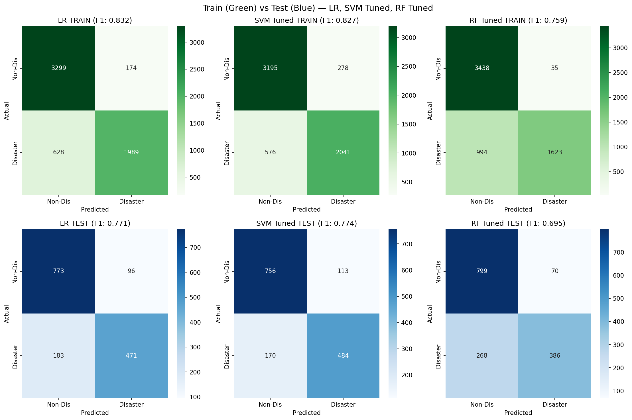
Confusion Matrices — LR, SVM Tuned, RF Tuned
Top row: Training (green) | Bottom row: Testing (blue) | Similar matrices = good generalization
SVM Tuned and LR have the most balanced test matrices — good precision and decent recall. RF Tuned controls overfitting but misses too many disasters (recall 0.59). False negatives remain the main weakness across all models.

Slide 9
Model Confidence Analysis
How confident is each model in its predictions? A reliable model should be both accurate and decisive.
SVM Tuned
Confidence: 0.29
Correct Prob: 0.71
Most decisive AND most accurate
LR
Confidence: 0.22
Correct Prob: 0.67
Moderate — less confident overall
RF Tuned
Confidence: 0.056
Correct Prob: 0.542
Near-zero confidence — barely above random
Another reason to trust SVM Tuned: it is the best calibrated model. When it says "80% disaster", it is usually right. RF Tuned hovers close to 50% for most predictions — barely distinguishing between classes. For real-world deployment, we need a model that is not just accurate but also knows when it is confident.

Slide 10
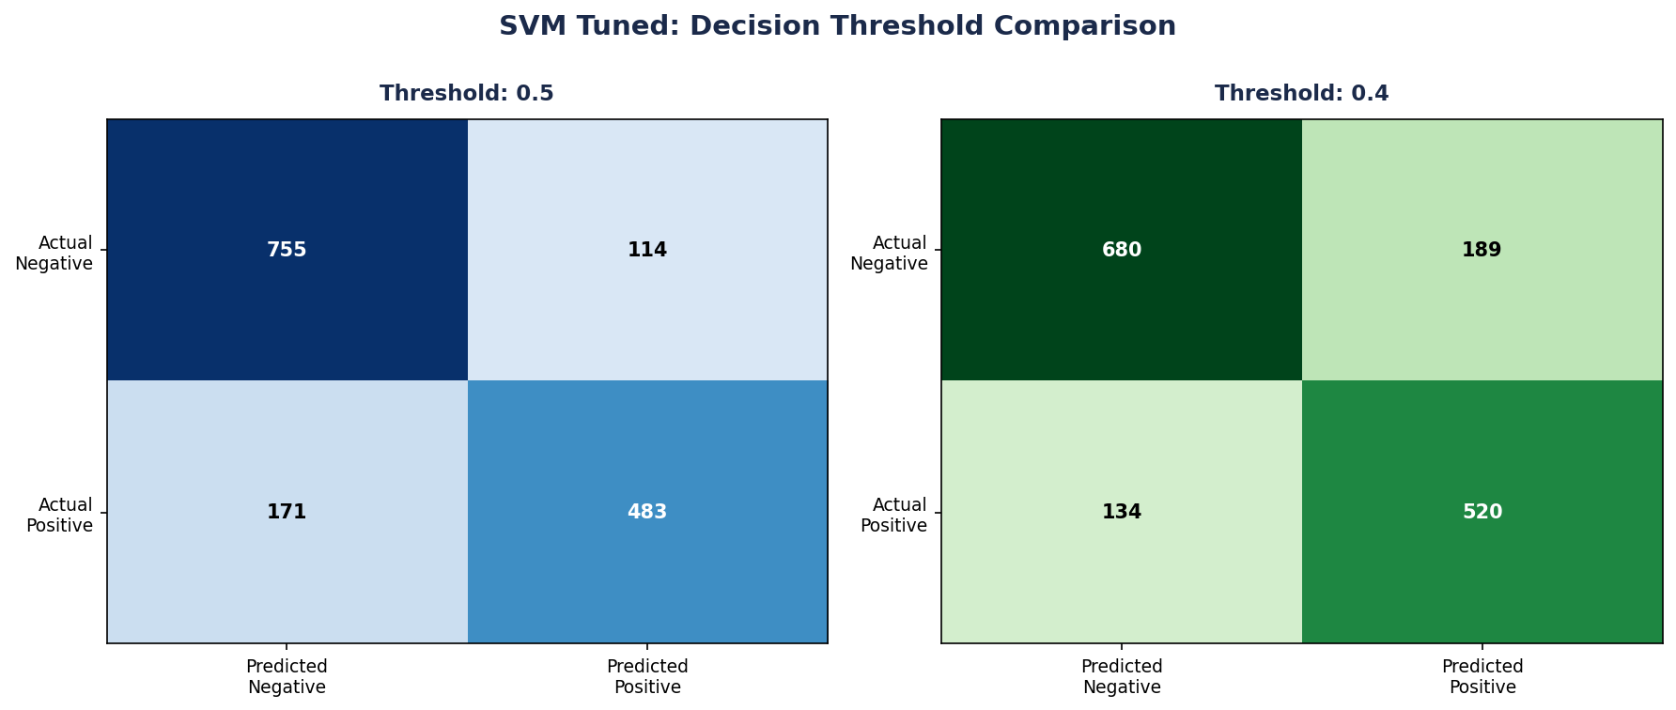
Threshold Tuning for Deployment
Adjusting SVM Tuned's decision threshold based on the use case.
Default Threshold: 0.5
→
Tuned Threshold: 0.4
F1: 0.77 Recall: 0.74 | Precision: 0.81
F1: 0.76 Recall: 0.80 (+6%) | Precision: 0.73
Catches 74% of real disasters
Catches 80% of real disasters, more false alarms
Deployment flexibility: Emergency systems where missing a disaster is costly → use 0.4 (higher recall). General monitoring where false alarms are disruptive → use 0.5 (higher precision).

Slide 11
Where the Model Fails
18.3% error rate — 278 out of 1,523 test tweets misclassified
False Positives (False Alarms)
False Negatives (Missed Disasters)
Model said disaster, but it wasn't:
"Sinking in my thoughts"
→ Metaphorical use of "sinking"
"My heart is on fire"
→ Emotional expression, not real fire
The model sees disaster keywords and can't tell if they're literal or figurative.
Model missed a real disaster:
"Pray for the people affected"
→ No disaster keywords used
"Entire neighborhood is gone"
→ Subtle language that TF-IDF misses
These tweets describe disasters without using standard disaster vocabulary.
Root cause: Both error types stem from TF-IDF treating words independently — it sees the word but not the context. This is expected for a bag-of-words approach and shows exactly where context-aware features (embeddings, BERT) would add value.

Slide 12
What This Model Can Do
The trained pipeline (TF-IDF + SVM Tuned) can classify any new tweet in real time.
How It Works
Real-World Applications
1. New tweet comes in
2. Pipeline preprocesses it (clean, lemmatize)
3. TF-IDF converts it to a 5,000-dim vector
4. SVM Tuned outputs: disaster / not disaster + confidence %
Emergency response — flag disaster reports for response teams in real time
News organizations — detect breaking disasters from social media before official reports
Government agencies — filter thousands of tweets during a crisis to surface real reports
Insurance companies — early detection of disaster reports for claims preparation
Adaptable to Business Needs
The decision threshold is adjustable: threshold 0.4 for emergency systems (catch more disasters, accept more false alarms) or threshold 0.5 for general monitoring (fewer false alarms, may miss some disasters). The model outputs a probability score with each prediction, so downstream systems can apply their own business rules.
Deployment: the sklearn Pipeline can be saved with joblib and served as an API endpoint for real-time classification.

Slide 13
Limitations & Future Work
Current Limitations
What Could Improve Results
TF-IDF cannot understand context
Same word gets the same score regardless of meaning
Small dataset (7,613 tweets)
Limits what complex models can learn
No metadata features used
keyword and location columns were not explored
Binary classification only
Cannot distinguish disaster types
Word embeddings (GloVe, Word2Vec)
Words get vectors that capture meaning
BERT / transformer models
Understands context — but needs 10,000+ tweets to avoid overfitting (110M params)
Feature engineering
Use keyword/location columns as extra signals
More training data + API deployment
Larger dataset + serve model as real-time endpoint
We also considered and decided against: GridSearchCV (too many models for small dataset), non-linear SVM (TF-IDF already linearly separable in 5,000 dimensions), neural networks (dataset too small), XGBoost (same overfitting risk as RF).

Slide 14
Key Takeaways
1
SVM Tuned (C=0.1) is our best model — Test F1: 0.77, lowest overfitting gap, best probability calibration
2
We proved it generalizes: small train-test gap, consistent confusion matrices, decisive confidence scores
3
TF-IDF was the right choice for this dataset size — and context-aware features (BERT, embeddings) are the clear next step to push beyond 0.77 F1
4
The model is deployment-ready: adjustable threshold, probability output, and a pipeline that can classify any new tweet in real time
5
Tuning taught us: SVM benefited from lower C, but even with 1,000 trees and depth=30, RF could not match linear models on sparse TF-IDF data
Thank you — Questions?

