Slide 1


Code Crafters
Grocery Store
Group Members: Rehatpreet Singh, Jesly James

Slide 2
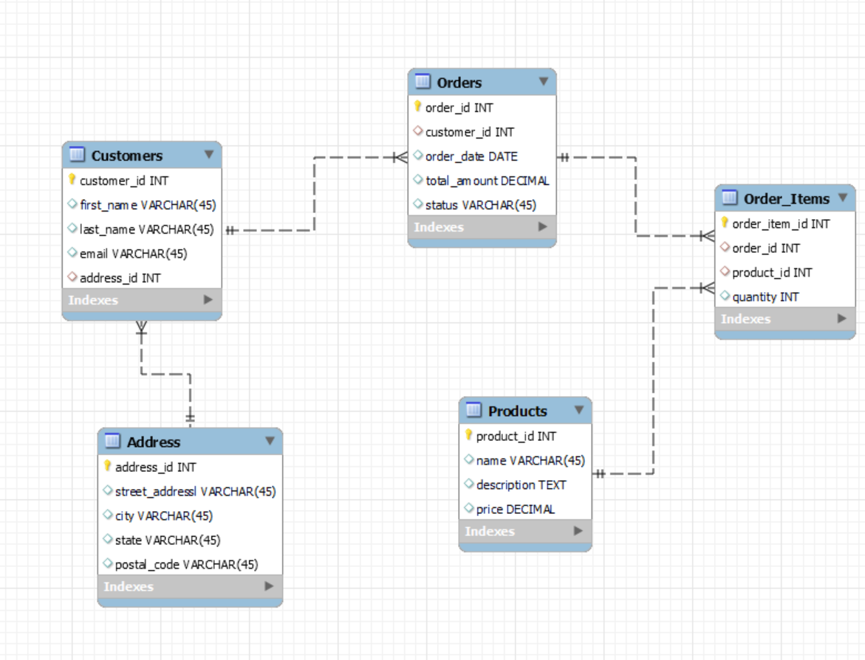


ER DIAGRAM

Slide 3
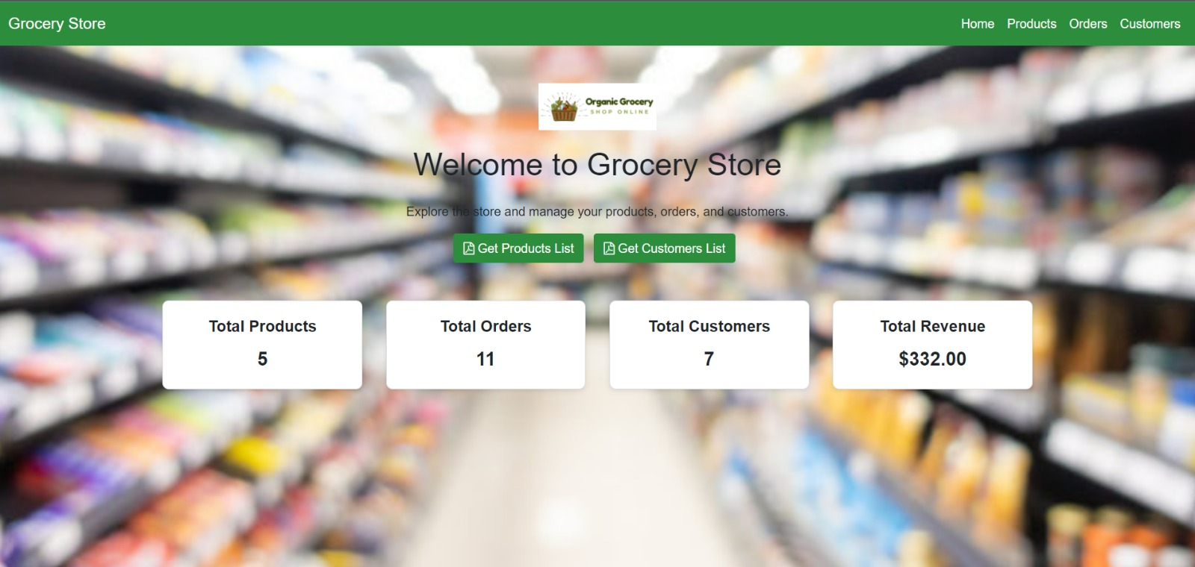
HOME PAGE

Slide 4

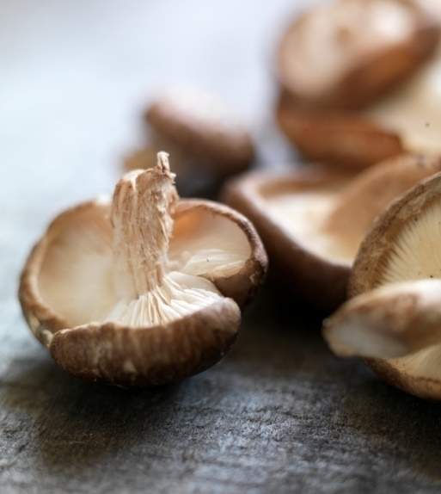

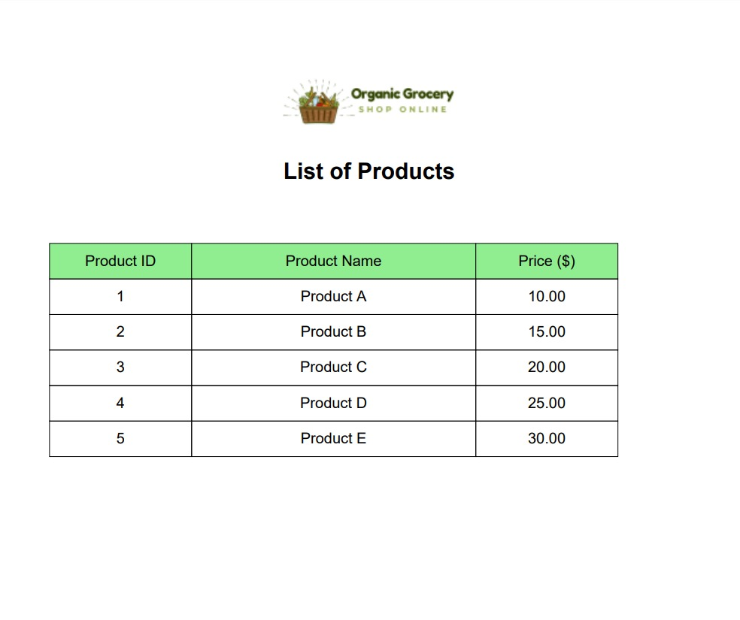

Our products

Slide 5


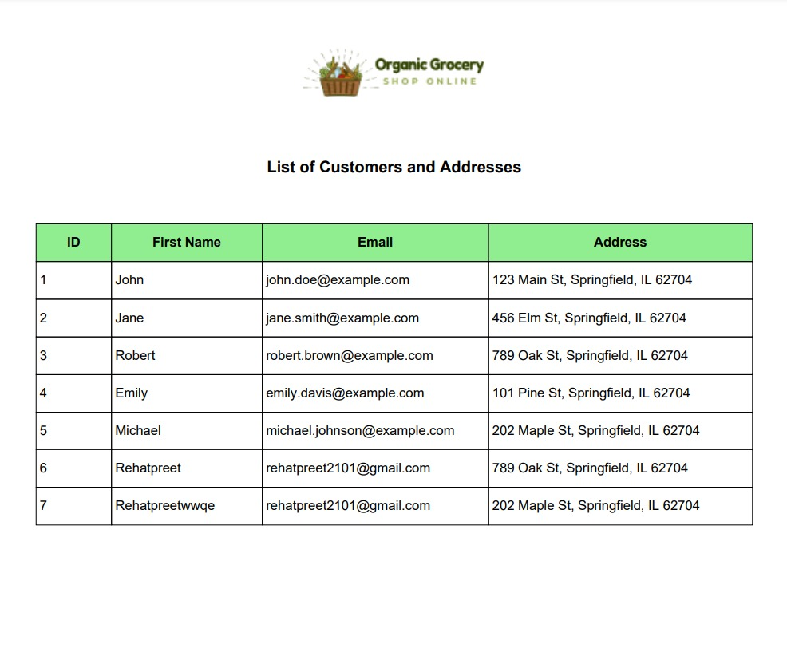

Form

Slide 6

Thank you

