Slide 1
Analysis of Venues and Prices of Apartments in Bengaluru

Slide 2
Introduction
Bengaluru, also known as Bangalore, is the capital city of the southern Indian state Karnataka. With a population of 12 million, it is the third-most populous city of India.
This cosmopolitan ‘Garden City of India’ and the ‘Silicon Valley of India’ attracts scores of national as well as foreign professionals for the opportunities it offers.
The population density of Bengaluru has seen a staggering growth of 47% over the past ten years.
With a large number of professionals moving to Bengaluru, it has earned the top spot as the ‘Most Traffic Congested City’ amongst 416 cities cross 57 countries
The objective of this study is to analyse neighbourhoods in Bengaluru with respect to cost of buying an apartment and access to different types of venues in the neighbourhoods.

Slide 3
Data Description
Wikipedia: The list of neighbourhoods in Bengaluru was web scraped from Wikipedia. A few more neighbourhoods were also added as the list gathered missed some localities in Bengaluru.
Google: The geographical co-ordinates of neighbourhoods were fetched from Google.
Foursquare: Details of venues in the neighbourhoods were gathered using Foursquare APIs.
Makaan.com: The dataset of cost of buying an apartment in various neighbourhoods was web scraped from the website Makaan.com.
99acres.com: This website to fill in the values missing in the dataset prepared from Makaan.com.

Slide 4
Methodology
Problem Definition
Data Collection
Data Preparation
Data cleaning: This task involved correction of neighbourhoods names, removing duplicate tuples and handling missing values.
Data integration: Integrating real-estate dataset with the list of neighbourhoods. The resulting dataset contained 68 neighbourhoods.
Data transformation: One-hot encoding was used to transform the venue dataset from Foursquare into a form suitable for calculating the distribution of types of venues in each neighbourhood Exploratory Data Analysis
Clustering and Evaluation

Slide 5
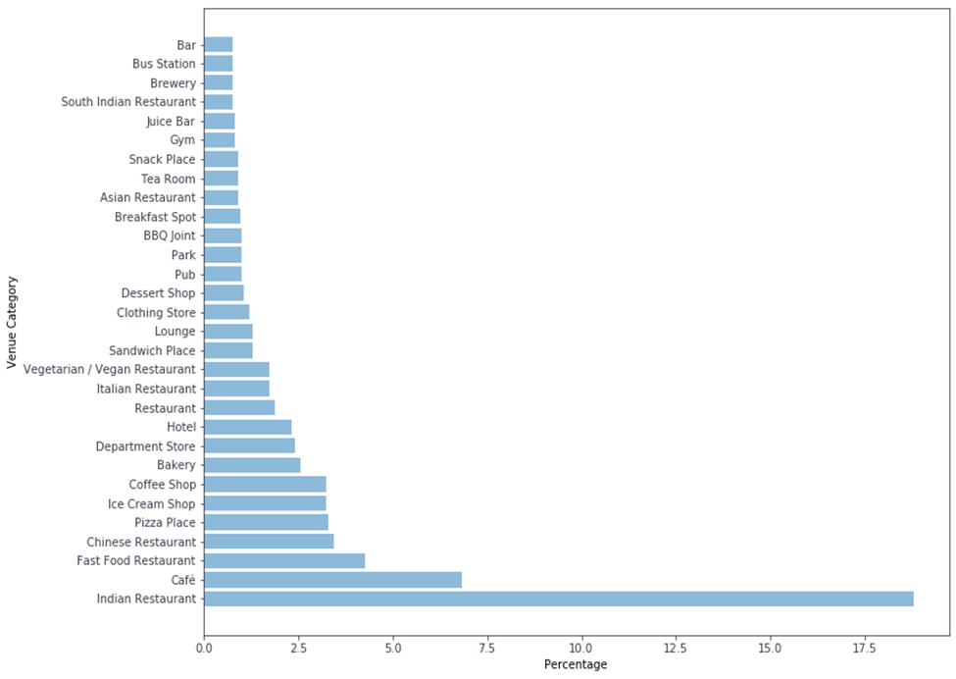
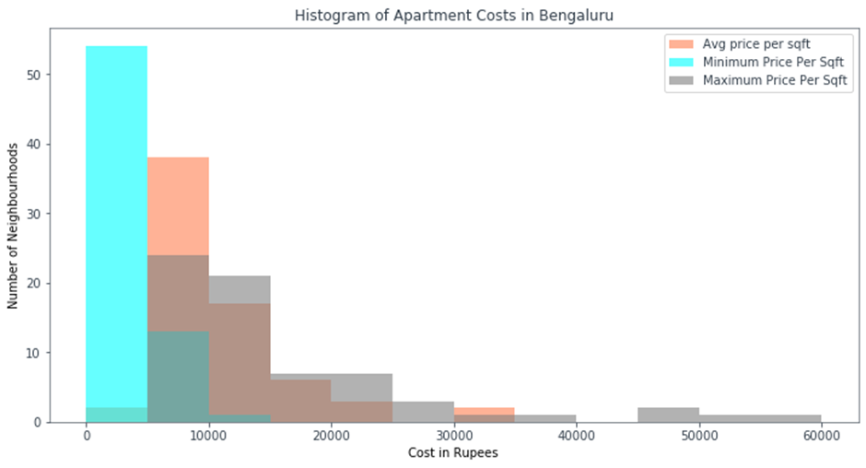
Exploratory Data Analysis
For a majority of the neighbourhoods, minimum cost is less than Rs. 5000 per sqft, average is Rs. 5000 – Rs. 10,000 per sqft and maximum cost is Rs. 5000 – Rs. 10,000 per sqft.

Slide 6
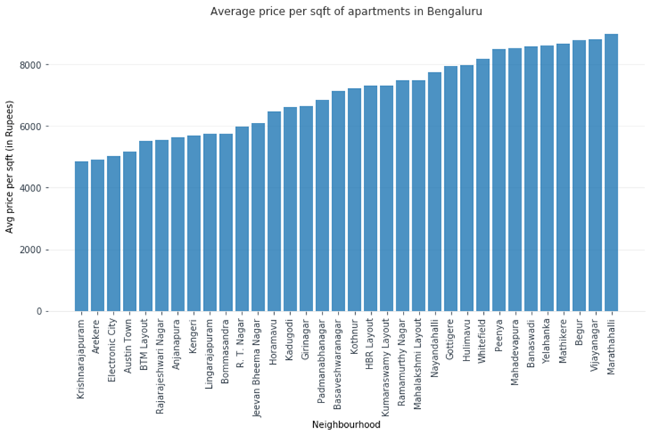
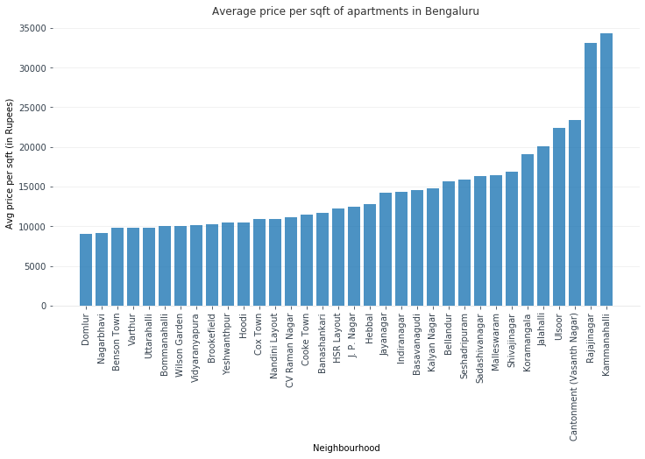
Exploratory Data Analysis Average Price Per Sqft
Rajajinagar and Kammanahalli are considerably expensive than other neighbourhoods.

Slide 7
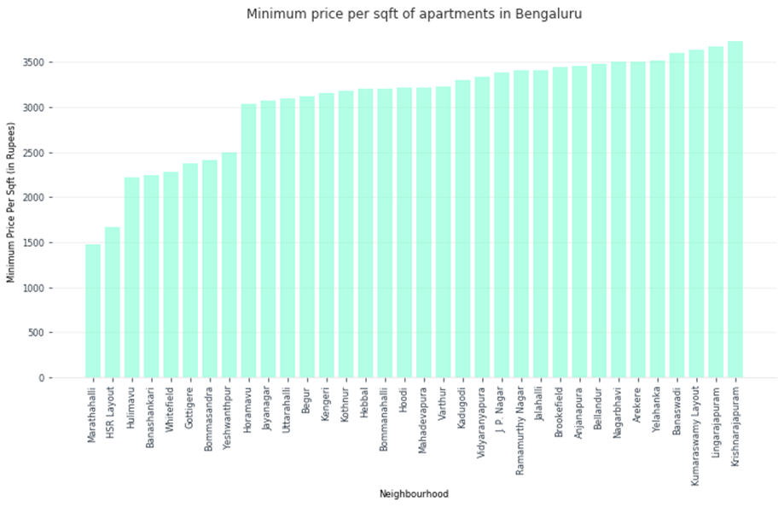
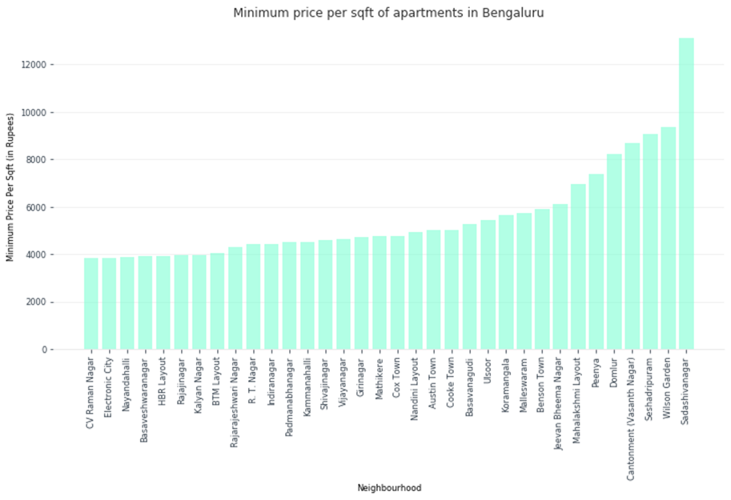
Exploratory Data Analysis Minimum Price Per Sqft
Sadashivanagar has a much higher lowest price per sqft.

Slide 8
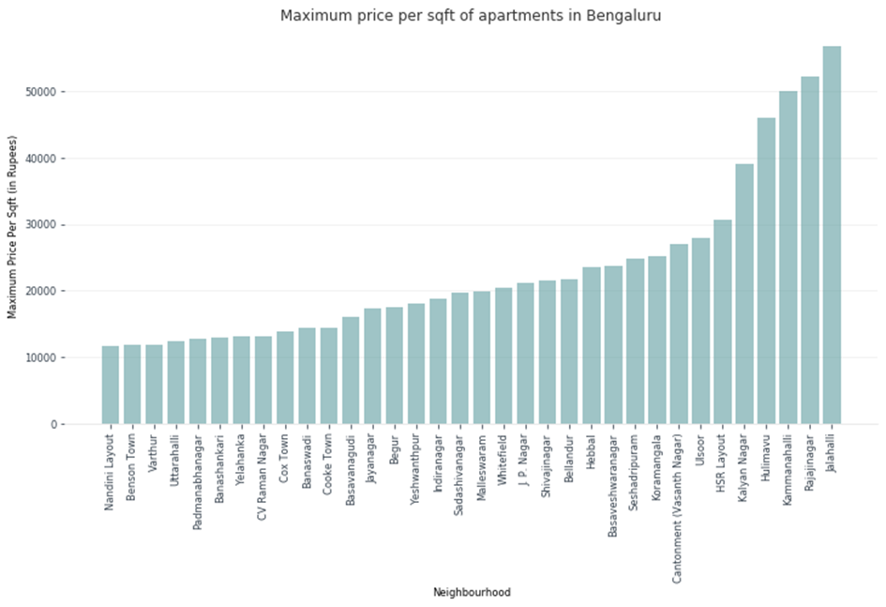
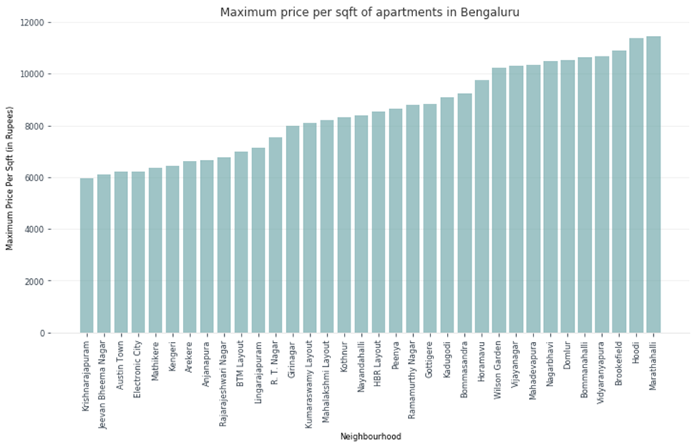
Exploratory Data Analysis Maximum Price Per Sqft
Kalyan Nagar, Hulimavu, Kammanhalli, Rajajinagar and Jalahalli have the highest maximum cost per sqft.

Slide 9
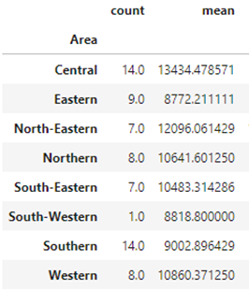
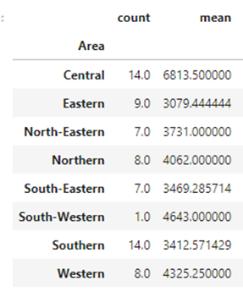
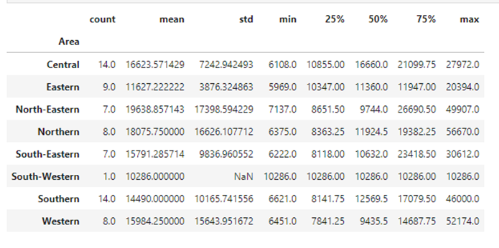
Exploratory Data Analysis Areas
It can be observed that central Bengaluru is the most expensive and eastern Bengaluru the cheapest in terms of buying an apartment.
Average price per sqft analysis of areas
Minimum price per sqft analysis of areas
Maximum price per sqft analysis of areas

Slide 10
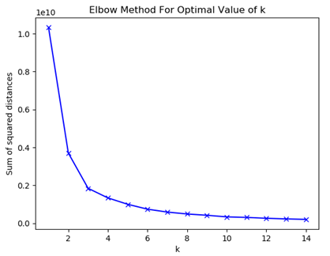
Clustering
The unsupervised machine learning technique K-Means clustering was used to cluster the neighbourhoods on the basis of average, maximum and minimum per sqft prices of apartments.
The optimal value of k was found out to be 3 using the elbow method.

Slide 11
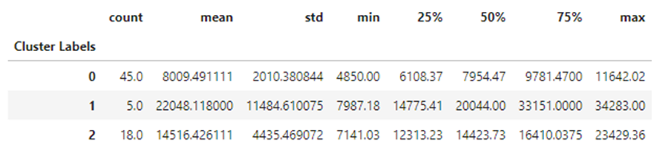
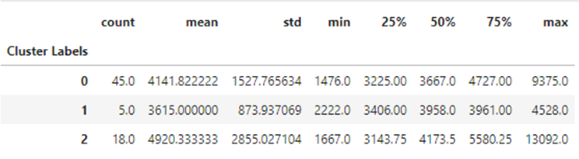
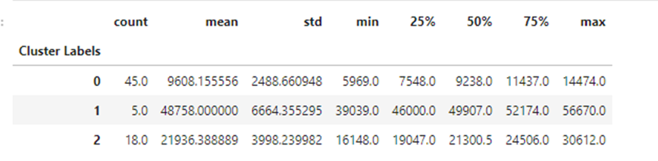
Results
Cluster 0 contains localities with the cheapest apartments and accounts for 68% of the neighbourhoods.
Cluster 1 has neighbourhoods which are expensive in Bengaluru. These neighbourhoods have a high average and maximum cost per sqft.
Neighbourhoods in Cluster 2 are averagely priced.
Average price per sqft analysis of clusters
Minimum price per sqft analysis of clusters
Maximum price per sqft analysis of clusters

Slide 12
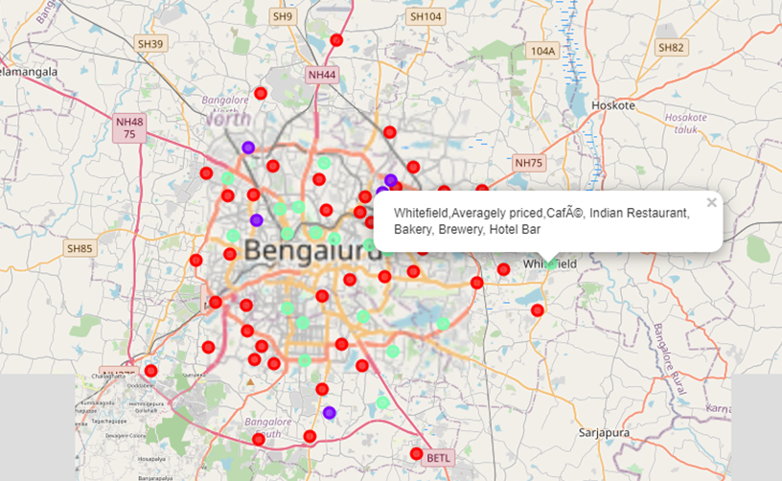
Results
S.NO. | CLUSTER | COLOUR | LABEL
1. | Cluster 0 | Red | Affordable
2. | Cluster 1 | Purple | Expensive
3. | Cluster 2 | Green | Averagely priced
Clusters plotted on a map

Slide 13
Conclusion
In this study, data was obtained from Wikipedia, Foursquare, Makaan.com and 99acres.com for the purpose analysing neighbourhoods in Bengaluru with respect to venues and prices of apartments.
K-means clustering technique was used to cluster neighbourhoods in Bengaluru on the basis of apartment prices.
The top 5 types of venues of each neighbourhood were also found to assist in selecting neighbourhoods for buying an apartment.
This project can be extended in multiple ways. We can do the same analysis on datasets pertaining to costs of buying a plot, builder floor and independent house. Another useful study would be comparing neighbourhoods on the basis of rental costs of apartments.

Slide 14
Thank You!

