Slide 1
Warm-up lab (no need to e-mail the code):
Make a class called Rectangle with the following methods:
// constructor
public Rectangle( double width, double height)
// returns width * height
public double getArea()
// returns 2 * width + 2 * height
public double getPerimeter()
You should be able to run this method on your class…
public static void main(String[] args) throws Exception
{
Rectangle r = new Rectangle(10, 5);
System.out.println(r.getArea()); //50
System.out.println(r.getPerimeter()); // 30
}
For more practice, you can try some other shapes: square, triangle, etc…

Slide 2
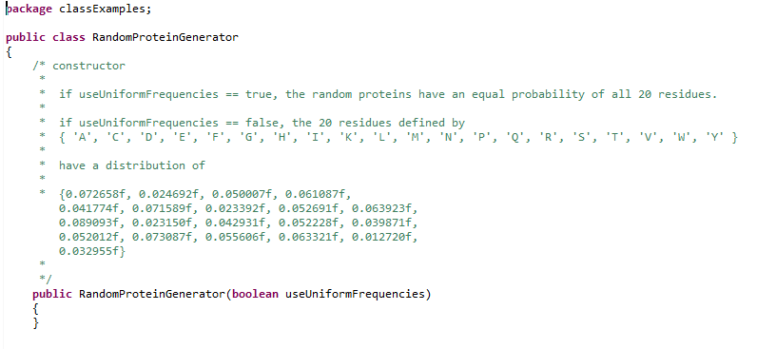
Lab # 4 due Sep. 23 (Wed!) before class
Here:
https://github.com/afodor/metagenomicsTools/blob/master/src/classExamples/RandomProteinGenerator.java
You will find a “stub” class that has the names of methods.
Your job is to implement this class and make it functional.
The constructor will determine if the class uses a uniform or “real” distribution of Amino Acids

Slide 3
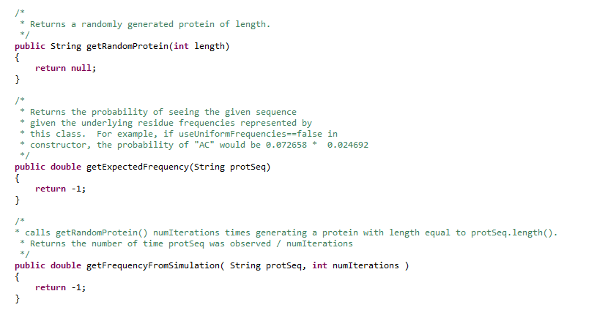
There are 3 methods that you responsible for implementing

Slide 4
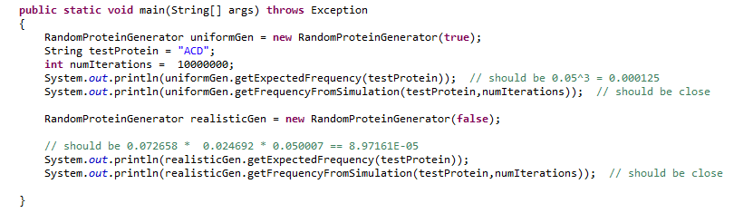

Once your code is done, you should be able to run the included main method…
And get results close to
(but not exactly) like these ones..

Slide 5
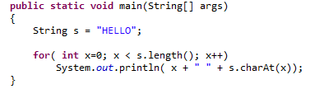
This code (that reads characters from a String one at a time) may help!
Send you code to afodor@uncc.edu and rlinchan@uncc.edu
Lab # 3 due Sep. 23 (wed) before class
Again, we’ll have two labs to work on this if we need them…

