Slide 1
Menus
Overriding paintComponent() or paint()
Towards a first bioinformatics example..

Slide 2
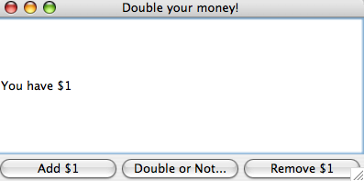
We’ll add some menus to our simple GUI example
A version of the “Double or Nothing” gui is here:
https://github.com/afodor/metagenomicsTools/blob/master/src/classExamples/gui/DoubleOrNothing.java

Slide 3
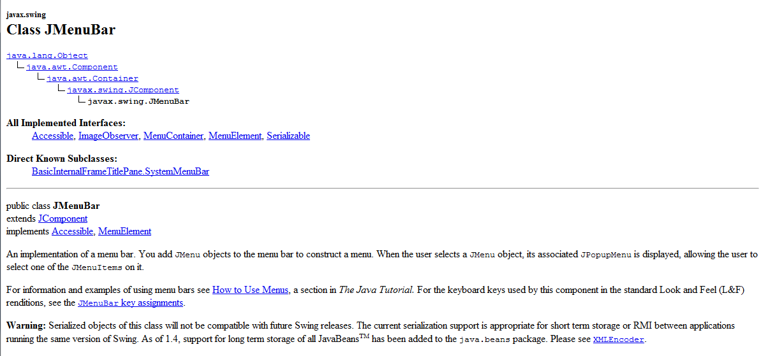
A JMenuBar is a Jcomponent is a Container is a Component
(is an Object)

Slide 4
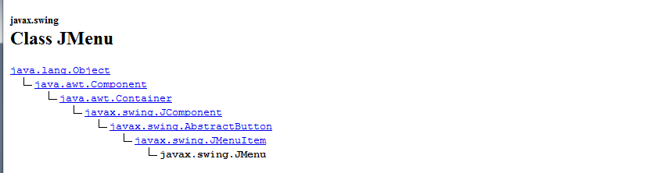
A JMenu (which we add to a JMenuBar) is a JMenuItem is
An AbstractButton is a JComponent is a Container is a Componenet
(is an Object)
JMenuItem is a super-class of JMenu.
Which means you can add menus to menus…

Slide 5
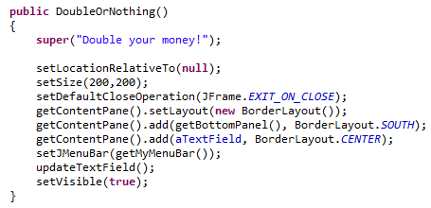
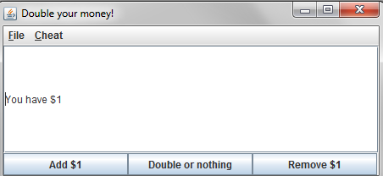
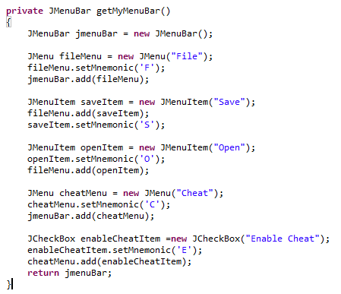
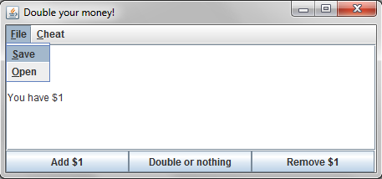
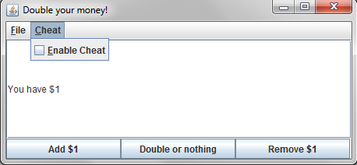
Adding menus is pretty straight-forward

Slide 6
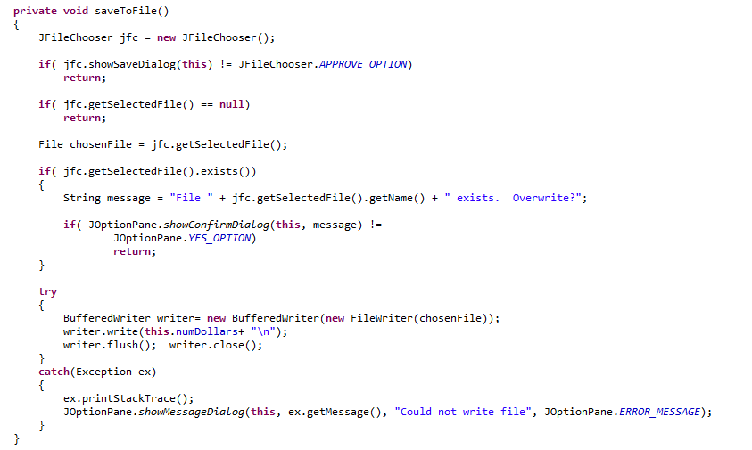
The menus are in the application, but they don’t do anything yet….
We have to add the functionality…
Here is the method to save the state of the application to the hard-disk
User hits cancel, we return
User decides not to
over-write an existing file

Slide 7
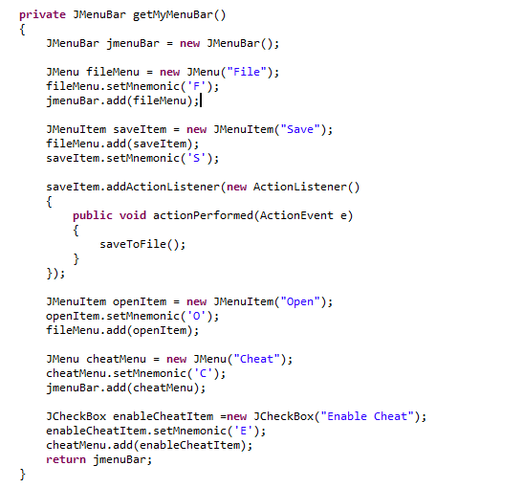
When the user clicks on the “Save” menuitem, we define an action
listener to invoke the “JFileChooser”

Slide 8
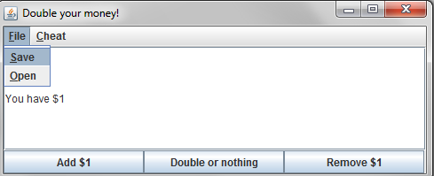
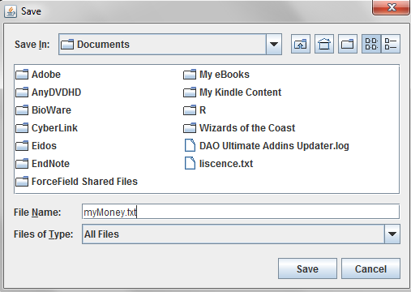
I choose
“File->Save”
The file-chooser comes up
If I hit cancel,
The FileDialog goes
away; no file is
saved
I have to type
a file name (I haven’t set any defaults….)
Will show all files
(I can change this behavior
by setting a FileFilter)

Slide 9
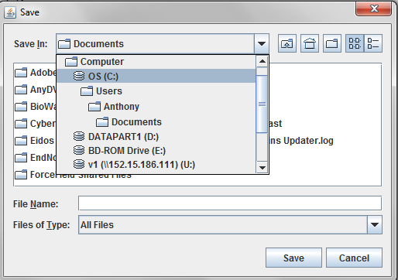
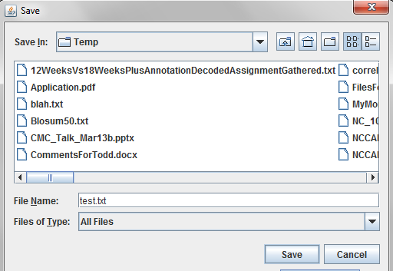
If all has gone well…
I navigate to C:\\temp
Hit save…

Slide 10
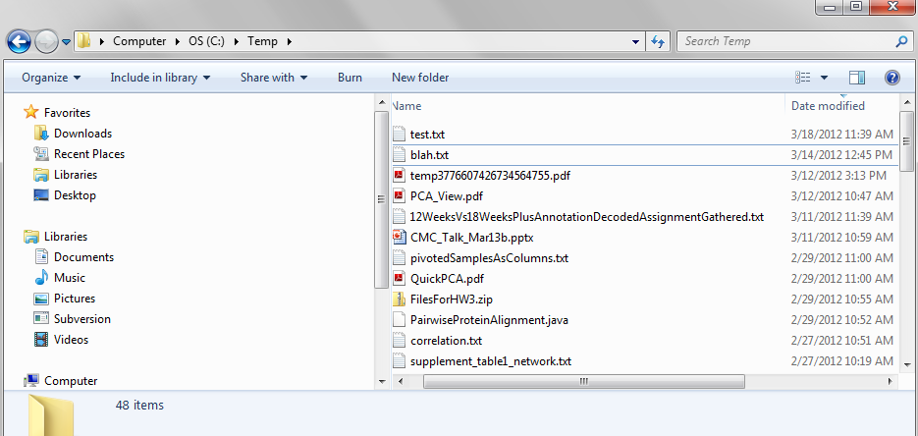
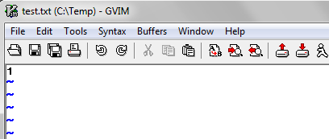
We have successfully saved the state of our program (such as it is)

Slide 11
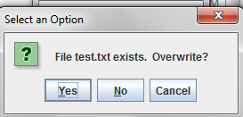
If the file exists, we let the user cancel….
(Here “no” and “cancel” do the same thing; probably not great UI design)
Probably should arrange it so that choosing “no” brings up another
FileChooser or just not show the cancel button..

Slide 12
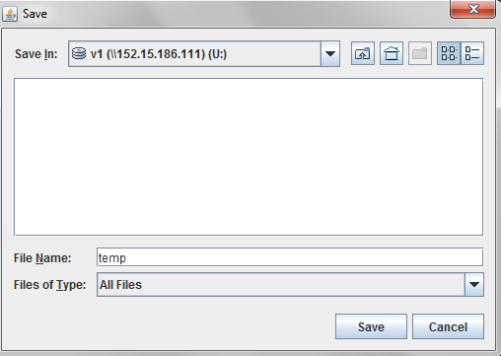
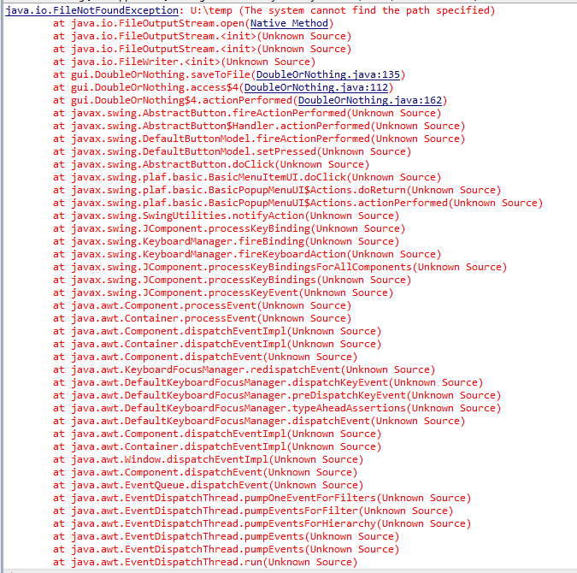
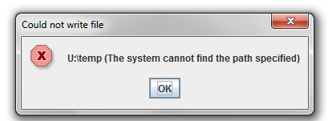
Finally if the write fails, we give the user (and the console) an error message and a graceful exit
Here we are writing to a network drive that is not visible to the Java VM

Slide 13
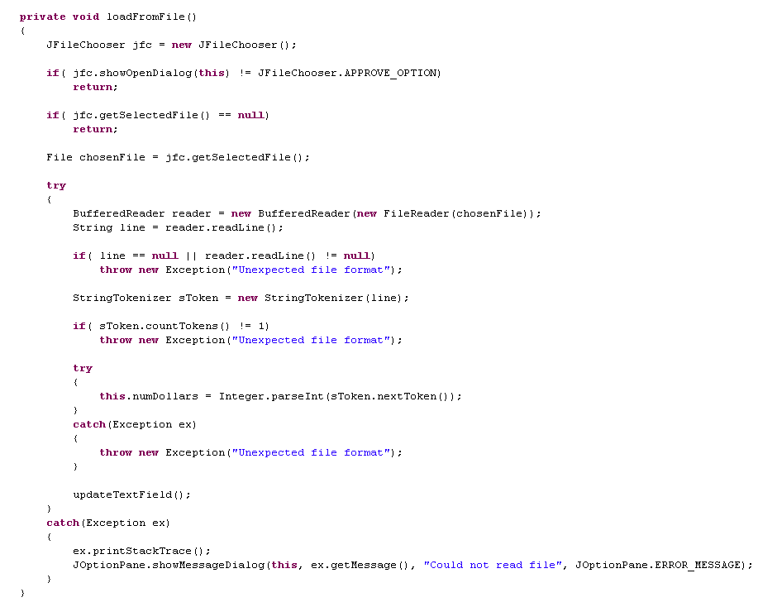
Corresponding code to re-load the state in… (probably could warn the user about erasing current state)

Slide 14
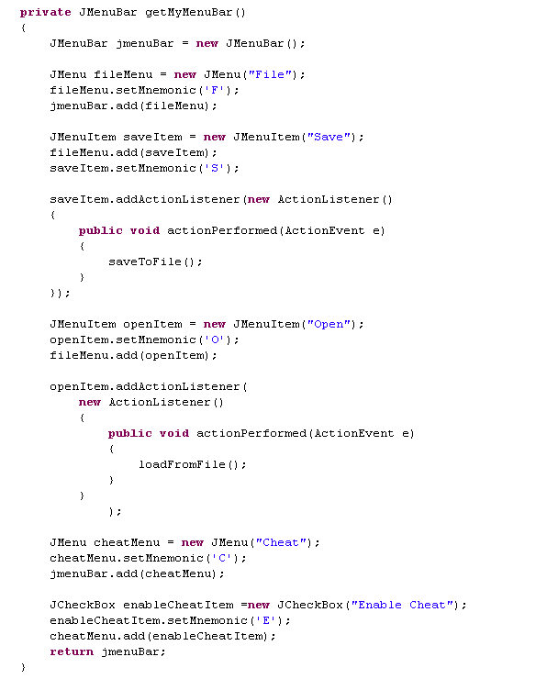
As before, we need to link our method to the correct menu item

Slide 15
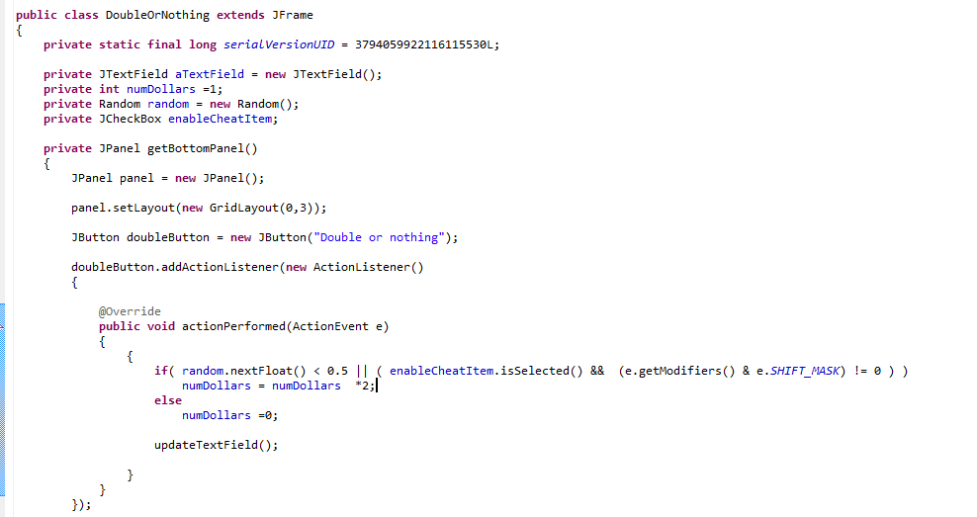
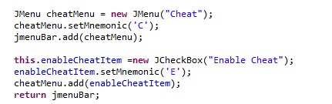
Getting the “cheat” box hooked in does not require an action lister
enableCheatItem has scope within our application
We check the state of the checkbox
We instantiate and add the
CheckBox to our menu

Slide 16
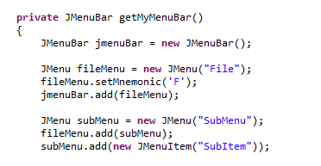
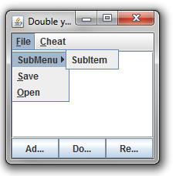
Because a JMenu is a JMenuItem, you can add menu to menus

Slide 17
Menus
Overriding paintComponent() or paint()
Towards a first bioinformatics example..

Slide 18
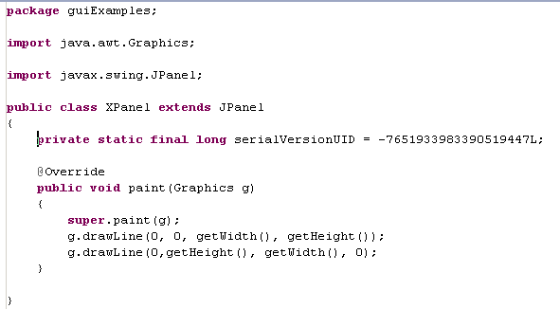
Each component knows how to Paint itself.
By overriding paint (), we can modify how that component paints itself
Here is a panel that draws an X.

Slide 19
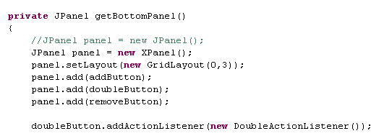
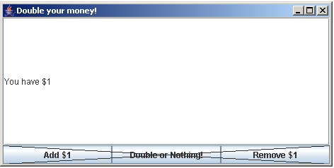
Replace our bottom Jpanel with an XPanel.
This works because an XPanel is a JPanel.
It has all the same code with the extra code drawing the X.

Slide 20
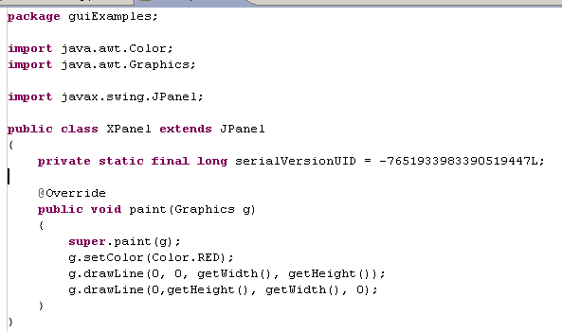
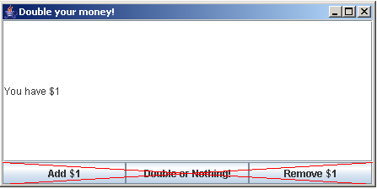
Lots of options on how to draw stuff
(covered in your basic Java book)

Slide 21
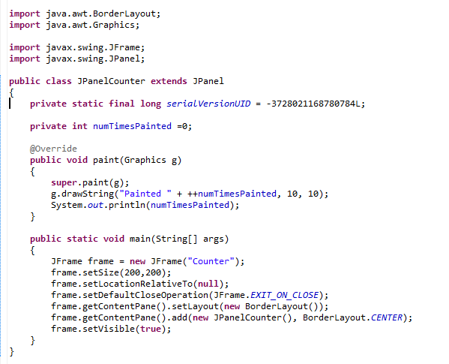
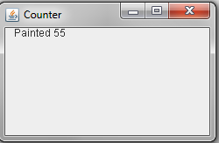
The paint () method gets called whenever the Frame gets damaged
(e.g. by another window passing over it).
Don’t worry about this

Slide 22
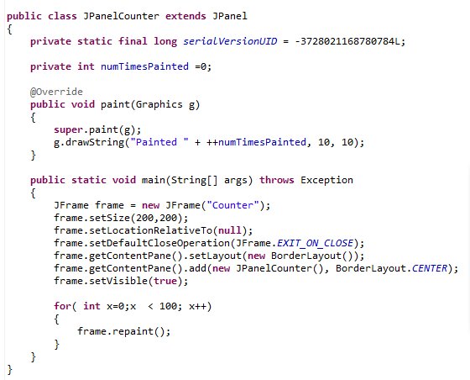
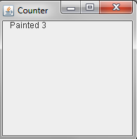
Don’t call paint(Graphics g) from your instantiating main method.
(You don’t have the graphics object to call)
Call repaint() which requests a repaint and then returns immediately.
Here repaint gets called 100 times, but paintComponent gets called three times

Slide 23
We are (finally) starting to think about threads
Main() thread
AWT thread()
Sends a request
to the AWT thread
repaint()
Calls paint(Graphics g)
(when it is not doing
anything else)
Returns
immediately

Slide 24
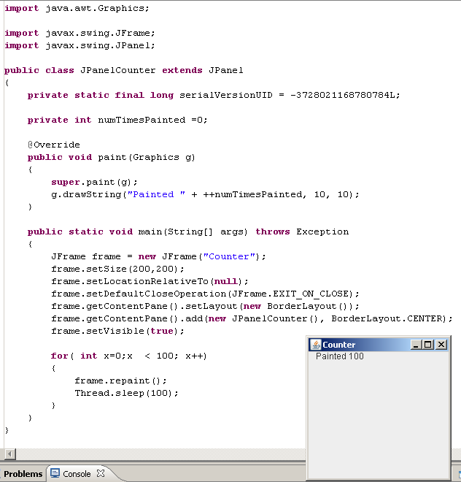
Here every repaint() request is granted (because the AWT thread
has time to grant each request and go back to waiting)

Slide 25
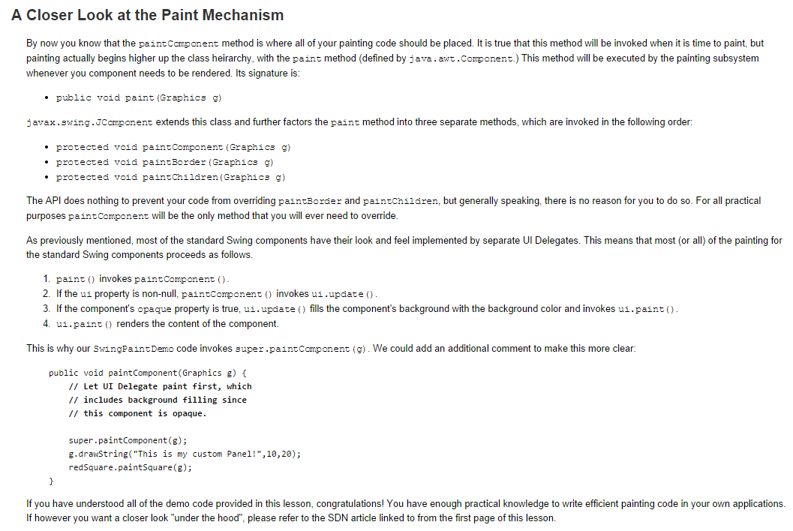
Alternatively, you can call paintComponent()..
http://docs.oracle.com/javase/tutorial/uiswing/painting/closer.html

Slide 26
Menus
Overriding paintComponent()
Towards a first bioinformatics example..

Slide 27
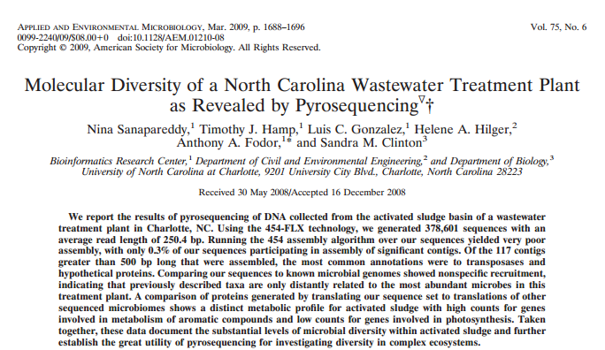
Another next-generation sequencing dataset…
paper: http://aem.asm.org/content/75/6/1688.full.pdf+html
sequences: http://fodorlab.uncc.edu/sites/fodorlab.uncc.edu/files/media/ML5_454Reads.zip

Slide 28
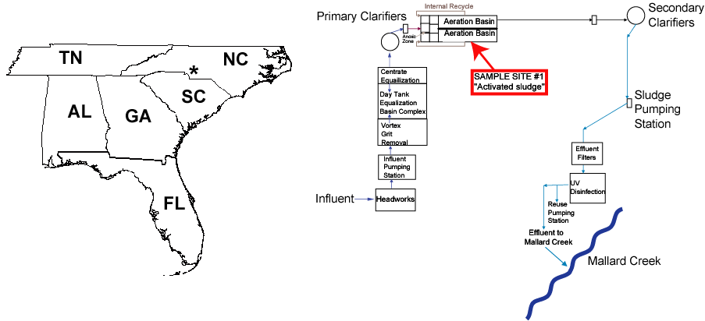

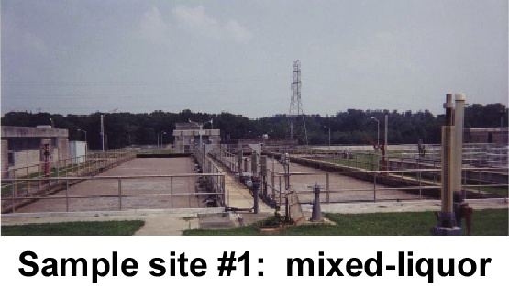
The Mallard Creek Wastewater treatment facility in Charlotte, NC
Helene Hilger
Microbes in this wastewater
treatment plant are a crucial
tool in environmental protection

Slide 29
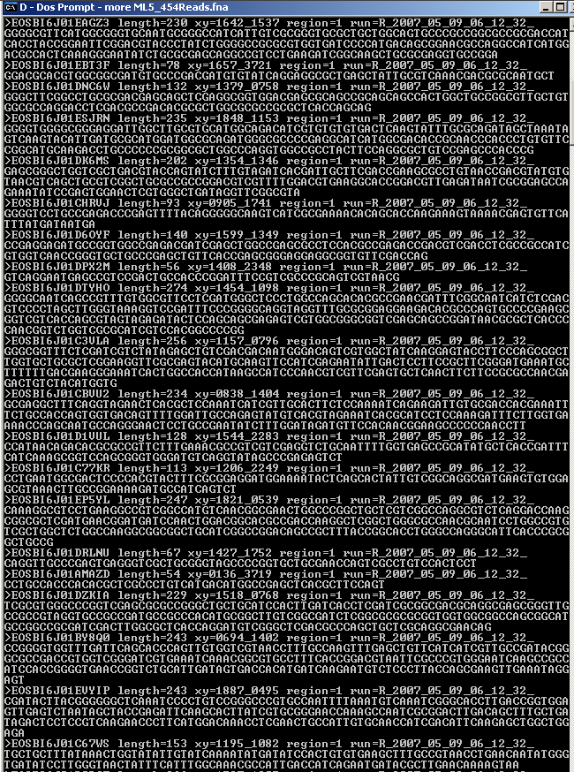
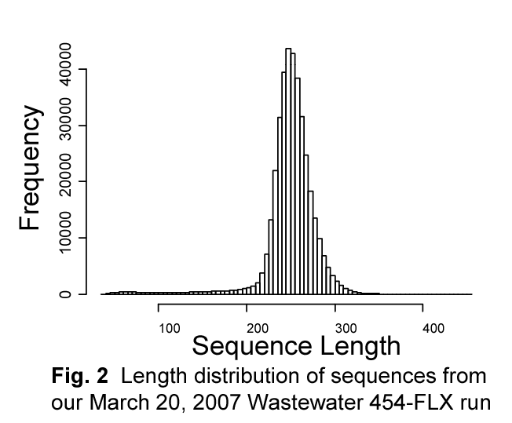
378,601 sequences
average length ~250bp

Slide 30
Attempt to
Assemble
378,601 sequences

Slide 31
We have many short reads…
We would like to stitch them together into longer pieces:
Contig
Our metagenomic dataset fails to assemble:
Only 1154 (or approximately 0.3%) of our reads were
recruited into 117 contigs greater than 500 base pairs
Assertion: Complex communities largely fail to assemble

Slide 32
Attempt to
Assemble
378,601 sequences

Slide 33
Attempt to
Assemble
378,601 sequences
Search for
homologies in
772 sequenced
genomes

Slide 34
772 sequenced genomes
1,442 assembled chromosomes and plasmids
Each of the 1,442 assembled sequences is made
into a blast database
We use blastn to search these 1,442 databases
with each of our 378,601 query sequences
(takes about 24 hours on a 140 CPU OS X cluster)
Only 20% of the sequences matched at an e-score of 0.01

Slide 35
“Fraction Genome Covered”
1
0.5
0

Slide 36
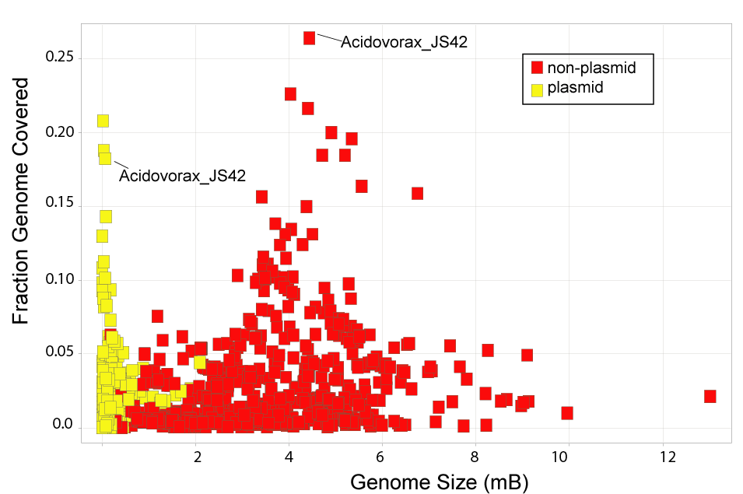
Assertion:No sequenced genome matches the wastewater metagenome

Slide 37
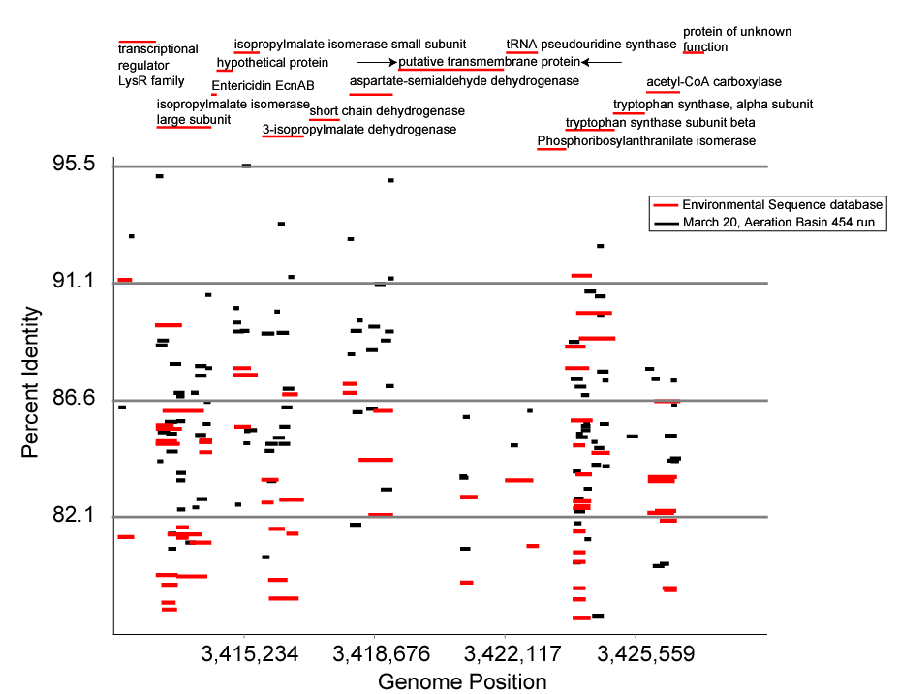
Assertion:Non-specific recruitment dominates assignment to known genomes

Slide 38
How little do we know about wastewater genomes?
Most of our 250 bp sequences can’t be assigned at the
nucleotide level.
Of those that can be assigned, most show non-specific
recruitment, suggesting that we don’t know the genomes
of the most prevalent bugs.
We know very little about these microbes…

Slide 39
We did this figure in Java. I’m going to show you how….

Slide 40
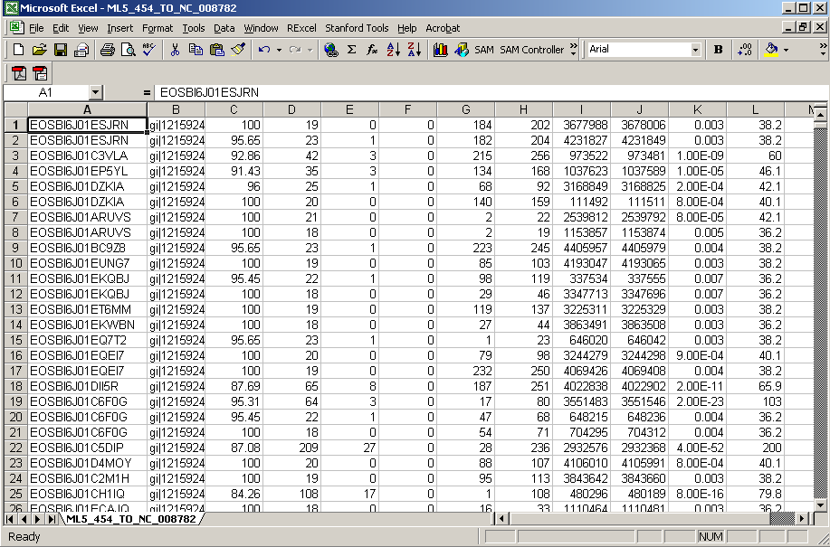
Here are the results of blasting the 454 sequences to NC_008782
(Acidovorax sp. JS42, complete genome)
This is from blastall with the tabular option output selected

Slide 41
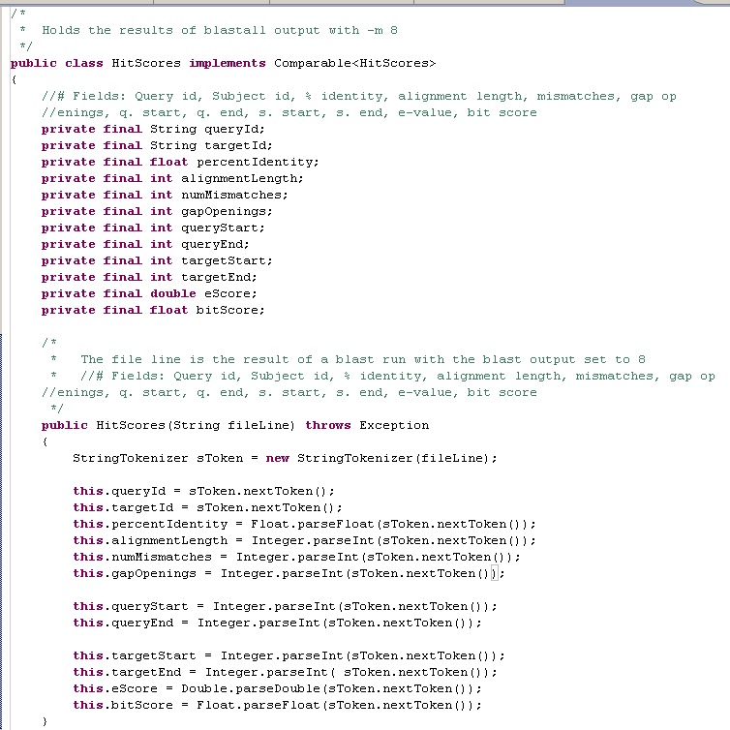
We start with a parser for these BlastResults…
https://github.com/afodor/metagenomicsTools/blob/master/src/parsers/HitScores.java

Slide 42
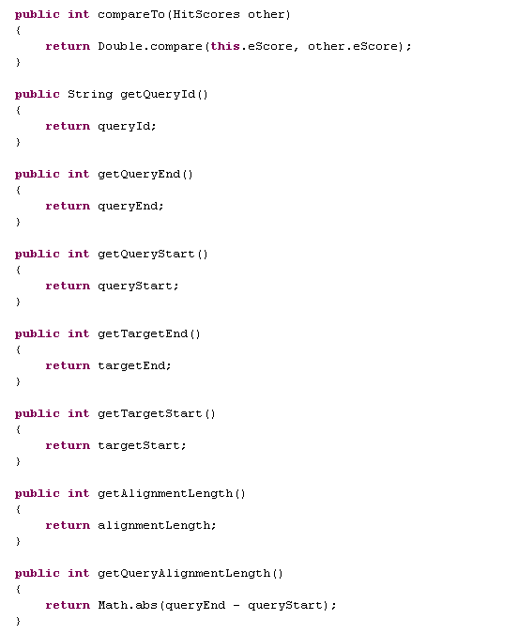
We add basic getters….

Slide 43
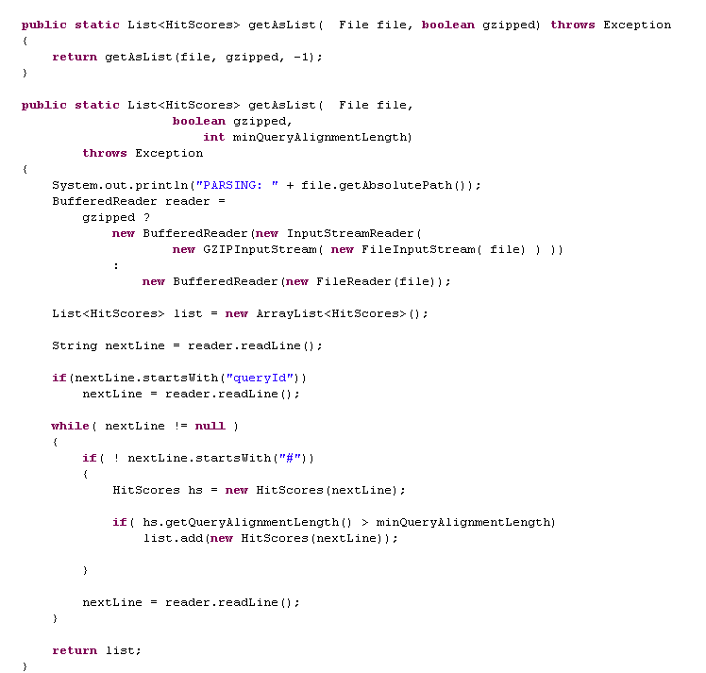
We add “plumbing code” to parse blast output
(as static factory methods)
https://github.com/afodor/metagenomicsTools/blob/master/src/parsers/HitScores.java

Slide 44
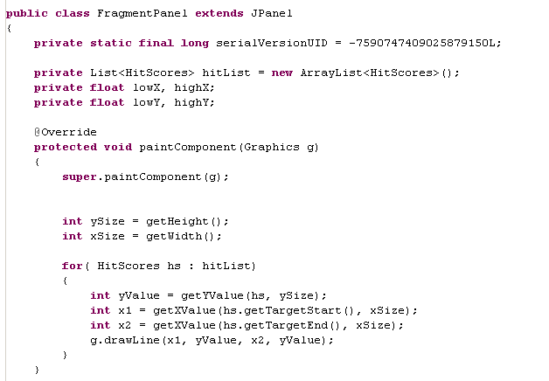
Start with a Panel that will show our data
This will define the zoom

Slide 45
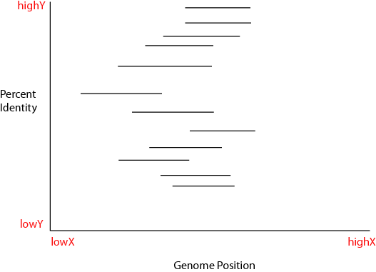
How do we figure out where to draw the lines given the scales?

Slide 46
We need to implement getXValue() and getYValue()

Slide 47

But that’s actually pretty easy…
We just scale the
available space by
where the data on the
X-axis is.

Slide 48

Almost the same thing on the y-axis
We just have to correct
For the fact that 0 is
“up” in Java (x,y)
coordinates

Slide 49
So pretty simple. Although the performance of this
simple implementation will be terrible as we will do the same
work over and over again. An efficient implementation would cache
the image (more on that later!)

Slide 50

What else do we need in FragmentPanel?
We need methods to read the blast results in and
set the initial scale.
So those are pretty easy….

Slide 51

We need a JFrame to put our FragmentPanel into…
Should really be
getContentPane().add(…)
but this seems to work!
This should all start to seem familiar!

Slide 52

Performance is atrocious.
We don’t have axes.
We don’t have zoom. etc. etc.
On the other hand, this is only a few screens of code!

Slide 53

Let’s to start to work towards making this an application..
Let’s get rid of junk hits ( we define as 75 nucleotides )
Performance perks up considerably….

Slide 54

Our view of the data gets a lot clearer with this restriction…

Slide 55

Let’s make it a little prettier!
white background!
Thicker lines!

Slide 56

Looking better…

Slide 57

We can manipulate the scale from our main method…
We have to call repaint to have the changes
take effect…

Slide 58

Because when we call repaint, all this stuff gets called again…

Slide 59

100
75
100K
400K
We are arguing that this is non-specefic recruitment.
That is, the genome of the strain that is in the wastewater
treatment plant is not known…

Slide 60

Just for fun, let’s add some vertical lines.
Make sure we don’t reset the color

Slide 61

Just drop this in..

Slide 62

Let’s get rid of this line here…
100
75
100K
400K

Slide 63

Before drawing the line, make sure it is on the panel!!

Slide 64

That cleans up the view and also improves performance
(since drawing the lines is much more expensive than the
boolean check)
100
75
100K
400K

Slide 65
Pretty close to our final figure…

Slide 66
A version (with lots of bugs!) of this simple genome browser is
here…
https://github.com/afodor/metagenomicsTools/tree/master/src/yagb
Coming up…
More on threads in GUIs.

