Slide 1
Developing a Testing Pipeline for Metagenomic Classification Tools 25 September 2015
Robert Player

Slide 2
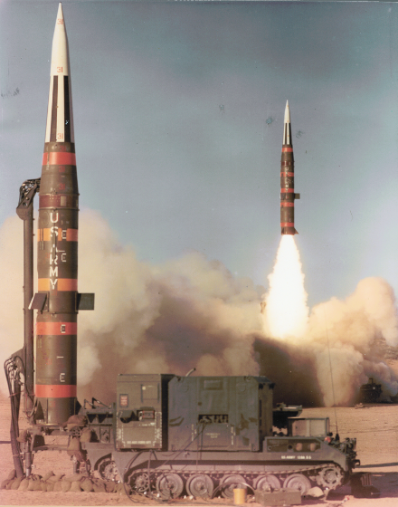
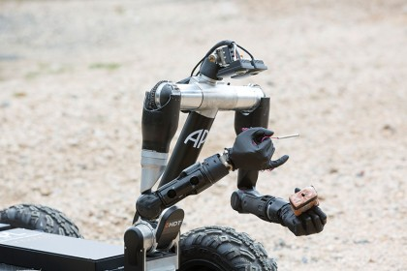

Johns Hopkins Applied Physics Laboratory (APL)
Established in 1942
Developed the ‘variable-time proximity fuze’
After WWII
Guided missile technology
First satellite positioning system (TRANSIT)
Played major role in development of GPS
Recently
Robo Sally
New Horizons Pluto flyby
https://en.wikipedia.org/wiki/MGM-31_Pershing
https://en.wikipedia.org/wiki/New_Horizons
http://api.hub.jhu.edu/factory/sites/default/files/styles/hub_medium/public/robosally-2.jpg?itok=HAhdHzMX
Notes:
Bring together university scientists and engineers to develop military technologies
EOD robot

Slide 3
APL AOS QPA - Applied Biological Sciences
Applied Physics Laboratory
AOS (Asymmetric Operations Sector)
QPA (Applied Biological Sciences Group)
QPA-2 (Biomolecular Sciences Section)
Aerosol Labs
Sequencing Center
- Roche 454
- Illumina MiSeq
- Oxford Nanopore MinION

Slide 4
Background and Goals
Problems and Approach
Algorithmic sequence classifiers may perform very differently on the same metagenomic dataset.
Certain classifiers may be better suited for a specific use case.
Given a metagenomic dataset, which is best suited for classification?
Develop testing pipeline for metagenomic classification tools.
Supports multiple projects:
IRAD RESIST: APL internal classification tool currently in development (Ben Baugher)
ARO MURI (Dave Karig)
Many Upcoming Projects
Notes:
Conventional lab assays and culturing methods determine the ability of a collected organism to grow and are used in the identification of the specific organism
“Viability” = ability of an organism to grow in favorable culture media
The appearance of growth takes time due to the incredibly small size of the organisms
<number>

Slide 5
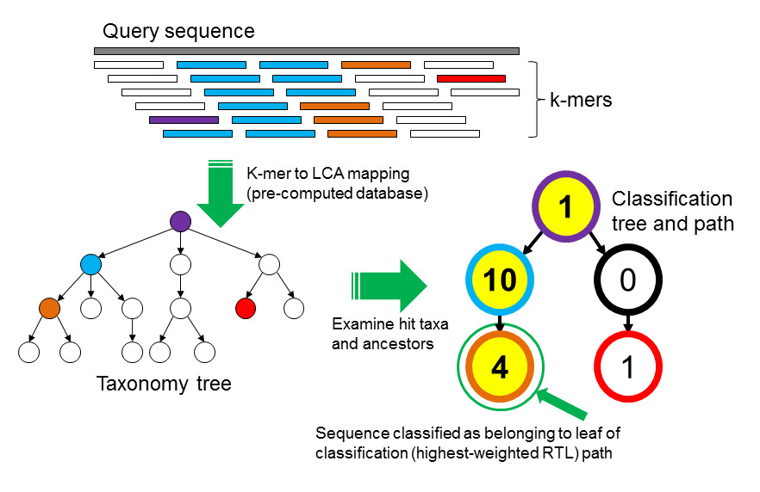
Classification Tools to be Tested
Kraken (Taxonomic Sequence Classification System)
Developed by JHU
Provides taxonomically accessible output
Classifies EXACT matches of k-mers to reference genomes
http://www.genomebiology.com/2014/15/3/R46
Notes:
Conventional lab assays and culturing methods determine the ability of a collected organism to grow and are used in the identification of the specific organism
“Viability” = ability of an organism to grow in favorable culture media
The appearance of growth takes time due to the incredibly small size of the organisms
<number>

Slide 6
Classification Tools to be Tested
BLAST (Basic Local Alignment Search Tool)
Developed 25 years ago by NCBI
Most widely used algorithm for sequence alignment
Is a more time-efficient variation of the Smith-Waterman algorithm
Classifies using computational heuristics (shortcuts)
finds a local instead of global optimal alignment
much faster, less accurate
Notes:
Conventional lab assays and culturing methods determine the ability of a collected organism to grow and are used in the identification of the specific organism
“Viability” = ability of an organism to grow in favorable culture media
The appearance of growth takes time due to the incredibly small size of the organisms
<number>

Slide 7
Classification Tools to be Tested
PathoScope 2.0
Developed by BU and GWU
Used for microbiome classification (Julia Oh et. al. 2014), therefore APL MURI team was interested in evaluating performance.
Classifies by aligning reads, scoring the alignment, then assigning each read to the highest scoring genome
Uses bowtie2 for alignment
Bowtie2 is an algorithm which extracts substrings of query sequence to seed extended alignments.
Used for comparative genomics (RNA-Seq, ChIP-Seq, etc)
Notes:
Conventional lab assays and culturing methods determine the ability of a collected organism to grow and are used in the identification of the specific organism
“Viability” = ability of an organism to grow in favorable culture media
The appearance of growth takes time due to the incredibly small size of the organisms
<number>

Slide 8
Test Databases
Reference genomes downloaded June 2015 from:
ftp://ftp.ncbi.nlm.nih.gov/genomes/
Completed Bacteria and Virus genomes only
wget ftp://ftp.ncbi.nlm.nih.gov/genomes/Bacteria/all.fna.tar.gz
wget ftp://ftp.ncbi.nlm.nih.gov/genomes/Viruses/all.fna.tar.gz
Custom database built for each classifier tool:
2786 total Bacteria genomes
4401 total Virus genomes
Notes:
Conventional lab assays and culturing methods determine the ability of a collected organism to grow and are used in the identification of the specific organism
“Viability” = ability of an organism to grow in favorable culture media
The appearance of growth takes time due to the incredibly small size of the organisms
<number>

Slide 9
Test Input – in silico read generation
Common bacteria and virus species selected:
11 Divergent Bacteria (differing Family)
9 Divergent Viruses (differing Genus)
6 Near-Neighbor Bacteria (B. anthracis strains)
Reference genomes used as input for read simulators:
ART: Illumina
MiSeq reads (Gold Standard for 2nd Gen sequencing)
Pbsim: PacBio
CLR reads (long and high error rate)
CCS reads (short(er) and low(er) error rate)
From each of the 26 organisms, kept 1000 of the simulated reads to use as input into each classifier.
Notes:
technology-specific read error model
<number>

Slide 10
Time and Resources of Classification
ODIN node | THOR
processors | 32 hyper-threaded cores @ 2.40 GHz each
memory | 32 x 16 GB DDR3 @ 1600 MHz + 1.2 TB ultra-low latency SSD as swap space
 | # of threads (not parallelized)
Kraken | 64
BlastN | 64
Pathoscope | Option N/A (8 for bowtie2)
Average read length
MiSeq | 250
CLR | 2829
CCS | 450
Notes:
Conventional lab assays and culturing methods determine the ability of a collected organism to grow and are used in the identification of the specific organism
“Viability” = ability of an organism to grow in favorable culture media
The appearance of growth takes time due to the incredibly small size of the organisms
<number>

Slide 11
Divergent Bacteria (different Family)
Taxonomic Level
Family
Genus
Species
Strain (No Rank)
Accuracy
Notes:
<number>

Slide 12
Divergent Viruses (different Genus)
Taxonomic Level
Family
Genus
Species
Strain (No Rank)
Accuracy
Notes:
Conventional lab assays and culturing methods determine the ability of a collected organism to grow and are used in the identification of the specific organism
“Viability” = ability of an organism to grow in favorable culture media
The appearance of growth takes time due to the incredibly small size of the organisms
<number>

Slide 13
Near-Neighbor Bacteria (different Strains)
Taxonomic Level
Family
Genus
Species
Strain (No Rank)
Accuracy
Notes:
Conventional lab assays and culturing methods determine the ability of a collected organism to grow and are used in the identification of the specific organism
“Viability” = ability of an organism to grow in favorable culture media
The appearance of growth takes time due to the incredibly small size of the organisms
<number>

Slide 14
TP + FP + FN
Notes:
Conventional lab assays and culturing methods determine the ability of a collected organism to grow and are used in the identification of the specific organism
“Viability” = ability of an organism to grow in favorable culture media
The appearance of growth takes time due to the incredibly small size of the organisms
<number>

Slide 15
Conclusions
Classifier | Strengths | Weaknesses
Kraken | Fastest classification time | Highest FP rate Algorithm based on exact matches, requires high accuracy base calls Requires most RAM for building reference database
blastn | Best CLR read classification Lowest FN rate | Output formatting problems for reporting best hit: - Multiple hits in different genomes
PathoScope | Highest overall accuracies Lowest FP rate | Highest FN rate Worst CLR read classification Requires most RAM during classification
Notes:
Conventional lab assays and culturing methods determine the ability of a collected organism to grow and are used in the identification of the specific organism
“Viability” = ability of an organism to grow in favorable culture media
The appearance of growth takes time due to the incredibly small size of the organisms
<number>

Slide 16
Future Work
Automate the pipeline
reads pulled from MANY sets of simulated data from ART and PBsim for each organism.
Classify non-simulated sequence reads
Increase Complexity of Test dataset
Expand list of organisms
Vary number of reads
Add noise (many host reads in 'real' metagenomic samples)
Define datasets for different use cases
Notes:
Conventional lab assays and culturing methods determine the ability of a collected organism to grow and are used in the identification of the specific organism
“Viability” = ability of an organism to grow in favorable culture media
The appearance of growth takes time due to the incredibly small size of the organisms
<number>

Slide 17
Acknowledgements
Jennifer Weller UNCC Mentor
Chris Bradburne AOS/QPA Supervisor
Ben Baugher AOS/QAI IRAD support
Dave Karig REDD/R1C MURI support
Tom Mehoke REDD/R1C Bioinformatics support
Ron Jacak REDD/R1C Cluster support
Brant Chee AOS/QAS General Q&A
Notes:
Conventional lab assays and culturing methods determine the ability of a collected organism to grow and are used in the identification of the specific organism
“Viability” = ability of an organism to grow in favorable culture media
The appearance of growth takes time due to the incredibly small size of the organisms
<number>

Slide 18
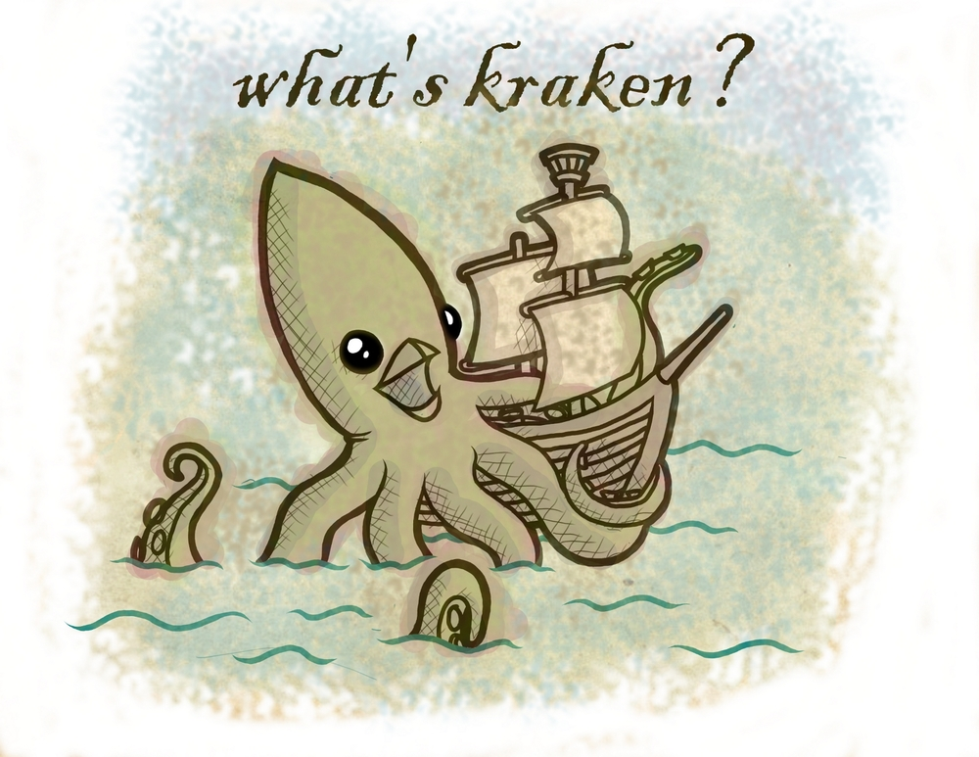
Thank You: Questions?
Background and Goals
Classification Tools to be Tested
BLASTN
Kraken
PathoScope
(GOTTCHA, Mini-kraken, SURPI)
Test Databases
Test Input (and generation of)
Test Output Statistics
Runtime and Resources
Divergent Bacteria
Near-Neighbor Bacteria
Viruses
Conclusions
Future Work
www.trygvewakenshaw.net
Notes:
Conventional lab assays and culturing methods determine the ability of a collected organism to grow and are used in the identification of the specific organism
“Viability” = ability of an organism to grow in favorable culture media
The appearance of growth takes time due to the incredibly small size of the organisms
<number>

Slide 19
Test Output Statistics
Definitions in Context
TP = number of reads classified correctly
FP = number of reads classified incorrectly
TN = 0
FN = number of reads NOT classified
P = TP+FP (total number of reads classified)
N = TN+FN (total number of reads left unclassified)
Accuracy = (TP+TN)/(P+N)
PPV = TP/P
Time and Resources
reads/min = 26,000/walltime(mins)
max RSS (resident set size)
Notes:
Conventional lab assays and culturing methods determine the ability of a collected organism to grow and are used in the identification of the specific organism
“Viability” = ability of an organism to grow in favorable culture media
The appearance of growth takes time due to the incredibly small size of the organisms
<number>

Slide 20
NEW Test Output Statistics
Definitions in Context
TP = read from [this taxid] classified as [this taxid]
TN = read from [any other taxid] did NOT classify as [this taxid]
FP = read from [any other taxid] classified as [this taxid]
FN = read from [this taxid] did NOT classify as [this taxid]
P = TP+FP (total number of reads classified as [this taxid])
N = TN+FN (total number of reads that did NOT classify as [this taxid])
Notes:
Conventional lab assays and culturing methods determine the ability of a collected organism to grow and are used in the identification of the specific organism
“Viability” = ability of an organism to grow in favorable culture media
The appearance of growth takes time due to the incredibly small size of the organisms
<number>

Slide 21
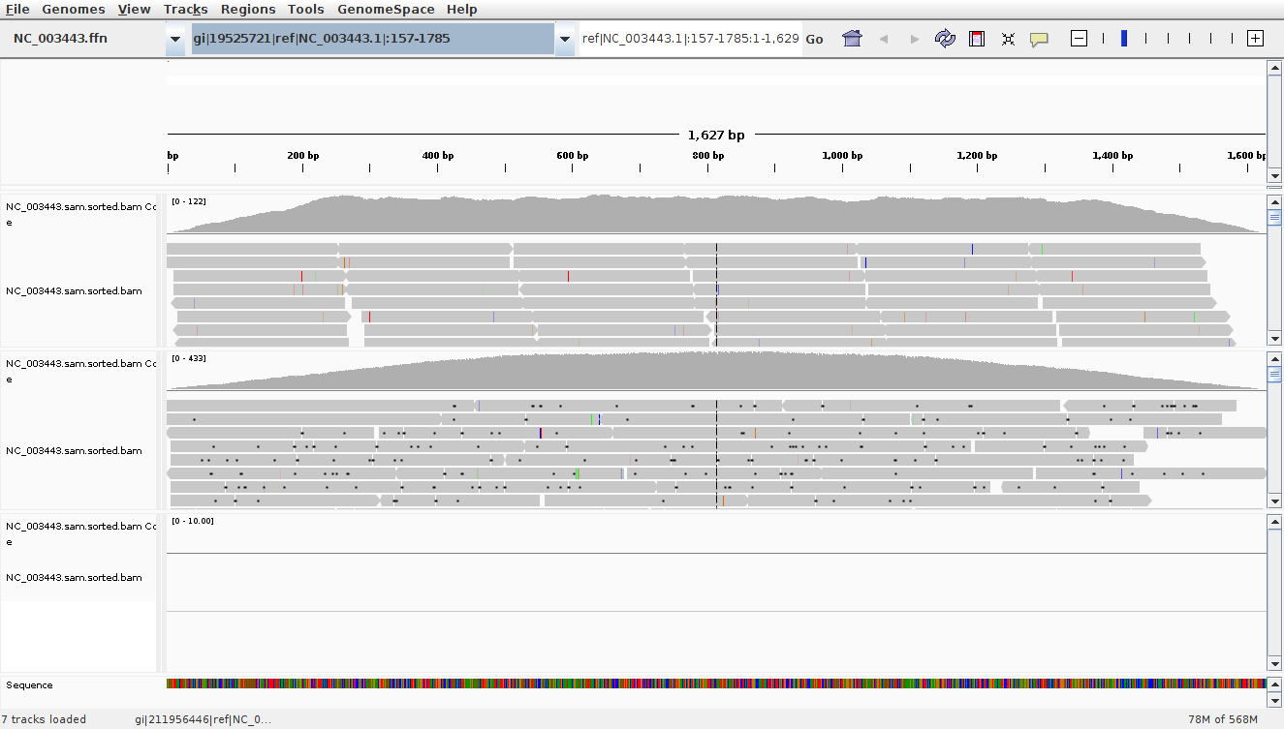
Test Input: Integrative Genomics Viewer (IGV)
Human parainfluenza virus 2 – smallest genome (3 Kbp)
MiSeq
Depth of Coverage
0-122
CCS
Depth of Coverage
0-433
CLR
Depth of Coverage
0
Notes:
Conventional lab assays and culturing methods determine the ability of a collected organism to grow and are used in the identification of the specific organism
“Viability” = ability of an organism to grow in favorable culture media
The appearance of growth takes time due to the incredibly small size of the organisms
<number>

Slide 22
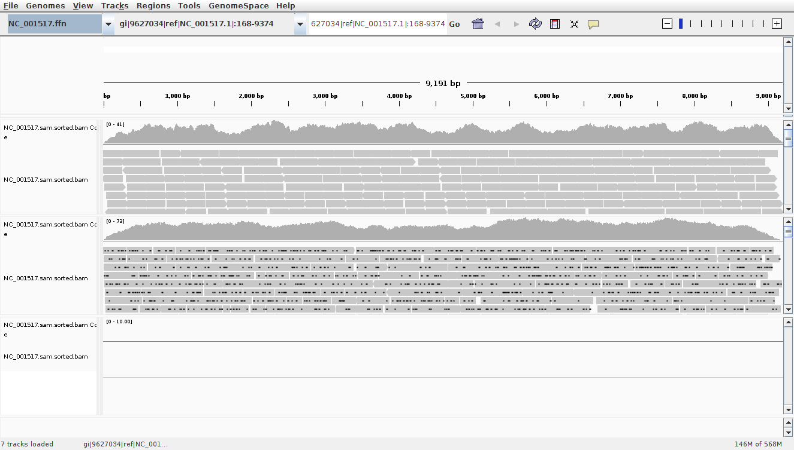
Test Input: Integrative Genomics Viewer (IGV)
Pepper mottle virus (9 Kbp)
MiSeq
Depth of Coverage
0-41
CCS
Depth of Coverage
0-73
CLR
Depth of Coverage
0
Notes:
Conventional lab assays and culturing methods determine the ability of a collected organism to grow and are used in the identification of the specific organism
“Viability” = ability of an organism to grow in favorable culture media
The appearance of growth takes time due to the incredibly small size of the organisms
<number>

Slide 23
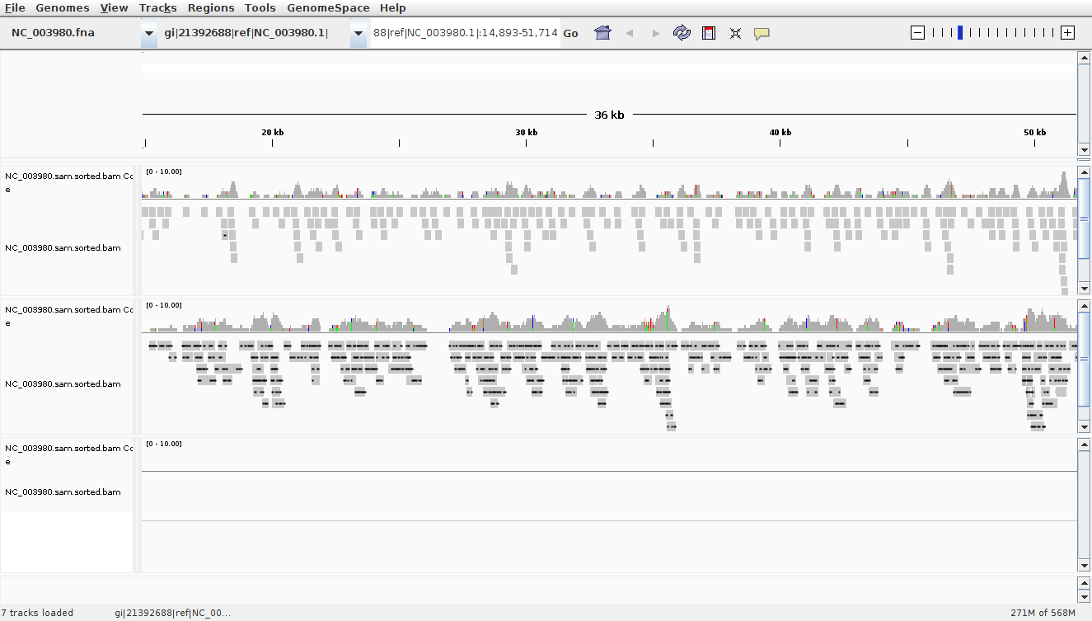
Test Input: Integrative Genomics Viewer (IGV)
Bacillus anthracis strain A2012 (184 Kbp)
MiSeq
Depth of Coverage
<10
CCS
Depth of Coverage
<10
CLR
Depth of Coverage
0
Notes:
Conventional lab assays and culturing methods determine the ability of a collected organism to grow and are used in the identification of the specific organism
“Viability” = ability of an organism to grow in favorable culture media
The appearance of growth takes time due to the incredibly small size of the organisms
<number>

Slide 24
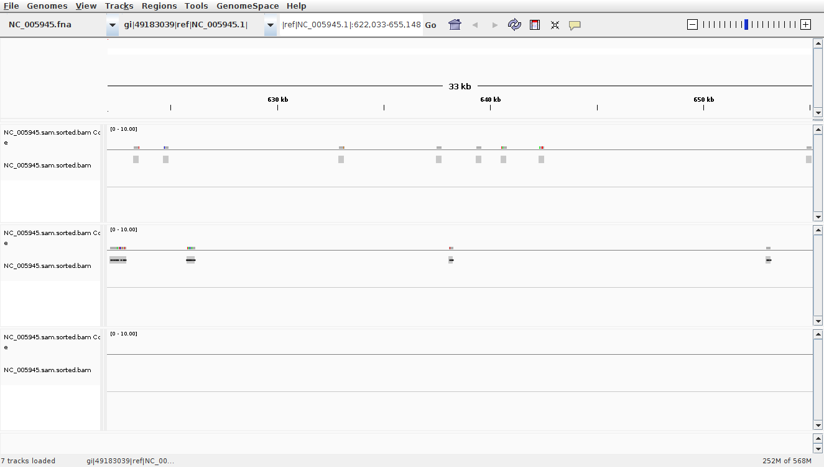
Test Input: Integrative Genomics Viewer (IGV)
Bacillus anthracis Sterne – largest genome (5303 Kbp)
MiSeq
Depth of Coverage
<1
CCS
Depth of Coverage
<1
CLR
Depth of Coverage
0
Notes:
Conventional lab assays and culturing methods determine the ability of a collected organism to grow and are used in the identification of the specific organism
“Viability” = ability of an organism to grow in favorable culture media
The appearance of growth takes time due to the incredibly small size of the organisms
<number>

Slide 25
Divergent Bacteria (different Family)
Taxonomic Level
Family
Genus
Species
Strain (No Rank)
Positive Predictive Value (PPV)
Notes:
Conventional lab assays and culturing methods determine the ability of a collected organism to grow and are used in the identification of the specific organism
“Viability” = ability of an organism to grow in favorable culture media
The appearance of growth takes time due to the incredibly small size of the organisms
<number>

Slide 26
Viruses (different Genus)
Taxonomic Level
Family
Genus
Species
Strain (No Rank)
Positive Predictive Value (PPV)
Notes:
Conventional lab assays and culturing methods determine the ability of a collected organism to grow and are used in the identification of the specific organism
“Viability” = ability of an organism to grow in favorable culture media
The appearance of growth takes time due to the incredibly small size of the organisms
<number>

Slide 27
Near-Neighbor Bacteria (different Strains)
Taxonomic Level
Family
Genus
Species
Strain (No Rank)
Positive Predictive Value (PPV)
Notes:
Conventional lab assays and culturing methods determine the ability of a collected organism to grow and are used in the identification of the specific organism
“Viability” = ability of an organism to grow in favorable culture media
The appearance of growth takes time due to the incredibly small size of the organisms
<number>

Slide 28
Average Accuracy
Notes:
Conventional lab assays and culturing methods determine the ability of a collected organism to grow and are used in the identification of the specific organism
“Viability” = ability of an organism to grow in favorable culture media
The appearance of growth takes time due to the incredibly small size of the organisms
<number>

Slide 29
Classifier default parameters
Kraken
The database
Contains records consisting of a k-mer and the LCA of all organisms whose genomes contain that k-mer
Default k-mer size for database build = 31
The classifier
Defaults to k-mer size used for database build
Blastn
Gap open penalty -5
Gap ext penalty -2
Match 1
Mismatch -3
Word size 11
Query filter DUST (filters highly repetitive sequences)
Pathoscope 2.0
Shown that 0.2x coverage is usually sufficient to identify difference between strains that have 99.9% similarity
PathoMAP, bowtie2 wrapper
Predetermined optimal alignment parameters for different read generation technologies
PathoID, user-defined prior values
Defaults is a parsimonious solution for non-unique reads, will assign these to only one of the highly similar strains
Notes:
Conventional lab assays and culturing methods determine the ability of a collected organism to grow and are used in the identification of the specific organism
“Viability” = ability of an organism to grow in favorable culture media
The appearance of growth takes time due to the incredibly small size of the organisms
<number>

Slide 30
Read Simulator parameters
ART (Illumina)
MiSeq
BACTERIA
art_illumina -i $refseq -l 250 -f 10 -o $out_path
VIRUSES
art_illumina -i $refseq -l 250 -f 100 -o $out_path
Pbsim (PacBio)
CLR
BACTERIA
pbsim --data-type CLR --depth 40 --model_qc "$model_path/model_qc_clr" "$fasta" --prefix "clr_model_d5.$base"
VIRUSES
pbsim --data-type CLR --depth 1000 --model_qc "$model_path/model_qc_clr" "$fasta" --prefix "clr_model_d100.$base"
CCS
BACTERIA
pbsim --data-type CCS --depth 5 --model_qc "$model_path/model_qc_ccs" "$fasta" --prefix "ccs_model_d5.$base"
VIRUSES
pbsim --data-type CCS --depth 400 --model_qc "$model_path/model_qc_ccs" "$fasta" --prefix "ccs_model_d100.$base"
Notes:
Conventional lab assays and culturing methods determine the ability of a collected organism to grow and are used in the identification of the specific organism
“Viability” = ability of an organism to grow in favorable culture media
The appearance of growth takes time due to the incredibly small size of the organisms
<number>

