Slide 1
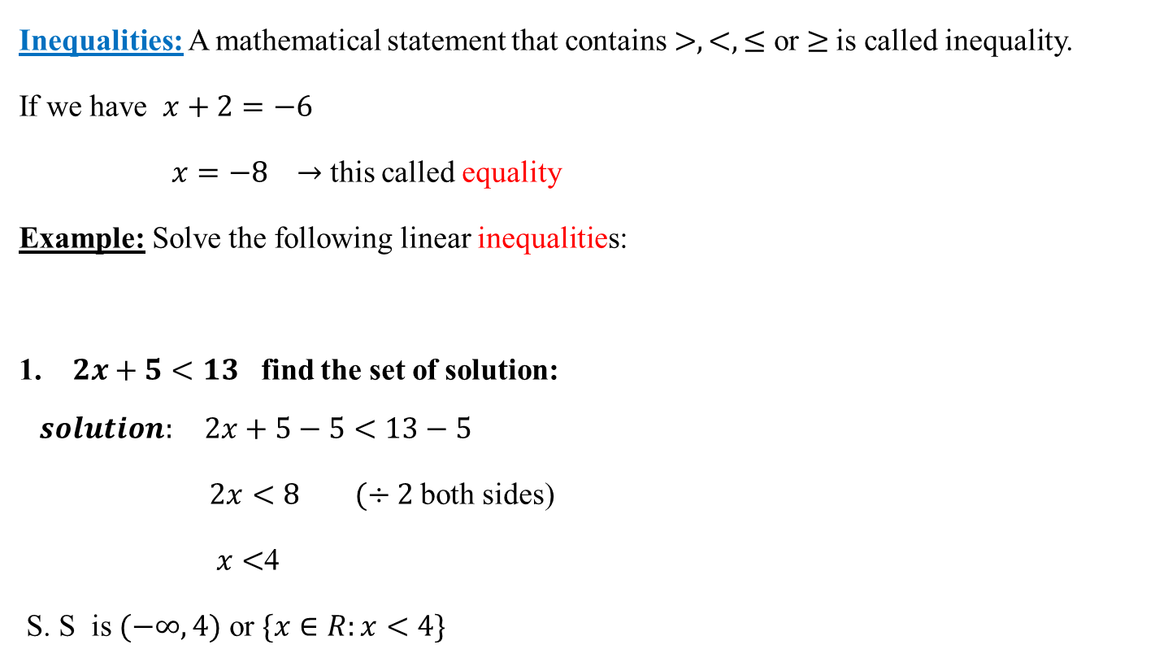
Inequalities
Inequalities: A mathematical statement that contains $>,<,≤$ or $≥$is called inequality.
If we have $x+2=−6$
$x=−8 →$ this called equality
Example: Solve the following linear inequalities:
1. $2x+5<13$ find the set of solution:
$$solution: 2x+5−5<13−5$$
$2x<8$ $(÷2$ both sides)
$x<$4
S. S is $(−∞,4)$ or $\{x∈R:x<4\}$

Slide 2
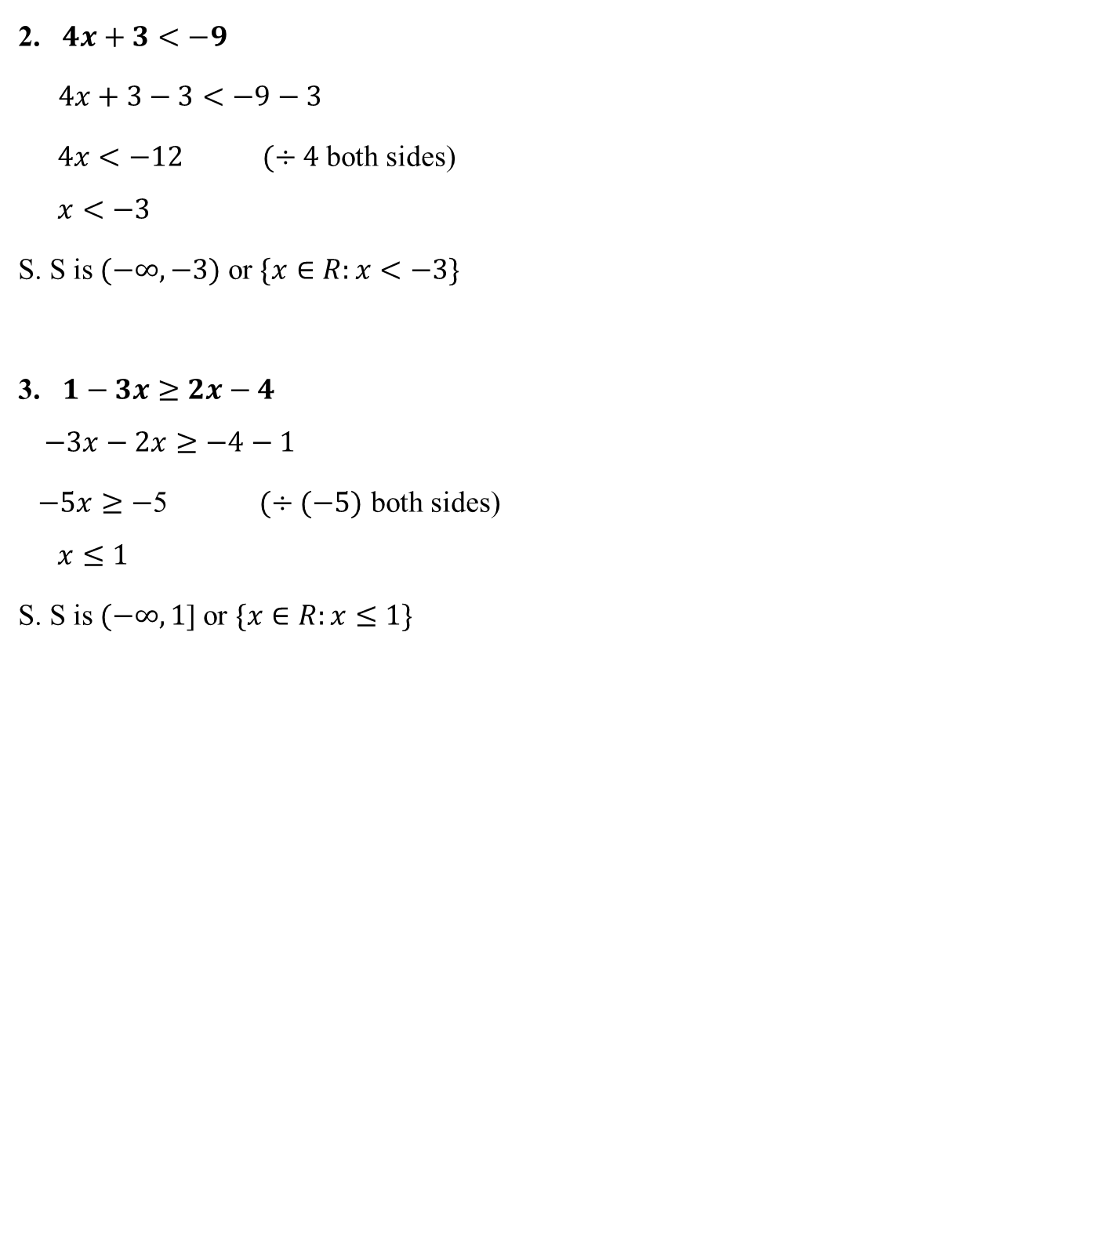
2. $4x+3<−9$
$4x+3−3<−9−3$
$4x<−12 (÷4$ both sides)
$$x<−3$$
S. S is $(−∞,−3)$ or $\{x∈R:x<−3\}$
3. $1−3x≥2x−4$
$$−3x−2x≥−4−1$$
$−5x≥−$5 $(÷(−5)$ both sides)
$$x≤1$$
S. S is $(−∞,1$] or $\{x∈R:x≤1\}$

Slide 3

4. $3−4x≤−5x+2<9x+8$
$3−4x≤−5x+2$ and $−5x+2<9x+8$
$−4x+5x≤2−3$ and $−5x−9x<8−2$
$x≤−1$ and $−14x<6$ $(÷\left(−14\right)$ both sides)
$x≤−1$ and $x>\frac{−3}{7}$
S. S is $\left(−∞,−1\right]∩\left(\frac{−3}{7},∞\right)=∅$
5. $\frac{−x}{2}≤3x−5$ $(×2$ both sides)
$−x≤2\left(3x−5\right)$
$−x≤6x−10$
$$−x−6x≤−10$$
$−7x≤−10⟹$ $x≥\frac{10}{7}$
S. S is $[\frac{10}{7},∞)$

Slide 4
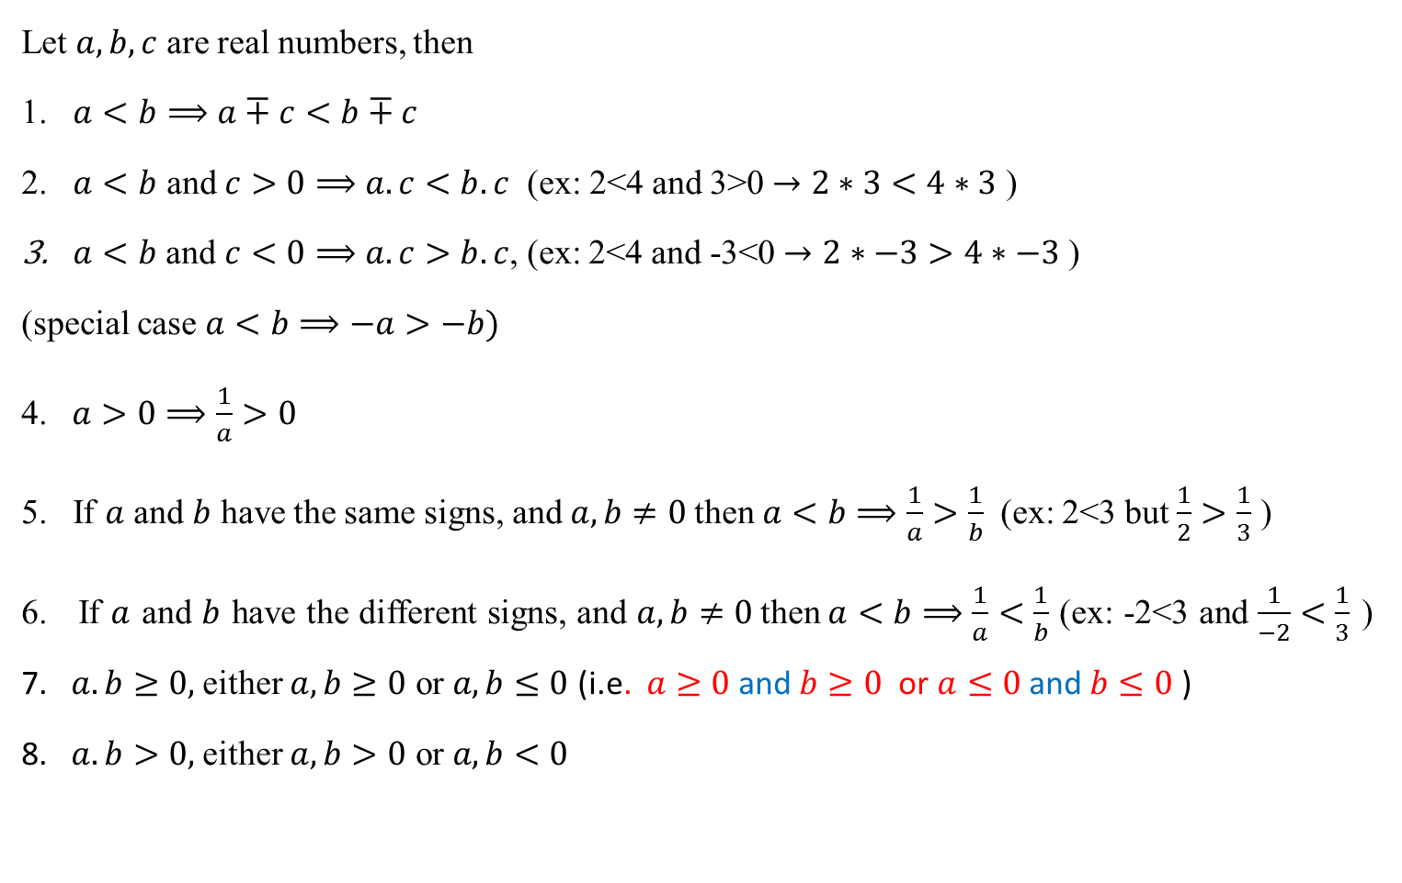
Rule of inequalities:
Let $a,b,c$ are real numbers, then
1. $a<b⟹a∓c<b∓c$
2. $a<b$ and $c>0⟹a.c<b.c$ (ex: 2<4 and 3>0 $→2∗3<4∗3$ )
$a<b$ and $c<0⟹a.c>b.c$, (ex: 2<4 and -3<0 $→2∗−3>4∗−3$ )
(special case $a<b⟹−a>−b)$
4. $a>0⟹\frac{1}{a}>0$
5. If $a$ and $b$ have the same signs, and $a,b≠0$then$a<b⟹\frac{1}{a}>\frac{1}{b}$ (ex: 2<3 but $\frac{1}{2}>\frac{1}{3}$ )
6. If $a$ and $b$ have the different signs, and $a,b≠0$then$a<b⟹\frac{1}{a}<\frac{1}{b}$ (ex: -2<3 and $\frac{1}{−2}<\frac{1}{3}$ ) 7. $a.b≥0,$either $a,b≥0$ or $a,b≤0$ (i.e. $a≥0$ and $b≥0$ or $a≤0$ and $b≤0$ )
8. $a.b>0,$either $a,b>0$ or $a,b<0$

Slide 5

$a.b≤0,$either $a≥0,b≤0$ or $a≤0, b≥0$
$a.b<0,$either $a>0,b<0$ or $a<0, b>0$
10. $\frac{a}{b}>0,$ either $a,b>0$ or $a,b<0$
$\frac{a}{b}≥0,$ either $a≥0,b>0$ or $a≤0,b<0$
$\frac{a}{b}≤0,$ either $a≥0,b<0$ or $a≤0,b>0$
13. $\frac{a}{b}<0,$ either $a>0,b<0$ or $a<0,b>0$

Slide 6
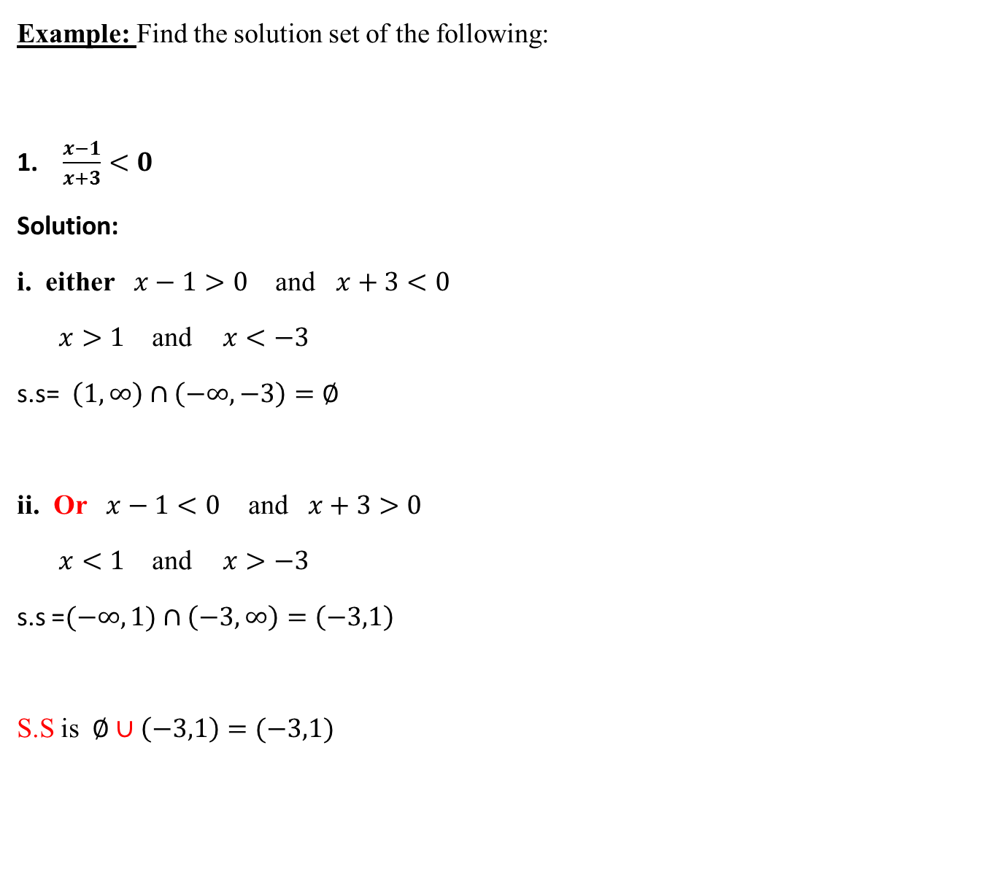
Example: Find the solution set of the following:
1. $\frac{x−1}{x+3}<0$
Solution:
i. either $x−1>0$ and $x+3<0$
$x>1$ and $x<−3$
s.s$\text{=}$ $\left(1,∞\right)∩\left(−∞,−3\right)=∅$
ii. Or $x−1<0$ and $x+3>0$
$x<1$ and $x>−3$
s.s =$(−∞,1)$ $∩\left(−3,∞\right)=\left(−3,1\right)$
S.S is $∅∪\left(−3,1\right)=(−3,1)$

Slide 7
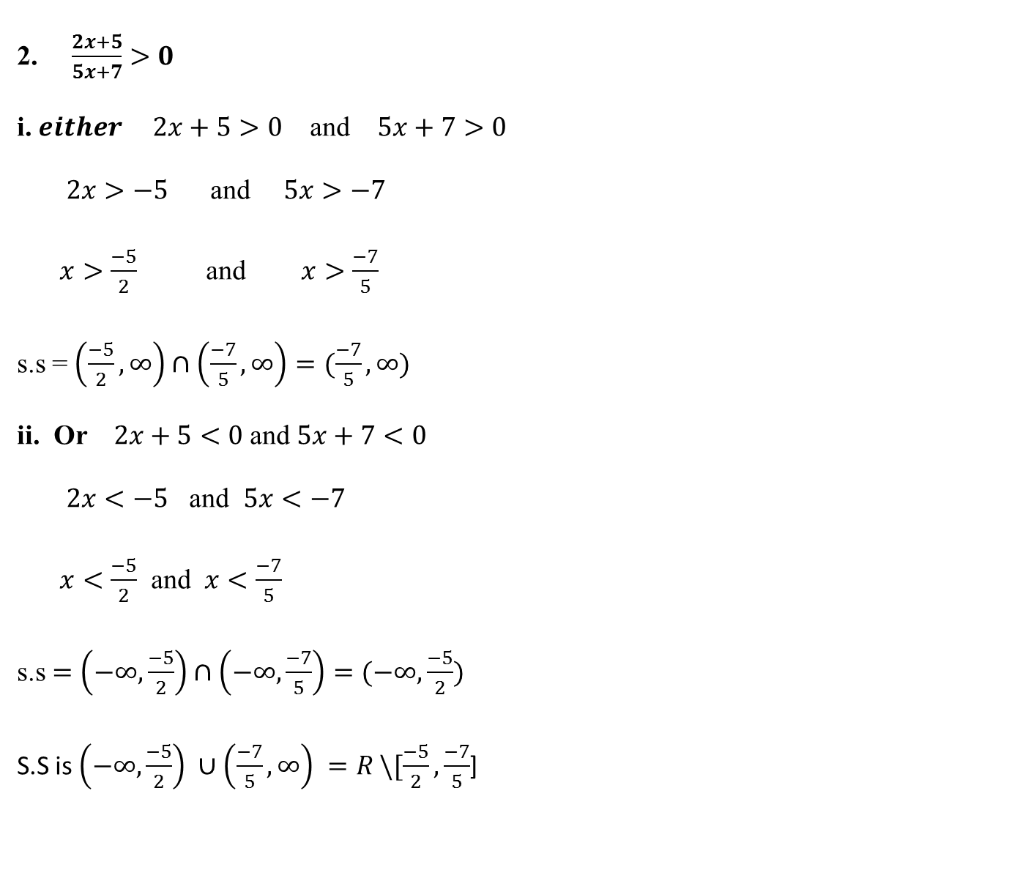
2. $\frac{2x+5}{5x+7}>0$
i.$either 2x+5>0$ and $5x+7>0$
$2x>−5$ and $5x>−7$
$x>\frac{−5}{2}$ and $x>\frac{−7}{5}$
s.s = $\left(\frac{−5}{2},∞\right)∩\left(\frac{−7}{5},∞\right)=(\frac{−7}{5},∞)$
ii. Or $2x+5<0$ and $5x+7<0$
$2x<−5$ and $5x<−7$
$x<\frac{−5}{2}$ and $x<\frac{−7}{5}$
s.s $=\left(−∞,\frac{−5}{2}\right)∩\left(−∞,\frac{−7}{5}\right)=(−∞,\frac{−5}{2})$
S.S is $\left(−∞,\frac{−5}{2}\right) ∪\left(\frac{−7}{5},∞\right) =R \backslash [\frac{−5}{2},\frac{−7}{5}$]

Slide 8
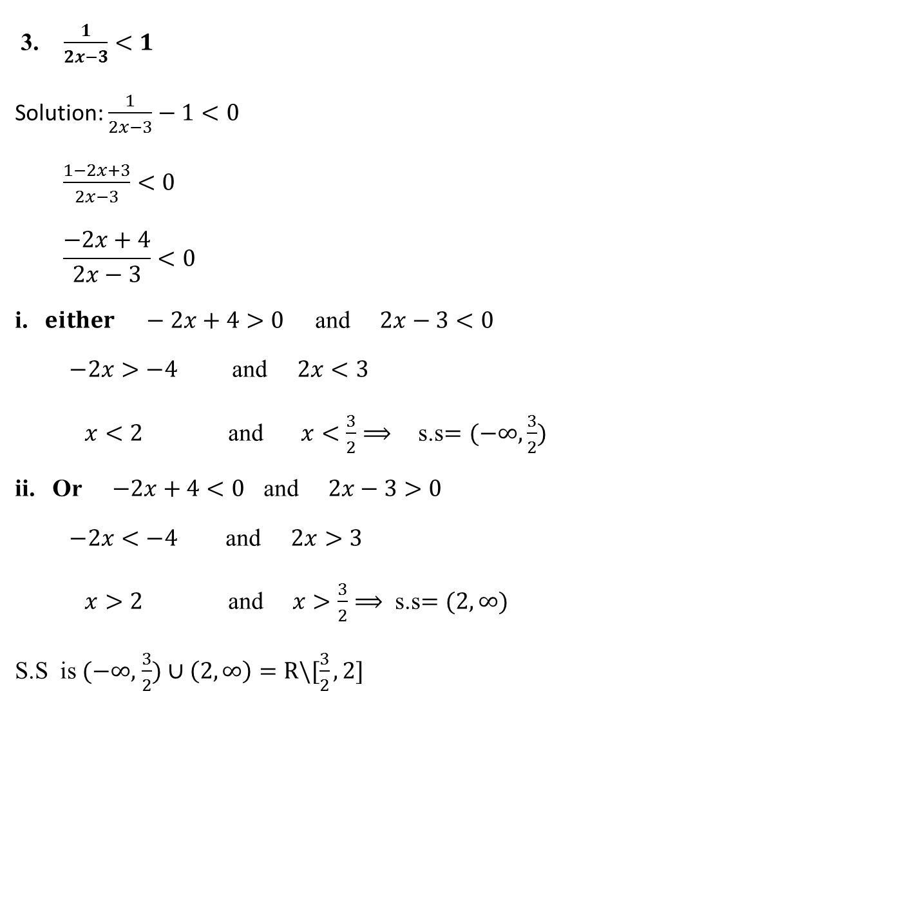
3. $\frac{1}{2x−3}<1$
Solution: $\frac{1}{2x−3}−1<0$
$\frac{1−2x+3}{2x−3}<0$
$$\frac{−2x+4}{2x−3}<0$$
i. $either −2x+4>0$ and $2x−3<0$
$−2x>−4$ and $2x<3$
$x<2$ and $x<\frac{3}{2}$ $⟹$s.s$=(−∞,$ $\frac{3}{2})$
ii. Or $−2x+4<0$ and $2x−3>0$
$−2x<−4$ and $2x>3$
$x>2$ and $x>\frac{3}{2}$ $⟹$ s.s$=(2,∞)$
S.S is $(−∞,$ $\frac{3}{2})∪$ $\left(2,∞\right)=R\backslash [\frac{3}{2},2]$

Slide 9

4. $\frac{3}{x−4}<0$
Solution: since $3>0,$then $x−4<0⟹x<4$
S.S is $(−∞,4)$
5. $\frac{{ (x−2)}^{2}}{x^{2}−2x+5}≤0$
Solution: Since${ (x−2)}^{2}≥0$
$⟹$ ${ x}^{2}−2x+5<0$ $ax^{2}+bx+(\frac{b}{2})^{2}−(\frac{b}{2})^{2}+c$
$a=1, b=−2, c=5,$ so $(\frac{−2}{2})^{2}=1$
$${ x}^{2}−2x+1−1+5<0$$
$$∴(x−1)^{2}+4<0$$
Always positive $+4<0 ×$
S.S $=∅$

Slide 10
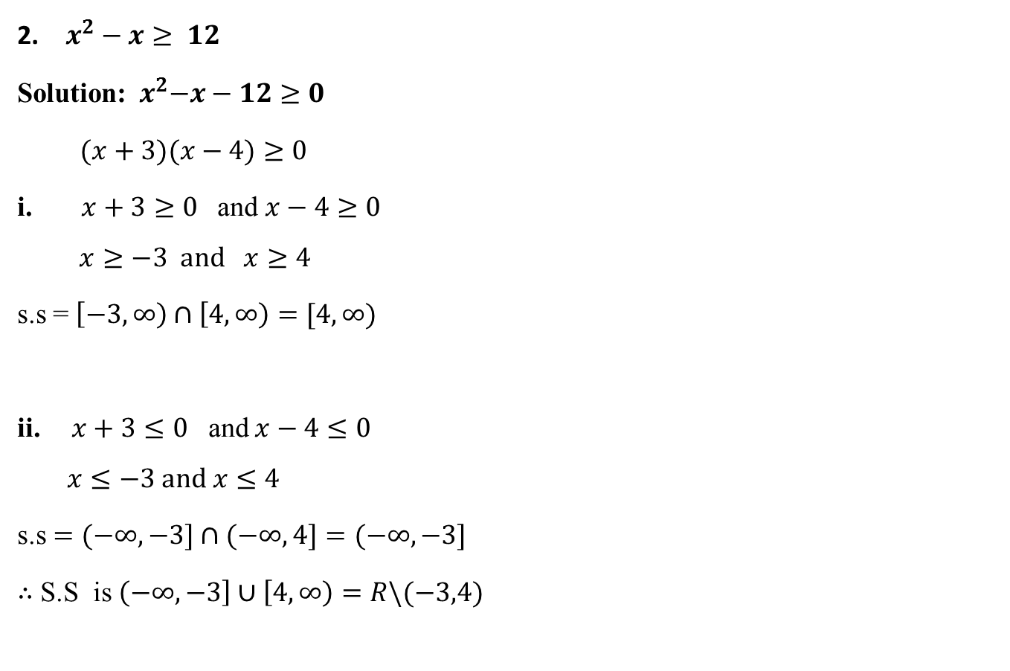
$x^{2}−x≥ 12$
Solution:${ x}^{2}−x−12≥0$
$(x+3)(x−4)≥0$
$\text{i}\text{.} x+3≥0$ and $x−4≥0$
$$x≥−3 and x≥4$$
s.s = $\left[−3,∞\right)∩\left[4,∞\right)=[4,∞)$
ii. $x+3≤0$ and $x−4≤0$
$$x≤−3 and x≤4$$
s.s $=(−∞,−3]∩(−∞,4]=(−∞,−3]$
$∴$ S.S is $\left(−∞,−3\right]∪\left[4,∞\right)=R\backslash (−3,4)$

Slide 11
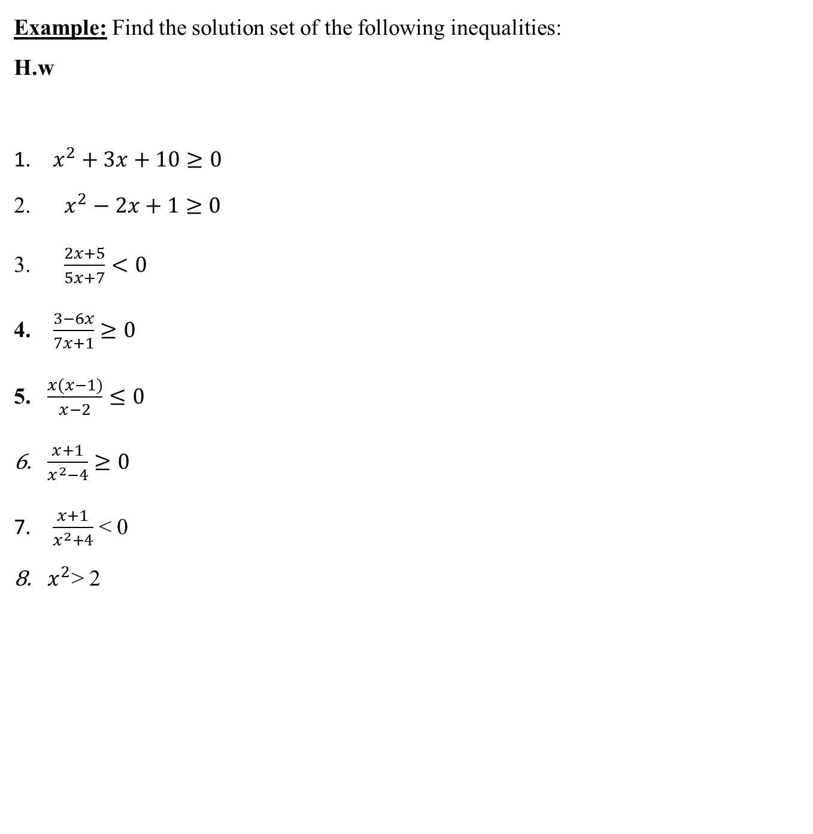
Example: Find the solution set of the following inequalities: H.w
$x^{2}+3x+10≥0$
$x^{2}−2x+1≥0$
$\frac{2x+5}{5x+7}<0$
4. $\frac{3−6x}{7x+1}≥0$
5. $\frac{x(x−1)}{x−2}≤0$
$\frac{x+1}{x^{2}−4}≥0$
$\frac{x+1}{x^{2}+4}$ < 0
$x^{2}$> 2

Slide 12


Absolute value
The absolute value of any real number $x$ is defined as:
$$\left|x\right|=\left\{\begin{aligned}x , x≥0 \\ \\ or \\ \\ −x , x <0\end{aligned}\right.$$
Example: $\left|−3\right|=3, \left|5\right|=5, \left|0\right|=0$
Geometrically the absolute value of the $x$ is the distance from $0$ to $x.$

Slide 13
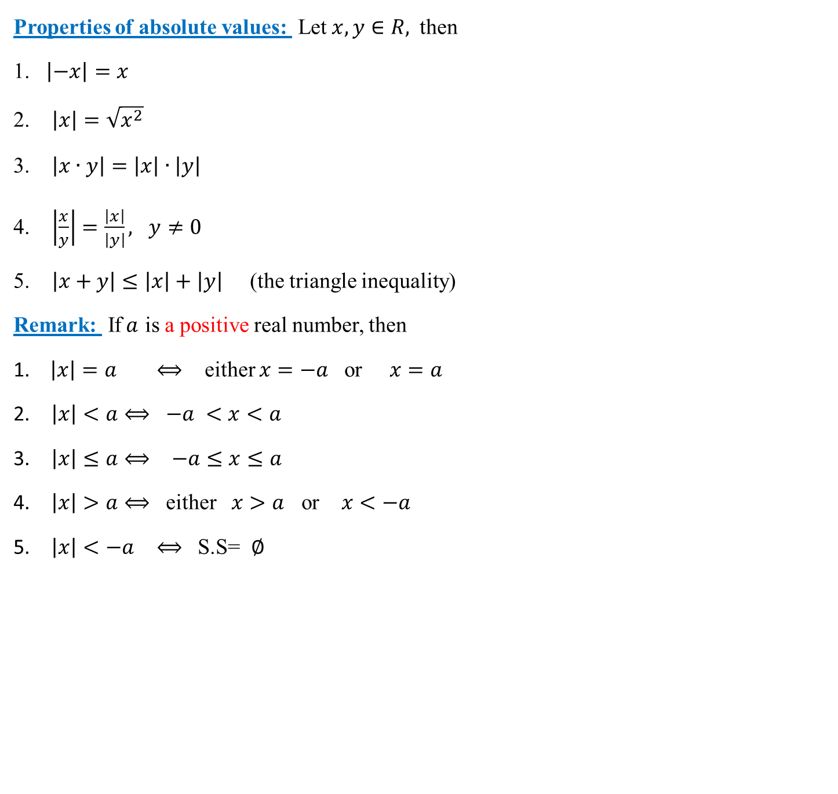
Properties of absolute values: Let $x,y∈R,$ then
1. $\left|−x\right|=x$
2. $\left|x\right|=\sqrt{x^{2}}$
3. $\left|x∙y\right|=\left|x\right|∙\left|y\right|$
4. $\left|\frac{x}{y}\right|=\frac{\left|x\right|}{\left|y\right|}, y≠0$
5. $\left|x+y\right|≤\left|x\right|+\left|y\right|$ (the triangle inequality)
Remark: If$a$ is a positive real number, then
1. $\left|x\right|=a ⟺$ either $x=−a$ or $x=a$
$\left|x\right|<a⟺$ $−a <x<a$
$\left|x\right|≤a⟺$ $−a≤x≤a$
$\left|x\right|>a⟺$ either $x>a$ or $x<−a$
$\left|x\right|<−a$ $⟺$ S.S= $∅$

Slide 14
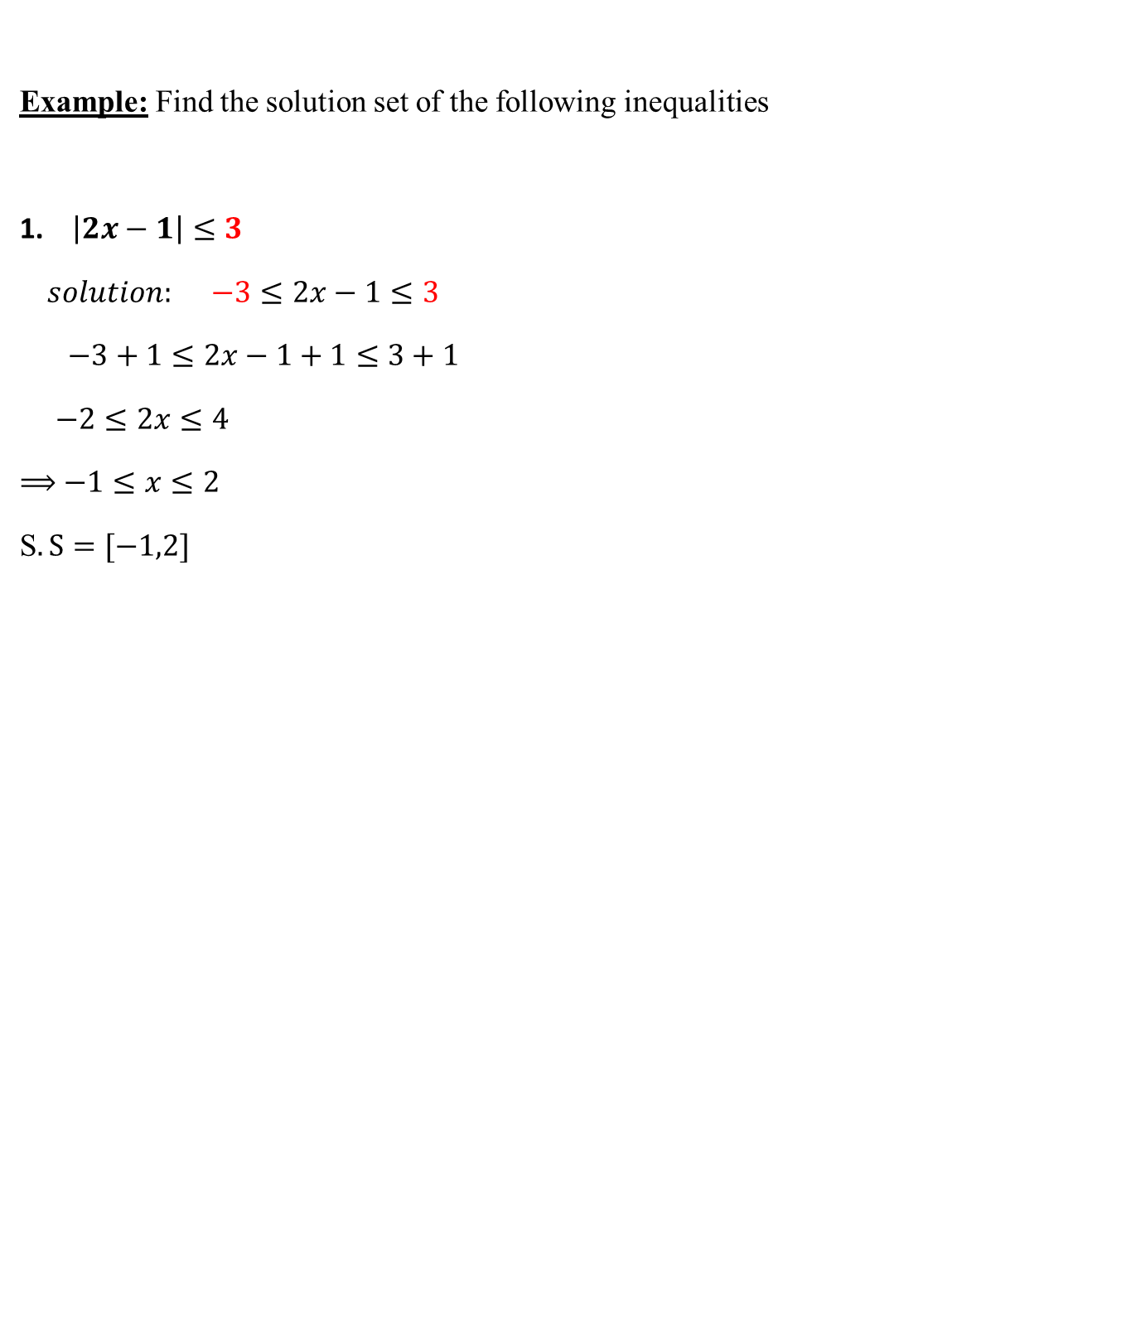
Example: Find the solution set of the following inequalities
1. $\left|2x−1\right|≤3$
$solution: −3≤2x−1≤3$
$−3+1≤2x−1+1≤3+1$
$−2≤2x≤4$
$⟹$ $−1≤x≤2$
S$.S=[−1,2]$

Slide 15
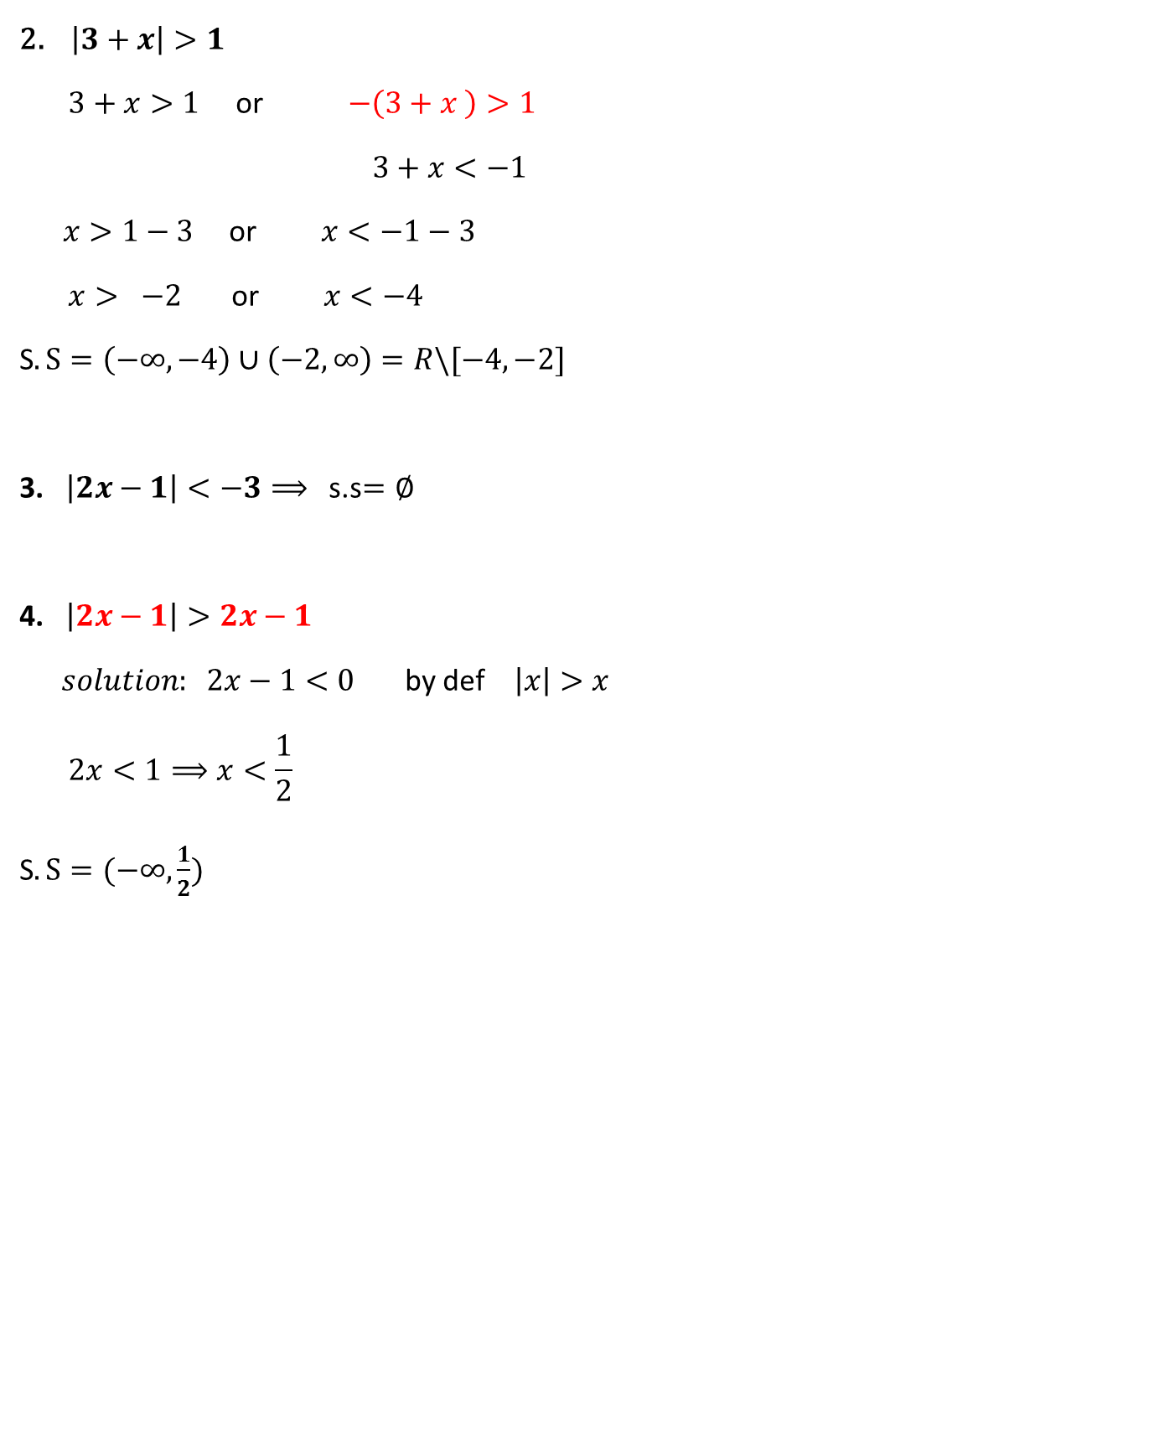
2. $\left|3+x\right|>1$
$3+x>1$ or $−\left(3+x \right)>1$
$3+x<−1$
$x>1−3$ or $x<−1−3$
$x> −2$ or $x<−4$
S$.S=\left(−∞,−4\right)∪\left(−2,∞\right)=R\backslash [−4,−2]$
3. $\left|2x−1\right|<−3⟹$ s.s$=∅$
4. $\left|2x−1\right|>2x−1$
$solution: 2x−1<0$ by def $\left|x\right|>x$
$$2x<1⟹x<\frac{1}{2}$$
S$.S=(−∞,\frac{1}{2})$

Slide 16
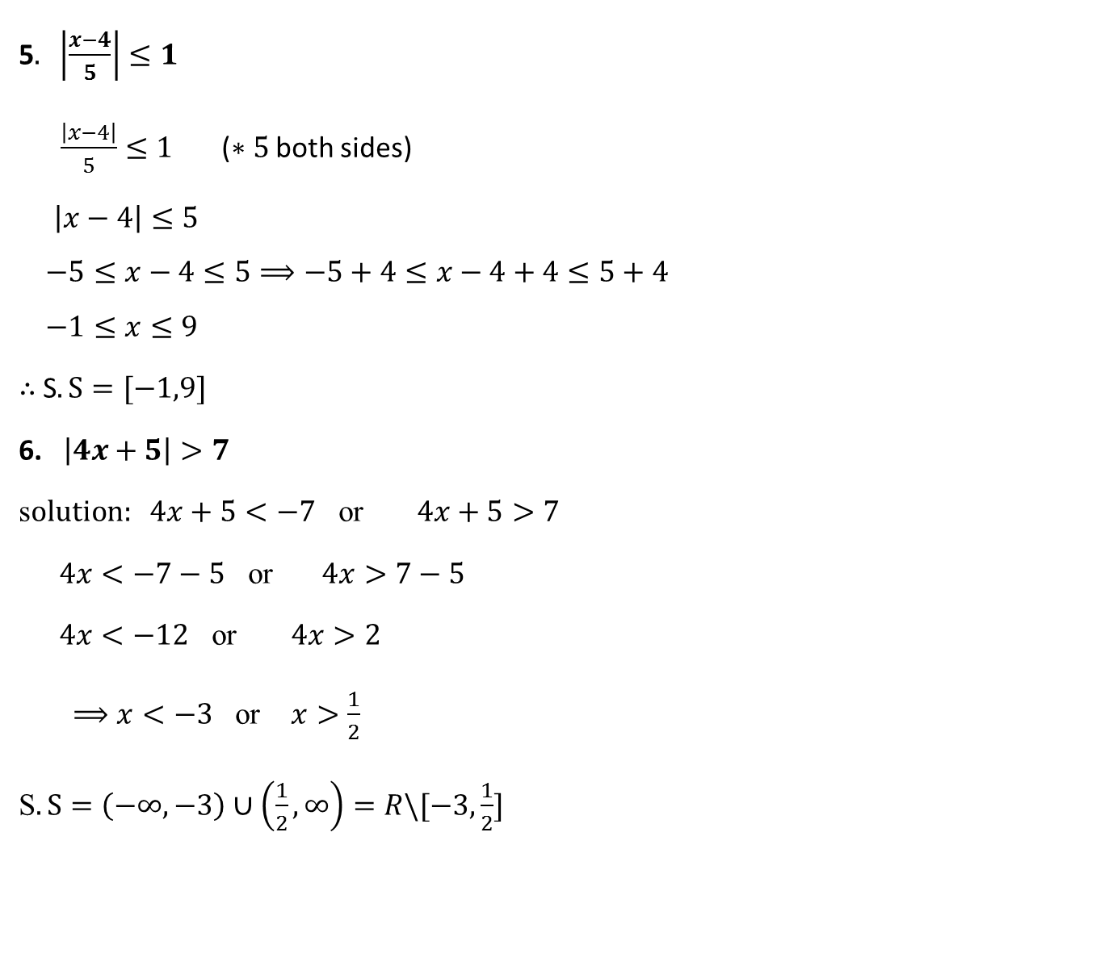
5$. \left|\frac{x−4}{5}\right|≤1$
$\frac{\left|x−4\right|}{5}≤1$ ($∗5$ both sides)
$\left|x−4\right|≤5$
$$−5≤x−4≤5⟹−5+4≤x−4+4≤5+4$$
$$−1≤x≤9$$
$∴$S$.S=[−1,9]$
6. $\left|4x+5\right|>7$
s$olution: 4x+5<−7$ or $4x+5>7$
$4x<−7−5$ or $4x>7−5$
$4x<−12$ or $4x>2$
$⟹x<−3$ or $x>\frac{1}{2}$
S$.S=\left(−∞,−3\right)∪\left(\frac{1}{2},∞\right)=R\backslash [−3,\frac{1}{2}]$

Slide 17
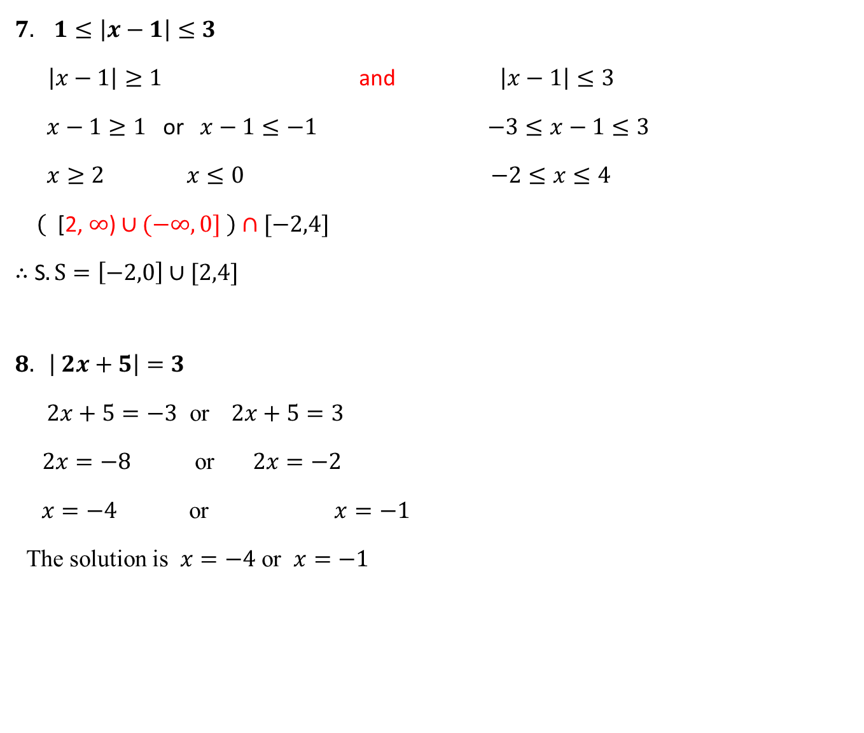
$$7. 1≤\left|x−1\right|≤3$$
$\left|x−1\right|≥1$ and $\left|x−1\right|≤3$
$x−1≥1$ or $x−1≤−1$ $−3≤x−1≤3$
$x≥2$ $x≤0$ $−2≤x≤4$
$\left( \text{[}\text{2}\text{, }∞\text{)}∪(−∞,0] \right)$ $∩[−2,4]$
$∴$ S$.S=\left[−2,0\right]∪[2,4]$
$$8. \left| 2x+5\right|=3$$
$2x+5=−3$ or $2x+5=3$
$2x=−8$or $2x=−2$
$x=−4$ or $x=−1$
The solution is $x=−4$ or $x=−1$

Slide 18



$$9. \left|x\right|>\left|x−1\right|$$
$$\text{Solution}\text{: }x=0 and x= 1$$
$$\text{i}\text{. }x<0 and −x> −\left(x−1\right)$$
$\left(−∞,0\right) and −x> −x+1⟹0>1 \text{no} \text{solution}$
$\text{s}\text{.}\text{s}=\left(−∞,0\right)∩∅ \text{=} ∅$
$0≤x<1 \text{and} x> −(x−1$)
$\left[0,1\right) and x+x>1 \text{, }2x>1 x>\frac{1}{2}\text{, }$
$$s.s=\left[0,1\right)∩\text{(}\frac{1}{2}\text{,}∞\text{)}\text{=} \text{(}\frac{1}{2}\text{,}1\text{)}$$
iii.. $x≥1$ and $x> x−1$
[$1$, $∞$) and $0>−1$ always true $R$ ,
s.s= [$1$, $∞$) $∩R= \left[1,∞\right)$
S$.S=∅∪ (\frac{1}{2},1)∪[1,∞)$= ($\frac{1}{2},∞$)

