Slide 1
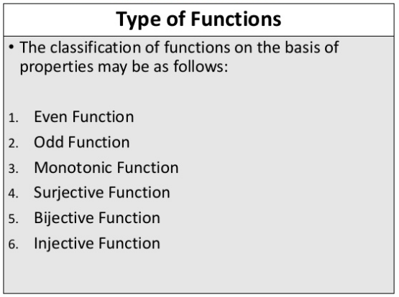

Slide 2
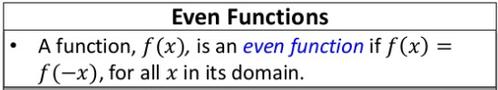
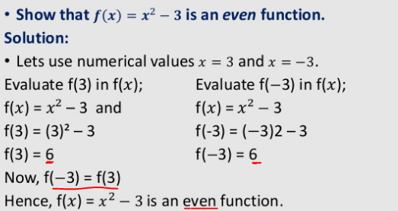

Slide 3
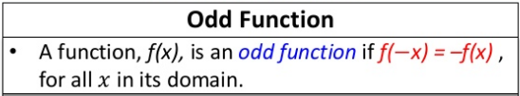
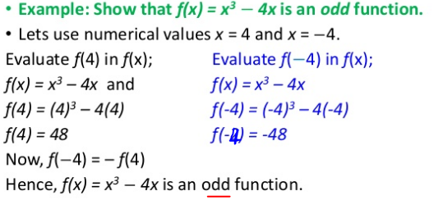

Slide 4
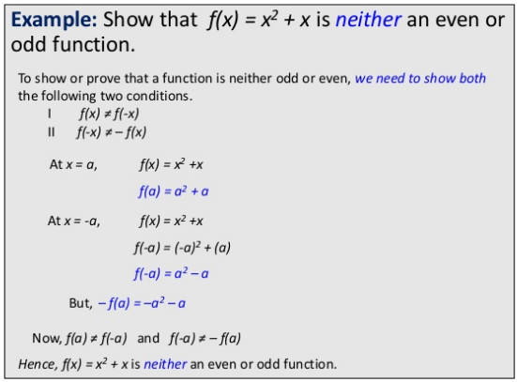
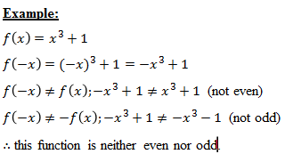

Slide 5
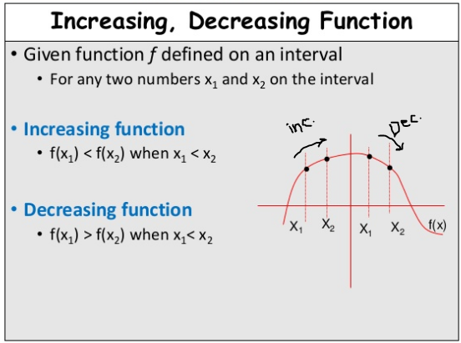
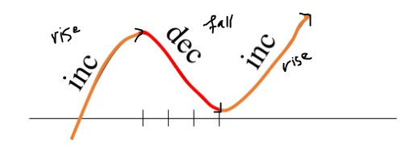

Slide 6
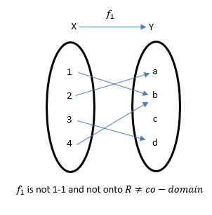
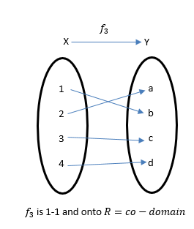

Def. One-to-one and Onto Functions: A function $f:X⟶Y,$ is called one-to-one (injective) (often written 1-1) if $f{(x}_{1})=f{(x}_{2})⟹x_{1}=x_{2},$ $∀ x_{1},x_{2}∈X.$
Negation $x_{1}≠x_{2}$ $⟹$ $f{(x}_{1})≠f{(x}_{2})$
It is called onto (Surjective) if for each $y∈Y$ there exists $x∈X$ such that $y=f\left(x\right).$
A function $f:X⟶Y,$ is called Bijective if it is 1-1 and onto.

Slide 7
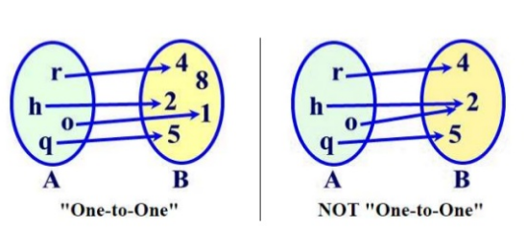
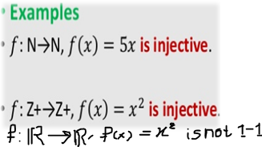
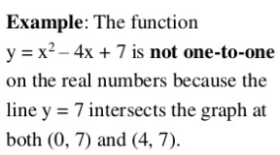

Slide 8
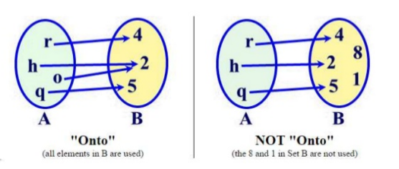
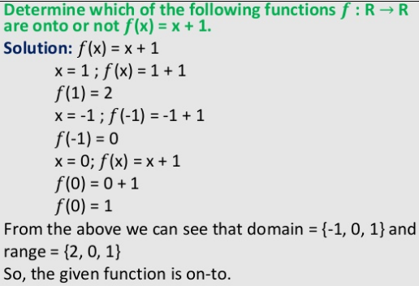
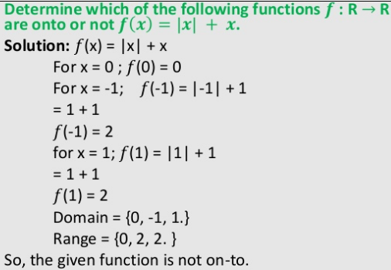

Slide 9
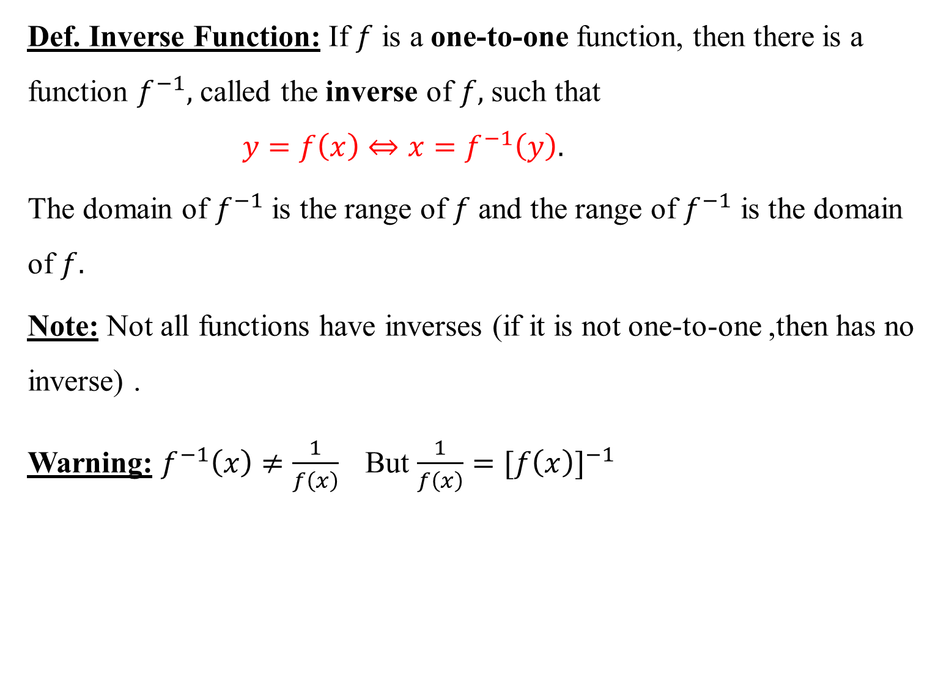
Def. Inverse Function: If $f$ is a one-to-one function, then there is a function $f^{−1},$ called the inverse of $f,$ such that $y=f\left(x\right)⇔{x=f}^{−1}\left(y\right).$
The domain of $f^{−1}$ is the range of $f$ and the range of $f^{−1}$ is the domain of $f.$
Note: Not all functions have inverses (if it is not one-to-one ,then has no inverse) .
Warning: $f^{−1}\left(x\right)≠\frac{1}{f\left(x\right)}$But $\frac{1}{f\left(x\right)}={[f\left(x\right)]}^{−1}$

Slide 10
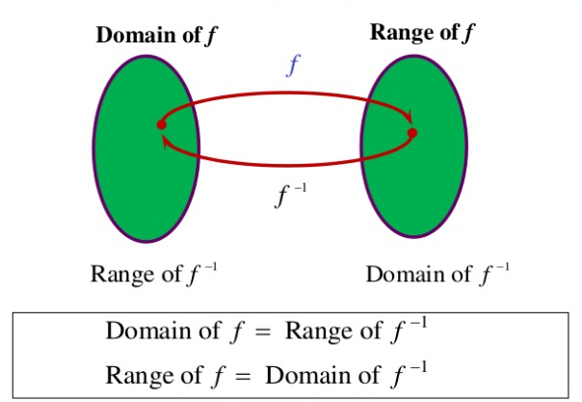
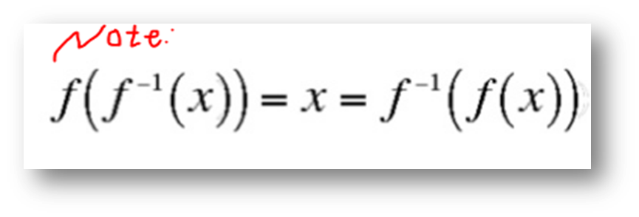

Slide 11
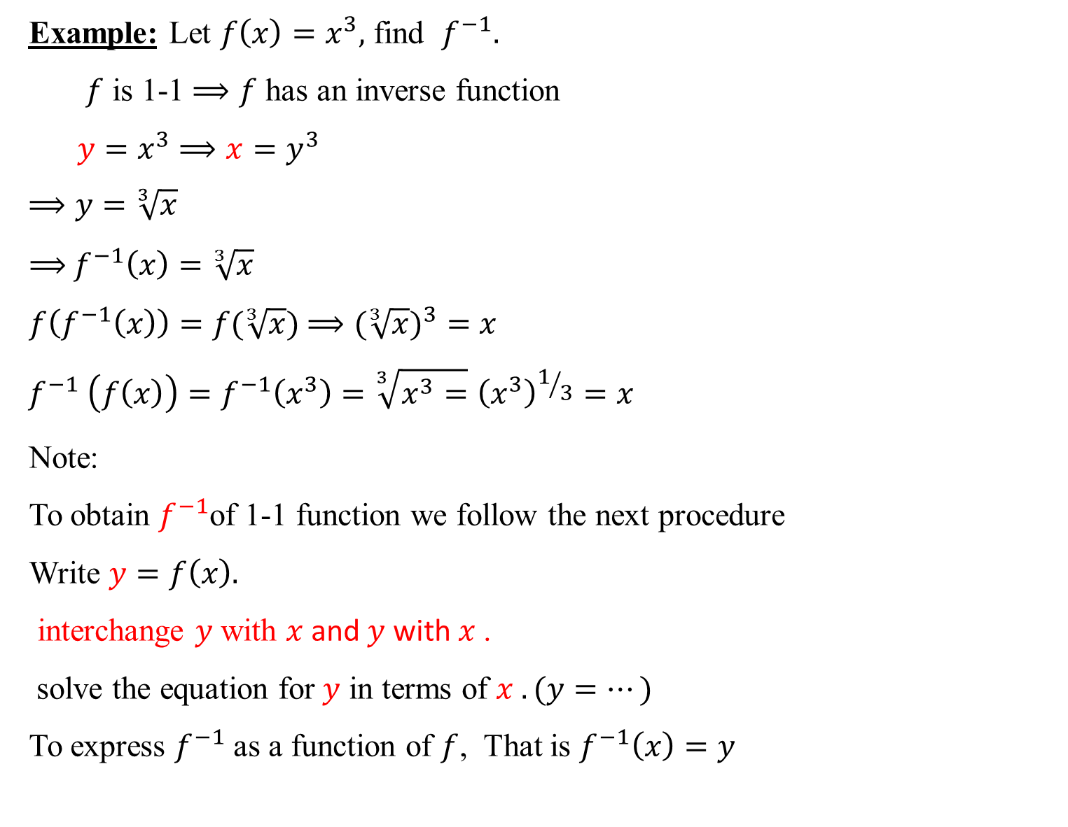
Example: Let $f\left(x\right)=x^{3},$ find $f^{−1}.$
$f$ is 1-1 $⟹f$ has an inverse function
${y=x}^{3}$ $⟹x=y^{3}$
$$⟹y=\sqrt[3]{x}$$
$⟹$ $f^{−1}\left(x\right)=\sqrt[3]{x}$
$f\left(f^{−1}\left(x\right)\right)=f(\sqrt[3]{x})$ $⟹(\sqrt[3]{x})^{3}=x$
$$f^{−1} \left(f\left(x\right)\right)=f^{−1}\left(x^{3}\right)=\sqrt[3]{x^{3}=}{\left(x^{3}\right)}^{1/3}=x$$
Note:
To obtain $f^{−1}$of 1-1 function we follow the next procedure
Write $y=f\left(x\right).$
. interchange $y$ with $x$and$y$with $x$
solve the equation for$y$ in terms of $x . (y=…)$
To express $f^{−1}$ as a function of $f$, That is $f^{−1}\left(x\right)=y$

Slide 12
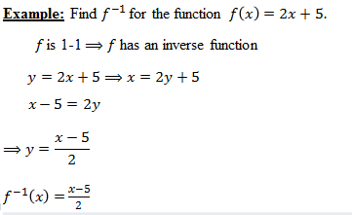

Slide 13
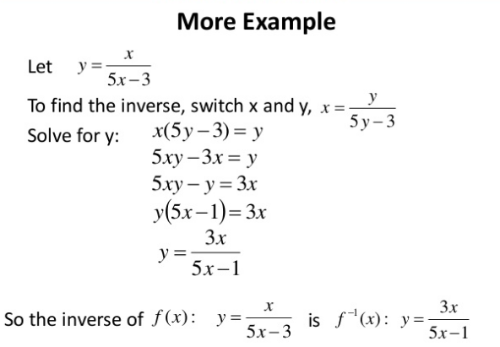

H.W: Let $f\left(x\right)=\frac{1}{\sqrt{1+x^{3}}}$ find $f^{−1}.$

Slide 14
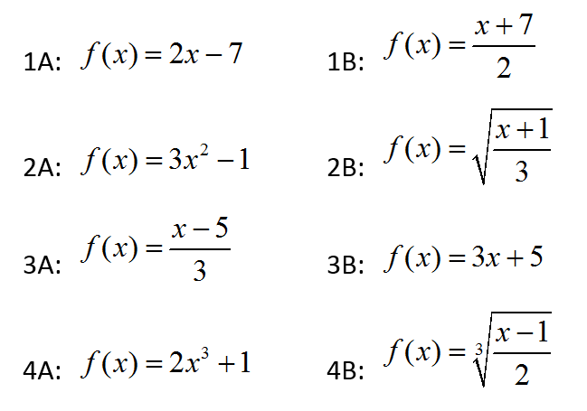

Slide 15
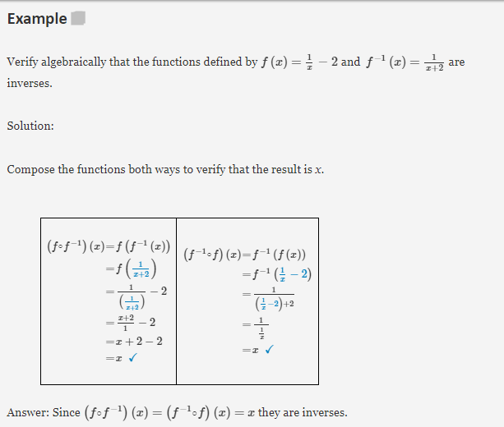

Slide 16
