Slide 1
Algebraic Functions
Domain of function
Range of function
Sketch graph of function

Slide 2
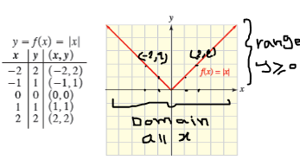

Domain, Range and Graph
The domain of a function is the set of its possible inputs $x$, i.e., the set of input values where for which the function is defined.
The range of a function is the complete set of all possible resulting values (out puts ) of the dependent variable (y, usually), after we have substituted the domain

Slide 3
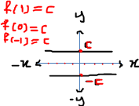
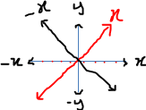
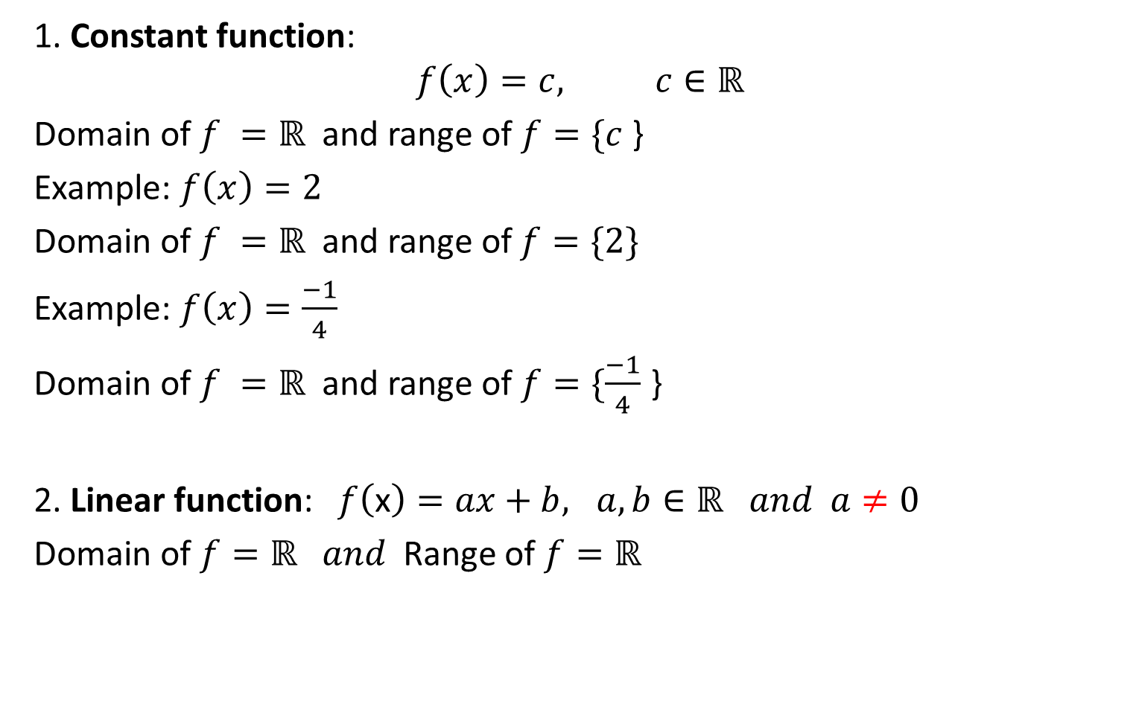
Algebraic functions
1. Constant function:
$$f\left(x\right)=c, c∈ℝ$$
Domain of $f =ℝ$ and range of $f=\{c$ }
Example: $f\left(x\right)=2$
Domain of $f =ℝ$ and range of $f=\{2\}$
Example: $f\left(x\right)=\frac{−1}{4}$
} Domain of $f =ℝ$ and range of $f=\{\frac{−1}{4}$
2. Linear function:$f\left(\text{x}\right)=ax+b, a,b∈ℝ and a≠0$
Domain of $f=ℝ and$Range of $f=ℝ$

Slide 4
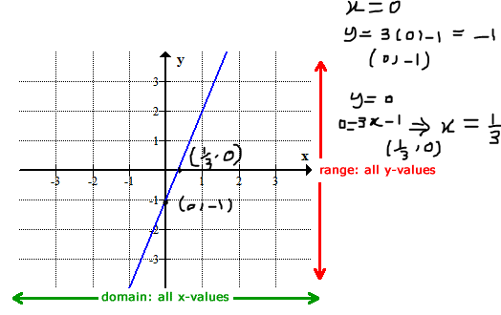

Example: find domain ,range and sketch the graph of
$$f\left(x\right)=3x−1$$
Solution:
Domain of $f=ℝ and$Range of $f=ℝ$

Slide 5
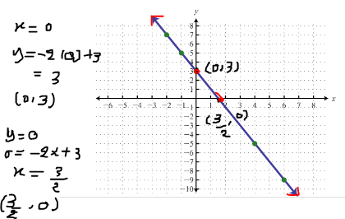

Example: let $y=3−2x$ find domain range and graph.
Solution: $f\left(x\right)=−2x+3$
D$f=ℝ and$R $f=ℝ$
H.W: $f\left(x\right)= \frac{3}{4}x−2$

Slide 6


Absolute value of linear function:
Domain of $f=ℝ and$Range of $f=ℝ^{+}$=[0,$∞$)
$f\left(x\right)=−\left|x\right|$
Domain of $f=ℝ and$Range of $f=ℝ^{−}$=($−∞$,0]
$$f\left(x\right)=\left|x\right|=\left\{\begin{aligned}x , x≥0 \\ \\ or \\ \\ −x , x <0\end{aligned}\right.$$

Slide 7
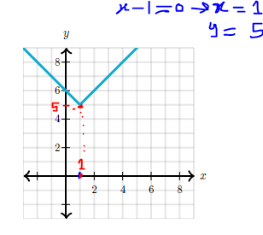
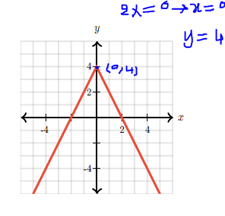

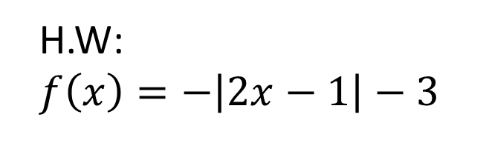
Example: $f(x)=∣x−1∣+5$
D$f=ℝ$
R$f=[5,∞)$
Example: $f(x)= −2∣x∣+4$
D$f=ℝ$
R$f=(−∞,4]$
H.W: $f\left(x\right)=−\left|2x−1\right|−3$

Slide 8
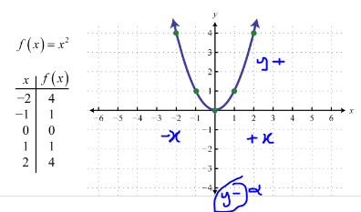
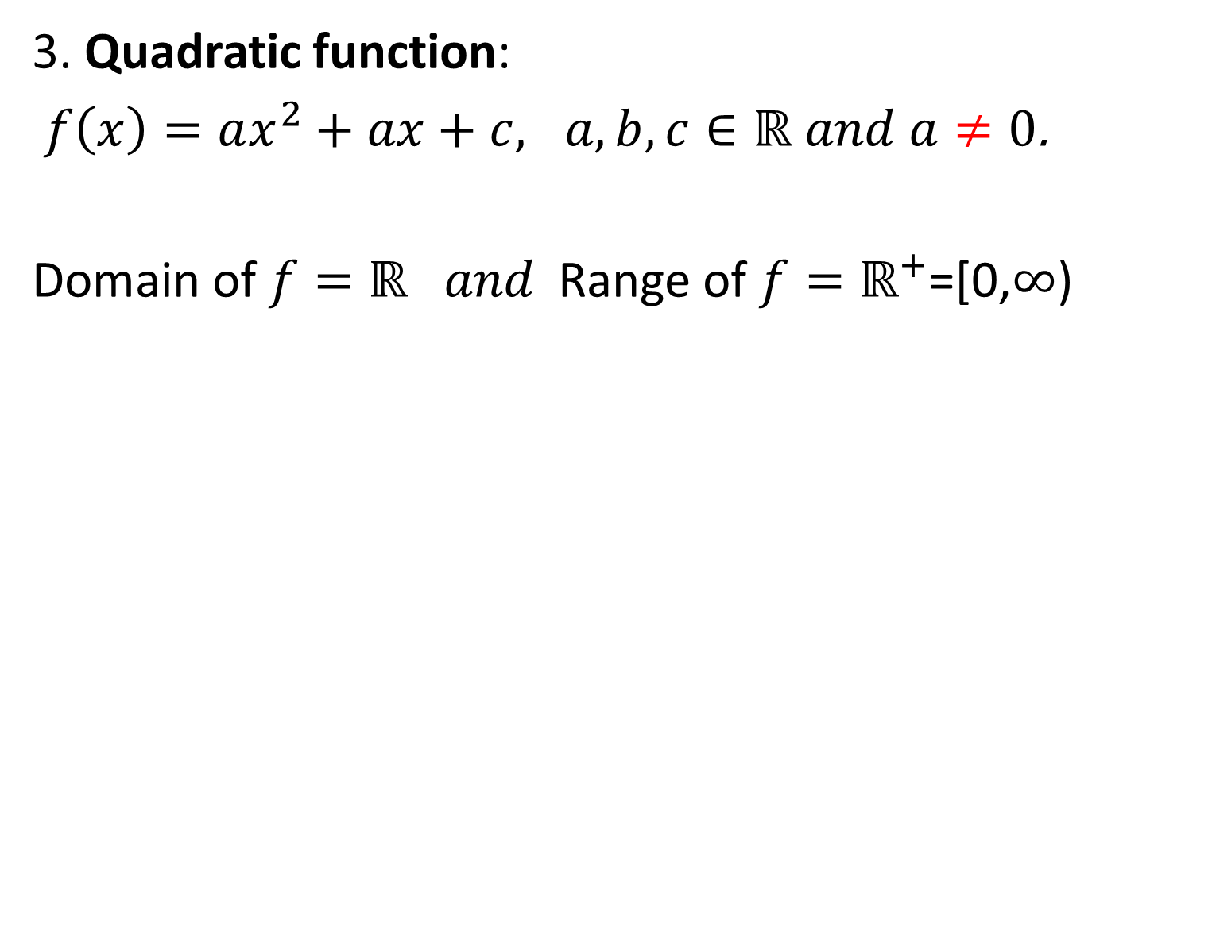
3. Quadratic function:
$f\left(x\right)=ax^{2}+ax+c, a,b,c∈ℝ and a≠0$.
Domain of $f=ℝ and$Range of $f=ℝ^{+}$=[0,$∞$)

Slide 9
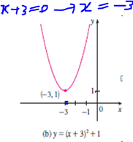

Example: Sketch the graph of the function $f\left(x\right)={6x+x}^{2}+10.$
$$y=x^{2}+6x+10$$
$=$ $x^{2}+6x+$9+1
$$=(x+3)(x+3)+1$$
$$⟹y=({x+3)}^{2}+1$$
Domain of $f=ℝ and$Range of $f=$[1,$∞$)

Slide 10
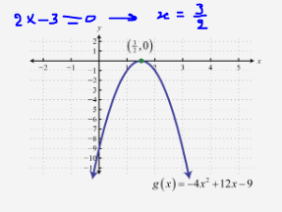
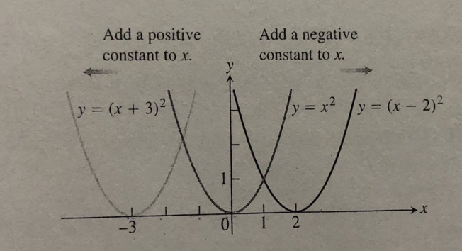
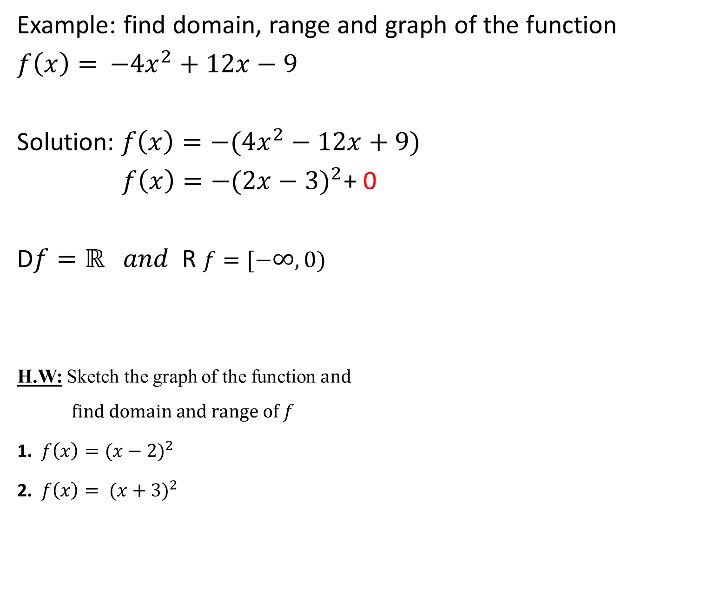
Example: find domain, range and graph of the function
$f\left(x\right)=$ ${−4x}^{2}+12x−9$
Solution: $f\left(x\right)=−(4x^{2}−12x+9)$
$f\left(x\right)=−{(2x−3)}^{2}$+ 0
D$f=ℝ and$R $f=[−∞,0)$
H.W: Sketch the graph of the function$and$
$$find domain and range of f$$
1. $f\left(x\right)=(x−2)^{2}$
2. $f\left(x\right)= ({x+3)}^{2}$

Slide 11
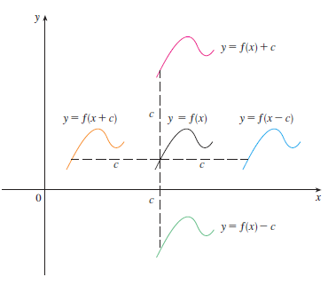

Vertical and Horizontal Shifts Formulas: Suppose $c>0$ to obtain the graph of
I. $y=f\left(x\right)+c,$ shift the graph of $y=f\left(x\right),$ a distance $c$ units upward.
II. $y=f\left(x\right)−c,$ shift the graph of $y=f\left(x\right),$ a distance $c$units down.
III. $y=f(x+c),$ shift the graph of $y=f\left(x\right),$ a distance $c$ units to the left.
Iv. $y=f(x−c),$ shift the graph of $y=f\left(x\right),$ a distance $c$units to the right.
Vertical shifts
Horizontal
shifts

Slide 12
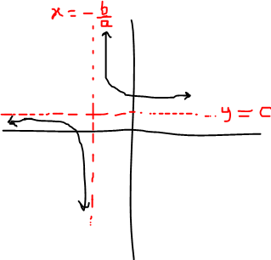
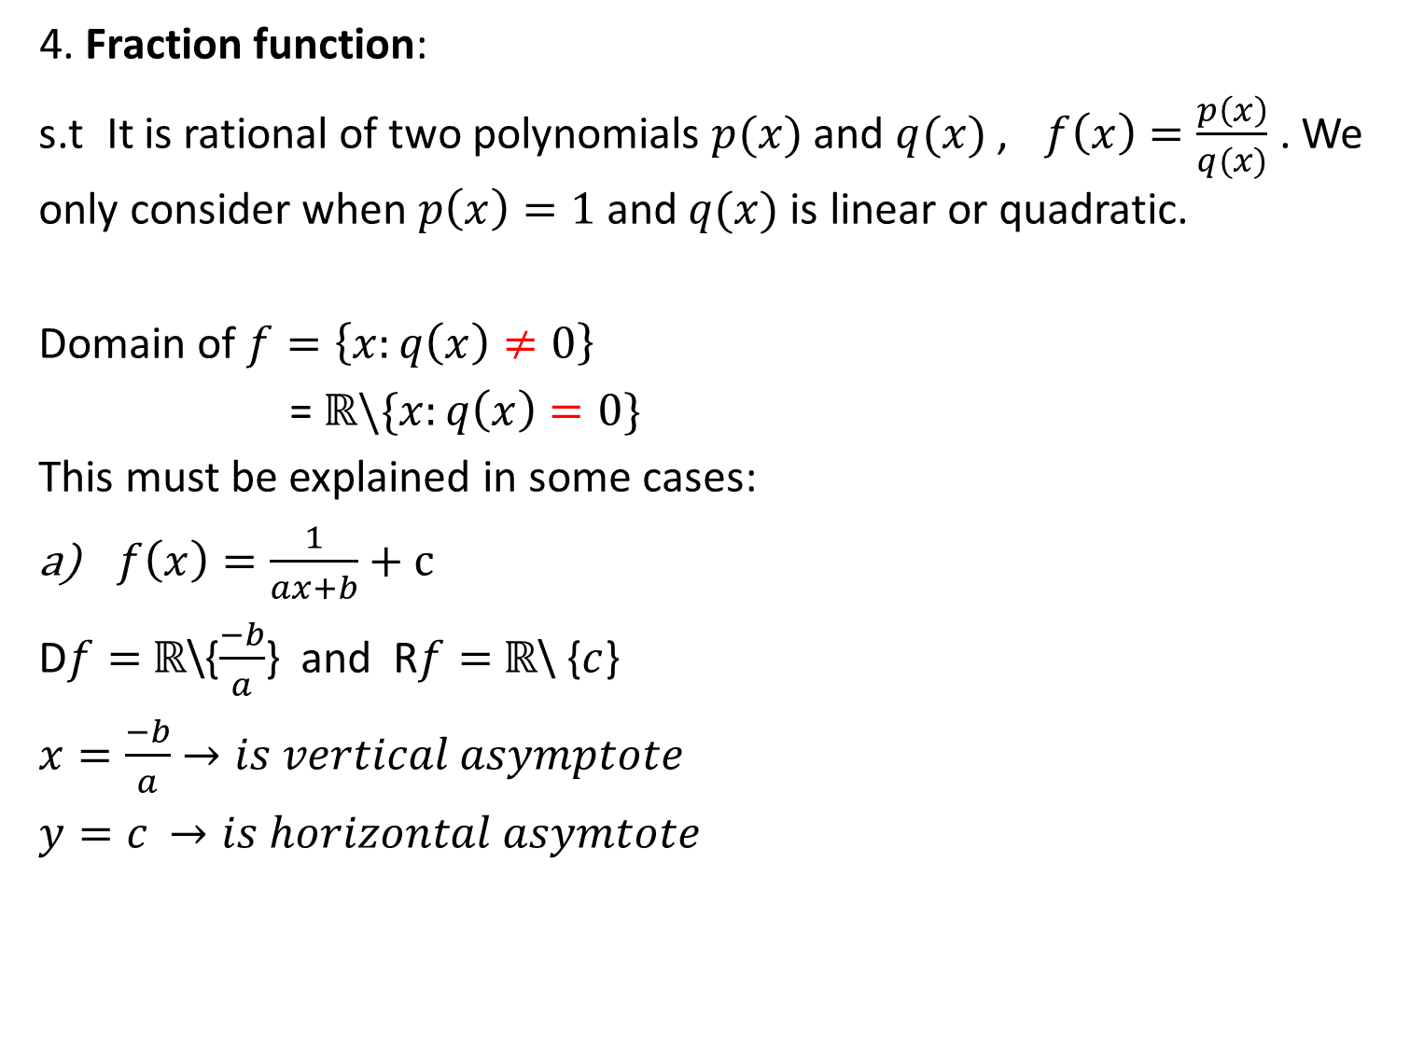
4. Fraction function:
s.t It is rational of two polynomials $p(x)$and $q(x)$, $f\left(x\right)=\frac{p\left(x\right)}{q(x)}$ . We only consider when $p\left(x\right)=1$and $q(x)$is linear or quadratic.
Domain of $f=\left\{x:q\left(x\right)≠0\right\}$
= $ℝ\backslash \{x:q\left(x\right)=0\}$
This must be explained in some cases:
$f\left(x\right)=\frac{1}{ax+b}+c$
D$f=$ $ℝ$\{$\frac{−b}{a}$} and R$f=$ $ℝ$\ {$c$}
$x=\frac{−b}{a}$ $→is vertical asymptote$
$y=c$ $→is horizontal asymtote$

Slide 13
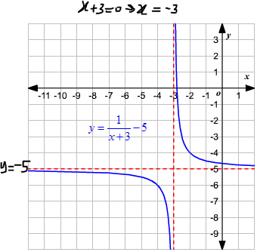
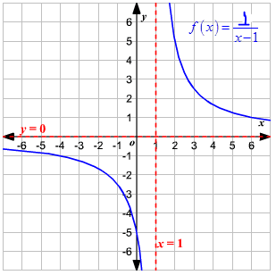
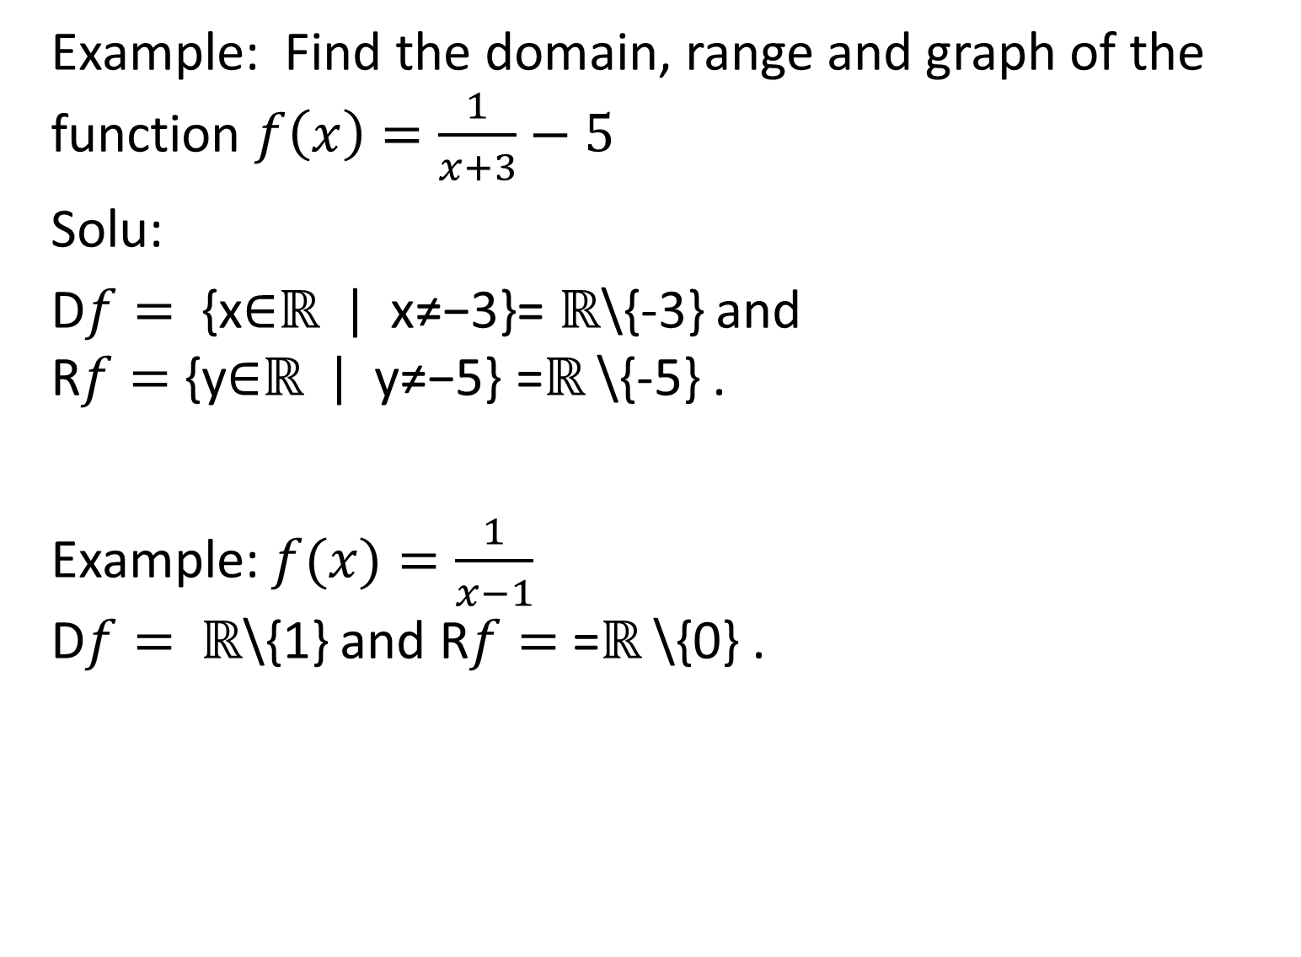
Example: Find the domain, range and graph of the function $f\left(x\right)=\frac{1}{x+3}−5$
Solu:
D$f=$ {x∈ℝ | x≠−3}= ℝ\{-3} and R$f=$ {y∈ℝ | y≠−5} =ℝ \{-5} .
Example: $f(x)=\frac{1}{x−1}$ D$f=$ ℝ\{1} and R$f=$ =ℝ \{0} .

Slide 14
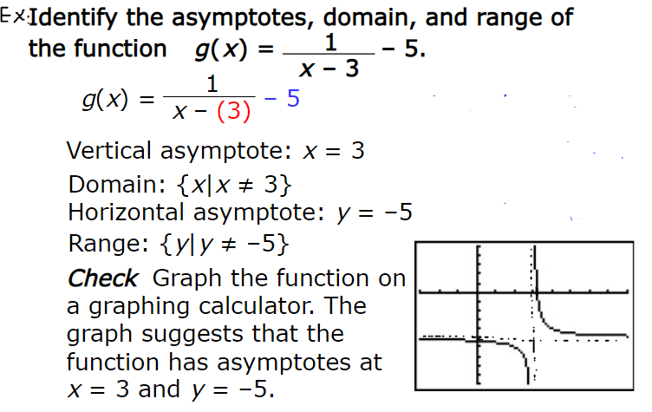

Slide 15
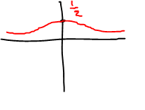
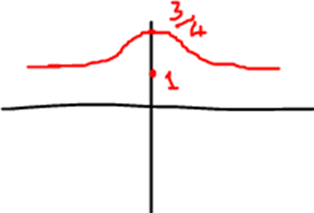
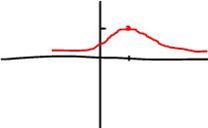

b) $f\left(x\right)=$ $\frac{\text{1}}{ax^{2}+bx+c }, a,b,c∈ℝ and a≠0$
i) $ax^{2}+bx+c \text{has} \text{no} \text{solution}\text{;}$
Example: $f\left(x\right)=\frac{1}{x^{2}+2}$
Solution: D$f$=$ℝ, Rf=(0\text{,}\frac{1}{2}]$
Example: $f\left(x\right)=\frac{1}{x^{2}+3}+1$
Solution: D$f$=$ℝ, Rf=(1\text{,}\frac{4}{3}]$
Example: $f\left(x\right)=\frac{1}{{(x−1)}^{2}+1 }$
D$f$=$ℝ, Rf=(0\text{,}1]$

Slide 16
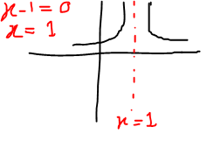
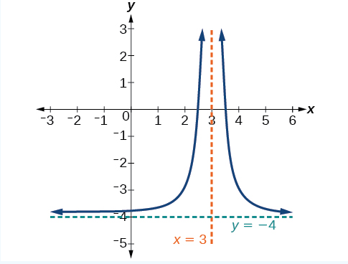

$\text{ii}\text{)} ax^{2}+bx+c \text{has} \text{one} \text{solution} \text{(}\text{k}$);
D$f$=$ℝ\backslash \left\{k\right\}, Rf=\left(0\text{,}∞\right)$
Example: $f\left(x\right)=\frac{1}{{(x−1)}^{2}}$
Solution: D$f$=$ℝ\backslash \left\{1\right\}, Rf=\left(0\text{,}∞\right)$
Example:
f$(x)=\frac{1}{({x−3)}^{2}}−4$
D$f$=$ℝ\backslash \left\{3\right\}$
$$Rf=\left(−5\text{,}∞\right)$$

Slide 17
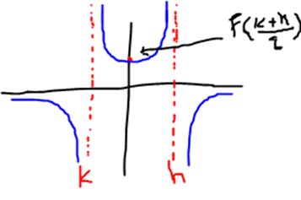
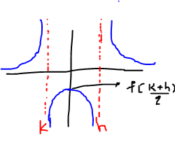

$\text{ii}\text{)} ax^{2}+bx+c \text{has} \text{two} \text{solution} \text{(}\text{k}\text{,}\text{h}$);
D$f$=$ℝ\backslash \left\{k,h\right\},$
If $f\left(\frac{k+h}{2}\right)>0 →Rf=ℝ\backslash [0,f(\frac{k+h}{2}))$
If $f\left(\frac{k+h}{2}\right)<0 →Rf=ℝ\backslash (f(\frac{k+h}{2}),0]$

Slide 18
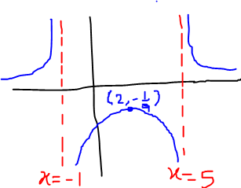
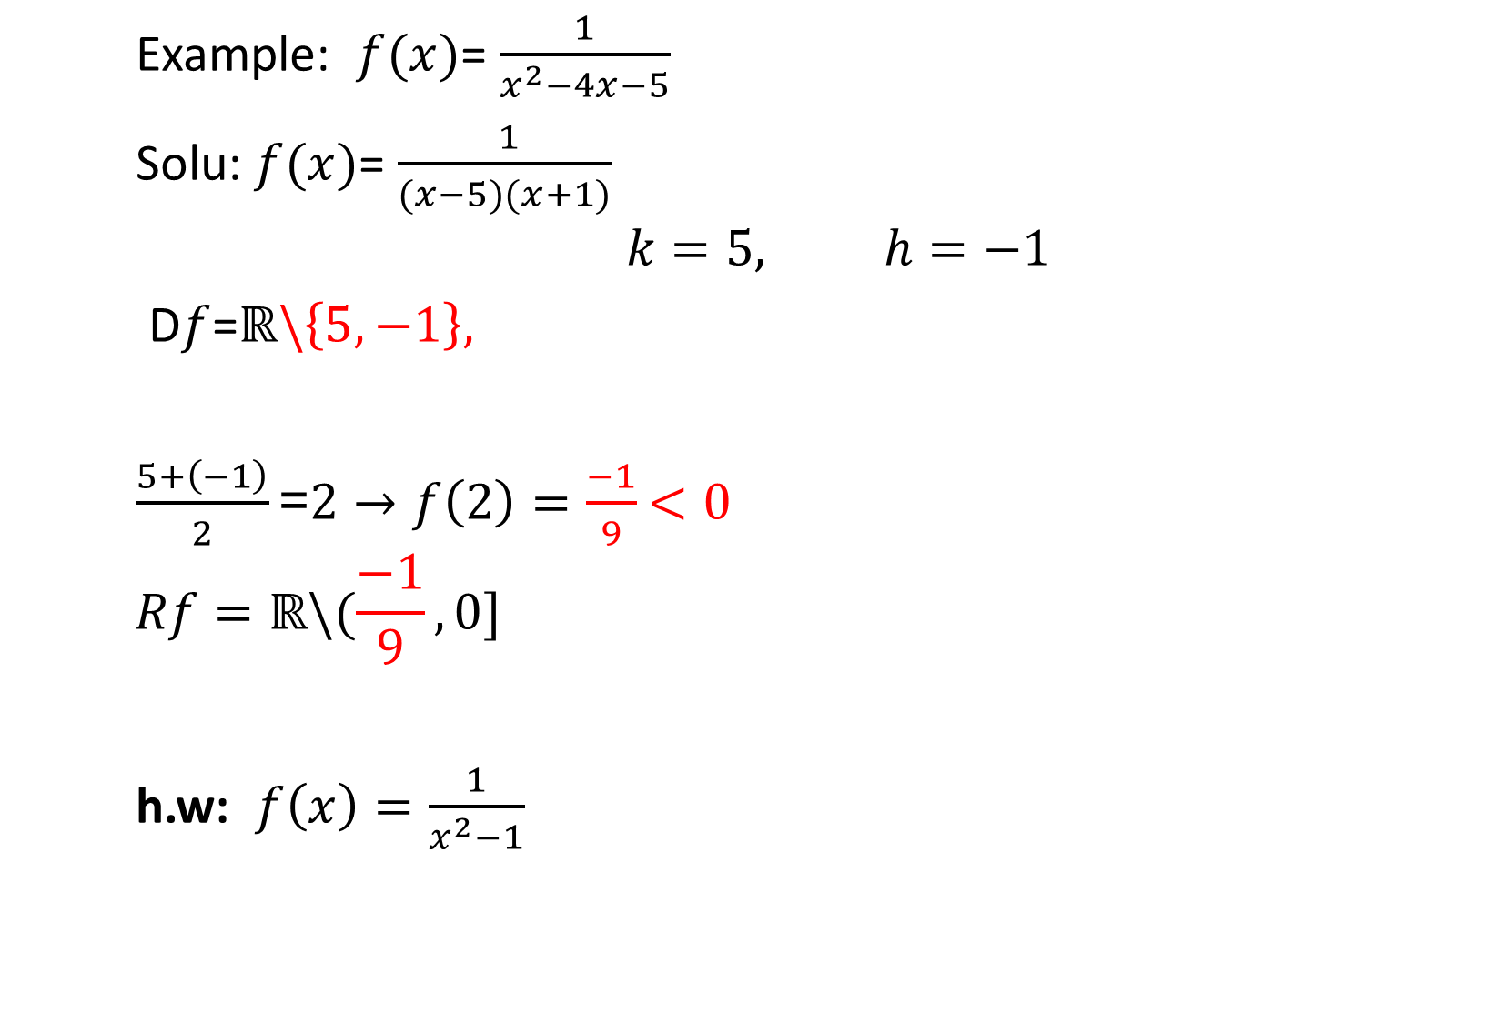
Example: $f(x)$= $\frac{1}{x^{2}−4x−5}$
Solu: $f(x)$= $\frac{ 1}{(x−5)(x+1)}$
$$k=5, h=−1$$
D$f$=$ℝ\backslash \left\{5,−1\right\},$
$\frac{5+\left(−1\right)}{2}\text{=}2→f\left(2\right)=\frac{−1}{9}$ $<0$
$$Rf=ℝ\backslash (\frac{−1}{9},0]$$
h.w: $f\left(x\right)=\frac{1}{x^{2}−1}$

Slide 19
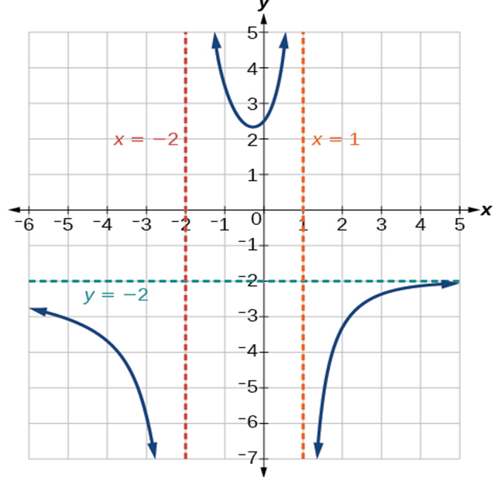


Example:
$$k(x)=\frac{5+2x^{2}}{2−x−x^{2}}$$
D$f$=$ℝ\backslash \left\{1,−2\right\},$
$$Rf=ℝ\backslash [0, 2.4)$$

Slide 20
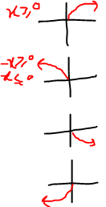
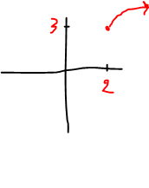
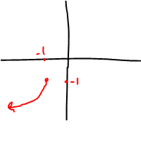
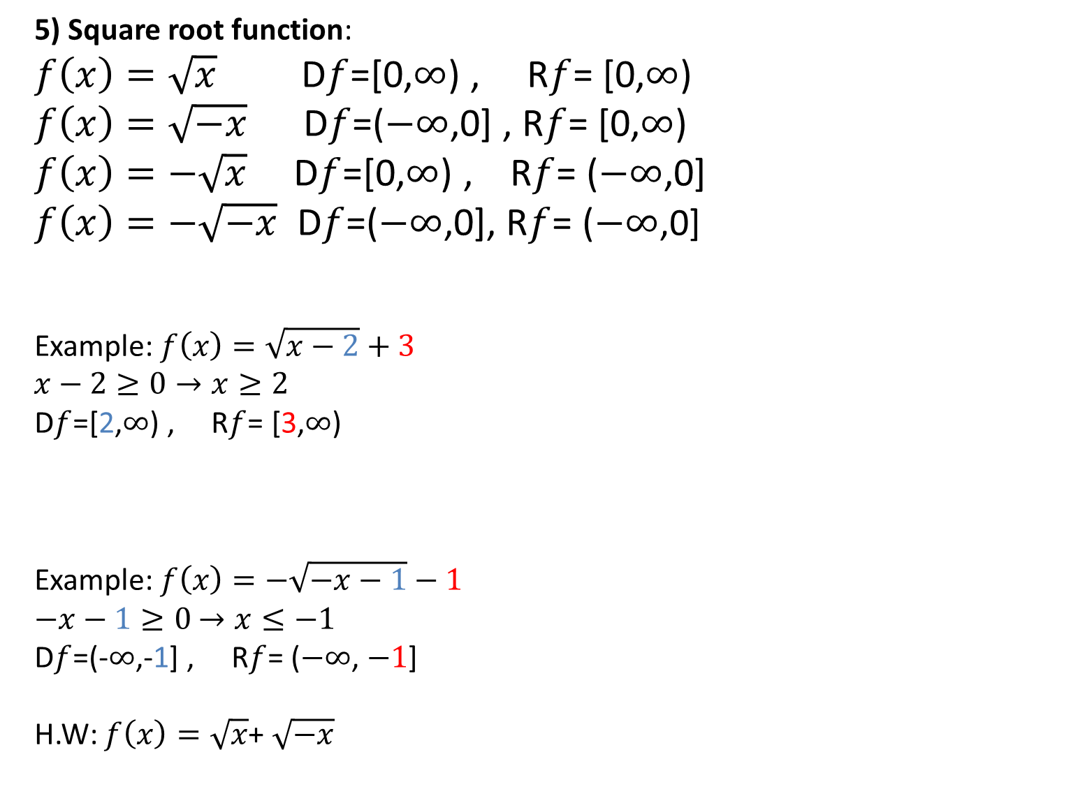
5) Square root function:
$f\left(x\right)=\sqrt{x}$ D$f$=[0,$∞$) , R$f$= [0,$∞$)
$f\left(x\right)=\sqrt{−x}$ D$f$=($−∞$,0] , R$f$= [0,$∞$)
$f\left(x\right)=−\sqrt{x}$ D$f$=[0,$∞$) , R$f$= ($−∞$,0]
$f\left(x\right)=−\sqrt{−x}$ D$f$=($−∞$,0], R$f$= ($−∞$,0]
Example: $f\left(x\right)=\sqrt{x−2}+3$
$$x−2≥0→x≥2$$
D$f$=[2,$∞$) , R$f$= [3,$∞$)
Example: $f\left(x\right)=−\sqrt{−x−1}−1$
$−x−1≥0$ $→x≤−1$
D$f$=(-$∞$,-1] , R$f$= ($−∞$, $−1$]
H.W: $f\left(x\right)=\sqrt{x}$+ $\sqrt{−x}$

Slide 21
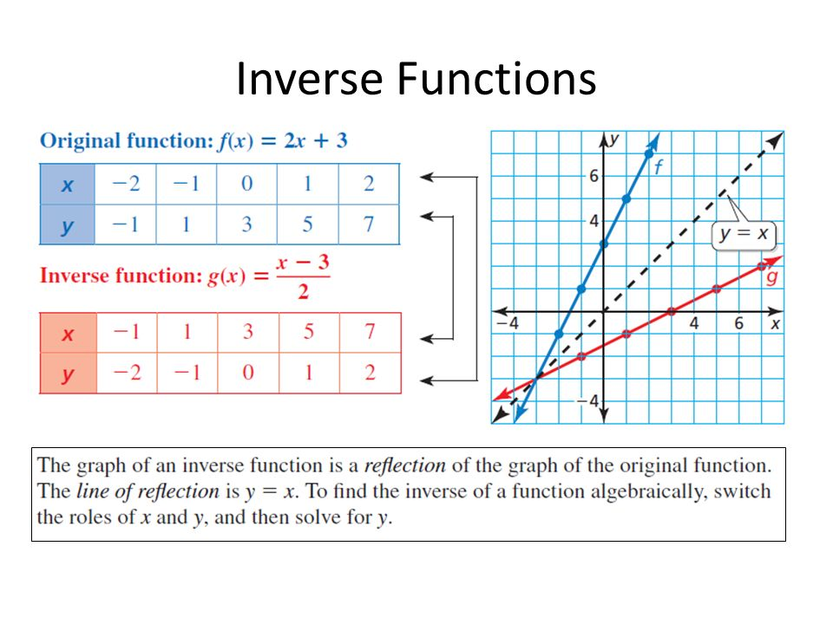

Slide 22


Slide 23


