Slide 1
Non-Algebraic function
Trigonometric function
Exponential function
Logarithmic function
Domain of function
Range of function
Sketch graph

Slide 2
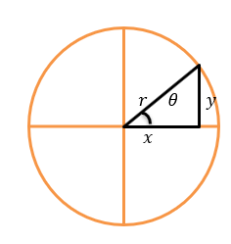
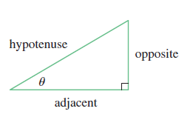
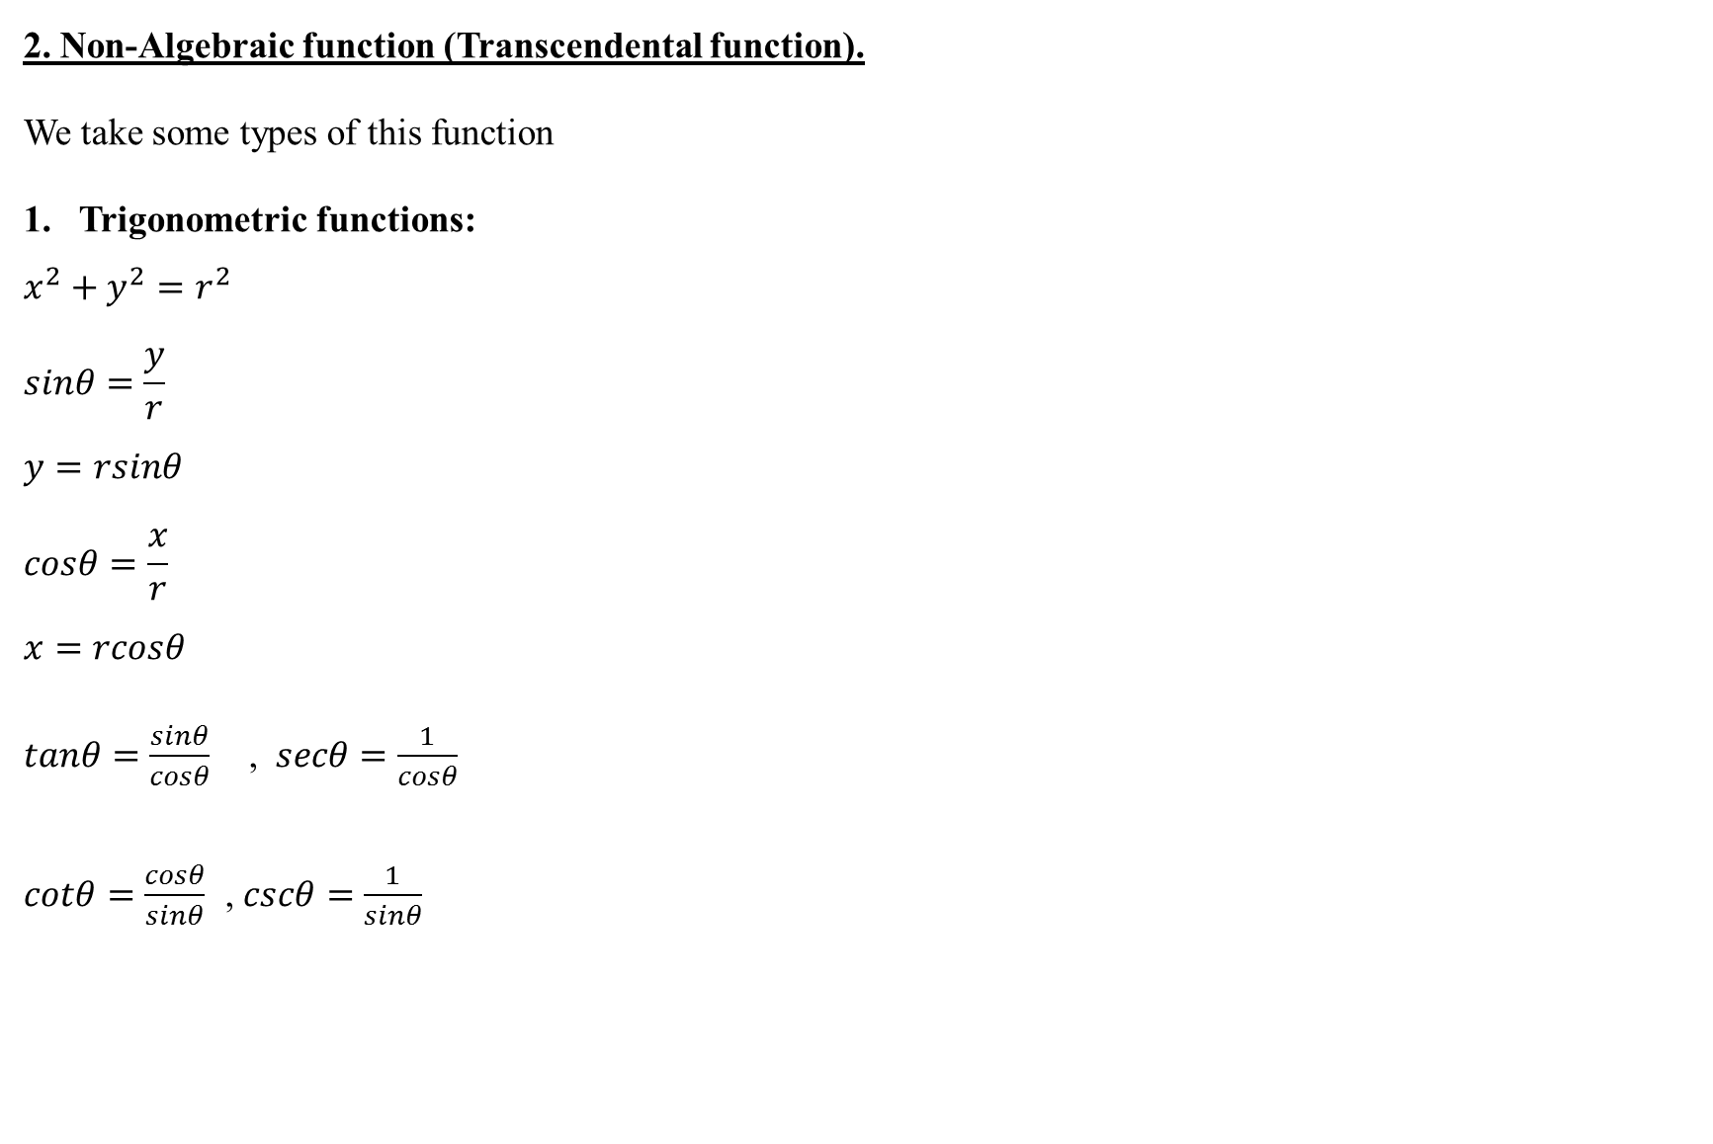
2. Non-Algebraic function (Transcendental function).
We take some types of this function
Trigonometric functions:
$$x^{2}+y^{2}=r^{2}$$
$$sinθ=\frac{y}{r}$$
$$y=rsinθ$$
$$cosθ=\frac{x}{r}$$
$$x=rcosθ$$
$tanθ=\frac{sinθ}{cosθ}$ , $secθ=\frac{1}{cosθ}$
$cotθ=\frac{cosθ}{sinθ}$ , $cscθ=\frac{1}{sinθ}$

Slide 3
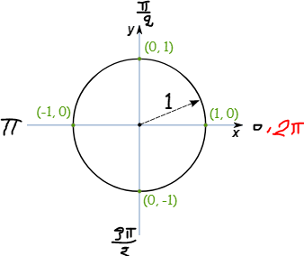

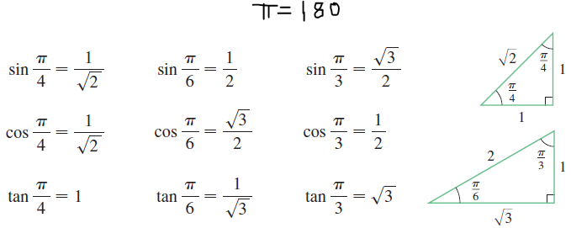

Slide 4
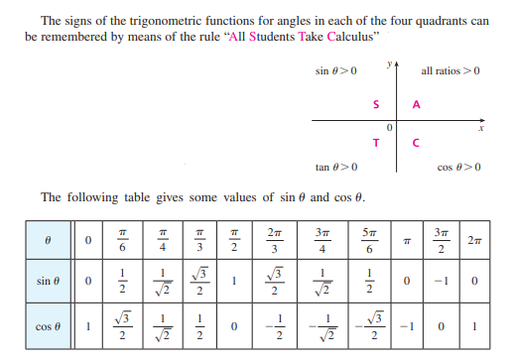

Slide 5
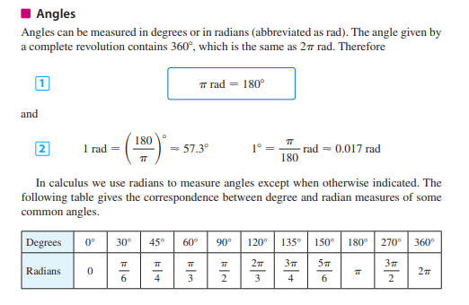

Slide 6
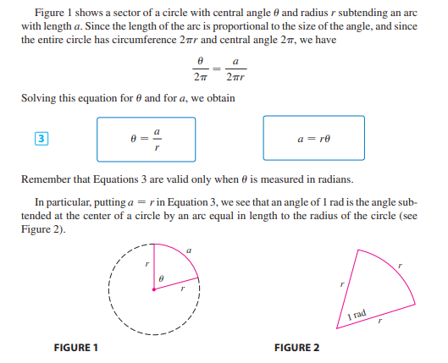

Slide 7
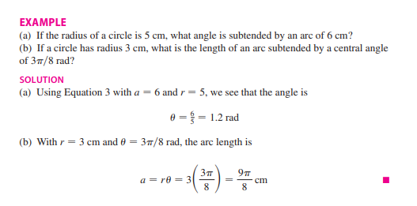

Slide 8
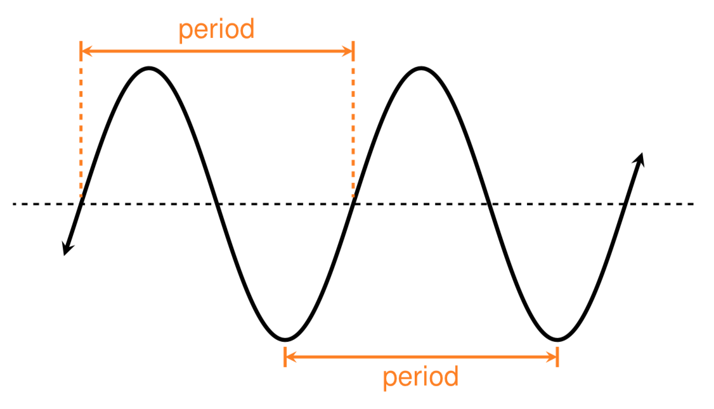

Def. A function $f$ is called periodic if $f\left(x+p\right)=f(x)$ for some $p∈R.$
$$\sin\left(x+2π\right)=sinx$$
$$\cos\left(x+2π\right)=cosx$$
$$\tan\left(x+π\right)=tanx$$
$$\cot\left(x+π\right)=cotx$$
$$\sec\left(x+2π\right)=secx$$
$$\csc\left(x+2π\right)=cscx$$
$$\cos^{2}θ+\sin^{2}θ=1$$
$$\sin\left(x±y\right)=sinx.cosy±cosx.siny$$
$\sin\left(x+2π\right)=$ $sinx.cos2π+cosx.sin$ $2π$=$sinx$
$$\cos\left(x±y\right)=cosx.cosy∓sinx.siny$$

Slide 9
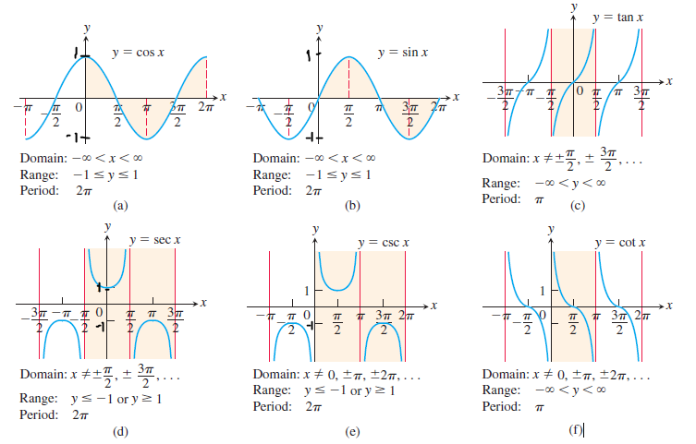


Slide 10
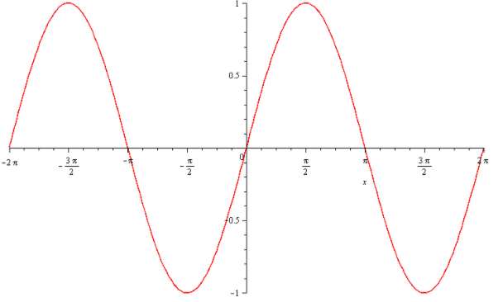
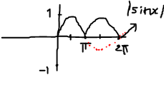
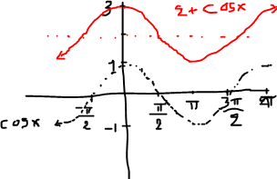
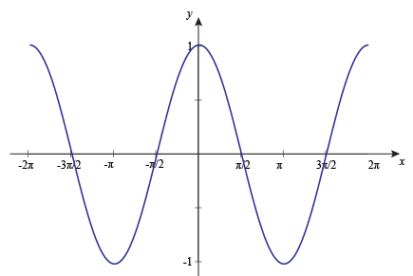
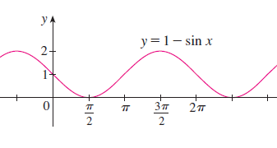
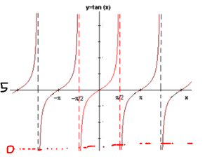
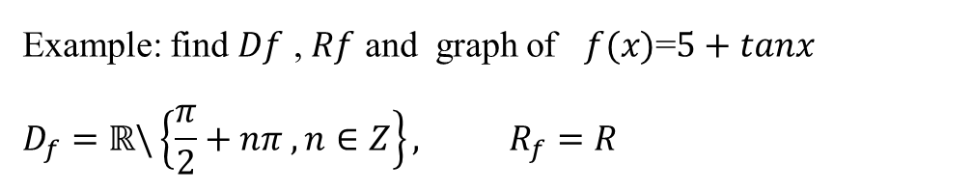

Example: find $Df$ , $Rf$ and graph of $f(x)$=$|\sin{x}|$
$D_{f}=ℝ$,${ R}_{f}=[0,1]$
Example: find $Df$ , $Rf$ and graph of $f\left(x\right)=2+\cos{x}$
$D_{f}=ℝ$,${ R}_{f}=[1,3]$
Example: find $Df$ , $Rf$ and graph of $f(x)$=$1−sin{x}$
$D_{f}=ℝ$,${ R}_{f}=[0,2]$
Example: find $Df$ , $Rf$ and graph of $f(x)$=$5+tanx$
$$D_{f}=ℝ\backslash \left\{\frac{π}{2}+nπ , n∈Z\right\}, R_{f}=R$$

Slide 11
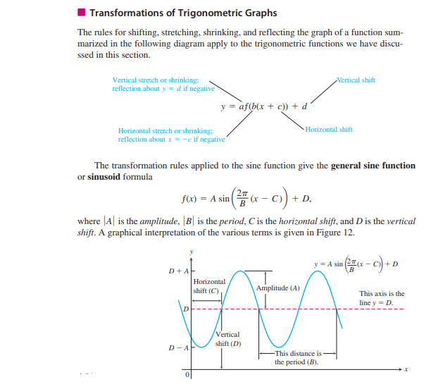

Slide 12
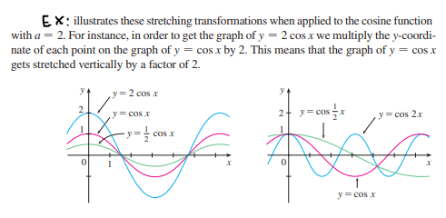

Slide 13
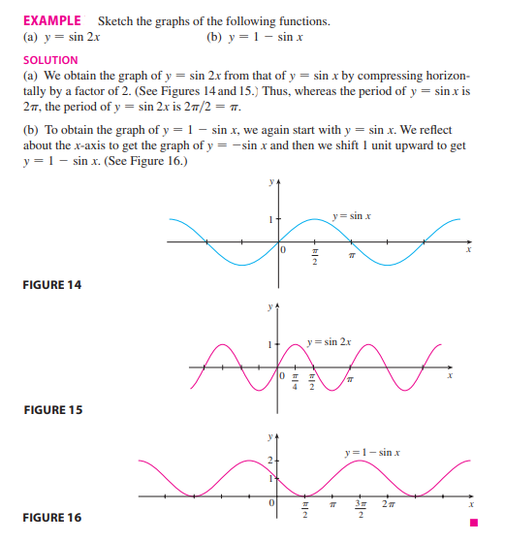

Slide 14
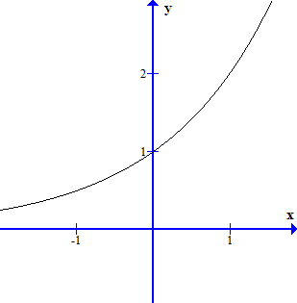
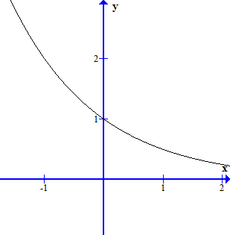
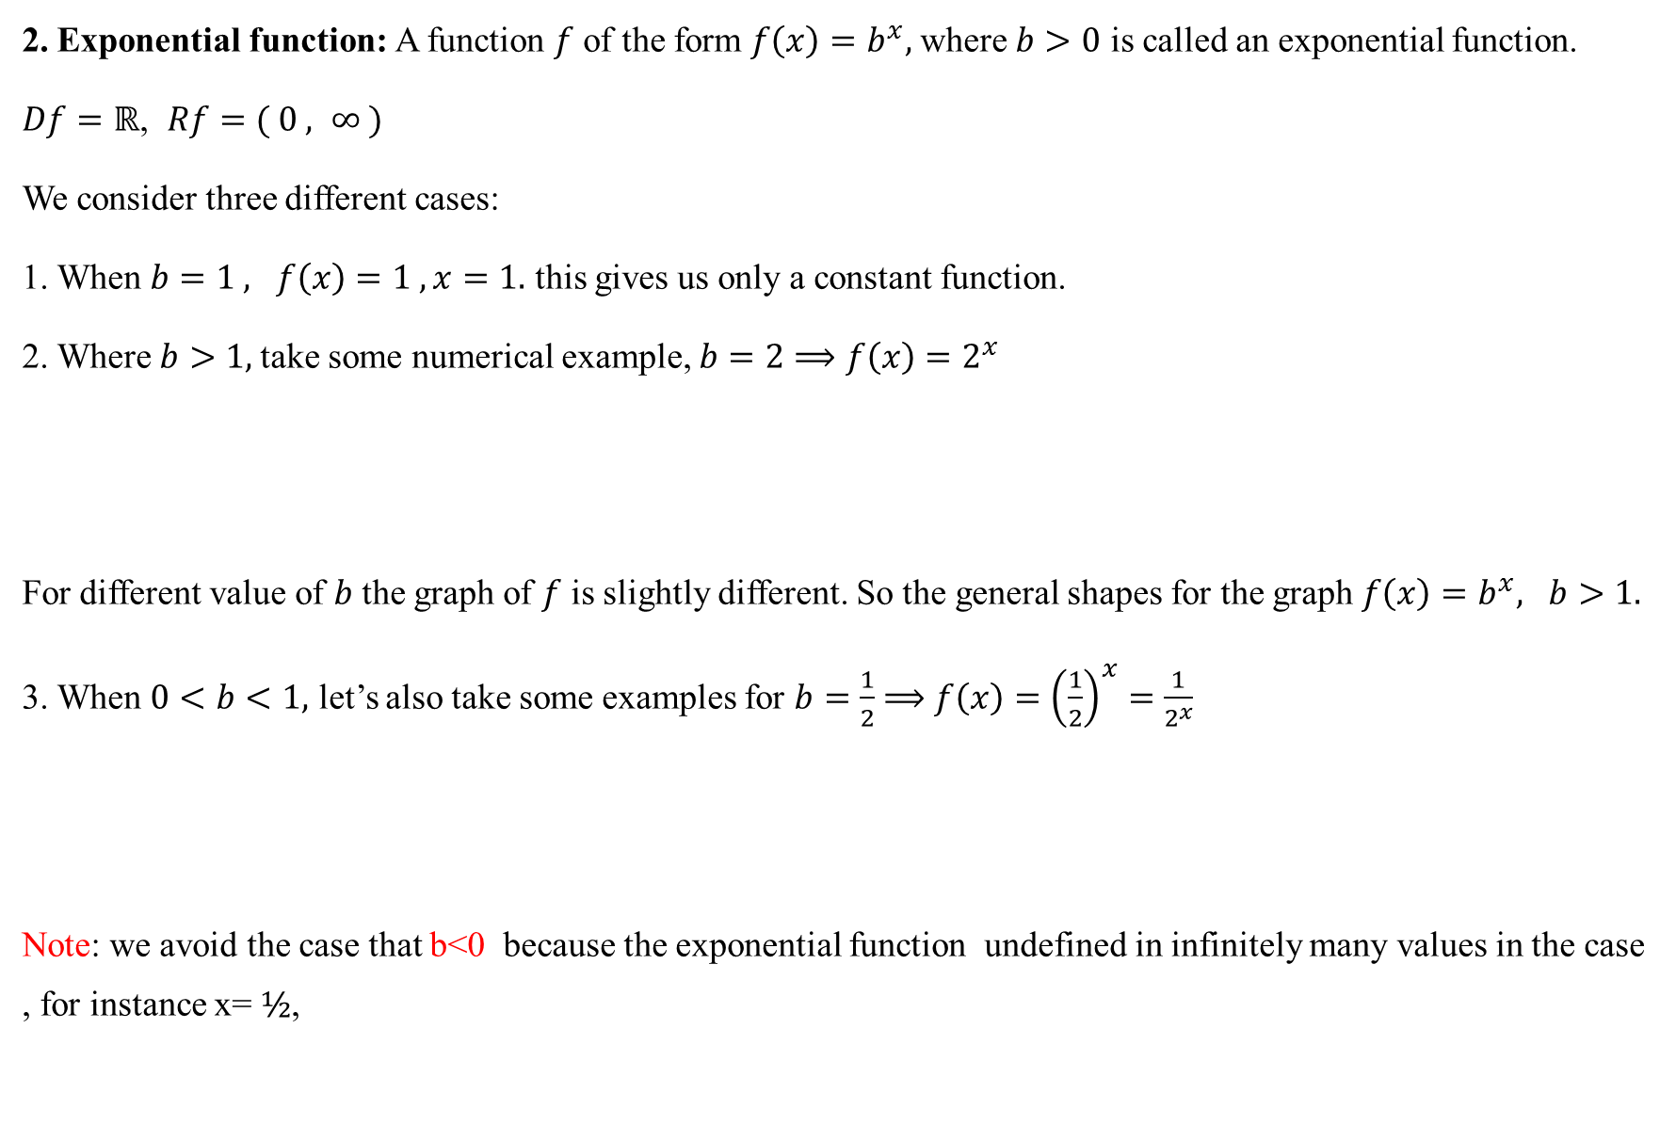
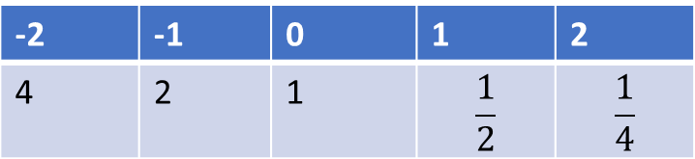
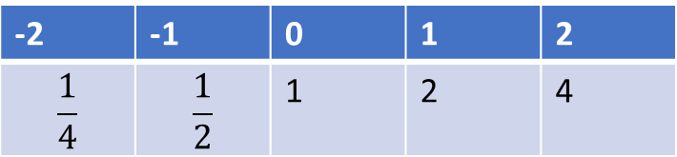
2. Exponential function: A function $f$ of the form $f\left(x\right)=b^{x},$where $b>0$ is called an exponential function.
$Df=ℝ$, $Rf=( 0 , ∞ )$
We consider three different cases:
1. When $b=1 , f\left(x\right)=1 ,x=1.$ this gives us only a constant function.
2. Where $b>1,$take some numerical example, $b=2⟹f\left(x\right)=2^{x}$
For different value of $b$ the graph of $f$ is slightly different. So the general shapes for the graph $f\left(x\right)=b^{x}, b>1.$
3. When $0<b<1,$ let’s also take some examples for $b=\frac{1}{2}$ $⟹f\left(x\right)={\left(\frac{1}{2}\right)}^{x}=\frac{1}{2^{x}}$
Note: we avoid the case that b<0 because the exponential function undefined in infinitely many values in the case , for instance x= $½$,
-2 | -1 | 0 | 1 | 2
$$\frac{1}{4}$$ | $$\frac{1}{2}$$ | 1 | 2 | 4
-2 | -1 | 0 | 1 | 2
4 | 2 | 1 | $$\frac{1}{2}$$ | $$\frac{1}{4}$$

Slide 15
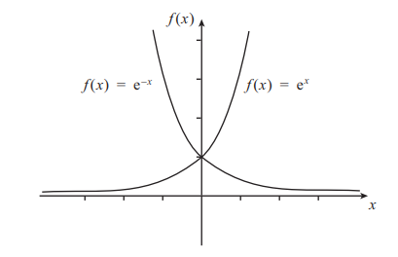

Laws of exponents (power): Let $a,b,x$ and $y∈ℝ,$ then
1. $a^{x}.a^{y}=$ $a^{x+y}$ 2. $\frac{a^{x}}{a^{y}}=a^{x−y}$ 3. ${(a^{x})}^{y}=a^{x.y}$4. ${(a.b)}^{x}=a^{x}b^{x}$
5. ${\left(\frac{a}{b}\right)}^{x}=\frac{a^{x}}{b^{x}}$ 6. ${(a)}^{0}=1$ 7. $a^{−x}=\frac{1}{a^{x}}$ 8. $a^{x}$= $a^{y}⟺x=y$ 9. $a^{x}$= $b^{x}$ $⟺a=b$ for $b≠0$
Remark: The exponential function with base $e$ where $e$ is mathematical constant $e≈2.7182…$
$f\left(x\right)=e^{x}$
$Df=ℝ$, $Rf=( 0 , ∞ )$
$$f\left(x\right)=e^{−x}$$
$Df=ℝ$, $Rf=( 0 , ∞ )$

Slide 16
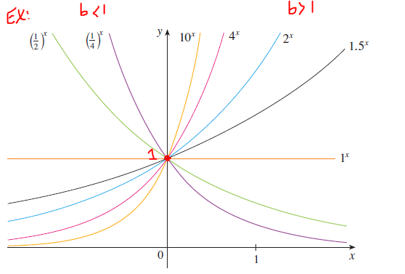
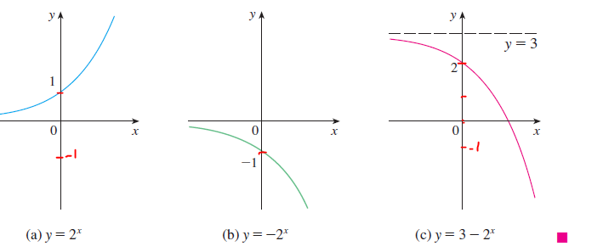
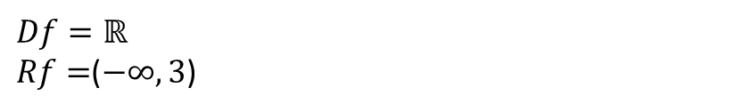
$$Df=ℝ$$
$Rf=$($−∞,3$)

Slide 17

Example:
Solve $4^{x−3}=8$
$solution : 2^{2\left(x−3\right)}=2^{3}$ $⟹$ $2^{2x−6}=2^{3}⟹2x−6=3$
$$∴x=\frac{9}{2}$$
2. ${\left(\frac{4}{5}\right)}^{6x+1}=\frac{5}{4}$ $solution:$ ${\left(\frac{4}{5}\right)}^{6x+1}={\left(\frac{4}{5}\right)}^{−1}$
$$⟹6x+1=−1$$
$$∴x=\frac{−1}{3}$$
3. $4^{2x+7}=8^{x+2}$ $solution:$ $2^{4x+14}=2^{3x+6}$ $⟹4x+14=3x+6$
$$∴x=−8$$
4. $5^{3}={(x+2)}^{3}$ $⟹5=x+2$
$$∴x=3$$

Slide 18
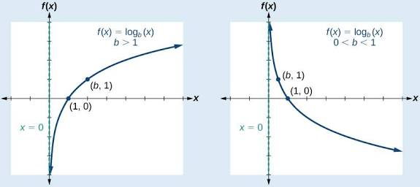
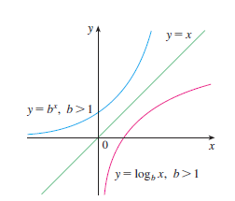
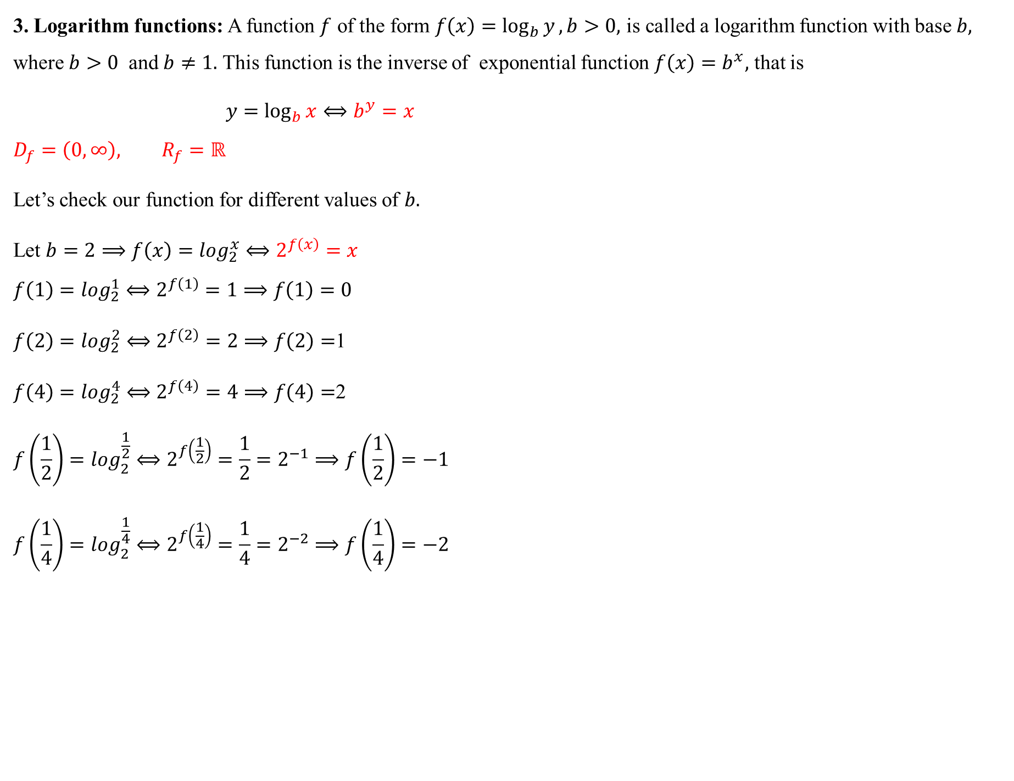
3. Logarithm functions: A function $f$ of the form $f\left(x\right)=\log_{b}{y}, b>0,$ is called a logarithm function with base $b,$ where $b>0$ and $b≠1.$ This function is the inverse of exponential function $f\left(x\right)=b^{x},$ that is
$y=\log_{b}{x}⟺b^{y}=x$
$$D_{f}=\left(0,∞\right), R_{f}=ℝ$$
Let’s check our function for different values of $b.$
Let $b=2⟹f\left(x\right)=\log_{2}^{x}⟺2^{f\left(x\right)}=x$
$$f\left(1\right)=\log_{2}^{1}⟺2^{f\left(1\right)}=1⟹f\left(1\right)=0$$
$f\left(2\right)=\log_{2}^{2}⟺2^{f\left(2\right)}=2⟹f\left(2\right)=$1
$f\left(4\right)=\log_{2}^{4}⟺2^{f\left(4\right)}=4⟹f\left(4\right)=$2
$$f\left(\frac{1}{2}\right)=\log_{2}^{\frac{1}{2}}⟺2^{f\left(\frac{1}{2}\right)}=\frac{1}{2}=2^{−1}⟹f\left(\frac{1}{2}\right)=−1$$
$$f\left(\frac{1}{4}\right)=\log_{2}^{\frac{1}{4}}⟺2^{f\left(\frac{1}{4}\right)}=\frac{1}{4}=2^{−2}⟹f\left(\frac{1}{4}\right)=−2$$

Slide 19
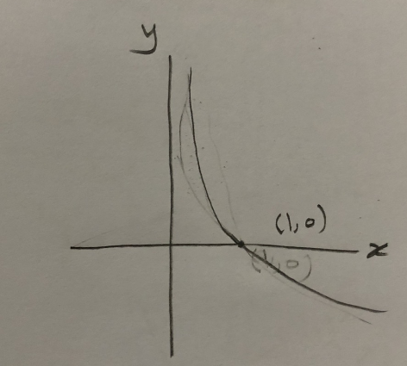
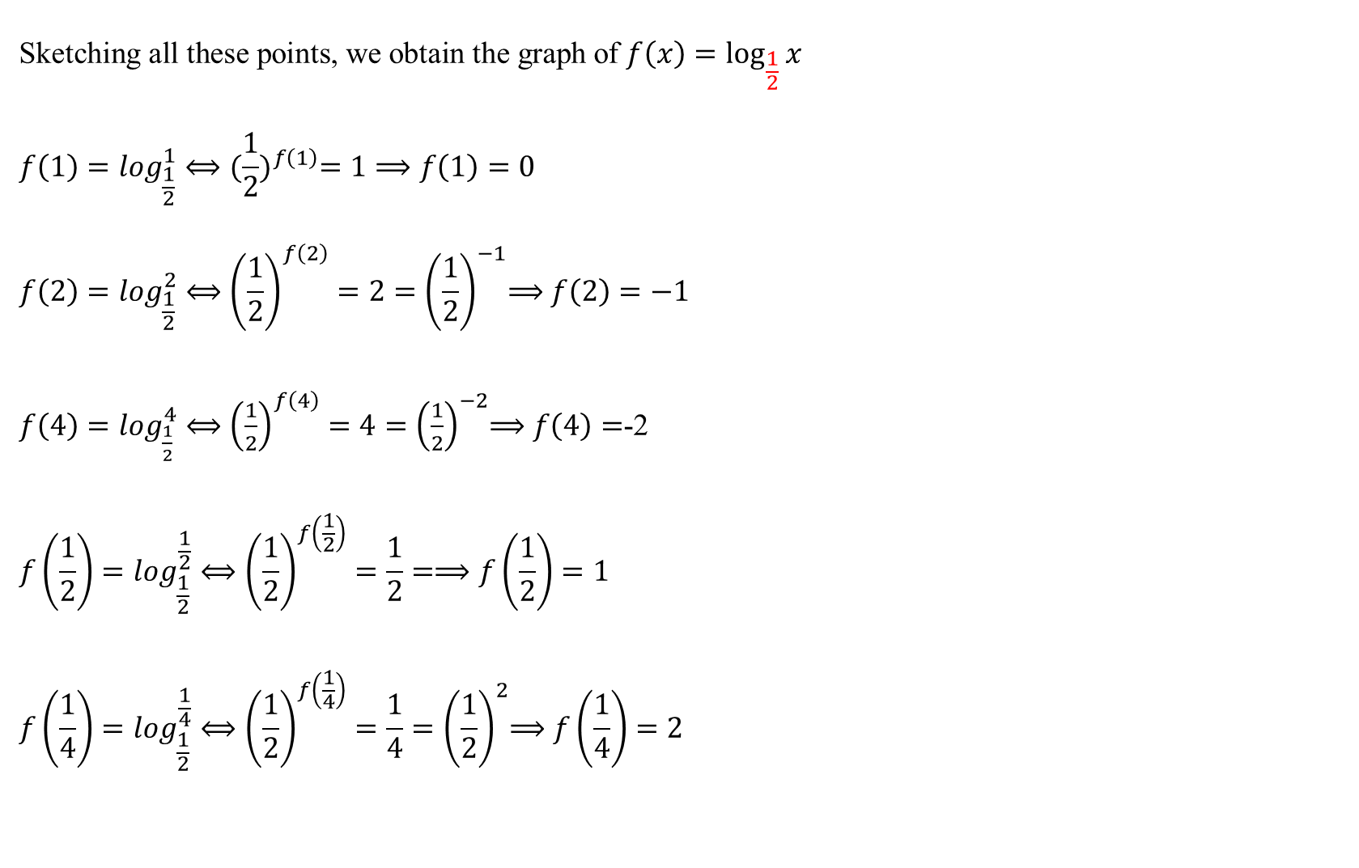
$$\text{Sketching} \text{all} \text{these} \text{points}\text{, }\text{we} \text{obtain} \text{the} \text{graph} \text{of} f\left(x\right)=\log_{\frac{1}{2}}{x}$$
$$f\left(1\right)=\log_{\frac{1}{2}}^{1}⟺{(\frac{1}{2})}^{f\left(1\right)}=1⟹f\left(1\right)=0$$
$$f\left(2\right)=\log_{\frac{1}{2}}^{2}⟺{\left(\frac{1}{2}\right)}^{f\left(2\right)}=2{=\left(\frac{1}{2}\right)}^{−1}⟹f\left(2\right)=−1$$
$f\left(4\right)=\log_{\frac{1}{2}}^{4}⟺{\left(\frac{1}{2}\right)}^{f\left(4\right)}=4{=\left(\frac{1}{2}\right)}^{−2}⟹f\left(4\right)=$-2
$$f\left(\frac{1}{2}\right)=\log_{\frac{1}{2}}^{\frac{1}{2}}⟺{\left(\frac{1}{2}\right)}^{f\left(\frac{1}{2}\right)}=\frac{1}{2}=⟹f\left(\frac{1}{2}\right)=1$$
$$f\left(\frac{1}{4}\right)=\log_{\frac{1}{2}}^{\frac{1}{4}}⟺{\left(\frac{1}{2}\right)}^{f\left(\frac{1}{4}\right)}=\frac{1}{4}{=\left(\frac{1}{2}\right)}^{2}⟹f\left(\frac{1}{4}\right)=2$$

Slide 20
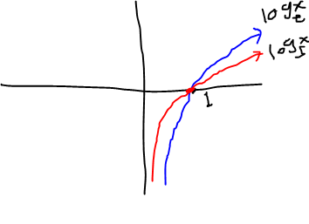
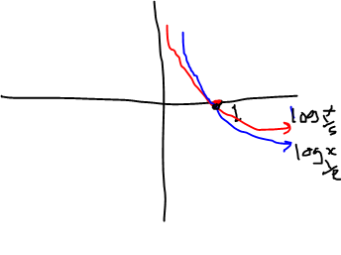
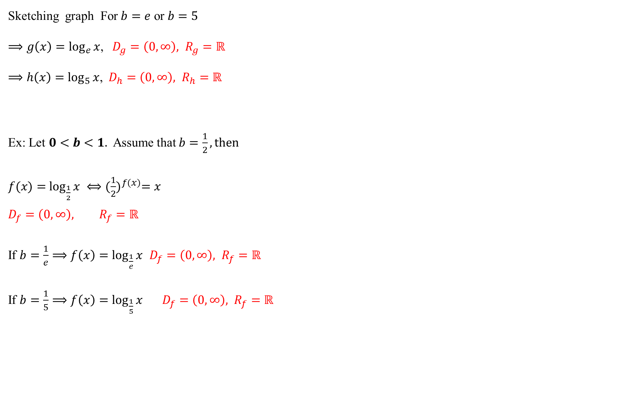
Sketching graph For $b=e$ or $b=5$
$⟹g\left(x\right)=\log_{e}{x}$,$D_{g}=\left(0,∞\right), R_{g}=ℝ$
$⟹h\left(x\right)=\log_{5}{x}$,$D_{h}=\left(0,∞\right), R_{h}=ℝ$
Ex: Let $0<b<1.$ Assume that $b=\frac{1}{2}, then$
$f(x)=$ $\log_{\frac{1}{2}}{x} ⟺{(\frac{1}{2})}^{f(x)}=x$
$$D_{f}=\left(0,∞\right), R_{f}=ℝ$$
If $b=\frac{1}{e}⟹f\left(x\right)=\log_{\frac{1}{e}}{x}$ $D_{f}=\left(0,∞\right), R_{f}=ℝ$
If $b=\frac{1}{5}⟹f\left(x\right)=\log_{\frac{1}{5}}{x}$ $D_{f}=\left(0,∞\right), R_{f}=ℝ$

Slide 21
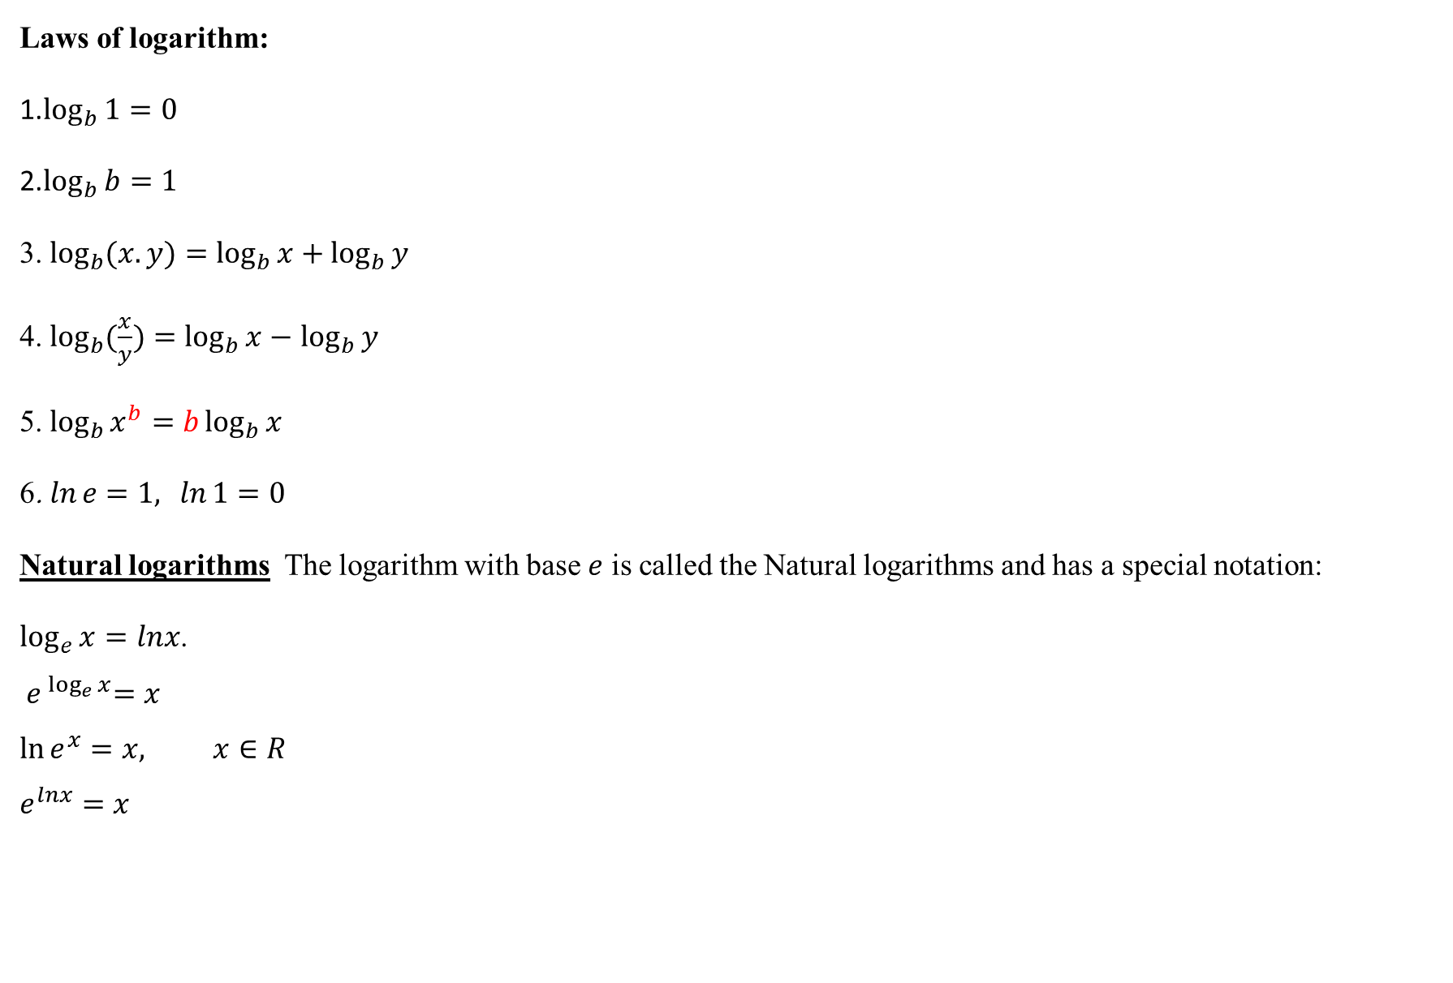
Laws of logarithm:
1.$\log_{b}{1}=0$
2.$\log_{b}{b}=1$
3. $\log_{b}{(x.y)}=\log_{b}{x}+\log_{b}{y}$
4. $\log_{b}{(\frac{x}{y}})=\log_{b}{x}−$ $\log_{b}{y}$
5. $\log_{b}{x^{b}}=b\log_{b}{x}$
6. $\ln{e=1,\ln{1=0 }}$
Natural logarithms The logarithm with base $e$ is called the Natural logarithms and has a special notation:
$\log_{e}{x}=lnx$.
$${ e}^{ \log_{e}{x}}=x$$
$$\ln{e^{x}}=x, x∈R$$
$$e^{lnx}=x$$

Slide 22


Example: Solve
1. $\log_{2}^{3x+5}=3$
$${ 2}^{3}=3x+5$$
$$8=3x+5$$
$x=1$
2. $3^{x−1}=9$
$${ 3}^{x−1}=3^{2}$$
$$x−1=2$$
$$x=3$$
3. $e^{2k}=10$find the value of $k$
$ln$ ($e^{2k}$)= $ln$(10)
$2k\ln{e=\ln{(10}}$)
$$2k=\ln{(10})$$
$$k=\frac{\ln{(10)}}{2}$$

Slide 23
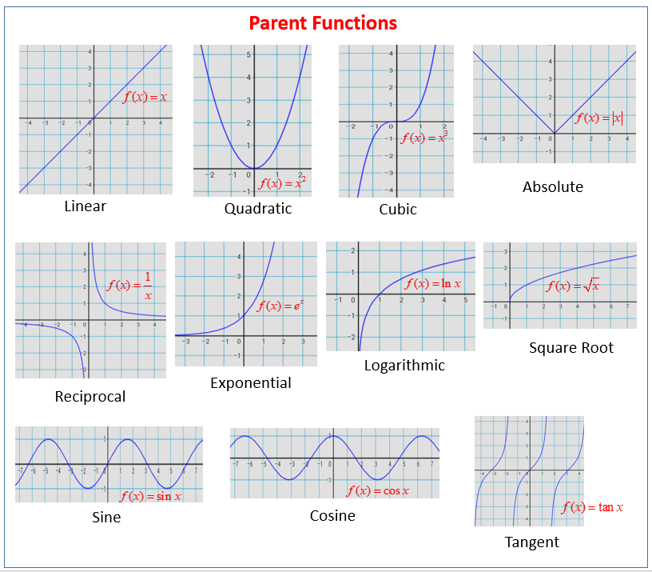

Slide 24
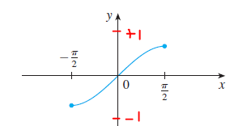
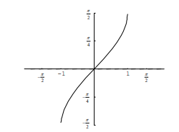

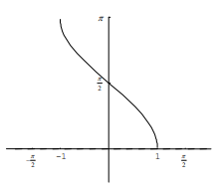
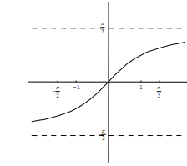

4. Inverse of trigonometric functions:
1. $f\left(x\right)=\sin^{−1}x$
$$D_{f}=\left[−1,1\right],{ R}_{f}=[\frac{−π}{2},\frac{π}{2}]$$
2. $f\left(x\right)=\cos^{−1}x$
$$D_{f}=\left[−1,1\right], R_{f}=[0,\frac{π}{2}]$$
3. $f\left(x\right)=\tan^{−1}x$
$$D_{f}=\left(−∞,∞\right),{ R}_{f}=(\frac{−π}{2},\frac{π}{2})$$

Slide 25




4. $f\left(x\right)=\cot^{−1}x$
$$D_{f}=\left(−∞,∞\right),R_{f}=(0,π).$$
5. $f\left(x\right)=\sec^{−1}x$
$D_{f}=ℝ\backslash (−1,1)$,
$$R_{f}=\left[0,π\right]\backslash \{\frac{π}{2}\}.$$
6. $f\left(x\right)=\csc^{−1}x$
$$D_{f}=ℝ\backslash (−1,1),$$
$$R_{f}=\left[\frac{−π}{2},\frac{π}{2}\right]\backslash \{0\}.$$

Slide 26


Slide 27



5. Hyperbolic Functions: The hyperbolic functions are formed by taking combinations of the two exponential functions $e^{x}$ and $e^{−x}.$ The hyperbolic $sine$ and hyperbolic $cosine$ functions are defined by the equations
1. $\sinh{x}=\frac{e^{x}−e^{−x}}{2}$
$$D_{f}=ℝ, R_{f}=ℝ$$
2. $coshx=\frac{e^{x}+e^{−x}}{2}$
$D_{f}=ℝ, { R}_{f}=[1,∞)$

Slide 28



3. $\tanh{x}=\frac{\sinh{x}}{coshx}=\frac{e^{x}−e^{−x}}{e^{x}+e^{−x}}$
$$D_{f}=ℝ, { R}_{f}=(−1,1)$$
$$4.\operatorname{csch}{x}=\frac{2}{e^{x}−e^{−x}}$$
$$D_{f}=ℝ\backslash \{0\}, R_{f}=ℝ\backslash \{0\}$$

Slide 29



5. $\operatorname{sech}{x=\frac{2}{e^{x}+e^{−x}}}$
$$D_{f}=ℝ, R_{f}=(0,1]$$
6. $\coth{x}=\frac{\cosh{x}}{\sinh{x}}=\frac{e^{x}+e^{−x}}{e^{x}−e^{−x}}$
$D_{f}=ℝ\backslash \{0\}, R_{f}=ℝ\backslash$[-1,1]

Slide 30

Relation among hyperbolic function or identities for hyperbolic function
1. $\cosh^{2}x−\sinh^{2}x=1$
Example: Prove that $\cosh^{2}x−\sinh^{2}x=1$
$\cosh^{2}x−\sinh^{2}x={\left(\frac{e^{x}+e^{−x}}{2}\right)}^{2}−$ ${\left(\frac{e^{x}−e^{−x}}{2}\right)}^{2}$
$$=\frac{e^{2x}+2e^{x}e^{−x}+e^{−2x}−e^{2x}+2e^{x}e^{−x}−e^{−2x}}{4}=\frac{4}{4}=1$$
divide both sides of$(1)$ by $\cosh^{2}x$ and$\sinh^{2}x,$ we get 2 and 3.
$$\frac{\cosh^{2}x}{\cosh^{2}x}−\frac{\sinh^{2}x}{\cosh^{2}x}=\frac{1}{\cosh^{2}x}$$
2. $1−\tanh^{2}x={sech}^{2}x$

Slide 31

$$\frac{\cosh^{2}x}{\sinh^{2}x}−\frac{\sinh^{2}x}{\sinh^{2}x}=\frac{1}{\sinh^{2}x}$$
3. $\coth^{2}x−1={csch}^{2}x$
4. $sinh2x=2sinhx∙coshx$
$$2∙\frac{e^{x}−e^{−x}}{2}∙\frac{e^{x}+e^{−x}}{2}$$
$$\frac{e^{2x}−e^{−2x}}{2}=sinh2x$$
5. $cosh2x=\cosh^{2}x+$ $\sinh^{2}x$
$={2cosh}^{2}x−1$
$${=1+2sinh}^{2}x$$

Slide 32

6. $\cosh^{2}x=\frac{cosh2x+1}{2}$
6. $\sinh^{2}x=\frac{cosh2x−1}{2}$
7. $sinh\left(x∓y\right)=sinhx∙coshy∓coshx∙sinhy$
8. $cosh\left(x∓y\right)=coshxh∙coshy∓sinhx.sinhy$
Example: Prove that $sinh\left(x+y\right)=sinhx∙coshy+coshx∙sinhy$
$$sinh\left(x+y\right)=\frac{e^{x+y}−e^{−(x+y)} }{2}$$
R.H.S. $sinhx∙coshy+coshx∙sinhy=\left(\frac{e^{x}−e^{−x}}{2}\right)\left(\frac{e^{y}+e^{−y}}{2}\right)+\left(\frac{e^{x}+e^{−x}}{2}\right)\left(\frac{e^{y}−e^{−y}}{2}\right)$
$=\frac{e^{x+y}+e^{x−y}−e^{−x+y}−e^{−(x+y)}}{4}+$ $\frac{e^{x+y}−e^{x−y}+e^{−x+y}−e^{−(x+y)}}{4}$
$$=\frac{e^{x+y}+e^{x−y}−e^{−x+y}−e^{−(x+y)}+e^{x+y}−e^{x−y}+e^{−x+y}−e^{−(x+y)}}{4}$$

Slide 33

$$=\frac{2{(e}^{x+y}−e^{−(x+y)})}{4}$$
$$=\frac{e^{x+y}−e^{−(x+y)}}{2}=sinh⁡(x+y)$$
10. $\tanh\left(x∓y\right)=\frac{tanhx∓tanhy}{1∓tanhx∙tanhy}$
Example: Prove that $\tanh{(x+y)}=\frac{sinh⁡(x+y)}{cosh⁡(x+y)}$ $=\frac{sinhx.coshy+coshx.sinhy}{coshx.coshy+sinhx.sinhy} (÷coshxcoshy)$
$$=\frac{\frac{sinhx∙coshy}{coshxcoshy}+\frac{coshx∙sinhy}{coshx∙coshy}}{\frac{coshx∙coshy}{coshx∙coshy}+\frac{sinhx∙sinhy}{coshx∙coshy}}=\frac{\frac{sinhx}{coshx}+\frac{sinhy}{coshy}}{1+\frac{sinhx}{coshx}∙\frac{sinhy}{coshy}}$$
$$=\frac{tanhx+tanhy}{1+tanhx.tanhy}$$

Slide 34

10. $e^{−x}=\cosh{x}−sinh⁡x$
$$\cosh{x}−sinh⁡x=\frac{e^{x}+e^{−x}}{2}−\frac{e^{x}−e^{−x}}{2}$$
$$=\frac{e^{x}+e^{−x}−e^{x}+e^{−x}}{2}=e^{−x}$$
11. ${ e}^{x}=\cosh{x}+sinh{x}$
Example: Show that $cosh2x=cosh^{2}x+sinh^{2}$
$cosh^{2}x+sinh^{2}=$ ${\left(\frac{e^{x}+e^{−x}}{2}\right)}^{2}+$ ${\left(\frac{e^{x}−e^{−x}}{2}\right)}^{2}$
$$=\frac{e^{2x}+e^{−2x}}{2}=cosh2x$$

Slide 35

$coshx,$ like $cosx,$ is an even function, and $sinhx$, like $sinx,$ is an odd function:
$$\cosh\left(−x\right)=\frac{e^{−x}+e^{−(−x)}}{2}=\frac{e^{x}+e^{−x}}{2}=coshx$$
$$\sinh\left(−x\right)=\frac{e^{−x}−e^{−(−x)}}{2}=\frac{e^{x}−e^{−x}}{2}=−sinhx$$

