Slide 1
Review of Fundamentals/ Pre-calculus First stage/First Semester Academic year (2021-2022) References https://www.kingstoncityschools.org/cms/lib/NY24000343/Centricity/Domain/280/PreCalc2edition.pdf https://erhsnyc.enschool.org/ourpages/auto/2018/9/4/44663551/Precalculus%20Book.pdf
https://notendur.hi.is/adl2/CalcI_Complete.pdf

Slide 2
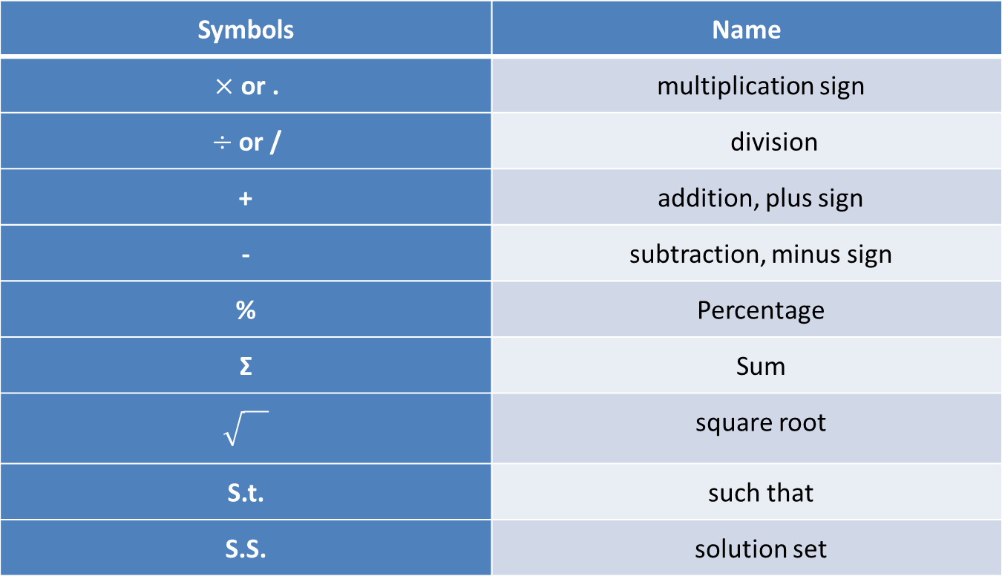
Symbols
Symbols | Name
$×$ or . | multiplication sign
$÷$or / | division
+ | addition, plus sign
- | subtraction, minus sign
% | Percentage
Σ | Sum
 | square root
S.t. | such that
S.S. | solution set

Slide 3
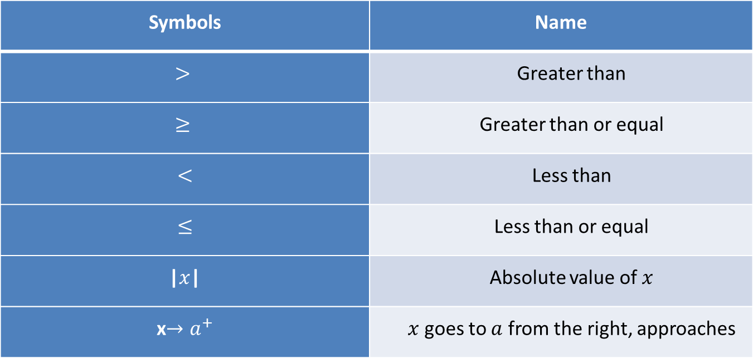
Symbols | Name
$$>$$ | Greater than
$$≥$$ | Greater than or equal
$<$ | Less than
$≤$ | Less than or equal
|$x$| | Absolute value of $x$
x$→a^{+}$ | $x$ goes to $a$ from the right, approaches

Slide 4
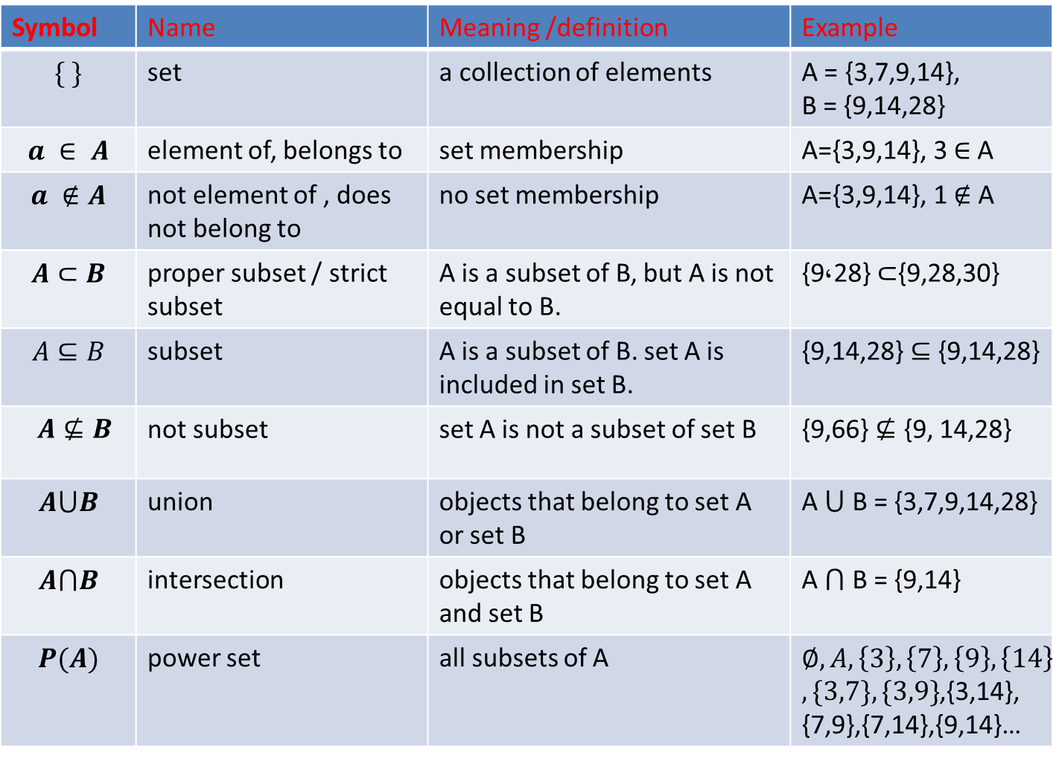
Example | Meaning /definition | Name | Symbol
A = {3,7,9,14}, B = {9,14,28} | a collection of elements | set | $$\{ \}$$
A={3,9,14}, 3 ∈ A | set membership | element of, belongs to | $$a ∈ A$$
A={3,9,14}, 1 ∉ A | no set membership | not element of , does not belong to | $$a ∉A$$
{9,28} $⊂${9,28,30} | A is a subset of B, but A is not equal to B. | proper subset / strict subset | $$A⊂B$$
{9,14,28} ⊆ {9,14,28} | A is a subset of B. set A is included in set B. | subset | $$A⊆B$$
{9,66} $⊈$ {9, 14,28} | set A is not a subset of set B | not subset | $A⊈B$
A ⋃ B = {3,7,9,14,28} | objects that belong to set A or set B | union | $$A⋃B$$
A ⋂ B = {9,14} | objects that belong to set A and set B | intersection | $$A⋂B$$
$$∅,A,\left\{3\right\},\left\{7\right\},\left\{9\right\},\left\{14\right\}$$ $,\{3,7\},\{3,9\}$,{3,14}, {7,9},{7,14},{9,14}… | all subsets of A | power set | $$P(A)$$

Slide 5
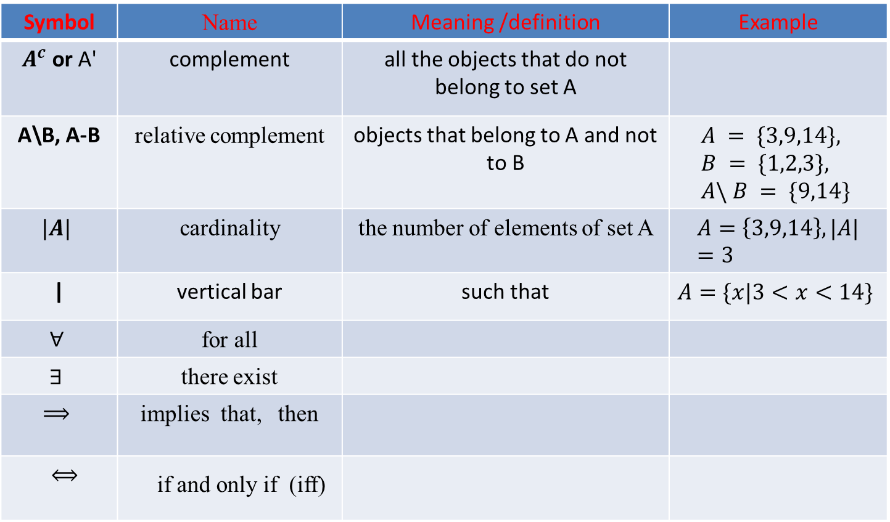
Example | Meaning /definition | Name | Symbol
 | all the objects that do not belong to set A | complement | $A^{c}$ or A'
$$A = \{3,9,14\}, \\ B = \{1,2,3\}, \\ A\backslash B = \{9,14\}$$ | objects that belong to A and not to B | relative complement | $\text{A}\text{\backslash }\text{B}$, A-B
$$A=\left\{3,9,14\right\},|A|=3$$ | the number of elements of set A | cardinality | $$|A|$$
$$A=\{x|3<x<14\}$$ | such that | vertical bar | |
 |  | for all | $$∀$$
 |  | there exist | $$∃$$
 |  | implies that, then | $$⟹$$
 |  | if and only if (iff) | $⟺$

Slide 6
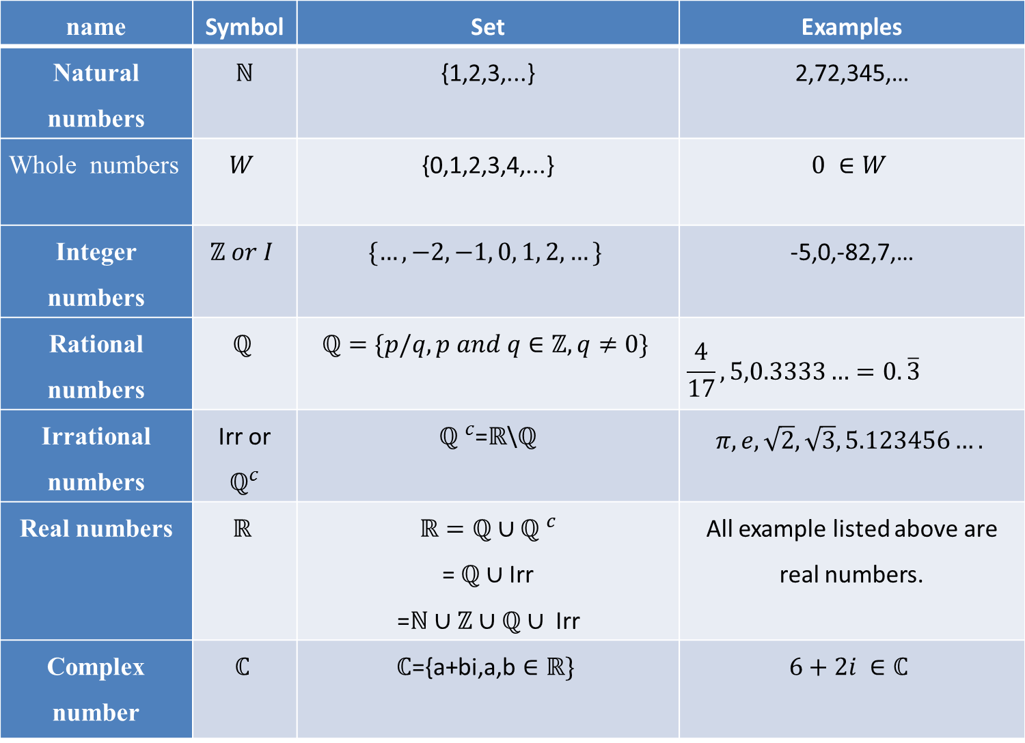
Sets of numbers
name | Symbol | Set | Examples
Natural numbers | $ℕ$ | {1,2,3,...} | 2,72,345,…
Whole numbers | $$W$$ | {0,1,2,3,4,...} | $$0 ∈W$$
Integer numbers | $$ℤ or I$$ | $$\{…,−2,−1, 0, 1, 2,…\}$$ | -5,0,-82,7,…
Rational numbers | $$ℚ$$ | $$ℚ=\{p/q, p and q∈ℤ, q≠0\}$$ | $$\frac{4}{17},5,0.3333…=0.\overline{3}$$
Irrational numbers | Irr or $ℚ^{c}$ | ${ℚ }^{c}$=$ℝ$\$ℚ$ | $$π,e,\sqrt{2},\sqrt{3},5.123456….$$
Real numbers | $$ℝ$$ | $$ℝ=ℚ∪{ℚ }^{c}$$ = $ℚ∪$Irr =$ℕ$ $∪ℤ∪ℚ∪ \text{Irr}$ | All example listed above are real numbers.
Complex number | $$ℂ$$ | $$ℂ\text{=\{}\text{a}\text{+}\text{bi}\text{,}\text{a}\text{,}\text{b}∈ℝ\}$$ | $6+2i ∈ℂ$

Slide 7
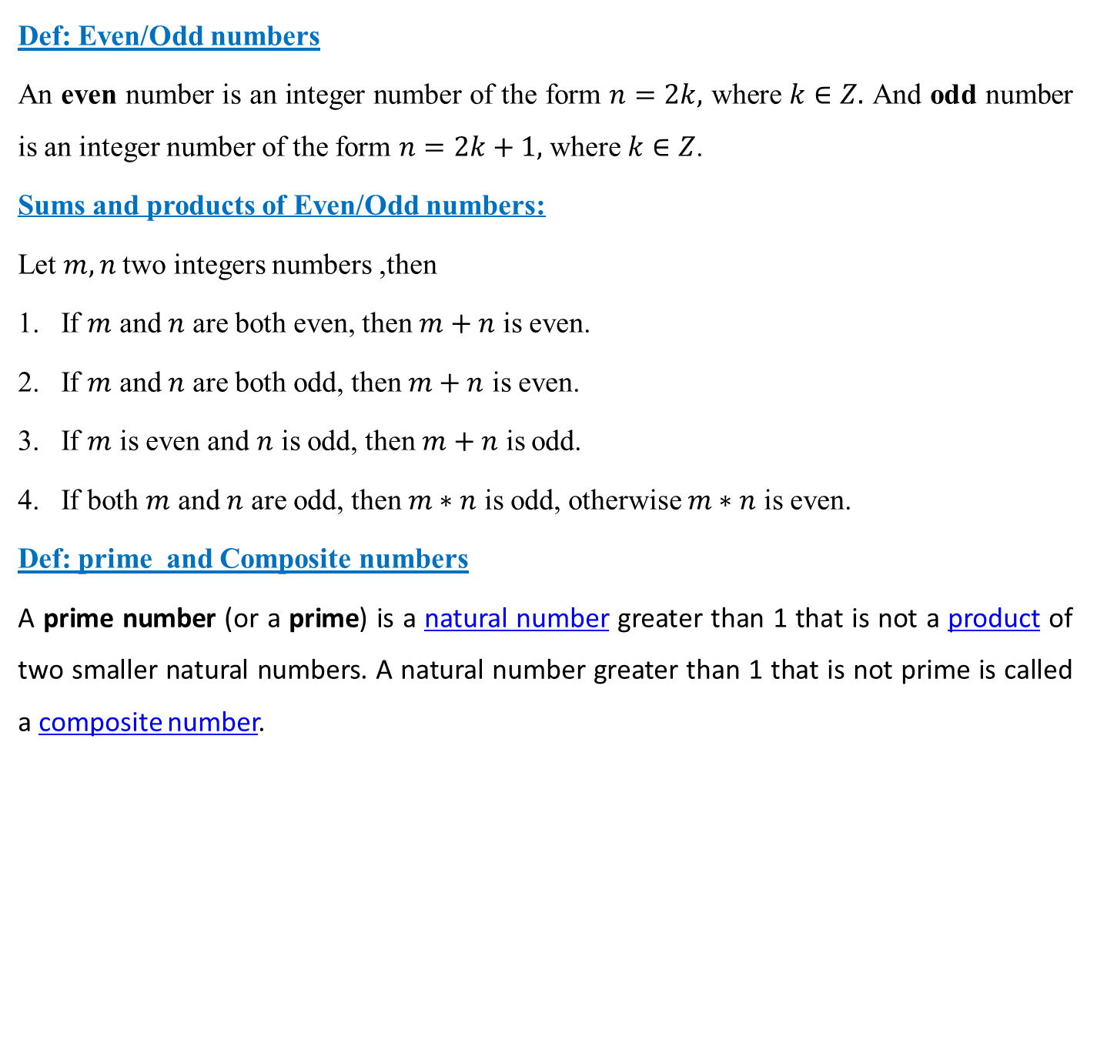
Some properties of numbers
Def: Even/Odd numbers
An even number is an integer number of the form $n=2k,$ where $k∈Z.$ And odd number is an integer number of the form $n=2k+1,$ where $k∈Z$.
Sums and products of Even/Odd numbers:
Let $m, n$two integers numbers ,then
If $m$ and $n$ are both even, then $m+n$ is even.
If $m$ and $n$ are both odd, then $m+n$ is even.
If $m$ is even and $n$ is odd, then $m+n$ is odd.
If both $m$ and $n$ are odd, then $m∗n$ is odd, otherwise $m∗n$ is even.
Def: prime and Composite numbers
A prime number (or a prime) is a natural number greater than 1 that is not a product of two smaller natural numbers. A natural number greater than 1 that is not prime is called a composite number.

Slide 8




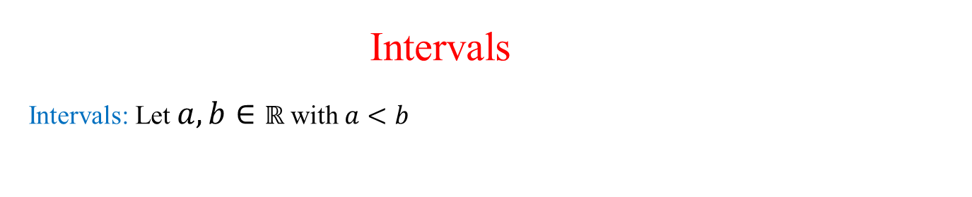
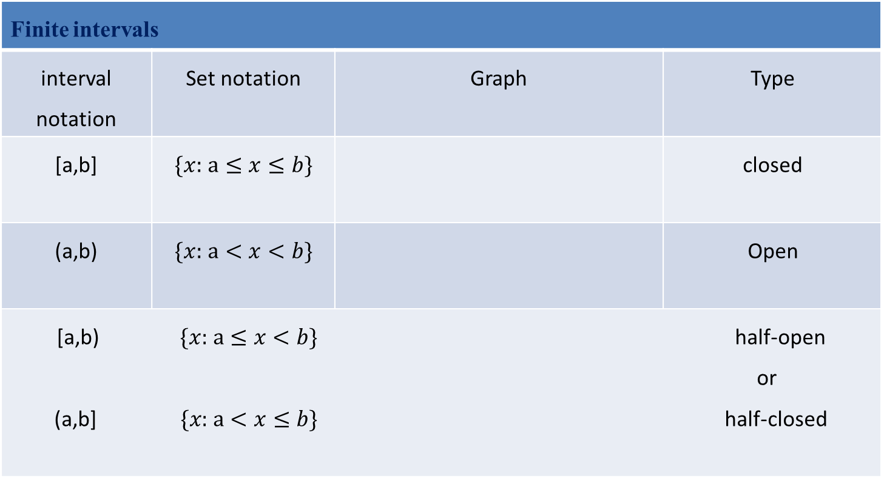
Intervals Intervals: Let $a,b∈ℝ$ with $a<b$
Finite intervals
Type | Graph | Set notation | interval notation
closed |  | $\{x:$ $a≤x≤b\}$ | [a,b]
Open |  | $\{x:$ $a<x<b\}$ | (a,b)
$\text{[}\text{a}\text{,}\text{b}\text{)} \{x:$ $a≤x<b\}$ half-open or (a,b] $\{x:$ $a<x≤b\}$ half-closed

Slide 9




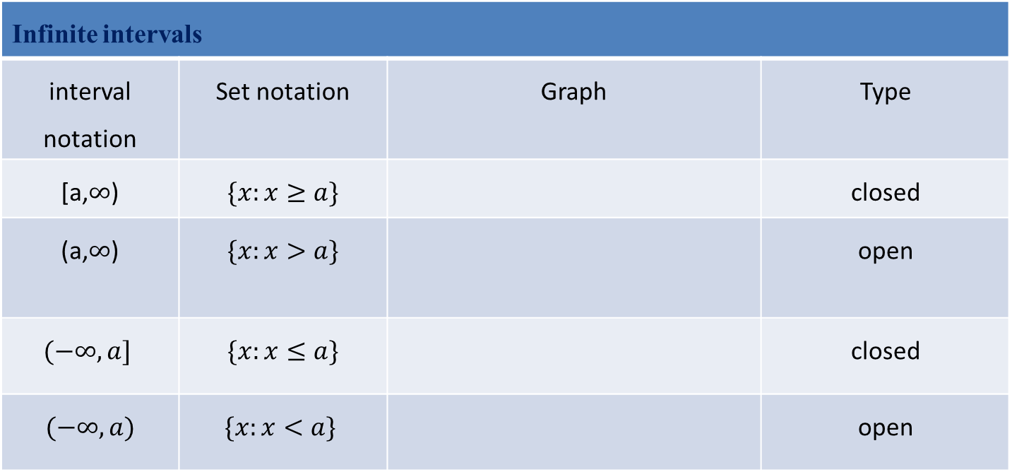
Infinite intervals
Type | Graph | Set notation | interval notation
closed |  | $$\{x:x≥a\}$$ | [a,$∞$)
open |  | $$\{x:x>a\}$$ | (a,$∞$)
closed |  | $$\{x:x≤a\}$$ | $$(−∞, a]$$
open |  | $$\{x:x<a\}$$ | $$(−∞, a)$$

Slide 10
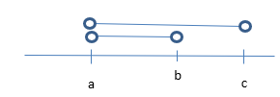



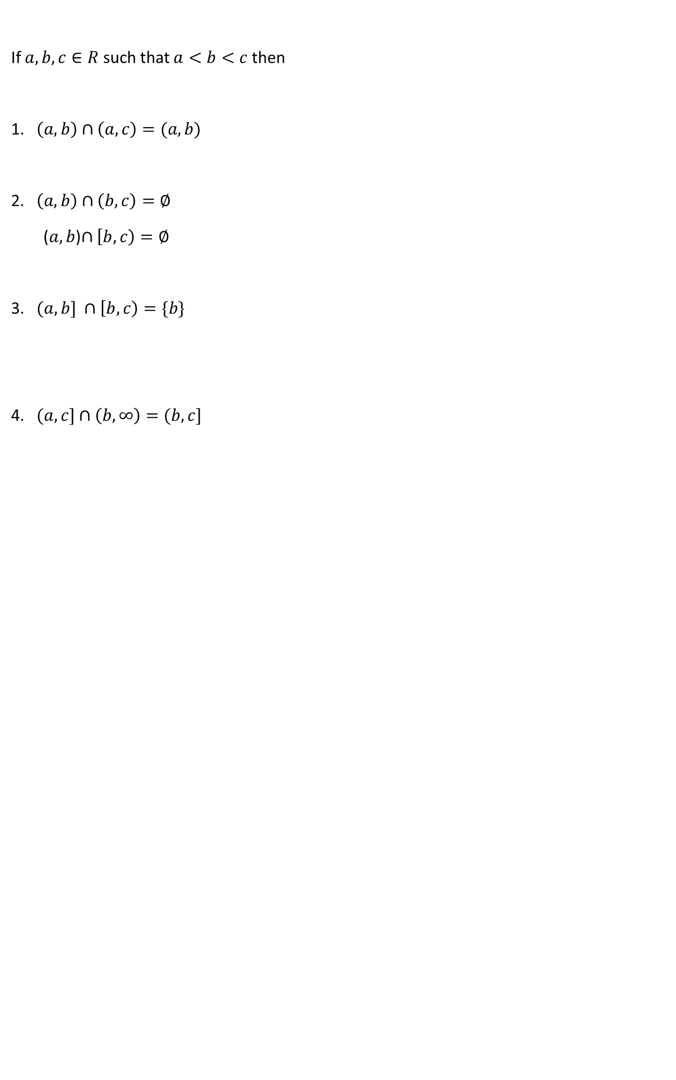
If $a,b,c∈R$ such that $a<b<c$ then
1. $\left(a,b\right)∩\left(a,c\right)=(a,b)$
2. $\left(a,b\right)∩\left(b,c\right)=∅$
($a,b$)$∩\left[b,c\right)=∅$
3. $(a,b] ∩\left[b,c\right)=\{b\}$
4. $(a,c]∩\left(b,∞\right)=(b,c]$

Slide 11


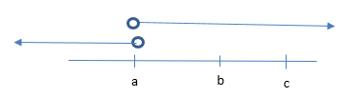
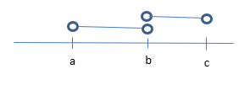

5. $\left(−∞,c\right)∩\left(a,∞\right)=(a,c)$
6. $\left(−∞,b\right)∩\left(c,∞\right)=∅$
7. $\left(−∞,a\right)∪\left(a,∞\right)=R\backslash \{a\}$
8. $\left(a,b\right)∪\left(b,c\right)=\left(a,c\right)\backslash \{b\}$

Slide 12



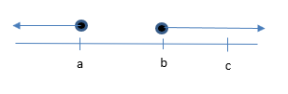

9. $\left(−∞,b\right)∪\left(c,∞\right)=R\backslash [b,c]$
10. $\left(−∞,a\right]∪\left(b,∞\right)=R\backslash (a,b]$
11. $\left(−∞,a\right)∪[b,∞)=R\backslash [a,b)$
12. $\left(−∞,a\right]∪[b,∞)=R\backslash (a,b)$

